Slide 1
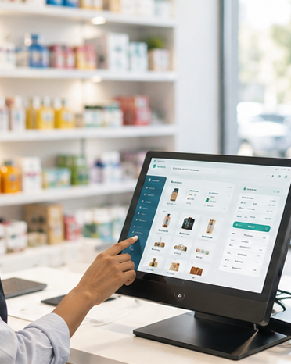

Smart business management for growing SMEs
A professional platform for owners to manage sales, products, inventory, employees, credits, payments, expenses, reports, subscriptions, and verification in one secure system.
27
9
BizTrack domain tables
Laravel/system tables
Notes:
[Sources]
Prepared from the BizTrack project scope, database table list, and implemented module phases in this repository.

Slide 2
SYSTEM PURPOSE
BizTrack brings daily business operations into one controlled workflow
The platform replaces disconnected notebooks, spreadsheets, manual receipts, and informal employee controls with a verified, role-aware digital operating system.
Core promise
Make small and medium businesses easier to run, easier to monitor, and safer to scale.
Owners see performance, cash movement, credit exposure, expenses, and stock health.
Employees work only inside the permissions assigned by the owner.
Super admins protect platform quality through verification, subscriptions, and oversight.
Audit logs and notifications create traceability across sensitive actions.
BizTrack Business Management System
02
Notes:
[Sources]
Prepared from the BizTrack system overview and implemented module behavior.

Slide 3
TECHNOLOGY
The current framework is built for professional expansion
Laravel
Inertia + React
Backend structure, authentication, policies, middleware, migrations, queues, notifications, tests.
Modern single-page user experience without separating the project into two disconnected apps.
MySQL
Tailwind CSS
Relational database for business operations, transactions, permissions, and audit history.
Consistent, custom product styling instead of default Laravel starter-kit visuals.
BizTrack Business Management System
03
Notes:
[Sources]
Prepared from the repository technology stack and installed Laravel/Inertia/React project structure.

Slide 4
BUSINESS MODEL
BizTrack earns from both access and platform usage
Subscription revenue
Service fee revenue
Business owners choose an active plan.
A configurable percentage is calculated from recorded payments.
Plans can control limits such as employees, features, and reporting access.
Owners can see how each fee was created and what is owed.
Inactive or expired subscriptions can block premium workflows.
The percentage can be negotiated per business.
BizTrack Business Management System
04
Notes:
[Sources]
Prepared from the implemented subscription and platform service fee modules in BizTrack.

Slide 5
ROLES
Three primary roles separate platform control from business work
Super Admin
1
Owns platform oversight: verification review, business status, subscriptions, service fees, users, and platform reports.
Business Owner
2
Runs the business: profile, products, inventory, employees, sales, payments, expenses, reports, notifications, and settings.
Employee
3
Works inside owner-assigned permissions. The role name can be cashier, manager, inventory officer, or another custom role.
BizTrack Business Management System
05
Notes:
[Sources]
Prepared from BizTrack RBAC design and implemented role modules.

Slide 6
RBAC
Permissions are fixed for platform safety and dynamic for business teams
Static platform guardrails
Dynamic business permissions
Super admin access is protected and cannot be casually reassigned.
Owners create employee roles with custom names.
Owner-only and employee-only routes are guarded by middleware and policies.
Owners decide which modules each employee can access.
Sensitive modules are separated by role-aware sidebar navigation.
The sidebar adapts so employees see only useful, allowed navigation.
BizTrack Business Management System
06
Notes:
[Sources]
Prepared from the dynamic employee roles and permissions module and RBAC sidebar behavior.

Slide 7
OWNER VALUE
The owner gains control over money, people, stock, and decisions
Sales and POS: record customer purchases, sale items, payments, and receipts.
Inventory: track stock movement, restocks, adjustments, low stock, and stagnant products.
Customers and credit: manage customer records, unpaid balances, and repayment history.
Expenses and reports: compare sales, payments, expenses, inventory value, and revenue trends.
Security: verification, audit logs, strong passwords, temporary passwords, and role-based access.
BizTrack Business Management System
07
Notes:
[Sources]
Prepared from BizTrack module phases: POS, inventory, customers, customer credit, expenses, reports, audit logging, and security.

Slide 8
VERIFICATION WORKFLOW
Business verification protects the platform before access is granted
Owner signs up
Super admin reviews
1
3
The account is created, but full system access waits for verification.
Documents can be approved, rejected with reason, or marked for resubmission.
Documents submitted
Business activated
2
4
National ID photo, FAN number, trade license, TIN, and dynamic VAT or rental documents.
A verified business can complete setup, select subscription, and use the system.
BizTrack Business Management System
08
Notes:
[Sources]
Prepared from implemented business verification review and resubmission workflow.

Slide 9
SUBSCRIPTION WORKFLOW
Subscription controls whether a verified business can operate normally
Plan selection
Activation
1
3
The owner chooses an available plan based on business needs.
An active plan unlocks subscribed limits and protected modules.
Payment handling
Renewal or restriction
2
4
Payment gateway integration can later connect Chapa, Santim Pay, or Telebirr-backed providers.
Expired or inactive plans can trigger notices, renewal flows, and access limits.
BizTrack Business Management System
09
Notes:
[Sources]
Prepared from BizTrack subscription design and planned Ethiopian payment gateway integration path.

Slide 10
DATABASE
The database separates BizTrack business data from Laravel system support
36
27
9
Total database tables
BizTrack application tables
Laravel/system tables
BizTrack tables store business identity, products, inventory, customers, sales, payments, credits, expenses, reports, notifications, audit logs, verification, permissions, service fees, and product insights.
Laravel tables support framework operations such as sessions, password resets, passkeys, jobs, cache, failed jobs, batches, and migration history.
BizTrack Business Management System
10
Notes:
[Sources]
Prepared from the current database table list supplied for BizTrack.

Slide 11
BIZTRACK TABLES
The 27 BizTrack tables cover the real business domain
Operational tables
Governance and intelligence
users, businesses, subscriptions, categories, products, inventory, inventory_transactions, customers, sales, sale_items, payments, customer_credits, expense_categories, expenses
reports, notifications, audit_logs, business_verification_documents, business_verification_reviews, business_permissions, business_roles, business_permission_business_role, security_questions, user_security_questions, service_fee_settings, service_fees, product_movement_insights
BizTrack Business Management System
11
Notes:
[Sources]
Prepared from the current BizTrack database table list. Table names are shown as implemented/planned database objects.

Slide 12
CUSTOMER WORKFLOW
Customer logic connects sales, payments, credit, and follow-up
Customer record
Payment or credit
1
3
The business stores customer identity and contact information.
Full payment completes the sale; unpaid balance creates customer credit.
Sale is recorded
Reports and reminders
2
4
Items, quantities, prices, discounts, and totals are attached to the sale.
Credit balances become visible in dashboards, reports, and notifications.
BizTrack Business Management System
12
Notes:
[Sources]
Prepared from implemented customer, sale, payment, customer credit, report, and notification modules.

Slide 13
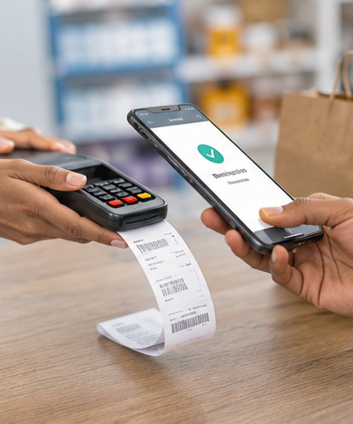
BizTrack is ready to move from product build to market readiness
Next priorities: real Ethiopian payment gateway integration, subscription enforcement, production deployment, security hardening, and onboarding support for early businesses.
A scalable foundation for verified business operations, recurring revenue, and data-driven owner decisions.
Notes:
[Sources]
Prepared from BizTrack project status and planned commercialization direction.

