Slide 1
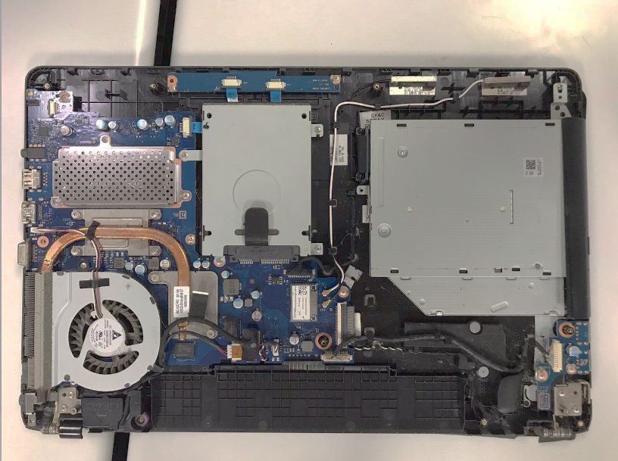

Slide 2

Dissipador de Calor
Cooler
Porta VGA
Memoria Ram
CD-ROM
SSD

