Slide 1
Semantic segmentation
Пугин Кирилл Райковский Даниил

Slide 2
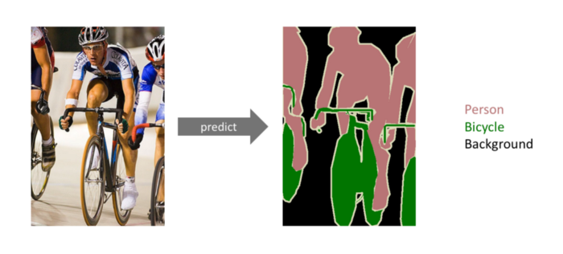
What is semantic segmentation?

Slide 3
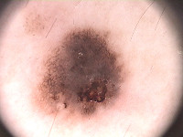

Dataset
Real image
Mask
Data base from ADDI Project (Automatic computer-based Diagnosis system for Dermoscopy Images)
contains 200 dermoscopic images of melanocytic lesions: melanomas and nevi. Link

Slide 4
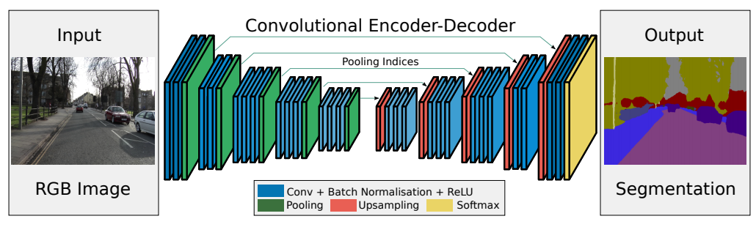
SegNet architecture
Badrinarayanan, V., Kendall, A., & Cipolla, R. (2015). SegNet: A deep convolutional encoder-decoder architecture for image segmentation

Slide 5
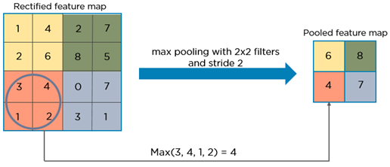
SegNet architecture
Max pooling operation
Downsampling

Slide 6
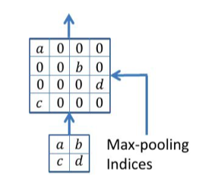
SegNet architecture
Upsampling

Slide 7
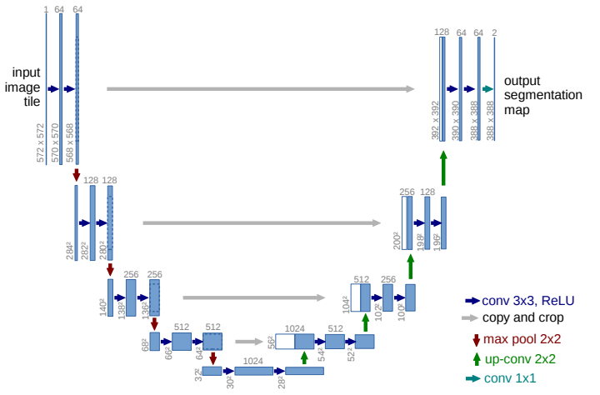
U-Net architecture

Slide 8

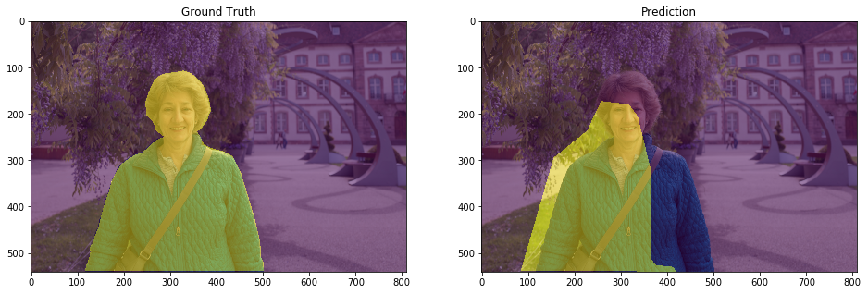
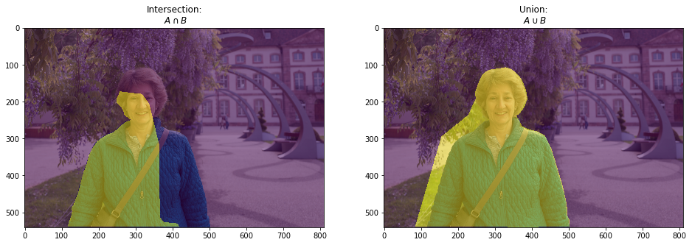
Results. Metric

Slide 9
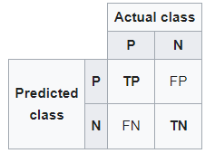
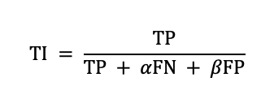
Results. Loss
P (positive) – mask pixels, N (negative) – background pixels
Tversky Index

Slide 10
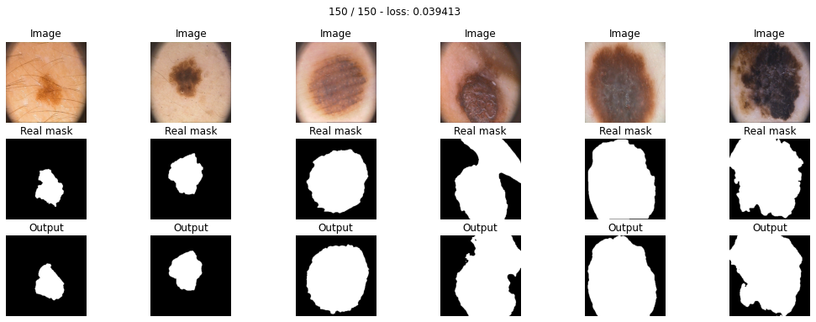
Results. Plots for SegNet

Slide 11
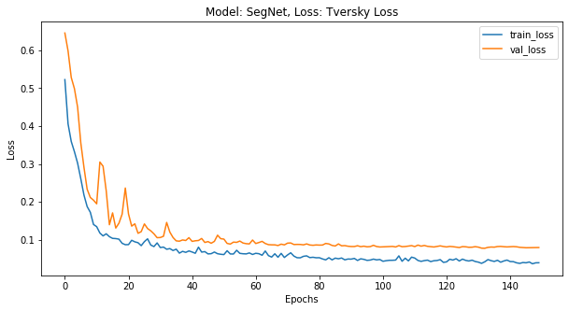
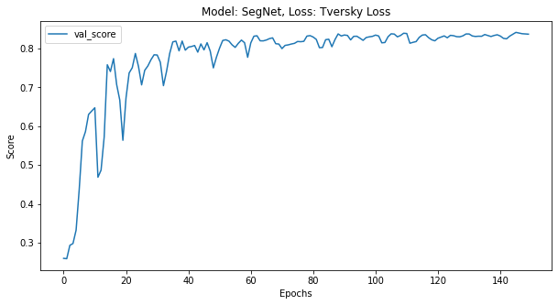
Results. Plots for SegNet

Slide 12

Results. Plots for U-Net

Slide 13
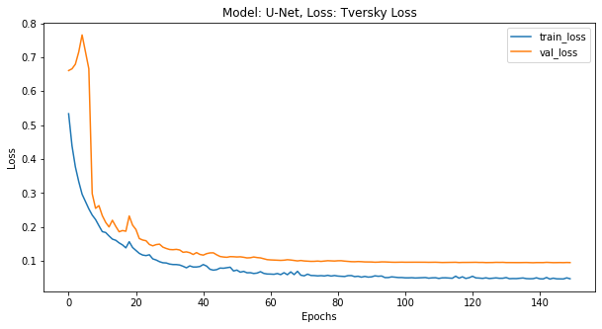
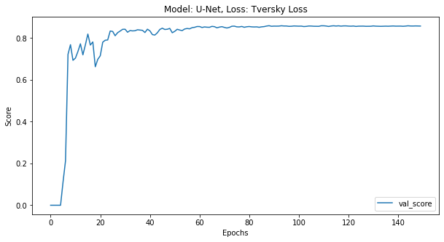
Results. Plots for U-Net

