Slide 1


Video Encoding Optimization
For Streaming and Storage

Slide 2
Overview about video encoding
Objectives
Codecs
Trade offs

Slide 3
Objectives
Reduce file size
Limit the bitrate

Slide 4

Codecs
H264, H265
MPEG-2, MPEG-4
VP8, VP9
Theora

Slide 5

Hardware Encoders
AMD VCE
Intel QSV
Nvidia NVENC <--

Slide 6
H264 encoding
Excellent quality, performance, and file size
Widely supported by media players, including mobile devices

Slide 7

Software encoders
x264 is the Software implementation of H264
Globally slower than hardware implementations
Claims to be efficient in term of compression capabilities over time

Slide 8

Encoding Scenario
4K video in input, 1080p video output (downscale)
Different quality inputs, constant output quality (preset=24)
VP9 input encoding

Slide 9

Handbrake
Open source multi-platform video transcoder
Wide selection of format and codecs
Highly customizable presets to tweak speed and compression rate

Slide 10
Handbrake presets
Software presets for x264 encoder
Medium, fast, faster, very fast, superfast, ultrafast
Increasingly less efficient compression

Slide 11
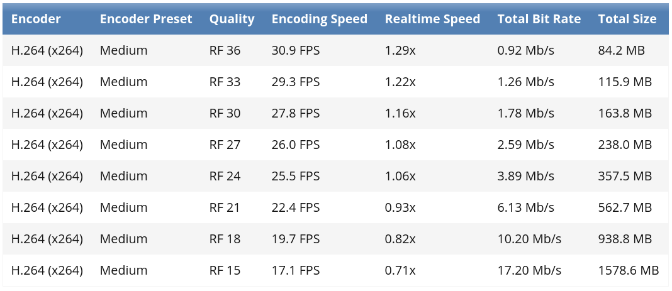
HandBrake Self Benchmarks (SW)
https://handbrake.fr/docs/en/latest/technical/performance.html

Slide 12
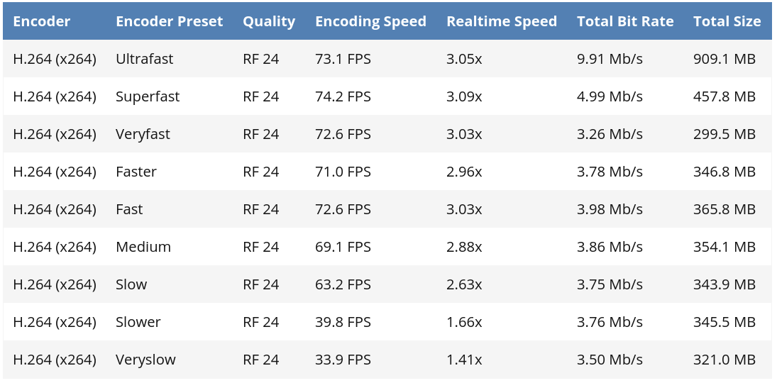
HandBrake Self Benchmarks (SW)
https://handbrake.fr/docs/en/latest/technical/performance.html

Slide 13
Hardware employed
ASUS laptop
CPU: Intel i7 10750H 6 core 12 threads TDP 45 W
GPU: NVIDIA GeForce GTX 1650 Mobile TGP 50 W
https://ark.intel.com/content/www/it/it/ark/products/201837/intel-core-i7-10750h-processor-12m-cache-up-to-5-00-ghz.html
https://www.nvidia.com/en-eu/geforce/gaming-laptops/gtx-1650/

Slide 14
5 different Movies Benchmarks
New Zealand landscapes, 4:26, 25fps, 529.4MB - timelapses, slowly changing images
Costa Rica documentary (HDR),5:13, 60fps, 1GB - more cuts, lots of details
NBA Highlights, 4:41, 30fps, 521.6MB - fast action but overall slow camera panning and few cuts
San Andreas (movie), 4:54, 23fps, 441.2MB - action movie, lots of cuts, visual effects and high speed movements
Pixar’s Film trailer, 6:05, 60fps, 951.8MB - kids movie, brighter and more uniform colors

Slide 15
Experimental data (encoding time)

Slide 16
Experimental data (output file size)

Slide 17

Which one is the fastest?
Normalized encoding time, as predicted, does get lower with faster presets
Caps at superfast (no significant improvement with ultrafast)
Always below 1 (every preset could handle live streaming)
In any case hardware encoding is faster than any software preset

Slide 18



Which one is the most compression-efficient?
Output size gets bigger with faster presets (less optimized encoding)
Faster and very fast presets are outliers (as also reported in the documentation): lower time and lower size at the same time
HW encoding is capable of obtaining good average result with some limit cases (San Andreas)

Slide 19

What about energy efficiency?
Encoding is a heavy task, so it leads hardware to per form at 100% of its capabilities
Components were at their peak of power consumption for the entire time of the test
Shorter time -> less energy drawn
Hardware tends to be the best

Slide 20

Software presets outliers
Faster and very fast presets seems to perform better compression in lower time than slower presets
This behavior shows an inaccurate software implementation of the standard
The algorithm is probably degrading the quality of the output in order to obtain better performance, despite the constant quality constraint

Slide 21

Conclusions
Software encoding proves to be more versatile
High reduction in size, suitable for data to be saved on disk
If encoding speed or energy efficiency is the priority, hardware implementation is to be preferred

