Slide 1


Video Encoding Optimization
For Streaming and Storage

Slide 2
Overview about encoding video
Objectives
Codecs
Trade offs

Slide 3
Objectives
Reduce file size
Limit the bitrate

Slide 4

Codecs
H264, H265
MPEG-2, MPEG-4
VP8, VP9
Theora

Slide 5

Hardware Encoders
AMD VCE
Intel QSV
Nvidia NVENC <--

Slide 6
H264 encoding
Excellent quality, performance, and file size
Widely supported by media players, including mobile devices

Slide 7

Software encoders
x264 is the Software implementation of H264
Globally slower than hardware implementations
Claim to be efficient in term of compression capabilities over time

Slide 8

Encoding Scenario
4K video in input, 1080p video output (downscale)
Different quality inputs, constant output quality (preset=24)
VP9 input encoding

Slide 9
5 different Movies Benchmarks
NBA Highlights, 4:41, 30fps, 521.6MB
New Zeland landscapes, 4:26, 25fps, 529.4MB
Costa Rica documentary (HDR),5:13, 60fps, 1GB
Pixar’s Film trailer, 6:05, 60fps, 951.8MB
Action Film Scene, 4:54, 23fps, 441.2MB

Slide 10
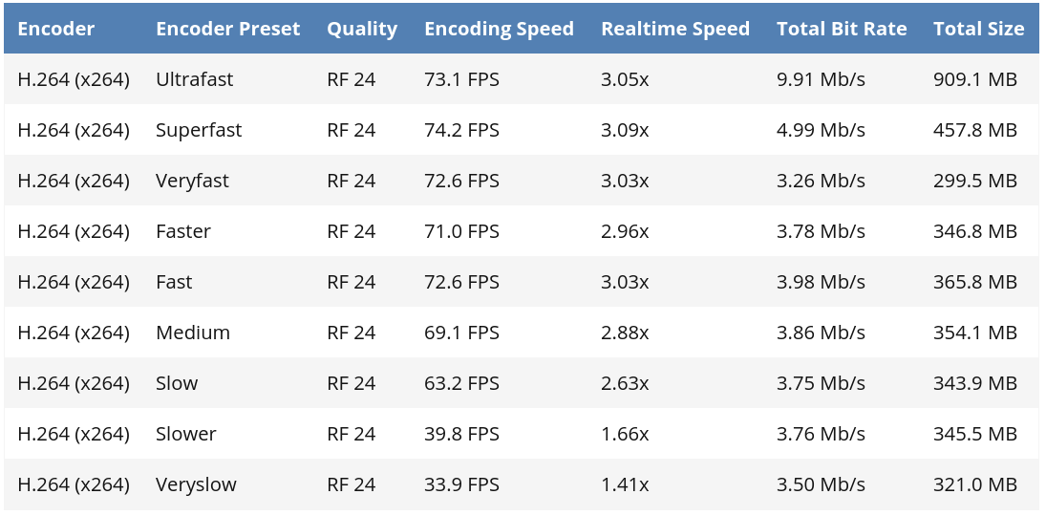
HandBrake Self Benchmarks
https://handbrake.fr/docs/en/latest/technical/performance.html

Slide 11
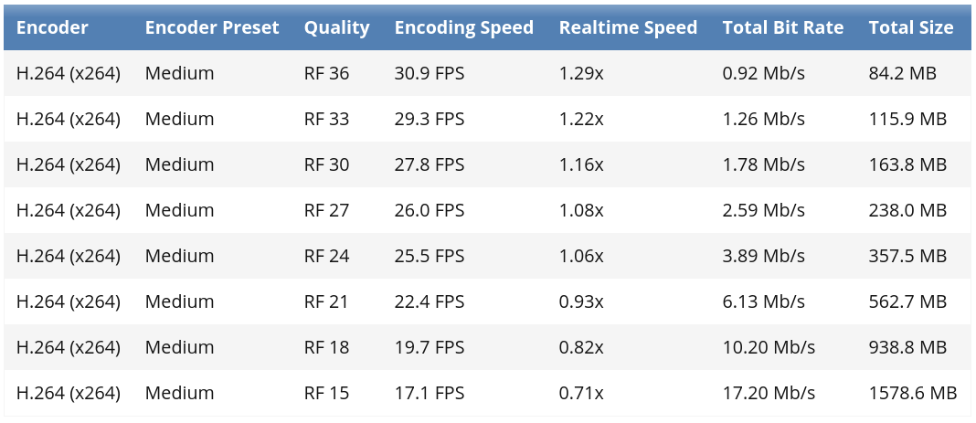
HandBrake Self Benchmarks
https://handbrake.fr/docs/en/latest/technical/performance.html

