Slide 1

RIDL Rogue In-Flight Data Load
Behaviour
Attacks
Mitigations
https://mdsattacks.com/

Slide 2
Microarchitectural Data Sampling
Side-channel vulnerabilities in Intel CPUs
Attackers can inspect µ-architectural buffers
Private data can leak across arbitrary security boundaries
https://mdsattacks.com/

Slide 3
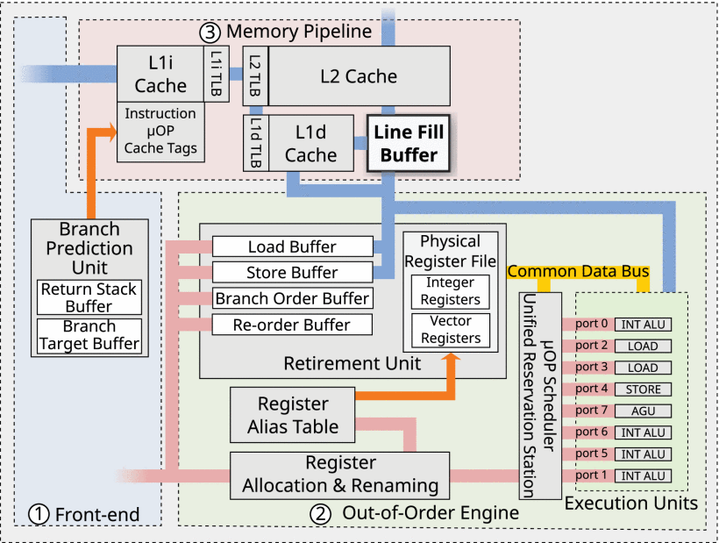
Line Fill Buffer (LFB)
µ-optimization:
Non-blocking cache
Load squashing
Write combining
Non-temporal requests
Reads that are not served from L1d pull data through the LFB, while writes push data through the LFB to either L1d or memory
S. van Schaik et al., "RIDL: Rogue In-Flight Data Load," 2019 IEEE Symposium on Security and Privacy (SP), San Francisco, CA, USA, 2019, pp. 88-105, doi: 10.1109/SP.2019.00087.
Notes:
Per le micro-opt v. pag. 5 del paper
13

Slide 4
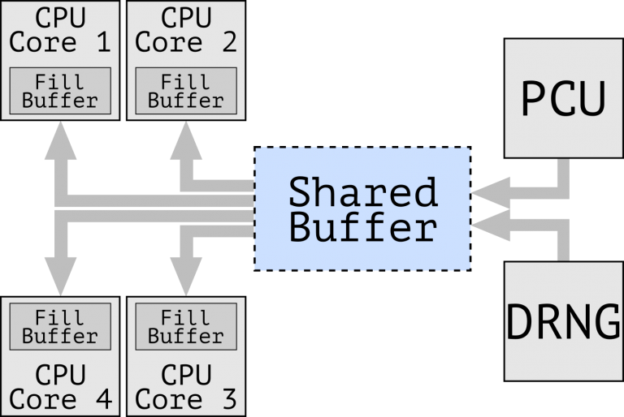
µ-architectural (shared) buffers
It is possible to discover and analyze the behaviour of µ-architectural buffers via reverse engineering
Performance counters:
Cache and buffers hits
µ-architectural requests
Speculative loads (Spectre):
FLUSH + RELOAD
PRIME + PROBE
CrossTalk: Speculative Data Leaks Across Cores Are Real. Ragab, H.; Milburn, A.; Razavi, K.; Bos, H.; and Giuffrida, C. In S&P, May 2021. Intel Bounty Reward
Notes:
Richieste micro-architetturali: se un'istruzione fa 20 micro-richieste, vuol dire che c'è stato qualche buffer flushato
<number>

Slide 5
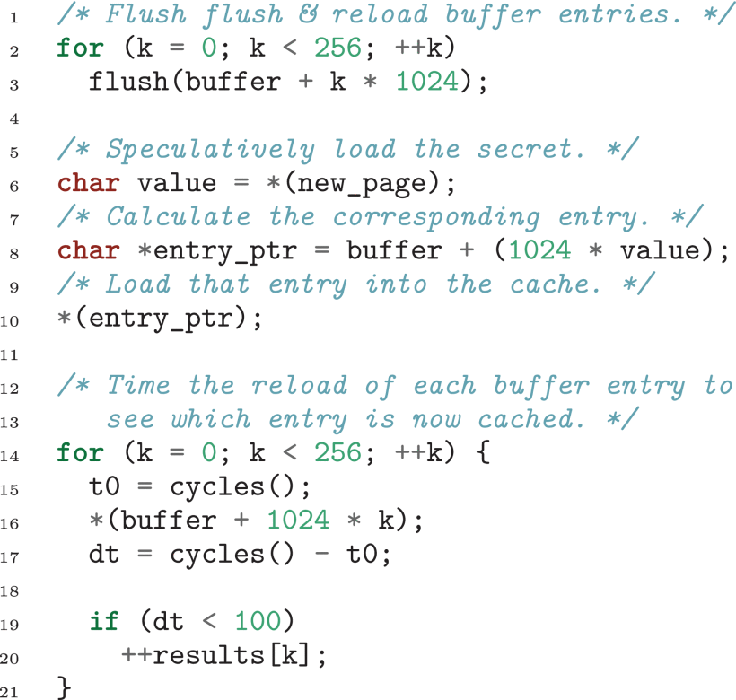
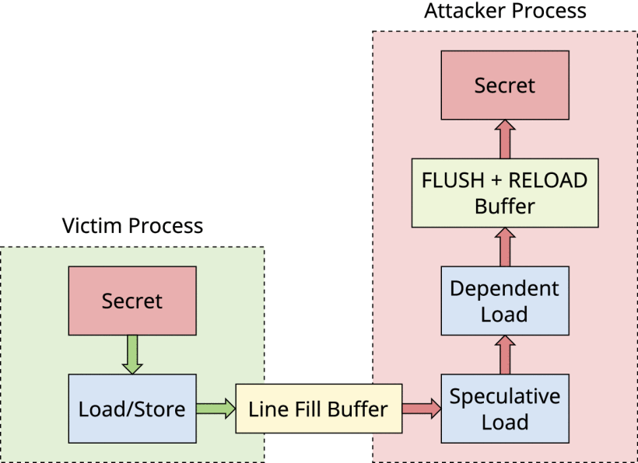
Listen to the "noise" from another thread
S. van Schaik et al., "RIDL: Rogue In-Flight Data Load," 2019 IEEE Symposium on Security and Privacy (SP), San Francisco, CA, USA, 2019, pp. 88-105, doi: 10.1109/SP.2019.00087.

Slide 6
Synchronization
To leak information, the attacker must make sure that the right data is visible in the LFB at the right time, by synchronizing with the victim. This can be done in 3 different ways:
Serialization
Instructions to create a point of synchronization that allows the attacker to observe the last few loads and stores before the buffers are completely drained.
Contention
With victim and attacker running in the same hardware thread (e.g., in a sandbox, without SMT), we can create contention forcing entries to be evicted from the LFB.
Eviction
Evicting cache entries from the cache set in which we are interested. If these cache lines were dirty, CPU has to write them back through the LFB.
Notes:
Serialization: mfence instruction guarantees that both load and stores before its execution become globally visible (eg in the LFB).
The mfence instruction forms a point of synchronization that allows us to observe the last few loads and stores before the buffers are completely drained
Eviction: Eviction
We can control the values that we leak from the victim by evicting cache entries from the cache set in which we are interested. If these cache lines were dirty, the processor has to write them back through the memory hierarchy and will do this through the LFB.
<number>

Slide 7
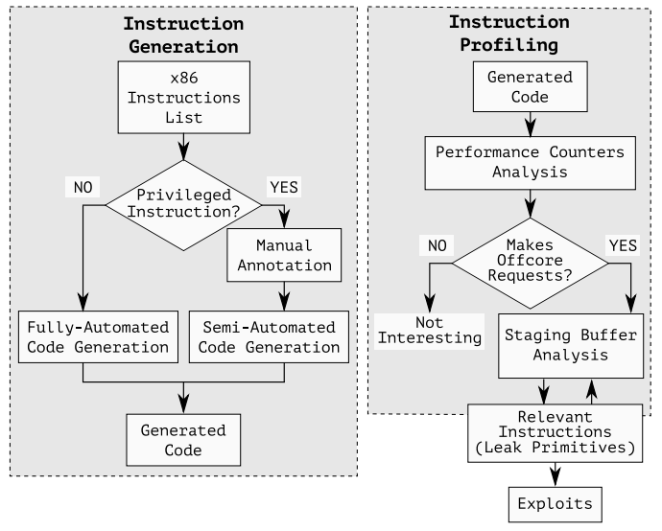
CrossTalk
Exploiting RIDL capabilities of reading µ-architectural buffers it is possible to leak the deep implementation of instructions
CPUID RDRANDR RDSEED CLFLUSH RDMSR
We are intrested in:
OFFCORE_REQUESTS
OFFCORE_RESPONSE
buffers flush
CrossTalk: Speculative Data Leaks Across Cores Are Real. Ragab, H.; Milburn, A.; Razavi, K.; Bos, H.; and Giuffrida, C. In S&P, May 2021. Intel Bounty Reward

Slide 8
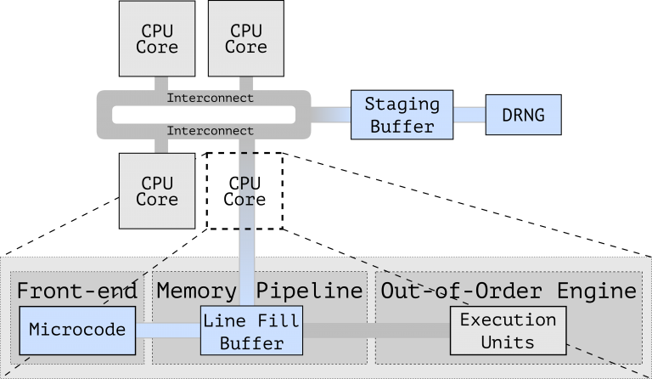
CrossTalk: The shared buffer
The Staging Buffer is shared among all cores
The Staging Buffer is used to store pending request to unique (shared) resources like the Random Number Generator; for optimization purpose this buffer is able to aggregate
µ-operations delivering unrequested data to ALL cores LFB
Note that the interconnection mechanism is (probably) asincronous
CrossTalk: Speculative Data Leaks Across Cores Are Real. Ragab, H.; Milburn, A.; Razavi, K.; Bos, H.; and Giuffrida, C. In S&P, May 2021. Intel Bounty Reward

Slide 9
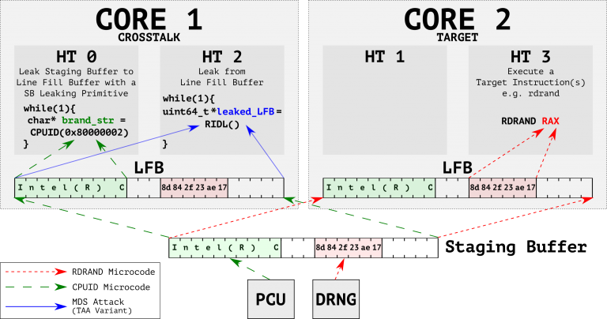
CrossTalk (in action)
CrossTalk: Speculative Data Leaks Across Cores Are Real. Ragab, H.; Milburn, A.; Razavi, K.; Bos, H.; and Giuffrida, C. In S&P, May 2021. Intel Bounty Reward

Slide 10
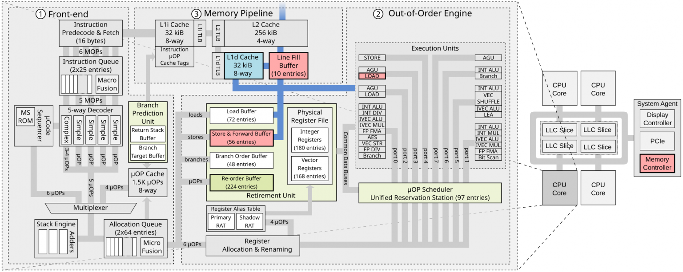
CrossTalk: Speculative Data Leaks Across Cores Are Real. Ragab, H.; Milburn, A.; Razavi, K.; Bos, H.; and Giuffrida, C. In S&P, May 2021. Intel Bounty Reward

Slide 11
Existing mitigations for old attacks
Older speculative execution attacks have been mitigated in 3 ways:
Inhibit the trigger of the speculation (µ-code updates)
Protect the secret (KPTI for Meltdown, multi-process isolation)
Disrupt the channel of the leakage
Notes:
2. RIDL demonstrates that not all the sources of data speculation rely on this assumption)
<number>

Slide 12
Existing mitigations for old attacks
RIDL is not impacted:
µ-code updates do not account for the LFB
Consider a valid address a strict requirement (not necessary for RIDL)

Slide 13
Intel mitigation for CrossTalk
Locks the entire memory bus before updating the staging buffer and only unlocks it after clearing its content
Implemented only in RDRAND, RDSEED, and EGETKEY instructions due to performance overhead
output from any other instruction that issues offcore requests can be still leaked across CPU cores.

Slide 14
New mitigations for RIDL
Disable SMT (however RIDL still possible in single-thread)
Flush the LFB when returing to less privileged environment (not easiliy done in SW for HW-based components such as SGX and MMU)
Foreshadow mitigation → L1 cache flushing (expensive)
RIDL mitigation → L1 cache flushing + LFB flushing on every context switch (even more expensive)
Probably too expensive to be useful in practice
Notes:
2. Flush the LFB when going back from kernel to user, or from hypervisor to VM execution
<number>

Slide 15
Future directions for RIDL mitigation
µ-code update to remove all possible sources of speculation when applying µ-optimizations
RIDL is a whole family of attacks → long time to find all instances
Rather than spot mitigations, developement and deployment of more fundamental ones
Notes:
<number>

Slide 16
Secure design tips
The shared buffer communication technique is by design unsecure and should be avoided for every security critical task →
A dedicated communication interface for the access to shared resources has to be adopted when possible;
Drawback → Dedicated lines are more complex to implement, involving more hadware components, causing higher powe consumption of the chip.

Slide 17
Secure design tips
In order to prevent data leakage through FLUSH+RELOAD cache side channel, we have to invalidate cache loads executed during a speculative window. This implies keeping track of which instruction requested every load. Then, in commit phase, speculatively loaded cache lines have to be invalidated.
This solution comes with two high performance drawbacks:
- A lot of hardware has to be added just to implement security checks
- Even not malicious loads have to be flushed, causing sub-optimal cache management (can be mitigated by compilers optimizations)

