Slide 1

RIDL Rogue In-Flight Data Load
Exploit detection and prevention
Yuri Mazzuoli
Marco Pinna
https://mdsattacks.com/

Slide 2
Quick recap of RIDL and Crosstalk
µ-optimizations in Intel CPUs (Line Fill Buffer and shared Staging Buffer)
this leads to the creation of side channels
attackers can exploit MDS to leak private data across arbitrary security boundaries
RIDL is the resulting family of vulnerabilities
Crosstalk (data leak across cores) is one of the RIDL-based exploits
https://mdsattacks.com/

Slide 3
Detect maliciuos behaveours
At execution time, it's almost impossible to detect the attack pattern
Malware that exploit hardware vulnerabilities are very hard to distinguish from benign software
"The exploitation [of RIDL] might not leave any traces in traditional log files." (https://cpu.fail/)
"While anti-virus software could theoretically detect MDS exploits, it is very unlikely to happen in practice." (https://mdsattacks.com/)

Slide 4
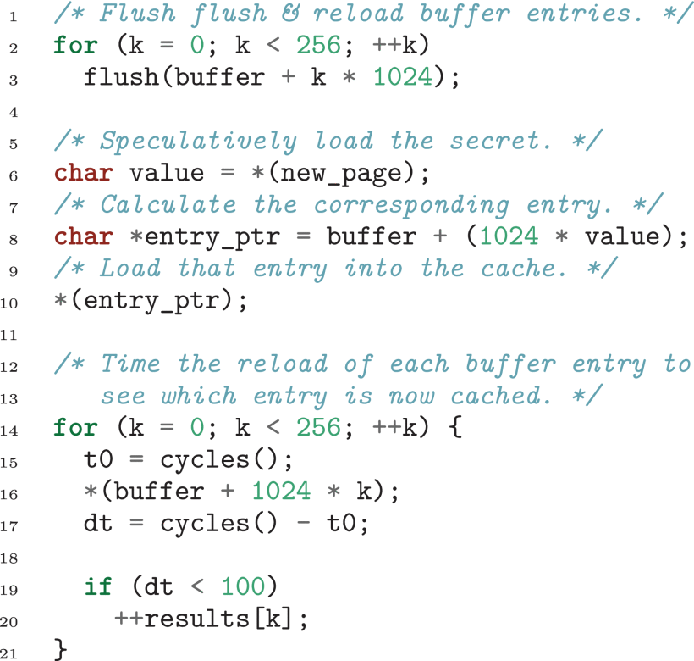
Totally normal code
Only a page fault
The attack consist in loading a (LEGAL!) memory location referred by an offset, from a base address:
It's an array lookup!
Actually, the only suspicious thing, high precision timer usage
Totally normal code

