Slide 1

TAK-861 HCP Referral Analysis Insights & Recommendations
May 14, 2026

Slide 2
Focus of the conversation today
Ahead of the oveporexton launch, this analysis maps the structure of HCP referral networks.
That foundation is then leveraged to quantify hubs, bridges, and regional clusters; trace patient leakage points; and surface how peer influence propagates across the narcolepsy care continuum
These hidden structural insights can help drive more meaningful actions for commercial, sales and marketing team
Project Objectives
What is completed?
Where are we today?
What is next?
Referral network modelling and analysis
Dashboard UI review
Insights and recommendation discussion
Dashboard SIT ongoing
Dashboard UAT - 5/18 onwards
Referral analytics code module transition

Slide 3
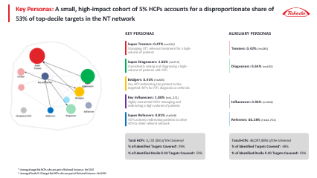
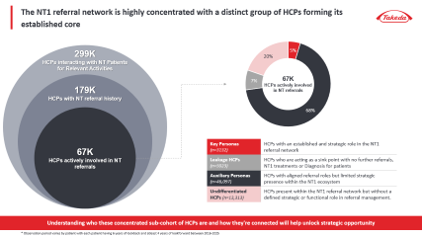
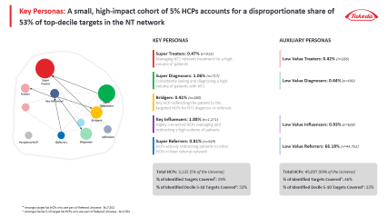
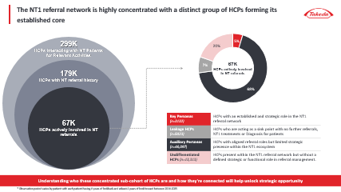
As a first step, the tagged referral data was transformed into a weighted network graph and analyzed using network intelligence algorithms to identify key HCP personas
Referral Network Overview
Key Analysis
HCP Referral Relationships: Identify the way HCPs within the universe interact with each other through patient hand-offs to ascertain what qualifies as referrals vs what might be disjointed interactions.
NT1 Referral Network Graph: Establish the provider-patient-provider transitions through their the NT1 journey and surface the established referral routes within the market.
HCP Personas: Isolate and tag the HCPs who play an influential and distinct role in the NT1 patients’ referral journey persistently.
Notes:
Here we are bringing together the full value of the engagement how we translate claims and referral data into a practical understanding of the narcolepsy ecosystem that Takeda can act on for launch.
We start with referral network structure, because in narcolepsy the way patients move is rarely linear. Instead of viewing care as a sequence of visits, we reconstruct the ecosystem as a network of providers and institutions connected by real patient flows.
This makes visible the structure that governs
where patients go,
who sits upstream,
who receives referrals,
and how tightly or loosely connected different parts of the system are.
This structural view becomes the foundation for everything else on the slide.
From there, we identify key referral hubs and bridge HCPs.
These are the providers and institutions that disproportionately influence patient movement either by anchoring referral pathways or by connecting specialties, care settings, or systems that would otherwise remain siloed.
Importantly, these control points don’t always align with the highest‑volume prescribers.
For launch, this helps Takeda focus attention on the HCPs and HCOs that shape access and downstream treatment behavior, not just those who see the most patients today.
The next layer translates the national network into regional distribution and clusters.
Referral behavior varies significantly by geography, driven by local systems, access constraints, and practice patterns.
By segmenting the ecosystem into regional clusters, we can characterize where networks are dense and coordinated versus fragmented and dependent on a small number of connectors.
This allows Takeda to move from a single national view to region‑specific insights that align with how the field actually operates.
Building on that, we identify regional opportunity areas.
These are geographies where fragmentation, under‑connected networks, or reliance on a limited set of hubs create opportunities for targeted education and engagement.
Rather than treating all regions equally, this output helps prioritize where focused intervention is most likely to accelerate diagnosis and treatment initiation ahead of launch.
We then shift from structure to patient flow and leakage.
This output identifies where patients stall, divert, or drop out across the care journey from suspicion to diagnosis to treatment.
Instead of viewing leakage as a generic problem, we quantify where it occurs and how frequently, providing a clear view of the specific points in the journey that delay care.
Crucially, we connect those leakage points back to the ecosystem through root‑cause analysis.
This helps distinguish whether delays are driven by missing referral bridges, access limitations, specialty handoffs, or network fragmentation.
For Takeda, this reframes leakage from a broad awareness challenge into a set of targeted, addressable issues tied to specific providers, regions, or structures.
Finally, we assess peer influence and adoption dynamics.
Adoption in specialty ecosystems rarely happens in isolation it propagates through professional relationships and referral networks.
By quantifying influence and connectivity, we identify where adoption is likely to spread quickly and where it may be slower due to network constraints.
This helps Takeda anticipate diffusion dynamics ahead of launch and prioritize stakeholders who can accelerate uptake beyond their own prescribing behavior.
Taken together, these outputs provide a unified ecosystem view showing who controls patient movement, how that varies by region, where patients leak, and how influence shapes adoption.
The goal is not just insight, but clear, actionable guidance that informs commercial, medical, and field execution as Takeda prepares for launch.

Slide 4
Executive Summary | Referral Network Overview
Insights
Preliminary Recommendations
Of the 299k HCPs interacting with NT patients, 67k are active in referrals and a core 3.1k hold an established, recurring role within the referral network, accounting for 53% of decile 5-10 target coverage.
This group is primary led by Sleep Specialists (28%), PCPs (21%), and Pulmonologists (19%).
The 3.1k core is geographically concentrated in Ohio, Michigan, Texas, and California, with sparser representation across central and southern markets.
Super Diagnosers and Super Treaters should be the primary conversion targets at launch given their high NT patient volumes and central role within the referral network.
Early engagement should focus on mechanism differentiation, clinical benefits, and identifying appropriate patients for oveporexton treatment.
Bridgers can play an important role in expanding referral flow across the broader NT1 ecosystem by connecting community HCPs to key diagnosing and treating centers.
Targeted education around referral pathways, patient identification, and care coordination can help scale adoption beyond the initial anchor accounts.
Key Influencers should be activated closer to launch to drive peer-to-peer awareness and broader network adoption.
Given their strong cross-network connectivity, early conversion within this group can accelerate confidence and uptake across a wider HCP base without requiring broad-based outreach.
Super Referrers should remain consistently engaged post-launch to sustain referral momentum into the NT1 treatment pathway.
Reinforcing referral triggers, treatment awareness, and center connectivity can help maintain long-term patient flow into the ecosystem.
Network Structure
Super Diagnosers (n=717) and Super Treaters (n=315) are the clinical anchors of the network, concentrated in Sleep Medicine and Pulmonology/Neurology, managing NT patient volumes 16x and 7x the market average respectively. Both skew strongly toward the Innovator attitudinal segment (73–75%)
A key group of HCPs act as Bridgers (n=280) directing patients from the broader HCP universe to these clinical anchors, ensuring patients receive appropriate care immediately post referral.
Key Influencers (n=1,271) are the most cross-connected HCPs, managing ~9 NT patients per HCP (Top 90th Percentile) and connecting various parts of the referral network.
549 Super Referrers consistently forward patients toward the NT1 care pathway and are PCP-dominant (53%).
HCP Roles Within the Network

Slide 5
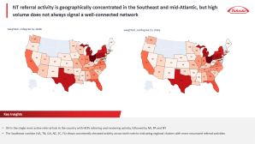

Leveraging the referral network, we deep-dive into insights across geography, patient flow, and influence dynamics
Regional Care Patterns
Patient Leakage Assessment
Influence Network Mapping
Key Analysis
Ecosystem Segmentation: Clustered self sustained regional referral ecosystems to reveal communities of strong referral relationships
Regional Profiling: Aggregated network metrics at regional level to understand the differences in care patterns
Patient Journey Leakage: Identified where patients stall, divert, or temporarily exit the referral pathway before correct diagnosis or treatment
HCP Barrier Profiling: Characterized systemic patterns of patient leakage to uncover the HCPs, and geographies requiring focused intervention
Diffusion Readiness Assessment: Evaluated how adoption propagates across referral relationships and connected networks
Influence Landscape Mapping: Identified providers with most prominent social and research influence amongst their peers and identified the Key leaders of social influence
KOL Overlap Assessment: Assessed how many KOLs overlap with the identified key persona HCPs and why the rest of the KOLs are not tagged as such
Notes:
Here we are bringing together the full value of the engagement how we translate claims and referral data into a practical understanding of the narcolepsy ecosystem that Takeda can act on for launch.
We start with referral network structure, because in narcolepsy the way patients move is rarely linear. Instead of viewing care as a sequence of visits, we reconstruct the ecosystem as a network of providers and institutions connected by real patient flows.
This makes visible the structure that governs
where patients go,
who sits upstream,
who receives referrals,
and how tightly or loosely connected different parts of the system are.
This structural view becomes the foundation for everything else on the slide.
From there, we identify key referral hubs and bridge HCPs.
These are the providers and institutions that disproportionately influence patient movement either by anchoring referral pathways or by connecting specialties, care settings, or systems that would otherwise remain siloed.
Importantly, these control points don’t always align with the highest‑volume prescribers.
For launch, this helps Takeda focus attention on the HCPs and HCOs that shape access and downstream treatment behavior, not just those who see the most patients today.
The next layer translates the national network into regional distribution and clusters.
Referral behavior varies significantly by geography, driven by local systems, access constraints, and practice patterns.
By segmenting the ecosystem into regional clusters, we can characterize where networks are dense and coordinated versus fragmented and dependent on a small number of connectors.
This allows Takeda to move from a single national view to region‑specific insights that align with how the field actually operates.
Building on that, we identify regional opportunity areas.
These are geographies where fragmentation, under‑connected networks, or reliance on a limited set of hubs create opportunities for targeted education and engagement.
Rather than treating all regions equally, this output helps prioritize where focused intervention is most likely to accelerate diagnosis and treatment initiation ahead of launch.
We then shift from structure to patient flow and leakage.
This output identifies where patients stall, divert, or drop out across the care journey from suspicion to diagnosis to treatment.
Instead of viewing leakage as a generic problem, we quantify where it occurs and how frequently, providing a clear view of the specific points in the journey that delay care.
Crucially, we connect those leakage points back to the ecosystem through root‑cause analysis.
This helps distinguish whether delays are driven by missing referral bridges, access limitations, specialty handoffs, or network fragmentation.
For Takeda, this reframes leakage from a broad awareness challenge into a set of targeted, addressable issues tied to specific providers, regions, or structures.
Finally, we assess peer influence and adoption dynamics.
Adoption in specialty ecosystems rarely happens in isolation it propagates through professional relationships and referral networks.
By quantifying influence and connectivity, we identify where adoption is likely to spread quickly and where it may be slower due to network constraints.
This helps Takeda anticipate diffusion dynamics ahead of launch and prioritize stakeholders who can accelerate uptake beyond their own prescribing behavior.
Taken together, these outputs provide a unified ecosystem view showing who controls patient movement, how that varies by region, where patients leak, and how influence shapes adoption.
The goal is not just insight, but clear, actionable guidance that informs commercial, medical, and field execution as Takeda prepares for launch.

Slide 6
Executive Summary | Regional Care Patterns
Insights
Preliminary Recommendations
The NT market organizes itself into 6,174 distinct HCP Clustered Communities averaging ~5 NT patients each, reflecting the inherent rarity of the disease and the formation of tight, self-organized care communities around individual patients with 99% of clusters exchange referrals primarily within the community, indicating
Additionally, there are 548 Self-sustained Hubs representing HCPs with the deepest NT commitment, independently managing the full diagnosis-to-treatment pathway.
4,871 Standalone Cohorts form the peripheral layer of the network with limited referral or treatment activity.
Treat the 548 self-sustained hubs as a concentrated, activation cohort pre-launch as these are high-impact switch targets.
Field effort at launch should be focused on clustered communities to drive patient volume from prescribing pattern switches. The strategy should be to engage with the most connected HCP within an active cluster eventually leading to activation of the referral network.
Reactively target the HCPs in 4,871 standalone cohorts for post-launch expansion based on real-time signals and gathered field intelligence.
Cluster Architecture Types
Relationship Dynamics
These Clustered Communities are held together by HCP relationships rather than institutional affiliation with 74% of referral activity crossing institutional lines making relationship-level engagement the most natural access point into NT1 care networks.
Cluster concentration is highest in TX, CA, FL, and OH (6–7% each), alongside NY, MI, PA, NC, IN, and TN, with these 10 states accounting for 50% of all clustered community referral activity.
Across the overall market, network maturity varies. OH, MI, and PA have the densest referral ecosystems. While, FL and CA present a high-volume opportunity with room to deepen structural engagement.
Prioritize OH, MI, and PA for oveporexton launch activation. Established referral relationships in these markets mean HCP conversions propagate through the network, maximizing reach per engagement.
Approach FL and CA as high-potential expansion markets. While the patient volume is there; building referral alignment through oveporexton conversations in referral channels can build sustained post-launch uptake
Geographic Concentration & Market Maturity

Slide 7
Executive Summary | Patient Leakage Assessment
Insights
Preliminary Recommendations
~70% of NT patients go through a misdiagnosis journey before eventually getting diagnosed with NT1.
Majority of them follow a predictable misdiagnosis pathway—moving from fatigue/anxiety-driven presentations to neurological misclassification, before converging on Sleep Apnea/Sleep Disorders as the final gateway to NT diagnosis.
Anxiety Disorder (359 days), Mood Disorder (361 days), ADHD (346 days), and Sleep Apnea (344 days) are the most common high-delay misdiagnosis pathways, contributing significantly to prolonged diagnosis timelines and delayed treatment initiation.
Prioritize sleep disorder stage HCPs as the key intervention point given proximity to diagnosis
Selectively shift upstream engagement to misdiagnosed cohorts where delay accumulation is highest
Build geographically distinct launch strategies. NM and central states warrant pre-diagnosis awareness investment to shorten the diagnostic loop. VT, ME, and NE require post-diagnosis treatment activation focus to close the gap between NT identification and oveporexton initiation.
Misdiagnosis Journey
Even among key specialties, routing efficiency is inconsistent: ~56% of Sleep Specialists successfully route to correct endpoints vs ~40% for others
15–22% of HCPs fail to reroute patients entirely, creating drop-offs in the pathway
Psychiatrists and Psychologists are the primary contributors to diagnostic delay across most major misdiagnosis pathways
Leakage patterns are consistent across specialties, pointing to a systemic routing issue (not just generalists)
Engage Psychiatrists and Psychologists earlier in the patient journey. Focused education around NT symptom overlap, referral triggers, and escalation pathways can help reduce prolonged routing through psychiatric and behavioral diagnoses.
HCP Behavior Driving Delay
5,023 HCPs function as sink nodes within the network, receiving patients without progressing them toward referral, diagnosis, or treatment, resulting in substantial patient leakage across the NT journey.
Post-diagnosis leakage remains significant. Of ~28.9k interacting HCPs, only 19.4k actively refer or manage NT-relevant treatment, while thousands of patients remain in non-specific care pathways or receive no further referrals following diagnosis.
Activate sink nodes post-launch to reduce patient leakage. Targeted education and referral enablement for passive HCP nodes can improve progression into the NT diagnosis and treatment ecosystem and strengthen referral continuity at scale.
Structural Leakage Points

Slide 8
Executive Summary | Influence Network Mapping
Insights
Preliminary Recommendations
No meaningful adoption propagation is observed within connected communities. Between immediately connected HCPs, modest signals emerge at 180 days (17.7%), growing to 36% at 365 days. Showing that adoption influence might be exerted only to the immediate HCP and does not propagate extensively.
For co-located HCPs, the signal at 180 days slightly improves (~29%). However, it is indicative of institutional access drivers instead.
Given the limited branded therapy data capture in the underlying dataset, these findings reflect a data constraint rather than an absence of influence. This analysis warrants re-exploration once branded treatment data is available.
Re-run the adoption propagation analysis with branded SP claims data post-launch to establish peer influence coefficients at the HCP pair level. This will enable influence-adjusted targeting and identify which connected HCPs are most likely to switch the treatment choice following a network peer.
Treatment Adoption Propagation
Beyond claims-based referral relationships, the Digital Influence Network identifies 3,745 HCPs connected through publications, clinical trials, conferences, payments, and media.
Of these, 278 carry high influence scores based on composite PageRank and Betweenness Centrality and are currently outside Takeda's engagement universe, collectively accounting for 14% of total social network activity with approximately 25 activity events per HCP.
While the 278 digital network-identified high-influence HCPs are not part of referral network, they can help support scientific engagement ahead of launch. Their disproportionate share of social activity makes them effective channels for oveporexton scientific communication beyond the referral network.
Digital Influence Network
KOL Overlap
73% of the 60 KOLs in the NT space map directly to a Super Persona in the referral network, with Super Diagnosers (40%) and Super Treaters (18%) dominating. The remaining 27% demonstrate high academic involvement with limited referral activity, indicating a segment of KOLs whose influence operates primarily through scientific channels rather than patient routing.
KOLs mapped to Super Diagnoser and Super Treater personas represent the highest-leverage peer influence entry points for oveporexton launch. Their academic credibility combined with referral network centrality makes them effective amplifiers of both scientific and clinical messaging simultaneously and their support can be leveraged for broader outreach

Slide 9
The NT1 referral network is highly concentrated with a distinct group of HCPs forming its established core
299K HCPs interacting with NT Patients for Relevant Activities
67K HCPs actively involved in NT referrals
179K HCPs with NT referral history
Key Personas (n=3132) | HCPs with an established and strategic role in the NT1 referral network
Leakage HCPs (n=5023) | HCPs who are acting as a sink point with no further referrals, NT1 treatments or Diagnosis for patients
Auxiliary Personas (n=46,097) | HCPs with aligned referral roles but limited strategic presence within the NT1 ecosystem
Undifferentiated HCPs (n=13,313) | HCPs present within the NT1 referral network but without a defined strategic or functional role in referral management.
67K HCPs actively involved in NT referrals
Understanding who these concentrated sub-cohort of HCPs are and how they're connected will help unlock strategic opportunity
* Observation period varies by patient with each patient having 6 years of lookback and atleast 4 years of lookforward between 2016-2025

Slide 10
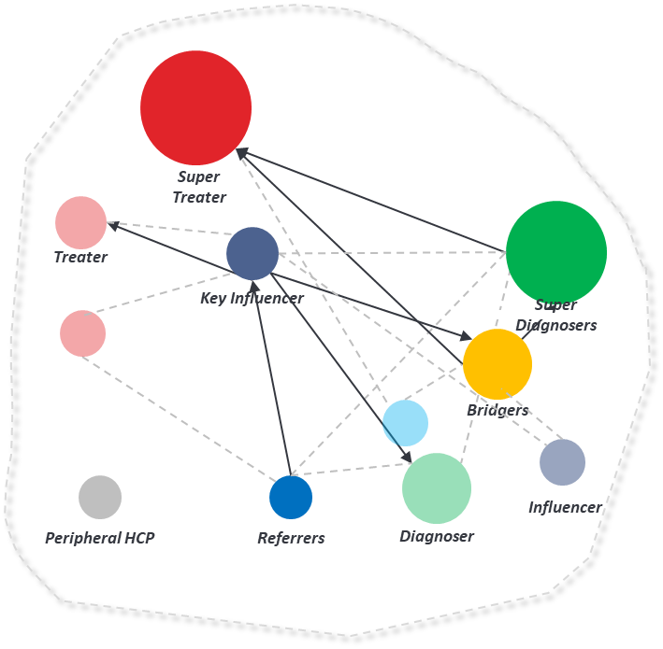
Key Personas: A small, high-impact cohort of 5% HCPs accounts for a disproportionate share of 53% of top-decile targets in the NT network
KEY PERSONAS
AUXILIARY PERSONAS
Super Treaters: 0.47% (n=315)
Managing NT1 relevant treatment for a high-volume of patients
Low Value Treaters: 0.42% (n=286)
Super Diagnosers: 1.06% (n=717)
Consistently seeing and diagnosing a high-volume of patients with NT1
Low Value Diagnosers: 0.64% (n=430)
Bridgers: 0.41% (n=280)
Key HCP redirecting the patient to the targeted HCPs for NT1 diagnosis or referrals
Key Influencers: 1.88% (n=1,271)
Highly connected HCPs managing and redirecting a high-volume of patients
Low Value Influencers: 0.93% (n=628)
Super Referrers: 0.81% (n=549)
HCPs actively redirecting patients to other HCPs in their referral network
Low Value Referrers: 66.18% (n=44,753)
Total HCPs: 3,132 (5% of the Universe)
% of Identified Targets Covered*: 29%
% of Identified Decile 5-10 Targets Covered^: 53%
Total HCPs: 46,097 (69% of the Universe)
% of Identified Targets Covered*: 46%
% of Identified Decile 5-10 Targets Covered^: 33%
* Amongst target list HCPs who are part of Referral Universe : N=7,562
^ Amongst Decile 5-10 target list HCPs who are part of Referral Universe : N=2,584

Slide 11
These HCP personas capture the distinct roles patients encounter as they navigate the NT1 referral network from initial symptoms to eventual treatment
Super Referrers
Key Influencers
Bridgers
Super Diagnosers
Super Treaters
HCPs actively redirecting patients to other HCPs in their referral network
Highly connected HCPs managing and redirecting a high-volume of patients
Key HCP redirecting the patient to the targeted HCPs for NT1 diagnosis or referrals
Consistently seeing and diagnosing a high-volume of patients with NT1
Managing NT1 relevant treatment for a high-volume of patients
Key Personas
Referral Strength: Weighted outdegree > 90th Percentile and Weighted indegree < 10th Percentile
Patient Volume: Interacted patient volume ≥ ~90th Percentile
Referral Activity: Referral activity with 2+ patients
Network Influence: Top 10% PageRank
OR
Connection Strength: Unique # of Connected HCPs > median
Patient Volume: Interacted patient volume ≥ ~90th Percentile
Network Influence: Top ~15% betweenness subset centrality
Rerouting Intensity: Min. 2 patients referred out
OR
Rerouting Value: 25%+ patients received NT Dx/Tx immediately post referral (min n=3)
Connection Strength: Inbound Referral Connections with ≥ 2 unique HCPs
Network Influence: Top 10% weighted indegree
Diagnosing Intensity: First NT diagnosing volume ≥ 95th percentile
Patient Volume: Interacted patient volume ≥ 90th Percentile
Network Influence: Top 10% weighted indegree
Treatment Intensity: NT-treated patient volume > 95th percentile
Patient Volume: Interacted patient volume ≥ 90th Percentile
Low Value Referrers: Referred out at least 1 patient
Low Value Influencers: Referral activity with at least 4 patients
Low Value Diagnosers: First NT diagnosing volume ≥ 90th percentile
Low Value Treaters: NT-treated patient volume > 90th percentile
Auxiliary Personas
A single HCP can have multiple personas; However, for a 1:1 tagging we have used the one they most often showcase
All interacted patient volumes are based on the identified NT patient cohort throughout their journey, including pre-diagnosis
All insights shown here are interim and subject to change post validation across all the dependent KBQs currently under analysis
Notes:
Total HCPs : 67,197 Targeted Cohort: 5,207 Treaters: 265 Diagnosers: 296 Bridgers: 96 Influencers: 621 Referrers: 3929

Slide 12
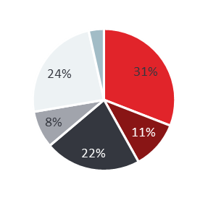
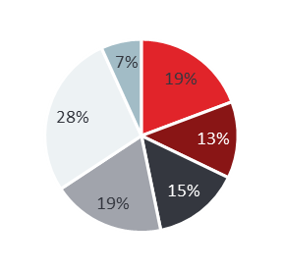
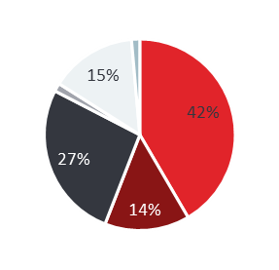
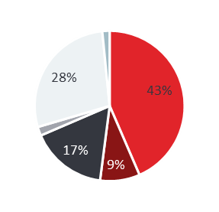

While Super Diagnosers and Key Influencers drive the highest share of top-decile targets, they require fundamentally different engagement strategies due to distinct specialty and profile mix
Super Referrers
Key Influencers
Bridgers
Super Diagnosers
Super Treaters
(n=549)
(n=1271)
(n=280)
(n=717)
(n=315)
Specialty Mix
% of Target List Covered*
2% | 12% | 2% | 9% | 4%
2% | 18% | 3% | 25% | 14%
Holistic Treaters (53%) | Innovators (50%) | Holistic Treaters (40%) | Innovators (45%) | Holistic Treaters (42%) | Innovators (73%) | Innovators (75%)
~3 pts/HCP receiving referrals vs market avg. <2 | ~9 pts/HCP managed vs market avg. ~2 | ~12 pts/HCP managed vs market avg. ~2 | ~16 pts/HCP receiving NT diagnosis vs market avg. ~1 | ~7 pts/HCP receiving NT treatments vs market avg. <1
% of Decile 6-10 Covered*
Primary Attitudinal Segment
Key patient referral insights
* Amongst target list HCPs who are part of Referral Universe : N=7585
Notes:
Total HCPs : 67,197 Targeted Cohort: 5,207 Treaters: 265 Diagnosers: 296 Bridgers: 96 Influencers: 621 Referrers: 3929

Slide 13
Innovators are the most represented group in the identified set of personas followed by Holistic Treaters
Personas | N-Size | Holistic Treaters | Traditionalists | Innovators | Off-Target
Super Treaters | 315 | 22% (68) | 2% (7) | 72% (226) | 4% (14)
Super Diagnosers | 717 | 23% (162) | 3% (19) | 69% (495) | 6% (41)
Bridger | 280 | 26% (72) | 8% (22) | 28% (77) | 39% (109)
Key Influencers | 1271 | 28% (353) | 7% (90) | 35% (447) | 30% (381)
Super Referrers | 549 | 17% (93) | 7% (36) | 8% (45) | 68% (375)
Low value Treaters | 286 | 31% (89) | 12% (35) | 40% (114) | 17% (48)
Low value Diagnosers | 430 | 25% (107) | 8% (33) | 33% (142) | 34% (148)
Low value Influencers | 628 | 27% (169) | 7% (46) | 27% (169) | 39% (244)
Low value Referrers | 44753 | 3% (1352) | 2% (769) | 1% (437) | 94% (42195)

Slide 14
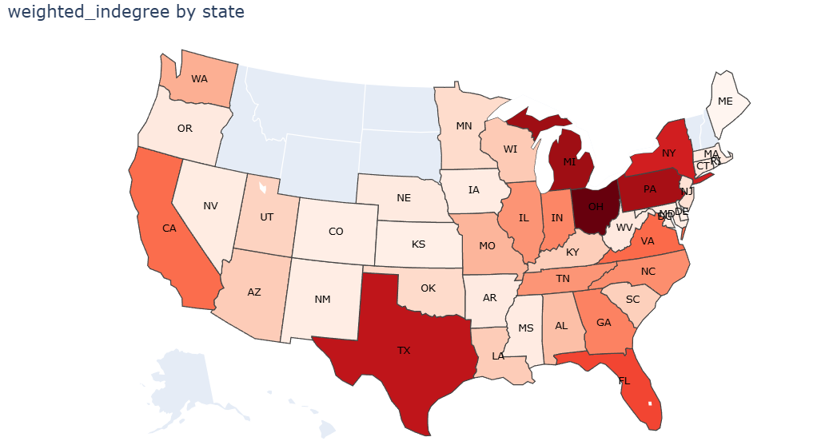
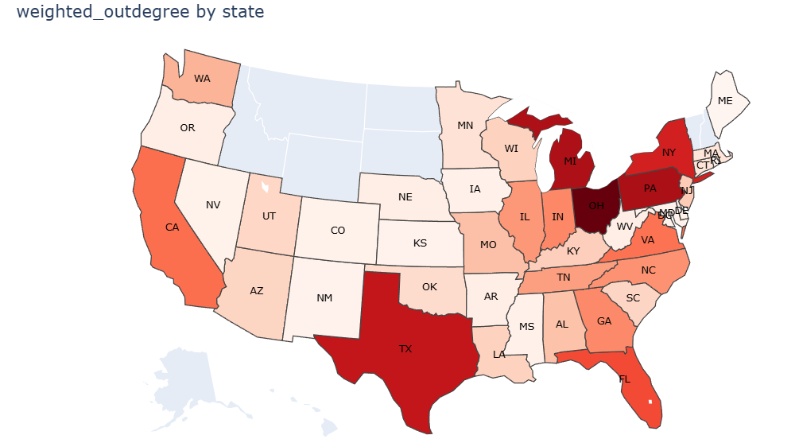
NT referral activity is geographically concentrated in the Southeast and mid-Atlantic, but high volume does not always signal a well-connected network
Key Insights
OH is the single most active referral hub in the country with HCPs referring and rendering activity, followed by MI, PA and NY
The Southeast corridor (VA, TN, GA, NC, SC, FL) shows consistently elevated activity across both metrics indicating regional clusters with more structured referral activities

Slide 15
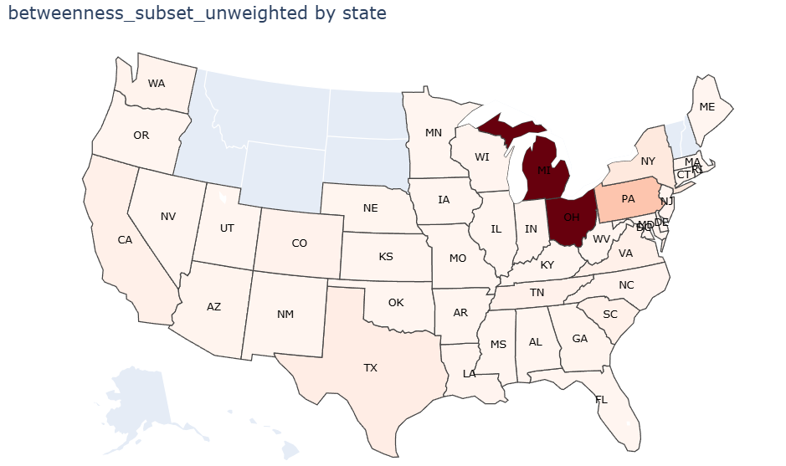
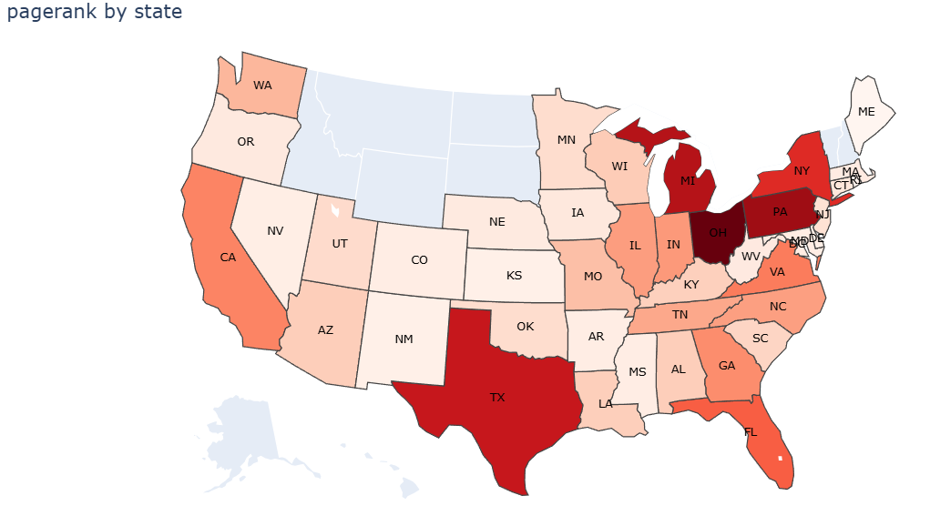
Michigan, Pennsylvania, and Ohio form the structural backbone of the NT referral network, where engagement has the highest systemic leverage beyond raw volume
Key Insights
FL and CA shows strong indegree and outdegree consistent with specialist concentration, but the network influence metrics indicate a lack of establish referral pattern
MI, PA and OH show strongest signal of a mature, trusted referral network with most critical bridges and high-quality inflow making them most structurally complete market in the country

Slide 16
NT referral communities are defined by relationships, not institutions as HCPs consistently refer within their behavioral network regardless of where they practice
Identifying the underlying clusters
6,174
Total HCP Clusters
Communities with 3 or more HCPs exchanging the referrals primarily amongst themselves
548
Self-sustained HCP HUBs
Communities with 1-2 HCPs managing 2+ patients and diagnosing or treating more than 67% of them
4,871
Standalone HCPs cohorts
1-2 connected HCPs with no prominent referral or treatment activity

