Slide 1
Customer Retention
-Rijul Kumar

Slide 2
Question
Customer satisfaction has emerged as one of the most important factors that guarantee the success of online store.
If customers are satisfied then they will definitely come back to online store again and this is called customer retention.
We have to find a pattern in the given data to see what factors affect customer satisfaction and in turn affects customer retention.

Slide 3
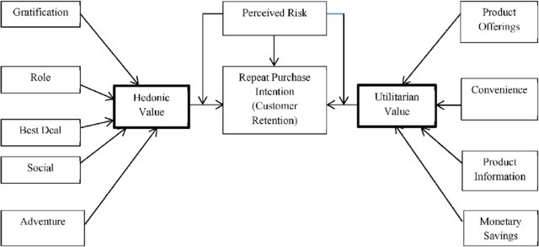
Factors affecting Customer Retention

Slide 4
EDA Steps
First of all i imported data from excel file to dataframe using pandas.
Then i used different functions (like .shape, .describe(), .dtypes) to know more about dataframe.
Next i checked whether there is a NULL value or not in dataframe using heatmap as well as .isnull()
After that i used count plots from seaborn library to plot all columns for visualisation.

Slide 5
Data for determining Customer Retention (EDA visualizations)

Slide 6
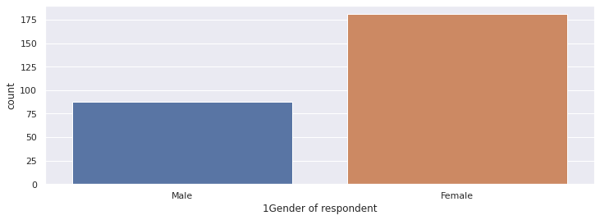
Gender of Customers:
As we can see most Customers are female while number of male customers are less than half of the female.

Slide 7
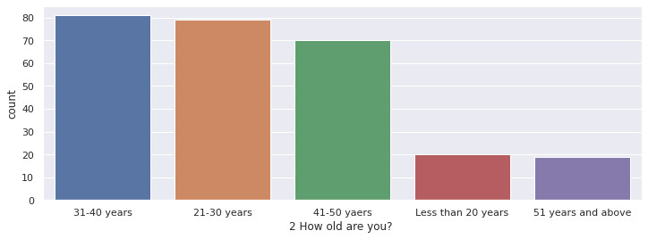
Age of Customers:
As we can see most Customers are between 21-50 years and others are very very less.

Slide 8
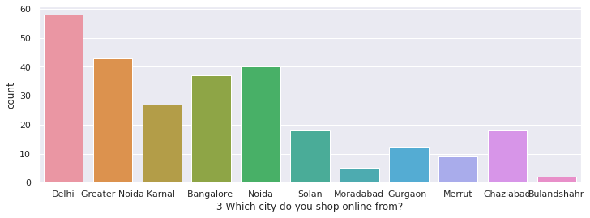
Location of Customers:
Here we can see that most customers are from big cities like Delhi,Greater Noida, Bangalore,Noida and lesser number are from smaller cities like Moradabad, Bulandshahr,etc

Slide 9
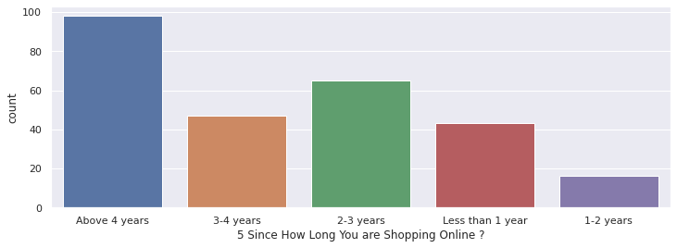
Number of Years’ Experience in online shopping:
As we can see most customers have been purchasing from online stores for more than 4 years and least number of customers have been purchasing from online stores for 1-2 years.

Slide 10
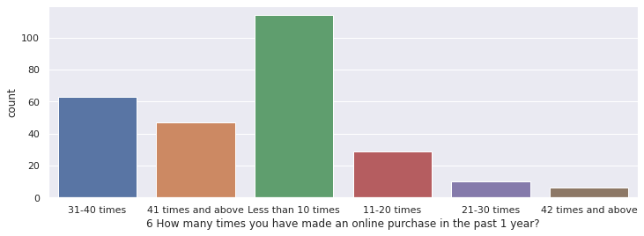
Last 1 year online purchases count:
In the last 1 year most customers has bought less than 10 items from online stores and least has bought more than 42 items from online stores

Slide 11
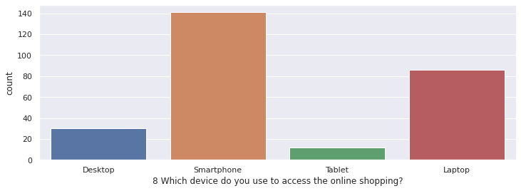
Device used for online shopping :
Most customers use Smartphone and laptops for shopping online.

Slide 12
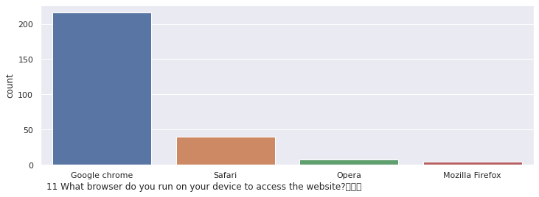
Browser used for online shopping:
Almost all people use Google chrome while some use Safari, others are used by negligible number of customers.

Slide 13
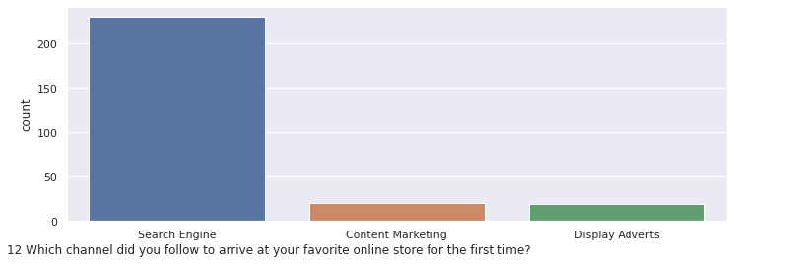
Channel which sent people to their favourite online store:
Most customers have been forwarded by search engines to their favourite online stores.

Slide 14
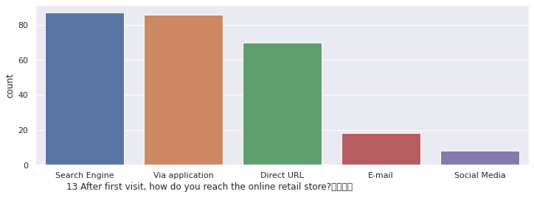
Mode of access to online store:
Most people either use search engine, application or direct website url to access their favourite online store.

Slide 15
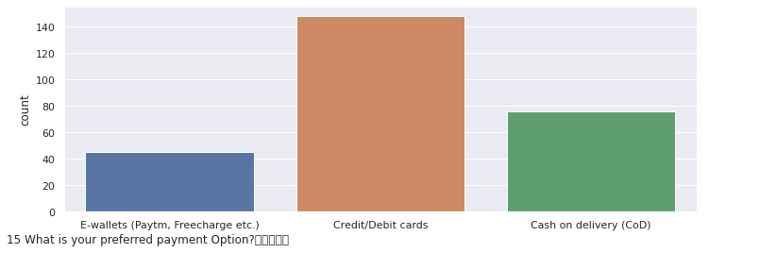
Preferred Mode of Payment:
Most customers use cards to pay while others either use COD or e-wallets.

Slide 16
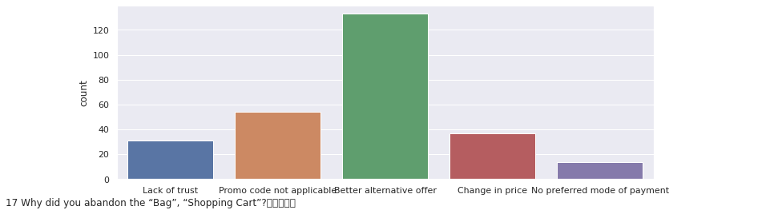
Reason for abandoning shopping cart by Customers:
As we can see most customers abandon shopping carts as they get better offers but there are also significant number of customers with other reasons.

Slide 17
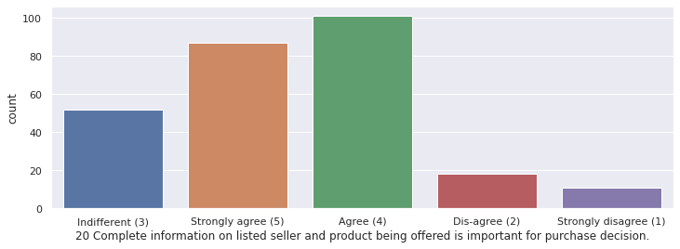
Availability of Complete information on listed seller and product:
As we can see most Customers agree and some are indifferent but very very less are against this idea.

Slide 18
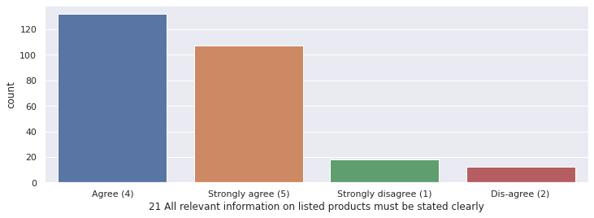
Availability of complete product information:
As we can see most Customers agree with this idea and negligible number of customers are against it.

Slide 19
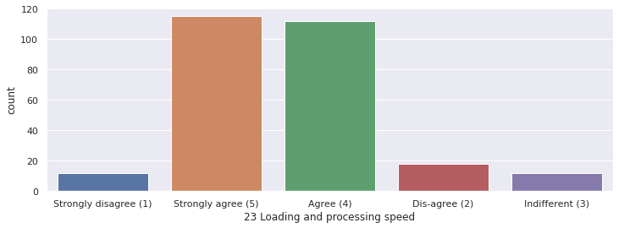
Loading and Processing speed:
As we can see most Customers agree that loading and processing speed of online store plays a part in their decision to purchase items from it.

Slide 20
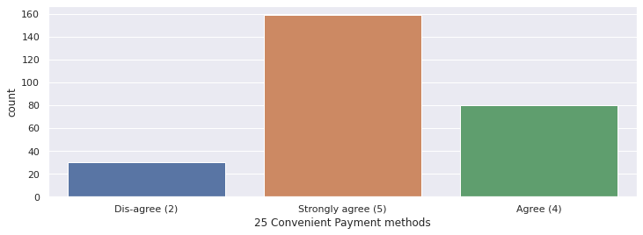
Convenience of Payment method:
As we can see most Customers agree that convenience of payment method provided by online store plays a part in their decision to purchase items from it.

Slide 21
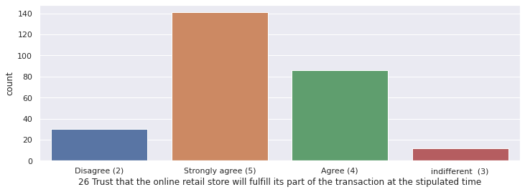
Trust on online store:
As we can see most Customers agree that trust on online store to complete its side of deal in given time plays a part in their decision to purchase items from it.

Slide 22
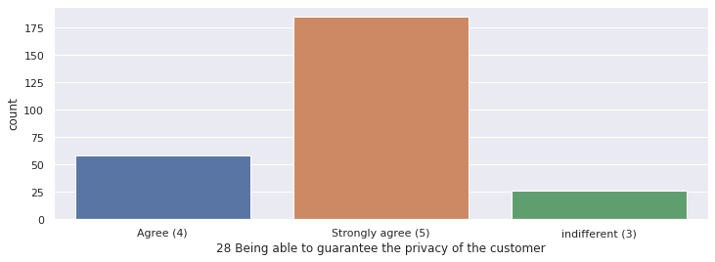
Customer Privacy:
As we can see most Customers agree that customer privacy provided by online store plays a part in their decision to purchase items from it.

Slide 23
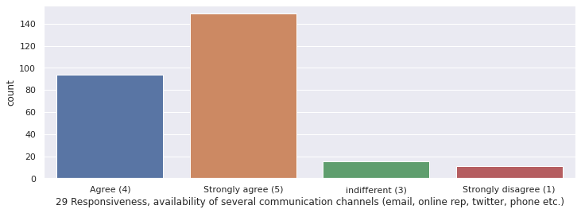
Availability of multiple communication channel:
As we can see most Customers agree that availability of multiple communication of online store plays a part in their decision to purchase items from it.

Slide 24
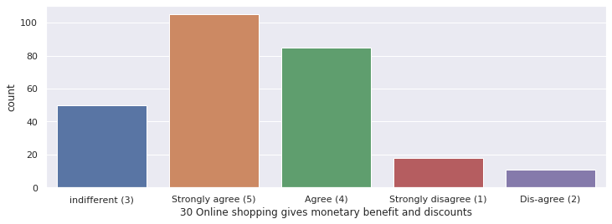
Availability of discounts:
As we can see most Customers agree that discounts in online store plays a part in their decision to purchase items from it.

Slide 25
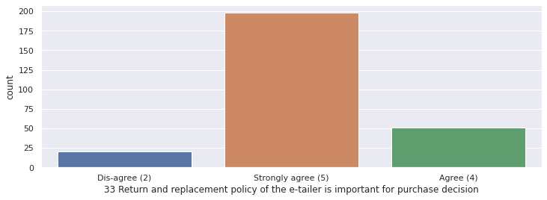
Return and replacement policy:
As we can see most Customers agree that return and replacement policies of online store plays a part in their decision to purchase items from it.

Slide 26
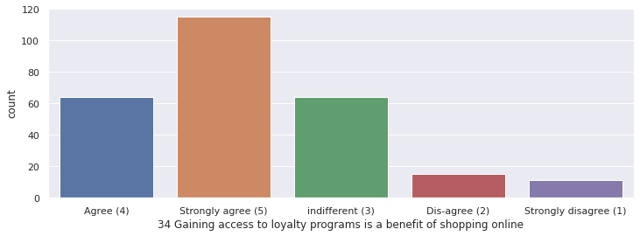
Access to Loyalty programs:
As we can see most Customers agree that availability of loyalty program in online store plays a part in their decision to purchase items from it.

Slide 27
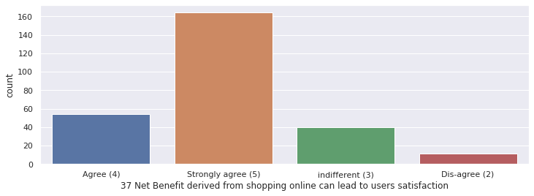
Net Benefit leads to user satisfaction:
As we can see most Customers agree with this idea and only negligible number of customers disagree.

Slide 28
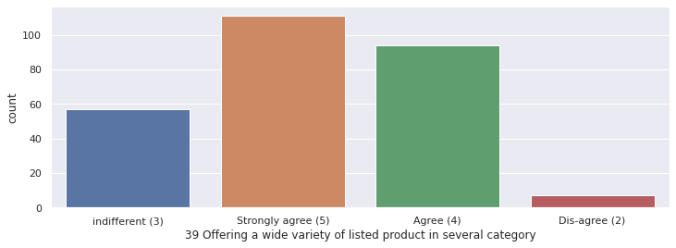
Availability of wide variety of Products:
As we can see most Customers agree that availability of wide variety of Products in online store plays a part in their decision to purchase items from it.

Slide 29
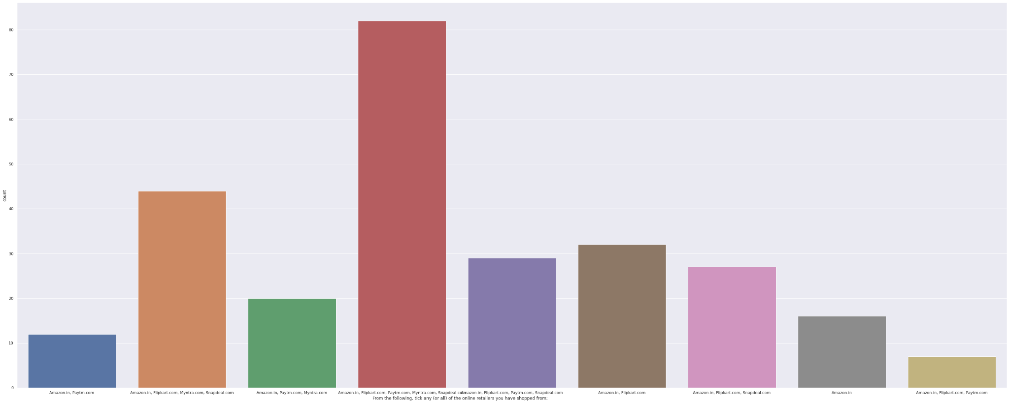
Most Online Retailers used:
As we can see most Customers use Amazon.in, Flipkart.com, Paytm.com, Myntra.com, Snapdeal.com

Slide 30
Assumptions Used
First assumption that i took was that all columns are nominal data and hence plotted count plots.
Next assumption was that the data (checked for NULL values) was clean data i.e no garbage value.

Slide 31
Analysis
We can see from above graphs that most customers are from big cities and roughly 2/3rd are female.
We can also see that most customers are of age 21-50 years and use smartphone or laptop mainly for online shopping.
Almost all customers access online store through search engine, application or direct website url and in that also Google chrome is the most used search engine.
Most customers have been forwarded by search engines to their favourite online stores during first time.
Customers prefer mode of payment in order (descending) - credit/debit cards, COD, e-wallet. Ease of payment increases customer retention in positive way.

Slide 32
Analysis (conti.)
Customers want complete information on product as well as listed seller.
Loading and processing speed as well as user friendly interface of online store plays an important role in customer retention.
Trust on online store as well as discounts provided by it is another major factor.
Return and replace policy as well as loyalty benefit programs are also very important according to customers.
And the last important factor is availability of wide range of products.

Slide 33
Conclusion
For Higher customer retention online shops should have:
Wide range of products mainly for customers of age 20-51 years.
Accessibility from laptop as well as smartphone.
Multiple mode of payments and wide range of products.
Fast loading and processing speed as well as user friendly interface for website as well as application.
Availability of good discounts, good return and replace policy as well as good loyalty benefit program.
Availability of complete information of product as well as listed seller.

Slide 34
Thank You

