Slide 1

Fake News Detection
-Rijul Kumar

Slide 2
Acknowledgement
Reference that i have used are:
Data Trained Education online video
Materials provided by Flip Robo
Youtube
Kaggle
Geeks for Geeks
Stackoverflow

Slide 3
Introduction

Slide 4
Business Problem Framing
Fake news has become one of the biggest problems of our age. It has serious impact on our online as well as offline discourse. One can even go as far as saying that, to date, fake news poses a clear and present danger to western democracy and stability of the society.
Fake news's simple meaning is to incorporate information that leads people to the wrong path. Nowadays fake news spreading like water and people share this information without verifying it.
For media outlets, the ability to attract viewers to their websites is necessary to generate online advertising revenue. So it is necessary to detect fake news.

Slide 5
Conceptual Background of the Domain Problem
The fake news can be detected with the help of some factors. Such as:
Some labeled text data
Certain recurring words
And so on...

Slide 6
Motivation for the Problem Undertaken
For media outlets, the ability to attract viewers to their websites is necessary to generate online advertising revenue. So it is necessary to detect fake news.
In this project, we are using some machine learning and Natural language processing libraries like NLTK, re (Regular Expression), Scikit Learn.
This model will then be used to predict whether a news is true or fake.

Slide 7
Analytical Problem Framing

Slide 8
Mathematical/ Analytical Modeling of the Problem
First of all i imported data from both csv files to dataframes using pandas.
After that i added label column (fake = 1 / true = 0) to the 2 dataframes and then i concatenated the 2 dataframes.
Then i used .dtypes to know data type of each column of dataframe.
After that i used .describe() to know the statistical information (such as max, min value,etc ) of continuous data columns in dataframe.
Then i used .shape to know shape of dataframe.

Slide 9
Data Sources and their formats
Training data has been extracted from ‘Fake.csv’ and ‘True.csv’ which has been obtained from flip robo (from kaggle)
‘Fake_news_project.docx’ from flip robo

Slide 10
Data Preprocessing Done
First of all for data preprocessing i checked whether there is a NULL value or not in dataframe using heatmap as well as .isnull()
After that i converted mail text into lower case alphabets and removed special characters from it.
Next i tokenized the reviews and removed the stop words from them.
After that i applied Lemmatization method.
Afterwards i interpreted them into Bag of words model.
Next i used Density plots from seaborn library to plot all continuous columns for visualisation.

Slide 11
Data Inputs- Logic- Output Relationships
Data Input :
These are basically the news which are to be tested for true or fake news.
Data Output :
Our Target variable is ‘label' which tells us if a news is true = 0 or fake = 1.

Slide 12
Hardware and Software Requirements and Tools Used
Hardware used:
Laptop with intel core i5 7th gen
Internet connection for web scraping
Software used:
Jupyter notebook
Required python libraries such as numpy, pandas, seaborn, matplotlib, etc
Required libraries for model such as sklearn, etc

Slide 13
Models Development and Evaluation

Slide 14
Identification of possible problem-solving approaches (methods)
After preprocessing data, i separated columns into features and target based on target variable ‘label’.
As this is a Binary classification problem of NLP field so i tried Naive Bayes Classifier

Slide 15
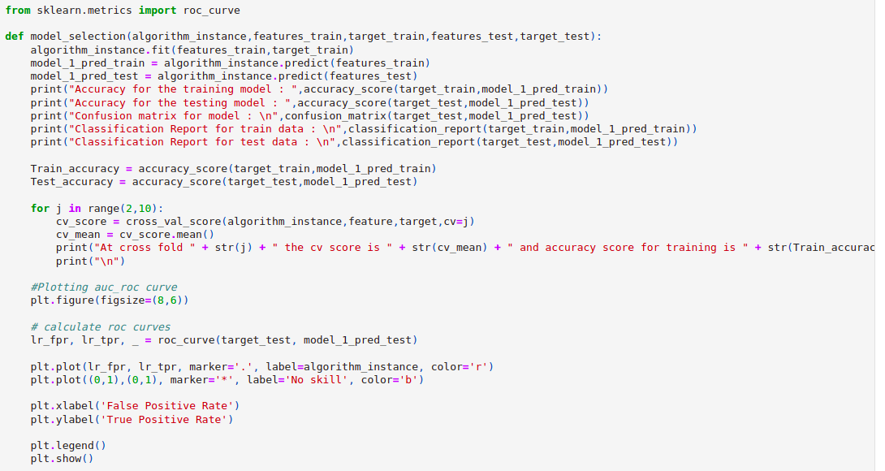
Run and Evaluate selected models
I defined a function model and then tried Naive Bayes Classification model using it

Slide 16
Run and Evaluate selected models (conti)
Result that i got for model :
Naive Bayes Classifier :
Accuracy for the training model : 0.9853272823454075
Accuracy for the testing model : 0.9858574610244989
At cross fold 2 the cv score is 0.892845546126935 and accuracy score for training is 0.9853272823454075 and accuracy score for testing is 0.9858574610244989

Slide 17
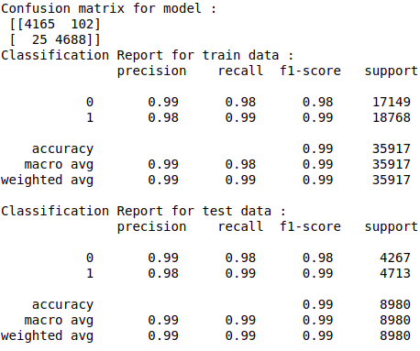
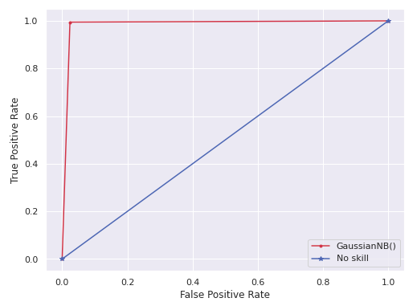
Run and Evaluate selected models (conti)
Naive Bayes Classifier :

Slide 18
Interpretation of the Results
So the results which i got were:
We got Training Accuracy as 98.53% and Testing Accuracy as 98.59%.
Since we have approximately balanced data (equal number of true and fake news), the precision is high for the data.

Slide 19
Conclusion

Slide 20
Key Findings and Conclusions of the Study
From this study i learnt that many news editor use certain words a lot while writing news which can be used to check if news is fake or not.
More number of frequent words we take, higher the accuracy will be in the model till a threshold point.

Slide 21
Learning Outcomes of the Study in respect of Data Science
Some problems faced and their solution (using visualisation and algorithm) used were:
When i used 500 most frequent words in bag of words the testing accuracy was higher than when i used 100 most frequent words in bag of words but the time taken for code execution was much longer in case of 500 most frequent words. For 1000 most frequent words code execution was taking much longer hence i chose the case with 500 most frequent words for my model.

Slide 22
Limitations of this work and Scope for Future Work
Some limitations are :
There are many other factors which are not in the data which may play major role in fake news such as human error, etc.
With evolving technology, there may be increase in intelligently hidden fake news which are also required to be taken care of.
Scope for future work :
This can be made further accurate by taking more and more factors as such as taking human error in consideration .

Slide 23
THE END

