Slide 1

Car Price Prediction
-Rijul Kumar

Slide 2
Acknowledgement
Reference that i have used are:
Data Trained Education online video
Materials provided by Flip Robo
Data extracted from https://www.cartrade.com/
Geeks for Geeks
Stackoverflow

Slide 3
Introduction

Slide 4
Business Problem Framing
With the covid 19 impact in the market, we have seen lot of changes in the car market. Now some cars are in demand hence making them costly and some are not in demand hence cheaper.
We are supposed to scrape at least 5000 used cars data from any website and then build a model to predict the price of an old car.

Slide 5
Conceptual Background of the Domain Problem
The prices of old cars depends on many factors. Such as:
Brand, Model, Variant of the car
Manufacturing year of the car
Driven Kilometers
Fuel type
Number of owners
Location of sale

Slide 6
Motivation for the Problem Undertaken
We are supposed to build a model using Machine Learning in order to predict the price of the old cars as they are currently much different than what they were before COVID.
This model will then be used to understand how exactly the prices vary with the variables. This can be used by companies to evaluate the prices of old cars in recent time.

Slide 7
Analytical Problem Framing

Slide 8
Mathematical/ Analytical Modeling of the Problem
First of all i imported data from excel file to dataframes using pandas.
After that i cleaned the data (like removed substring ‘kms’ from Driven kilometers column data, etc).
Afterwards i used .dtypes to know data type of each column of dataframe.
Then i changed Driven kilometers and Price column from object datatype to float datatype.
After that i used .describe() to know the statistical information (such as max, min value,etc ) of dataframe.
Then i used .shape to know shape of dataframe.

Slide 9
Data Sources and their formats
Training data has been extracted from ‘https://www.cartrade.com/’ using Selenium.
Using Selenium, data was extracted to excel file named ‘car_price_data.xlsx’.

Slide 10
Data Preprocessing Done
First of all for data preprocessing i checked whether there is a NULL value or not in dataframe using heatmap as well as .isnull()
After that NULL values were removed.
After that i used count plots from seaborn library to plot all categorical columns for visualisation.
Next i used Density plots from seaborn library to plot all continuous columns for visualisation.
Then i encoded the dataframe using Ordinal Encoder.

Slide 11
Data Preprocessing Done (conti)
After that i checked for correlations using heatmaps, correlation matrix and BAR plot.
Finally i confirmed high correlations using VIF and i got that there was no high correlation (i.e. all were less than 10).
After that i checked and removed skewness for continuous data columns (except target variable) using yeo-johnson transformation.
Finally i checked outliers using boxplot as well as z-score method and afterwards.
As removal of outliers from continuous data columns (except target variable column) gave very less loss (1.65%) so i removed them.

Slide 12
Data Inputs- Logic- Output Relationships
Data Input :
These are basically the factors (such as Brand, Model, Variant, Manufacturing year, etc) which affects the prices of cars.
Data Output :
Our Target variable is ‘Price (in ₹)' which is the price of the old cars and we are supposed to predict it with the help of data input (i.e factors affecting car prices).

Slide 13
Hardware and Software Requirements and Tools Used
Hardware used:
Laptop with intel core i5 7th gen
Internet connection for web scraping
Software used:
Jupyter notebook
Required python libraries such as numpy, pandas, seaborn, matplotlib, etc
Required libraries for model such as sklearn, etc
Required libraries for web scraping such as selenium,etc

Slide 14
Models Development and Evaluation

Slide 15
Identification of possible problem-solving approaches (methods)
After preprocessing data (removing NULL, encoding, checking for high correlations, removing skewness and outliers) i separated columns into features and target.
As this is a regression problem so we tried 4 models - LinearRegression, SVR, RandomForestRegressor and DecisionTreeRegressor
I also tried 4 metrics method - r2_score, mse, rms, mae
Then i used Lasso for regularization.
Finally i used Ensemble Technique.

Slide 16
Testing of Identified Approaches (Algorithms)
As this is a regression problem so we tried following 4 models -
LinearRegression
SVR
RandomForestRegressor
DecisionTreeRegressor

Slide 17
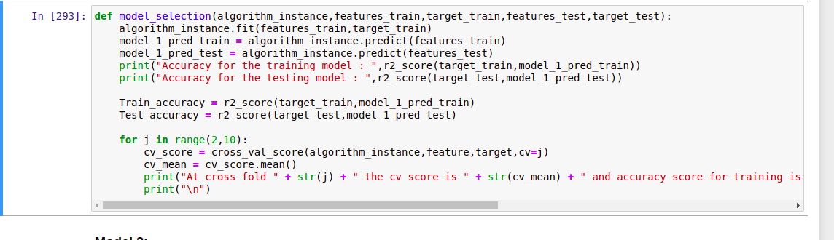
Run and Evaluate selected models
I defined a function model and then tried 4 different models using it

Slide 18
Run and Evaluate selected models (conti)
Result that i got for each model :
LinearRegression :
At random state 7 the training accuracy is : 0.16383619784543546
At random state 7 the testing accuracy is : 0.1469071923098223
At cross fold 2 the cv score is 0.15704804394672922 and accuracy score for training is -0.1580800000323732 and accuracy score for testing is 0.1469071923098223
SVR:
Accuracy for the training model : -0.12253247357201102
Accuracy for the testing model : -0.16873651665433442
At cross fold 2 the cv score is -0.12869919468300006 and accuracy score for training is -0.12253247357201102 and accuracy score for testing is -0.16873651665433442

Slide 19
Run and Evaluate selected models (conti)
Result that i got for each model (conti) :
RandomForestRegressor :
Accuracy for the training model : 0.9866976687986722
Accuracy for the testing model : 0.8840525978432557
At cross fold 2 the cv score is 0.8635985105119979 and accuracy score for training is 0.9866976687986722 and accuracy score for testing is 0.8840525978432557
DecisionTreeRegressor :
Accuracy for the training model : 0.9981689203007841
Accuracy for the testing model : 0.8626950354828585
At cross fold 2 the cv score is 0.8295530091338674 and accuracy score for training is 0.9981689203007841 and accuracy score for testing is 0.8626950354828585

Slide 20
Run and Evaluate selected models (conti)
Finally i concluded that RandomForestRegressor() gives best accuracy
Hence i took it as main model

Slide 21
Key Metrics for success in solving problem under consideration
I tried 4 different metrics method:
r2_score
mse
rms
mae
I got best results from r2_score and hence used it in final model

Slide 22
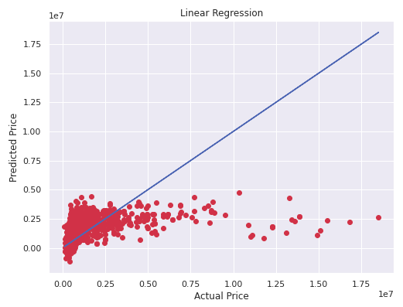
Visualizations
We can see that for Linear Regression almost all points lie near best fit curve but not on it.

Slide 23
Interpretation of the Results
So the results which i got were:
Although RandomForestRegressor() is best model but DecisionTreeRegressor() can also be used as they are also very good models.
Above point can be seen through r2_score which is the also best among 4 metrics tried.
We got our final accuracy (r2_score) as 84.94% after hypertuning.

Slide 24
Conclusion

Slide 25
Key Findings and Conclusions of the Study
From this study i learnt that sometimes some unrelated factors like COVID can also result in change in prices of old cars in market.
Prices of old cars are not highly dependent on any of the factors taken in this project.
Almost all of the old cars are sold by their first owner, very few by second owner and others are negligible.
Most cars which are sold were manufactured around 2017.

Slide 26
Learning Outcomes of the Study in respect of Data Science
Some problems faced and their solution (using visualisation and algorithm) used were:
While web scraping for data i needed to visit 5000 urls for extracting data from description page of each old car which needed more GPU than i had in my system. So what i did was that i distributed that 5000 urls in a group of 200 each (i.e url[0:200], and so on…) and then executed the code block 25 times as variable data list was already appending.
After web scraping some data which was supposed to be continuous data column was stored as object datatype in excel file. So what i did was in data cleaning part of model i converted them to float datatype using .astype()

Slide 27
Limitations of this work and Scope for Future Work
Some limitations are :
There are many other factors which are not in the data which may play major role in prices of some old cars such as car colour.
Unrelated factors such as COVID may indirectly also affect price of old cars.
With evolving technology, prices of cars made with new technology increases while those made with old technologies decreases.
Scope for future work :
This can be made further accurate by taking more and more factors into account

Slide 28
THE END

