Slide 1

Ratings Prediction Project
-Rijul Kumar

Slide 2
Acknowledgement
Reference that i have used are:
Data Trained Education online video
Materials provided by Flip Robo
Data extracted from www.amazon.com and www.flipkart.com
Geeks for Geeks
Stackoverflow

Slide 3
Introduction

Slide 4
Business Problem Framing
There is website where people write different reviews for technical products. Now there is a new feature on the website i.e. The reviewer will have to add stars(rating) as well with the review. The rating is out 5 stars and it only has 5 options available 1 star, 2 stars, 3 stars, 4 stars, 5 stars.
Now we want to predict ratings for the reviews which were written in the past and we don’t have a rating. So, we have to build an application which can predict the rating by seeing the review.
We are supposed to scrape at least 20000 rows of data for the model.

Slide 5
Conceptual Background of the Domain Problem
The rating can be derived from reviews with the help of some factors. Such as:
Some data with both review and ratings
Certain recurring words in reviews such as good, bad, etc
And so on...

Slide 6
Motivation for the Problem Undertaken
We need to scrape the reviews of different laptops, Phones, Headphones, smart watches, Printers, etc.
We have to scrape at least 20000 rows of data.
This model will then be used to predict ratings for the reviews which were written in the past and for which we don’t have a rating.

Slide 7
Analytical Problem Framing

Slide 8
Mathematical/ Analytical Modeling of the Problem
First of all i imported data from excel file to dataframes using pandas.
I used .dtypes to know data type of each column of dataframe.
After that i used .describe() to know the statistical information (such as max, min value,etc ) of continuous data columns in dataframe.
Then i used .shape to know shape of dataframe.

Slide 9
Data Sources and their formats
Training data has been extracted from ‘https://www.amazon.com/’ and ‘https://www.flipkart.com/’ using Selenium.
Using Selenium, data was extracted to excel file named ‘Ratings_prediction_data.xlsx’.

Slide 10
Data Preprocessing Done
First of all for data preprocessing i checked whether there is a NULL value or not in dataframe using heatmap as well as .isnull()
After that i removed punctuations and converted reviews into lower case alphabets.
Next i tokenized the reviews and removed the stop words from them.
After that i applied both Stemming and Lemmatization method.
Afterwards i focused on lemmatized output and interpreted them into Bag of words model.
Next i used Density plots from seaborn library to plot all continuous columns for visualisation.

Slide 11
Data Preprocessing Done (conti)
After that i checked for correlations using heatmaps and correlation matrix.
After that i checked and removed skewness for continuous data columns (except target variable) but as almost all columns were skewed.
Finally i checked outliers using boxplot as well as z-score method and discovered lots of outliers.
As there was too much skewness and outliers so i chose to use tree based algorithms in model building phase rather than removing all those because it would lead to too much data loss.

Slide 12
Data Inputs- Logic- Output Relationships
Data Input :
These are basically the reviews which are to be rated by the machine learning model.
Data Output :
Our Target variable is ‘Rating' which is the rating of the reviews.

Slide 13
Hardware and Software Requirements and Tools Used
Hardware used:
Laptop with intel core i5 7th gen
Internet connection for web scraping
Software used:
Jupyter notebook
Required python libraries such as numpy, pandas, seaborn, matplotlib, etc
Required libraries for model such as sklearn, etc
Required libraries for web scraping such as selenium,etc

Slide 14
Models Development and Evaluation

Slide 15
Identification of possible problem-solving approaches (methods)
After preprocessing data (removing NULL, encoding, checking for high correlations, removing skewness and outliers) i separated columns into features and target.
As this is a regression problem so we tried 4 models - LinearRegression, XGBRegressor, RandomForestRegressor and DecisionTreeRegressor
I also tried 4 metrics method - r2_score, mse, rms, mae
Then i used Lasso for regularization.
Finally i used Ensemble Technique.

Slide 16
Testing of Identified Approaches (Algorithms)
As this is a regression problem so we tried following 4 models -
LinearRegression
XGBRegressor
RandomForestRegressor
DecisionTreeRegressor

Slide 17
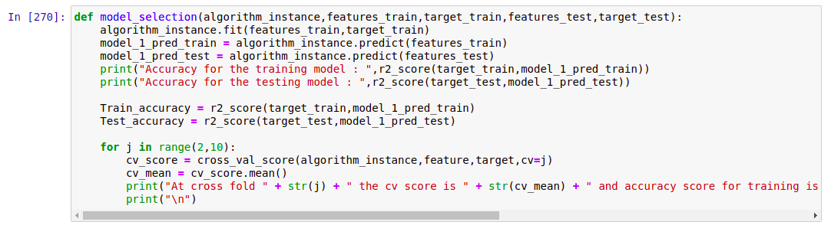
Run and Evaluate selected models
I defined a function model and then tried 4 different models using it

Slide 18
Run and Evaluate selected models (conti)
Result that i got for each model :
LinearRegression :
At random state 3 the training accuracy is : 0.10499536558166533
At random state 3 the testing accuracy is : 0.09688953257873034
At cross fold 2 the cv score is -7.148313218511615e+24 and accuracy score for training is -0.11419990928700341 and accuracy score for testing is 0.09688953257873034
XGBRegressor:
Accuracy for the training model : 0.17113317595280508
Accuracy for the testing model : 0.17444362379688338
At cross fold 2 the cv score is -0.12343403113445128 and accuracy score for training is 0.17113317595280508 and accuracy score for testing is 0.17444362379688338

Slide 19
Run and Evaluate selected models (conti)
Result that i got for each model (conti) :
RandomForestRegressor :
Accuracy for the training model : 0.18998468920871847
Accuracy for the testing model : 0.17938940743021847
At cross fold 2 the cv score is -0.10493400123583363 and accuracy score for training is 0.18998468920871847 and accuracy score for testing is 0.17938940743021847
DecisionTreeRegressor :
Accuracy for the training model : 0.20051157005475173
Accuracy for the testing model : 0.13323484216975012
At cross fold 2 the cv score is -0.11696279466012482 and accuracy score for training is 0.20051157005475173 and accuracy score for testing is 0.13323484216975012

Slide 20
Run and Evaluate selected models (conti)
Finally i concluded that RandomForestRegressor() gives best accuracy
Hence i took it as main model

Slide 21
Key Metrics for success in solving problem under consideration
I tried 4 different metrics method:
r2_score
mse
rms
mae
I got best results from r2_score and hence used it in final model

Slide 22
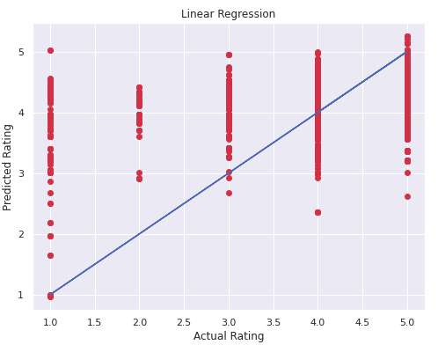
Visualizations
We can see that for Linear Regression almost all points do not lie near best fit curve.

Slide 23
Interpretation of the Results
So the results which i got were:
Although RandomForestRegressor() is best model but DecisionTreeRegressor() can also be used as it is also very good model.
Above point can be seen through r2_score which is the also best among 4 metrics tried.
We got our final accuracy (r2_score) as 18.12% after hypertuning.

Slide 24
Conclusion

Slide 25
Key Findings and Conclusions of the Study
From this study i learnt that many users use certain words a lot while writing reviews such as good, worthless, etc.
There can also be many fake reviews whose authenticity we can not check among all the data gathered.
Many users have given different ratings with the same review such as 2 people have given 3 star and 4 star for a certain product and the review which they have given for the same product is ‘good product’.

Slide 26
Learning Outcomes of the Study in respect of Data Science
Some problems faced and their solution (using visualisation and algorithm) used were:
There was skewness and outliers in almost all columns removing which would have created huge data loss (88.1%). So i chose to use tree based algorithm in model building phase rather than removing skewness and outliers as tree based algorithms are not affected by them.

Slide 27
Limitations of this work and Scope for Future Work
Some limitations are :
There are many other factors which are not in the data which may play major role in review ratings such as authenticity of review, etc.
With evolving technology, there may be increase in bot reviews which are also required to be taken care of.
Scope for future work :
This can be made further accurate by taking more and more factors as well as authenticity of user / review into account.

Slide 28
THE END

