Slide 1

Flight Price Prediction
-Rijul Kumar

Slide 2
Acknowledgement
Reference that i have used are:
Data Trained Education online video
Materials provided by Flip Robo
Data extracted from https://www.yatra.com/
Geeks for Geeks
Stackoverflow

Slide 3
Introduction

Slide 4
Business Problem Framing
Anyone who has booked a flight ticket knows how unexpectedly the prices vary. The cheapest available ticket on a given flight gets more and less expensive over time.
So, we have to work on a project where we have to collect data of flight fares with other features and work to make a model to predict fares of flights.
We are supposed to scrape at least 1500 rows of data for the model.

Slide 5
Conceptual Background of the Domain Problem
The prices of flight ticket depends on many factors. Such as:
Airline Name
Date of journey
Source and Destination
Departure time and Arrival time
Duration
Total stops
And so on...

Slide 6
Motivation for the Problem Undertaken
We are supposed to build a model using Machine Learning in order to predict the price of the flight tickets.
This model will then be used to understand how exactly the prices vary with the variables. This can be used to evaluate the best interval of time to purchase flight tickets at its cheapest price.

Slide 7
Analytical Problem Framing

Slide 8
Mathematical/ Analytical Modeling of the Problem
First of all i imported data from excel file to dataframes using pandas.
After that i cleaned the data (like converted Duration and Price from object datatype to numeric datatype,etc).
I used .dtypes to know data type of each column of dataframe.
After that i used .describe() to know the statistical information (such as max, min value,etc ) of continuous data columns in dataframe.
Then i used .shape to know shape of dataframe.

Slide 9
Data Sources and their formats
Training data has been extracted from ‘https://www.yatra.com/’ using Selenium.
Using Selenium, data was extracted to excel file named ‘flight_price_data.xlsx’.

Slide 10
Data Preprocessing Done
First of all for data preprocessing i checked whether there is a NULL value or not in dataframe using heatmap as well as .isnull()
After that i used count plots from seaborn library to plot all categorical columns for visualisation.
Next i used Density plots from seaborn library to plot all continuous columns for visualisation.
Afterwards i used other graphs to visualize pattern of Price with respect to other columns.
Then i encoded the dataframe using Ordinal Encoder.

Slide 11
Data Preprocessing Done (conti)
After that i checked for correlations using heatmaps, correlation matrix and BAR plot.
Finally i confirmed correlations using VIF.
After that i checked and removed skewness for continuous data columns (except target variable) using box-cox transformation.
Finally i checked outliers using boxplot as well as z-score method and discovered that only target variable had outliers so we ignored outliers.

Slide 12
Data Inputs- Logic- Output Relationships
Data Input :
These are basically the factors (such as airline name, date of journey, source, destination, departure time, arrival time, duration, total stops, etc) which affects the prices of flight tickets.
Data Output :
Our Target variable is ‘Price' which is the price of the flight tickets and we are supposed to predict it with the help of data input (i.e factors affecting flight ticket prices).

Slide 13
Hardware and Software Requirements and Tools Used
Hardware used:
Laptop with intel core i5 7th gen
Internet connection for web scraping
Software used:
Jupyter notebook
Required python libraries such as numpy, pandas, seaborn, matplotlib, etc
Required libraries for model such as sklearn, etc
Required libraries for web scraping such as selenium,etc

Slide 14
Models Development and Evaluation

Slide 15
Identification of possible problem-solving approaches (methods)
After preprocessing data (removing NULL, encoding, checking for high correlations, removing skewness and outliers) i separated columns into features and target.
As this is a regression problem so we tried 4 models - LinearRegression, SVR, RandomForestRegressor and DecisionTreeRegressor
I also tried 4 metrics method - r2_score, mse, rms, mae
Then i used Lasso for regularization.
Finally i used Ensemble Technique.

Slide 16
Testing of Identified Approaches (Algorithms)
As this is a regression problem so we tried following 4 models -
LinearRegression
SVR
RandomForestRegressor
DecisionTreeRegressor

Slide 17
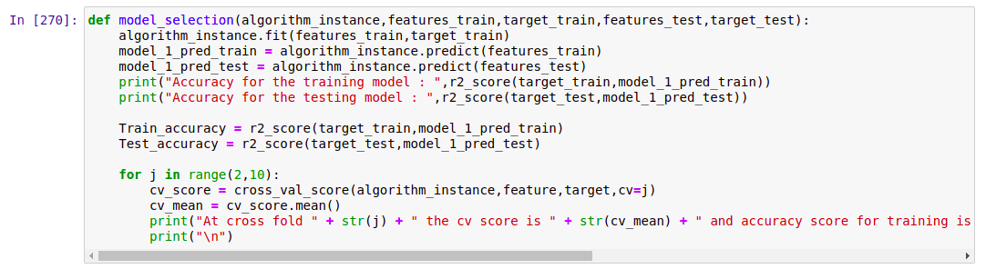
Run and Evaluate selected models
I defined a function model and then tried 4 different models using it

Slide 18
Run and Evaluate selected models (conti)
Result that i got for each model :
LinearRegression :
At random state 9 the training accuracy is : 0.5116297288576696
At random state 9 the testing accuracy is : 0.5056275585665695
At cross fold 2 the cv score is -0.2727951750529799 and accuracy score for training is 0.5116297288576696 and accuracy score for testing is 0.5056275585665695
SVR:
Accuracy for the training model : -0.06462320433380886
Accuracy for the testing model : -0.0950997703540779
At cross fold 2 the cv score is -0.9216749933443029 and accuracy score for training is -0.06462320433380886 and accuracy score for testing is -0.0950997703540779

Slide 19
Run and Evaluate selected models (conti)
Result that i got for each model (conti) :
RandomForestRegressor :
Accuracy for the training model : 0.9741278615603357
Accuracy for the testing model : 0.7942563514092913
At cross fold 2 the cv score is -0.6672666487812541 and accuracy score for training is 0.9741278615603357 and accuracy score for testing is 0.7942563514092913
DecisionTreeRegressor :
Accuracy for the training model : 0.9998320583184103
Accuracy for the testing model : 0.6399770563950407
At cross fold 2 the cv score is -1.0505756461889422 and accuracy score for training is 0.9998320583184103 and accuracy score for testing is 0.6399770563950407

Slide 20
Run and Evaluate selected models (conti)
Finally i concluded that RandomForestRegressor() gives best accuracy
Hence i took it as main model

Slide 21
Key Metrics for success in solving problem under consideration
I tried 4 different metrics method:
r2_score
mse
rms
mae
I got best results from r2_score and hence used it in final model

Slide 22
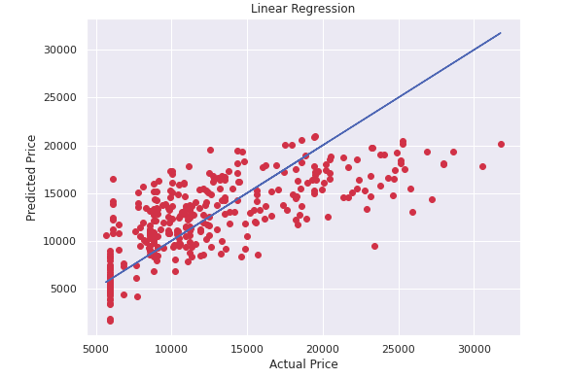
Visualizations
We can see that for Linear Regression almost all points lie near best fit curve but not on it which shows large amount of error.

Slide 23
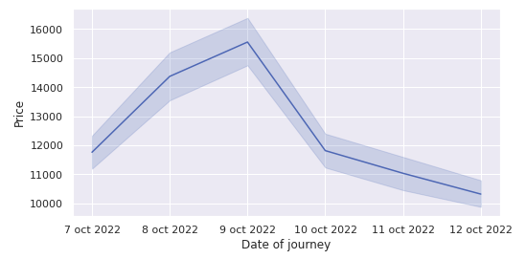
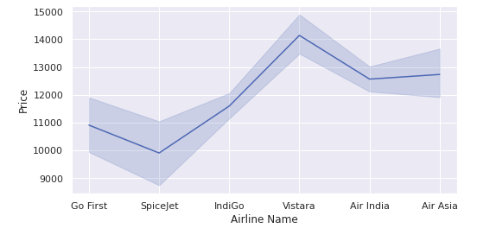
Visualizations (conti)
As we can see that more the difference between date of booking and date of journey, lesser will be the flight price. We can also see that cheapest flight is Spicejet and most expensive is Vistara.

Slide 24
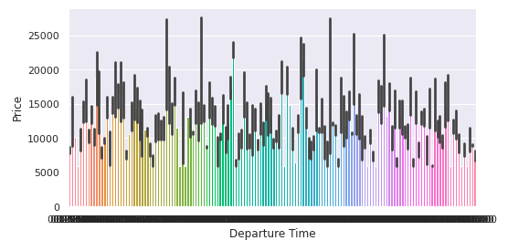
Visualizations
This is barplot of Price vs Departure time (from 0:00 to 23:59).
Here we can see that prices vary throughout the day.

Slide 25
Interpretation of the Results
So the results which i got were:
Although RandomForestRegressor() is best model but DecisionTreeRegressor() can also be used as they are also very good models.
Above point can be seen through r2_score which is the also best among 4 metrics tried.
We got our final accuracy (r2_score) as 80.72% after hypertuning.

Slide 26
Conclusion

Slide 27
Key Findings and Conclusions of the Study
From this study i learnt that many airlines increase their prices for people who book their flights closer to date of their departure.
Prices of Flight tickets are not very highly dependent on any of the factors taken in this project , they do have good dependency on some.
Prices of Flight tickets fluctuate a lot throughout the day.
Some companies provides slightly cheaper flight tickets than others.

Slide 28
Learning Outcomes of the Study in respect of Data Science
Some problems faced and their solution (using visualisation and algorithm) used were:
When i tried to go from yatra.com homepage to flight list page of yatra.com using web scraping script the website stopped me. So i directly visited the url of flight list page of yatra.com using chromedriver.
After web scraping some data which was supposed to be continuous data column was stored as object datatype in excel file. So what i did was in data cleaning part of model i converted them to float datatype using .astype()

Slide 29
Limitations of this work and Scope for Future Work
Some limitations are :
There are many other factors which are not in the data which may play major role in prices of some flight prices such as discount offers,etc.
Unrelated factors such as availability of beverages may indirectly also affect price of flight tickets.
With evolving technology, prices of flight tickets may also decrease.
Scope for future work :
This can be made further accurate by taking more and more factors as well as more source and destinations (domestic as well as international) into account.

Slide 30
THE END

