Slide 1

Housing Project
-Rijul Kumar

Slide 2
Acknowledgement
Reference that i have used are:
Data Trained Education online video
Materials provided by Flip Robo
Geeks for Geeks
Stackoverflow

Slide 3
Introduction

Slide 4
Business Problem Framing
Houses are one of the necessary need of each and every person around the globe and therefore housing and real estate market is one of the markets which is one of the major contributors in the world’s economy.
We are supposed to build a model using Machine Learning in order to predict the actual value of the prospective properties.

Slide 5
Conceptual Background of the Domain Problem
The prices of houses depends on many factors. Such as:
Lot size
Type of road access to property
Type of utilities available
Physical locations within city limits
Rates the overall material and finish of the house
Heating quality and condition, Central air conditioning
Kitchen quality
And so on…

Slide 6
Motivation for the Problem Undertaken
We are supposed to build a model using Machine Learning in order to predict the actual value of the prospective properties.
This model will then be used to understand how exactly the prices vary with the variables. This can be used to concentrate on areas that will yield high returns.

Slide 7
Analytical Problem Framing

Slide 8
Mathematical/ Analytical Modeling of the Problem
First of all i imported data from train and test csv files to DataFrames using pandas.
After that i used .describe() to know the statistical information (such as max, min value,etc ) of train dataframe.
Then i used .shape to know shape of train and test dataframe.
Afterwards i used .dtypes to know data type of each column of train and test dataframe.

Slide 9
Data Sources and their formats
test.csv and train.csv provided by FlipRobo
DataDescription.txt provided by FlipRobo

Slide 10
Data Preprocessing Done
First of all for data preprocessing i checked whether there is a NULL value or not in dataframe using heatmap as well as .isnull()
After that NULL values were filled with mode of columns for categorical columns and mean of columns for continuous columns.
After that i used count plots from seaborn library to plot all categorical columns for visualisation.
Next i used Density plots from seaborn library to plot all continuous columns for visualisation.

Slide 11
Data Preprocessing Done (conti)
Then i did encoded the dataframe using Ordinal Encoder.
After that i checked for correlations using heatmaps, correlation matrix and BAR plot.
Finally i confirmed high correlations using VIF and dropped highly correlated columns.
After that i removed skewness and checked outliers.

Slide 12
Data Inputs- Logic- Output Relationships
Data Input :
These are basically the factors (such as lot size, type of road access to property, type of utilities available, etc) which affects the prices of house.
Data Output :
Our Target variable is SalesPrice which is the price of the houses and we are supposed to predict it with the help of data input (i.e factors affecting house prices).

Slide 13
Set of assumptions used
First assumption that i took was that all ‘object’ data type columns are categorical data and hence plotted count plots.
Next assumption that i took was that all ‘float64’ and ‘int64’ data type columns are continuous data and hence plotted density plots.

Slide 14
Hardware and Software Requirements and Tools Used
Hardware used:
Laptop with intel core i5 7th gen
Software used:
Jupyter notebook
Required python libraries such as numpy, pandas, seaborn, matplotlib, etc
Required libraries for model such as sklearn, etc

Slide 15
Models Development and Evaluation

Slide 16
Identification of possible problem-solving approaches (methods)
After preprocessing data (removing NULL, encoding, removing high correlations, removing skewness and outliers) i separated columns into features and target.
As this is a regression problem so we tried 4 models - LinearRegression, XGBRegressor, RandomForestRegressor and SVR
I also tried 4 metrics method - r2_score, mse, rms, mae
Then i used Lasso for regularization.
Finally i used Ensemble Technique.

Slide 17
Testing of Identified Approaches (Algorithms)
As this is a regression problem so we tried following 4 models -
LinearRegression
XGBRegressor
RandomForestRegressor
SVR

Slide 18
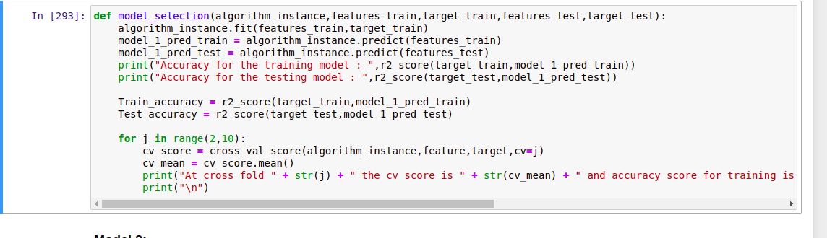
Run and Evaluate selected models
I defined a function model and then tried 4 different models using it

Slide 19
Run and Evaluate selected models (conti)
Result that i got for each model :
LinearRegression :
At random state 1 the training accuracy is : 0.8258075894920763
At random state 1 the testing accuracy is : 0.7944252079267548
At cross fold 2 the cv score is 0.6755921993594929 and accuracy score for training is -0.6501706537893246 and accuracy score for testing is 0.7944252079267548
XGBRegressor :
Accuracy for the training model : 0.999928181520936
Accuracy for the testing model : 0.8173283235415273
At cross fold 2 the cv score is 0.7937274760605788 and accuracy score for training is 0.999928181520936 and accuracy score for testing is 0.8173283235415273

Slide 20
Run and Evaluate selected models (conti)
Result that i got for each model (conti) :
RandomForestRegressor :
Accuracy for the training model : 0.9729581383527576
Accuracy for the testing model : 0.8475074393604315
At cross fold 2 the cv score is 0.8040774368386595 and accuracy score for training is 0.9729581383527576 and accuracy score for testing is 0.8475074393604315
SVR :
Accuracy for the training model : -0.0497743509077444
Accuracy for the testing model : -0.024558376537638482
At cross fold 2 the cv score is -0.0579295586606845 and accuracy score for training is -0.0497743509077444 and accuracy score for testing is -0.024558376537638482

Slide 21
Run and Evaluate selected models (conti)
Finally i concluded that RandomForestRegressor() gives best accuracy
Hence i took it as main model

Slide 22
Key Metrics for success in solving problem under consideration
I tried 4 different metrics method:
r2_score
mse
rms
mae
I got best results from r2_score and hence used it in final model

Slide 23
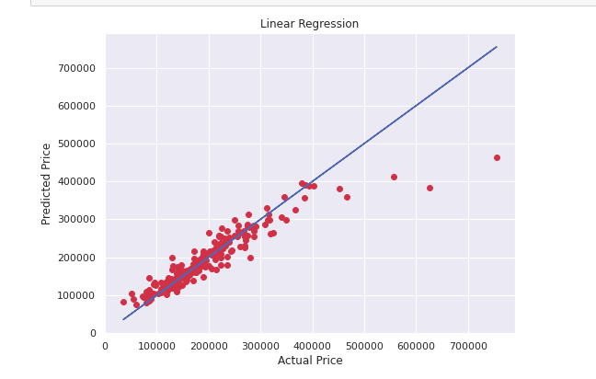
Visualizations
Got a good best fit curve for linear regression as most of the points lie on it

Slide 24
Interpretation of the Results
So the results which i got were:
Although RandomForestRegressor() is best model but LinearRegression() and XGBRegressor() can also be used as they are also good models.
Above point can be seen through best fit curve as well as r2_score which is the also best among 4 metrics tried.
We got our final accuracy as 82.69%

Slide 25
Conclusion

Slide 26
Key Findings and Conclusions of the Study
From this study i learnt that sometimes when purchasing houses people may have some very strict requirement for some amenities like in land contour factor almost all wanted Leveled one while in some factors like Foundation they are willing to accept more options.
House prices are highly dependent on Overall Quality and Ground Living area as they were highly correlated in the dataframe.

Slide 27
Learning Outcomes of the Study in respect of Data Science
Some problems faced and their solution (using visualisation and algorithm) used were:
Removing outliers was leading to very high data loss (57.45%). So in place of removing it i used RandomForestRegressor() which is not sensitive to outliers.
Too many columns which made me unable to check which column has all NULL values. So here i used heatmaps which helped me to find column with all NULL values.

Slide 28
Limitations of this work and Scope for Future Work
Some limitations are :
There are many other factors which are not in the data which may play major role in prices of some houses.
Unrelated factors such as global warming may indirectly also affect price of houses.
With evolving technology, prices of houses made with new technology increases while those made with old technologies decreases.
Scope for future work :
This can be made further accurate by taking more and more factors into account

Slide 29
THE END

