Slide 1

Micro Credit Defaulter
-Rijul Kumar

Slide 2
Acknowledgement
Reference that i have used are:
Data Trained Education online video
Materials provided by Flip Robo
Geeks for Geeks
Stackoverflow

Slide 3
Introduction

Slide 4
Business Problem Framing
Microfinance Institution (MFI) is an organization that offers financial services to low income populations.
We are working with one such client that is in Telecom Industry. They are a fixed wireless telecommunications network provider. They are collaborating with an MFI to provide micro-credit on mobile balances to be paid back in 5 days.
We have to build a model which can be used to predict in terms of a probability for each loan transaction, whether the customer will be paying back the loaned amount within 5 days of insurance of loan.

Slide 5
Conceptual Background of the Domain Problem
The probability of repaying loan within 5 days of issuing the loan can be predicted with the help of some factors. Such as:
Average main account balance over last 90 days
Average payback time in days over last 90 days
Total amount of loans taken by user in last 90 days
Daily amount spent from main account, averaged over last 90 days (in Indonesian Rupiah)
And so on…

Slide 6
Motivation for the Problem Undertaken
We have to build a model which can be used to predict in terms of a probability for each loan transaction, whether the customer will be paying back the loaned amount within 5 days of insurance of loan.
Then with help of this model telecom company will be able to focus on providing their services and products to low income families and poor customers efficiently.

Slide 7
Analytical Problem Framing

Slide 8
Mathematical / Analytical Modeling of the Problem
First of all i imported data from train and test csv files to DataFrames using pandas.
After that i used .describe() to know the statistical information (such as max, min value,etc ) of train dataframe.
Then i used .shape to know shape of train and test dataframe.
Afterwards i used .dtypes to know data type of each column of train and test dataframe.
Next i moved on to data preprocessing part.

Slide 9
Data Sources and their formats
Data file.csv provided by FlipRobo
Micro Credit Loan Use Case.docx provided by FlipRobo
Data_Description.xlsx provided by FlipRobo

Slide 10
Data Preprocessing Done
First of all for data preprocessing i checked whether there is a NULL value or not in dataframe using heatmap as well as .isnull()
After that i used count plots from seaborn library to plot all categorical columns for visualisation.
Next i used Density plots from seaborn library to plot all continuous columns for visualisation.
Then i did encoded the dataframe using Ordinal Encoder.

Slide 11
Data Preprocessing Done (conti)
After that i checked for correlations using heatmaps, correlation matrix and BAR plot.
Finally i confirmed high correlations using VIF and dropped highly correlated columns.
After that i removed skewness from continuous data using yeo-johnson algorithm.
Afterwards i checked for outliers.
Since removal of outliers was giving data loss of 18.56%, i did not remove outliers but opted to take tree based models during later part as tree algorithms are not affected by them.

Slide 12
Data Inputs- Logic- Output Relationships
Data Input :
These are basically the factors (such as Average main account balance over last 90 days, etc) which helps us in predicting whether a person will repay the loan or not within 5 days of issuing the loan.
Data Output :
Our Target variable is label which is the flag indicating whether the user paid back the credit amount within 5 days of issuing the loan {1:success, 0:failure}.

Slide 13
Hardware and Software Requirements and Tools Used
Hardware used:
Laptop with intel core i5 7th gen
Software used:
Jupyter notebook
Required python libraries such as numpy, pandas, seaborn, matplotlib, etc
Required libraries for model such as sklearn, etc

Slide 14
Models Development and Evaluation

Slide 15
Identification of possible problem-solving approaches (methods)
After preprocessing data (checking NULL, encoding, removing high correlations, removing skewness and outliers) i separated columns into features and target.
As this is a regression problem so we tried 4 models - LogisticRegression, DecisionTreeClassifier, RandomForestClassifier and Gaussian Naive Bayes.
We checked for each model analytically (classification report and confusion matrix) as well as graphically (AUC-ROC curves).
Finally i used Ensemble Technique.

Slide 16
Testing of Identified Approaches (Algorithms)
As this is a regression problem so we tried following 4 models -
LogisticRegression
DecisionTreeClassifier
RandomForestClassifier
Gaussian Naive Bayes

Slide 17
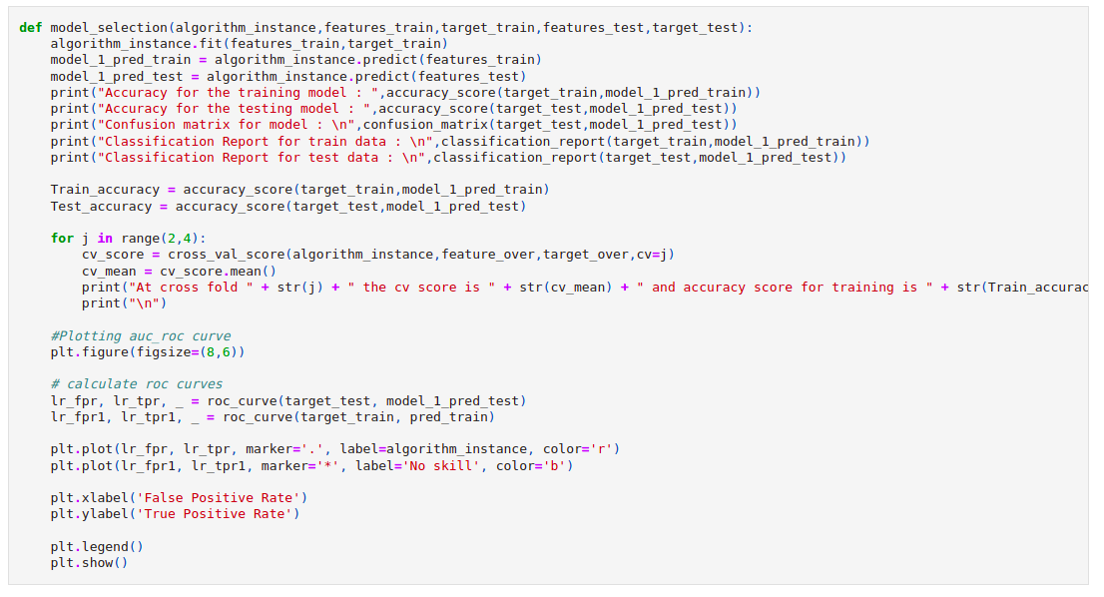
Run and Evaluate selected models
I defined a function ‘model’ and then tried 4 different models using it

Slide 18
Run and Evaluate selected models (conti)
Result that i got for each model :
LogisticRegression :
At random state 8 the training accuracy is : 0.6921008964560852
At random state 8 the testing accuracy is : 0.6910443896256117
At cross fold 2 the cv score is 0.5317612617278431 and accuracy score for training is 0.49965756808602707 and accuracy score for testing is 0.6910443896256117

Slide 19
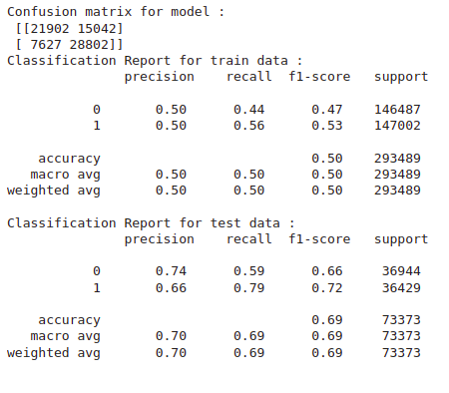
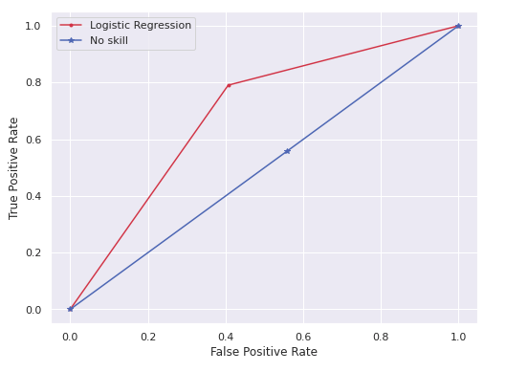
Run and Evaluate selected models (conti)
Result that i got for each model :
LogisticRegression (conti) :

Slide 20
Run and Evaluate selected models (conti)
Result that i got for each model :
DecisionTreeClassifier :
Accuracy for the training model : 1.0
Accuracy for the testing model : 0.962452128167037
At cross fold 2 the cv score is 0.4982527489900835 and accuracy score for training is 1.0 and accuracy score for testing is 0.962452128167037

Slide 21
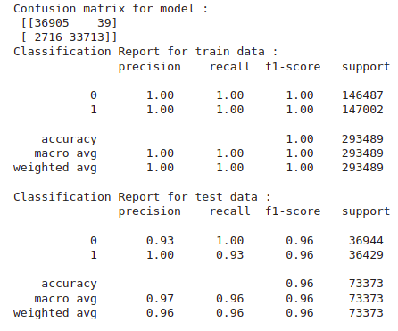
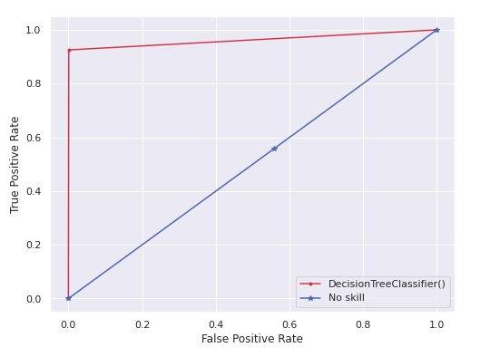
Run and Evaluate selected models (conti)
Result that i got for each model :
DecisionTreeClassifier (conti) :

Slide 22
Run and Evaluate selected models (conti)
Result that i got for each model (conti) :
RandomForestClassifier :
Accuracy for the training model : 0.9999965927172739
Accuracy for the testing model : 0.979665544546359
At cross fold 2 the cv score is 0.5288473594975768 and accuracy score for training is 0.9999965927172739 and accuracy score for testing is 0.979665544546359

Slide 23
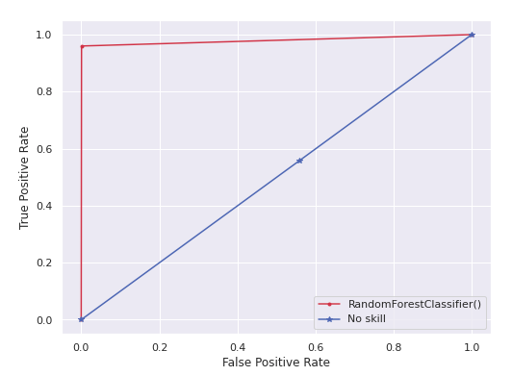
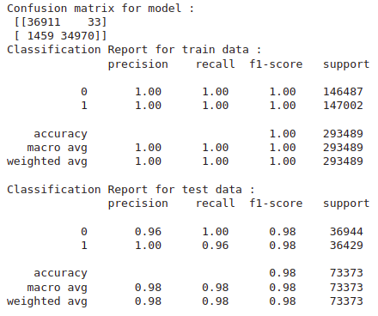
Run and Evaluate selected models (conti)
Result that i got for each model (conti) :
RandomForestClassifier (conti):

Slide 24
Run and Evaluate selected models (conti)
Result that i got for each model (conti) :
GaussianNB :
Accuracy for the training model : 0.7295707845949934
Accuracy for the testing model : 0.7297643547353931
At cross fold 2 the cv score is 0.5900174997683052 and accuracy score for training is 0.7295707845949934 and accuracy score for testing is 0.7297643547353931

Slide 25
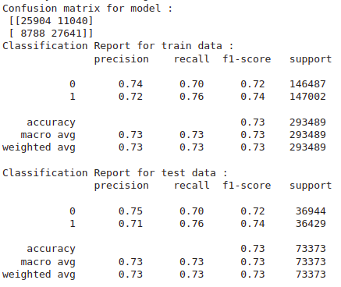
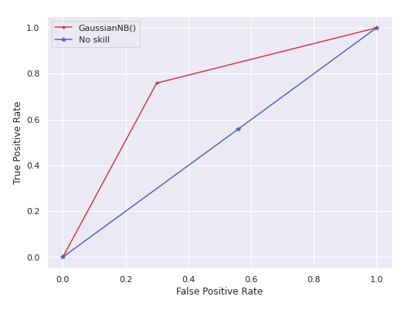
Run and Evaluate selected models (conti)
Result that i got for each model (conti) :
GaussianNB (conti) :

Slide 26
Run and Evaluate selected models (conti)
Finally i concluded that although RandomForestRegressor() gives best accuracy.
But DecisionTreeClassifier() gives approximately same accuracy as well as much higher model training speed.
Hence i took DecisionTreeClassifier() as main model

Slide 27
Interpretation of the Results
So the results which i got were:
Although RandomForestRegressor() is best model in terms of accuracy but DecisionTreeClassifier() is much better if accuracy as well as training speed is considered.
Above point can be seen through best fit curve as well as accuracy_score.
We got our final accuracy as 77.1% for target variable after hypertuning.

Slide 28
Conclusion

Slide 29
Key Findings and Conclusions of the Study
From this study i learnt that sometimes loan repayment can be deduced on the basis of some factors which involves customers past records.
Many columns (such as daily_decr30 and daily_decr90) which contains record of last 30 days and last 90 days were highly correlated i.e. behaviour of customers remains almost same over a period of time.

Slide 30
Learning Outcomes of the Study in respect of Data Science
Some problems faced and their solution (using visualisation and algorithm) used were:
Removing outliers was leading to very high data loss (18.56%). So in place of removing it i used tree algorithms based model which is not sensitive to outliers.
Having large data and lack of high GPU resulted in some models giving each fold of output cross validation in a very long time. So to solve this problem i decreased number of folds of cross validations.

Slide 31
Limitations of this work and Scope for Future Work
Some limitations are :
There are many other factors (such as competition with other telecom company) which are not in the data which may play major role in predicting loan repayment within 5 days.
Unrelated factors such as family emergencies, etc also plays minor role in affecting our target variable.
Scope for future work :
This can be made further accurate by taking more and more factors into account

Slide 32
THE END

