Slide 1

MALIGNANT COMMENT CLASSIFICATION
-Rijul Kumar

Slide 2
Acknowledgement
Reference that i have used are:
Data Trained Education online video
Materials provided by Flip Robo
Geeks for Geeks
Stackoverflow

Slide 3
Introduction

Slide 4
Business Problem Framing
The proliferation of social media enables people to express their opinions widely online. However, at the same time, this has resulted in the emergence of conflict and hate, making online environments uninviting for users.
Many celebrities and influences are facing backlashes from people and have to come across hateful and offensive comments. This can take a toll on anyone and affect them mentally leading to depression, mental illness, self-hatred and suicidal thoughts.
Our goal is to build a prototype of online hate and abuse comment classifier which can used to classify hate and offensive comments so that it can be controlled and restricted from spreading hatred and cyberbullying.

Slide 5
Conceptual Background of the Domain Problem
The classification of the hate and abusive comments can be done by many methods. Such as:
Number of characters in a comment
By using hateful words which are repeating in past comments
And so on…

Slide 6
Motivation for the Problem Undertaken
We have to build a model which can be used to identify as well as classify hateful comments. This will be a multi label binary classifier model.
Then with help of this model people can filter out the hate comments leading to a healthier mental state (i.e lack of depression, mental illness, self-hatred and suicidal thoughts).

Slide 7
Analytical Problem Framing

Slide 8
Mathematical / Analytical Modeling of the Problem
First of all i imported data from train and test csv files to DataFrames using pandas.
After that i used .describe() to know the statistical information (such as max, min value,etc ) of train and test dataframe.
Then i used .shape to know shape of train and test dataframe.
Afterwards i used .dtypes to know data type of each column of train and test dataframe.
Next i moved on to data preprocessing part.

Slide 9
Data Sources and their formats
Problem Statement.docx provided by FlipRobo
test.csv and train.csv provided by FlipRobo
Data_Description.xlsx provided by FlipRobo

Slide 10
Data Preprocessing Done
First of all for data preprocessing i checked whether there is a NULL value or not in train and test dataframe using heatmap as well as .isnull()
After that i used count plots from seaborn library to plot all categorical columns for visualisation.
After that i plotted many graphs related to number of characters in comments and different hate comment type.
Then i added a ‘comment_size’ column to train data as well as test data.
Then i did encoded the dataframe using Ordinal Encoder.

Slide 11
Data Preprocessing Done (conti)
After that i checked for correlations using heatmaps, correlation matrix and BAR plot.
Finally i confirmed that there were no high correlations using VIF.
After that i checked skewness for continuous data in both train and test dataframe.
Afterwards i checked for outliers for continuous data in both train and test dataframe using boxplot as well as z-score method.

Slide 12
Data Inputs- Logic- Output Relationships
Data Input :
These are basically the comments which are to be checked and classified under different categories of hated comments.
Data Output :
As this is a Multi label binary classification problem so output are the multiple target variables which are in this problem different categories of hated comments.

Slide 13
Hardware and Software Requirements and Tools Used
Hardware used:
Laptop with intel core i5 7th gen
Software used:
Jupyter notebook
Required python libraries such as numpy, pandas, seaborn, matplotlib, etc
Required libraries for model such as sklearn, etc

Slide 14
Models Development and Evaluation

Slide 15
Identification of possible problem-solving approaches (methods)
After preprocessing data (checking NULL, encoding, removing high correlations, removing skewness and outliers) i separated columns into features and different target.
As this is a multi label binary classification problem so we tried 4 models - LogisticRegression, DecisionTreeClassifier, RandomForestClassifier and Gaussian Naive Bayes.
We checked for each model analytically (classification report and confusion matrix) as well as graphically (AUC-ROC curves).
Finally i used Ensemble Technique.

Slide 16
Testing of Identified Approaches (Algorithms)
As this is a regression problem so we tried following 4 models -
LogisticRegression
DecisionTreeClassifier
RandomForestClassifier
Gaussian Naive Bayes

Slide 17
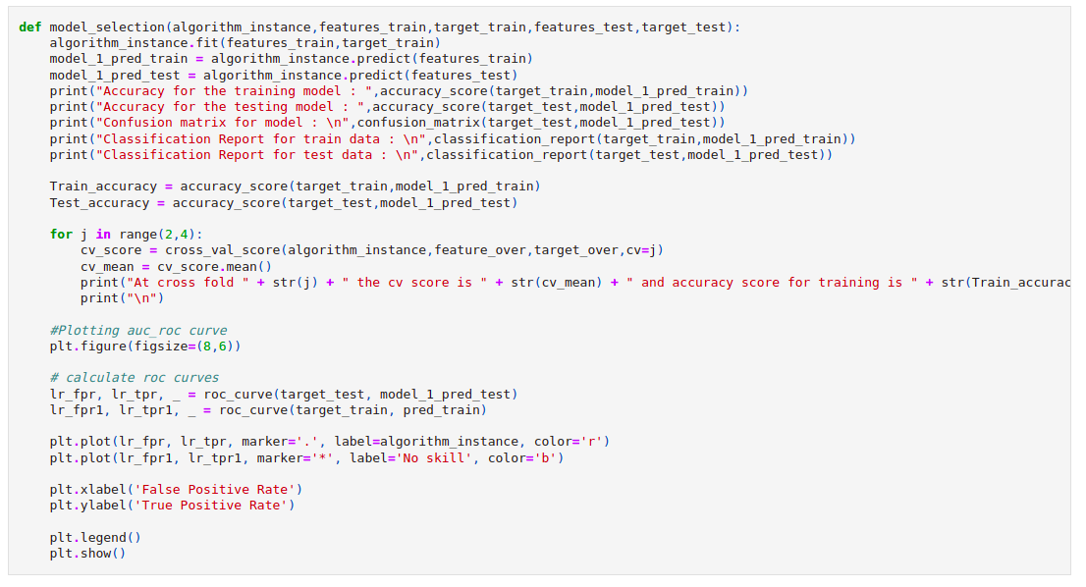
Run and Evaluate selected models
I defined a function ‘model’ and then tried 4 different models using it

Slide 18
Run and Evaluate selected models (conti)
For target variable ‘malignant’
Result that i got for each model :
LogisticRegression :
At random state 4 the training accuracy is : 0.9042269850222473
At random state 4 the testing accuracy is : 0.9038696537678208
At cross fold 2 the cv score is 0.9041555169761383 and accuracy score for training is 0.9042269850222473 and accuracy score for testing is 0.9038696537678208

Slide 19
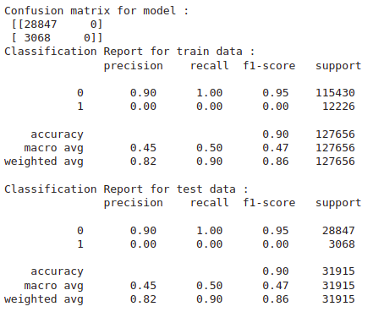
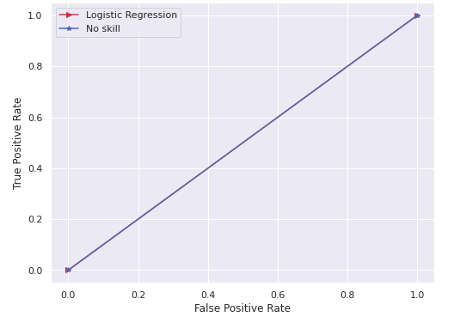
Run and Evaluate selected models (conti)
LogisticRegression (conti) :

Slide 20
Run and Evaluate selected models (conti)
For target variable ‘malignant’
Result that i got for each model :
DecisionTreeClassifier :
Accuracy for the training model : 1.0
Accuracy for the testing model : 0.8541124862917123
At cross fold 2 the cv score is 0.852492000123015 and accuracy score for training is 1.0 and accuracy score for testing is 0.8541124862917123

Slide 21
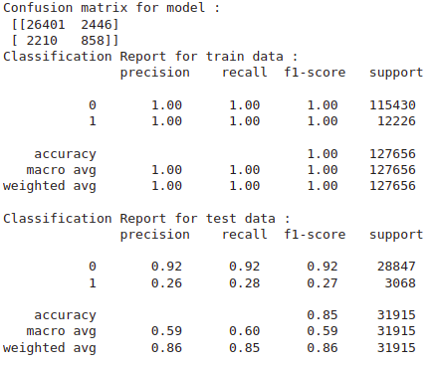
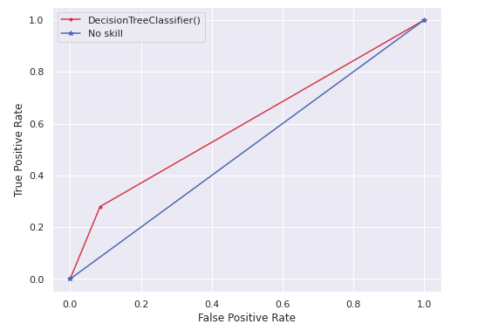
Run and Evaluate selected models (conti)
DecisionTreeClassifier (conti) :

Slide 22
Run and Evaluate selected models (conti)
For target variable ‘malignant’
Result that i got for each model (conti) :
RandomForestClassifier :
Accuracy for the training model : 0.9998668296045623
Accuracy for the testing model : 0.9044963183456055
At cross fold 2 the cv score is 0.9044876576458245 and accuracy score for training is 0.9998668296045623 and accuracy score for testing is 0.9044963183456055

Slide 23
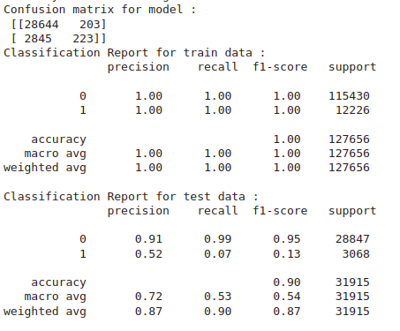
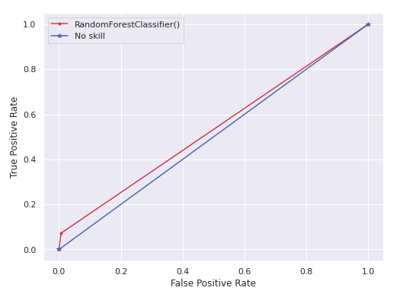
Run and Evaluate selected models (conti)
RandomForestClassifier (conti):

Slide 24
Run and Evaluate selected models (conti)
For target variable ‘malignant’
Result that i got for each model (conti) :
GaussianNB :
Accuracy for the training model : 0.904320987654321
Accuracy for the testing model : 0.9040576531411562
At cross fold 2 the cv score is 0.9026013401258531 and accuracy score for training is 0.904320987654321 and accuracy score for testing is 0.9040576531411562

Slide 25
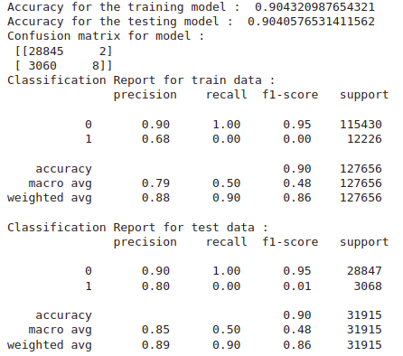
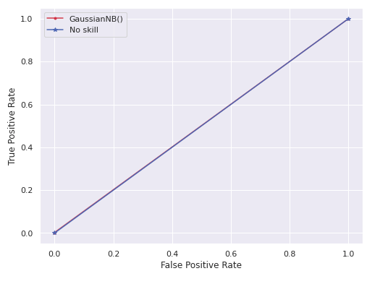
Run and Evaluate selected models (conti)
GaussianNB (conti) :

Slide 26
Run and Evaluate selected models (conti)
Finally i concluded that DecisionTreeClassifier() gives best accuracy which can be seen from auc-roc curve as well as from classification report.
Hence i took DecisionTreeClassifier() as main model

Slide 27
Run and Evaluate selected models (conti)
For target variable ‘highly_malignant’
DecisionTreeClassifier :
Accuracy for the training model : 1.0
Accuracy for the testing model : 0.9827667241109196
At cross fold 2 the cv score is 0.98312976770736 and accuracy score for training is 1.0 and accuracy score for testing is 0.9827667241109196

Slide 28
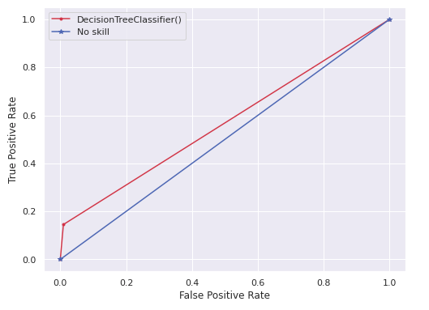
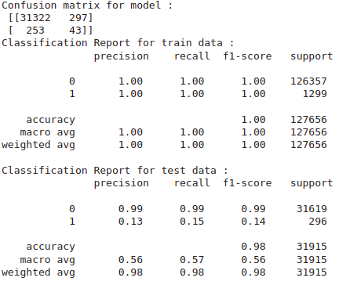
Run and Evaluate selected models (conti)
For target variable ‘highly_malignant’
DecisionTreeClassifier :

Slide 29
Run and Evaluate selected models (conti)
For target variable ‘rude’
DecisionTreeClassifier :
Accuracy for the training model : 1.0
Accuracy for the testing model : 0.9130816230612565
At cross fold 2 the cv score is 0.9092316120592818 and accuracy score for training is 1.0 and accuracy score for testing is 0.9130816230612565

Slide 30
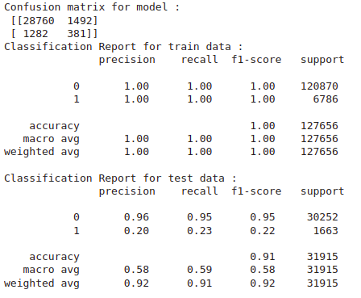
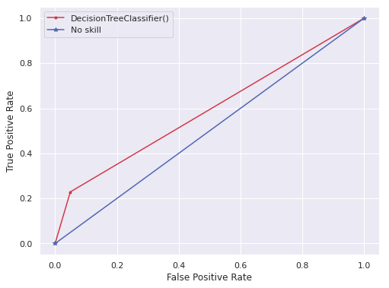
Run and Evaluate selected models (conti)
For target variable ‘rude’
DecisionTreeClassifier :

Slide 31
Run and Evaluate selected models (conti)
For target variable ‘threat’
DecisionTreeClassifier :
Accuracy for the training model : 1.0
Accuracy for the testing model : 0.9948613504621652
At cross fold 2 the cv score is 0.9945604156626277 and accuracy score for training is 1.0 and accuracy score for testing is 0.9948613504621652

Slide 32
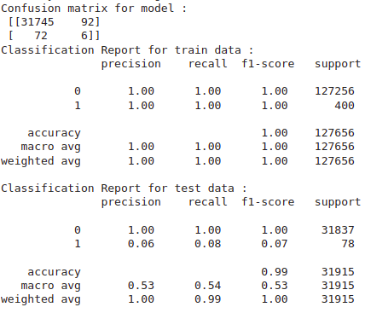
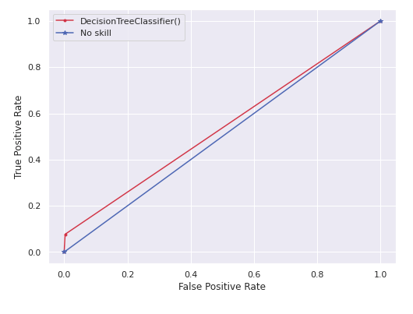
Run and Evaluate selected models (conti)
For target variable ‘threat’
DecisionTreeClassifier :

Slide 33
Run and Evaluate selected models (conti)
For target variable ‘abuse’
DecisionTreeClassifier :
Accuracy for the training model : 1.0
Accuracy for the testing model : 0.9189409368635438
At cross fold 2 the cv score is 0.9165324437989752 and accuracy score for training is 1.0 and accuracy score for testing is 0.9189409368635438

Slide 34
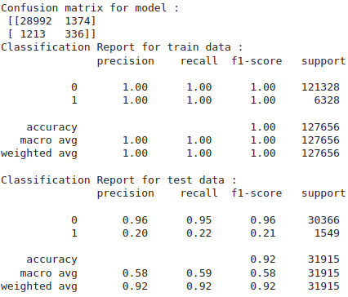
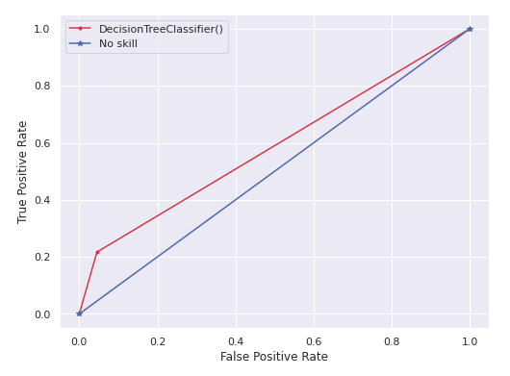
Run and Evaluate selected models (conti)
For target variable ‘abuse’
DecisionTreeClassifier :

Slide 35
Run and Evaluate selected models (conti)
For target variable ‘loathe’
DecisionTreeClassifier :
Accuracy for the training model : 1.0
Accuracy for the testing model : 0.9827040576531412
At cross fold 2 the cv score is 0.8214264433131013 and accuracy score for training is 1.0 and accuracy score for testing is 0.9827040576531412

Slide 36
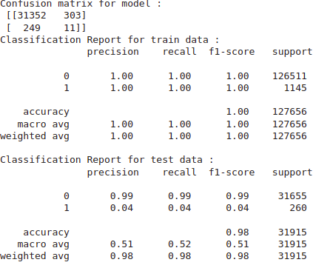
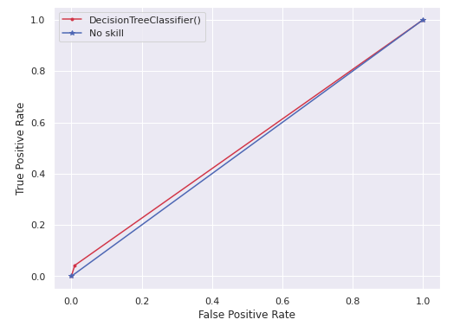
Run and Evaluate selected models (conti)
For target variable ‘loathe’
DecisionTreeClassifier :

Slide 37
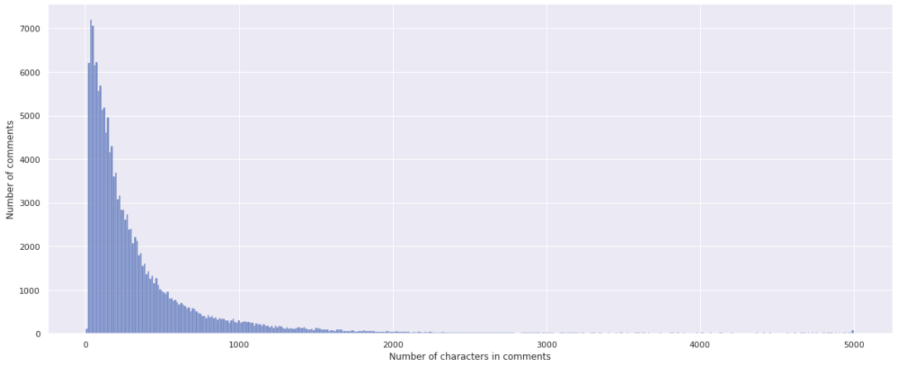
Visualizations
This graph represents number of comments vs comment size

Slide 38
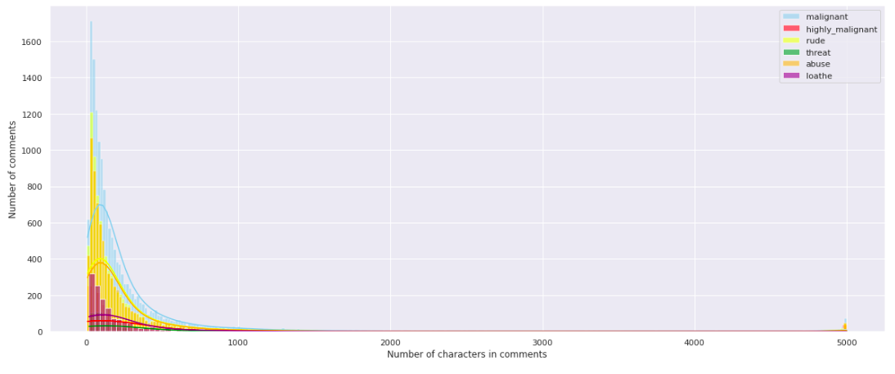
Visualizations (conti…)
This graph represents comparison for all target variables of number of comments vs comment size

Slide 39
Interpretation of the Results
So the results which i got were:
DecisionTreeClassifier() gives best accuracy which can be seen from auc-roc curve as well as from classification report.
We got our final accuracy as 90.41% for target variable (‘malignant’) after hypertuning.

Slide 40
Conclusion

Slide 41
Key Findings and Conclusions of the Study
All the target variables are mutually exclusive i.e. we can ignore any correlation between them.
We can identify as well as categorise the type of hated comments based on some factors such as number of character in a comment.

Slide 42
Limitations of this work and Scope for Future Work
Some limitations are :
There are many other factors (such as topic on which the person has commented,etc) which are not in the data which may play major role in predicting and classifying the type of hated comments.
Unrelated factors (such as person who is commenting might be under stress in daily life,etc) also plays minor role in affecting our target variable.
Scope for future work :
This can be made further accurate by taking more and more factors into account

Slide 43
THE END

