Slide 1
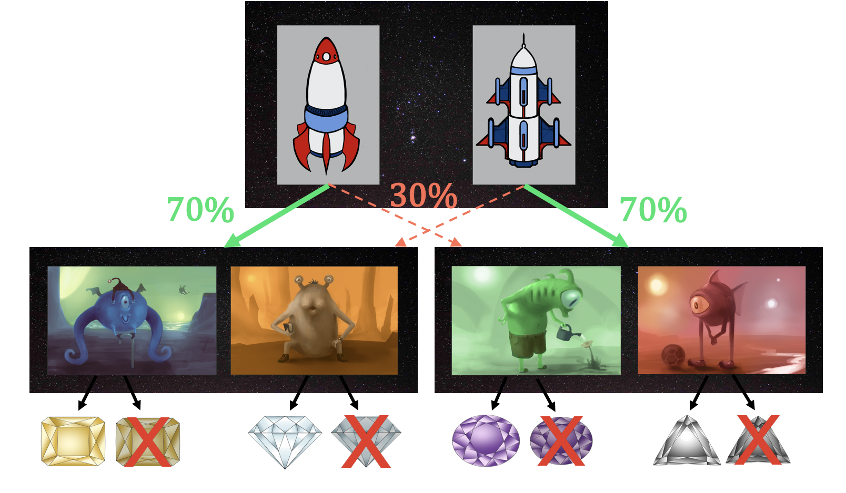
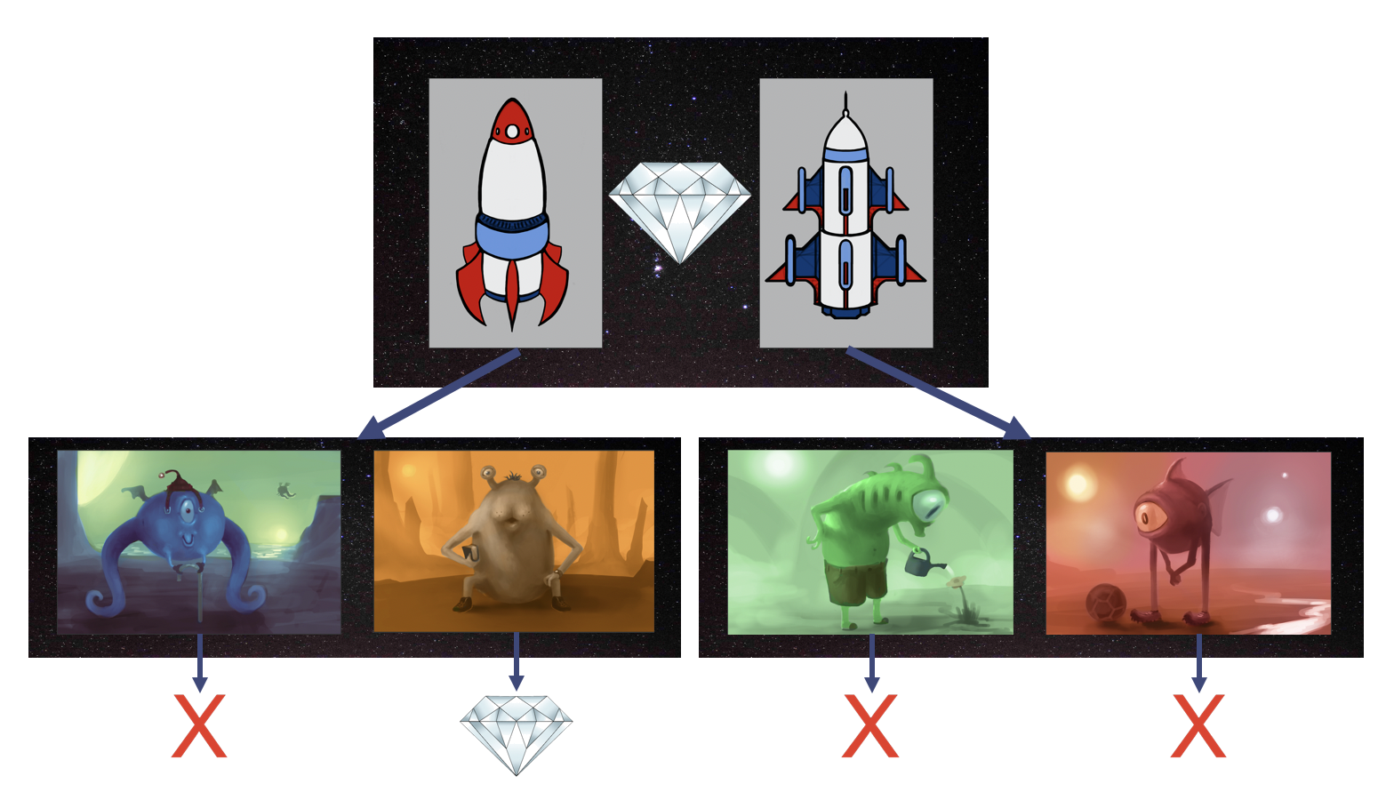
Stylised Two Step Descision Task
Stylised Two Step Descision Task
For Outcome Devaluation

