Slide 1
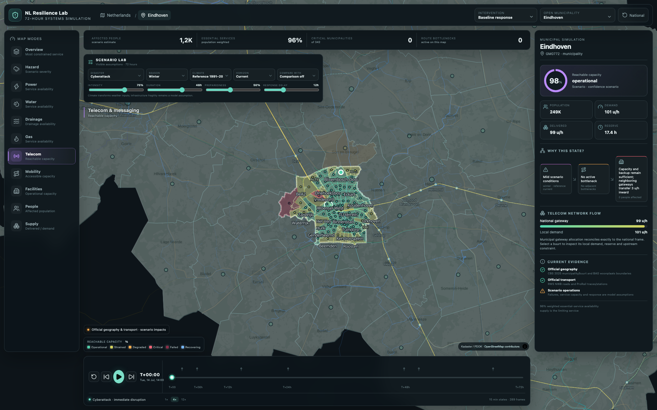
NL RESILIENCE LAB
Exploring the
first 72 hours
A transparent disaster-cascade simulator for the Netherlands
SCENARIO EXPLORATION
EXPLAINABLE MODEL
OFFICIAL DUTCH DATA
Rik Stokmans / DisasterSimulator
github.com/Rik-Stokmans/DisasterSimulator
Notes:
Opening: The project asks what happens after the initial hazard—when essential services start depending on one another. It is an interactive scenario-exploration prototype, not a forecast or calibrated digital twin.

Slide 2
NL RESILIENCE LAB
PROBLEM FRAMING
WHY
A disaster is not one failure.
It is a sequence of dependencies, delays and constrained choices.
01
02
03
INITIATING EVENT
SERVICE CASCADE
HUMAN PRESSURE
Wind, water, heat, cyber, ground motion or fire
Power, telecom, water, mobility and supply degrade on different clocks
Consequences emerge from duration, geography and response—not severity alone
CORE QUESTION
How does the system evolve—and which intervention changes the outcome?
Notes:
Frame the project around cascades. The simulator does not just color a hazard map; it steps through how service availability, reserves, repair and transport access interact across 72 hours.

Slide 3
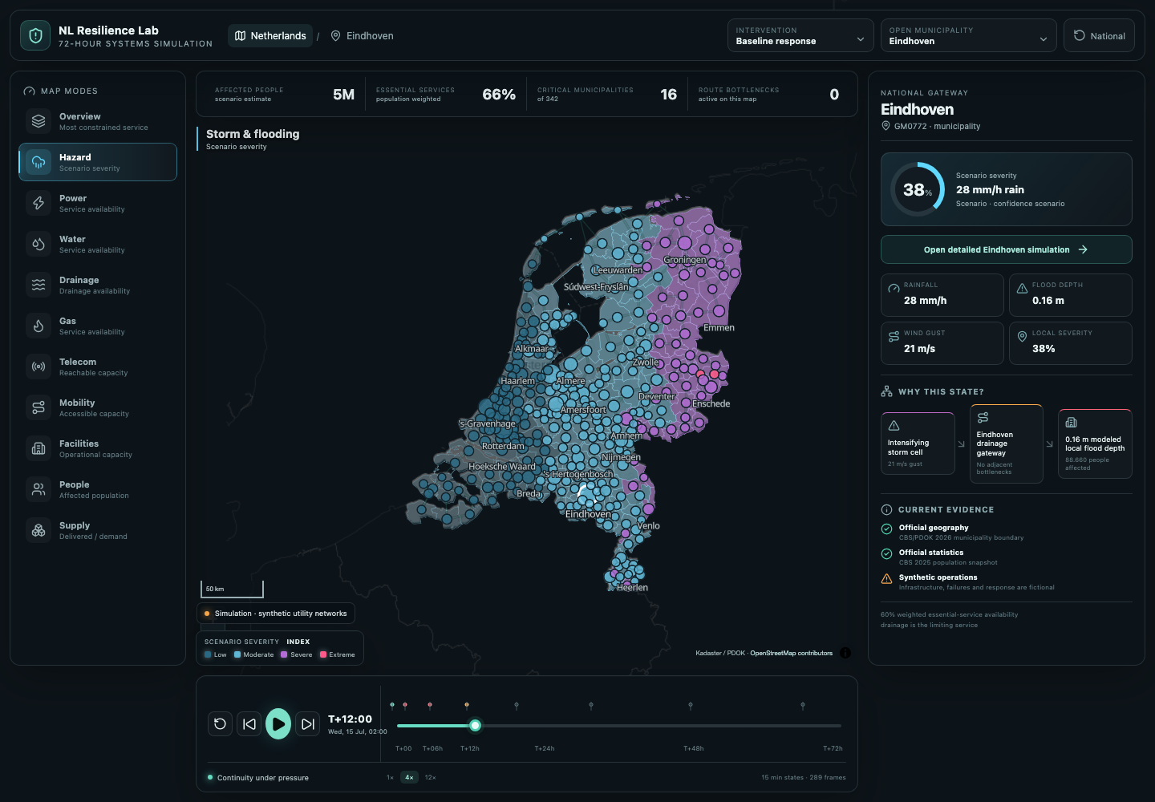
NL RESILIENCE LAB
PROJECT OVERVIEW
OVERVIEW
The simulator at a glance
A national model that stays inspectable down to municipality and CBS neighbourhood scale.
342
72 h
289
MUNICIPALITIES
SIMULATION WINDOW
15-MINUTE STATES
10
8
11
SCENARIO PRESETS
ESSENTIAL SERVICES
MAP QUESTIONS
NATIONAL → MUNICIPAL → BUURT
2D / 3D / REALISTIC
Counts from the current repository snapshot · 4 September 2026
Notes:
The national experience contains 342 municipalities and 289 quarter-hour states. Users can switch between ten hazard presets, eight modeled services and eleven map modes, then zoom into municipality and neighbourhood detail.

Slide 4
NL RESILIENCE LAB
SYSTEM DESIGN
GEOGRAPHY
One model, three spatial scales
The same time, service state and intervention remain coherent while the view changes.
03
02
01
CBS BUURT
MUNICIPALITY
NETHERLANDS
Population + vulnerability weights
Local impact allocation
Official regional context
One stable gateway
Demand, delivery and reserve
Local causal trace
342 municipalities
National service balancing
Affected-region footprint
CONSERVATION RULE
Local allocation redistributes municipal inflow; it never creates supply.
Notes:
The view changes, not the underlying state. National transfer totals are preserved. When users zoom in, the municipality’s inflow is distributed across CBS neighbourhoods using population and vulnerability context, then reconciled exactly back to the municipal total.

Slide 5
NL RESILIENCE LAB
SIMULATION MODEL
ENGINE
How a simulation is produced
Each quarter-hour frame is a deterministic sequence of visible model stages.
01
02
03
04
05
06
SCENARIO
HAZARD
DAMAGE
CASCADE
BALANCE
EXPLAIN
Hazard, season, climate, intensity, start and duration
Time envelope + spatial eligibility + audited guards
Service-specific pressure × resilience and preparedness
Power and mobility propagate into dependent services
Conservative route transfers reduce local shortfalls
Impacts, status, causes and counterfactuals
REPRODUCIBILITY
same configuration + same stable seed → same state and same explanation
Deterministic means repeatable—not calibrated or forecast-certain.
Notes:
Walk left to right. The engine resolves scenario controls, generates a time- and place-dependent hazard state, applies service-specific damage and recovery, propagates dependencies, balances only supported route flows, then emits outputs plus their explanation metadata. No runtime random draws are used.

Slide 6
NL RESILIENCE LAB
SIMULATION MODEL
DEPENDENCIES
The cascade has two structural hubs
Power constrains dependent services; mobility constrains emergency supply.
WATER
DRAINAGE
DIRECT HAZARD PRESSURE CAN AFFECT EVERY SERVICE
backup window
continuous
POWER
MOBILITY
EMERGENCY
SUPPLY
TELECOM
GAS CONTROLS
Road access + logistics
battery window
partial passive
NWB corridors are causal only for Mobility and explicitly modeled road logistics / Supply.
FACILITIES
generators
Notes:
Power is the main upstream service. Water and telecom are protected by finite backup windows; drainage and gas controls degrade with power; facilities use modeled generators. Mobility is the upstream service for supply. The road graph is deliberately not reused as electricity, water, gas or telecom topology.

Slide 7
NL RESILIENCE LAB
SIMULATION MODEL
TIME
The answer changes across 72 hours
Shock, backup endurance, cascading shortfall and restoration happen on different clocks.
289 quarter-hour states
EVENT START
BACKUPS DEPLETE
RECOVERY STATE
T+0
T+6
T+24
T+48
T+72
EARLY RESPONSE
CASCADE / REPAIR
RESPONSE DELAY
BACKUP ENDURANCE
ACCESS GUARD
PEAK DAMAGE
sets when organized restoration may begin
temporarily decouples dependent services from power
standing-water stress can pause generic repair
can persist after current forcing has declined
Notes:
Scrubbing the timeline is central. A service may remain healthy while backup lasts, fall later as upstream power fails, and recover only after both response delay and access constraints allow repair. The map therefore tells a different story at T+6, T+24 and T+72.

Slide 8
NL RESILIENCE LAB
DATA COUPLING
COUPLING RULES
What actually drives the model?
The simulator separates causal inputs from visible evidence and from unresolved gaps.
affectsSimulation = false by default for operational context
CAUSAL
Scenario + model inputs
Disaster, intensity, duration, climate, preparedness, response, demand, backup, network and repair controls
STRUCTURAL
Geography + allocation
CBS municipality/buurt context; audited NWB/GTFS/lifeline connectivity for Mobility and road-logistics Supply
CONTEXT
Observed / official overlays
KNMI, NDW, RWS, RIVM and utility geometry—timestamped and visible, but non-causal unless explicitly bound
UNKNOWN
Unsupported or missing evidence
NoData remains Unknown. It is never silently converted into zero impact, open roads or operational services.
Model contract: README “Data and provenance” + packages/sim-core
Notes:
This is the most important data-governance slide. Some inputs are deliberately causal. Others exist only to orient the operator. Near-real-time road, weather, water or air-quality observations do not automatically become a 72-hour scenario. They need explicit time, location and semantics before they can affect the engine.

Slide 9
NL RESILIENCE LAB
DATA COUPLING
SOURCES
A Dutch public-data ecosystem
Official and public datasets are grouped by role, provenance and valid time.
PLACE + PEOPLE
MOBILITY
WEATHER + HAZARDS
ESSENTIAL SERVICES
FACILITIES
CBS / PDOK
BAG / BRT TOP10NL
NWB / ProRail
OVapi · NDOV / NDW / FIS
KNMI / RWS Waterinfo / LIWO
AHN4 / RIVM / Risicokaart / RVO
Liander / Stedin / Netbeheer NL
HWH · DAMO · GWSW / RDI / ENTSOG
KVK public services
RIVM acute care / DUO education
63,567
WATER ASSETS
32,270
ANTENNA SITES
12,883
EDUCATION LOCATIONS
79
ACUTE-CARE LOCATIONS
Every refresh preserves source URL, edition, licence, retrieval time and caveats.
Checked-in dataset counts from the current repository snapshot
Notes:
Do not read this as one giant fused truth layer. The integrations are categorized. CBS and PDOK anchor place and people; transport geometry comes from NWB, ProRail and public transport feeds; weather and hazards come from KNMI, Rijkswaterstaat and related public sources; service and facility layers provide context with explicit coverage limits.

Slide 10
NL RESILIENCE LAB
DATA COUPLING
EVIDENCE
Observed is not the same as simulated
Each layer tells the user what it can—and cannot—support.
OFFICIAL CONTEXT
OBSERVED CONTEXT
SCENARIO STATE
UNKNOWN / NODATA
Boundaries, assets, provider areas and registers
Radar, stations, incidents and current measurements
Synthetic hazard, availability, demand and recovery
Missing coverage, horizon, permission or semantics
Where things are
What was observed
What the model explores
What must not be inferred
NO DATA ≠ ZERO HAZARD ≠ OPEN ROUTE ≠ HEALTHY SERVICE
Notes:
A current radar image is an observation, not a future scenario. A road incident feed is not automatically a future closure. A utility line on a map is not outage telemetry. Unknown is a first-class state so missing evidence cannot masquerade as safety.

Slide 11
NL RESILIENCE LAB
EXPLAINABILITY
WHY THIS STATE?
Explainability is part of the engine
Every municipality frame returns its own drivers, stage deltas and counterfactuals.
SERVICE AVAILABILITY TRACE
DRIVERS
CONTRIBUTIONS
BASELINE RESILIENCE
starting state
Which inputs and assumptions were active?
Which stage increased or reduced availability?
DIRECT HAZARD
exact stage change
RESTORATION
repair progress
DEPENDENCY CHAIN
COUNTERFACTUALS
UPSTREAM DEPENDENCY
power / mobility effect
Which upstream service caused the constraint?
What changes without damage, delay or dependency?
INTERVENTION
selected policy effect
NETWORK TRANSFER
supported route effect
Generated by deterministic reruns—not post-hoc AI prose.
Notes:
The explanation is not a narrative invented after the fact. The engine records the calculation stages. Counterfactuals are exact deterministic reruns: for example, the same frame without direct hazard damage or with an upstream service restored to full availability.

Slide 12
NL RESILIENCE LAB
SCENARIO DESIGN
SCENARIO LAB
Ten starting points, many controlled variants
Presets provide a reproducible baseline; operators can then test assumptions.
WEATHER + WATER
SYSTEM + GEOPHYSICAL
SEVERE WINDSTORM
URBAN CLOUDBURST
CYBERATTACK
GRONINGEN EARTHQUAKE
RIVER HIGH WATER
COASTAL SURGE
WILDFIRE + SMOKE
COMPOUND CASCADE
HEATWAVE + DROUGHT
WINTER STORM
CONTROL LEVERS
season · KNMI’23 path + horizon · intensity · duration · response delay · infrastructure preparedness
day type · local start time · demand · backup · repair · network capacity · household preparedness · reference date
Notes:
The ten presets cover meteorological, hydrological, geophysical, digital and compound events. The strength of the Scenario Lab is that users can hold the event constant and vary preparedness, response delay, backup endurance, repair capacity, climate path, season and demand assumptions.

Slide 13
NL RESILIENCE LAB
MODEL ASSURANCE
SAFETY GUARDS
Designed to fail safely
Unsupported local precision is withheld instead of rendered as confident detail.
245
1
AUDIT
2
COMPILE
Scenario matrix, numerical invariants, spatial plausibility, dependencies and T+72 recovery
Correction-required or blocked findings become deterministic generated guards
OF 342 MUNICIPALITIES
AUDITED
as of 3 September 2026
3
WITHHOLD
4
BLOCK BUILD
Unsupported hazard pathways and downstream claims become Unknown / neutral
A missing or stale generated guard prevents production output
Audit prose never becomes a causal model automatically.
Audit manifest generated 3 September 2026
Notes:
The municipality audit program is a notable assurance mechanism. It checks numerical and spatial plausibility and compiles explicit guards. If a location-specific pathway is unsupported, the simulator withholds the consequence rather than showing false precision. Human review remains necessary for hydraulic and coastal corrections.

Slide 14
NL RESILIENCE LAB
CRITICAL REFLECTION
SCOPE
Powerful for exploration—careful about claims
The prototype is explicit about what is modeled, observed, assumed and unresolved.
WHAT IT DOES WELL
WHAT IT DOES NOT CLAIM
Compare assumptions and response policies
A calibrated digital twin or forecast
Reveal time-dependent service cascades
Live utility outage or capacity telemetry
Keep national and local views coherent
Physical power / water / telecom topology
Expose drivers and counterfactuals
Observed affected-person headcounts
Preserve provenance and uncertainty
Real-world units for generalized route capacity
The honest limitation is a feature: uncertainty stays visible.
Notes:
Use this slide to calibrate expectations. The project is valuable for asking comparative “what if” questions and revealing dependencies. It should not be presented as an operational forecast, exact headcount or digital twin. Route capacities are generalized units and utility geometry is context, not full topology or live state.

Slide 15
NL RESILIENCE LAB
PRESENTATION FLOW
LIVE DEMO
A four-minute walkthrough
Tell one causal story instead of showing every control.
1
START NATIONAL
2
MOVE THROUGH TIME
Choose Compound cascade; keep the affected-region overlay visible.
Scrub from T+0 to T+24 and call out the changing headline metrics.
3
FOLLOW A DEPENDENCY
4
ZOOM TO EINDHOVEN
Switch Power → Telecom, or Mobility → Supply, to reveal the cascade.
Open municipality and buurt detail; compare demand, delivery and reserve.
5
CHANGE ONE LEVER
6
EXPLAIN THE RESULT
Increase backup or reduce response delay—keep everything else constant.
Open “Why this state?” and finish with the exact causal trace.
Presenter rule: change one assumption, then show one downstream effect.
Notes:
Recommended demo: start national, move the timeline, follow one dependency, zoom into Eindhoven, change exactly one assumption, and open the explanation. Avoid touring every layer. The audience should leave understanding one causal chain and one policy comparison.

Slide 16
NL RESILIENCE LAB
NEXT STEPS
ROADMAP
From exploration prototype to calibrated exercises
The next gains come from stronger event binding, topology and validation—not more visual layers.
01
EVENT-BOUND WEATHER
Bind checksum-versioned forecast cycles; preserve the T+60–T+72 coverage gap.
02
HYDRAULIC CALIBRATION
Select compatible LIWO / breach scenarios with depth, arrival and recession.
03
SERVICE-SPECIFIC NETWORKS
Add authorized topology, capacity, switching and restoration semantics.
04
FACILITIES + RESPONSE
Calibrate shelter, acute-care, staffing, generators, fuel and dispatch resources.
05
VALIDATION
Compare outputs with historical incidents and expert tabletop exercises.
CALIBRATION
GOVERNANCE
VALIDATION
EXERCISE DESIGN
Notes:
The next stage should prioritize calibration and validation. Weather forecasts must be bound to explicit cycles; flood impacts need compatible hydraulic scenarios; utility models need service-specific topology; and response resources need real inventories and endurance. Historical events and expert exercises can then test whether the model behaves credibly.

Slide 17
NL RESILIENCE LAB
CLOSE
See the cascade.
Question the assumptions.
Improve the response.
Questions?
GitHub
github.com/Rik-Stokmans/DisasterSimulator
Preview
rikstokmans.com/warroom/projects/disasterSimulator
Notes:
Closing line: The simulator is valuable because it makes the cascade, the assumptions and the uncertainty inspectable. Invite questions about either the system model, the public-data couplings or the next calibration steps.

