Slide 1

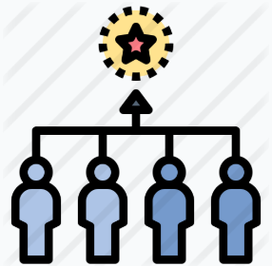

COMPETITION
A pool of characteristics, to which it is possible to associate a value
Every competitor has
A value that identifies their performance

Slide 2


THE PROBLEM
Trade-off
Trade-off level
Performance
Which trade-offs are the truly significative …
… and how much significative are they ?

Slide 3






AN ISTANCE OF THE PROBLEM
Roll the die
Buy stars on specific (always changing) boxes
Move on the game board
Get or drop coins on boxes

Slide 4



RESOURCES
Faces that permit movement
max mov_mean
Faces that give/get coins
… and their associated risk (variance)
max coin_mean
max mov_var
max coin_var
: risk seeker
min mov_var
min coin_var
risk adverse:
Movement options (number of non-zero and different one from each other)
max mov_variety

Slide 5
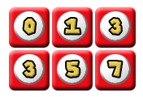
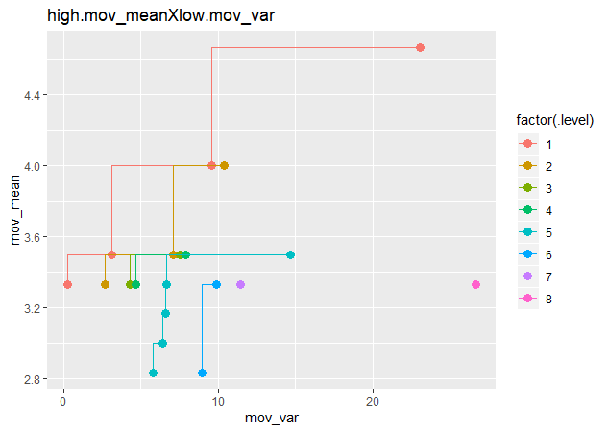




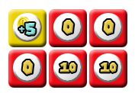
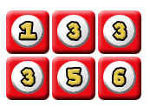
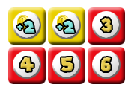
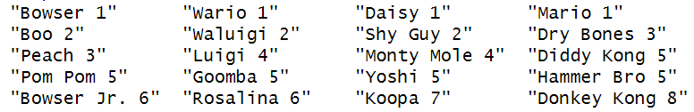
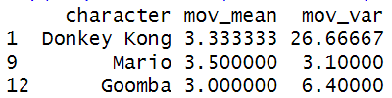
PREFERENCE
max mov_mean
min mov_var

Slide 6
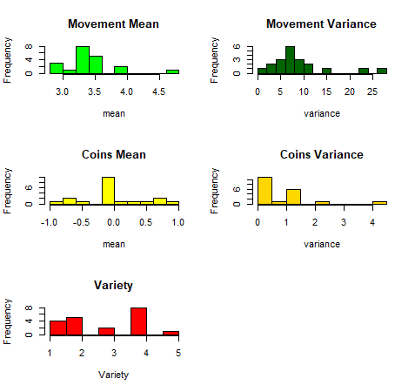
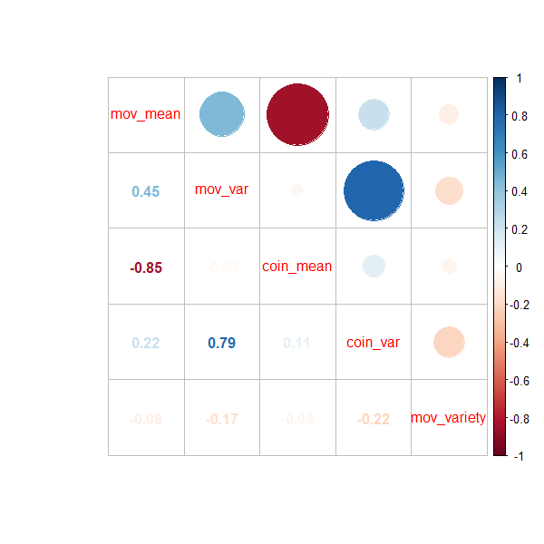
dice.data

Slide 7
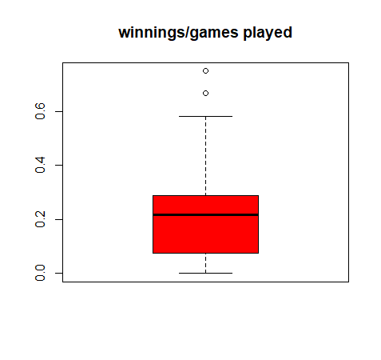

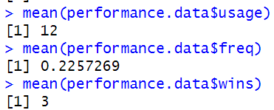
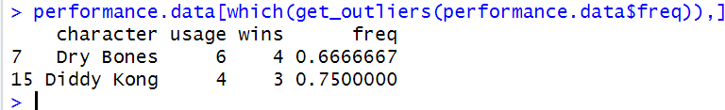
games.data

Slide 8
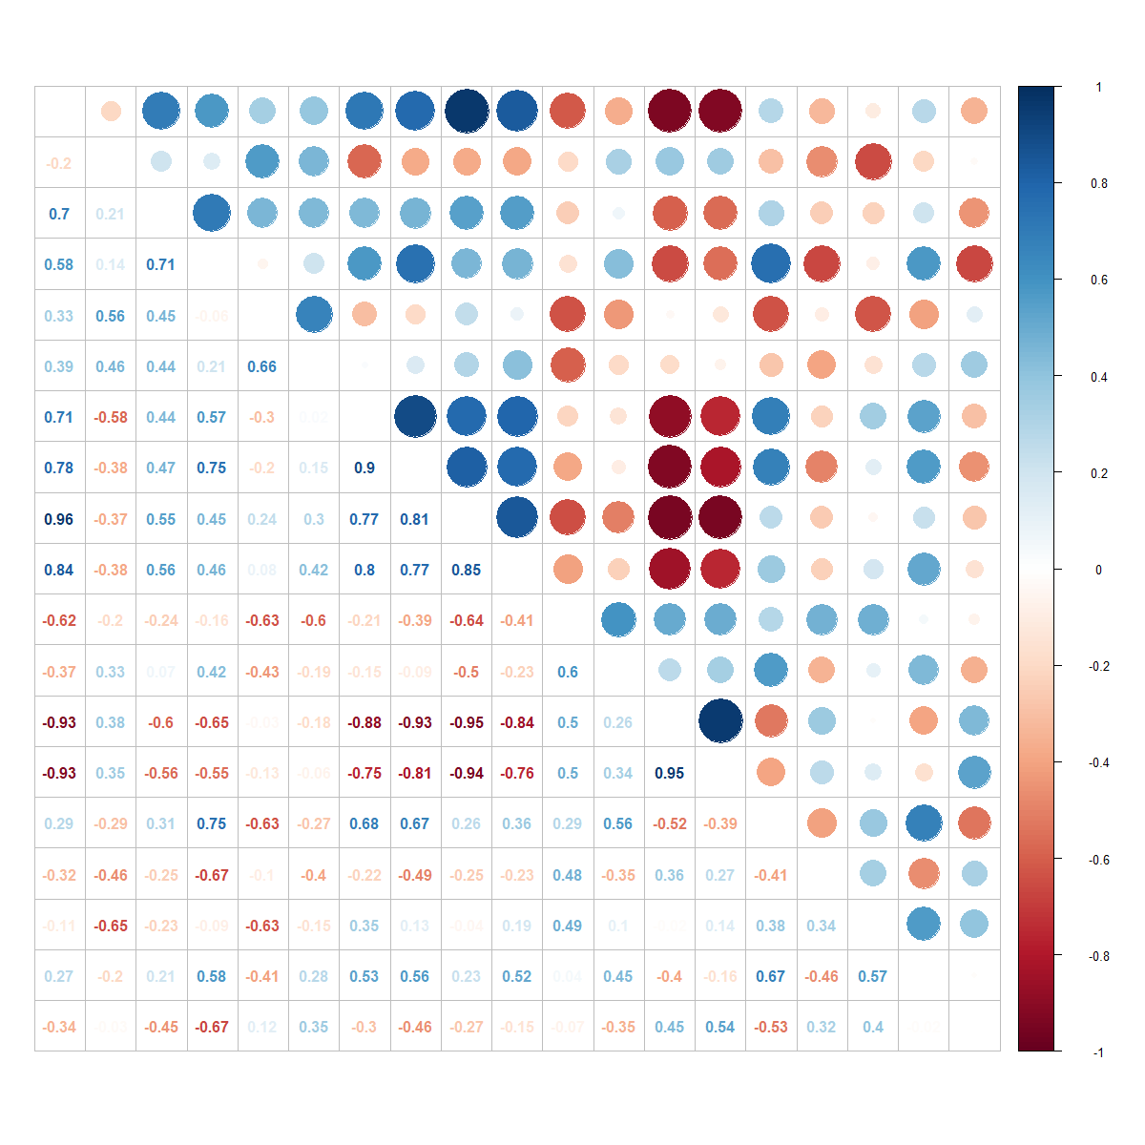
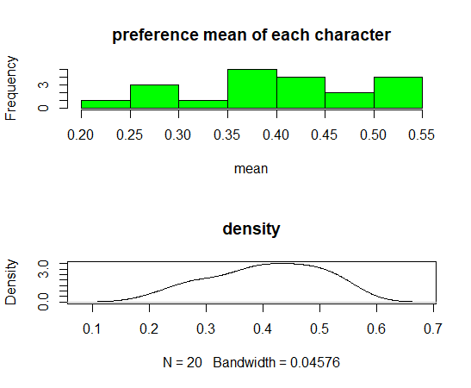

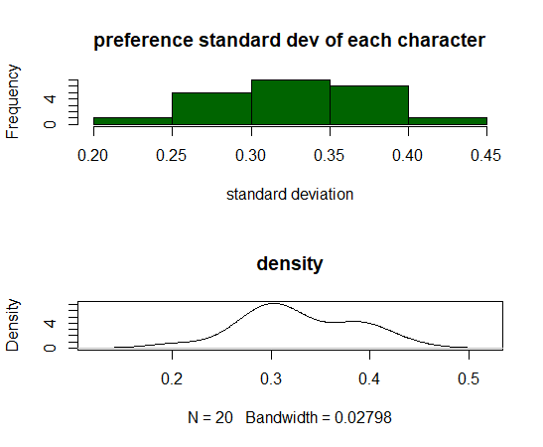

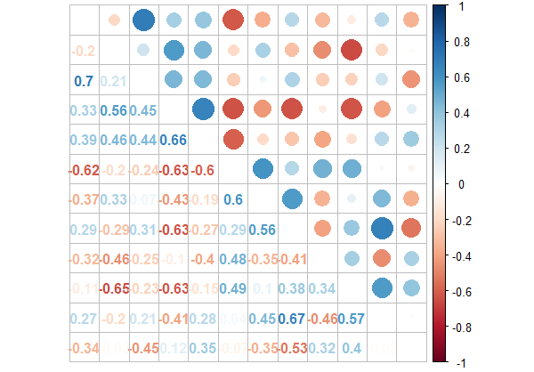
levels.data

Slide 9
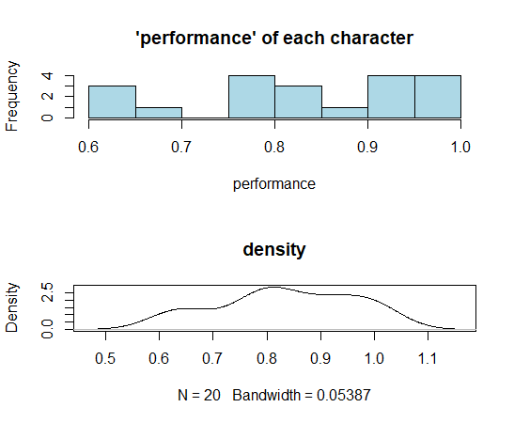

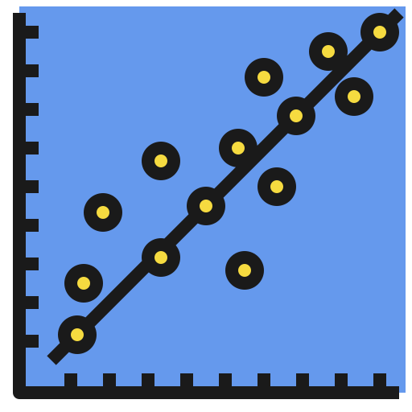
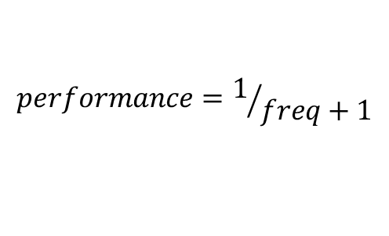
PERFORMANCE
$$performance=1/{freq+1}$$
Levels
0: preference = 1 (best die)
1: highest preference(worst die)
Performance
0.5: character has 100% winning rate (best possible)
1: character has 0% winning rate (worst possible)

Slide 10
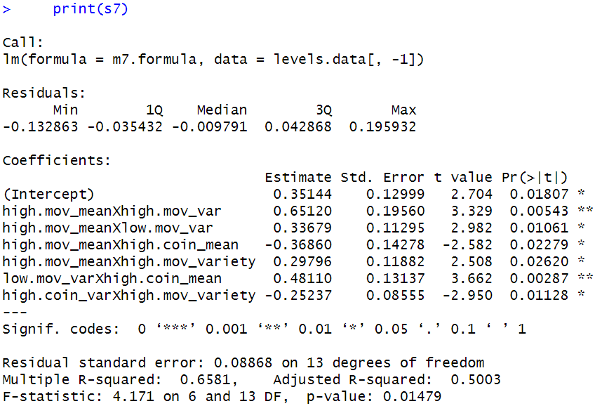
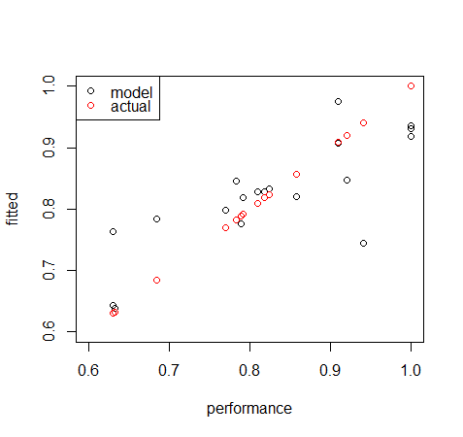
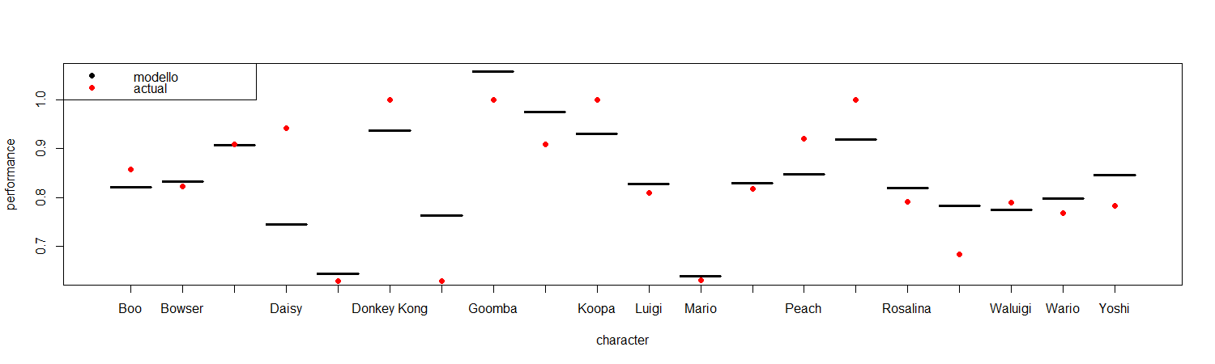
REGRESSION

Slide 11
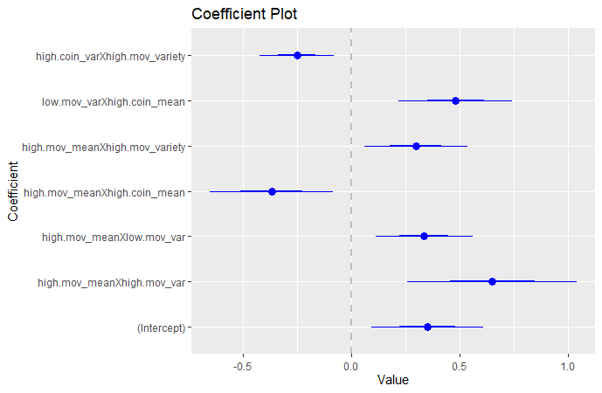
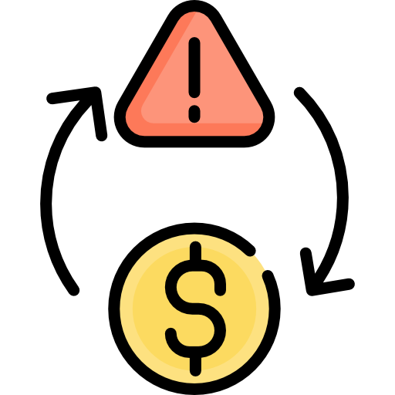

COEFFICIENTS

Slide 12


CONCLUSIONS : A REPRODUCIBLE APPROACH
Characteristics:
Engine Displacement
Trunk volume
Gasoline Consumption
…
Performance:
Sold Units

Slide 13

Icons made by <a href="https://www.flaticon.com/authors/becris" title="Becris">Becris</a> from <a href="https://www.flaticon.com/" title="Flaticon"> www.flaticon.com</a>
<div>Icons made by <a href="https://www.flaticon.com/authors/freepik" title="Freepik">Freepik</a> from <a href="https://www.flaticon.com/" title="Flaticon">www.flaticon.com</a></div>
Icons made by <a href="https://www.flaticon.com/authors/freepik" title="Freepik">Freepik</a> from <a href="https://www.flaticon.com/" title="Flaticon"> www.flaticon.com</a>
Icons made by <a href="https://www.flaticon.com/authors/eucalyp" title="Eucalyp">Eucalyp</a> from <a href="https://www.flaticon.com/" title="Flaticon"> www.flaticon.com</a>
Icons made by <a href="https://www.flaticon.com/authors/freepik" title="Freepik">Freepik</a> from <a href="https://www.flaticon.com/" title="Flaticon"> www.flaticon.com</a>
Icons made by <a href="https://www.flaticon.com/authors/freepik" title="Freepik">Freepik</a> from <a href="https://www.flaticon.com/" title="Flaticon"> www.flaticon.com</a>
Icons made by <a href="https://www.flaticon.com/authors/freepik" title="Freepik">Freepik</a> from <a href="https://www.flaticon.com/" title="Flaticon"> www.flaticon.com</a>
Icons made by <a href="https://www.flaticon.com/authors/freepik" title="Freepik">Freepik</a> from <a href="https://www.flaticon.com/" title="Flaticon"> www.flaticon.com</a>
Icons made by <a href="https://www.flaticon.com/authors/srip" title="srip">srip</a> from <a href="https://www.flaticon.com/" title="Flaticon"> www.flaticon.com</a>
<div>Icons made by <a href="https://www.flaticon.com/authors/freepik" title="Freepik">Freepik</a> from <a href="https://www.flaticon.com/" title="Flaticon">www.flaticon.com</a></div>
Icons made by <a href="https://www.flaticon.com/authors/eucalyp" title="Eucalyp">Eucalyp</a> from <a href="https://www.flaticon.com/" title="Flaticon"> www.flaticon.com</a>
Icons made by <a href="https://www.flaticon.com/authors/becris" title="Becris">Becris</a> from <a href="https://www.flaticon.com/" title="Flaticon"> www.flaticon.com</a>
Icons made by <a href="https://www.flaticon.com/authors/freepik" title="Freepik">Freepik</a> from <a href="https://www.flaticon.com/" title="Flaticon"> www.flaticon.com</a>
Icons made by <a href="https://www.flaticon.com/authors/creaticca-creative-agency" title="Creaticca Creative Agency">Creaticca Creative Agency</a> from <a href="https://www.flaticon.com/" title="Flaticon"> www.flaticon.com</a>
Icons made by <a href="https://www.flaticon.com/authors/freepik" title="Freepik">Freepik</a> from <a href="https://www.flaticon.com/" title="Flaticon"> www.flaticon.com</a>
Icons made by <a href="https://www.flaticon.com/authors/freepik" title="Freepik">Freepik</a> from <a href="https://www.flaticon.com/" title="Flaticon"> www.flaticon.com</a>
Icons made by <a href="https://www.flaticon.com/authors/smalllikeart" title="smalllikeart">smalllikeart</a> from <a href="https://www.flaticon.com/" title="Flaticon"> www.flaticon.com</a>
Icons made by <a href="https://www.flaticon.com/authors/freepik" title="Freepik">Freepik</a> from <a href="https://www.flaticon.com/" title="Flaticon"> www.flaticon.com</a>
<div>Icons made by <a href="https://www.flaticon.com/authors/freepik" title="Freepik">Freepik</a> from <a href="https://www.flaticon.com/" title="Flaticon">www.flaticon.com</a></div>
Icons made by <a href="https://www.flaticon.com/authors/freepik" title="Freepik">Freepik</a> from <a href="https://www.flaticon.com/" title="Flaticon"> www.flaticon.com</a>
Icons made by <a href="https://www.flaticon.com/authors/freepik" title="Freepik">Freepik</a> from <a href="https://www.flaticon.com/" title="Flaticon"> www.flaticon.com</a>
Icons made by <a href="https://www.flaticon.com/authors/dmitri13" title="dmitri13">dmitri13</a> from <a href="https://www.flaticon.com/" title="Flaticon"> www.flaticon.com</a>
Icons made by <a href="https://www.flaticon.com/authors/freepik" title="Freepik">Freepik</a> from <a href="https://www.flaticon.com/" title="Flaticon"> www.flaticon.com</a>
Icons made by <a href="https://www.flaticon.com/authors/freepik" title="Freepik">Freepik</a> from <a href="https://www.flaticon.com/" title="Flaticon"> www.flaticon.com</a>
Icons made by <a href="https://www.flaticon.com/authors/pixel-perfect" title="Pixel perfect">Pixel perfect</a> from <a href="https://www.flaticon.com/" title="Flaticon"> www.flaticon.com</a>

