Slide 1
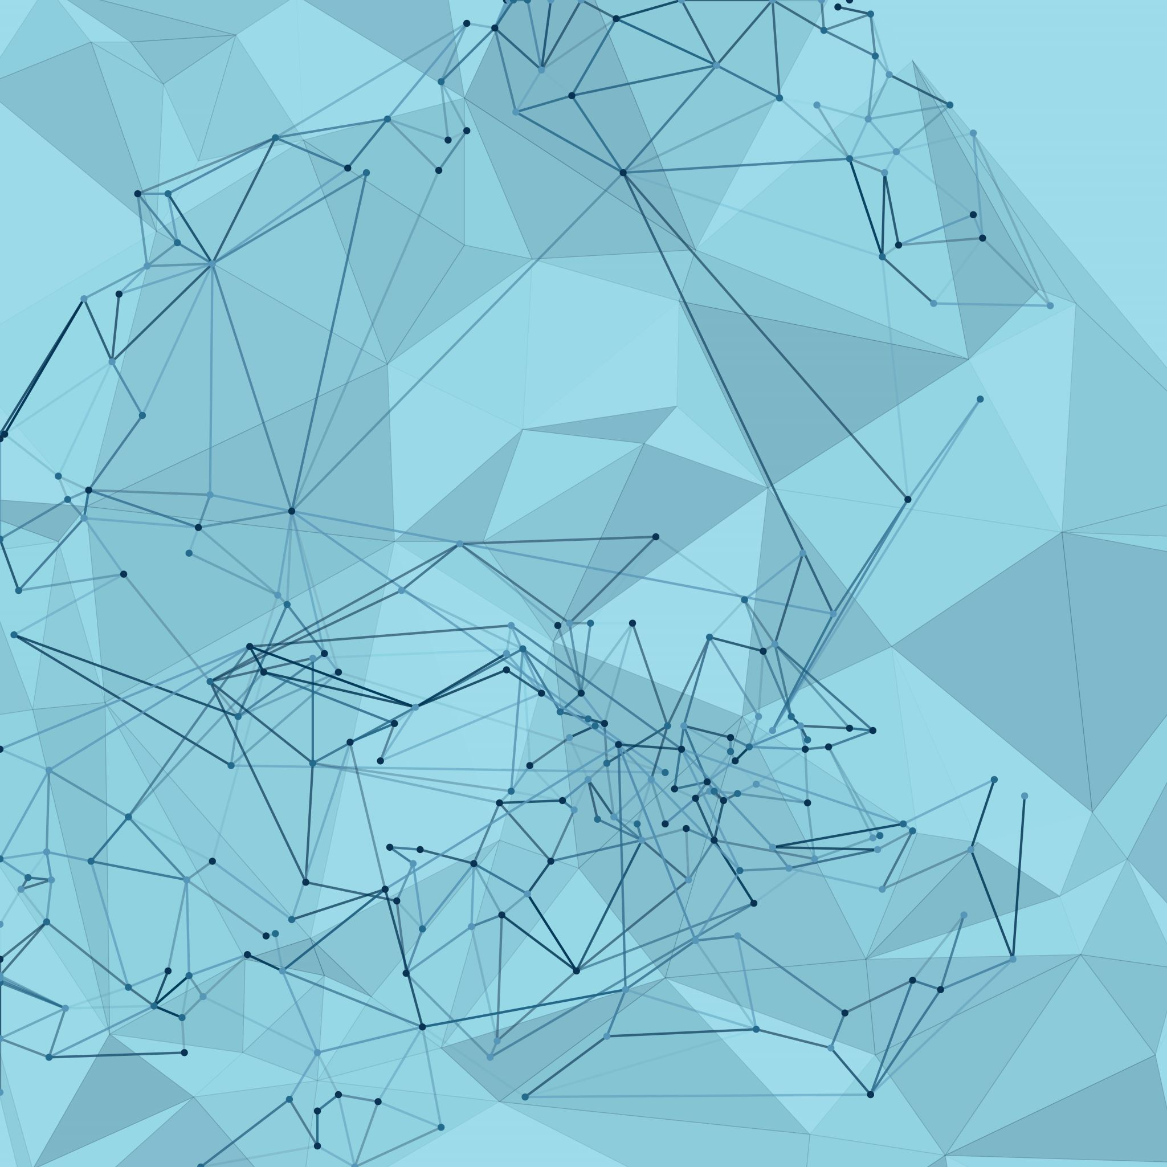
Transfer Learning In MI-Brain Computer Interface (BCI)

Slide 2
Table of Contents
Introduction
Aims and Objectives
Motor-Imagery BCI
Transfer Learning
Data
Signal Processing
Classification
Transfer Learning Methodologies
Results
Conclusion and Future Work

Slide 3
Introduction
Background→ Motor imagery-based brain computer interface (BCI) is a novel human-computer interface technology helpful for those with severe motor limitation.
Neurorehabilitation.
Positive effects on repetitive use.
Motivation→ Due to non-stationary behaviour and uniqueness of EEG signal, 10-20 mins is required to calibrate the system before every session.
Need → A BCI system with higher accuracy and less calibration time through transfer learning.

Slide 4
Aims and Objectives
Literature review on Motor-Imagery BCI and Transfer Learning
State of the art classifier with robust feature extraction
Effect of training size on the performance of Motor-Imagery BCI
Novel transfer learning algorithm to Improve performance of BCI based on ensemble learning while keeping the calibration time as low as possible
Effect of weighting mechanism on the performance of developed transfer learning model

Slide 5
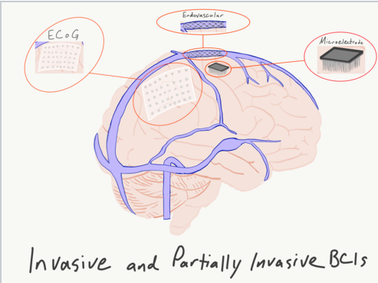
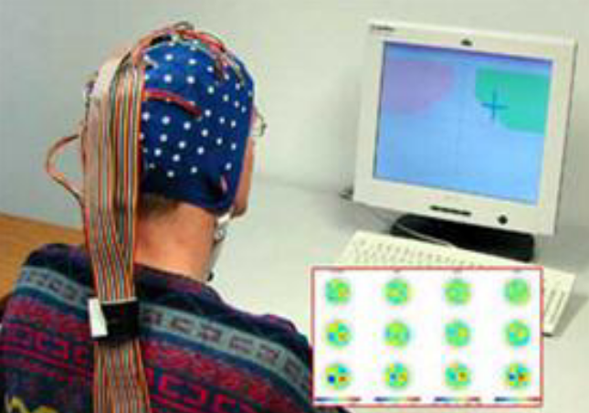
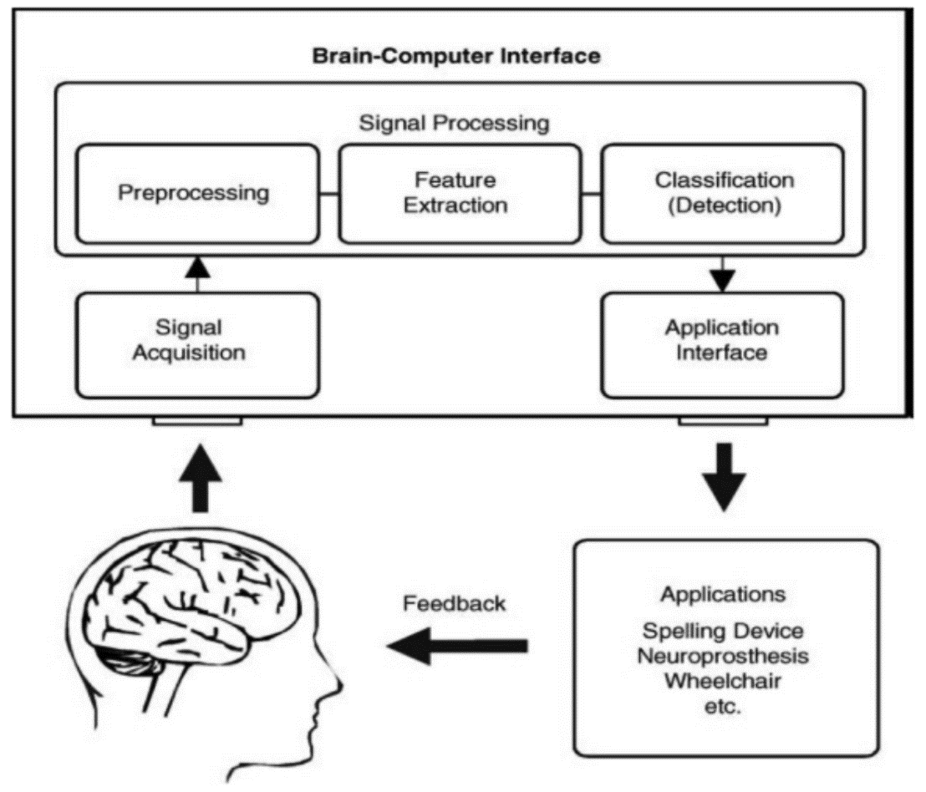
Motor-Imagery (BCI)
Process by which brain signals of a person imagining motor movements measured with the help of electroencephalogram (EEG) is known as Motor Imagery.

Slide 6
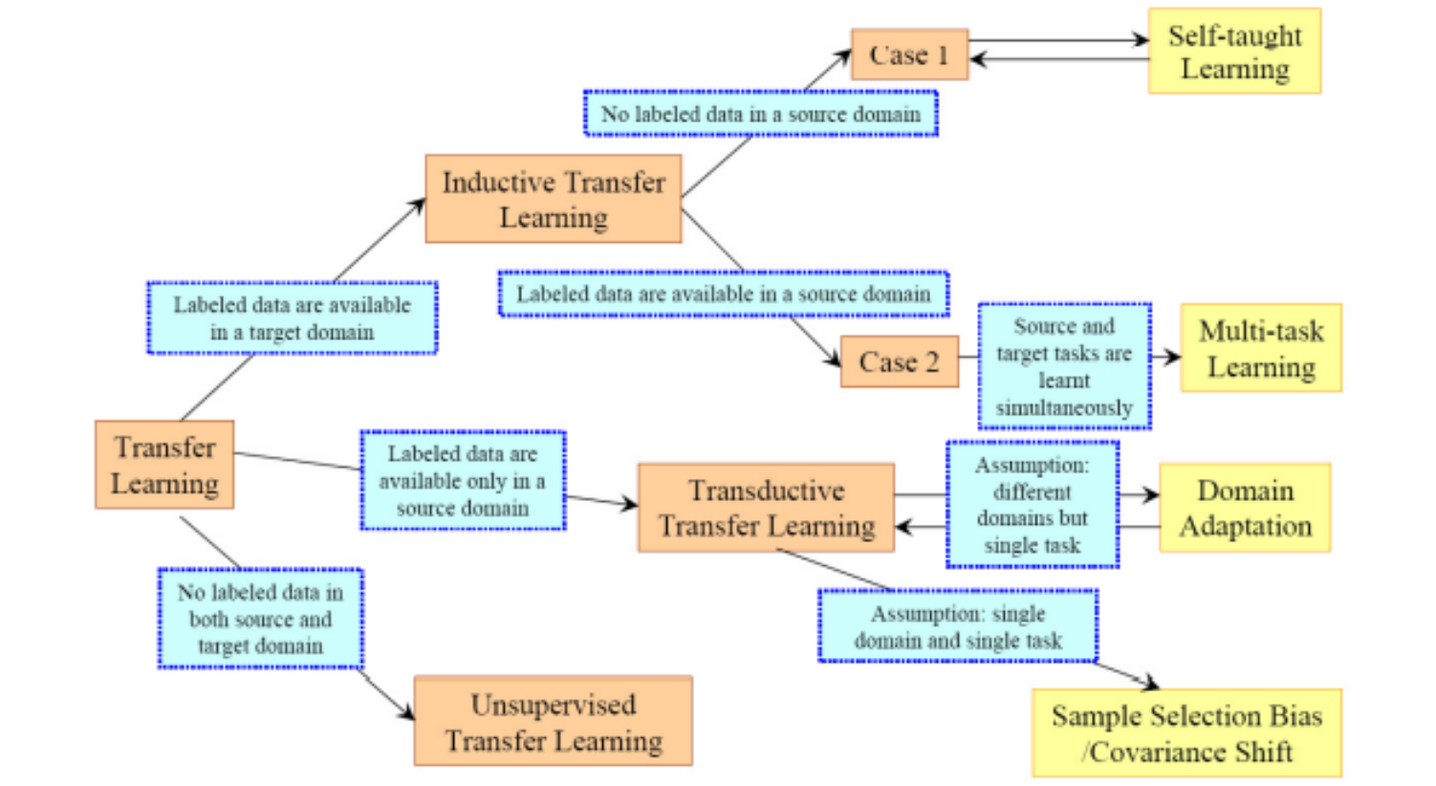
Transfer Learning
Solving knowledge gained solving one problem and applying it to different but related problem.
Categories→
Inductive
Transductive
Unsupervised

Slide 7

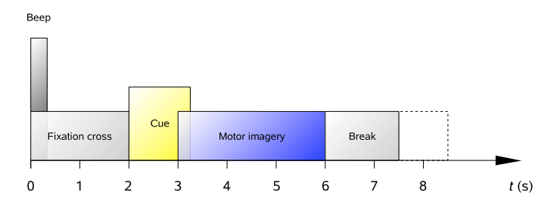
Data
9 subjects consists of 4 different motor-imagery tasks.
2 sessions→ 6 runs→ 48 trials.
Data Recording→
International 10-20 system with 25 Ag/AgCl electrodes (22 EEG, 3 EoG).
Sampling rate of 250 Hz.

Slide 8
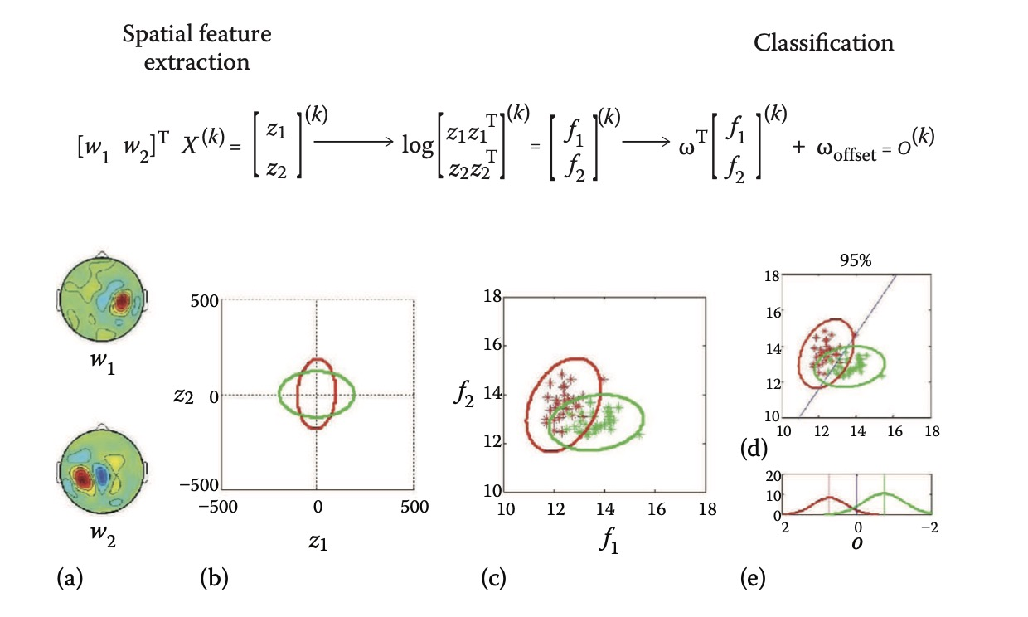
Signal Processing
Pre-Processing→
Increase SNR
Right and Left hand imagery
Band-pass filtering (8-35 Hz)
Spatial Filtering & Feature Extraction→
CSP algorithm→ Maximizes variance for one class while minimizing the other class.
Features→ Variance of CSP filtered signals.

Slide 9
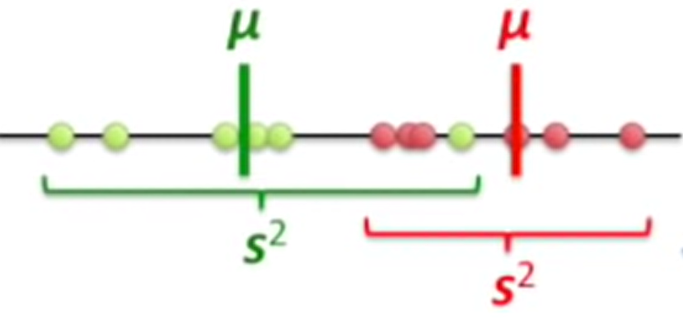
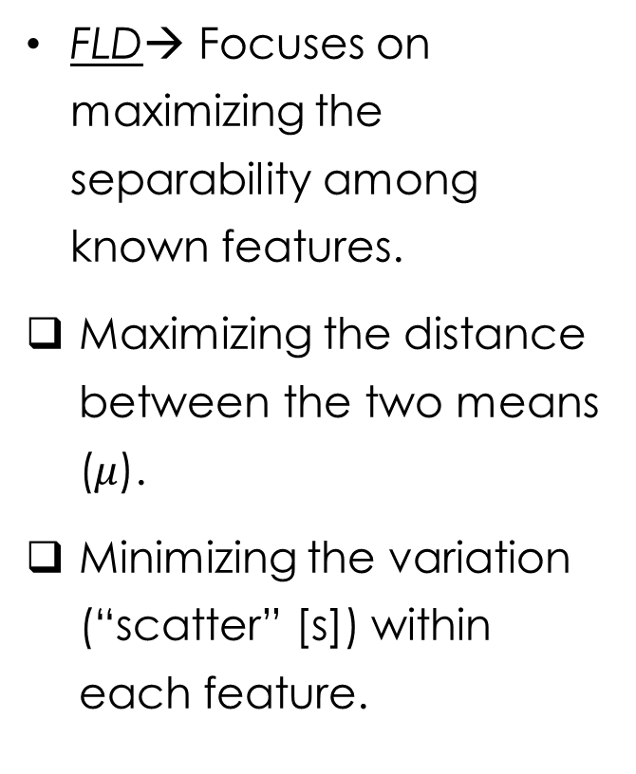
Classification
FLD→ Focuses on maximizing the separability among known features.
Maximizing the distance between the two means ($μ$).
Minimizing the variation (“scatter” [s]) within each feature.

Slide 10
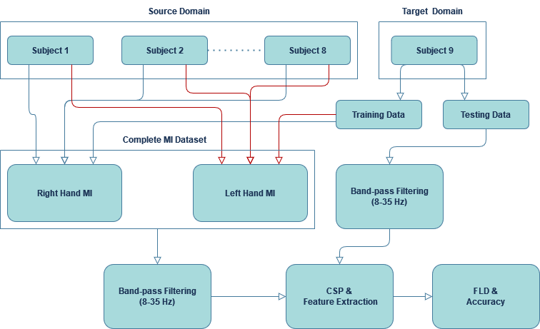
Transfer Learning Methodologies
Naïve Transfer Learning
Simplest form of transfer learning
Motor-imagery data from right hand in source domain is added together with right hand data from target domain, similar in case of left hand.

Slide 11
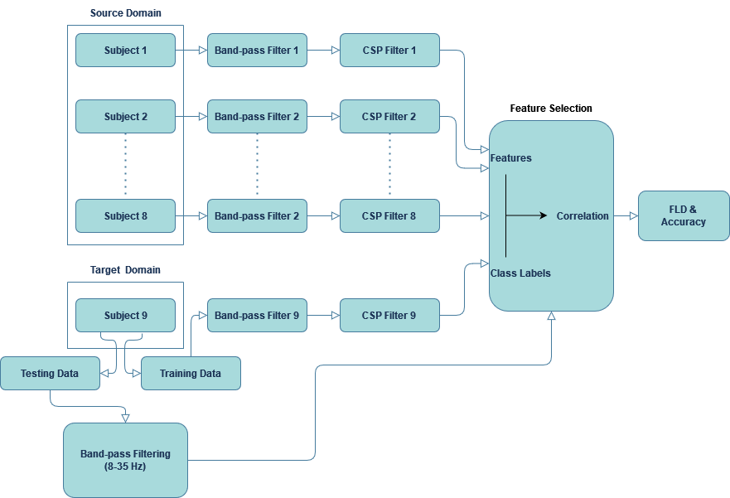
Transfer Learning Methodologies
Co-relation based Transfer Learning
Feature specific transfer.
Co-relation between trained features and class labels is calculated in order to test the validation dataset.

Slide 12
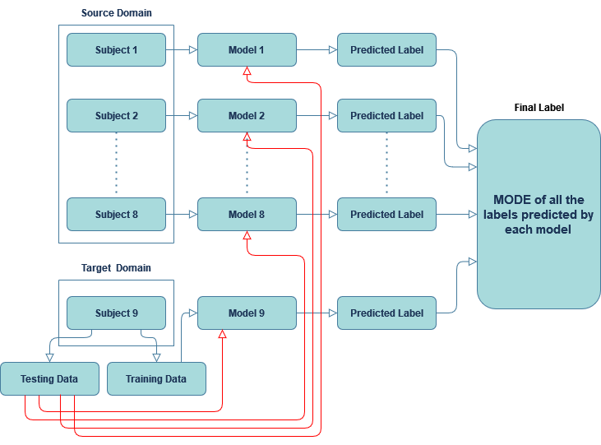
Transfer Learning Methodologies
Majority Voting
Hard Voting→
Non-weighted
Predicts label with the highest number of votes in the ensemble model.

Slide 13
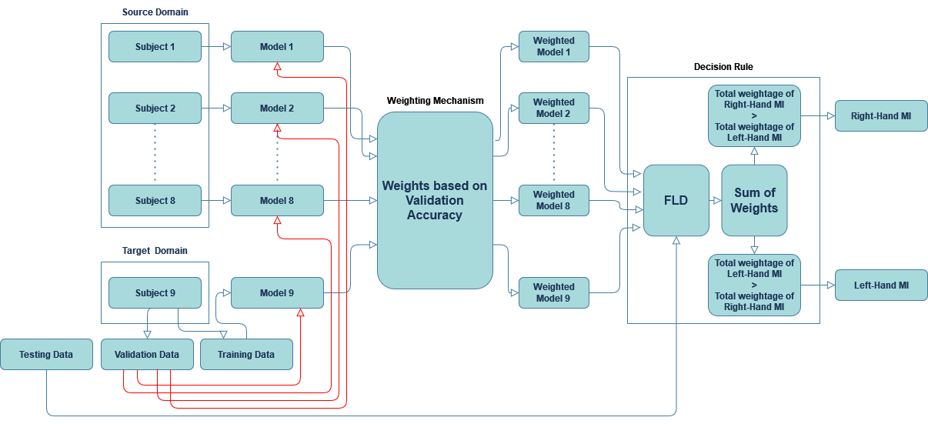
Transfer Learning Methodologies
Weighting Mechanism
Soft Voting→
Specific weights are given to each model in the ensemble architecture based on performance on validation data.
Labels are predicted based on highest probability.

Slide 14
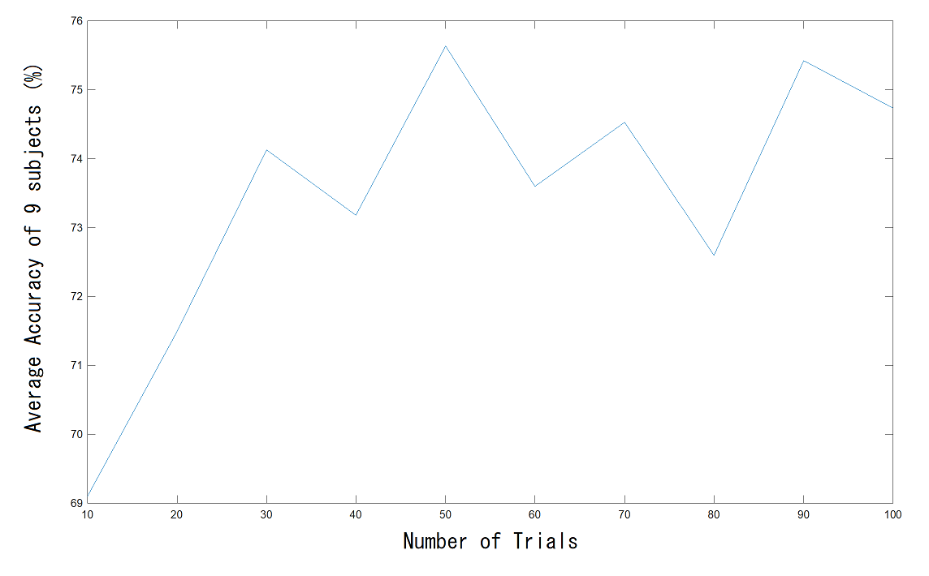
Results
Impact of Training Size

Slide 15
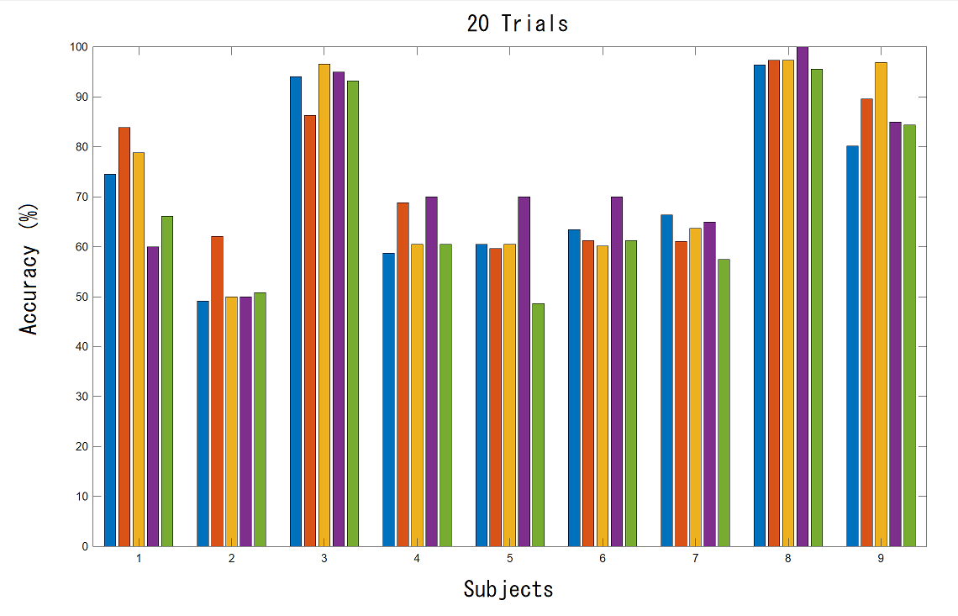
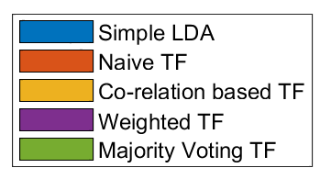
Results
Different Methodologies

Slide 16
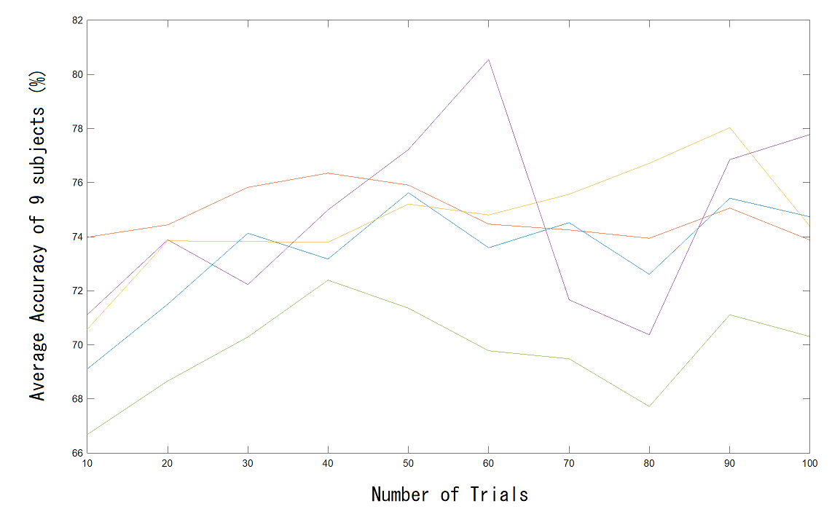
Results
Different Methodologies

Slide 17
Related Coursework
Data Modelling
Deep Learning
BCI Experiment
How to process required data.
Different machine learning algorithms.
Practical Projects
Deep Neural networks, CNN, RNN, Q Learning.
Different types of optimization techniques.
Practical Projects
How BCI experiments are conducted.
Difficulties in gathering huge amount of data.

Slide 18
Conclusion and Future Work
Objectives mentioned above have been achieved.
Results obtained are quite satisfactory.
Proposed Transfer Learning methodologies performed better than simple motor-imagery BCI algorithms.
Future Work→
Transfer Learning based of Distribution Matching methods.
Testing the proposed methodologies in an online scenario.

Slide 19
Thank You

