Slide 1
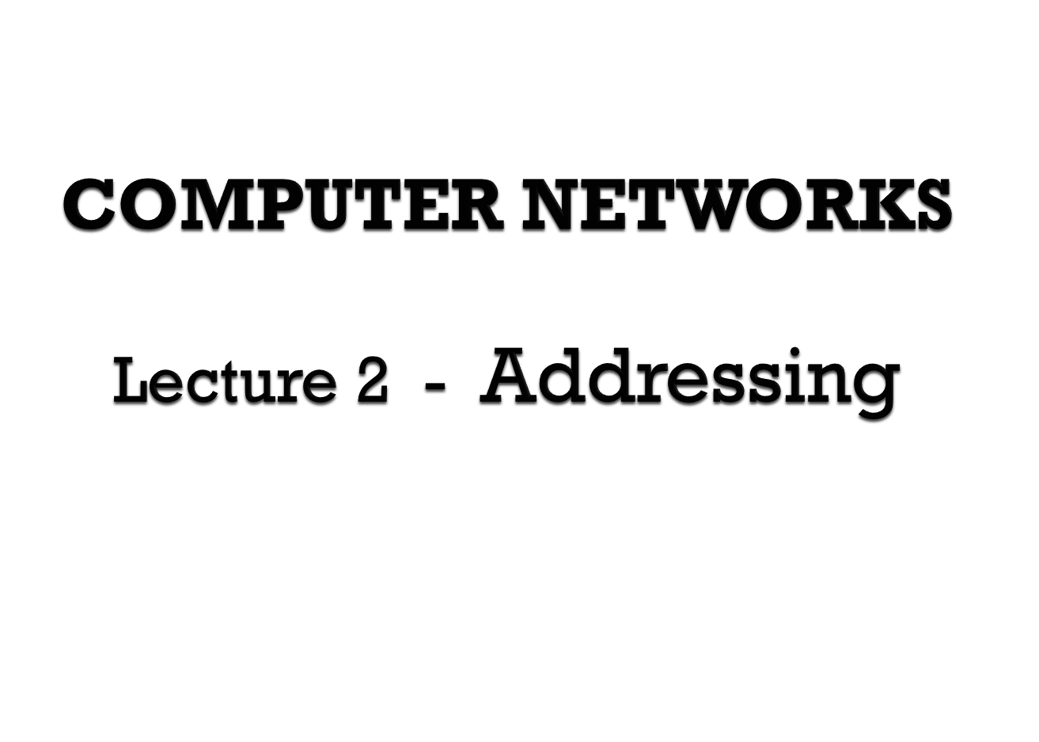

Slide 2
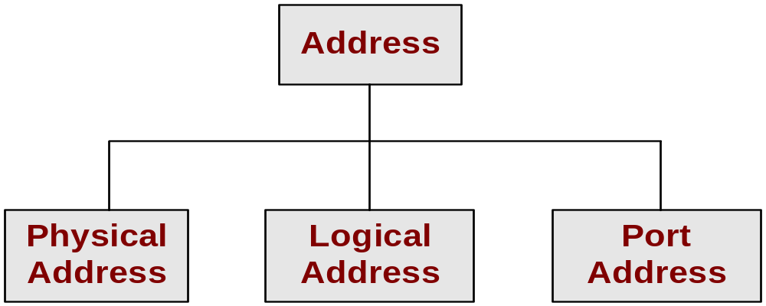
MAC Address
IP Address
Port Address
Identify a Computer
Identify a Process

Slide 3
Stored in the Network Interface Card (NIC)
A hardware setting set by the manufacturer of NIC .
Unchangeable
Ex :- MAC address
For Ethernet, the MAC address is a 48 bit or 12 Hex number
Ex : 5A:B3:87:F1:93:7C
5A-B3-87-F1-93-7C
MAC address operates in the Data Link Layer (Layer 2)
Ethernet Frame
CRC/FCS | DATA | DA | SA | SOF | Preamble

Slide 4
Address scheme depends on the used protocol
Widely used protocol is TCP/IP
Ex :- IP Address
192.168.16.53
10.39.40.3
Logical address operates at the Network Layer (Layer 3)

Slide 5

Uniquely identifies devices
IP Addresses
IP Version 4 (IPV4)
32 bit scheme
IP Version 6 (IPV6) (IPng)
128 bit scheme

Slide 6
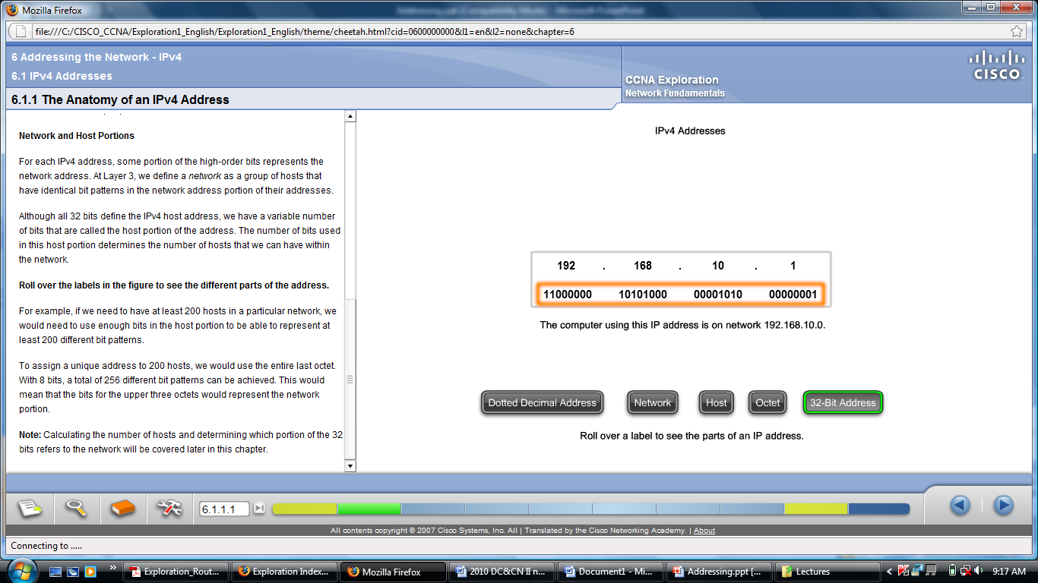
The 32 bits are represented in following manner.
Byte 1. Byte 2. Byte 3. Byte 4
( 1 byte = 8 bits)

Slide 7
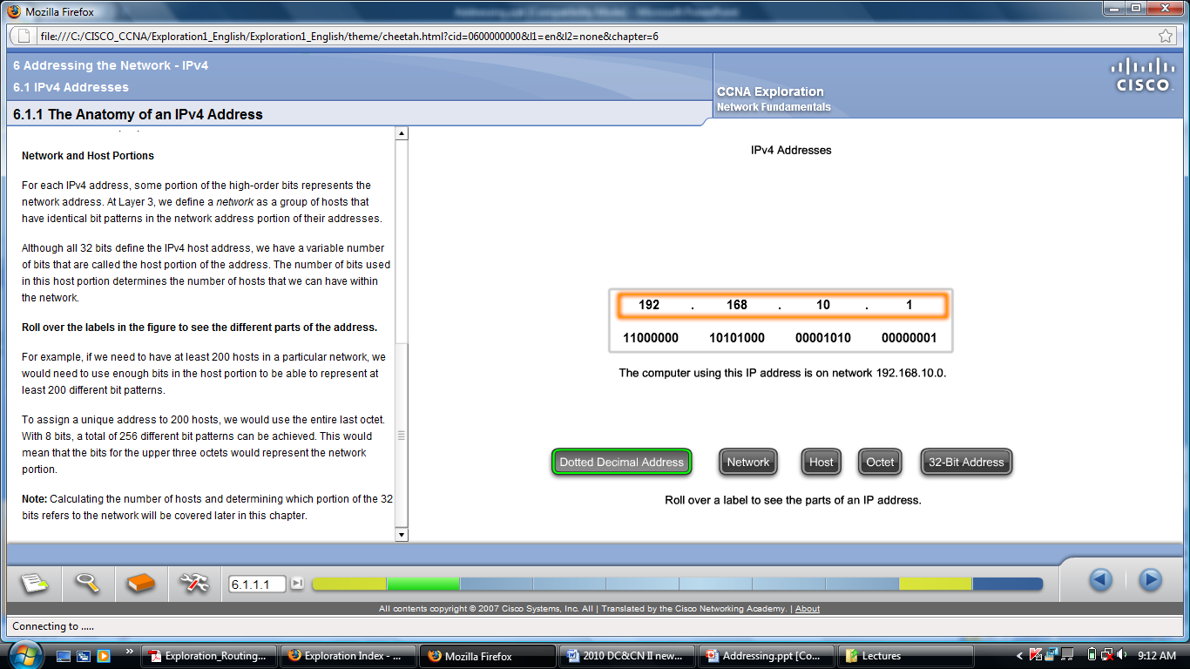

Slide 8
The minimum value of a byte
00000000 = 0
The maximum value of a byte
11111111 = 255
The minimum IP Address
0.0.0.0
The maximum IP Address
255.255.255.255

Slide 9
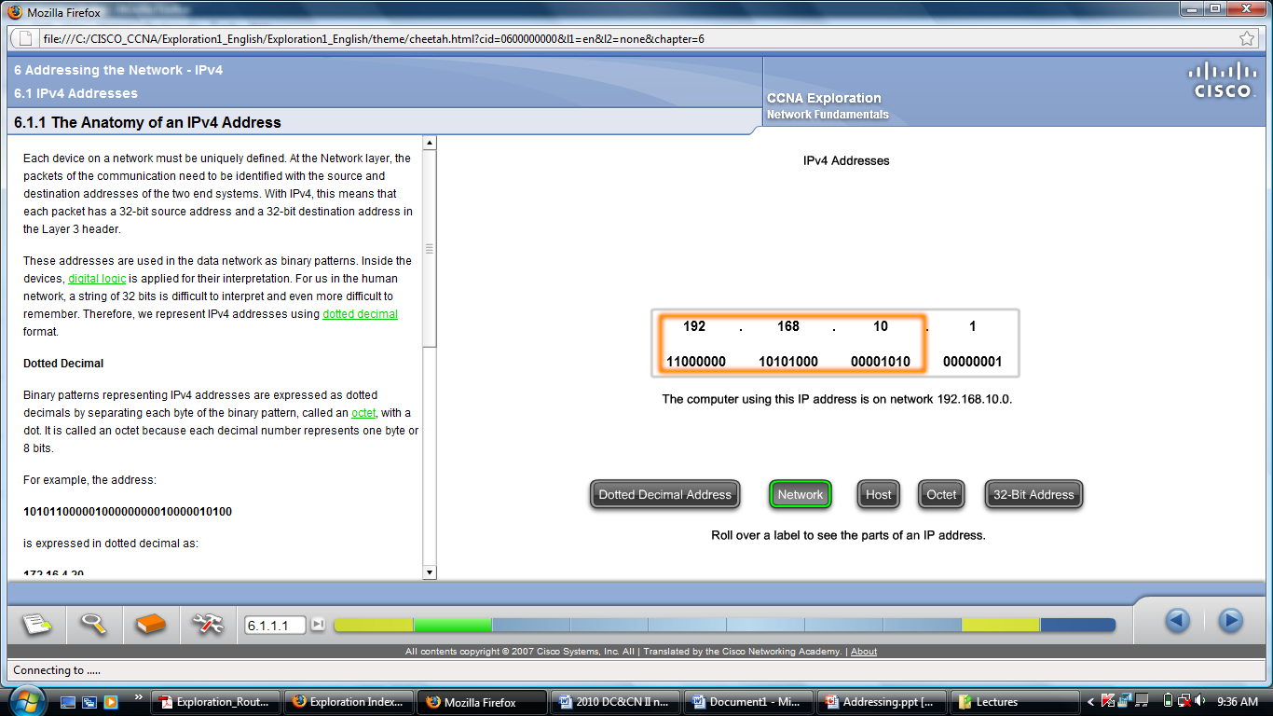
IP Addresses ➔ Network ID + Host ID
Class | Net ID | Host ID
A | 1 Byte | 3 Bytes
B | 2 Bytes | 2 Bytes
C | 3 Bytes | 1 Byte

Slide 10
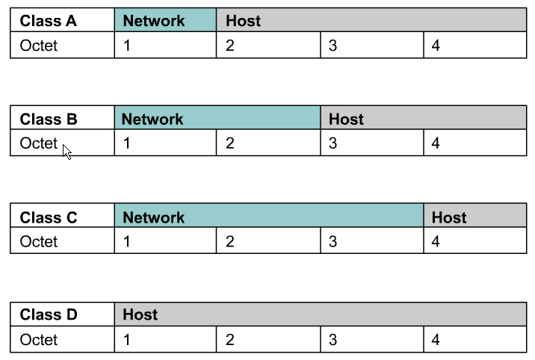
Rick Graziani graziani@cabrillo.edu

Slide 11

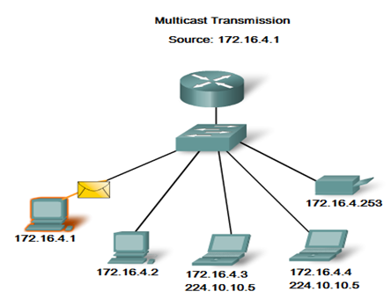
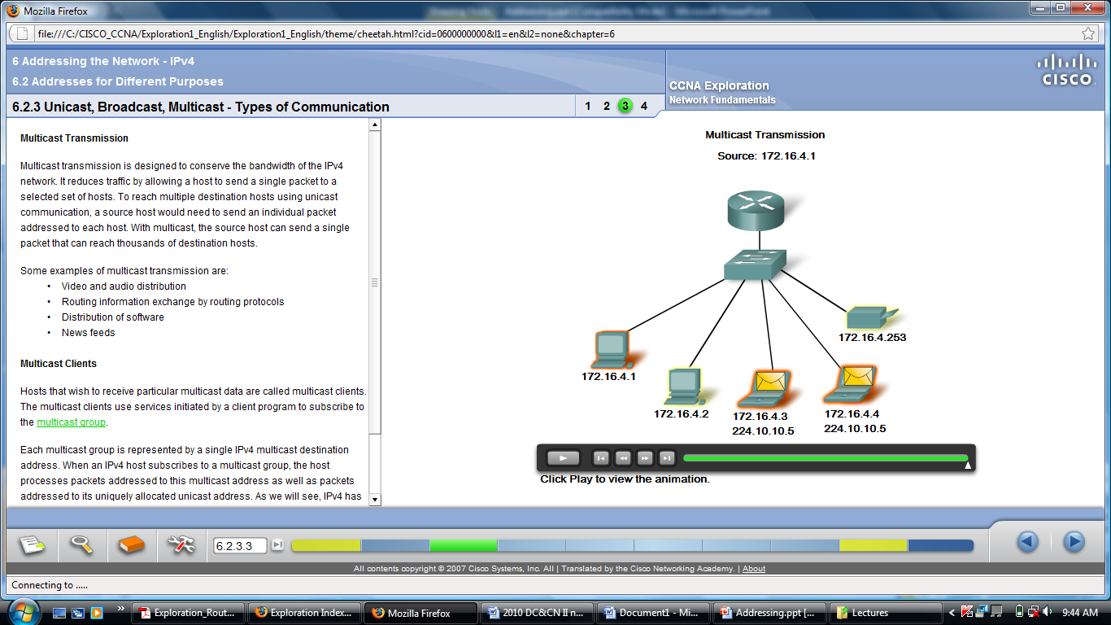
Class D is introduced for Multicasting
Class E is reserved

Slide 12
Class D Addresses
A Class D address begins with binary 1110 in the first octet.
First octet range 224 to 239.
Class D address can be used to represent a group of hosts called a host group, or multicast group.
Class E Addresses
First octet of an IP address begins with 1111
Class E addresses are reserved for experimental purposes and should not be used for addressing hosts or multicast groups.

Slide 13
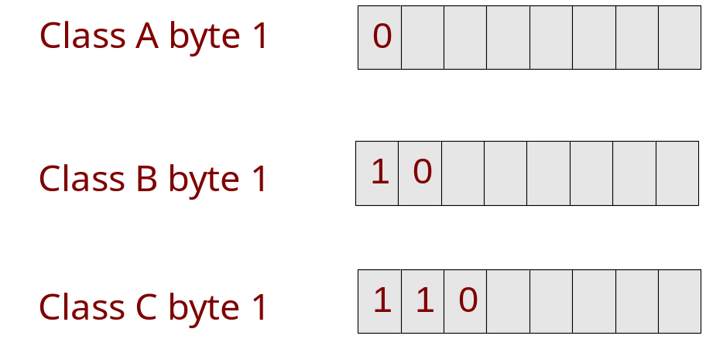
Class | Minimum Network ID | Maximum Networks ID
A | 0 0000000 0 | 0 1111111 127
B | 10 000000.00000000 128.0 | 10 111111.11111111 191.255
C | 110 00000.00000000.00000000 192.0.0 | 110 11111.11111111.11111111 223.255.255

Slide 14

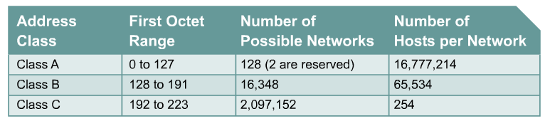

Slide 15
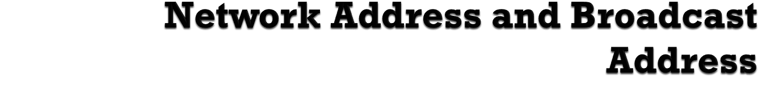
For the Network Address, the Host ID part of the IP Address will be considered as All 0s
For the Broadcast Address, the Host ID part of the IP Address will be considered as All 1s
Ex : 103.58.35.1
    This is a Class A address
    Net ID is = 103
    Host ID is = 58.35.1
    Network Address ➔ 103.0.0.0
    Broadcast Address ➔ 103.255.255.255

Slide 16
198 . 8 . 0 . 1
1100 0110 . 0000 1000 . 0000 0000 . 0000 0001
Both in Network ID and Host ID all 0s and all 1s are reserved for special purposes.
The actual maximum no. Networks
= 2²⁴
The actual maximum no. of Hosts per Network
=2⁸ - 2 = 254
Network Address :
1100 0110 . 0000 1000 . 0000 0000 . 0000 0000 (198.8.0.0)
Broadcast Address :
1100 0110 . 0000 1000 . 0000 0000 . 1111 1111 (198.8.0.255)
Class C
Network ID : 3 bytes (24 bits)
Host ID : 1 byte (8 bits)

Slide 17

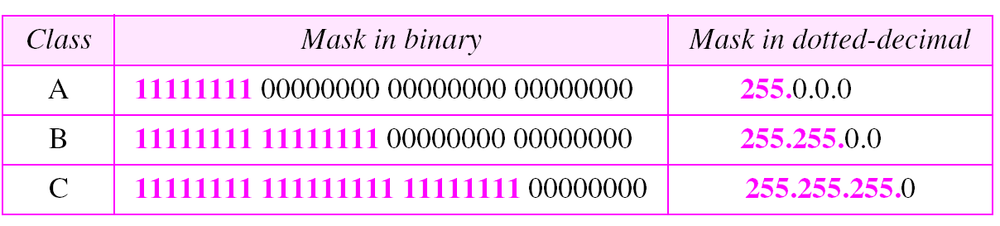
Net ID part : All 1’s
Host ID part : All 0’s

Slide 18
IP Address | Class | Subnet Mask | Actual No.of hosts | Network Address | Broadcast Address
140.35.45.55
50.60.70.5
201.35.40.201
125.38.55.185
193.201.55.105
127.53.35.10

Slide 19
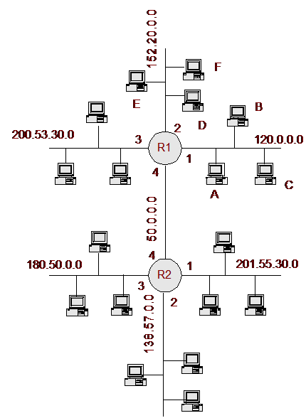
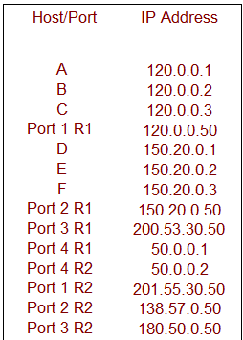
A router has many ports. (LAN and WAN Ports)
An IP address is assigned to each port.

Slide 20
Network Address | Gateway IP Address
120.0.0.0 | 120.0.0.50
152.20.0.0 | 152.20.0.50
200.53.30.0 | 200.53.30.50
201.55.30.0 | 201.55.30.50
138.57.0.0 | 138.57.0.50
180.50.0.0 | 180.50.0.50
The IP address of router port which is connected to a particular LAN is called the “Gateway IP Address” of the LAN

Slide 21
A public IP address is any valid address that can be accessed over the Internet
The Internet is a Public Computer Network which is spread all over the world.
Allocations of IP addresses are controlled by the Internet Assigned Number Authority (IANA) which responsible for the IP address ranges allocation to different countries.
CINTEC assigns different range of IP address to different Internet Service Providers (ISPs)
The ISPs allocate IP addresses to their customers
Sri Lanka Telecom(SLT) provides allocates 8 IP addresses for each 64 kb/s leased line.

Slide 22
A private IP address is address assigned to a device on a private LAN that is accessible only within the LAN.
A network which is not connected to Internet can use any IP address range without obtaining any permission
It is not advisable to use any IP address since the network may connect to Internet in the future
To avoid such problems, IANA has reserved some IP address ranges for private use
Class | Private Network Address | No.of Networks
A | 10.0.0.0 | 1
B | 172.16.0.0 to 172.31.0.0 | 16
C | 192.168.0.0 to 192.168.255.0 | 256

Slide 23
 | Net ID | Host ID | Remarks
Network Address | Specific | All 0’s | None
Direct Broadcast Address | Specific | All 1’s | Destination Address
Limited Broadcast Address | All 1’s | All 1’s | Destination Address
This Host on this Network | All 0’s | All 0’s | Source Address
Specific host on this network | All 0’s | Specific | Destination Address
Loopback Address | 127 | Any (All 1’s, All 0’s,Combinations) | Destination Address e.g. 127.0.0.0 127.255.255.255 127.0.0.1

Slide 24
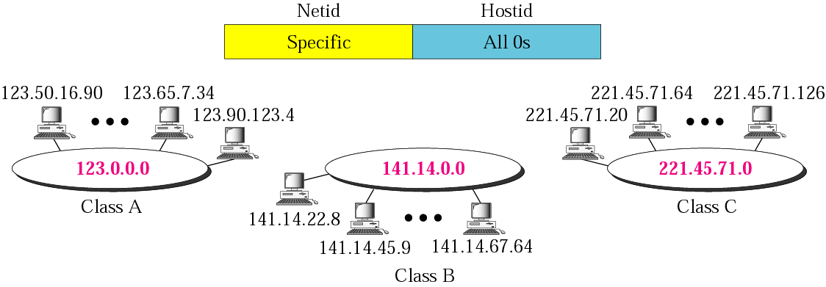

Slide 25
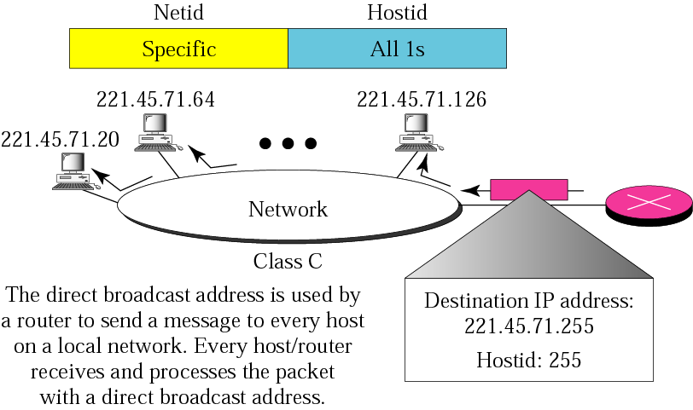

Slide 26
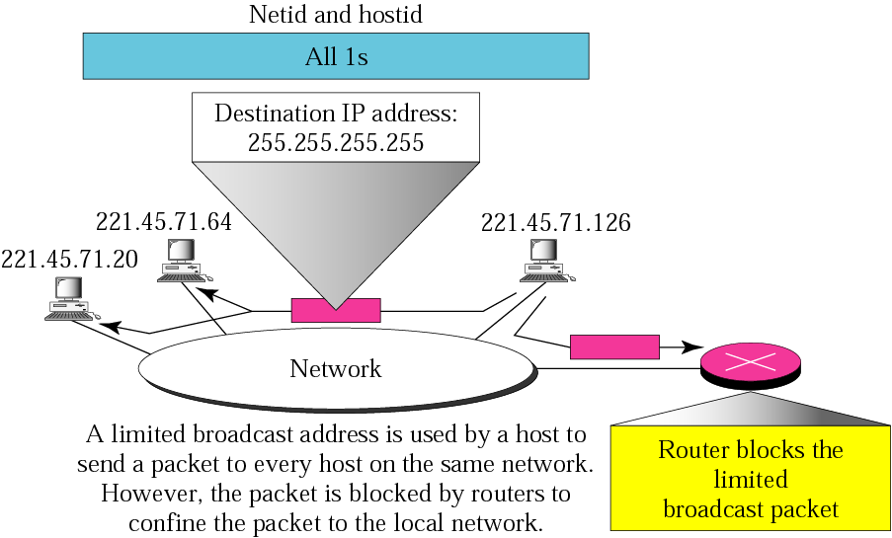

Slide 27
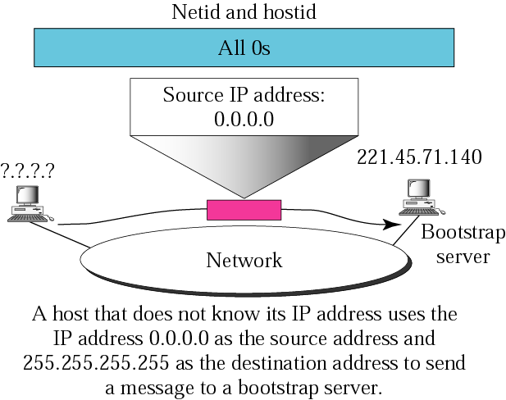

Slide 28
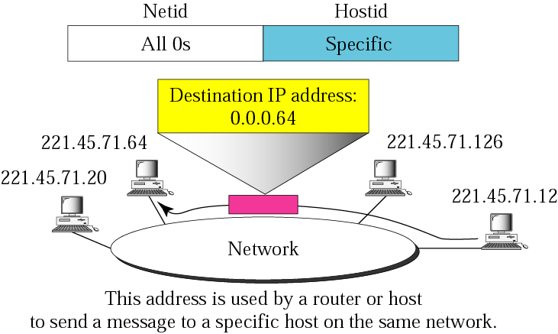

Slide 29
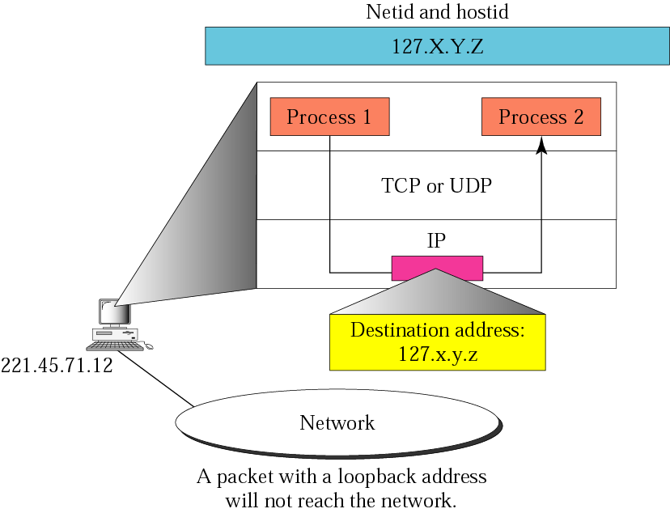

Slide 30

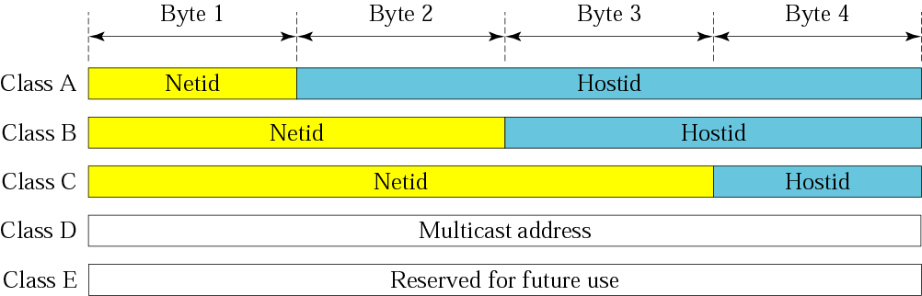

Slide 31
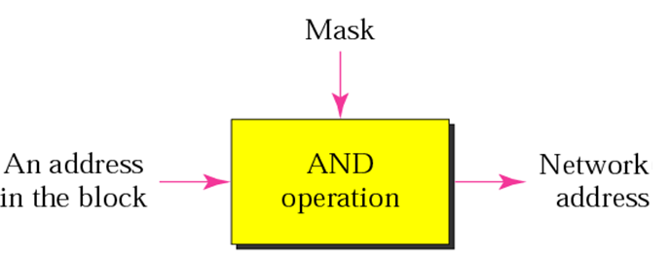

Slide 32
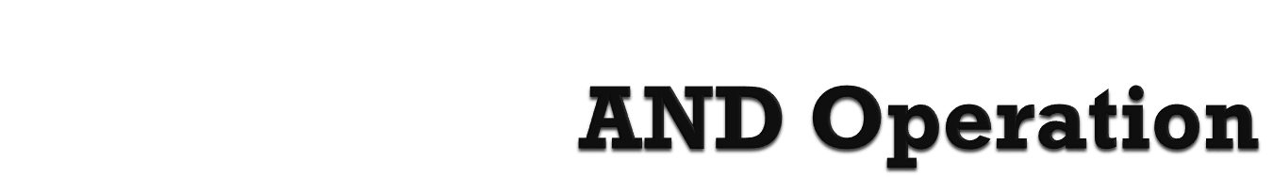
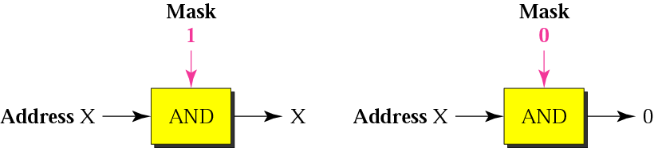

Slide 33
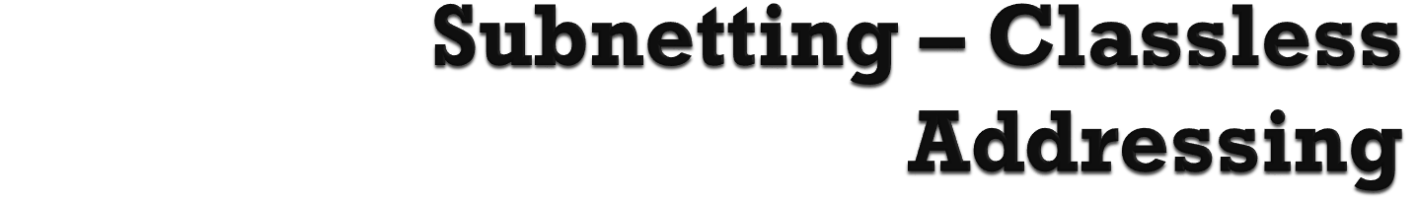
Suppose you are given a network address 150.100.0.0 /16 for your network.
10010110.01100100.00000000.00000000
You have the computers of Finance, Production and Administration Sections. In order to enhance the efficiency of network you want divide this into three networks. But you cannot get another two network addresses. This requirement can be satisfied from the same network address by using the subnet concept.
Now the IP address is divided into three parts.
Net ID Subnet ID Host ID

Slide 34
The original Net ID bits not changed.
Part of Host ID is allocated for “Subnet ID”.
Most significant bits allocated as Subnet ID.
XXXX XXXX. XXXX XXXX.. XXXX XXXX. XXXX XXXX
Net ID Subnet ID Host ID

Slide 35
subnets can be written as
Subnet 0 10010110.01100100.00000000.00000000
Subnet 1 10010110.01100100.01000000.00000000
Subnet 2 10010110.01100100.10000000.00000000
Subnet 3 10010110.01100100.11000000.00000000
In dotted decimal, it can be written as,
Subnet 0 address 150.100.0.0 /18
Subnet 1 address 150.100.64.0 /18
Subnet 2 address 150.100.128.0 /18
Subnet 3 address 150.100.192.0 /18

Slide 36
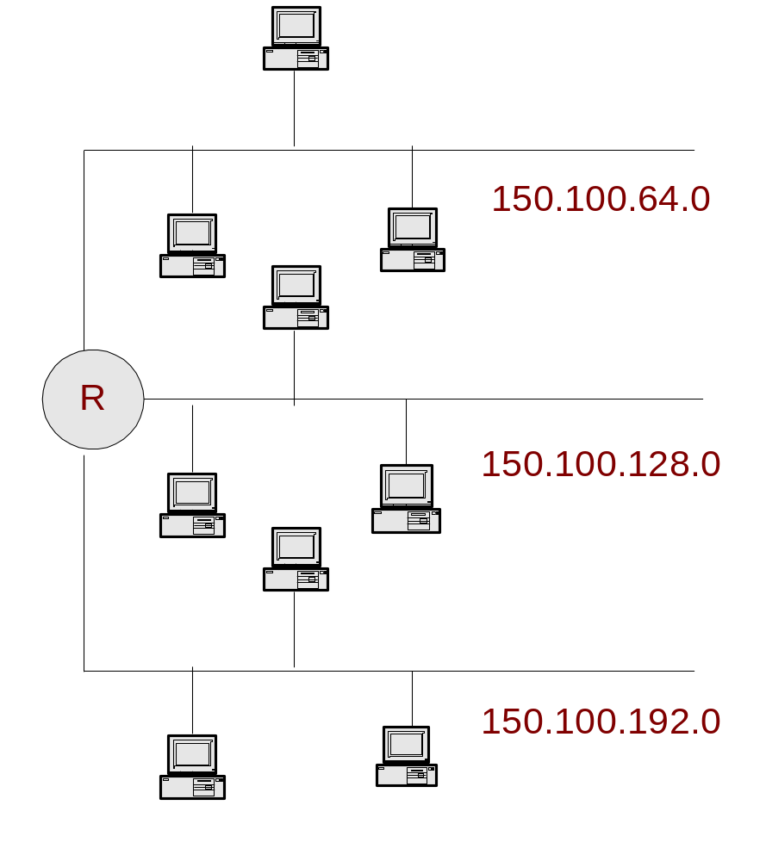
For the above example the Finance, Production and Administration Sections can be put to three subnets as follows.
Consider the hosts in subnet 150.100.64.0
The IP addresses can be given as
150.100.64.1
150.100.64.2
150.100.64.3
150.100.64.4 etc.

Slide 37
In classless addressing the number of bits for network address cannot be decided.
Indicated with a “/” symbol.
The IP address is written as,
150.100.64.1 /18
150.100.64.2 /18
150.100.64.3 /18
the subnet mask will be,
11111111.11111111.11000000.00000000
255.255.192.0

Slide 38
Write the possible 12 subnet addresses of 150.72.0.0 / 16 network.
  150.72.0.0 / 20
  150.72.16.0 / 20
  150.72.32.0 / 20
  150.72.48.0 / 20
  150.72.64.0 / 20
  150.72.80.0 / 20
  150.72.96.0 / 20
  150.72.112.0 / 20
  150.72.128.0 / 20
  150.72.144.0 / 20
  150.72.160.0 / 20
  150.72.176.0 / 20

