Slide 1
Data Structures and Algorithms
Introduction

Slide 2
Subject Group
Malabe Campus
Mr. Samantha Rajapaksha
Ms. Namalie Walgampaya
Dr Jeewani Bamunusinghe
Ms. Sanjeewi Chandrasiri
Metro Campus
Mr. Samantha Rajapaksha
Matara Center
Ms. Chamari Silva
Kandy Center
Ms. Sachini Rajapakse

Slide 3
Teaching Methods
Lectures – 2 hours/week
Tutorials – 1 hour/week
Labs – 2 hours /week

Slide 4
Student Evaluation
Assignments (Two exams) - 40 %
Final Examination - 60 %

Slide 5
Lectures will cover
Data Structures
Stack data structure
Queue data structure
Linked list data structure
Tree data structure
Algorithms
- Asymptotic Notations
- Algorithm designing techniques
- Heaps
- Searching and Sorting algorithms

Slide 6
Tutorials and Labs will cover
- Solve problems using the knowledge acquired in the lecture
- Get hands on experience in writing programs
- Java , Eclipse
- Python

Slide 7
Academic Integrity Policy
Are you aware that following are not accepted in SLIIT???
Plagiarism - using work and ideas of other individuals intentionally or unintentionally
Collusion - preparing individual assignments together and submitting similar work for assessment.
Cheating - obtaining or giving assistance during the course of an examination or assessment without approval
Falsification – providing fabricated information or making use of such materials
From year 2018 the committing above offenses come with serious consequences !
See General support section of Courseweb for full information.

Slide 8
Progression Criteria
In order to progress from one academic year to the next, you must maintain the following minimum academic standard.
From year 1 to year 2 – No more than 5 failed or incomplete modules
From year 2 to year 3 – No more than 3 failed or incomplete modules
From year 3 to year 4 – No more than 2 failed or incomplete modules
If you do not meet the above criteria, you will not be able to progress to the next year.
For those who have started studies at SLIIT prior to 2018, the above requirement may be waived based on parental requests.
For those who have started studies at SLIIT in 2018 onwards, the above requirement will not be waived.

Slide 9
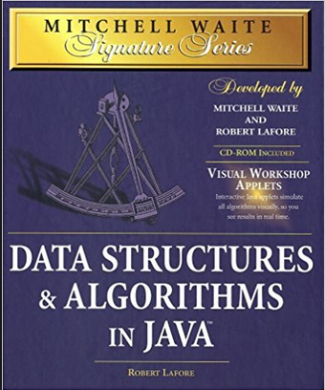
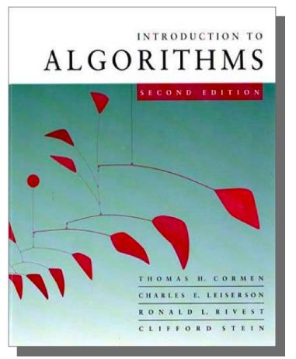
References
Mitchell Waite,Robert Lafore, Data Structures and Algorithms in Java,2nd Edition, Waite Group Press,1998.
T.H. Cormen, C.E. Leiserson, R.L. Rivest, Introduction to Algorithms,3rd Edition, MIT Press, 2009.

