Slide 1
Data Structures and Algorithms
Introduction

Slide 2
Data Structures and Algorithms
Data Structures
- Data structure is an arrangement of data in a computer’s memory or sometimes on a disk.
Ex: stacks, queues, linked lists, trees
Algorithms
- Algorithms manipulate the data in these structures in various ways.
Ex: searching and sorting algorithms

Slide 3
Usage of data structures
Real world data storage
Real world modeling
- queue, can model customers waiting in line
- graphs, can represent airline routes between cities
Programmers Tools
- stacks, queues are used to facilitate some other operations

Slide 4
Algorithms
Algorithm is a well defined computational procedure that takes some value or set of values as input and produce some value or set of values as output.
An algorithm should be
- correct.
- unambiguous.
- give the correct solution for all cases.
- simple.
- terminate.

Slide 5
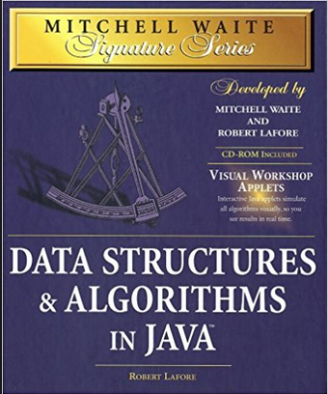
References
Mitchell Waite,Robert Lafore, Data Structures and Algorithms in Java,2nd Edition, Waite Group Press,1998.

