Slide 1
Data Structures and Algorithms
Stacks

Slide 2


Stack
Allows access to only one data item; the last item inserted
If you remove this item, then you can access the next-to-last item inserted

Slide 3



Stack
Top
In a stack all insertions and deletions are made at one end (Top). Insertions and deletions are restricted from the Middle and at the End of a Stack
Adding an item is called Push
Removing an item is called Pop
Elements are removed from a Stack in the reverse order of that in which the elements
were inserted into the Stack
The elements are inserted and removed according to the Last-In-First-Out (LIFO) principle.

Slide 4
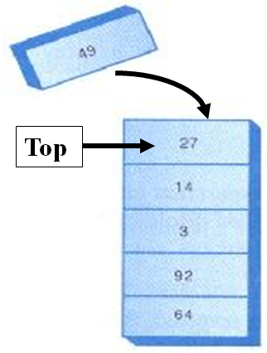
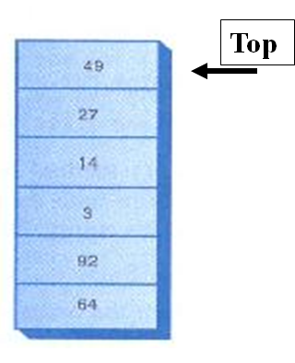
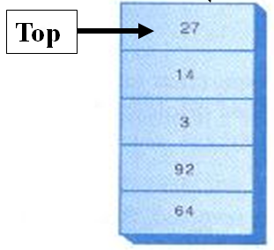
Stack - Push
Push item 49
Before inserting
Item 49 is inserted on top
After inserting

Slide 5

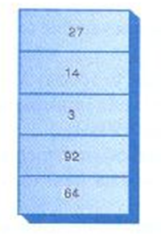
Stack - Pop
Pop
Before removing
Top item is removed
After removing

Slide 6
Stack - Peek
49
Peek
Stack remains the same
Peek is used to read the value from the top of the stack without removing it. You can peek only the Top item, all the other items are invisible to the stack user.

Slide 7
Question
Draw the stack frame after performing the below operations to the stack given below.
25
300
Top
Maximum size of
this stack is 4
Push item 50
Push item 500
Peek
Push item 100
Pop
Pop
Pop
Pop

Slide 8
Uses of Stack
The stack operations are built into the microprocessor.
When a method is called, its return address and arguments are pushed onto a stack, and when it returns they’re popped off.

Slide 9
Stack - Implementation
Stack implementation using an array
class StackX {
private int maxSize; // size of stack array
private double[] stackArray;
private int top; //top of the stack
publc StackX(int s) { // constructor
maxSize = s; // set array size
stackArray = new double[maxSize];
top = -1; // no items
}
…………………….
…………………….
}
Constructor creates a new stack
of a size specified in its argument.
Variable top, which stores the
index of the item on the top of the
stack.

Slide 10
Stack – Implementation - push
class StackX{
private int maxSize; // size of stack array
private double[] stackArray;
private int top; //top of the stack
publc StackX(int s) { // constructor
maxSize = s; // set array size
stackArray = new double[maxSize];
top = -1; // no items
}
public void push(double j) {
// increment top
// insert item
}

Slide 11
Stack – Implementation - push
class StackX {
private int maxSize; // size of stack array
private double[] stackArray;
private int top; //top of the stack
publc StackX(int s) {// constructor
maxSize = s; // set array size
stackArray = new double[maxSize];
top = -1; // no items
}
public void push(double j) {
// increment top. insert item
stackArray[++top] = j;
}
What if the stack is full ?

Slide 12
Stack – Implementation - push
class StackX
{
private int maxSize; // size of stack array
private double[] stackArray;
private int top; //top of the stack
public StackX(int s) {// constructor
maxSize = s; // set array size
stackArray = new double[maxSize];
top = -1; // no items
}
public void push(double j) {
// check whether stack is full
if (top == maxSize – 1)
System.out.println(“Stack is full”);
else
stackArray[++top] = j;
}

Slide 13
Stack – Implementation – pop/peek
class StackX
{
private int maxSize; // size of stack array
private double[] stackArray;
private int top; //top of the stack
public StackX(int s) {// constructor
maxSize = s; // set array size
stackArray = new double[maxSize];
top = -1; // no items
}
public void push(double j) {
// check whether stack is full
if (top == maxSize – 1)
System.out.println(“Stack is full”);
else
stackArray[++top] = j;
}
public double pop() {
// check whether stack is empty
// if not
// access item and decrement top
}
public double peek() {
// check whether stack is empty
// if not
// access item
}

Slide 14
Stack – Implementation – pop/peek
class StackX {
private int maxSize; // size of stack array
private double[] stackArray;
private int top; //top of the stack
public StackX(int s) { // constructor
maxSize = s; // set array size
stackArray = new double[maxSize];
top = -1; // no items
}
public void push(double j) {
// check whether stack is full
if (top == maxSize – 1)
System.out.println(“Stack is full”);
else
stackArray[++top] = j;
}
public double pop() {
if (top == -1)
return -99;
else
return stackArray[top--];
}
public double peek() {
if (top == -1)
return -99;
else
return stackArray[top];
}

Slide 15
Question
isEmpty() method returns true if the stack is empty and isFull() method return true if the
Stack is full.
Implement isEmpty() and isFull() methods of the stack class.

Slide 16
Creating a stack
Question
Using the implemented StackX class, Write a program to create a stack with
maximum size 10 and insert the following items to the stack.
80 100 25
Delete all the items from the stack and display the deleted items.

Slide 17
Creating a stack
class StackApp {
public static void main(String[] args) {
StackX theStack = new StackX(10); // create a stack with max size 10
theStack.push(30); // insert given items
theStack.push(80);
theStack.push(100);
theStack.push(25);
while( !theStack.isEmpty() ) { // until it is empty, delete item from stack
double val = theStack.pop();
System.out.print(val);
System.out.print(“ “);
}
}
} // end of class

Slide 18
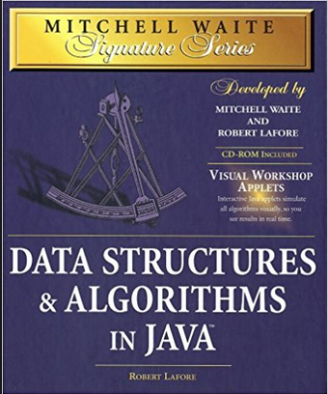
References
Mitchell Waite,Robert Lafore, Data Structures and Algorithms in Java,2nd Edition, Waite Group Press,1998.

