Slide 1
NeedGPT
Hackathon
by Conhacks
Redesigning conestoga student portal
By – Rikhi Singh, Krishan Singh

Slide 2
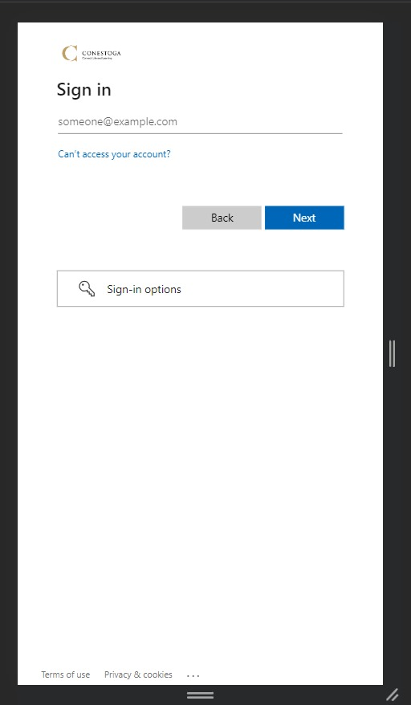
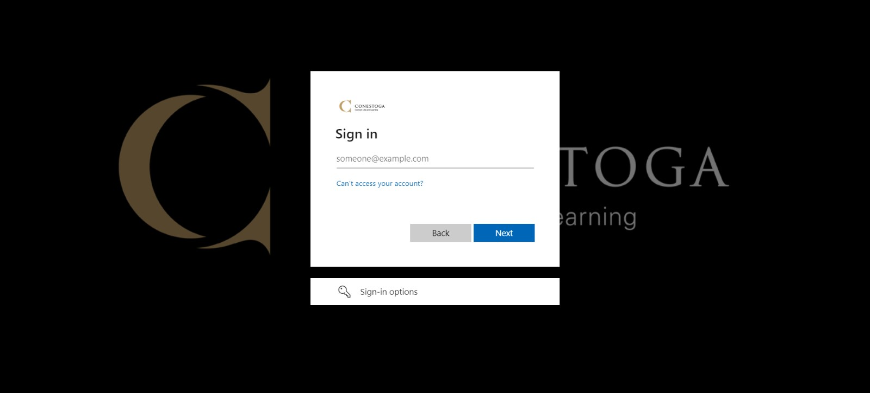
LOGIN PAGE
ORIGNAL
Desktop View
Mobile View

Slide 3
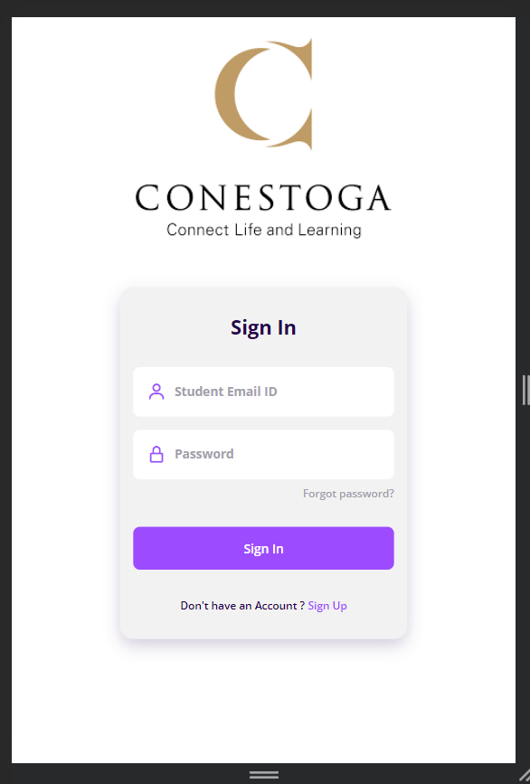
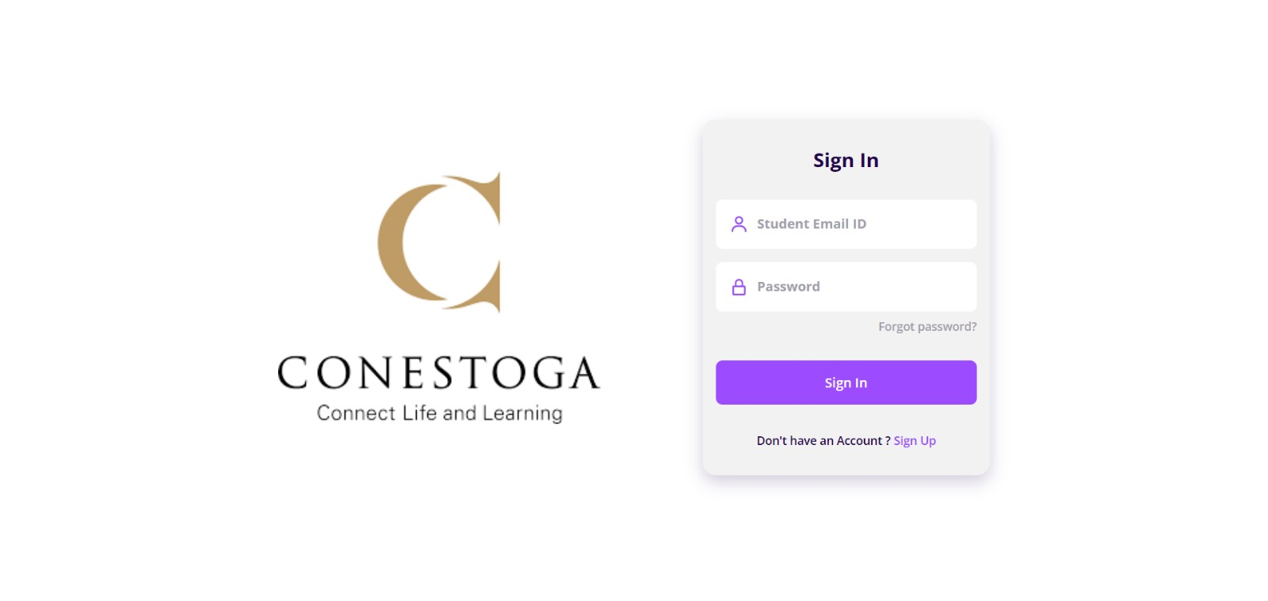
LOGIN PAGE
REDESIGN
Desktop View
Mobile View

Slide 4
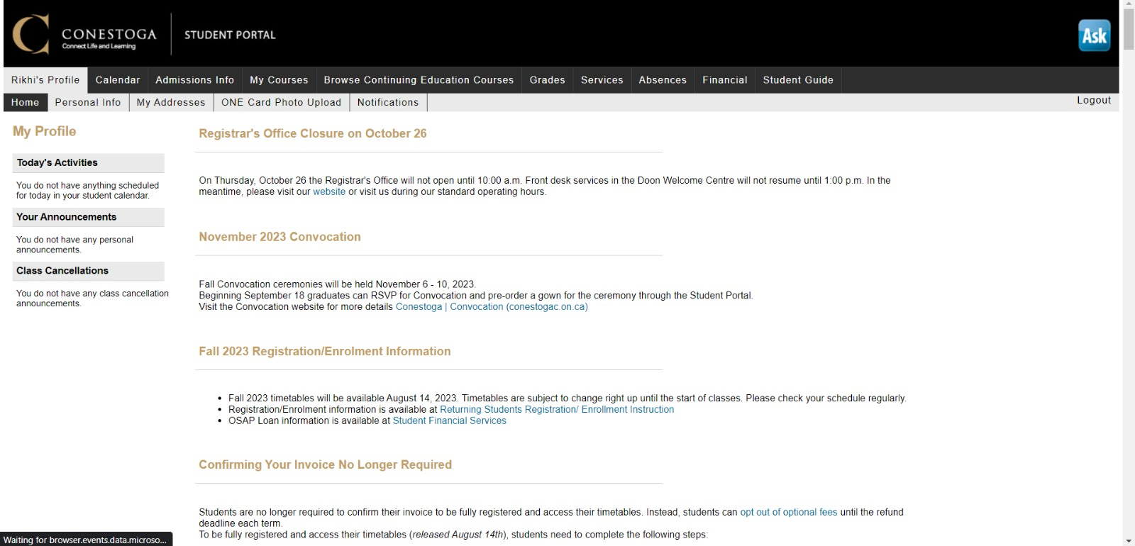
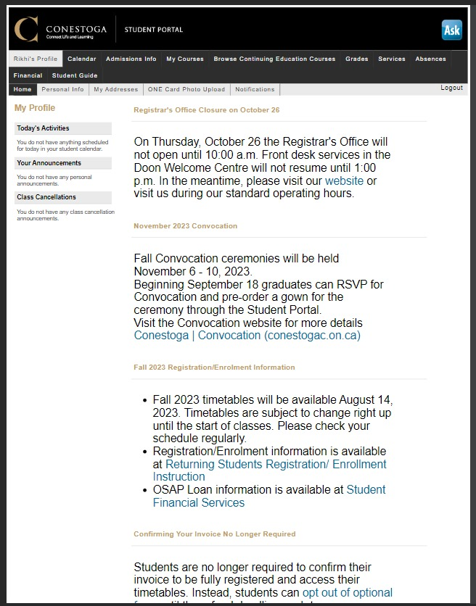
HOME PAGE
ORIGNAL
Desktop View
Mobile View

Slide 5
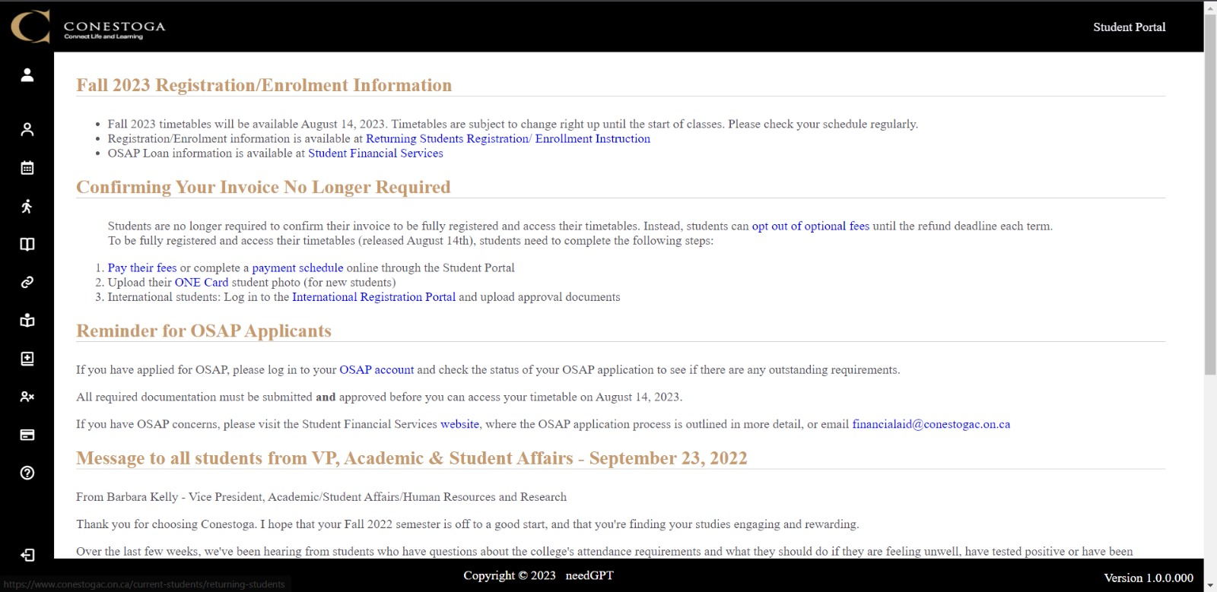
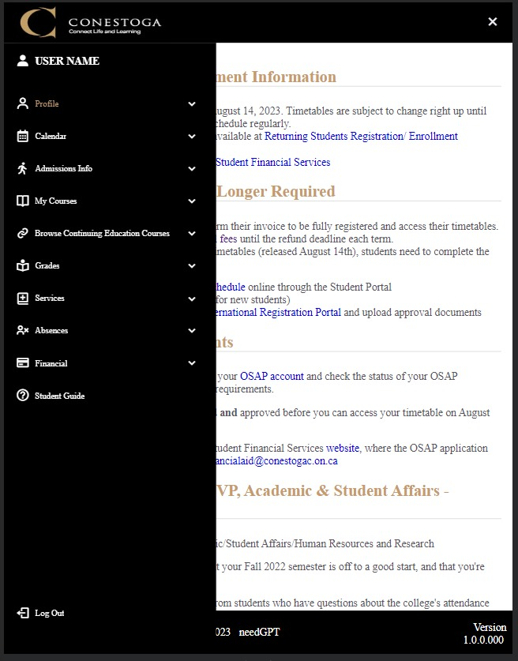
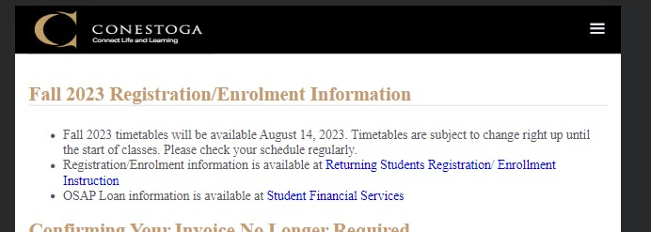
HOME PAGE
REDESIGN
Desktop View
Mobile View

Slide 6
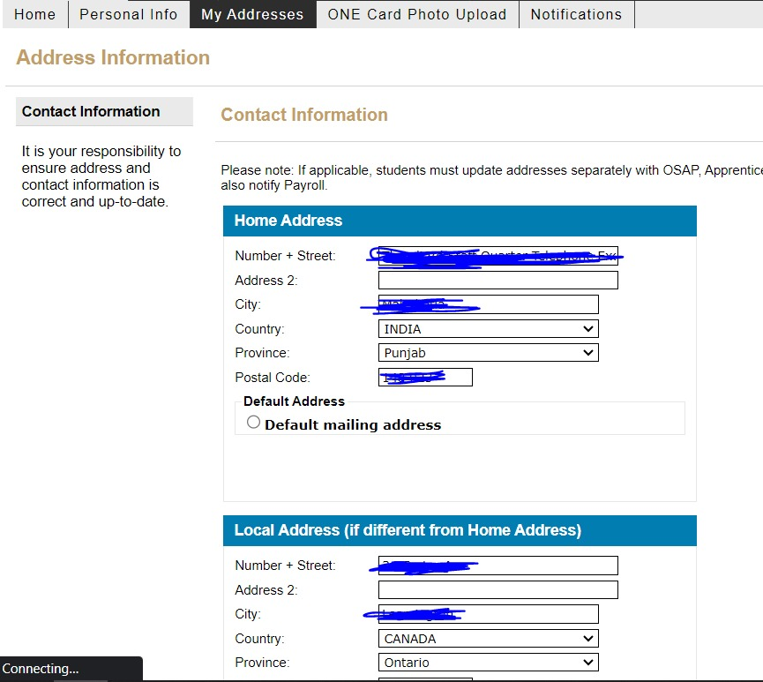
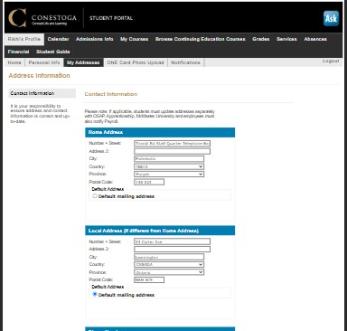
ADDRESS PAGE
ORIGNAL
Desktop View
Mobile View

Slide 7
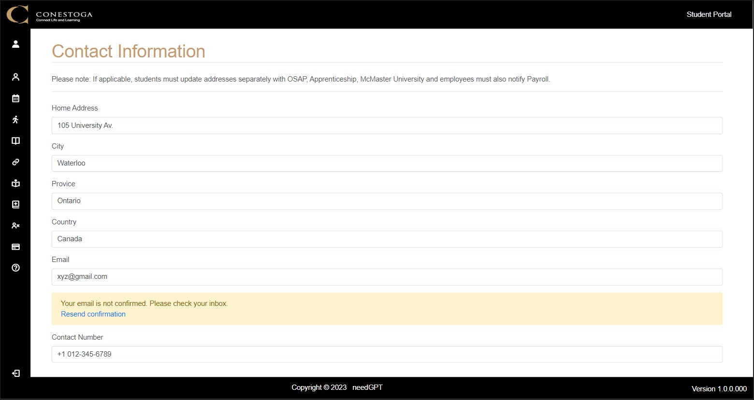
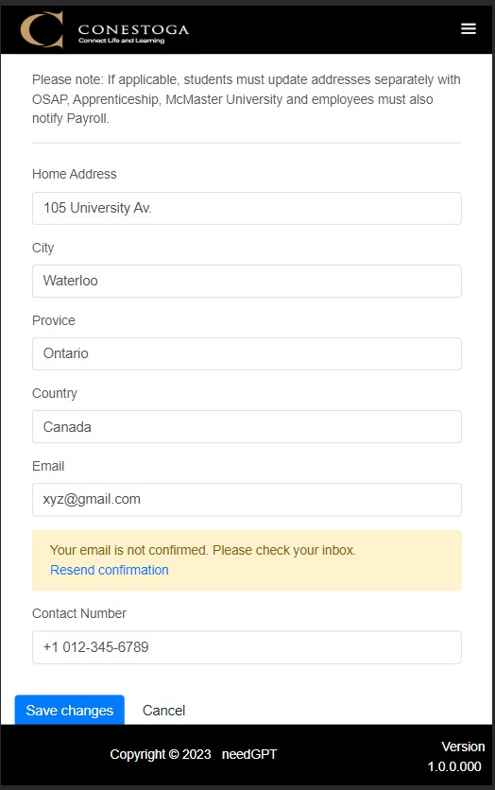
ADDRESS PAGE
REDESIGN
Desktop View
Mobile View

Slide 8
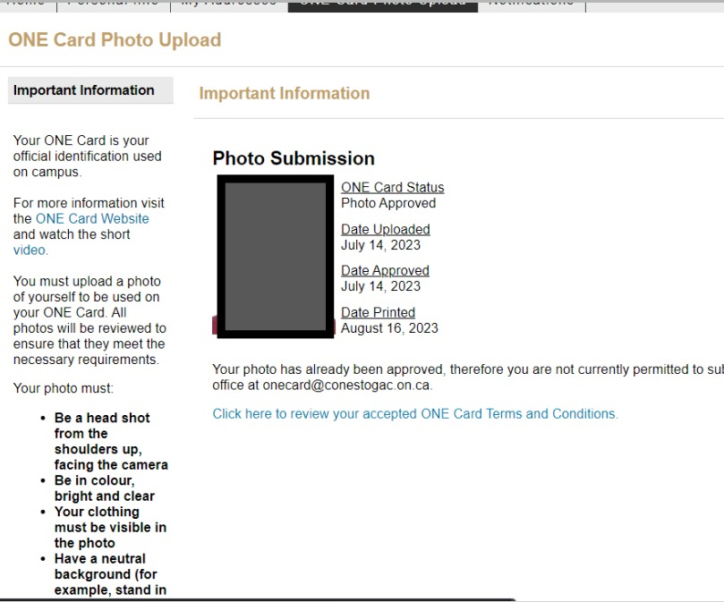
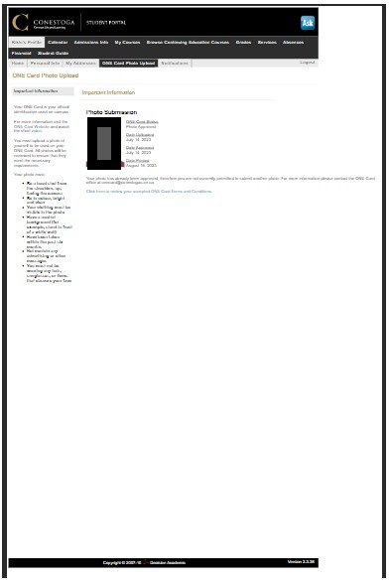
ADDRESS PAGE
ORIGNAL
Desktop View
Mobile View

Slide 9
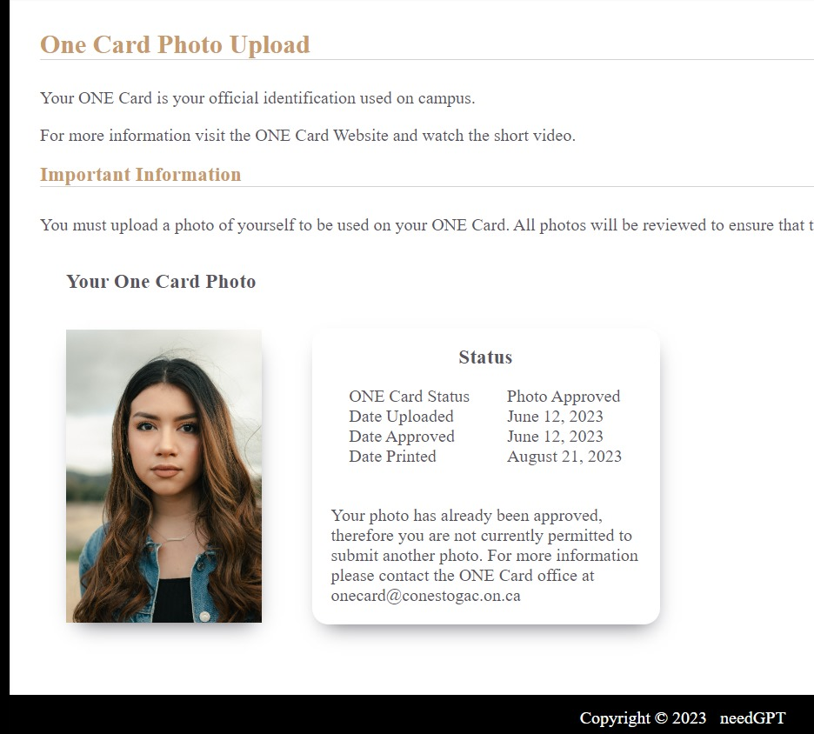
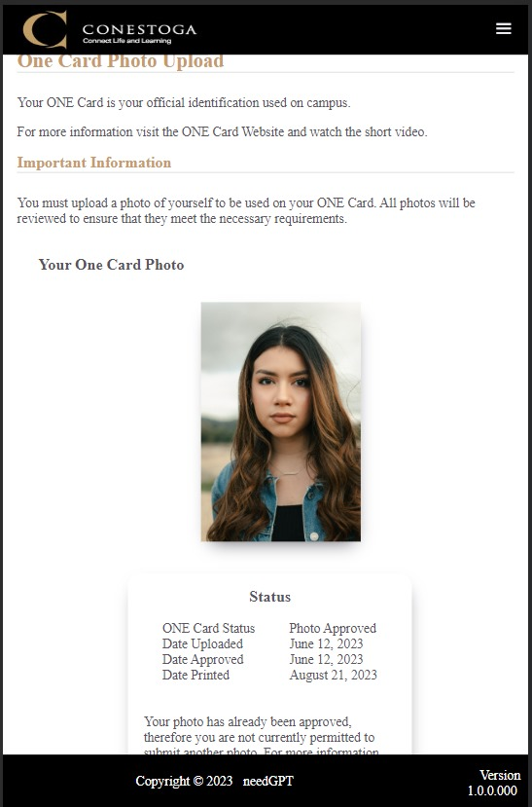
ADDRESS PAGE
REDESIGN
Desktop View
Mobile View

Slide 10
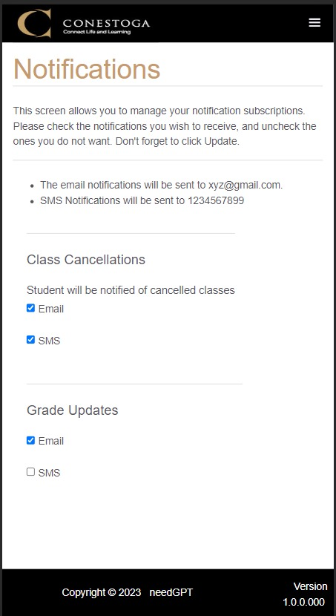
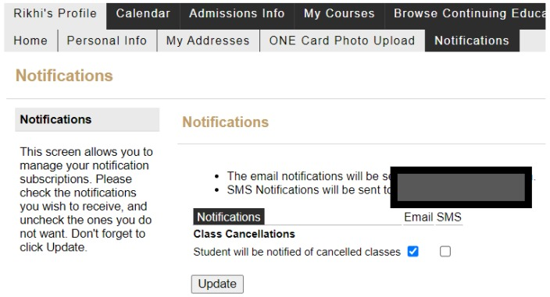
ADDRESS PAGE
ORIGNAL
REDESIGN

Slide 11
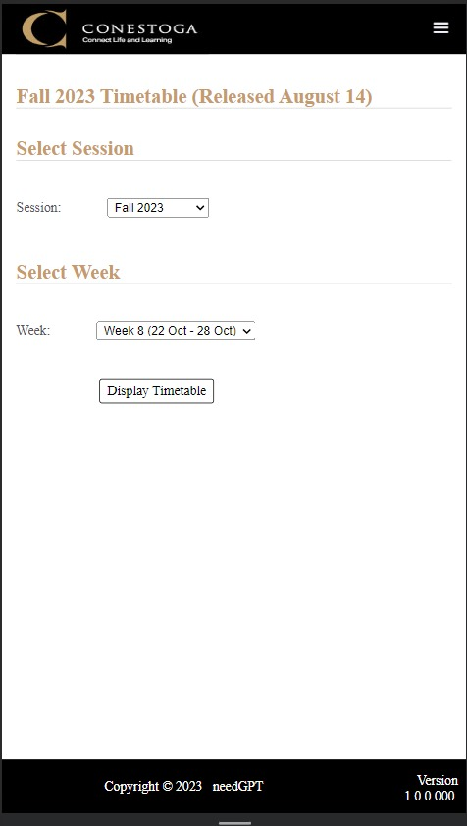
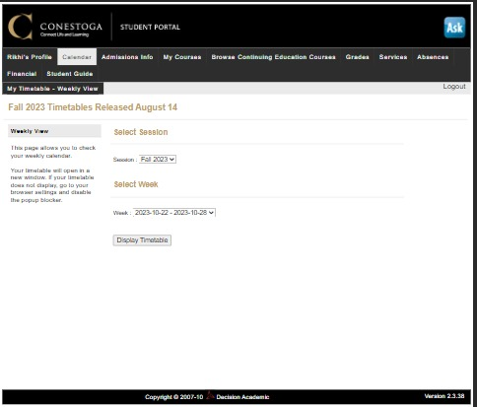
ADDRESS PAGE
ORIGNAL
REDESIGN

