Slide 1
PROJECT 7
Analyzing the Impact of Car Features on Price and Profitability
Rikin Correya

Slide 2
Project Description
The automotive industry is evolving rapidly, with a focus on fuel efficiency, sustainability, and innovation. As electric and hybrid vehicles gain popularity and alternative fuels emerge, traditional gasoline cars remain a significant part of the market. The client seeks to optimize car pricing and product development to boost profitability while meeting consumer demand.
This project will analyze car features, market segments, and pricing to identify popular and profitable attributes. Using techniques like regression and market segmentation, manufacturers can align pricing with demand and prioritize key features for future models, enhancing both competitiveness and profitability.
* All the Excel Files links are provided on Slide 5 after “Approach” Section. *

Slide 3
Tech_Stack used
MS Excel
It was used in order to open the .csv file, cleaning the data and then applying statistical functions on the useful data to analyse, as well as a very important tool in order to draw insights out of the data in form of tables and charts.
It was also used to prepare interactive Dashboards, for easy visualization and understanding of the insights.
Google Slides
It was used to prepare the report and to document all the insights of different tasks of the project.

Slide 4
Approach
Data Pre-Processing - Cleaned the raw data, by first removing duplicate row entries, and replacing all NULL values by Imputing the data values. After replacing all the NULLs, the next step was to find any error in data entries and correct it, and detect OUTLIERS in the dataset and correct or remove it.
After the Dataset was cleaned, it was available for Analysis, hence carried on with the Analysis using Excel Functions, Tables and Statistical Functions, and found correlation, top performers & much more.
After completing all the Insight Tasks, Dashboard was prepared using Excel tools like Pivot Tables, Slicers & Charts/Graphs for better visualization & Understanding of all the Tasks Insights.

Slide 5
Links to Files
Note - Its a .xlsx file format, hence you may see certain things not shown properly if you open it on google sheets. So it’s recommended to download the file and open it in Excel.
Final Dataset & Insights - https://docs.google.com/spreadsheets/d/1MVdaIuqlO2IkyqyhcN_qfxV38g7_If__/edit?usp=drive_link&ouid=109416836118642236108&rtpof=true&sd=true
Dashboard - https://docs.google.com/spreadsheets/d/1bJcRRSBrdqj4D-abjKNLMYpTTwxLMdM0/edit?usp=drive_link&ouid=109416836118642236108&rtpof=true&sd=true
Video Presentation -
https://app.recorditor.com/recording/f0c8c9f493ee26b1396ce6c8487dfd660e6b86cfbce291f24a0424a7df67aae16df4cdda7537cf021f2ab4d33c5464022b80b7c5812e5d7a0f5a689524cf842c
Note -> I couldn’t record Loom Video for more than 5 minutes, so I have used another online recorder, whose link i have provided in the VIDEO LINK while submitting.
Steps to watch my video - Click on the Video Link provided -> Then they will ask to Sign in, so if you are new then Sign in to the account -> after creating an account,you will be on the dashboard. -> Then again go back to my My VIDEO LINK and click it again, then it will load for 2 - 3 minutes, as it's a 30 minute video.
I couldn’t download the Video Presentation as I have to pay for it, hence only link can be used to watch it. Sorry for the inconvenience.

Slide 6
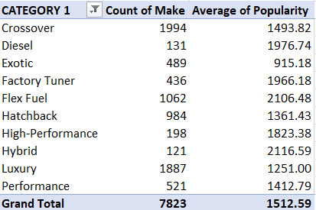
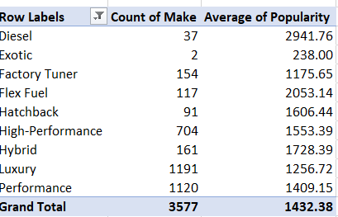
Insights
TASK 1(A) - Create a pivot table that shows the number of car models in each market category and their corresponding popularity scores.

Slide 7
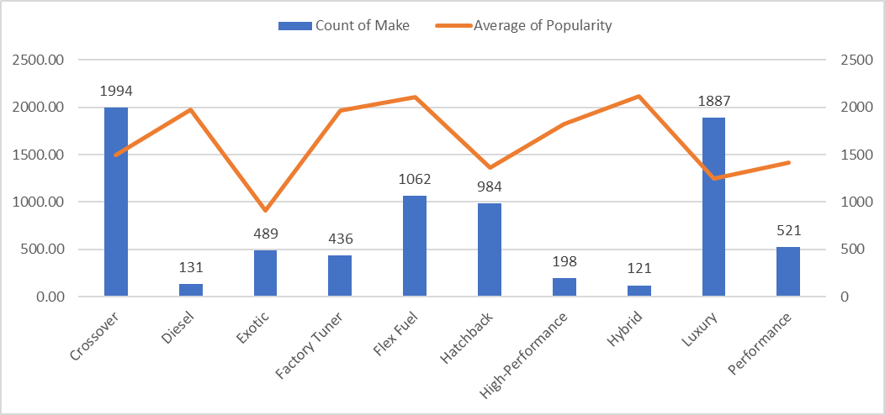
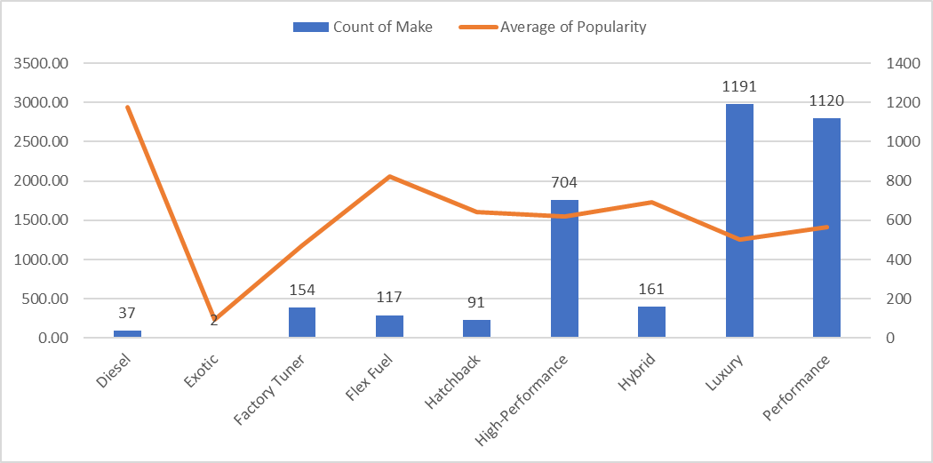
TASK 1(B) - Create a combo chart that visualizes the relationship between market category and popularity.

Slide 8
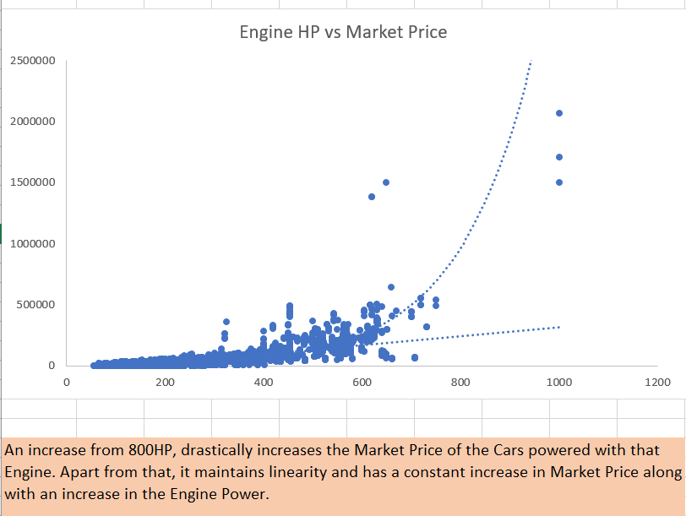
TASK 2 - Create a scatter chart that plots engine power on the x-axis and price on the y-axis. Add a trendline to the chart to visualize the relationship between these variables.

Slide 9
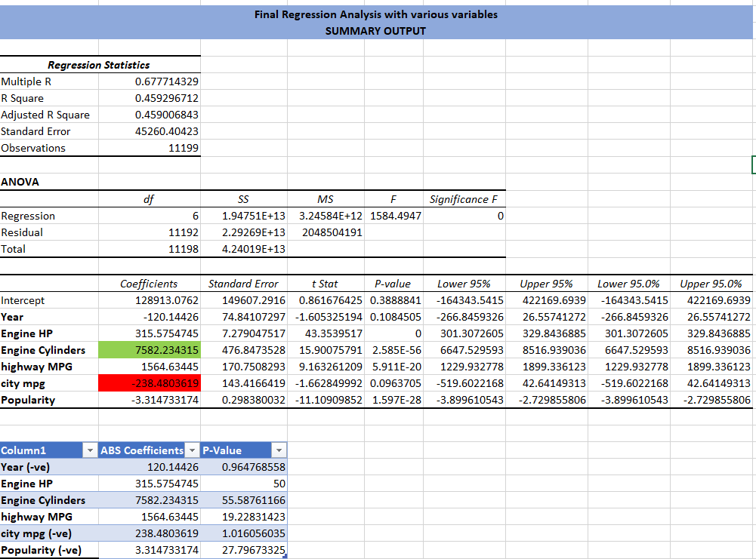
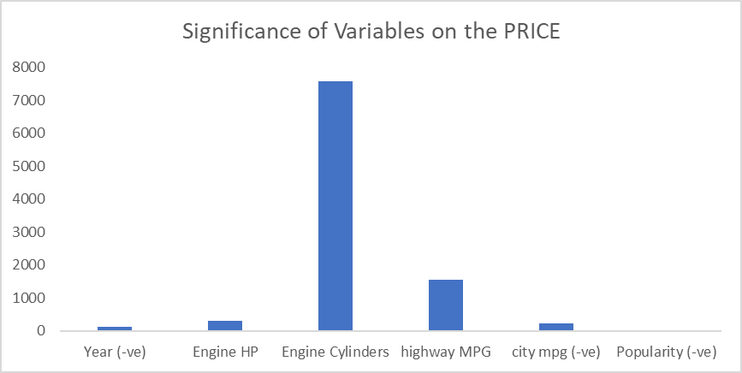
TASK 3 - Use regression analysis to identify the variables that have the strongest relationship with a car's price. Then create a bar chart that shows the coefficient values for each variable to visualize their relative importance.

Slide 10
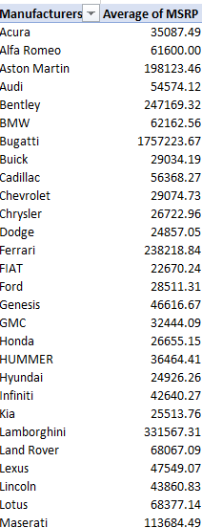
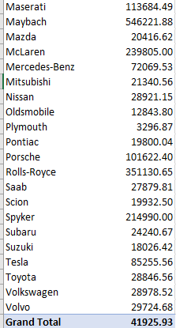
TASK 4(A) - Create a pivot table that shows the average price of cars for each manufacturer.

Slide 11
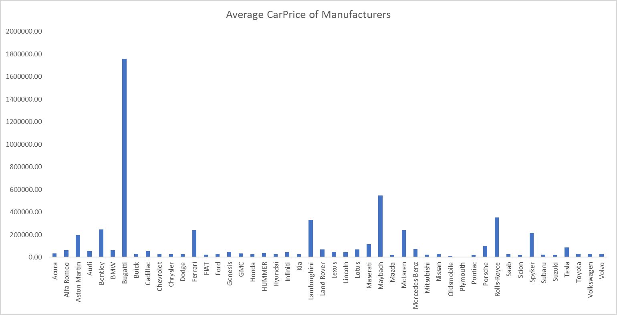
TASK 4(B) - Create a bar chart or a horizontal stacked bar chart that visualizes the relationship between manufacturer and average price.

Slide 12
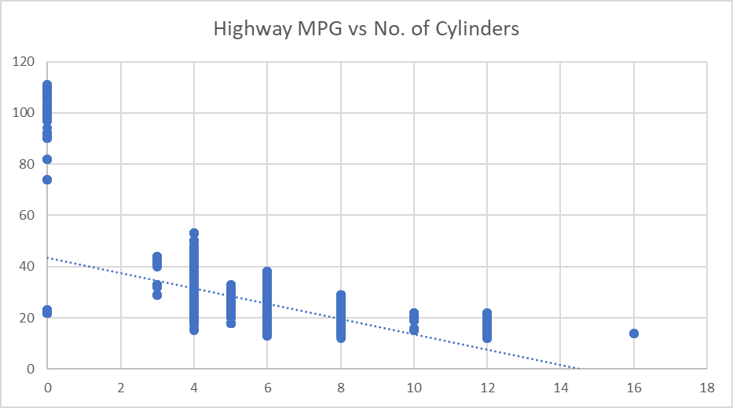
TASK 5(A) - Create a scatter plot with the number of cylinders on the x-axis and highway MPG on the y-axis. Then create a trendline on the scatter plot to visually estimate the slope of the relationship and assess its significance.

Slide 13
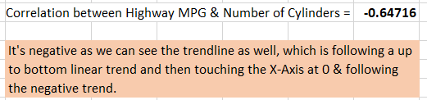
TASK 5(B) - Calculate the correlation coefficient between the number of cylinders and highway MPG to quantify the strength and direction of the relationship.

Slide 14
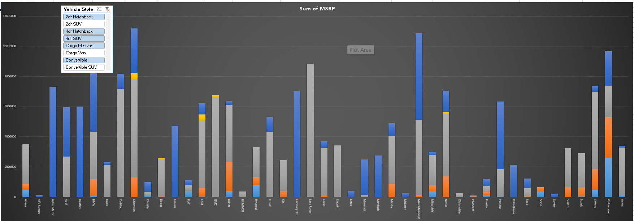
DASHBOARD
TASK 1 - How does the distribution of car prices vary by brand and body style?

Slide 15
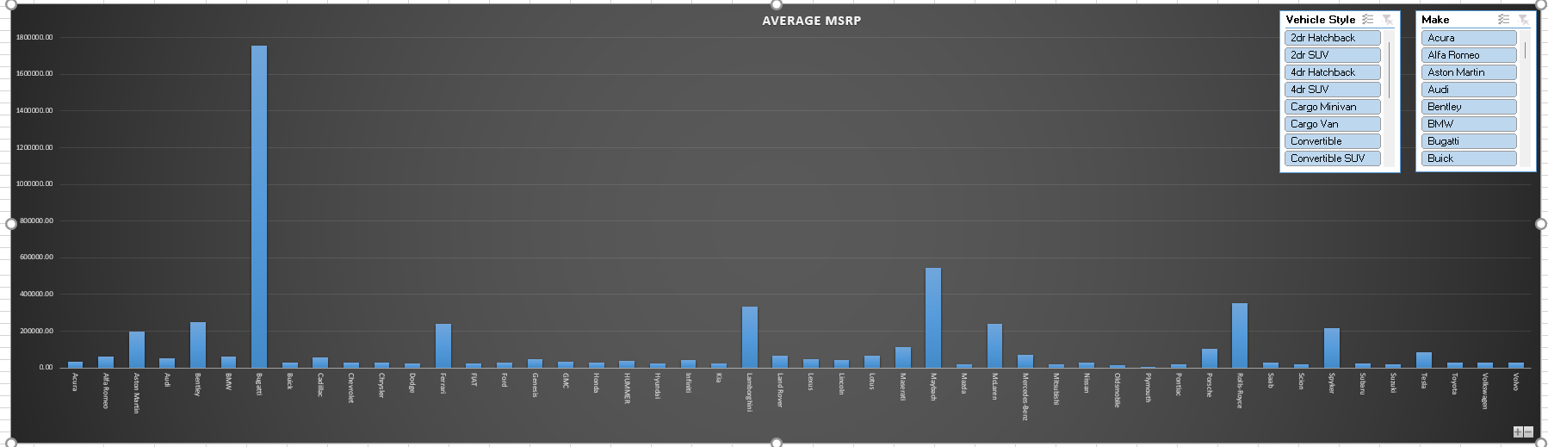
TASK 2 - Which car brands have the highest and lowest average MSRPs, and how does this vary by body style?

Slide 16
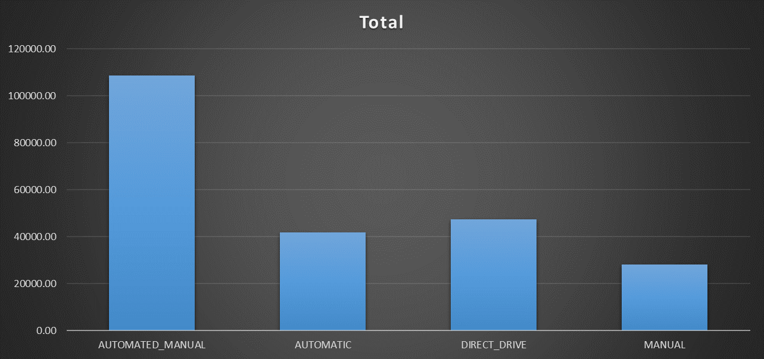
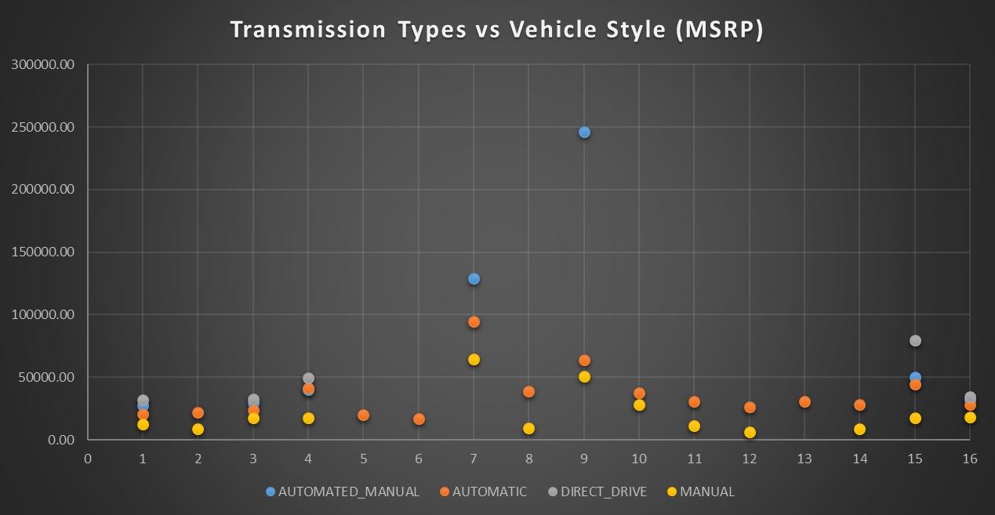
TASK 3 - How do the different feature such as transmission type affect the MSRP, and how does this vary by body style?

Slide 17
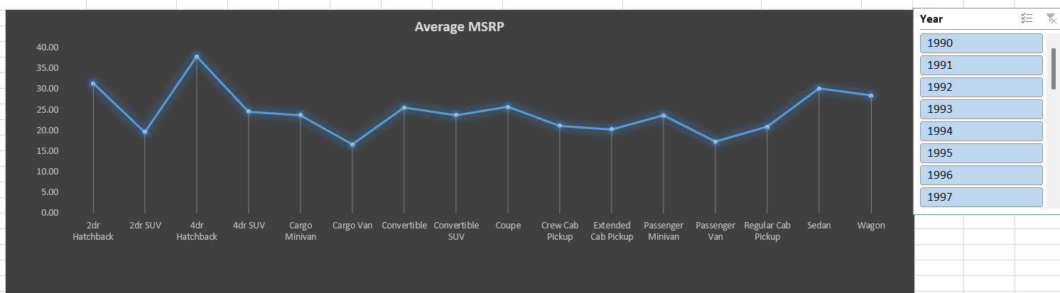
TASK 4 - How does the fuel efficiency of cars vary across different body styles and model years?

Slide 18
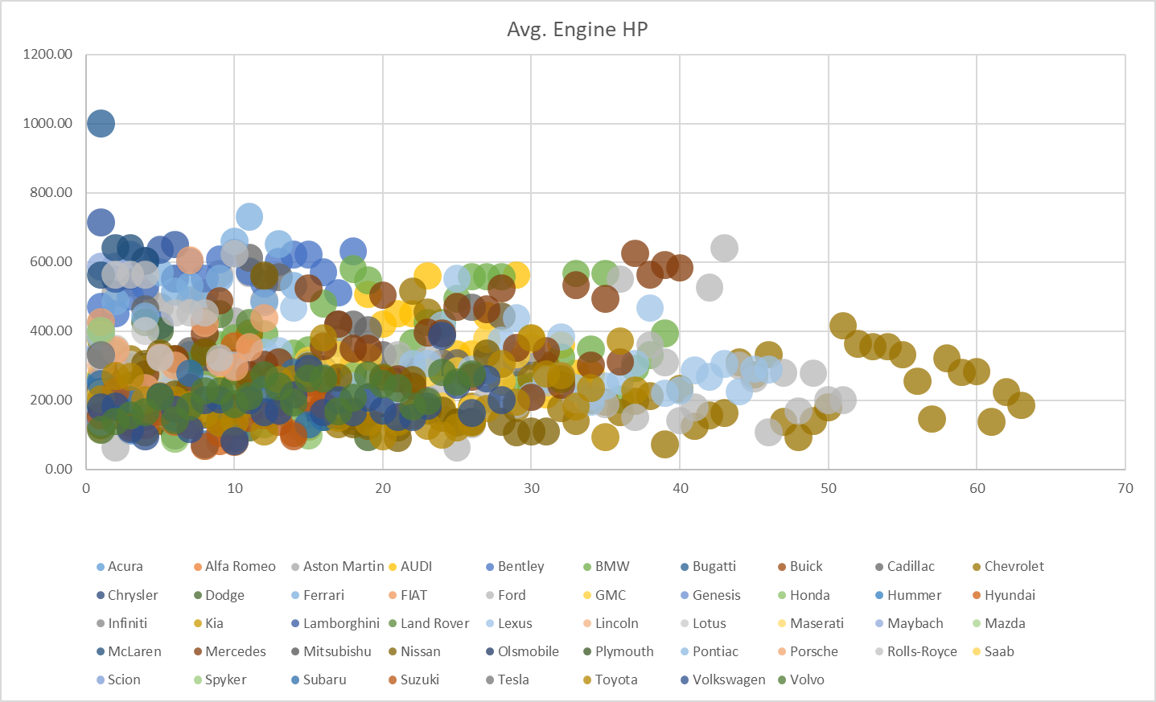
TASK 5 - How does the car's horsepower, MPG, and price vary across different Brands?

Slide 19
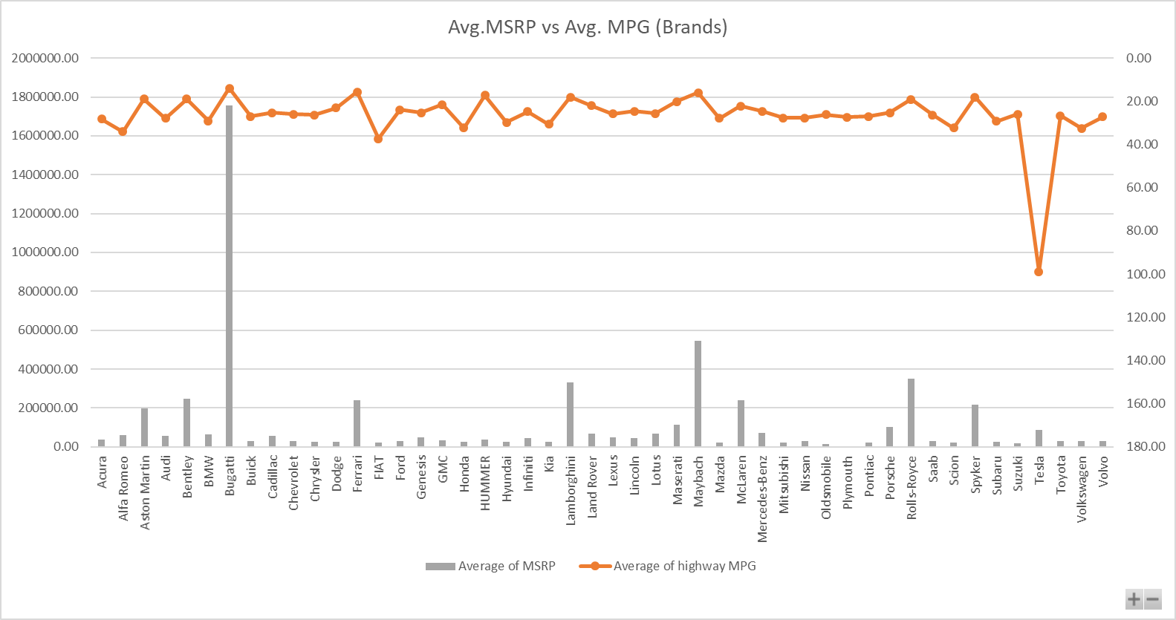
TASK 5 - Continue

Slide 20
Result
Helped me in understanding more about Car Data analysis, and how different factors can be dependent on other factors.
2) Increased understanding of Correlation
3) Gaining more knowledge of Scatter-Plots and bubble charts & understanding it’s importance and how to make it look more appealing.
4) Created a Dashboard which was interactive with the help of slicers & filter buttons for viewers.

Slide 21
THANK YOU
Note -> I couldn’t record Loom Video for more than 5 minutes, so I have used another online recorder, whose link i have provided in the VIDEO LINK while submitting.
Steps to watch my video - Click on the Video Link provided -> Then they will ask to Sign in, so if you are new then Sign in to the account -> after creating an account,you will be on the dashboard. -> Then again go back to my My VIDEO LINK and click it again, then it will load for 2 - 3 minutes, as it's a 30 minute video.
Video link - https://app.recorditor.com/recording/f0c8c9f493ee26b1396ce6c8487dfd660e6b86cfbce291f24a0424a7df67aae16df4cdda7537cf021f2ab4d33c5464022b80b7c5812e5d7a0f5a689524cf842c

