Slide 1
PROJECT 8
ABC Call Volume Trend Analysis
Rikin Correya

Slide 2
Project Description
This project focuses on analyzing Customer Experience (CX) data from an inbound calling team. There is a 23-day dataset that includes details like agent names, queue times, call times, durations, and call statuses (e.g., abandoned, answered, or transferred).
•In the given project we have to calculate the average call duration and total number of call per hour
•We had to propose a manpower plan required during each time bucket and reduce the abandon rate to 10%
* All the Files links are provided on Slide 5 after “Approach” Section. *

Slide 3
Tech_Stack used
MS Excel
It was used in order to open the .csv file, cleaning the data and then applying statistical functions on the useful data to analyse, as well as a very important tool in order to draw insights out of the data in form of tables and charts.
It was also used to prepare interactive Dashboards, for easy visualization and understanding of the insights.
Google Slides
It was used to prepare the report and to document all the insights of different tasks of the project.

Slide 4
Approach
1
2
3
4
Data Cleaning and understanding the data set.
(All NULL values were replaced with #N/A, because categorical values were missing.)
Understanding the tasks, and figuring out the important columns to work with
Making Pivot Tables, and using formulas to find out different relevant numerical values for the respective tasks.
Making Charts and Graphs for better visualization and results.

Slide 5
Links to Files
Note - Its a .xlsx file format, hence you may see certain things not shown properly if you open it on google sheets. So it’s recommended to download the file and open it in Excel.
Final Dataset & Insights -
https://docs.google.com/spreadsheets/d/1qrLFbJjd1uP0TavGJHd2XW-B-Sggtaqp/edit?usp=sharing&ouid=109416836118642236108&rtpof=true&sd=true
Video Presentation -
https://app.recorditor.com/recording/5145939fb6bceb3c4ad078fc5d0bb19ed16302719e387df234024739280e0fd17aff0f2f0f09ac9308e4329fd62e62bb698b587653122bdb0bd2820723f1a41e
Note -> I couldn’t record Loom Video for more than 5 minutes, so I have used another online recorder, whose link i have provided in the VIDEO LINK while submitting.
Steps to watch my video - Click on the Video Link provided -> Then they will ask to Sign in, so if you are new then Sign in to the account -> after creating an account,you will be on the dashboard. -> Then again go back to my My VIDEO LINK and click it again, then it will load for 2 - 3 minutes, as it's a 20 minute video.
I couldn’t download the Video Presentation as I have to pay for it, hence only link can be used to watch it. Sorry for the inconvenience.

Slide 6
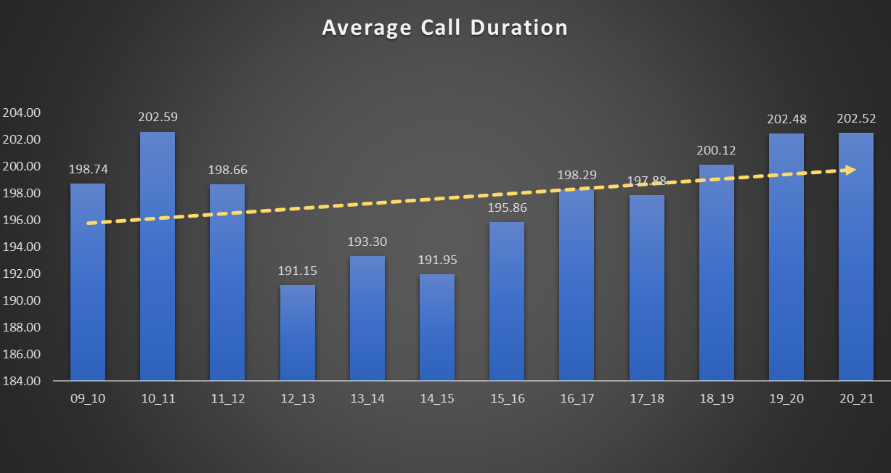
Insights
TASK 1 - Average Call Duration - Determine the average duration of all incoming calls received by agents. This should be calculated for each time bucket.

Slide 7
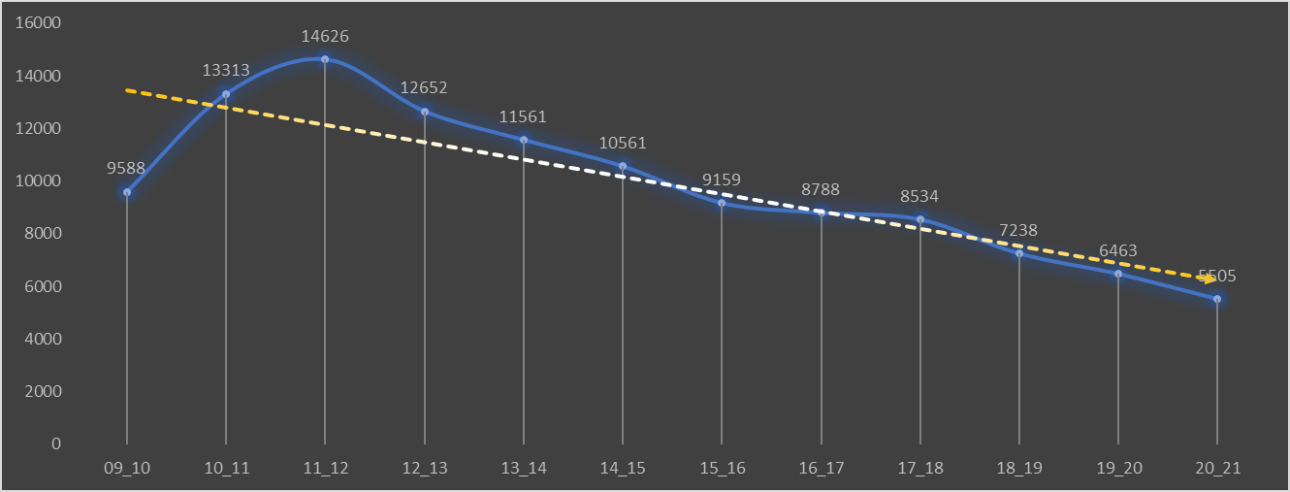
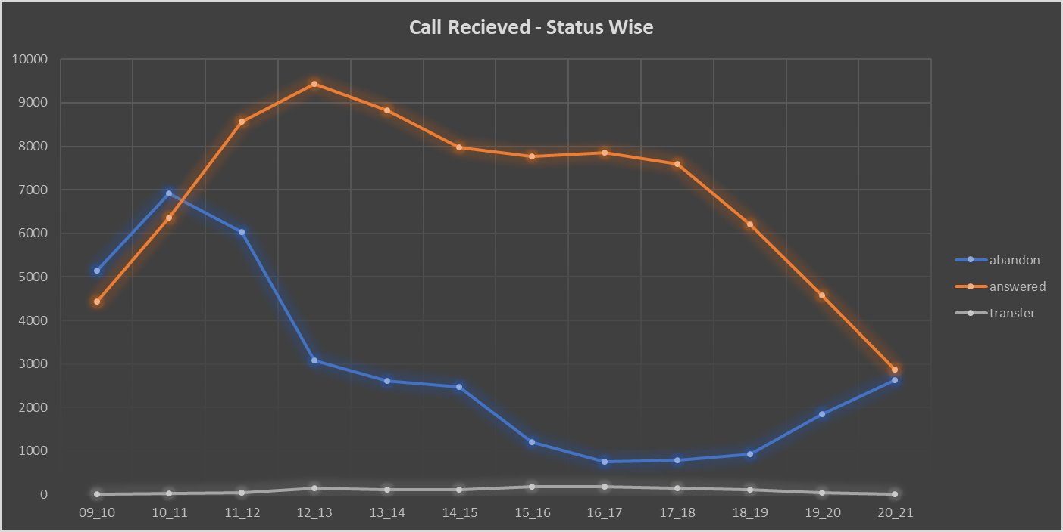
TASK 2 - Call Volume Analysis - Visualize the total number of calls received. This should be represented as a graph or chart showing the number of calls against time. Time should be represented in buckets

Slide 8
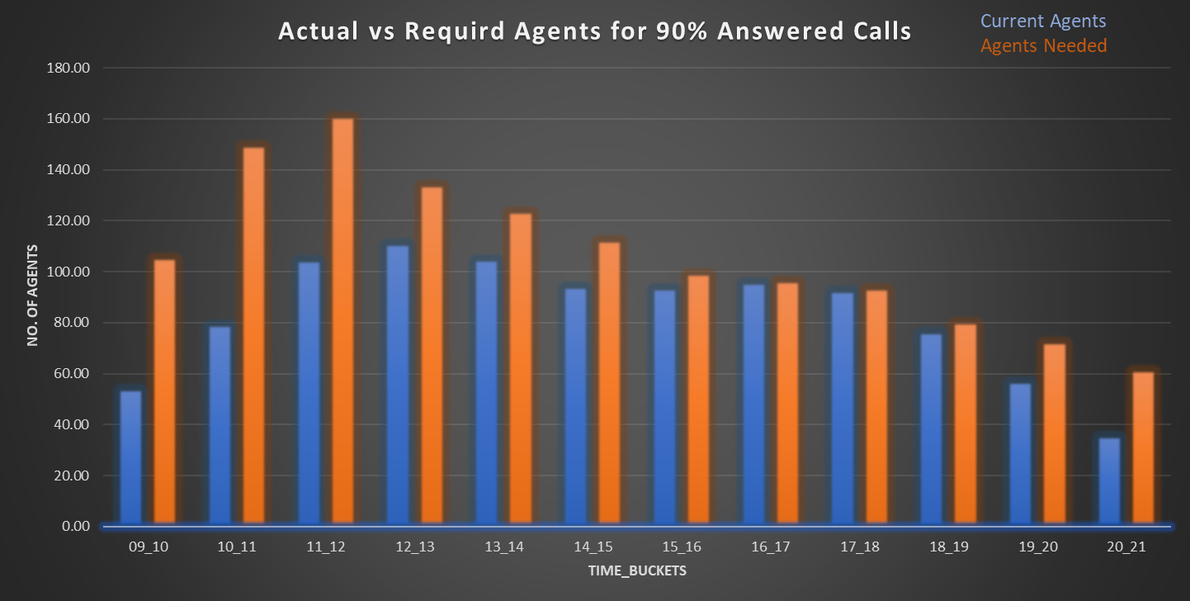
TASK 3 - Manpower Planning - The current rate of abandoned calls is approximately 30%. Propose a plan for manpower allocation during each time bucket (from 9 am to 9 pm) to reduce the abandon rate to 10%.

Slide 9
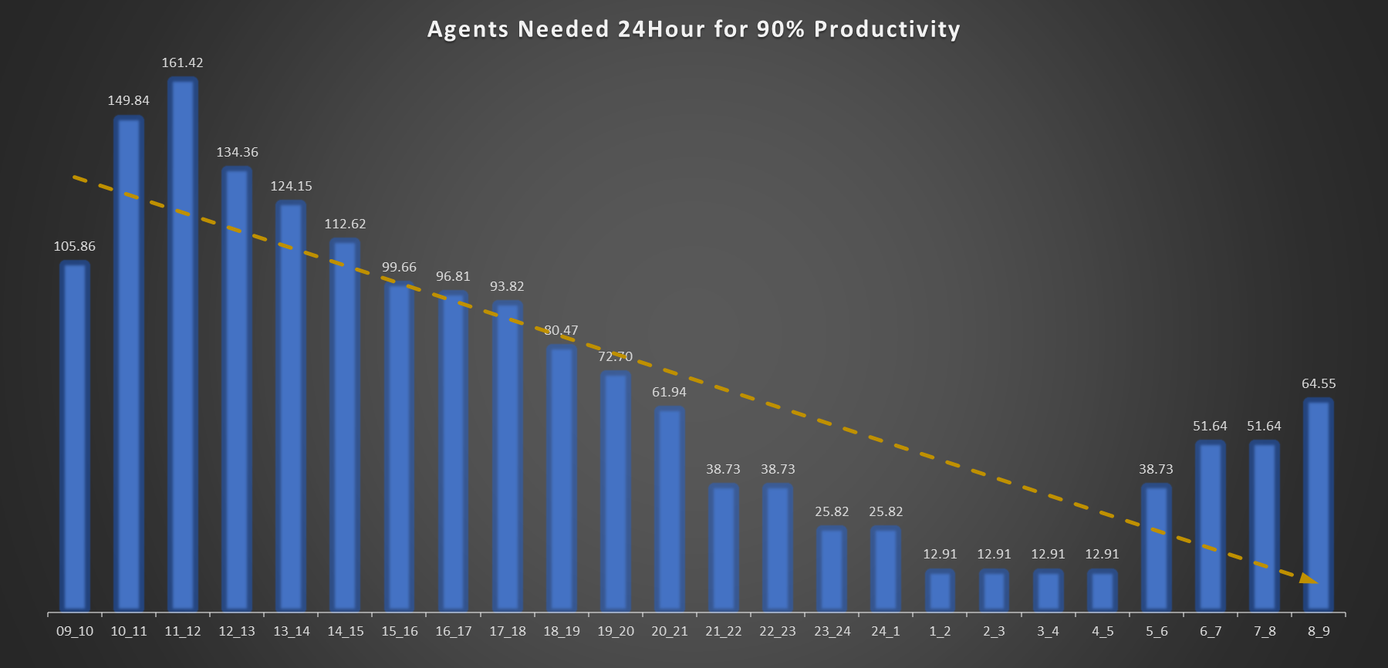
TASK 4 - Night Shift Manpower Planning - Customers also call ABC Insurance Company at night but don't get an answer because there are no agents available. This creates a poor customer experience. Assume that for every 100 calls that customers make between 9 am and 9 pm, they also make 30 calls at night between 9 pm and 9 am. The distribution of these 30 calls is as follows:

Slide 10
Result
The project helped in understanding how to analyse call centre data and make effective insights
The project helped in giving a glimpse of a high stake problem where customer satisfaction and profitability needs to be kept in mind along with how the jobs of people are in balance.
Understanding importance of the role of CX Team to improve the productivity of a business indirectly through customer experience satisfaction.
Further understanding of Pivot Tables and better Visualization.

Slide 11
THANK YOU
Note -> I couldn’t record Loom Video for more than 5 minutes, so I have used another online recorder, whose link i have provided in the VIDEO LINK while submitting.
Steps to watch my video - Click on the Video Link provided -> Then they will ask to Sign in, so if you are new then Sign in to the account -> after creating an account,you will be on the dashboard. -> Then again go back to my My VIDEO LINK and click it again, then it will load for 2 - 3 minutes, as it's a 20 minute video.
Video link - https://app.recorditor.com/recording/5145939fb6bceb3c4ad078fc5d0bb19ed16302719e387df234024739280e0fd17aff0f2f0f09ac9308e4329fd62e62bb698b587653122bdb0bd2820723f1a41e

