Slide 1
PROJECT 4
Hiring Process Analytics
Rikin Correya

Slide 2
Project Description
To analyse the given data and record of the previous hires for the employees and their rejections, interviews, job positions, departments and so on. Using statistical formulas and analysing techniques, providing a report of different tasks to the hiring team which helps them understand the past and current hiring scenarios.
-> Excel file link - https://docs.google.com/spreadsheets/d/1nLNAZtVsFaK57hhi7_AAPgpwbL85li-q/edit?usp=drive_link&ouid=109416836118642236108&rtpof=true&sd=true
Note - Its a .xlsx file format, hence you may see certain things not shown properly if you open it on google sheets. So it’s recommended to download the file and open it in Excel.

Slide 3
Tech_Stack used
MS Excel
It was used in order to open the .csv file, cleaning the data and then applying statistical functions on the useful data to analyse, as well as a very important tool in order to draw insights out of the data in form of tables and charts.
Google Slides
It was used to prepare the report and to document all the insights of different tasks of the project.

Slide 4
TASK A - Determine the gender distribution of hires
Approach
Created a pivot table and added the required parameters and filtered by “HIRED” to create the necessary data and then created column graph using the output data.
We can also do the following without the help of Pivot table and just formulas. Formula used => Male Hired - =COUNTIFS(D:D, "Male", C:C, "Hired") (Similarly for females)
In order to handle blanks, I followed these steps -
Filtered out blank cells in gender, got a total of them by using COUNT.
Then got the percentage ratio of MALES, FEMALES, and DON’T WANT TO SAY from the non-blank record.eg Male (54.68%), Female(39.6%), Don’t want to say (5.72%)
Then divided the total blank cells as per the ratio. Eg - Total was 10 blank, hence Male(54.68 percent of 10) similarly for female and don’t want to say, hence getting Male(5), Female(4), Don’t want to say (1) .
Then added the divided genders to the already existing data.

Slide 5
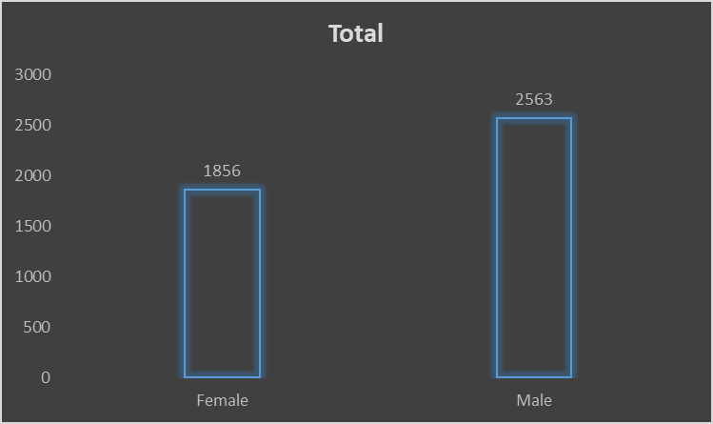
Insight
Without handling Blanks
Male - 2563
Female - 1856
After Handling Blanks
Male - 2568
Female - 1860
We can observe that the amount of Males hired are significantly more than the females hired.
The number of male applicants are also higher than female, hence more rejection and hiring numbers for males.

Slide 6
TASK B - Determine the the average salary offered by this company
Approach
We can also do the following with just a formula. Formula used => = AVERAGE(G:G)
In order to handle outliers, I used the Z-Score method and followed these steps -
Used the =STDEV to find the standard deviation of the salary column.
Created a column for Z-Scores for the salary using formula =(salary - average) /standard_deviation
Those salary having Zscore more than 3 and less than -3 are traditionally marked as an OUTLIER.
Obtained average of the salaries excluding the OUTLIERS. (used to replace the OUTLIER’s Salary)
Created another column named “Corrected Salary” , and used the formula using IF Condition. =if(Zscore>3 or Zscore<-3 then replace it with the average salary calculated without outliers, else let it be the previous salary)
Note -> I have used the average to replace the outliers, so that the outliers don’t affect that much on the average of the salary, as 2lakh, 3lakh and 4lakh were very out of the range.

Slide 7
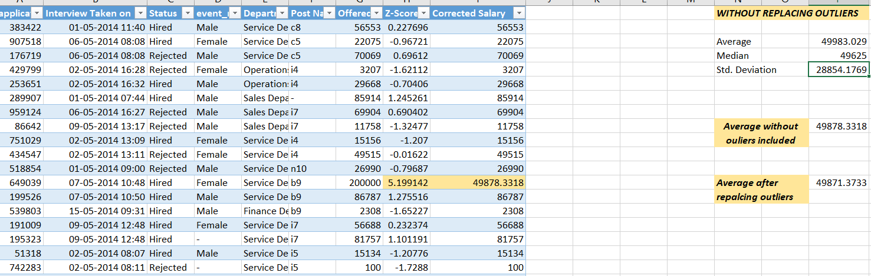
Insight
As we replaced the outliers with Average, there has been not much difference in the AVERAGE calculated after replacing the outliers.
If we had replaced the outliers with the closest Z-score possible value, then the AVERAGE would have increased, as this is a right-skewed salary data.
I have purposely used Average to replace, because if there is even a thought of considering these salaries as outliers then it should be handled as average of others which are very less, using the closest Z-score doesn’t make any sense, better than that would be to just consider it as NOT AN OUTLIERS because these salaries are possible if the employee has great experience and qualifications

Slide 8
TASK C - Create class intervals for the salaries in the company
Approach
We can do the following with just a formula. Formula used => =COUNTIFS(G:G,">=0",G:G,"<10000") similarly different class intervals like >=10000 and <20000, etc.
Then after creating intervals and counting the no. of employees with their salary in the range, we can use that table to create a Histogram Chart.
-> In order to handle outliers, we can use the same Z-Score method as previous task and then replace the salaries and add them to their respective salary intervals.

Slide 9
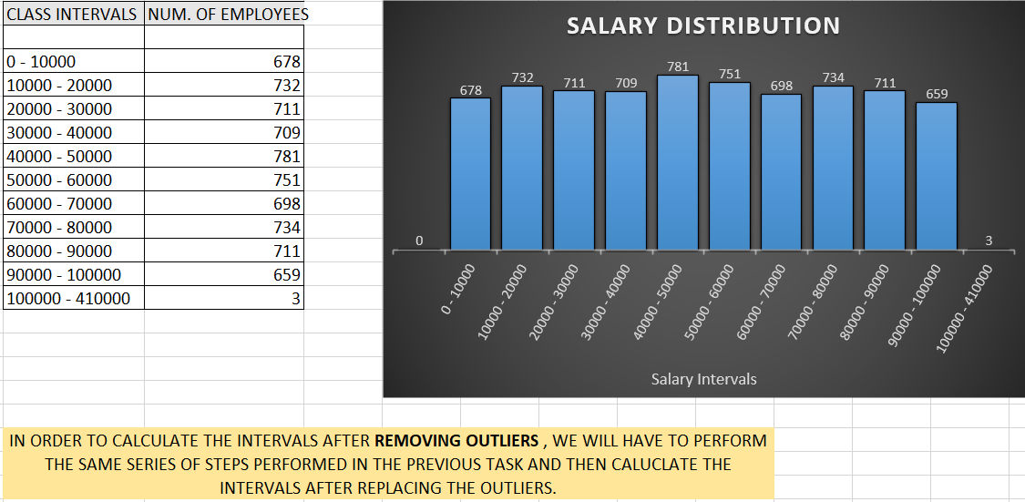
Insight

Slide 10
TASK D - To show the proportion of people working in different departments
Approach
First i made a pivot table, in which I included the column APPLICATION_ID in values to count the number of employees, then I added the STATUS in filter in order to filter the employees which are HIRED. Finally also used the department column in rows,in order to segregate the number of employees in different departments.
Moving ahead, I created a pivot chart (Pie of Pie type) using the pivot table created, and adjusted all the data for better visualization.
-> Also added the %of total employees column in the pivot table, for better understanding of proportion of hired employees in each department.

Slide 11
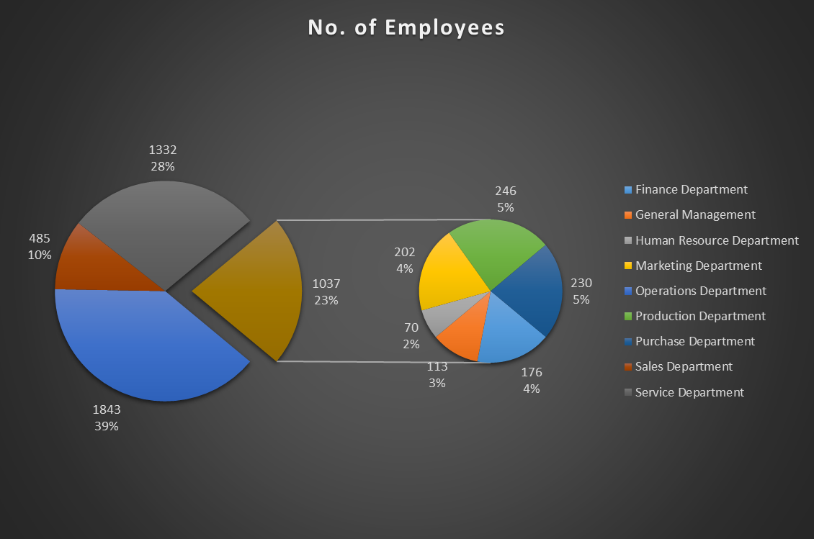
Insight

Slide 12
TASK E - To represent the different position tiers within the company
Approach
First i made a pivot table, in which i counted the application_id, and then filtered only the HIRED employees , and finally segregated all the employees as per their position in the organization.

Slide 13
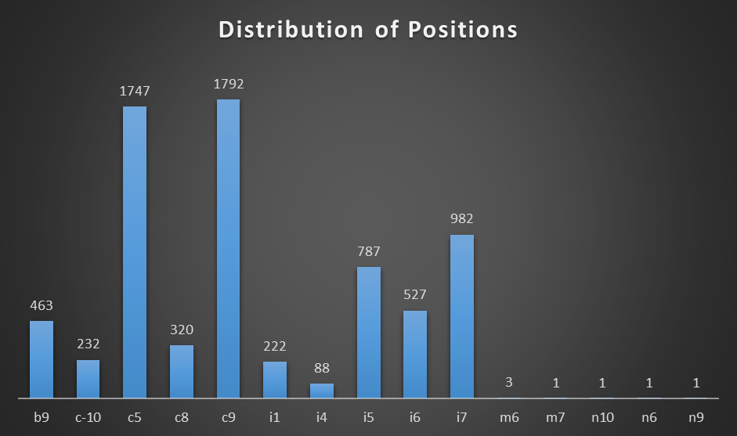
Insight

Slide 14
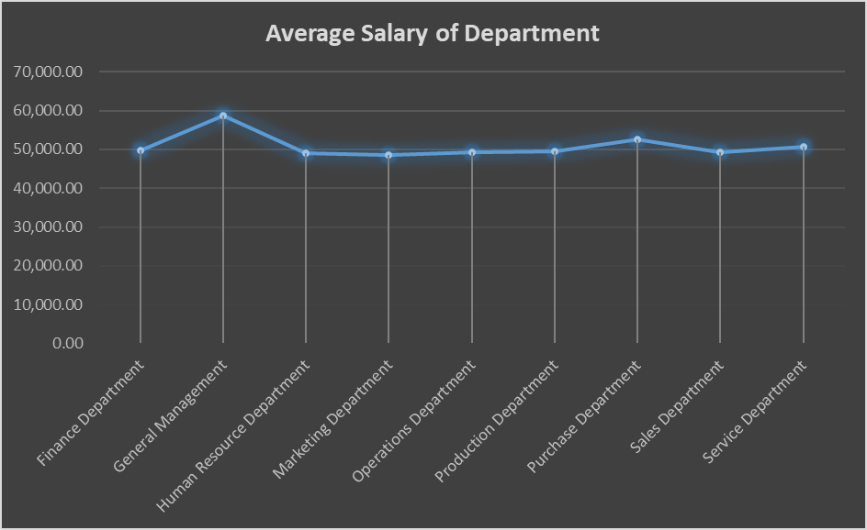
Some more Analysis & Visualization
Department Wise Average salary of employees.
The highest paid employees work in the General Management Department.
All other departments average salary are mostly the same.

Slide 15
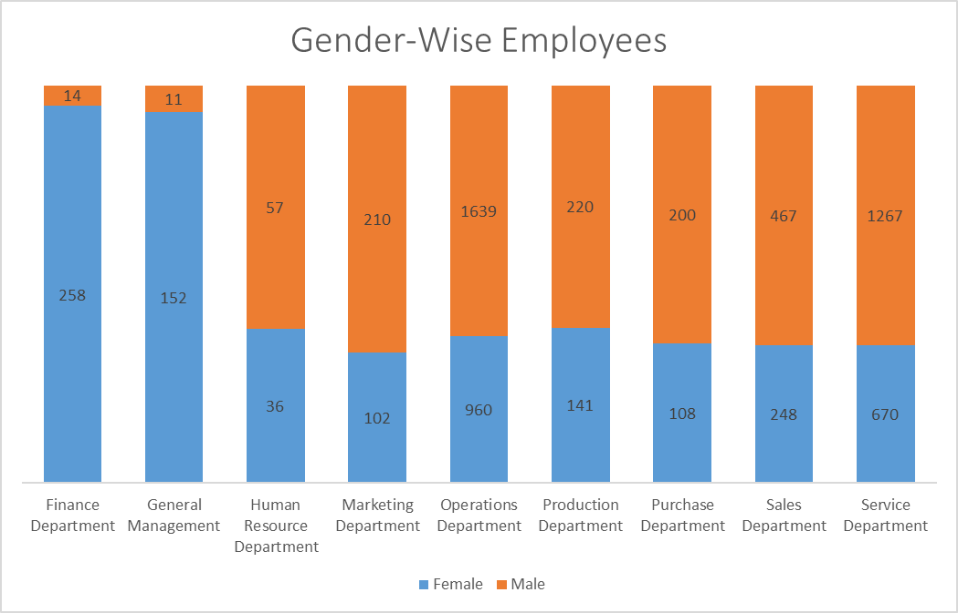
Some more Analysis & Visualization
Gender Wise proportion of employees working in each department.
The lowest amount of females works in Finance Department and General management, the ratio of male to female is the lowest as well in these two departments.

Slide 16
Result
The project has helped me gain insights and has increased knowledge in using FORMULAS in Excel.
Got introduced to use statistical functions such as Z-Score method to detect outliers in real-time data.
Helped in utilising more detailed elements of different charts using pivot table and understanding them and its usage.

Slide 17
THANK
YOU

