Slide 1
PROJECT 2
Instagram User Analytics
Rikin Correya

Slide 2
Purpose
This project has 2 sections -
Marketing Analysis - Analyzing data of Instagram users in order to find and understand how the users interact with the social media platform and how to market different Advertisements to the users.
Investor Metrics - Analyze data to understand user behaviour on the platform and to help investors gain insights of the platform’s growth and performance.

Slide 3
Approach
Tech-Stack Used
Creating a database using SQL queries and creating a database and entering values in the schemas.
Using SQL queries in order to analyse the Instagram User database by extracting the needful information from the database, and finding some insights from marketing and investing point of views.
Preparing a final report of all the extracted information for easy presentation.
MySQL Servers and Workbench 8.0 .
The above software is the easiest and the most comfortable platform for simple extraction of data from database using queries. It’s also economical and quite efficient on windows.

Slide 4
Insights
This Instagram user analytics project helped me to explore SQL in better depth and enhanced my understanding of complex queries work and how to cultivate meaningful business insights from given data . It enabled me to ask the right necessary questions and pinpoint the required solutions effectively to the given problems.

Slide 5
Results
Following query statements are the ones I executed to extract the required data from the database and get results.
All the different questions in both sections were answered correctly from the database. Different subqueries and joins along with aggregate functions have been used to analyse the selected data for the tasks.
Note - The heading of the Task is given along with the query used. A more easy to understand query indentation is shown in the screenshots provided below it, which also shows the Output of the query as well as detailed Tasks explanation.

Slide 6
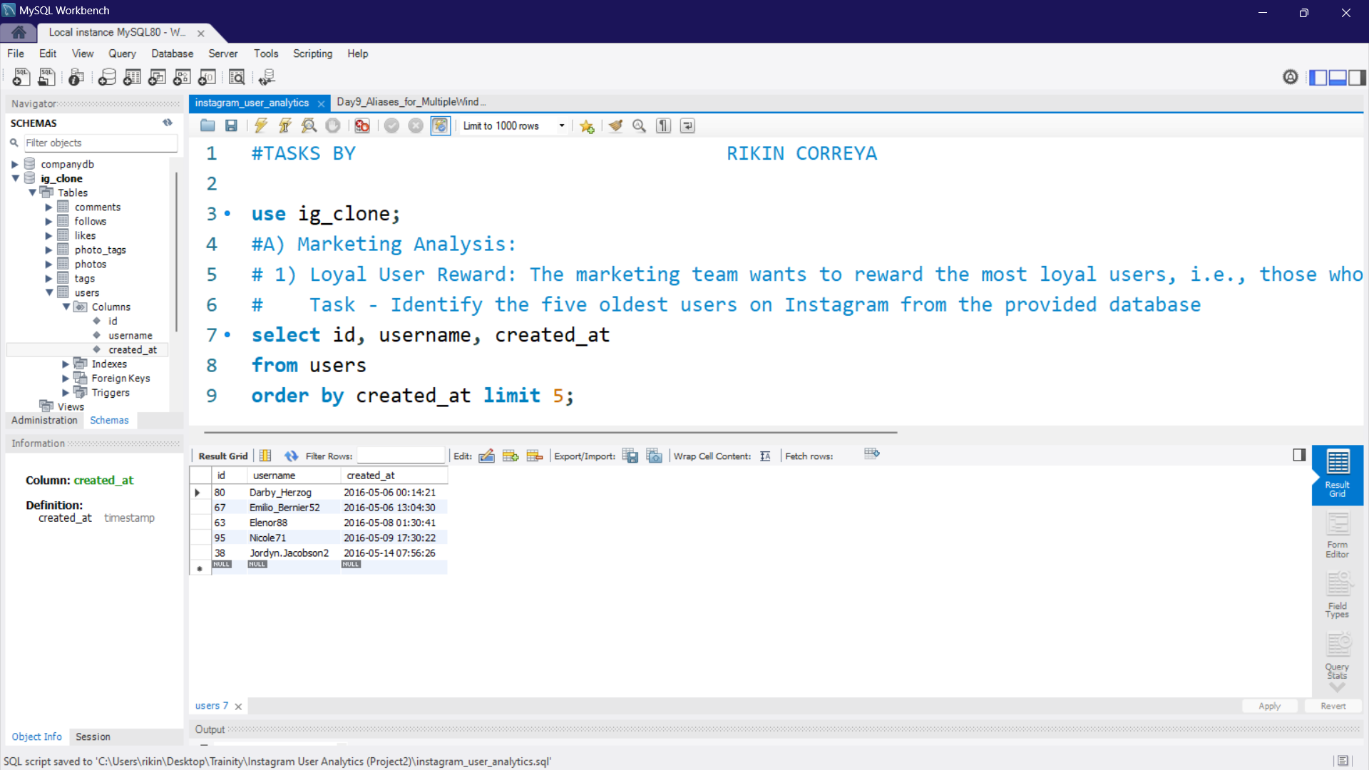
Marketing Analysis
1) Loyal User Award
Query used - select id, username, created_at from users order by created_at limit 5;

Slide 7
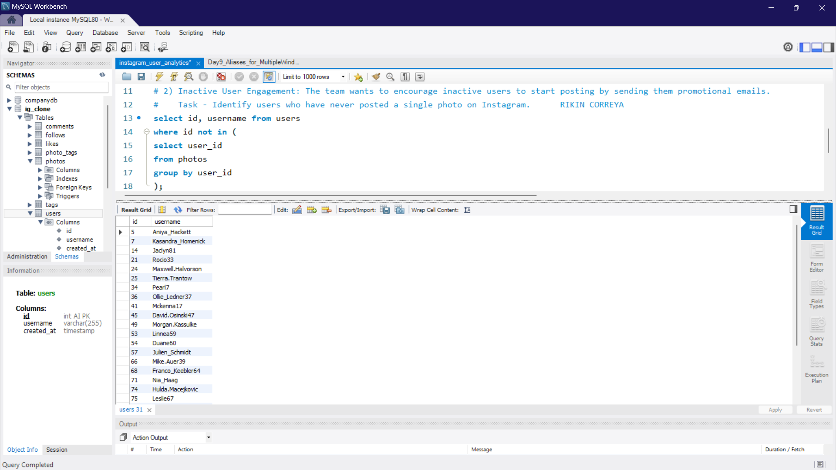
2) Inactive User Engagement
Query used - select id, username from users where id not in (select user_id from photos group by user_id);

Slide 8
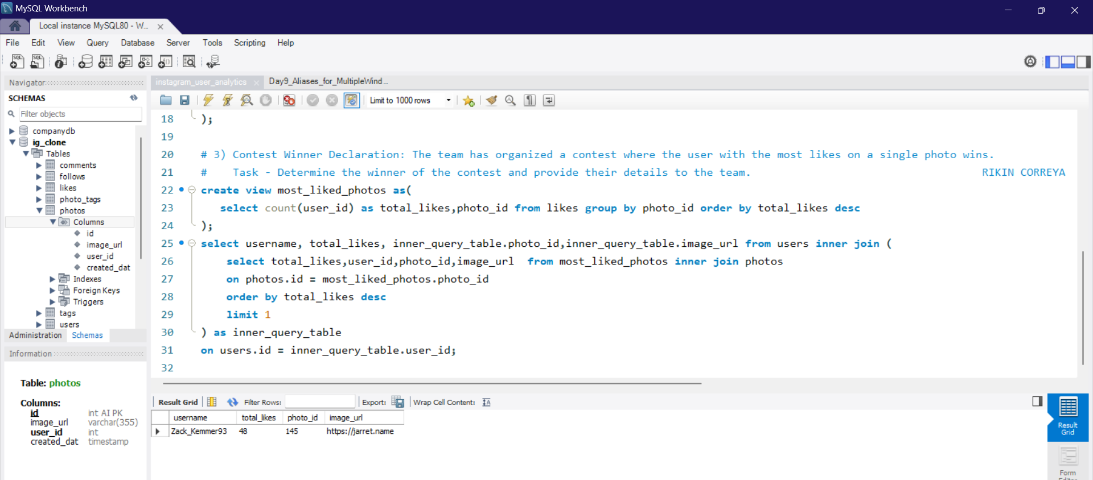
3) Contest Winner Declaration
Query used - create view most_liked_photos as(select count(user_id) as total_likes,photo_id from likes group by photo_id ); select username, total_likes, inner_query_table.photo_id,inner_query_table.image_url from users inner join (select total_likes,user_id,photo_id,image_url from most_liked_photos inner join photos on photos.id = most_liked_photos.photo_id order by total_likes desc limit 1) as inner_query_table on users.id = inner_query_table.user_id;

Slide 9
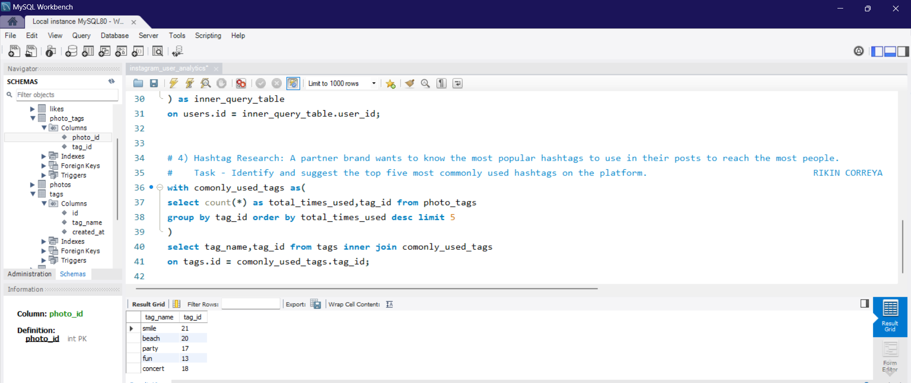
4) Hashtag Research
Query used - with comonly_used_tags as(select count(*) as total_times_used,tag_id from photo_tags group by tag_id order by total_times_used desc limit 5) select tag_name,total_times_used from tags inner join comonly_used_tags on tags.id = comonly_used_tags.tag_id;

Slide 10
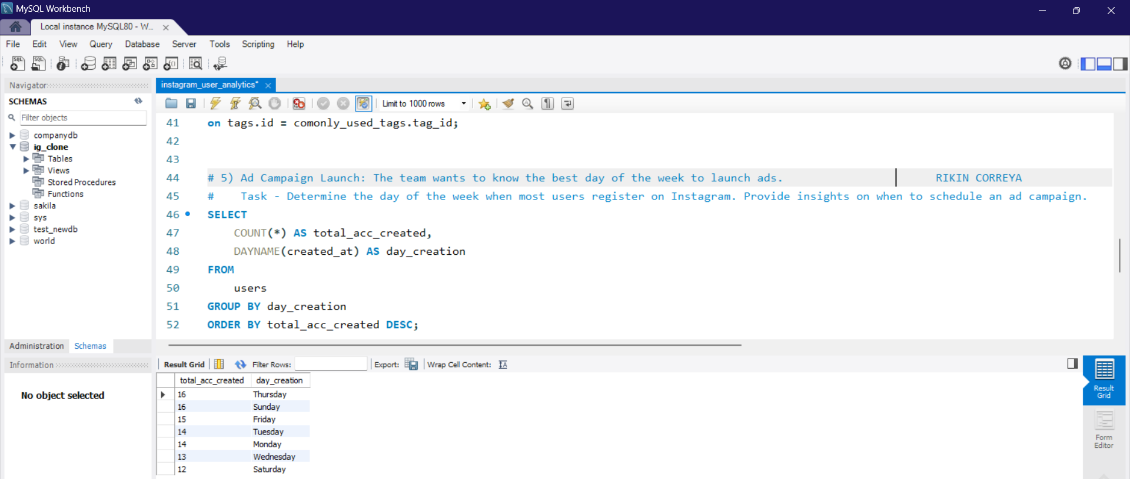
5) Ad Campaign Launch
Query used - SELECT COUNT(*) AS total_acc_created, DAYNAME(created_at) AS day_creation FROM users GROUP BY day_creation ORDER BY total_acc_created DESC;

Slide 11
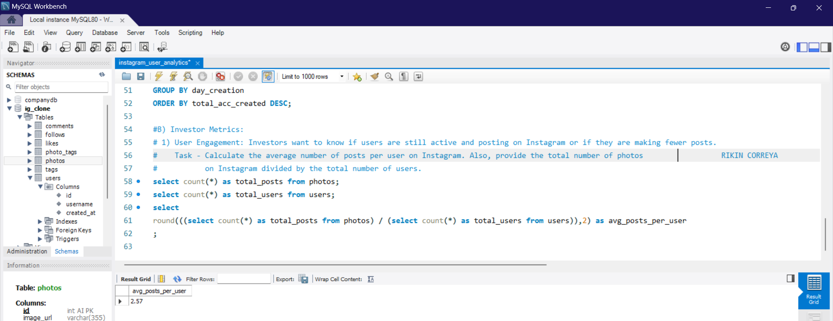
B) Investor Metrics
1) User Engagement
Query used - select round(((select count(*) as total_posts from photos) / (select count(*) as total_users from users)),2) as avg_posts_per_user;

Slide 12
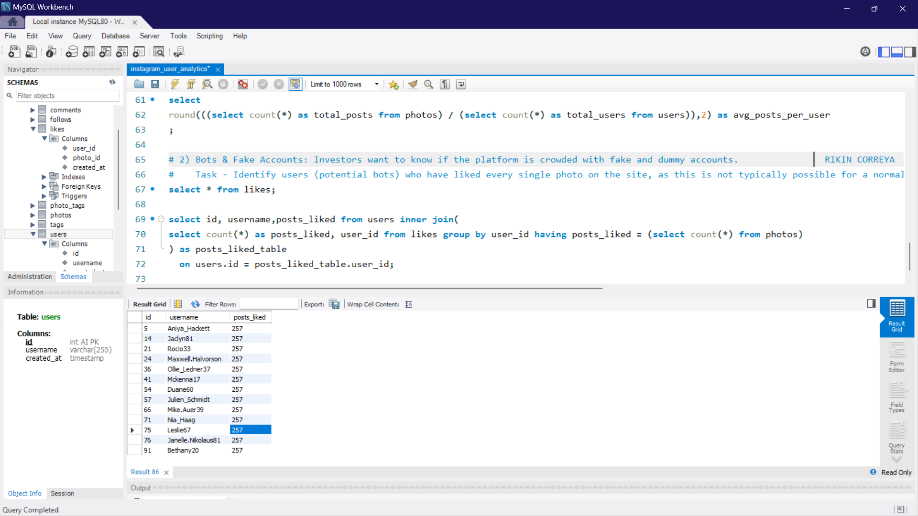
2) Bots & Fake Accounts
Query used - select id, username,posts_liked from users inner join(select count(*) as posts_liked, user_id from likes group by user_id having posts_liked = (select count(*) from photos)) as posts_liked_table on users.id = posts_liked_table.user_id;

Slide 13
Thank You

