Slide 1
PROJECT 3
Operation Analytics and Investigating Metric Spike
Rikin Correya

Slide 2
Project Description
This involves understanding and explaining sudden changes in key metrics, such as a dip in daily user engagement, weekly/monthly user analysis, growth of certain aspects,etc in a company’s database.
This project involves 2 parts -
Given is a job_databse in which all data of users reviewing certain jobs, how long and the language they reviewed in, what action they took for that job post, date of reviewing,etc is provided and I have to analyse various operational metrics which would be useful for company’s betterment.
Given are 3 related databases from which we have to investigate metric spikes such as user engagement, weekly uses, weekly growth and engagement , devices used, etc are determined.

Slide 3
Tech_Stack used
MySQL Servers and Workbench 8.0 .
The above software is the easiest and the most comfortable platform for simple extraction of data from database using queries. It’s also economical and quite efficient on windows.
MS Excel
It was used in order to open the .csv files and cleaning the raw data and then importing the useful data to MySQL Database, as well as very important tool in order to draw insights out of the queried data in form of tables and charts.
Google Slides
It was used to prepare the report and to document all the insights of different tasks of the project.

Slide 4
Approach
Part 1
For the first part, I curated all the data gathered in an excel file and entered it into a created database in MySQL Server, making sure that no blank entries are entered and keeping the DATE column in TIMEDATE datatype for ease in analysing, and lastly analysed the data for different tasks using Advanced SQL Queries.
Part 2
For the second part, the collected data were in 3 different .csv formats and were very huge to manually load, hence proceeded to clean the data by deleting the blank entries in MS Excel itself, and then following a set of code in order to import all the data to MySQL database, and then using SQL commands such as ALTER, UPDATE,CHANGE,etc made sure that all the date and time columns were in TIMEDATE datatype in order to perform errorless analysis. After cleaning the data and curating it, i moved forward by using SQL queries in order to complete several tasks.

Slide 5
Insights
The insights and the Queries starts from the next slide.
Showed in the following order -
Query, Approach, Insights
Sql Query screenshots with output
Graphs, Charts and Tables if needed for more information

Slide 6
PART 1
Task A
Query = select count( distinct job_id) / (sum(time_spent)/3600) as jobs_reviewed_per_hour, date(ds) as November_Date from job_data where month(ds)=11 group by date(ds) order by jobs_reviewed_per_hour; select distinct date(ds), dayname(ds) from job_data;
Approach = Selected the job_data table, then filtered out just the November month out of the data, then grouped it by different dates of November and then selected date column and made another column by using AGG FUNCs in order to first count total number of distinct jobs reviewed on that date and dividing it by total time spent by all the users reviewing different jobs on the platform on that same date.
-> Also added another column using DAYNAME, hence making it easy to understand which DAYS of the November provides highest job reviewed per hour.
Insights - We can observe by the output that, WEEKENDS are the most traffic time, what is Saturday (28 Nov) and Sunday (29 Nov), while the least user interaction day is Friday (27 Nov).

Slide 7
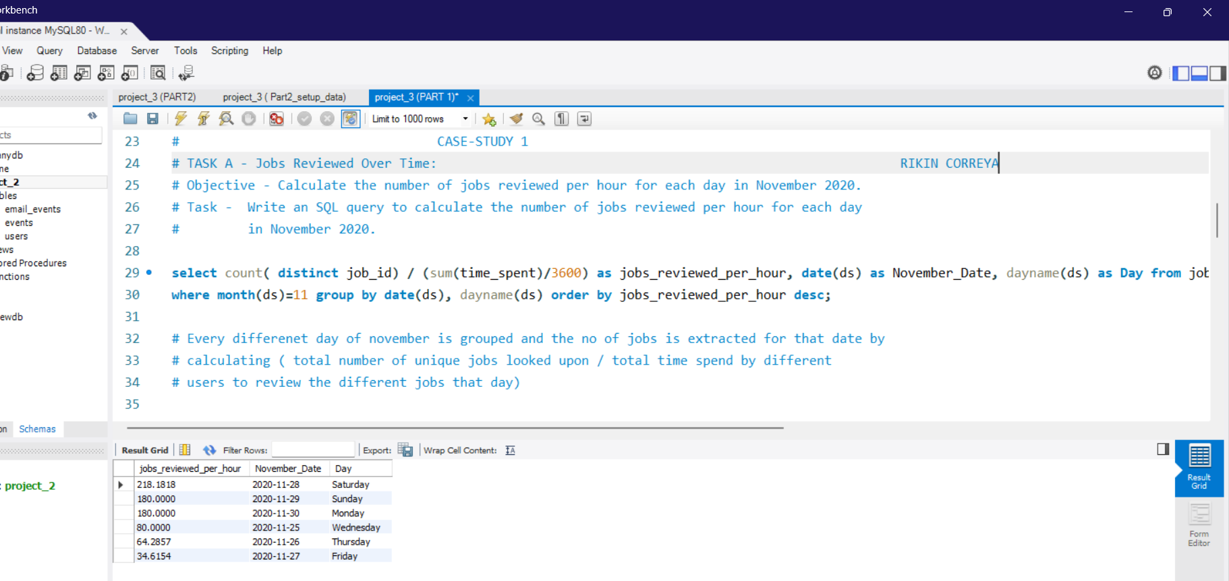
Task A - Screenshot

Slide 8
PART 1
Task B
Query = with throughput as(select round(count( event ) / (sum(time_spent)),3) as events_per_second, ds from job_data group by ds),rolling_average_throughput as( select ds, events_per_second, round(avg(events_per_second) over ( order by ds rows between 6 preceding and current row),3) as rolling_average_7days from throughput)select ds,events_per_second, rolling_average_7days from rolling_average_throughput;
Approach = We first a create a CTE named throughput ,in which we query to get the EVENTS PER SEC for EVERY DATE, then we create another CTE which gives us the Rolling AVG using the OVER() Func and the throughput data which we obtained in the first CTE. Then finally we use SELECT to get all the necessary output from the 2nd CTE.
-> We could have gotten the result without using any CTEs and just one query but that doesn't look appealing and would be very complex to understand for someone with no SQL knowledge.
Insights = On the 27th there is a dip in throughput as we see the rolling_avg falling down but then onwards it keeps rising again.

Slide 9
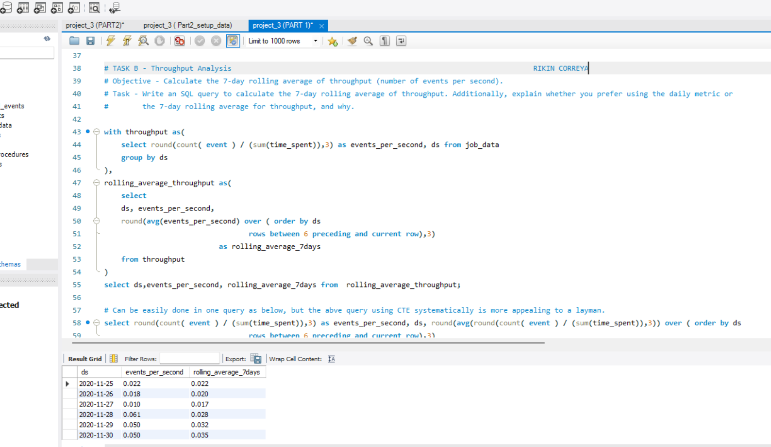
Task B - Screenshot

Slide 10
PART 1
Task C
Query = with total as (select ds, language , count(language) over() as t from job_data order by ds,language ),ratio_language_used as (select language , count(language)/t as tl from total group by language),percentage as (select language, round((tl*100),2) as p from ratio_language_used) select * from ratio_language_used;
Approach = The first CTE adds another column using OVER() which gives us total times jobs were reviewed in diff. languages, the 2nd CTE groups the jobs reviewed using LANGUAGES USED, then counts times each language was used and divides it by total we got from 1st CTE to obtain the ratio for each diff.language used, then final CTE just converts the ratio to percentage for ease of understanding.
-> In order for this query to work for the LAST 30 DAYS PARAMETER, as this data didn’t have 30 days I had COMMENTED OUT the WHERE CLAUSE in the 1st CTE (can see in the NEXT SLIDE) in order to clean unwanted query lines, if we un commnet it if needed, it will get filtered to the last 30 days.
Insights = We can see that Persian is the most used language for job reviews on the platform with a massie share of 37.5 % out of 6 different languages.

Slide 11
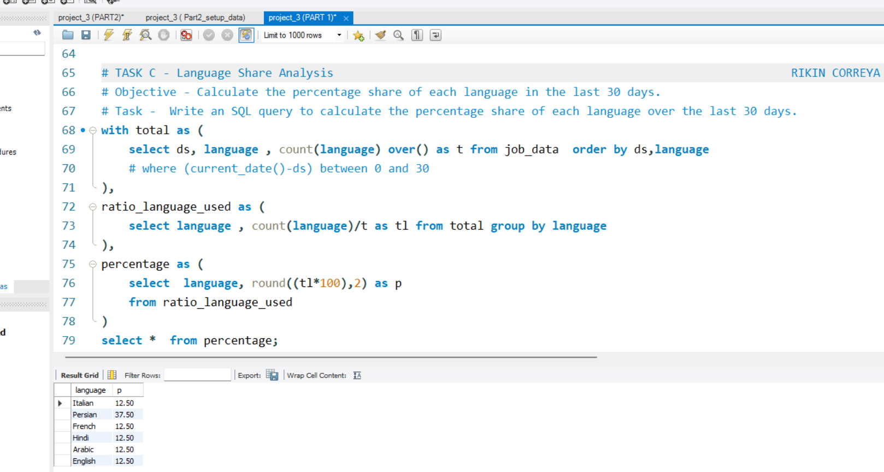
Task C - Screenshot

Slide 12
PART 1
Task D
Query = select * from (select *, row_number() over (partition by ds,job_id,actor_id,language,time_spent,org) as duplicate_rows from job_data) as a where duplicate_rows>1;
Approach = It’s a nested query in which, the inner query uses the ROW_NUMBER function with OVER() Clause and then ranks the rows by first grouping the data by each and every column, in this way if every column of any rows are DUPLICATE it would be given row_number 1,2, and so on, and if every column are not same then they are not duplicates, hence just gettin grow_number = 1 . After obtaining this, we just use an outer query which selects every column out of this inner query data but using a WHERE clause which asks for row_number>1, hence giving out just duplicate rows in the table.
-> in the data we have no duplicates, hence I have personally added one entry which is the duplicate entry of the last entry, in order to verify the query .
('2020-11-25', 20 , 1003 , 'transfer' , 'Italian' , 45 , 'C' )
Insights = The output has given us the row which was found to be exactly same as other row in the table, which is shown above.

Slide 13
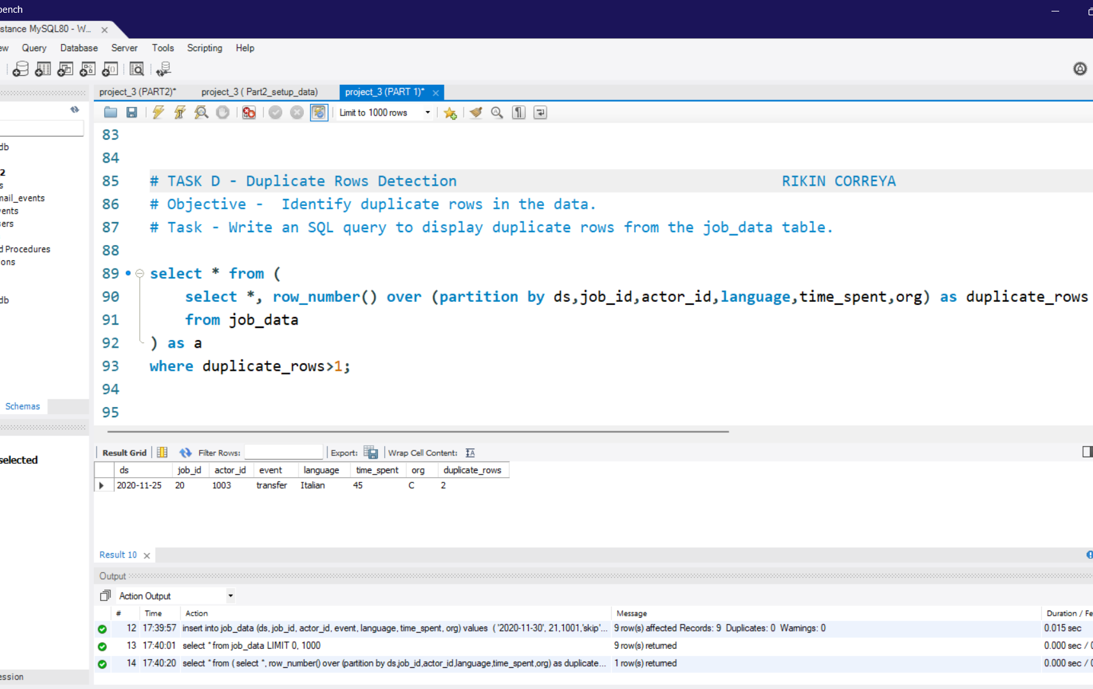
Task D - Screenshot

Slide 14
PART 2
Task A
Query = select count(event_name) as no_of_events, week(occurred_at) as week_no from events where event_type <> 'signup_flow' group by week_no;
Approach = We use the WEEK Func to get the WEEK No. of the occurred event, then group the selection by weeks of the data given and then count number of events in the divided weeks,and filtering out engagements which are NOT ‘Signup Flow’ as we need engagements on platform not signing up activity, hence finally giving us weekly user engagement.
Insights = 29th week of the year, has seen the highest number of engagements by the users, while the 17th and the 35th has the lowest as , 17th was the start of the platform with new years just SIGNING UP and 35th week has just a few days data.

Slide 15
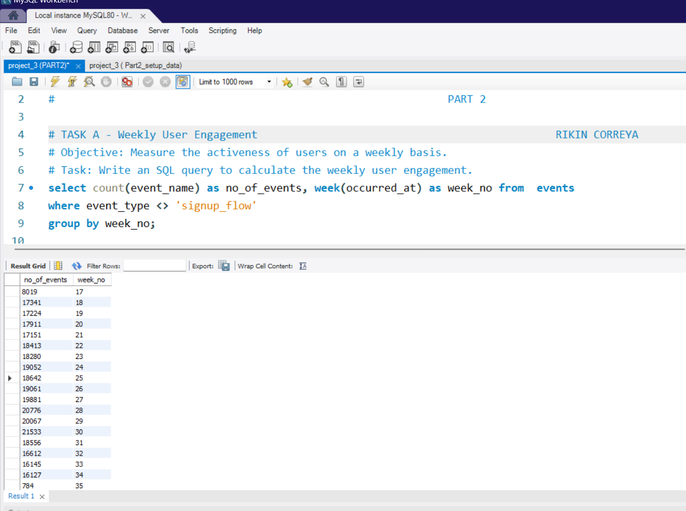
Task A - Screenshot

Slide 16
PART 2
Task B
Query = select month(created_at) as month_no, year(created_at) as year_created, count(user_id) as no_of_acc_created from users group by year_created, month_no ;
Approach = As we need how many users are being added to the platform, we use the users table. We use MONTH and YEAR function for create_at column, in order for better understanding of which months in different years have more users being signed up , and we obtain the number of users by using the COUNT function after grouping the users by month and year.
Insights = We can observe that there has been no signs of dips in number of users, except the THIRD month where Number of users fell to 150 from 160 monthly, other than that there has just been a gradual rise in number of users being signed up every month.

Slide 17
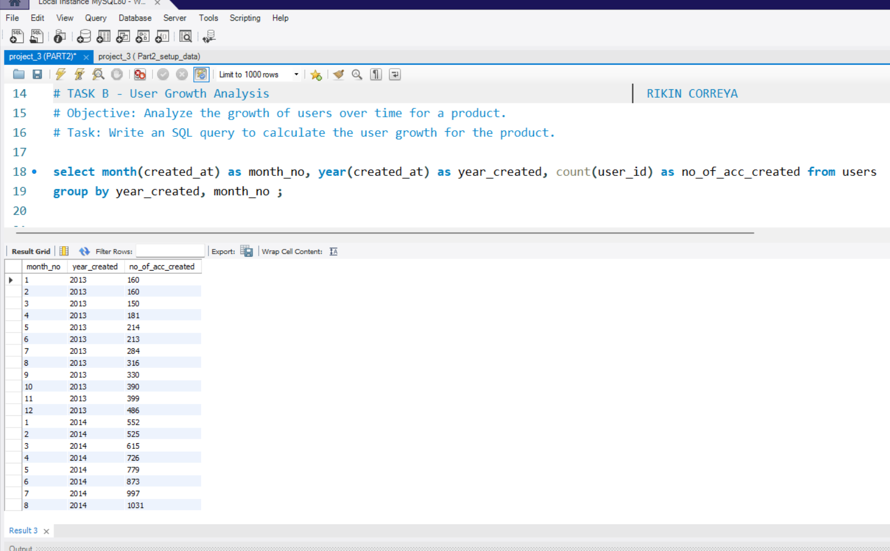
Task B - Screenshot

Slide 18
PART 2
Task C
Query =select distinct timestampdiff(week, a.activated_at, b.occurred_at) as week_period_after_signing_up , count(distinct a.user_id) as no_of_users_retended, round(count(distinct a.user_id)*100/lag(count(distinct a.user_id), 1) over(),2) as percentage_retained from (select user_id, activated_at from users) a inner join (select user_id, occurred_at from events) b on a.user_id = b.user_id group by week_period_after_signing_up order by week_period_after_signing_up ;
Approach = We join two tables users and events on their respective user_id and obtain created_at and occurred_at columns, and then we use this table as an inner nested query. The outer query uses the TIMESTAMPDIFF func with WEEK, which gives the week diff. between the USER’s acc. Created date and its EVENTS occurred date, and while grouping the data with this output we count the distinct USERS, hence obtaining different users having made at least one engagement after they signed up, along with the week users engaged.
-> I have also added an extra percentage column, which calculates percentage of users dropped or gained in comparison with the previous weeks retention, this provides an extra clarity of how much growth or drop has been noticed relative to a week before or after.
Insights = We notice that there is a drastic fall of almost 55% of users who engaged with the platform in the 2nd week after signing up, and the no. of users there onwards just keeps falling down, eventually ending at just 2 from 3772 on 86th week after signing up.

Slide 19
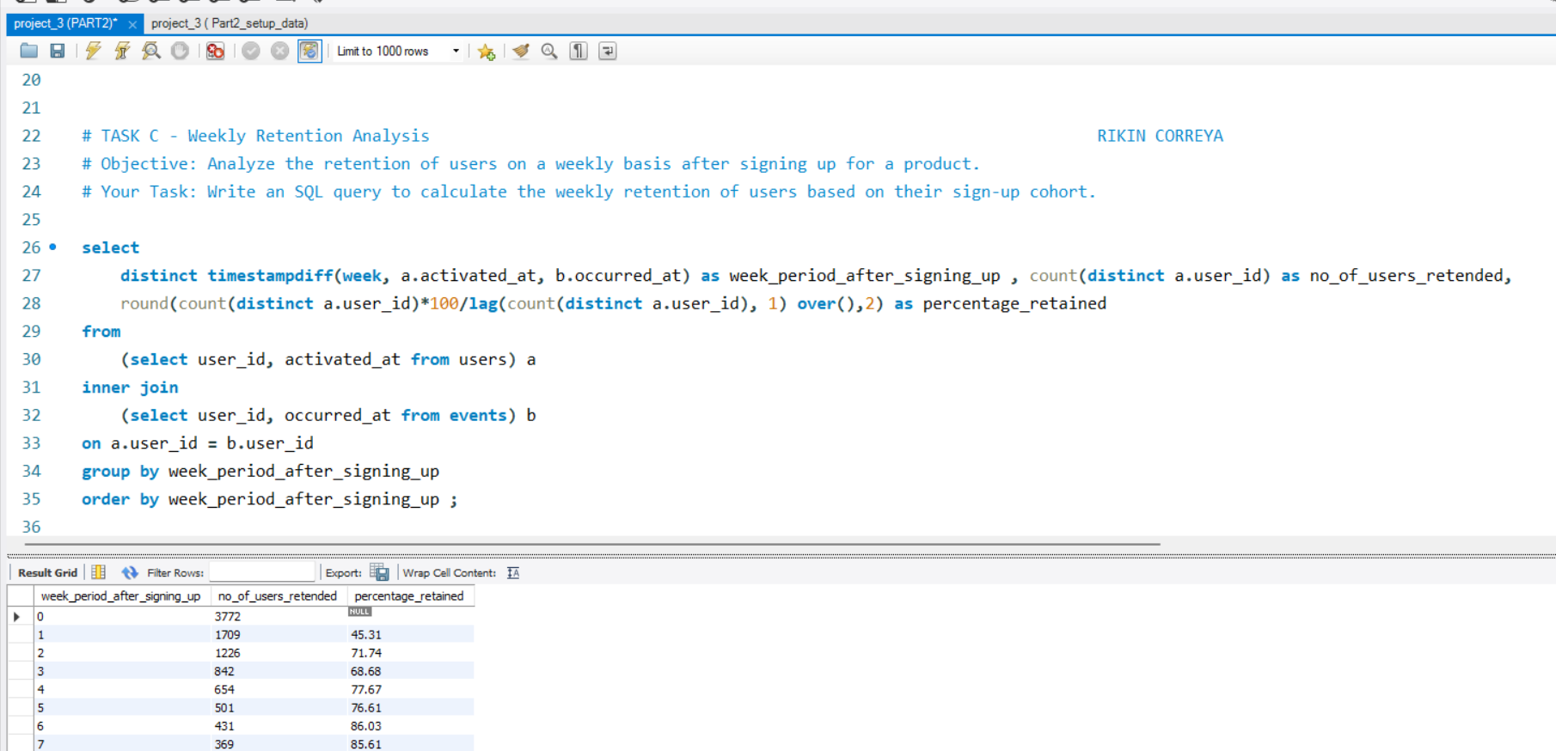
Task C - Screenshot (Raw Output table on next slide)

Slide 20
Task C - Output table
0 3772
1 1709 45.31
2 1226 71.74
3 842 68.68
4 654 77.67
5 501 76.61
6 431 86.03
7 369 85.61
8 360 97.56
9 331 91.94
10 292 88.22
11 295 101.03
12 266 90.17
13 282 106.02
14 289 102.48
15 258 89.27
16 276 106.98
17 283 102.54
18 269 95.05
19 276 102.6
20 277 100.36
21 232 83.75
22 222 95.69
23 220 99.1
24 207 94.09
25 240 115.94
26 225 93.75
27 196 87.11
28 197 100.51
29 191 96.95
30 195 102.09
31 179 91.79
32 192 107.26
33 153 79.69
34 159 103.92
35 155 97.48
36 153 98.71
37 161 105.23
38 165 102.48
39 169 102.42
40 168 99.41
41 158 94.05
42 152 96.2
43 160 105.26
44 162 101.25
45 144 88.89
46 137 95.14
47 124 90.51
48 106 85.48
49 112 105.66
50 112 100
51 100 89.29
52 109 109
53 115 105.5
54 109 94.78
55 100 91.74
56 106 106
57 101 95.28
58 98 97.03
59 90 91.84
60 100 111.11
61 95 95
62 86 90.53
63 98 113.95
64 96 97.96
65 98 102.08
66 101 103.06
67 99 98.02
68 105 106.06
69 101 96.19
70 85 84.16
71 82 96.47
72 77 93.9
73 72 93.51
74 56 77.78
75 50 89.29
76 49 98
77 41 83.67
78 26 63.41
79 29 111.54
80 22 75.86
81 9 40.91
82 15 166.67
83 15 100
84 9 60
85 3 33.33
86 2 66.67

Slide 21
PART 2
Task D
Query = select distinct week(occurred_at) as week_no, count(event_name) over(partition by device, week(occurred_at)) as no_of_engagements, device from events order by week_no;
Approach = We use the over function and get the count of event_name after dividing the table by grouping it first by device and then be week(occurred_at), hence getting number of engagements made by different users on that specific week on that specific device.
-> I have also added another query which gives us the NUMBER OF USERS ENGAGING ON WEEKLY BASIS.But as we need the NUMBER OF ENGAGEMENTS, my first query is more appropriate for the task.
Insights = The most used device by users across all weeks for engaging with the platform is Macbook Pro with having over 17% of total engagements (50,000) , while samsung galaxy tablet has the lowest with just 0.56% of events done which totals to just 1811 events.

Slide 22
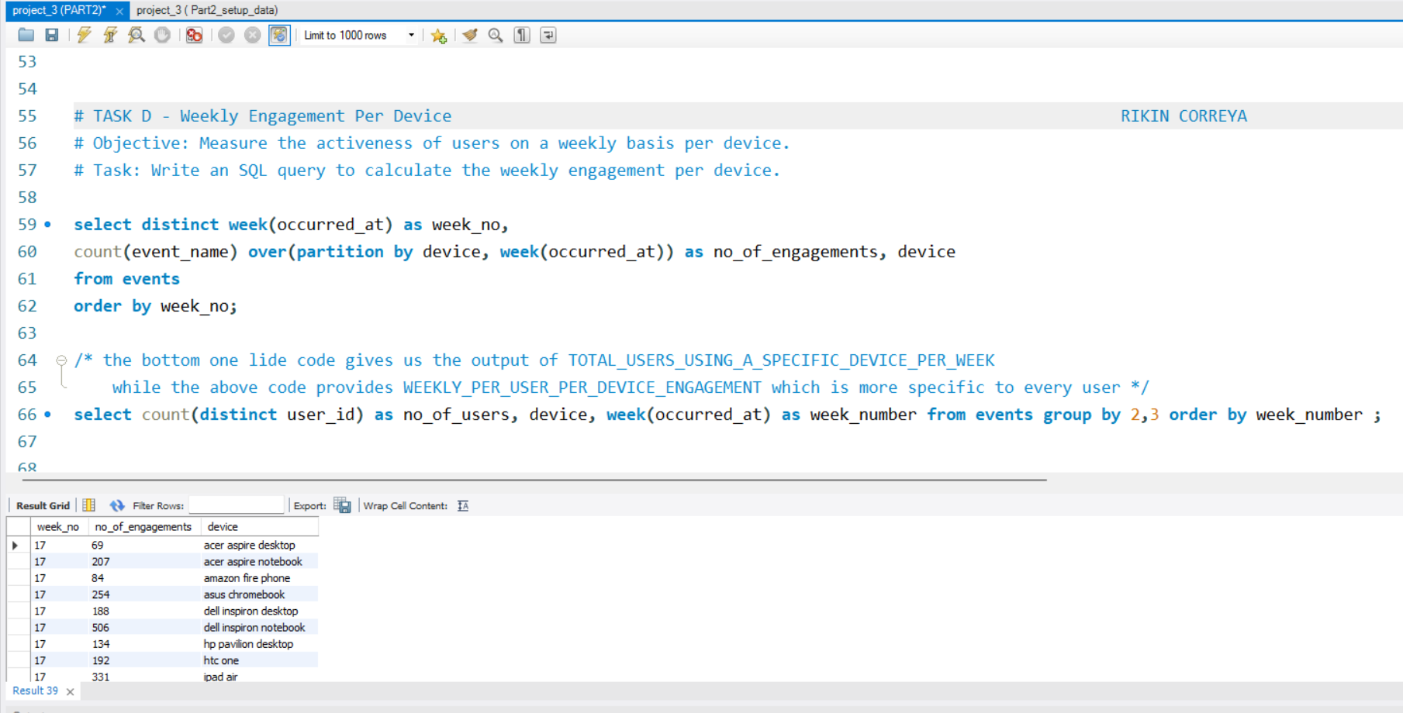
Task D - Screenshot ( Pie graph of week 17 and 18 on next slide)

Slide 23
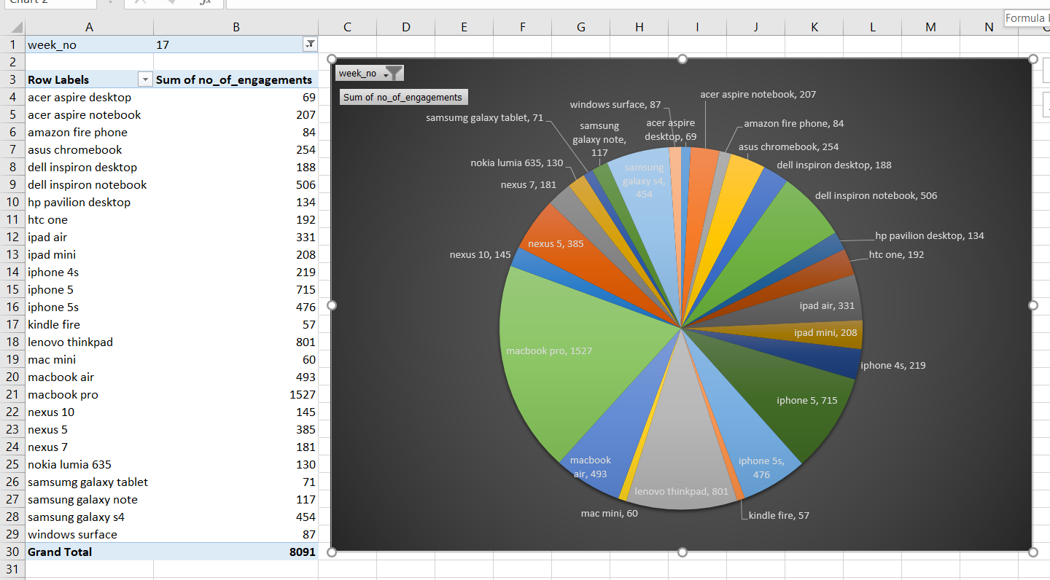
Task D - PIE Graph of week 17 for reference
WEEK
17

Slide 24
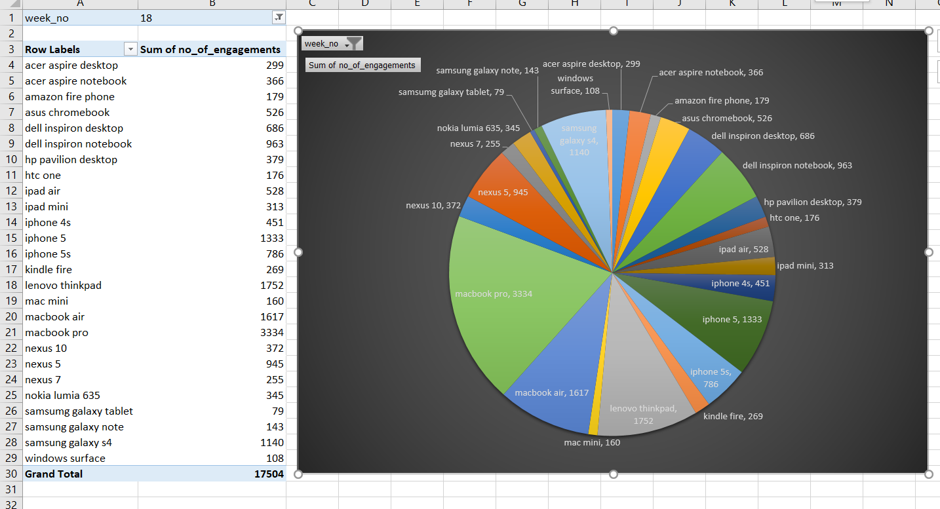
Task D - Output Graph of week 18 for reference
WEEK
18

Slide 25
PART 2
Task E
Query = select week(occurred_at) as week_number, count(distinct user_id) as no_of_users, count(action) as no_of_engagement, (count(action) - lag(count(action),1) over(order by week(occurred_at))) as growth_email_engagements from email_events group by week_number order by week_number ;
Approach = I have first counted different user_id who have made actions on email platform by counting them on a specific week, then counted the actions which they performed on a specific week, then finally using the OVER() function and LAG() to see the difference of user engagements between the previous week and the current, hence showing the growth or dip in engagements WEEK WISE.
Insights = The highest number of engagements was seen on week 34 (6390), while the lowest were the 1st and last week having just 1457 and 127 respectively. The highest GROWTH in Engagements was seen on week 18, with 2644 more engagements than the previous week

Slide 26
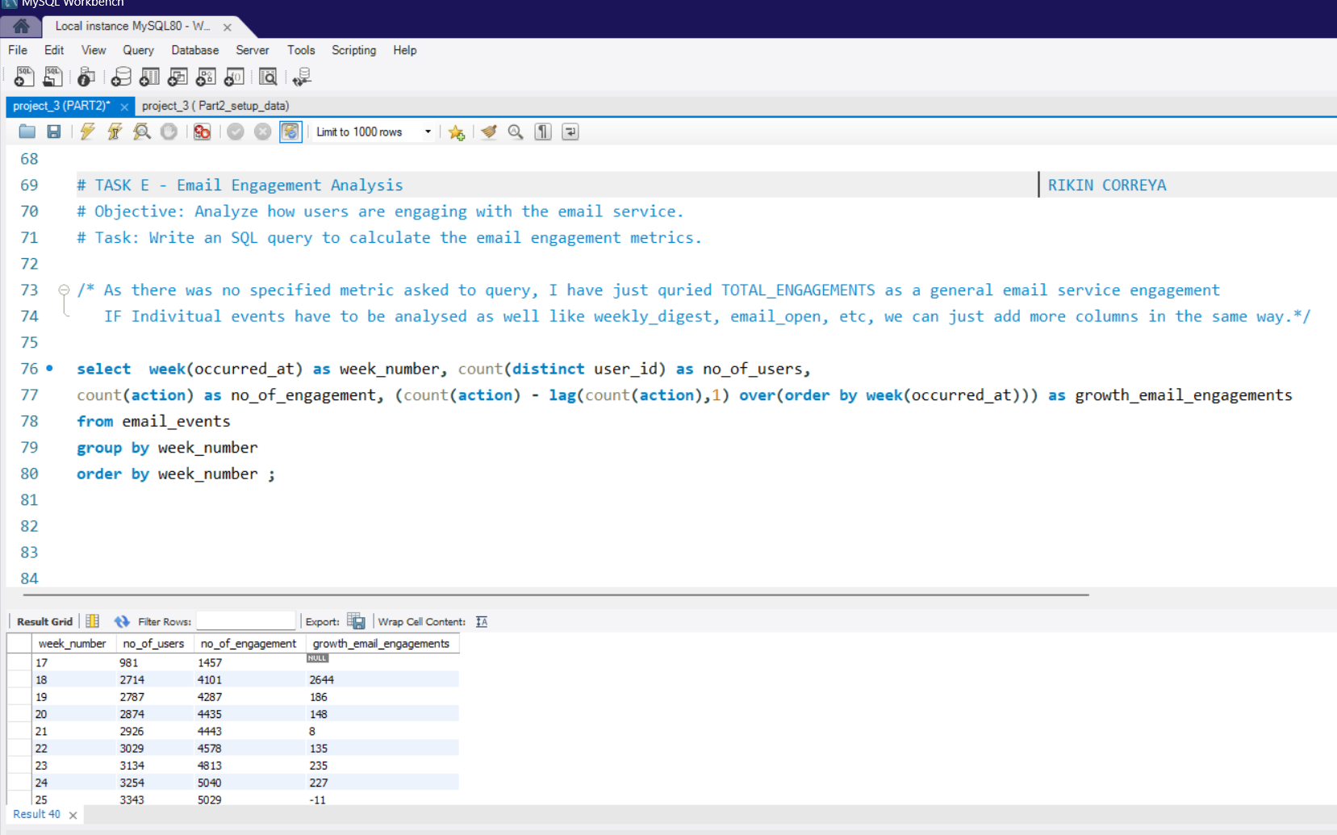
Task E - Screenshot ( Output table on next slide)

Slide 27
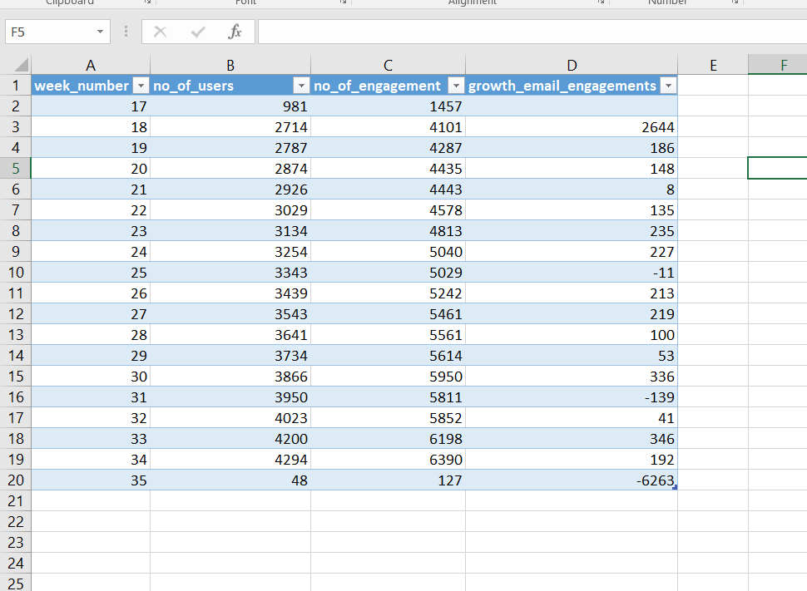
Task E - Output Table for reference

Slide 28
Results
It was a really engaging project, especially some tasks which were needed to be done using some advanced queries.
It has really increased my knowledge to work with large number of rows and finding some great analytical data such as cohort retention, weekly retention, as well as the rolling average.
Rolling average was an analysis which i personally found very useful and could be very useful for enterprises for daily analysis of their data.
Some query functions which I am now more confident to work with are TIMESTAMP, WEEK,DATE, LAG, RANK along with the previous basic ones which were used often.
Also using Excel for basic charts and table has come handy in this project.

Slide 29
THANK
YOU

