Slide 1
FINAL PROJECT REPORT
Transformer-Based Sleep Stage Classification and Personalized Sleep Health Profiling
Using Fast SCFormer-U, Evidential Learning and Soft-Viterbi Sequence Decoding
Presented by: Rikin Parekh, Om Ahuja
Enrollment No.: 23BIT044, 23BIT014
Project Guide: Dr. Santosh Sathpathy
Department: Information and Communication Technology
Institute/University: Pandit Deendayal Energy University
Final evaluation: 7 October 2026
Academic engineering / AI project
Notes:
Authors, enrollment numbers, guide and institution are supplied by the project owner. Full project title retained across title and subtitle. HMC-PPT-20261007-01

Slide 2
Problem Statement
• Classify four-channel EEG into Wake, N1, N2, N3 and REM at 30-second resolution.
• Automate epoch scoring, expose evidential uncertainty, and decode recording-level stage sequences.
• Convert scored sequences into interpretable research sleep profiles.
EEG
Five-stage
classification
Sequence
decoding
Research
profile
Scope: academic engineering research; no diagnostic or clinical-validation claim.
Source: HMC-PPT-20261007-01 | project scope, preprocessing_config.json
02
Notes:
Problem Statement
Run: HMC-PPT-20261007-01
Sources: project scope, preprocessing_config.json
Test recordings: SN009, SN001, SN004, SN022.
Checkpoint: /content/drive/MyDrive/Sleep_Health_Profiling/models/HMC_CHECKPOINTS/best_objective1_model.keras
Checkpoint SHA256: 3bf1423246d5672ce7473562079cb4e8d9aa1a578e18c1cb65e6b43e4156b226
All classification results use identical corrected test epochs.
Only four test recordings; no external validation.
Final training hardware and global training RNG state not preserved.
Notebook execution counts were cleared; saved outputs are historical evidence rather than complete execution provenance.
Test records were evaluated repeatedly in notebook development; not a newly blinded clinical test.
Rule thresholds have no clinical validation in this project.
Evidential probabilities are not a separately fitted self-calibrated condition.
SN identifiers denote recordings; repository assumes one subject per ID and has no independent person-identity mapping.

Slide 3
Project Objectives
01 Sleep-stage classification
Predict five stages using a compact CNN–self-attention–BiLSTM evidential model.
02 Sequence refinement
Decode stage probabilities with training-derived transitions, separately for each recording.
03 Subject-level profiling
Compute source-defined biomarkers, compare with ground truth and apply research risk rules.
Source: HMC-PPT-20261007-01 | checkpoint_config.json, transition_config.json, biomarker_equations.md
03
Notes:
Project Objectives
Run: HMC-PPT-20261007-01
Sources: checkpoint_config.json, transition_config.json, biomarker_equations.md
Test recordings: SN009, SN001, SN004, SN022.
Checkpoint: /content/drive/MyDrive/Sleep_Health_Profiling/models/HMC_CHECKPOINTS/best_objective1_model.keras
Checkpoint SHA256: 3bf1423246d5672ce7473562079cb4e8d9aa1a578e18c1cb65e6b43e4156b226
All classification results use identical corrected test epochs.
Only four test recordings; no external validation.
Final training hardware and global training RNG state not preserved.
Notebook execution counts were cleared; saved outputs are historical evidence rather than complete execution provenance.
Test records were evaluated repeatedly in notebook development; not a newly blinded clinical test.
Rule thresholds have no clinical validation in this project.
Evidential probabilities are not a separately fitted self-calibrated condition.
SN identifiers denote recordings; repository assumes one subject per ID and has no independent person-identity mapping.

Slide 4
Dataset and Experimental Split
24 recordings
24 unique SN IDs
16 training
15,216 epochs
4 validation
3,619 epochs
4 test
3,773 epochs
Total evaluated usable epochs: 22,608
Overall counts: Wake 4,288 · N1 2,446 · N2 8,258 · N3 4,103 · REM 3,513
Selected EEG channels: F4–M1 · C4–M1 · O2–M1 · C3–M2
Test IDs: SN009, SN001, SN004, SN022
SN001 correction: 190 stored epochs → 854 EDF-derived epochs. Original data preserved.
No subject/recording ID appears in more than one split.
Source: HMC-PPT-20261007-01 | split_summary.json, split_subjects.csv, input_repairs.json
04
Notes:
Dataset and Experimental Split
Run: HMC-PPT-20261007-01
Sources: split_summary.json, split_subjects.csv, input_repairs.json
Test recordings: SN009, SN001, SN004, SN022.
Checkpoint: /content/drive/MyDrive/Sleep_Health_Profiling/models/HMC_CHECKPOINTS/best_objective1_model.keras
Checkpoint SHA256: 3bf1423246d5672ce7473562079cb4e8d9aa1a578e18c1cb65e6b43e4156b226
All classification results use identical corrected test epochs.
Only four test recordings; no external validation.
Final training hardware and global training RNG state not preserved.
Notebook execution counts were cleared; saved outputs are historical evidence rather than complete execution provenance.
Test records were evaluated repeatedly in notebook development; not a newly blinded clinical test.
Rule thresholds have no clinical validation in this project.
Evidential probabilities are not a separately fitted self-calibrated condition.
SN identifiers denote recordings; repository assumes one subject per ID and has no independent person-identity mapping.
Full split: {"train": ["SN017", "SN006", "SN020", "SN025", "SN015", "SN011", "SN019", "SN012", "SN016", "SN018", "SN002", "SN013", "SN023", "SN007", "SN010", "SN003"], "val": ["SN024", "SN005", "SN021", "SN008"], "test": ["SN009", "SN001", "SN004", "SN022"]}

Slide 5
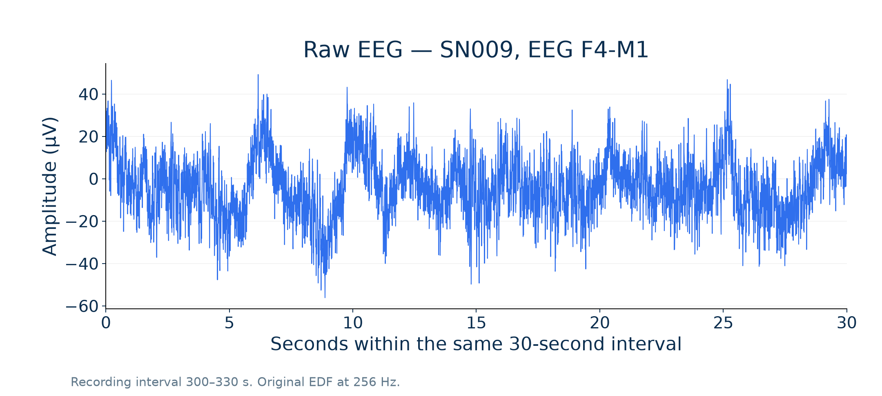
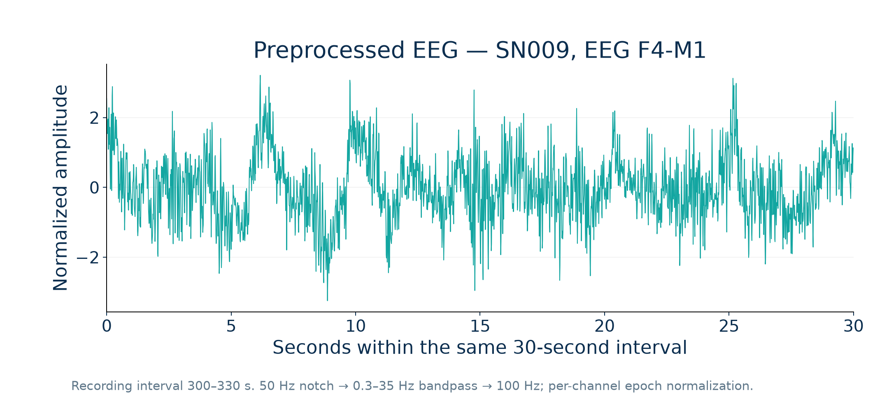
EEG Preprocessing
Channel selection → 50 Hz notch → 0.3–35 Hz bandpass → resample 256→100 Hz
30-second epochs → channel-wise epoch normalization → input shape (4, 3000)
No amplitude-based rejection; reject_by_annotation=False in the source.
Source: HMC-PPT-20261007-01 | preprocessing_config.json, eeg_example_metadata.json
05
Notes:
EEG Preprocessing
Run: HMC-PPT-20261007-01
Sources: preprocessing_config.json, eeg_example_metadata.json
Test recordings: SN009, SN001, SN004, SN022.
Checkpoint: /content/drive/MyDrive/Sleep_Health_Profiling/models/HMC_CHECKPOINTS/best_objective1_model.keras
Checkpoint SHA256: 3bf1423246d5672ce7473562079cb4e8d9aa1a578e18c1cb65e6b43e4156b226
All classification results use identical corrected test epochs.
Only four test recordings; no external validation.
Final training hardware and global training RNG state not preserved.
Notebook execution counts were cleared; saved outputs are historical evidence rather than complete execution provenance.
Test records were evaluated repeatedly in notebook development; not a newly blinded clinical test.
Rule thresholds have no clinical validation in this project.
Evidential probabilities are not a separately fitted self-calibrated condition.
SN identifiers denote recordings; repository assumes one subject per ID and has no independent person-identity mapping.

Slide 6
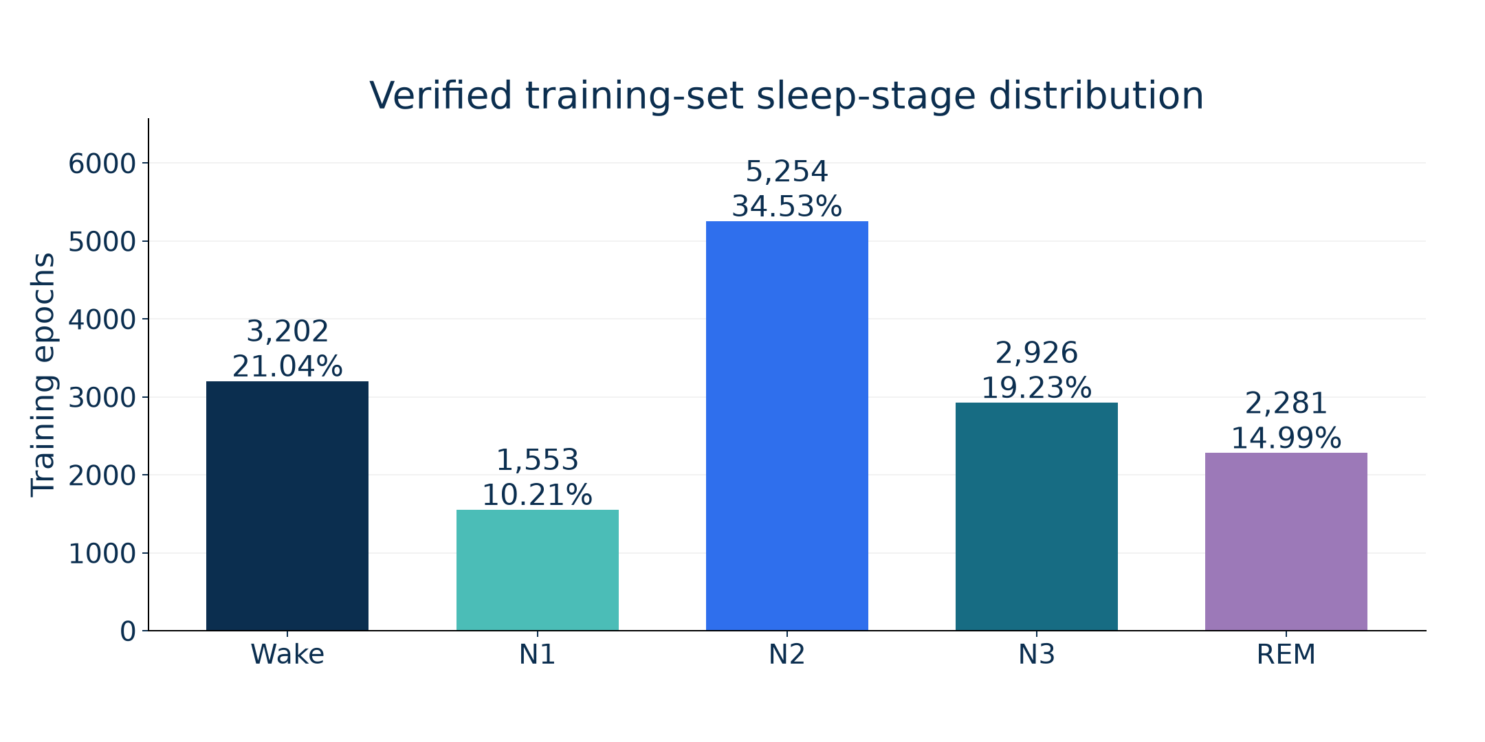
Sleep Stage Distribution
Class weighting: Ntraining / (5 × training class count); computed from training labels only.
Source: HMC-PPT-20261007-01 | stage_distribution.csv, class_weights.csv
06
Notes:
Sleep Stage Distribution
Run: HMC-PPT-20261007-01
Sources: stage_distribution.csv, class_weights.csv
Test recordings: SN009, SN001, SN004, SN022.
Checkpoint: /content/drive/MyDrive/Sleep_Health_Profiling/models/HMC_CHECKPOINTS/best_objective1_model.keras
Checkpoint SHA256: 3bf1423246d5672ce7473562079cb4e8d9aa1a578e18c1cb65e6b43e4156b226
All classification results use identical corrected test epochs.
Only four test recordings; no external validation.
Final training hardware and global training RNG state not preserved.
Notebook execution counts were cleared; saved outputs are historical evidence rather than complete execution provenance.
Test records were evaluated repeatedly in notebook development; not a newly blinded clinical test.
Rule thresholds have no clinical validation in this project.
Evidential probabilities are not a separately fitted self-calibrated condition.
SN identifiers denote recordings; repository assumes one subject per ID and has no independent person-identity mapping.

Slide 7
Fast SCFormer-U Architecture
EEG epoch
4 × 3000
Conv1D 64
k7, stride4
750 × 64
Conv1D 128
k5, stride4
188 × 128
Self-attention
4 heads, key16
188 × 128
Softplus 5
evidence
α = e + 1
Average pool
Dense 128
Dropout .2/.1
BiLSTM 64×2
188 × 128
Residual + LN
FFN 128→128
GELU
Hybrid CNN–Transformer/self-attention–BiLSTM | 225,925 trainable parameters
Source: HMC-PPT-20261007-01 | checkpoint_config.json, model_layers.csv
07
Notes:
Fast SCFormer-U Architecture
Run: HMC-PPT-20261007-01
Sources: checkpoint_config.json, model_layers.csv
Test recordings: SN009, SN001, SN004, SN022.
Checkpoint: /content/drive/MyDrive/Sleep_Health_Profiling/models/HMC_CHECKPOINTS/best_objective1_model.keras
Checkpoint SHA256: 3bf1423246d5672ce7473562079cb4e8d9aa1a578e18c1cb65e6b43e4156b226
All classification results use identical corrected test epochs.
Only four test recordings; no external validation.
Final training hardware and global training RNG state not preserved.
Notebook execution counts were cleared; saved outputs are historical evidence rather than complete execution provenance.
Test records were evaluated repeatedly in notebook development; not a newly blinded clinical test.
Rule thresholds have no clinical validation in this project.
Evidential probabilities are not a separately fitted self-calibrated condition.
SN identifiers denote recordings; repository assumes one subject per ID and has no independent person-identity mapping.

Slide 8
Role of Each Model Component
CNN downsampling
Convolutional filters learn local patterns; strides reduce 3000 samples to 188 feature positions.
Self-attention + feed-forward block
Four attention heads combine feature positions within each individual 30-second epoch.
Bidirectional LSTM
64 units in each direction model the downsampled within-epoch sequence.
Evidential output
Five nonnegative evidence values define Dirichlet means and total-evidence uncertainty.
Source: HMC-PPT-20261007-01 | checkpoint_config.json, model_layers.csv
08
Notes:
Role of Each Model Component
Run: HMC-PPT-20261007-01
Sources: checkpoint_config.json, model_layers.csv
Test recordings: SN009, SN001, SN004, SN022.
Checkpoint: /content/drive/MyDrive/Sleep_Health_Profiling/models/HMC_CHECKPOINTS/best_objective1_model.keras
Checkpoint SHA256: 3bf1423246d5672ce7473562079cb4e8d9aa1a578e18c1cb65e6b43e4156b226
All classification results use identical corrected test epochs.
Only four test recordings; no external validation.
Final training hardware and global training RNG state not preserved.
Notebook execution counts were cleared; saved outputs are historical evidence rather than complete execution provenance.
Test records were evaluated repeatedly in notebook development; not a newly blinded clinical test.
Rule thresholds have no clinical validation in this project.
Evidential probabilities are not a separately fitted self-calibrated condition.
SN identifiers denote recordings; repository assumes one subject per ID and has no independent person-identity mapping.

Slide 9
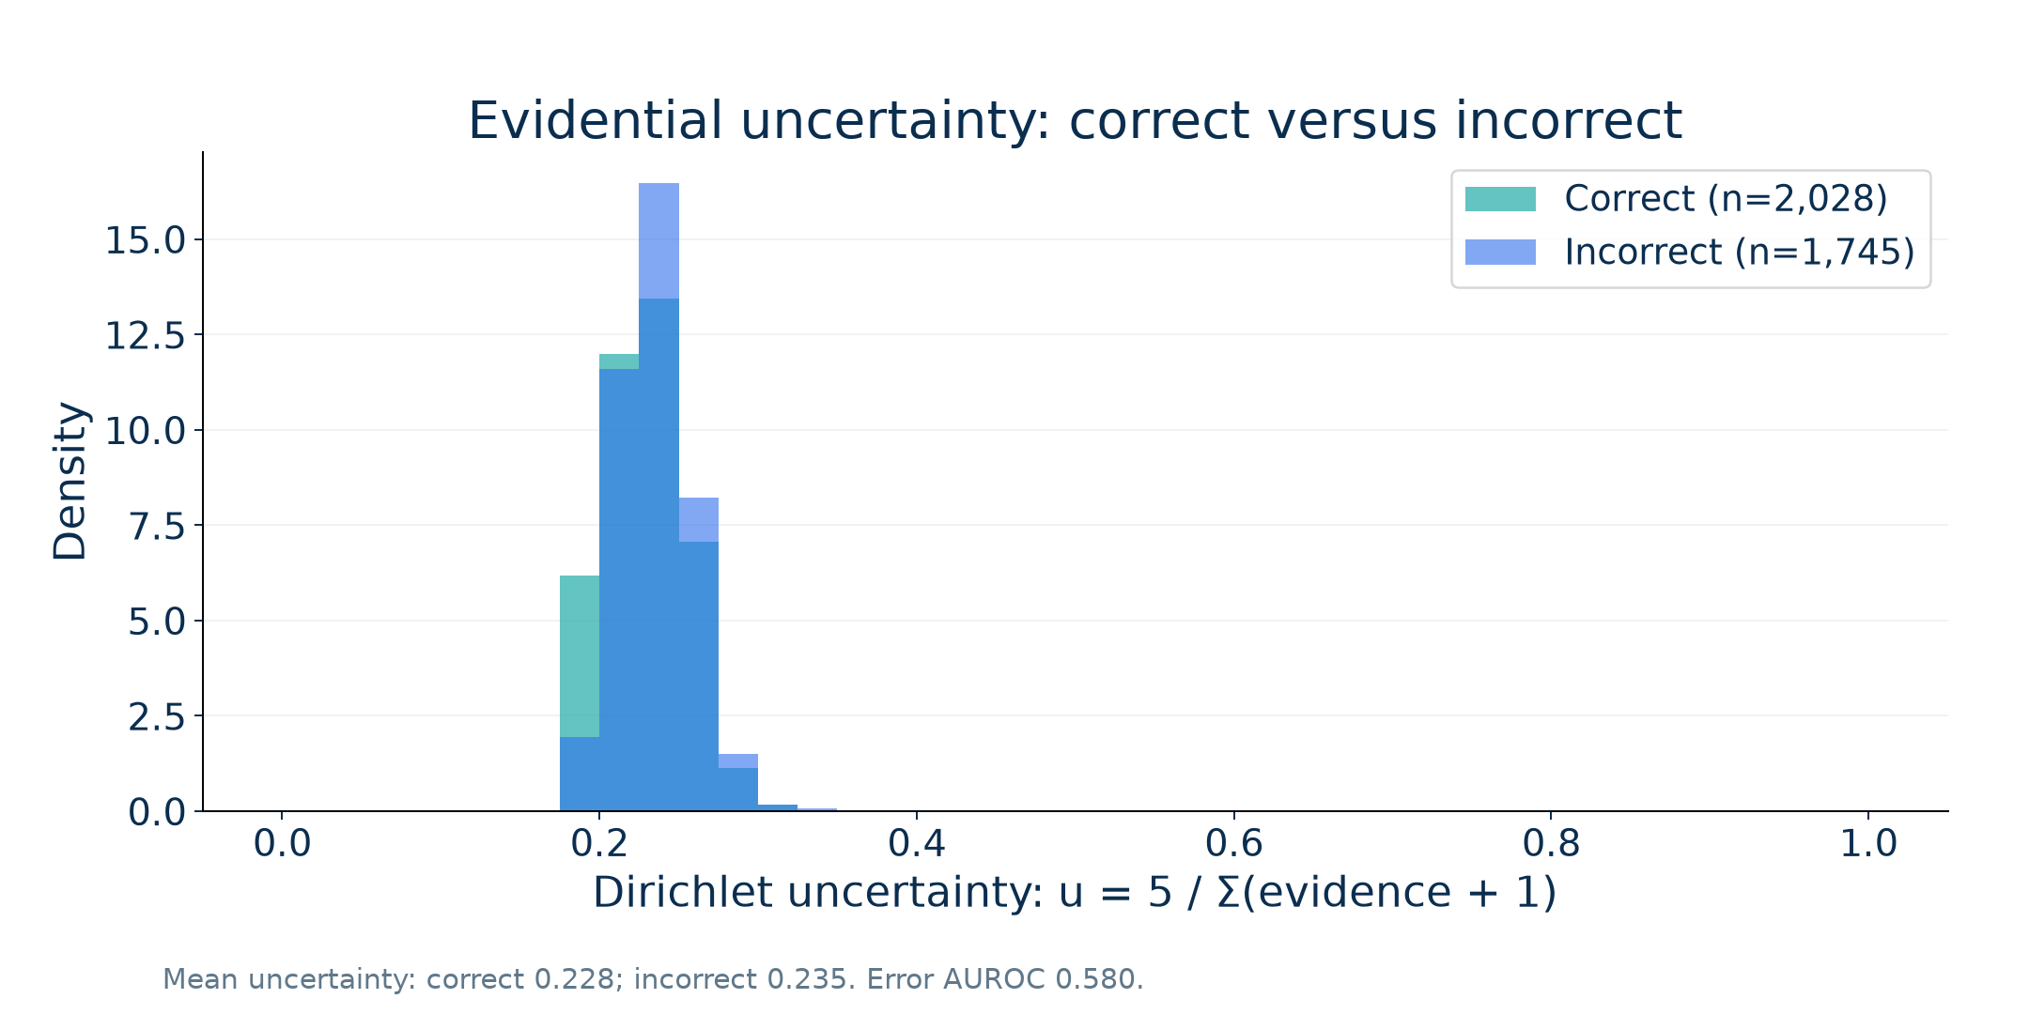
Uncertainty-Aware Classification
Actual output
αk = evidencek + 1
pk = αk / Σα
u = 5 / Σα
Error-detection AUROC
0.580
Higher uncertainty is useful only if it separates errors; this is evaluated, not assumed.
Source: HMC-PPT-20261007-01 | calibration_metrics.json, test_uncertainty.csv
09
Notes:
Uncertainty-Aware Classification
Run: HMC-PPT-20261007-01
Sources: calibration_metrics.json, test_uncertainty.csv
Test recordings: SN009, SN001, SN004, SN022.
Checkpoint: /content/drive/MyDrive/Sleep_Health_Profiling/models/HMC_CHECKPOINTS/best_objective1_model.keras
Checkpoint SHA256: 3bf1423246d5672ce7473562079cb4e8d9aa1a578e18c1cb65e6b43e4156b226
All classification results use identical corrected test epochs.
Only four test recordings; no external validation.
Final training hardware and global training RNG state not preserved.
Notebook execution counts were cleared; saved outputs are historical evidence rather than complete execution provenance.
Test records were evaluated repeatedly in notebook development; not a newly blinded clinical test.
Rule thresholds have no clinical validation in this project.
Evidential probabilities are not a separately fitted self-calibrated condition.
SN identifiers denote recordings; repository assumes one subject per ID and has no independent person-identity mapping.

Slide 10
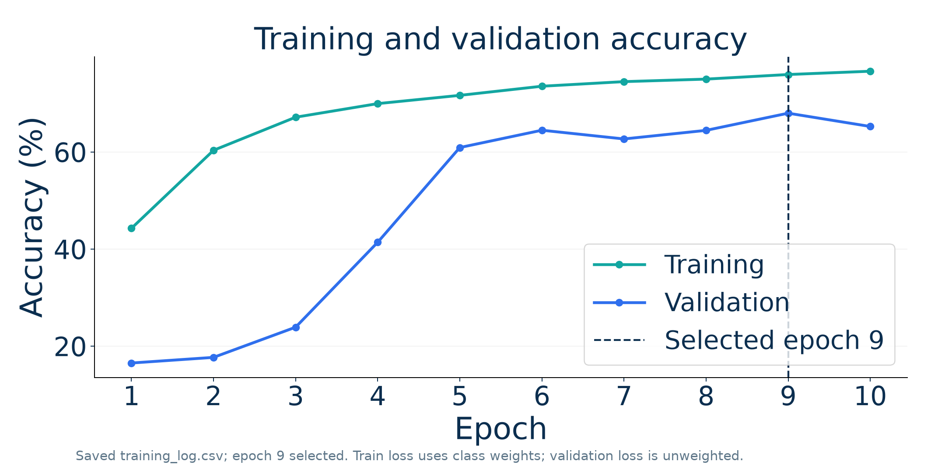
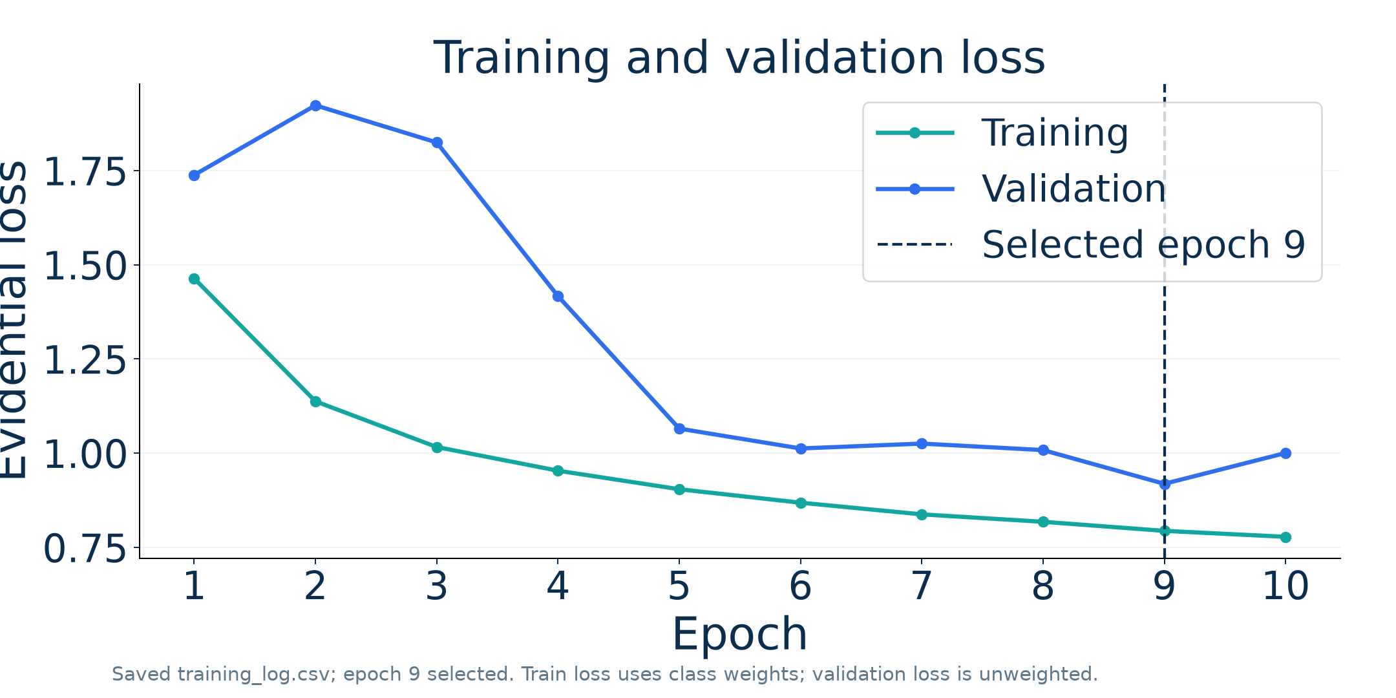
Model Training Progress
Setting | Verified value | Setting | Verified value
Optimizer | Adam | Learning rate | 1 × 10⁻⁴
Batch size | 128 | Epochs | 10; selected 9
Early stopping | Patience 5; not triggered | Training hardware | Not preserved in run log
Source: HMC-PPT-20261007-01 | training_history.csv, hyperparameters.json
10
Notes:
Model Training Progress
Run: HMC-PPT-20261007-01
Sources: training_history.csv, hyperparameters.json
Test recordings: SN009, SN001, SN004, SN022.
Checkpoint: /content/drive/MyDrive/Sleep_Health_Profiling/models/HMC_CHECKPOINTS/best_objective1_model.keras
Checkpoint SHA256: 3bf1423246d5672ce7473562079cb4e8d9aa1a578e18c1cb65e6b43e4156b226
All classification results use identical corrected test epochs.
Only four test recordings; no external validation.
Final training hardware and global training RNG state not preserved.
Notebook execution counts were cleared; saved outputs are historical evidence rather than complete execution provenance.
Test records were evaluated repeatedly in notebook development; not a newly blinded clinical test.
Rule thresholds have no clinical validation in this project.
Evidential probabilities are not a separately fitted self-calibrated condition.
SN identifiers denote recordings; repository assumes one subject per ID and has no independent person-identity mapping.

Slide 11
Sleep-Stage Classification Performance
Accuracy
Balanced accuracy
Macro F1
53.75%
57.83%
55.12%
Weighted F1
Cohen’s kappa
Raw evidential model
3,773 epochs · four held-out test IDs
54.92%
0.4060
Final checkpoint, corrected test inputs, one run. Subject-disjoint fit; no external validation.
Source: HMC-PPT-20261007-01 | overall_metrics.json, test_epoch_predictions.csv
11
Notes:
Sleep-Stage Classification Performance
Run: HMC-PPT-20261007-01
Sources: overall_metrics.json, test_epoch_predictions.csv
Test recordings: SN009, SN001, SN004, SN022.
Checkpoint: /content/drive/MyDrive/Sleep_Health_Profiling/models/HMC_CHECKPOINTS/best_objective1_model.keras
Checkpoint SHA256: 3bf1423246d5672ce7473562079cb4e8d9aa1a578e18c1cb65e6b43e4156b226
All classification results use identical corrected test epochs.
Only four test recordings; no external validation.
Final training hardware and global training RNG state not preserved.
Notebook execution counts were cleared; saved outputs are historical evidence rather than complete execution provenance.
Test records were evaluated repeatedly in notebook development; not a newly blinded clinical test.
Rule thresholds have no clinical validation in this project.
Evidential probabilities are not a separately fitted self-calibrated condition.
SN identifiers denote recordings; repository assumes one subject per ID and has no independent person-identity mapping.

Slide 12
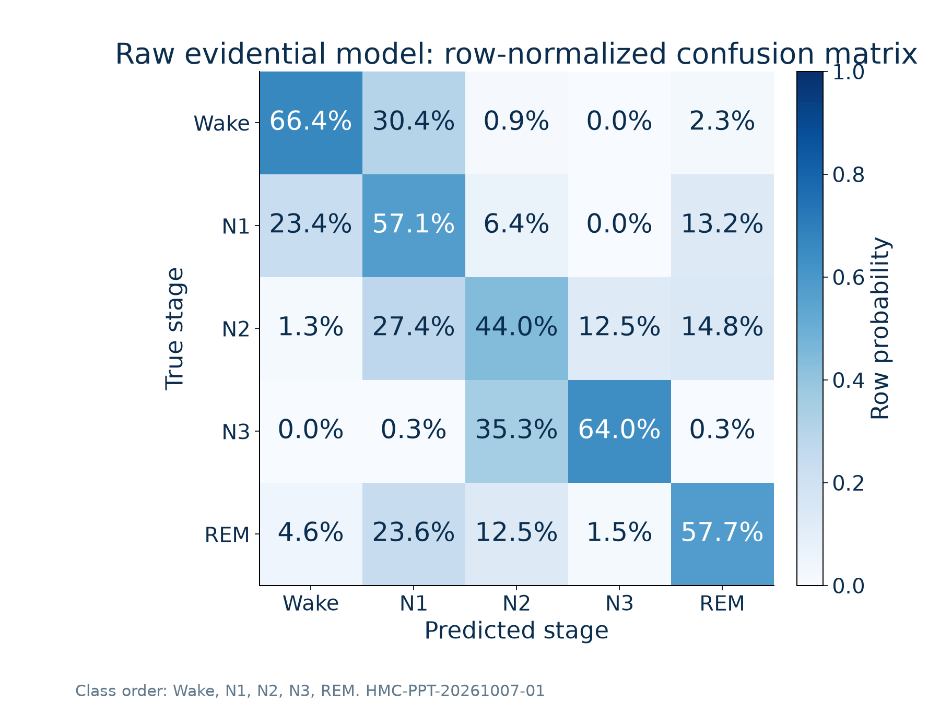
Sleep Stage Confusion Matrix
• Highest recall: Wake (66.36%).
• Lowest recall: N2 (44.00%).
• Largest off-diagonal share: N3 → N2 (35.33%).
Source: HMC-PPT-20261007-01 | confusion_matrix_normalized.csv, classification_report.csv
12
Notes:
Sleep Stage Confusion Matrix
Run: HMC-PPT-20261007-01
Sources: confusion_matrix_normalized.csv, classification_report.csv
Test recordings: SN009, SN001, SN004, SN022.
Checkpoint: /content/drive/MyDrive/Sleep_Health_Profiling/models/HMC_CHECKPOINTS/best_objective1_model.keras
Checkpoint SHA256: 3bf1423246d5672ce7473562079cb4e8d9aa1a578e18c1cb65e6b43e4156b226
All classification results use identical corrected test epochs.
Only four test recordings; no external validation.
Final training hardware and global training RNG state not preserved.
Notebook execution counts were cleared; saved outputs are historical evidence rather than complete execution provenance.
Test records were evaluated repeatedly in notebook development; not a newly blinded clinical test.
Rule thresholds have no clinical validation in this project.
Evidential probabilities are not a separately fitted self-calibrated condition.
SN identifiers denote recordings; repository assumes one subject per ID and has no independent person-identity mapping.

Slide 13
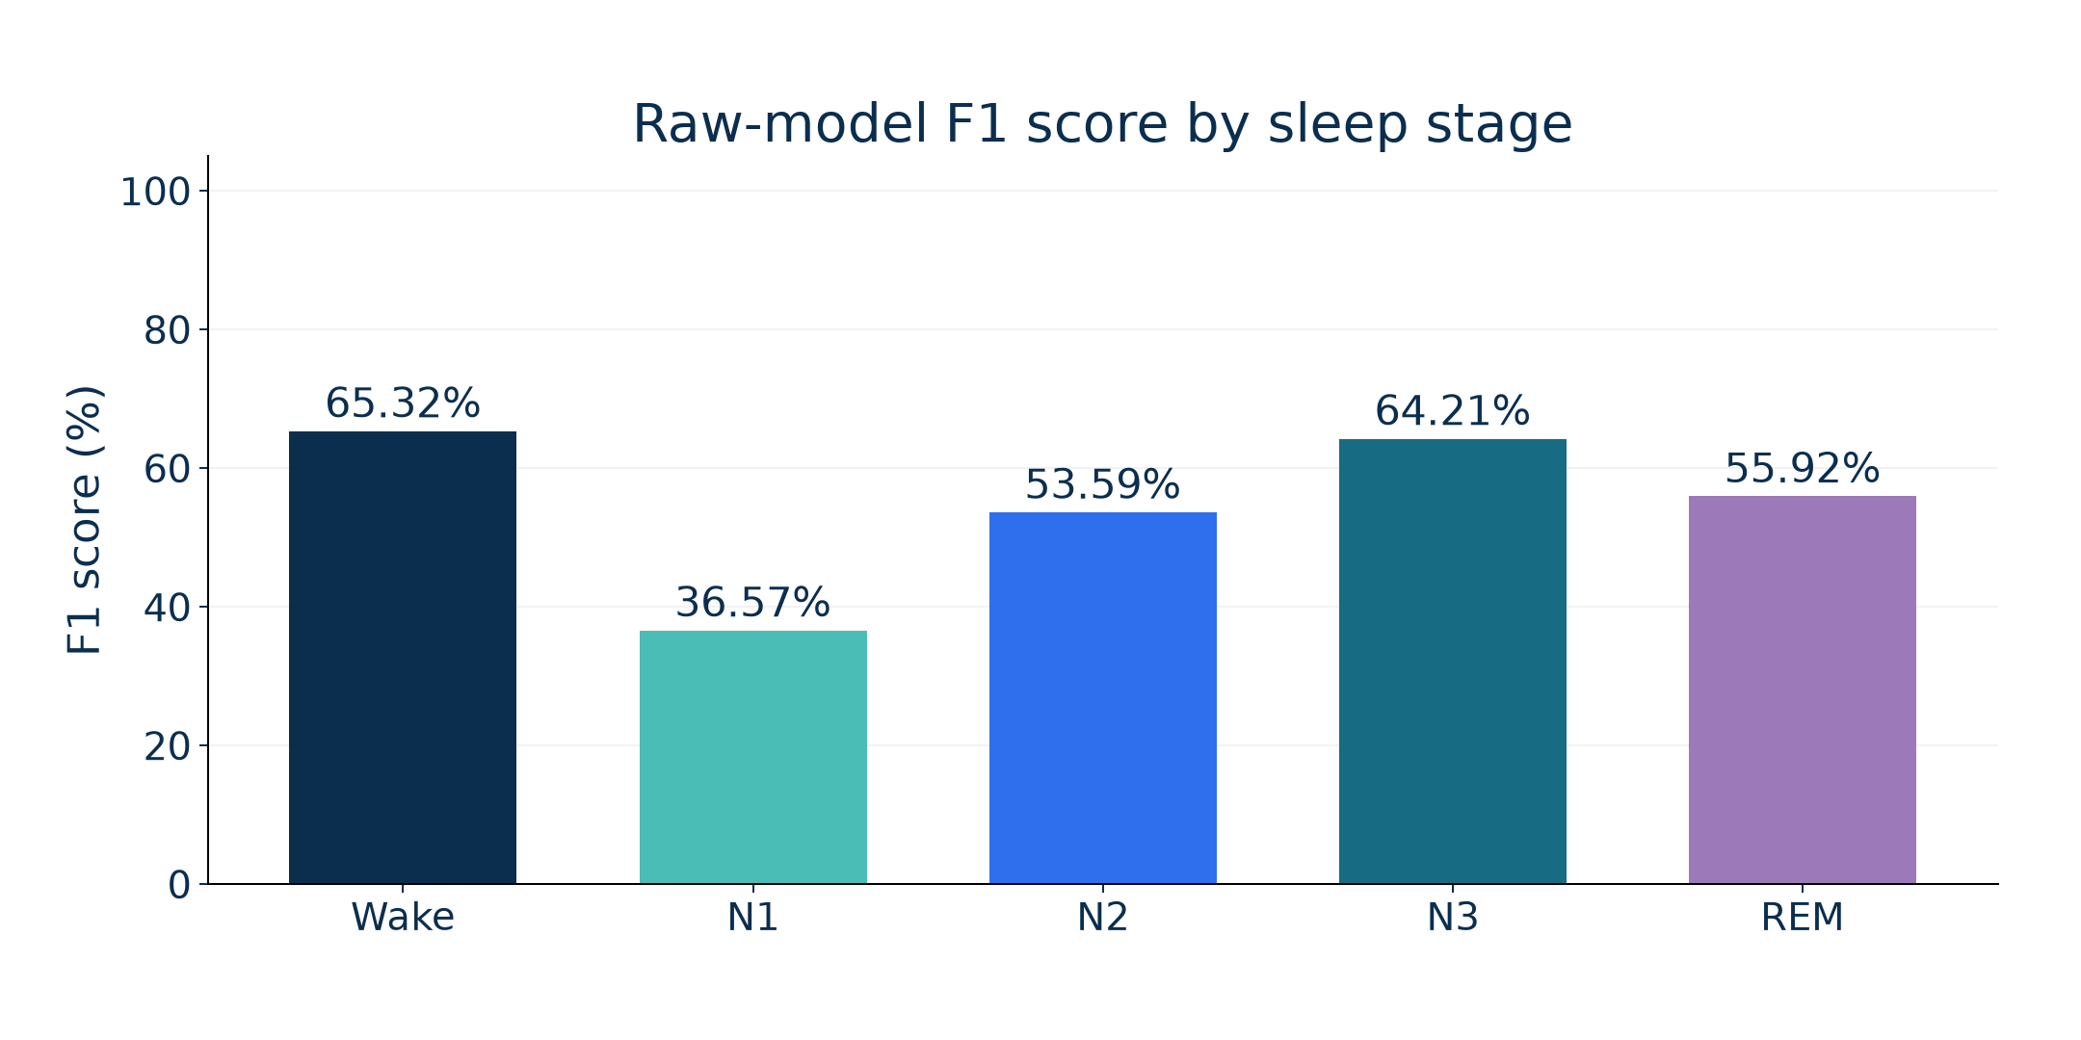
Class-Wise Classification Performance
Stage | Precision | Recall
Wake | 0.643 | 0.664
N1 | 0.269 | 0.571
N2 | 0.685 | 0.440
N3 | 0.644 | 0.640
REM | 0.543 | 0.577
Lowest class F1: N1; all values come from the raw-model condition.
Source: HMC-PPT-20261007-01 | classification_report.csv
13
Notes:
Class-Wise Classification Performance
Run: HMC-PPT-20261007-01
Sources: classification_report.csv
Test recordings: SN009, SN001, SN004, SN022.
Checkpoint: /content/drive/MyDrive/Sleep_Health_Profiling/models/HMC_CHECKPOINTS/best_objective1_model.keras
Checkpoint SHA256: 3bf1423246d5672ce7473562079cb4e8d9aa1a578e18c1cb65e6b43e4156b226
All classification results use identical corrected test epochs.
Only four test recordings; no external validation.
Final training hardware and global training RNG state not preserved.
Notebook execution counts were cleared; saved outputs are historical evidence rather than complete execution provenance.
Test records were evaluated repeatedly in notebook development; not a newly blinded clinical test.
Rule thresholds have no clinical validation in this project.
Evidential probabilities are not a separately fitted self-calibrated condition.
SN identifiers denote recordings; repository assumes one subject per ID and has no independent person-identity mapping.

Slide 14
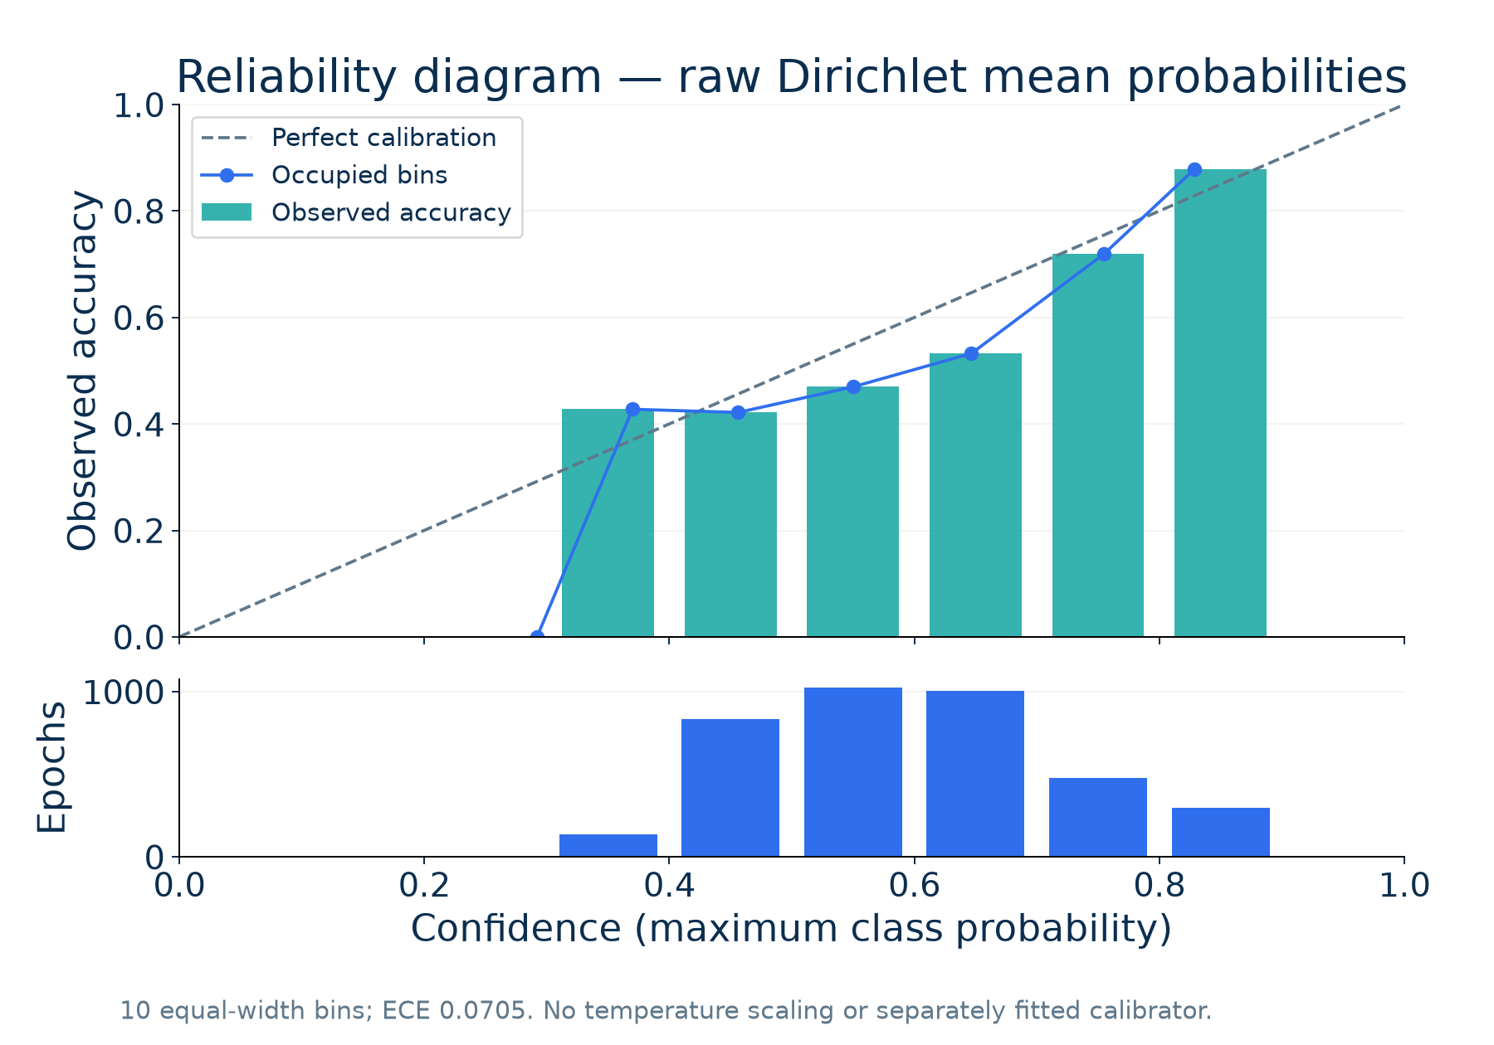
Uncertainty and Calibration
ECE (10 bins): 0.0705 | Brier (multiclass sum): 0.5879
NLL: 1.1012 | Error AUROC: 0.5798
Source: HMC-PPT-20261007-01 | calibration_metrics.json, calibration_bins.csv
14
Notes:
Uncertainty and Calibration
Run: HMC-PPT-20261007-01
Sources: calibration_metrics.json, calibration_bins.csv
Test recordings: SN009, SN001, SN004, SN022.
Checkpoint: /content/drive/MyDrive/Sleep_Health_Profiling/models/HMC_CHECKPOINTS/best_objective1_model.keras
Checkpoint SHA256: 3bf1423246d5672ce7473562079cb4e8d9aa1a578e18c1cb65e6b43e4156b226
All classification results use identical corrected test epochs.
Only four test recordings; no external validation.
Final training hardware and global training RNG state not preserved.
Notebook execution counts were cleared; saved outputs are historical evidence rather than complete execution provenance.
Test records were evaluated repeatedly in notebook development; not a newly blinded clinical test.
Rule thresholds have no clinical validation in this project.
Evidential probabilities are not a separately fitted self-calibrated condition.
SN identifiers denote recordings; repository assumes one subject per ID and has no independent person-identity mapping.

Slide 15
Soft-Viterbi Sleep Stage Refinement
• The model scores each 30-second epoch independently.
• The decoder balances those stage probabilities with transitions estimated from training labels.
• A log-space dynamic program selects one sequence for each recording; it never joins subjects.
Dirichlet mean
probabilities
Training-label
transition matrix
Weighted MAP
Viterbi decoder
Decoded
hypnogram
Smoothing may improve aggregate scores while erasing brief stages. All transitions remain possible.
Source: HMC-PPT-20261007-01 | soft_viterbi_pseudocode.txt, transition_config.json
15
Notes:
Soft-Viterbi Sleep Stage Refinement
Run: HMC-PPT-20261007-01
Sources: soft_viterbi_pseudocode.txt, transition_config.json
Test recordings: SN009, SN001, SN004, SN022.
Checkpoint: /content/drive/MyDrive/Sleep_Health_Profiling/models/HMC_CHECKPOINTS/best_objective1_model.keras
Checkpoint SHA256: 3bf1423246d5672ce7473562079cb4e8d9aa1a578e18c1cb65e6b43e4156b226
All classification results use identical corrected test epochs.
Only four test recordings; no external validation.
Final training hardware and global training RNG state not preserved.
Notebook execution counts were cleared; saved outputs are historical evidence rather than complete execution provenance.
Test records were evaluated repeatedly in notebook development; not a newly blinded clinical test.
Rule thresholds have no clinical validation in this project.
Evidential probabilities are not a separately fitted self-calibrated condition.
SN identifiers denote recordings; repository assumes one subject per ID and has no independent person-identity mapping.

Slide 16
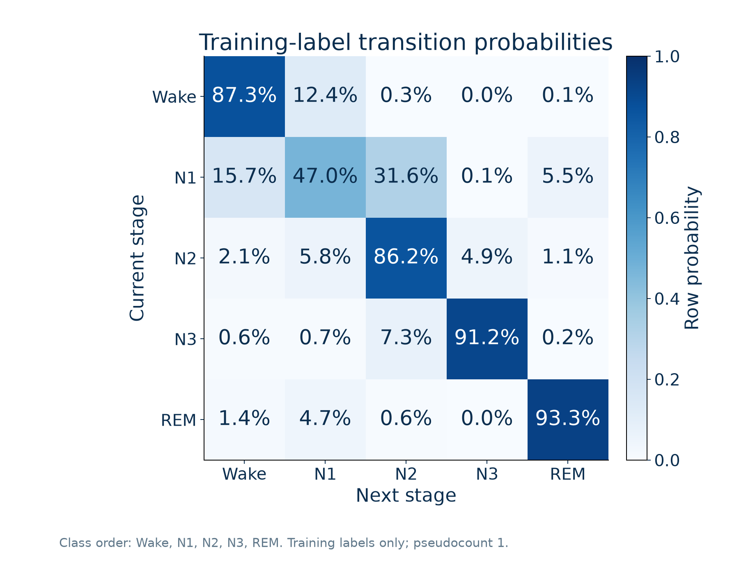
Sleep Stage Transition Modeling
Training labels only
Pseudocount: 1 per cell
Rows sum to one
Initialization: stage prevalence
Separate recording boundaries
Emission log-weight: 0.9
Source: HMC-PPT-20261007-01 | transition_matrix.csv, transition_config.json
16
Notes:
Sleep Stage Transition Modeling
Run: HMC-PPT-20261007-01
Sources: transition_matrix.csv, transition_config.json
Test recordings: SN009, SN001, SN004, SN022.
Checkpoint: /content/drive/MyDrive/Sleep_Health_Profiling/models/HMC_CHECKPOINTS/best_objective1_model.keras
Checkpoint SHA256: 3bf1423246d5672ce7473562079cb4e8d9aa1a578e18c1cb65e6b43e4156b226
All classification results use identical corrected test epochs.
Only four test recordings; no external validation.
Final training hardware and global training RNG state not preserved.
Notebook execution counts were cleared; saved outputs are historical evidence rather than complete execution provenance.
Test records were evaluated repeatedly in notebook development; not a newly blinded clinical test.
Rule thresholds have no clinical validation in this project.
Evidential probabilities are not a separately fitted self-calibrated condition.
SN identifiers denote recordings; repository assumes one subject per ID and has no independent person-identity mapping.

Slide 17
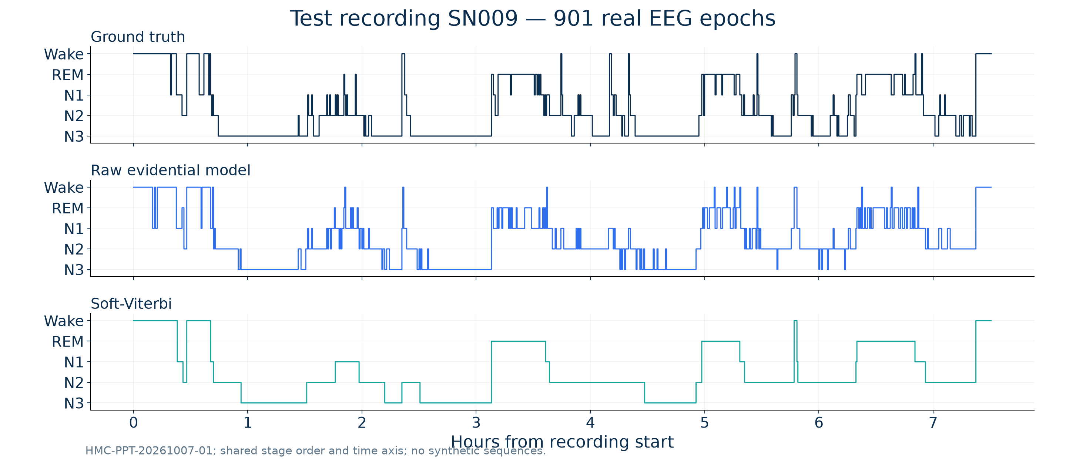
Raw vs Smoothed Sequence — SN009
Source: HMC-PPT-20261007-01 | test_epoch_predictions.csv
17
Notes:
Raw vs Smoothed Sequence — SN009
Run: HMC-PPT-20261007-01
Sources: test_epoch_predictions.csv
Test recordings: SN009, SN001, SN004, SN022.
Checkpoint: /content/drive/MyDrive/Sleep_Health_Profiling/models/HMC_CHECKPOINTS/best_objective1_model.keras
Checkpoint SHA256: 3bf1423246d5672ce7473562079cb4e8d9aa1a578e18c1cb65e6b43e4156b226
All classification results use identical corrected test epochs.
Only four test recordings; no external validation.
Final training hardware and global training RNG state not preserved.
Notebook execution counts were cleared; saved outputs are historical evidence rather than complete execution provenance.
Test records were evaluated repeatedly in notebook development; not a newly blinded clinical test.
Rule thresholds have no clinical validation in this project.
Evidential probabilities are not a separately fitted self-calibrated condition.
SN identifiers denote recordings; repository assumes one subject per ID and has no independent person-identity mapping.

Slide 18
Impact of Sequence Smoothing
Metric | Raw model | Soft-Viterbi | Absolute change
Accuracy | 53.75% | 61.99% | +8.24 pp
Balanced accuracy | 57.83% | 64.26% | +6.43 pp
Macro F1 | 55.12% | 61.76% | +6.64 pp
Weighted F1 | 54.92% | 61.93% | +7.01 pp
Cohen’s kappa | 0.4060 | 0.4999 | +0.0939
Improved: Accuracy, Balanced accuracy, Macro F1, Weighted F1, Cohen’s kappa.
All listed aggregate metrics improved; per-subject outcomes may differ.
Source: HMC-PPT-20261007-01 | raw_vs_smoothed_metrics.csv, smoothing_delta.json
18
Notes:
Impact of Sequence Smoothing
Run: HMC-PPT-20261007-01
Sources: raw_vs_smoothed_metrics.csv, smoothing_delta.json
Test recordings: SN009, SN001, SN004, SN022.
Checkpoint: /content/drive/MyDrive/Sleep_Health_Profiling/models/HMC_CHECKPOINTS/best_objective1_model.keras
Checkpoint SHA256: 3bf1423246d5672ce7473562079cb4e8d9aa1a578e18c1cb65e6b43e4156b226
All classification results use identical corrected test epochs.
Only four test recordings; no external validation.
Final training hardware and global training RNG state not preserved.
Notebook execution counts were cleared; saved outputs are historical evidence rather than complete execution provenance.
Test records were evaluated repeatedly in notebook development; not a newly blinded clinical test.
Rule thresholds have no clinical validation in this project.
Evidential probabilities are not a separately fitted self-calibrated condition.
SN identifiers denote recordings; repository assumes one subject per ID and has no independent person-identity mapping.

Slide 19
Personalized Sleep Health Indicators
Evaluated-recording SE (%)
100 × non-Wake epochs / all evaluated epochs; a recording-duration proxy.
WASO (minutes)
Wake epochs between first and last sleep epoch × 0.5; excludes trailing Wake.
N3 proportion (%)
100 × N3 epochs / all evaluated epochs, including Wake in the denominator.
SFI (transitions / sleep hour)
N2/N3/REM → Wake/N1 transitions divided by hours scored as sleep; coarse stage-transition proxy.
No verified time-in-bed denominator; these indicators are research measures, not diagnoses.
Source: HMC-PPT-20261007-01 | biomarker_equations.md, subject_biomarkers.csv
19
Notes:
Personalized Sleep Health Indicators
Run: HMC-PPT-20261007-01
Sources: biomarker_equations.md, subject_biomarkers.csv
Test recordings: SN009, SN001, SN004, SN022.
Checkpoint: /content/drive/MyDrive/Sleep_Health_Profiling/models/HMC_CHECKPOINTS/best_objective1_model.keras
Checkpoint SHA256: 3bf1423246d5672ce7473562079cb4e8d9aa1a578e18c1cb65e6b43e4156b226
All classification results use identical corrected test epochs.
Only four test recordings; no external validation.
Final training hardware and global training RNG state not preserved.
Notebook execution counts were cleared; saved outputs are historical evidence rather than complete execution provenance.
Test records were evaluated repeatedly in notebook development; not a newly blinded clinical test.
Rule thresholds have no clinical validation in this project.
Evidential probabilities are not a separately fitted self-calibrated condition.
SN identifiers denote recordings; repository assumes one subject per ID and has no independent person-identity mapping.

Slide 20
Rule-Based Sleep Health Risk Stratification
Flags: SE <75% · WASO >60 min · N3 <10% · SFI >10 transitions/sleep hour
Priority | Research category | Exact assignment rule
1 | High Risk | ≥3 flags OR SE <65% OR SFI >15/h
2 | Mild Risk | Otherwise, at least one flag
3 | Healthy | Otherwise, no flags
Missing/nonfinite input → Unclassified in the new evaluator.
Thresholds are source-code rules; no clinical validation is established.
Source: HMC-PPT-20261007-01 | risk_rules.json, risk_rules_table.csv
20
Notes:
Rule-Based Sleep Health Risk Stratification
Run: HMC-PPT-20261007-01
Sources: risk_rules.json, risk_rules_table.csv
Test recordings: SN009, SN001, SN004, SN022.
Checkpoint: /content/drive/MyDrive/Sleep_Health_Profiling/models/HMC_CHECKPOINTS/best_objective1_model.keras
Checkpoint SHA256: 3bf1423246d5672ce7473562079cb4e8d9aa1a578e18c1cb65e6b43e4156b226
All classification results use identical corrected test epochs.
Only four test recordings; no external validation.
Final training hardware and global training RNG state not preserved.
Notebook execution counts were cleared; saved outputs are historical evidence rather than complete execution provenance.
Test records were evaluated repeatedly in notebook development; not a newly blinded clinical test.
Rule thresholds have no clinical validation in this project.
Evidential probabilities are not a separately fitted self-calibrated condition.
SN identifiers denote recordings; repository assumes one subject per ID and has no independent person-identity mapping.

Slide 21
Test Subject Sleep Health Profiles
Recording | SE proxy | WASO (min) | N3 / all | SFI (/h) | Risk
SN009 | 90.01% | 14.0 | 23.97% | 1.18 | Healthy
SN001 | 91.45% | 31.5 | 24.71% | 1.84 | Healthy
SN004 | 88.48% | 34.5 | 7.19% | 2.27 | Mild Risk
SN022 | 84.03% | 74.0 | 9.08% | 2.00 | Mild Risk
Source: Soft-Viterbi labels only. Ground-truth profiles are stored separately.
Research category agreement with ground truth: 2/4 recordings.
SFI is a stage-transition proxy. Time in bed was not directly verified.
Source: HMC-PPT-20261007-01 | subject_risk_profiles.csv, biomarker_validation.csv
21
Notes:
Test Subject Sleep Health Profiles
Run: HMC-PPT-20261007-01
Sources: subject_risk_profiles.csv, biomarker_validation.csv
Test recordings: SN009, SN001, SN004, SN022.
Checkpoint: /content/drive/MyDrive/Sleep_Health_Profiling/models/HMC_CHECKPOINTS/best_objective1_model.keras
Checkpoint SHA256: 3bf1423246d5672ce7473562079cb4e8d9aa1a578e18c1cb65e6b43e4156b226
All classification results use identical corrected test epochs.
Only four test recordings; no external validation.
Final training hardware and global training RNG state not preserved.
Notebook execution counts were cleared; saved outputs are historical evidence rather than complete execution provenance.
Test records were evaluated repeatedly in notebook development; not a newly blinded clinical test.
Rule thresholds have no clinical validation in this project.
Evidential probabilities are not a separately fitted self-calibrated condition.
SN identifiers denote recordings; repository assumes one subject per ID and has no independent person-identity mapping.

Slide 22
Complete End-to-End Framework
Four-channel
EDF EEG
Verified
preprocessing
30-second
epochs
Fast SCFormer-U
hybrid model
Research profile
+ ground-truth check
SE / WASO
N3 / SFI
Decoded
hypnogram
Probabilities
+ uncertainty
Second row is read right to left: probabilities → per-recording Viterbi → biomarkers → research rules.
Source: HMC-PPT-20261007-01 | evaluate_authoritative_run.py, final_results.json
22
Notes:
Complete End-to-End Framework
Run: HMC-PPT-20261007-01
Sources: evaluate_authoritative_run.py, final_results.json
Test recordings: SN009, SN001, SN004, SN022.
Checkpoint: /content/drive/MyDrive/Sleep_Health_Profiling/models/HMC_CHECKPOINTS/best_objective1_model.keras
Checkpoint SHA256: 3bf1423246d5672ce7473562079cb4e8d9aa1a578e18c1cb65e6b43e4156b226
All classification results use identical corrected test epochs.
Only four test recordings; no external validation.
Final training hardware and global training RNG state not preserved.
Notebook execution counts were cleared; saved outputs are historical evidence rather than complete execution provenance.
Test records were evaluated repeatedly in notebook development; not a newly blinded clinical test.
Rule thresholds have no clinical validation in this project.
Evidential probabilities are not a separately fitted self-calibrated condition.
SN identifiers denote recordings; repository assumes one subject per ID and has no independent person-identity mapping.

Slide 23
Project Progress — Verified Deliverables
Completed and checked
Saved checkpoint loaded; disjoint split audited; corrupted SN001 test input reconstructed; inference rerun on all four test recordings.
Completed and checked
Confusion matrices, class reports, uncertainty/calibration, transition decoding, real EEG plots and all four hypnograms generated from one run.
Research limits remain
External validation, clinical threshold review and independent diagnostic validation have not been performed.
Source: HMC-PPT-20261007-01 | final_results.json, input_repairs.json
23
Notes:
Project Progress — Verified Deliverables
Run: HMC-PPT-20261007-01
Sources: final_results.json, input_repairs.json
Test recordings: SN009, SN001, SN004, SN022.
Checkpoint: /content/drive/MyDrive/Sleep_Health_Profiling/models/HMC_CHECKPOINTS/best_objective1_model.keras
Checkpoint SHA256: 3bf1423246d5672ce7473562079cb4e8d9aa1a578e18c1cb65e6b43e4156b226
All classification results use identical corrected test epochs.
Only four test recordings; no external validation.
Final training hardware and global training RNG state not preserved.
Notebook execution counts were cleared; saved outputs are historical evidence rather than complete execution provenance.
Test records were evaluated repeatedly in notebook development; not a newly blinded clinical test.
Rule thresholds have no clinical validation in this project.
Evidential probabilities are not a separately fitted self-calibrated condition.
SN identifiers denote recordings; repository assumes one subject per ID and has no independent person-identity mapping.

Slide 24
Current Research Limitations
• Limited cohort: 24 SN recording IDs; only four final test recordings (3,773 epochs).
• EEG-only inputs; no multimodal PSG or cross-dataset validation.
• Historical notebook test reuse limits claims of a newly blinded evaluation.
• Evidential uncertainty and reliability require stronger independent validation.
• Research biomarker definitions and thresholds are not clinically validated.
• Training hardware and final global training RNG state were not preserved.
Source: HMC-PPT-20261007-01 | final_results.json, calibration_metrics.json
24
Notes:
Current Research Limitations
Run: HMC-PPT-20261007-01
Sources: final_results.json, calibration_metrics.json
Test recordings: SN009, SN001, SN004, SN022.
Checkpoint: /content/drive/MyDrive/Sleep_Health_Profiling/models/HMC_CHECKPOINTS/best_objective1_model.keras
Checkpoint SHA256: 3bf1423246d5672ce7473562079cb4e8d9aa1a578e18c1cb65e6b43e4156b226
All classification results use identical corrected test epochs.
Only four test recordings; no external validation.
Final training hardware and global training RNG state not preserved.
Notebook execution counts were cleared; saved outputs are historical evidence rather than complete execution provenance.
Test records were evaluated repeatedly in notebook development; not a newly blinded clinical test.
Rule thresholds have no clinical validation in this project.
Evidential probabilities are not a separately fitted self-calibrated condition.
SN identifiers denote recordings; repository assumes one subject per ID and has no independent person-identity mapping.

Slide 25
Future Work
External validation
Multimodal PSG
Evaluate on independent HMC recordings and another sleep dataset.
Test EEG + EOG + EMG with a preregistered protocol.
Generalization
Calibration
Study montage, device and population changes.
Fit any calibrator on validation data, then test once.
Clinical review
Prospective validation
Review biomarker denominators and research thresholds with experts.
Assess blinded recording-level outcomes before clinical claims.
Source: HMC-PPT-20261007-01 | verified scope and limitations
25
Notes:
Future Work
Run: HMC-PPT-20261007-01
Sources: verified scope and limitations
Test recordings: SN009, SN001, SN004, SN022.
Checkpoint: /content/drive/MyDrive/Sleep_Health_Profiling/models/HMC_CHECKPOINTS/best_objective1_model.keras
Checkpoint SHA256: 3bf1423246d5672ce7473562079cb4e8d9aa1a578e18c1cb65e6b43e4156b226
All classification results use identical corrected test epochs.
Only four test recordings; no external validation.
Final training hardware and global training RNG state not preserved.
Notebook execution counts were cleared; saved outputs are historical evidence rather than complete execution provenance.
Test records were evaluated repeatedly in notebook development; not a newly blinded clinical test.
Rule thresholds have no clinical validation in this project.
Evidential probabilities are not a separately fitted self-calibrated condition.
SN identifiers denote recordings; repository assumes one subject per ID and has no independent person-identity mapping.

Slide 26
Verified Example System Output
Test recording SN009
SE proxy: 90.01%
WASO: 14.0 min
N3 / all epochs: 23.97%
SFI: 1.18 /sleep h
Research category: Healthy
Outputs: hypnogram, epoch probabilities, uncertainty and ground-truth validation.
Source: HMC-PPT-20261007-01 | eeg_example_metadata.json, subject_risk_profiles.csv
26
Notes:
Verified Example System Output
Run: HMC-PPT-20261007-01
Sources: eeg_example_metadata.json, subject_risk_profiles.csv
Test recordings: SN009, SN001, SN004, SN022.
Checkpoint: /content/drive/MyDrive/Sleep_Health_Profiling/models/HMC_CHECKPOINTS/best_objective1_model.keras
Checkpoint SHA256: 3bf1423246d5672ce7473562079cb4e8d9aa1a578e18c1cb65e6b43e4156b226
All classification results use identical corrected test epochs.
Only four test recordings; no external validation.
Final training hardware and global training RNG state not preserved.
Notebook execution counts were cleared; saved outputs are historical evidence rather than complete execution provenance.
Test records were evaluated repeatedly in notebook development; not a newly blinded clinical test.
Rule thresholds have no clinical validation in this project.
Evidential probabilities are not a separately fitted self-calibrated condition.
SN identifiers denote recordings; repository assumes one subject per ID and has no independent person-identity mapping.

Slide 27
Conclusion
• A compact hybrid CNN–self-attention–BiLSTM pipeline supports five-stage EEG scoring and evidential uncertainty.
• On 3,773 epochs from four test recordings, raw accuracy was 53.75%; Soft-Viterbi accuracy was 61.99%.
• All final results use one checkpoint and the same verified test epochs; SN001’s shortened input was corrected.
• Research sleep profiles are reproducible, but clinical validity and external generalization remain unestablished.
EEG → stage probabilities + uncertainty → decoded hypnogram → research sleep profile
Source: HMC-PPT-20261007-01 | final_results.json, overall_metrics.json
27
Notes:
Conclusion
Run: HMC-PPT-20261007-01
Sources: final_results.json, overall_metrics.json
Test recordings: SN009, SN001, SN004, SN022.
Checkpoint: /content/drive/MyDrive/Sleep_Health_Profiling/models/HMC_CHECKPOINTS/best_objective1_model.keras
Checkpoint SHA256: 3bf1423246d5672ce7473562079cb4e8d9aa1a578e18c1cb65e6b43e4156b226
All classification results use identical corrected test epochs.
Only four test recordings; no external validation.
Final training hardware and global training RNG state not preserved.
Notebook execution counts were cleared; saved outputs are historical evidence rather than complete execution provenance.
Test records were evaluated repeatedly in notebook development; not a newly blinded clinical test.
Rule thresholds have no clinical validation in this project.
Evidential probabilities are not a separately fitted self-calibrated condition.
SN identifiers denote recordings; repository assumes one subject per ID and has no independent person-identity mapping.

Slide 28
Thank You
Questions & Discussion
Rikin Parekh · Om Ahuja
23BIT044 · 23BIT014
Project Guide: Dr. Santosh Sathpathy
Notes:
Names and guide retained from original deck and user metadata. HMC-PPT-20261007-01

Slide 29
Appendix
Technical details and reproducible evidence
Checkpoint architecture · classification · uncertainty · sequence decoding
Training settings · source equations · additional real hypnograms · literature
Source: HMC-PPT-20261007-01 | verified artifact package
29
Notes:
Appendix
Run: HMC-PPT-20261007-01
Sources: verified artifact package
Test recordings: SN009, SN001, SN004, SN022.
Checkpoint: /content/drive/MyDrive/Sleep_Health_Profiling/models/HMC_CHECKPOINTS/best_objective1_model.keras
Checkpoint SHA256: 3bf1423246d5672ce7473562079cb4e8d9aa1a578e18c1cb65e6b43e4156b226
All classification results use identical corrected test epochs.
Only four test recordings; no external validation.
Final training hardware and global training RNG state not preserved.
Notebook execution counts were cleared; saved outputs are historical evidence rather than complete execution provenance.
Test records were evaluated repeatedly in notebook development; not a newly blinded clinical test.
Rule thresholds have no clinical validation in this project.
Evidential probabilities are not a separately fitted self-calibrated condition.
SN identifiers denote recordings; repository assumes one subject per ID and has no independent person-identity mapping.

Slide 30
Appendix — Model Summary
Component | Output / setting | Parameters
Input + permute | 4 × 3000 → 3000 × 4 | 0
Conv1D 64 + BN + ReLU | 750 × 64 | 2,112
Conv1D 128 + BN + ReLU | 188 × 128 | 41,600
Multi-head attention | 188 × 128; 4 heads × key16 | 33,088
Residual/LN + FFN + residual/LN | 188 × 128; GELU 128→128 | 33,536
Bidirectional LSTM | 188 × 128; 64 per direction | 98,816
Global average pool + dropout | 128; dropout .2 | 0
Dense + dropout | 128; ReLU; dropout .1 | 16,512
Evidential dense | 5; softplus | 645
Total 226,309; trainable 225,925; non-trainable 384. Full layer export in model_layers.csv.
Source: HMC-PPT-20261007-01 | model_layers.csv, model_summary.txt
30
Notes:
Appendix — Model Summary
Run: HMC-PPT-20261007-01
Sources: model_layers.csv, model_summary.txt
Test recordings: SN009, SN001, SN004, SN022.
Checkpoint: /content/drive/MyDrive/Sleep_Health_Profiling/models/HMC_CHECKPOINTS/best_objective1_model.keras
Checkpoint SHA256: 3bf1423246d5672ce7473562079cb4e8d9aa1a578e18c1cb65e6b43e4156b226
All classification results use identical corrected test epochs.
Only four test recordings; no external validation.
Final training hardware and global training RNG state not preserved.
Notebook execution counts were cleared; saved outputs are historical evidence rather than complete execution provenance.
Test records were evaluated repeatedly in notebook development; not a newly blinded clinical test.
Rule thresholds have no clinical validation in this project.
Evidential probabilities are not a separately fitted self-calibrated condition.
SN identifiers denote recordings; repository assumes one subject per ID and has no independent person-identity mapping.

Slide 31
Appendix — Classification Report
Stage / average | Precision | Recall | F1 | Support
Wake | 0.643 | 0.664 | 0.653 | 437
N1 | 0.269 | 0.571 | 0.366 | 471
N2 | 0.685 | 0.440 | 0.536 | 1,618
N3 | 0.644 | 0.640 | 0.642 | 600
REM | 0.543 | 0.577 | 0.559 | 647
macro avg | 0.557 | 0.578 | 0.551 | 3,773
weighted avg | 0.597 | 0.538 | 0.549 | 3,773
Raw model; support total 3,773. Macro averages weight stages equally; weighted averages use support.
Source: HMC-PPT-20261007-01 | classification_report.csv
31
Notes:
Appendix — Classification Report
Run: HMC-PPT-20261007-01
Sources: classification_report.csv
Test recordings: SN009, SN001, SN004, SN022.
Checkpoint: /content/drive/MyDrive/Sleep_Health_Profiling/models/HMC_CHECKPOINTS/best_objective1_model.keras
Checkpoint SHA256: 3bf1423246d5672ce7473562079cb4e8d9aa1a578e18c1cb65e6b43e4156b226
All classification results use identical corrected test epochs.
Only four test recordings; no external validation.
Final training hardware and global training RNG state not preserved.
Notebook execution counts were cleared; saved outputs are historical evidence rather than complete execution provenance.
Test records were evaluated repeatedly in notebook development; not a newly blinded clinical test.
Rule thresholds have no clinical validation in this project.
Evidential probabilities are not a separately fitted self-calibrated condition.
SN identifiers denote recordings; repository assumes one subject per ID and has no independent person-identity mapping.

Slide 32
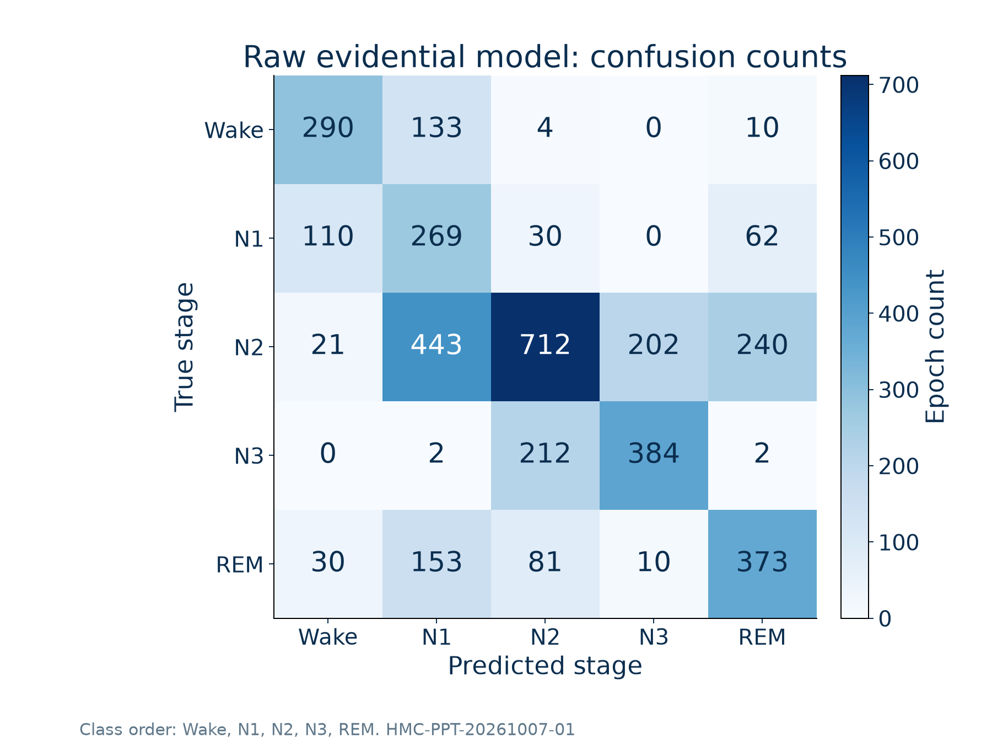
Appendix — Raw Confusion Counts
Source: HMC-PPT-20261007-01 | confusion_matrix_counts.csv
32
Notes:
Appendix — Raw Confusion Counts
Run: HMC-PPT-20261007-01
Sources: confusion_matrix_counts.csv
Test recordings: SN009, SN001, SN004, SN022.
Checkpoint: /content/drive/MyDrive/Sleep_Health_Profiling/models/HMC_CHECKPOINTS/best_objective1_model.keras
Checkpoint SHA256: 3bf1423246d5672ce7473562079cb4e8d9aa1a578e18c1cb65e6b43e4156b226
All classification results use identical corrected test epochs.
Only four test recordings; no external validation.
Final training hardware and global training RNG state not preserved.
Notebook execution counts were cleared; saved outputs are historical evidence rather than complete execution provenance.
Test records were evaluated repeatedly in notebook development; not a newly blinded clinical test.
Rule thresholds have no clinical validation in this project.
Evidential probabilities are not a separately fitted self-calibrated condition.
SN identifiers denote recordings; repository assumes one subject per ID and has no independent person-identity mapping.

Slide 33
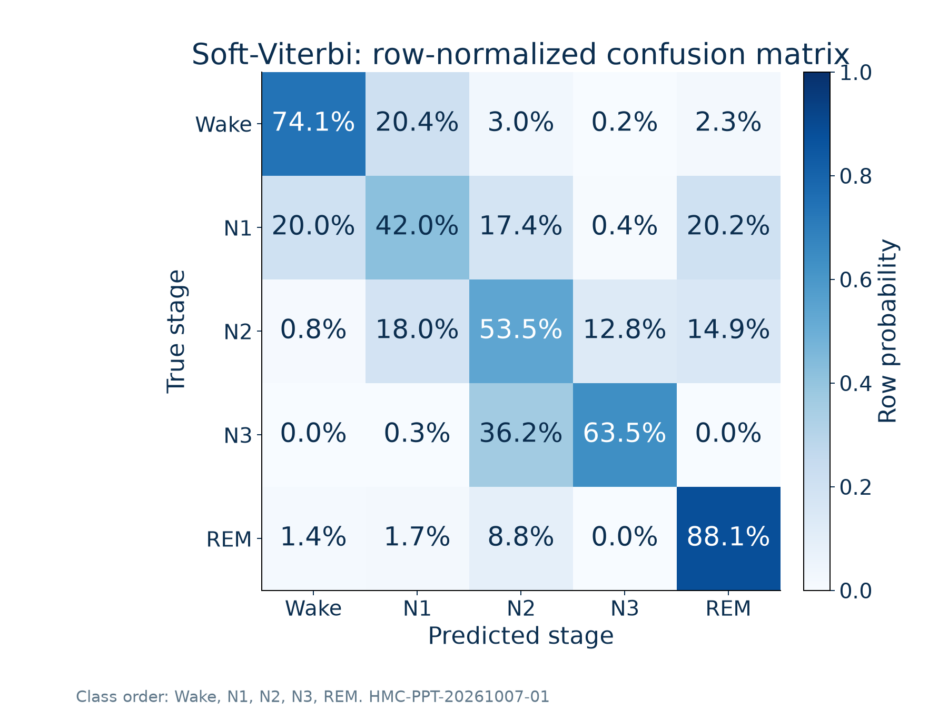
Appendix — Soft-Viterbi Confusion Matrix
Source: HMC-PPT-20261007-01 | smoothed_confusion_matrix_normalized.csv
33
Notes:
Appendix — Soft-Viterbi Confusion Matrix
Run: HMC-PPT-20261007-01
Sources: smoothed_confusion_matrix_normalized.csv
Test recordings: SN009, SN001, SN004, SN022.
Checkpoint: /content/drive/MyDrive/Sleep_Health_Profiling/models/HMC_CHECKPOINTS/best_objective1_model.keras
Checkpoint SHA256: 3bf1423246d5672ce7473562079cb4e8d9aa1a578e18c1cb65e6b43e4156b226
All classification results use identical corrected test epochs.
Only four test recordings; no external validation.
Final training hardware and global training RNG state not preserved.
Notebook execution counts were cleared; saved outputs are historical evidence rather than complete execution provenance.
Test records were evaluated repeatedly in notebook development; not a newly blinded clinical test.
Rule thresholds have no clinical validation in this project.
Evidential probabilities are not a separately fitted self-calibrated condition.
SN identifiers denote recordings; repository assumes one subject per ID and has no independent person-identity mapping.
Renamed unsupported self-calibrated appendix condition: no such checkpoint exists in the final project model directory.

Slide 34
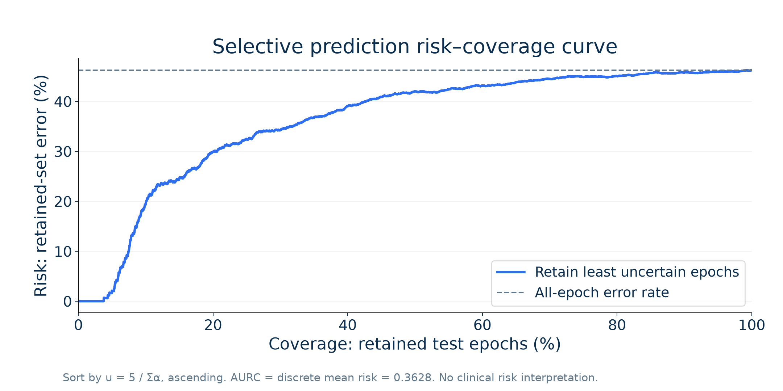
Appendix — Risk–Coverage Curve
Source: HMC-PPT-20261007-01 | risk_coverage_data.csv, calibration_metrics.json
34
Notes:
Appendix — Risk–Coverage Curve
Run: HMC-PPT-20261007-01
Sources: risk_coverage_data.csv, calibration_metrics.json
Test recordings: SN009, SN001, SN004, SN022.
Checkpoint: /content/drive/MyDrive/Sleep_Health_Profiling/models/HMC_CHECKPOINTS/best_objective1_model.keras
Checkpoint SHA256: 3bf1423246d5672ce7473562079cb4e8d9aa1a578e18c1cb65e6b43e4156b226
All classification results use identical corrected test epochs.
Only four test recordings; no external validation.
Final training hardware and global training RNG state not preserved.
Notebook execution counts were cleared; saved outputs are historical evidence rather than complete execution provenance.
Test records were evaluated repeatedly in notebook development; not a newly blinded clinical test.
Rule thresholds have no clinical validation in this project.
Evidential probabilities are not a separately fitted self-calibrated condition.
SN identifiers denote recordings; repository assumes one subject per ID and has no independent person-identity mapping.

Slide 35
Appendix — Reliability and Calibration
Raw probabilities
10 equal-width bins
ECE: 0.0705
Brier: 0.5879
NLL: 1.1012
Bin counts shown below the curve.
Source: HMC-PPT-20261007-01 | calibration_bins.csv, calibration_metrics.json
35
Notes:
Appendix — Reliability and Calibration
Run: HMC-PPT-20261007-01
Sources: calibration_bins.csv, calibration_metrics.json
Test recordings: SN009, SN001, SN004, SN022.
Checkpoint: /content/drive/MyDrive/Sleep_Health_Profiling/models/HMC_CHECKPOINTS/best_objective1_model.keras
Checkpoint SHA256: 3bf1423246d5672ce7473562079cb4e8d9aa1a578e18c1cb65e6b43e4156b226
All classification results use identical corrected test epochs.
Only four test recordings; no external validation.
Final training hardware and global training RNG state not preserved.
Notebook execution counts were cleared; saved outputs are historical evidence rather than complete execution provenance.
Test records were evaluated repeatedly in notebook development; not a newly blinded clinical test.
Rule thresholds have no clinical validation in this project.
Evidential probabilities are not a separately fitted self-calibrated condition.
SN identifiers denote recordings; repository assumes one subject per ID and has no independent person-identity mapping.

Slide 36
Appendix — Training Class Weights
Stage | Training epochs | Balanced weight
Wake | 3,202 | 0.950406
N1 | 1,553 | 1.959562
N2 | 5,254 | 0.579216
N3 | 2,926 | 1.040055
REM | 2,281 | 1.334152
wk = Ntraining / (5 × Nk)
Balanced weights use training labels only; passed to model.fit(class_weight=...).
Source: HMC-PPT-20261007-01 | class_weights.csv
36
Notes:
Appendix — Training Class Weights
Run: HMC-PPT-20261007-01
Sources: class_weights.csv
Test recordings: SN009, SN001, SN004, SN022.
Checkpoint: /content/drive/MyDrive/Sleep_Health_Profiling/models/HMC_CHECKPOINTS/best_objective1_model.keras
Checkpoint SHA256: 3bf1423246d5672ce7473562079cb4e8d9aa1a578e18c1cb65e6b43e4156b226
All classification results use identical corrected test epochs.
Only four test recordings; no external validation.
Final training hardware and global training RNG state not preserved.
Notebook execution counts were cleared; saved outputs are historical evidence rather than complete execution provenance.
Test records were evaluated repeatedly in notebook development; not a newly blinded clinical test.
Rule thresholds have no clinical validation in this project.
Evidential probabilities are not a separately fitted self-calibrated condition.
SN identifiers denote recordings; repository assumes one subject per ID and has no independent person-identity mapping.

Slide 37
Appendix — Final Hyperparameters
Setting | Verified configuration
Optimizer / learning rate | Adam / 1 × 10⁻⁴
Batch / epoch limit / completed | 128 / 10 / 10
Checkpoint selection | Maximum validation evidential accuracy; epoch 9
Early stopping / scheduler | Patience 5, restore best; not triggered / no scheduler
Dropout / evidence penalty | 0.2 and 0.1 / coefficient 0.003
Label smoothing / class weighting | 0.05 / balanced training-label weights
Seed provenance | Split seed 42; final training RNG state not recoverable
Hardware / versions | Training hardware not recorded; checkpoint Keras 3.13.2
Source: HMC-PPT-20261007-01 | hyperparameters.json, checkpoint_config.json
37
Notes:
Appendix — Final Hyperparameters
Run: HMC-PPT-20261007-01
Sources: hyperparameters.json, checkpoint_config.json
Test recordings: SN009, SN001, SN004, SN022.
Checkpoint: /content/drive/MyDrive/Sleep_Health_Profiling/models/HMC_CHECKPOINTS/best_objective1_model.keras
Checkpoint SHA256: 3bf1423246d5672ce7473562079cb4e8d9aa1a578e18c1cb65e6b43e4156b226
All classification results use identical corrected test epochs.
Only four test recordings; no external validation.
Final training hardware and global training RNG state not preserved.
Notebook execution counts were cleared; saved outputs are historical evidence rather than complete execution provenance.
Test records were evaluated repeatedly in notebook development; not a newly blinded clinical test.
Rule thresholds have no clinical validation in this project.
Evidential probabilities are not a separately fitted self-calibrated condition.
SN identifiers denote recordings; repository assumes one subject per ID and has no independent person-identity mapping.

Slide 38
Appendix — Implemented Biomarker Equations
Measure | Exact source equation
SE proxy (%) | 100 × nsleep / N
WASO (min) | 0.5 × Wake count between first and last sleep
N3 / all (%) | 100 × nN3 / N
SFI (/sleep h) | Count({N2,N3,REM} → {Wake,N1}) / (nsleep / 120)
N: evaluated 30-second epochs; nsleep: non-Wake epochs; nN3: N3 epochs.
WASO excludes trailing Wake; no-sleep WASO/SFI return 0 in source.
No verified time-in-bed denominator. SFI is a stage-transition proxy, not micro-arousal scoring.
Source: HMC-PPT-20261007-01 | biomarker_equations.md
38
Notes:
Appendix — Implemented Biomarker Equations
Run: HMC-PPT-20261007-01
Sources: biomarker_equations.md
Test recordings: SN009, SN001, SN004, SN022.
Checkpoint: /content/drive/MyDrive/Sleep_Health_Profiling/models/HMC_CHECKPOINTS/best_objective1_model.keras
Checkpoint SHA256: 3bf1423246d5672ce7473562079cb4e8d9aa1a578e18c1cb65e6b43e4156b226
All classification results use identical corrected test epochs.
Only four test recordings; no external validation.
Final training hardware and global training RNG state not preserved.
Notebook execution counts were cleared; saved outputs are historical evidence rather than complete execution provenance.
Test records were evaluated repeatedly in notebook development; not a newly blinded clinical test.
Rule thresholds have no clinical validation in this project.
Evidential probabilities are not a separately fitted self-calibrated condition.
SN identifiers denote recordings; repository assumes one subject per ID and has no independent person-identity mapping.

Slide 39
Appendix — Weighted Viterbi Details
Aij = (1 + training transitions i→j) / row sum
πj = (1 + training countj) / (5 + Ntraining)
ptj = (etj + 1) / Σk(etk + 1)
D0j = log(πj + ε) + 0.9 log(p0j + ε)
Dtj = maxi[Dt−1,i + log(Aij + ε)] + 0.9 log(ptj + ε)
Store argmax predecessors; backtrack from argmaxj DT−1,j.
ε = 10⁻¹²; training-only transitions; class order Wake/N1/N2/N3/REM.
Restart at each recording or missing-epoch gap. This is weighted MAP Viterbi, not differentiable soft-DP.
Source: HMC-PPT-20261007-01 | soft_viterbi_pseudocode.txt, transition_config.json
39
Notes:
Appendix — Weighted Viterbi Details
Run: HMC-PPT-20261007-01
Sources: soft_viterbi_pseudocode.txt, transition_config.json
Test recordings: SN009, SN001, SN004, SN022.
Checkpoint: /content/drive/MyDrive/Sleep_Health_Profiling/models/HMC_CHECKPOINTS/best_objective1_model.keras
Checkpoint SHA256: 3bf1423246d5672ce7473562079cb4e8d9aa1a578e18c1cb65e6b43e4156b226
All classification results use identical corrected test epochs.
Only four test recordings; no external validation.
Final training hardware and global training RNG state not preserved.
Notebook execution counts were cleared; saved outputs are historical evidence rather than complete execution provenance.
Test records were evaluated repeatedly in notebook development; not a newly blinded clinical test.
Rule thresholds have no clinical validation in this project.
Evidential probabilities are not a separately fitted self-calibrated condition.
SN identifiers denote recordings; repository assumes one subject per ID and has no independent person-identity mapping.

Slide 40
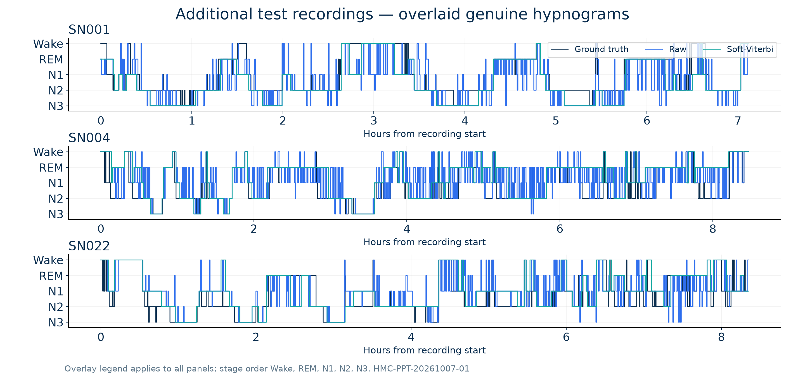
Appendix — Additional Test Hypnograms
Source: HMC-PPT-20261007-01 | test_epoch_predictions.csv
40
Notes:
Appendix — Additional Test Hypnograms
Run: HMC-PPT-20261007-01
Sources: test_epoch_predictions.csv
Test recordings: SN009, SN001, SN004, SN022.
Checkpoint: /content/drive/MyDrive/Sleep_Health_Profiling/models/HMC_CHECKPOINTS/best_objective1_model.keras
Checkpoint SHA256: 3bf1423246d5672ce7473562079cb4e8d9aa1a578e18c1cb65e6b43e4156b226
All classification results use identical corrected test epochs.
Only four test recordings; no external validation.
Final training hardware and global training RNG state not preserved.
Notebook execution counts were cleared; saved outputs are historical evidence rather than complete execution provenance.
Test records were evaluated repeatedly in notebook development; not a newly blinded clinical test.
Rule thresholds have no clinical validation in this project.
Evidential probabilities are not a separately fitted self-calibrated condition.
SN identifiers denote recordings; repository assumes one subject per ID and has no independent person-identity mapping.

Slide 41
Appendix — Related Literature
Study | Dataset | Modality | Protocol | Accuracy / macro F1
SeqSleepNet [1] 2019 | MASS; 200 | EEG+EOG+EMG | 20-fold subject CV | 87.10% / 83.30%
DeepSleepNet [2] 2017 | Sleep-EDF; 20 | EEG Fpz–Cz | 20-fold subject CV | 82.00% / 76.90%
Current raw model 2026 | HMC subset; 24 | Four-channel EEG | Fixed 16/4/4 split | 53.75% / 55.12%
Context only: different datasets, modalities and split protocols prevent direct ranking.
[1] DOI: 10.1109/TNSRE.2019.2896659
[2] DOI: 10.1109/TNSRE.2017.2721116
HMC dataset: DOI 10.13026/t79q-fr32. Full sources and protocols in references.txt.
Source: HMC-PPT-20261007-01 | literature_comparison.csv, references.txt
41
Notes:
Appendix — Related Literature
Run: HMC-PPT-20261007-01
Sources: literature_comparison.csv, references.txt
Test recordings: SN009, SN001, SN004, SN022.
Checkpoint: /content/drive/MyDrive/Sleep_Health_Profiling/models/HMC_CHECKPOINTS/best_objective1_model.keras
Checkpoint SHA256: 3bf1423246d5672ce7473562079cb4e8d9aa1a578e18c1cb65e6b43e4156b226
All classification results use identical corrected test epochs.
Only four test recordings; no external validation.
Final training hardware and global training RNG state not preserved.
Notebook execution counts were cleared; saved outputs are historical evidence rather than complete execution provenance.
Test records were evaluated repeatedly in notebook development; not a newly blinded clinical test.
Rule thresholds have no clinical validation in this project.
Evidential probabilities are not a separately fitted self-calibrated condition.
SN identifiers denote recordings; repository assumes one subject per ID and has no independent person-identity mapping.

