Slide 1
FINAL PROJECT REPORT
EEG Sleep Classification and Reference-Based Sleep-Health Profiling
Existing evidential Transformer with targeted N1/N2 spectral refinement
Rikin Parekh · Om Ahuja
23BIT044 · 23BIT014
Guide: Dr. Santosh Sathpathy
Information and Communication Technology
Pandit Deendayal Energy University
Verified notebook reproduction · 7 October 2026
Notes:
Source: Biomarker_N1_N2_Refinement.ipynb cells 1–46; independent reproduction HMC-N1N2-20261007.
HMC is a heterogeneous clinical cohort, not a healthy normative population.
Deviation levels count domains, not clinical severity or disease risk.
Stored SN001 has 190 epochs (95 minutes); whole-night interpretation is unsupported.
Epoch-index timing assumes continuity; original EDF alignment needs separate verification.
Reference architecture is estimated in sample on training recordings.
Transformer uncertainty applies to the original five-stage output, not refined classification confidence.

Slide 2
Problem and project scope
Classify each 30-second EEG epoch as Wake, N1, N2, N3, or REM.
Baseline confusion: 506 true N2 epochs were predicted N1.
Extend the retained classifier with spectral refinement and recording-level descriptive profiles.
HMC comparisons are research reference comparisons, not diagnostic conclusions.
Source: HMC-N1N2-20261007 · notebook and reproduced artifacts
02 / 41
Notes:
Source: Biomarker_N1_N2_Refinement.ipynb cells 1–46; independent reproduction HMC-N1N2-20261007.
HMC is a heterogeneous clinical cohort, not a healthy normative population.
Deviation levels count domains, not clinical severity or disease risk.
Stored SN001 has 190 epochs (95 minutes); whole-night interpretation is unsupported.
Epoch-index timing assumes continuity; original EDF alignment needs separate verification.
Reference architecture is estimated in sample on training recordings.
Transformer uncertainty applies to the original five-stage output, not refined classification confidence.

Slide 3
Implemented project objectives
Retain the five-stage evidential Transformer and its uncertainty output.
Refine Transformer-predicted N1/N2 using nine EEG spectral features.
Calculate architecture metrics and aggregate spectral biomarkers.
Compare with the 16-recording training reference and display four-domain deviation profiles.
Source: HMC-N1N2-20261007 · notebook and reproduced artifacts
03 / 41
Notes:
Source: Biomarker_N1_N2_Refinement.ipynb cells 1–46; independent reproduction HMC-N1N2-20261007.
HMC is a heterogeneous clinical cohort, not a healthy normative population.
Deviation levels count domains, not clinical severity or disease risk.
Stored SN001 has 190 epochs (95 minutes); whole-night interpretation is unsupported.
Epoch-index timing assumes continuity; original EDF alignment needs separate verification.
Reference architecture is estimated in sample on training recordings.
Transformer uncertainty applies to the original five-stage output, not refined classification confidence.

Slide 4
HMC Sleep Staging Database v1.1
151 whole-night PSG recordings; 85 male and 66 female.
Mean age: 53.9 ± 15.4 years.
A heterogeneous population referred for PSG examinations.
The project uses 24 recordings and four EEG channels sampled originally at 256 Hz.
Source: PhysioNet HMC v1.1
04 / 41
Notes:
Dataset source: https://physionet.org/content/hmc-sleep-staging/1.1/
HMC is a heterogeneous clinical cohort, not a healthy normative population.
Deviation levels count domains, not clinical severity or disease risk.
Stored SN001 has 190 epochs (95 minutes); whole-night interpretation is unsupported.
Epoch-index timing assumes continuity; original EDF alignment needs separate verification.
Reference architecture is estimated in sample on training recordings.
Transformer uncertainty applies to the original five-stage output, not refined classification confidence.

Slide 5
Recording-wise experimental split
Partition | Recordings | Stored epochs
Training | 16 | 15,216
Validation | 4 | 3,619
Testing | 4 | 3,109
Total | 24 | 21,944
Test IDs: SN001, SN004, SN009, SN022. SN identifiers name recordings; partitions are disjoint.
Source: HMC-N1N2-20261007 · notebook and reproduced artifacts
05 / 41
Notes:
Source: Biomarker_N1_N2_Refinement.ipynb cells 1–46; independent reproduction HMC-N1N2-20261007.
Test IDs: SN001, SN004, SN009, SN022. SN identifiers name recordings; partitions are disjoint.
HMC is a heterogeneous clinical cohort, not a healthy normative population.
Deviation levels count domains, not clinical severity or disease risk.
Stored SN001 has 190 epochs (95 minutes); whole-night interpretation is unsupported.
Epoch-index timing assumes continuity; original EDF alignment needs separate verification.
Reference architecture is estimated in sample on training recordings.
Transformer uncertainty applies to the original five-stage output, not refined classification confidence.

Slide 6
Evaluation scope and SN001 segment
Current notebook: 3,109 test epochs, including SN001’s stored 190 epochs (95 minutes).
Earlier EDF alignment audit: SN001 reconstructed to 854 epochs; test total 3,773.
The 55.45% → 59.34% comparison belongs to the current stored-input experiment.
SN001’s segment duration and onset do not establish whole-night sleep-health measurements.
Source: HMC-N1N2-20261007 · notebook and reproduced artifacts
06 / 41
Notes:
Source: Biomarker_N1_N2_Refinement.ipynb cells 1–46; independent reproduction HMC-N1N2-20261007.
HMC is a heterogeneous clinical cohort, not a healthy normative population.
Deviation levels count domains, not clinical severity or disease risk.
Stored SN001 has 190 epochs (95 minutes); whole-night interpretation is unsupported.
Epoch-index timing assumes continuity; original EDF alignment needs separate verification.
Reference architecture is estimated in sample on training recordings.
Transformer uncertainty applies to the original five-stage output, not refined classification confidence.

Slide 7
EEG preprocessing and model input
Channels: EEG F4-M1, EEG C4-M1, EEG O2-M1, EEG C3-M2.
Actual preprocessing order: 50 Hz notch at the original rate, 0.3–35 Hz bandpass, resample to 100 Hz.
Complete 30-second epochs; per-epoch, per-channel normalization.
Each input epoch: 4 channels × 3,000 samples. Apply the notch before 100 Hz resampling.
Source: HMC-N1N2-20261007 · notebook and reproduced artifacts
07 / 41
Notes:
Source: Biomarker_N1_N2_Refinement.ipynb cells 1–46; independent reproduction HMC-N1N2-20261007.
HMC is a heterogeneous clinical cohort, not a healthy normative population.
Deviation levels count domains, not clinical severity or disease risk.
Stored SN001 has 190 epochs (95 minutes); whole-night interpretation is unsupported.
Epoch-index timing assumes continuity; original EDF alignment needs separate verification.
Reference architecture is estimated in sample on training recordings.
Transformer uncertainty applies to the original five-stage output, not refined classification confidence.

Slide 8
Retained Fast SCFormer-U architecture
4 × 3,000 EEG → Conv1D 64 (kernel 7, stride 4) → Conv1D 128 (kernel 5, stride 4)
Self-attention: 4 heads, key dimension 16; residual normalization and feed-forward layers
Bidirectional LSTM: 64 units per direction; pooling and dense evidence head
Five softplus evidence outputs; 226,309 total parameters. Attention and recurrence operate within the epoch.
Source: HMC-N1N2-20261007 · notebook and reproduced artifacts
08 / 41
Notes:
Source: Biomarker_N1_N2_Refinement.ipynb cells 1–46; independent reproduction HMC-N1N2-20261007.
HMC is a heterogeneous clinical cohort, not a healthy normative population.
Deviation levels count domains, not clinical severity or disease risk.
Stored SN001 has 190 epochs (95 minutes); whole-night interpretation is unsupported.
Epoch-index timing assumes continuity; original EDF alignment needs separate verification.
Reference architecture is estimated in sample on training recordings.
Transformer uncertainty applies to the original five-stage output, not refined classification confidence.

Slide 9
Role of the retained components
Component | Role
CNN encoder | Local EEG patterns and temporal downsampling
Self-attention | Relations between positions within each epoch
BiLSTM | Downsampled within-epoch sequence
Evidence head | Five-class Dirichlet evidence
Spectral refinement | Independent classifier for N1/N2 candidates
Source: HMC-N1N2-20261007 · notebook and reproduced artifacts
09 / 41
Notes:
Source: Biomarker_N1_N2_Refinement.ipynb cells 1–46; independent reproduction HMC-N1N2-20261007.
HMC is a heterogeneous clinical cohort, not a healthy normative population.
Deviation levels count domains, not clinical severity or disease risk.
Stored SN001 has 190 epochs (95 minutes); whole-night interpretation is unsupported.
Epoch-index timing assumes continuity; original EDF alignment needs separate verification.
Reference architecture is estimated in sample on training recordings.
Transformer uncertainty applies to the original five-stage output, not refined classification confidence.

Slide 10
Evidential probabilities and uncertainty
alpha_k = evidence_k + 1
P_k = alpha_k / sum(alpha)
Uncertainty = 5 / sum(alpha)
Refinement changes the selected N1/N2 label. Transformer probabilities and uncertainty still refer to the original five-stage output.
Source: HMC-N1N2-20261007 · notebook and reproduced artifacts
10 / 41
Notes:
Source: Biomarker_N1_N2_Refinement.ipynb cells 1–46; independent reproduction HMC-N1N2-20261007.
HMC is a heterogeneous clinical cohort, not a healthy normative population.
Deviation levels count domains, not clinical severity or disease risk.
Stored SN001 has 190 epochs (95 minutes); whole-night interpretation is unsupported.
Epoch-index timing assumes continuity; original EDF alignment needs separate verification.
Reference architecture is estimated in sample on training recordings.
Transformer uncertainty applies to the original five-stage output, not refined classification confidence.

Slide 11
Retained training configuration
Setting | Existing Transformer
Optimizer / learning rate | Adam / 0.0001
Batch size / maximum epochs | 128 / 10
Validation-selected checkpoint | Epoch 9
Class weighting | Training labels only
Architecture replacement | None
The refinement audit loads the saved checkpoint; it does not retrain the Transformer.
Source: HMC-N1N2-20261007 · notebook and reproduced artifacts
11 / 41
Notes:
Source: Biomarker_N1_N2_Refinement.ipynb cells 1–46; independent reproduction HMC-N1N2-20261007.
The refinement audit loads the saved checkpoint; it does not retrain the Transformer.
HMC is a heterogeneous clinical cohort, not a healthy normative population.
Deviation levels count domains, not clinical severity or disease risk.
Stored SN001 has 190 epochs (95 minutes); whole-night interpretation is unsupported.
Epoch-index timing assumes continuity; original EDF alignment needs separate verification.
Reference architecture is estimated in sample on training recordings.
Transformer uncertainty applies to the original five-stage output, not refined classification confidence.

Slide 12
Original Transformer performance
Metric | Stored-input test set
Accuracy | 55.45%
Macro F1 | 57.42%
N1 F1 | 36.60%
N2 F1 | 57.12%
Evaluated epochs | 3,109
Same labels and epochs are used for the baseline/refinement comparison.
Source: HMC-N1N2-20261007 · notebook and reproduced artifacts
12 / 41
Notes:
Source: Biomarker_N1_N2_Refinement.ipynb cells 1–46; independent reproduction HMC-N1N2-20261007.
Same labels and epochs are used for the baseline/refinement comparison.
HMC is a heterogeneous clinical cohort, not a healthy normative population.
Deviation levels count domains, not clinical severity or disease risk.
Stored SN001 has 190 epochs (95 minutes); whole-night interpretation is unsupported.
Epoch-index timing assumes continuity; original EDF alignment needs separate verification.
Reference architecture is estimated in sample on training recordings.
Transformer uncertainty applies to the original five-stage output, not refined classification confidence.

Slide 13
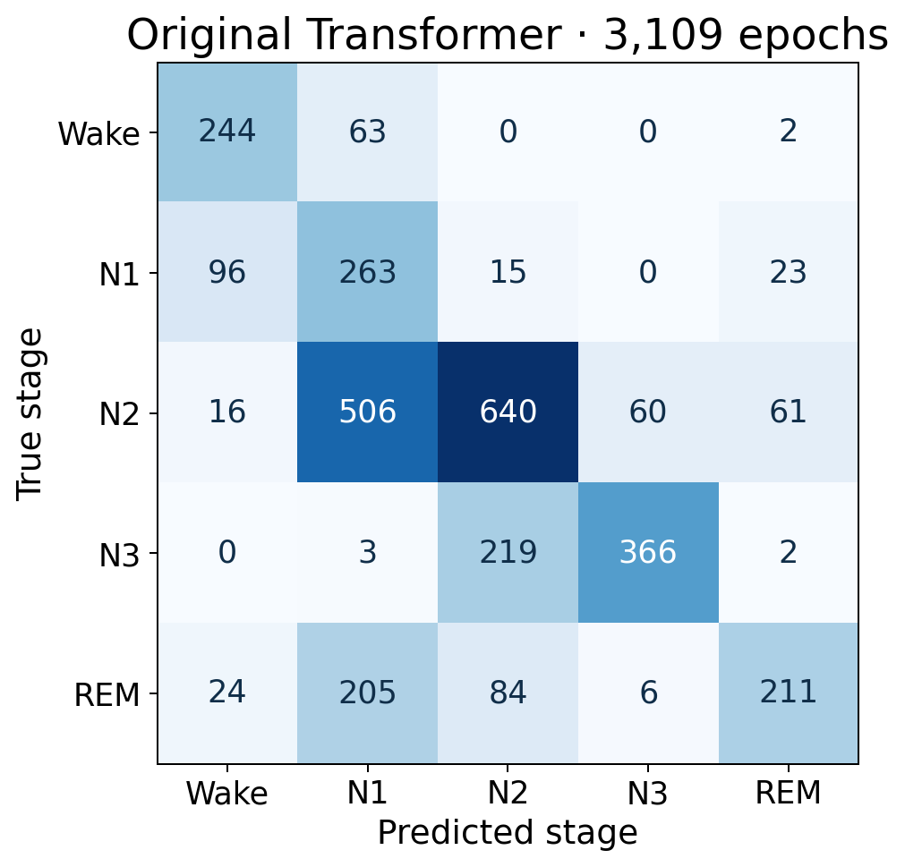
Baseline confusion matrix
Largest N2 error: 506 N2 epochs predicted N1. Rows are true labels; columns are predictions.
Source: HMC-N1N2-20261007 · notebook and reproduced artifacts
13 / 41
Notes:
Source: Biomarker_N1_N2_Refinement.ipynb cells 1–46; independent reproduction HMC-N1N2-20261007.
Largest N2 error: 506 N2 epochs predicted N1. Rows are true labels; columns are predictions.
HMC is a heterogeneous clinical cohort, not a healthy normative population.
Deviation levels count domains, not clinical severity or disease risk.
Stored SN001 has 190 epochs (95 minutes); whole-night interpretation is unsupported.
Epoch-index timing assumes continuity; original EDF alignment needs separate verification.
Reference architecture is estimated in sample on training recordings.
Transformer uncertainty applies to the original five-stage output, not refined classification confidence.

Slide 14
Nine EEG features for N1/N2 refinement
Feature group | Features
Relative band power | Delta, Theta, Alpha, Sigma, Beta
Ratios to Delta | Sigma/Delta, Theta/Delta, Alpha/Delta, Beta/Delta
Frequency bands (Hz) | 0.5–4; 4–8; 8–12; 12–16; 16–30
Candidate gate | Transformer predicts N1 or N2
These are project feature boundaries, not AASM staging definitions. Sigma power does not measure spindle density.
Source: HMC-N1N2-20261007 · notebook and reproduced artifacts
14 / 41
Notes:
Source: Biomarker_N1_N2_Refinement.ipynb cells 1–46; independent reproduction HMC-N1N2-20261007.
These are project feature boundaries, not AASM staging definitions. Sigma power does not measure spindle density.
HMC is a heterogeneous clinical cohort, not a healthy normative population.
Deviation levels count domains, not clinical severity or disease risk.
Stored SN001 has 190 epochs (95 minutes); whole-night interpretation is unsupported.
Epoch-index timing assumes continuity; original EDF alignment needs separate verification.
Reference architecture is estimated in sample on training recordings.
Transformer uncertainty applies to the original five-stage output, not refined classification confidence.

Slide 15
Welch spectral extraction
Welch PSD per channel: 100 Hz, 400-sample windows (4 seconds), 200-sample overlap.
Integrate each band with a lower-inclusive, upper-exclusive frequency mask.
Average band powers across the four channels before computing relative powers and ratios.
Relative power denominator: measured total power in 0.5–30 Hz. Aggregate epoch features by arithmetic mean per recording.
Source: HMC-N1N2-20261007 · notebook and reproduced artifacts
15 / 41
Notes:
Source: Biomarker_N1_N2_Refinement.ipynb cells 1–46; independent reproduction HMC-N1N2-20261007.
HMC is a heterogeneous clinical cohort, not a healthy normative population.
Deviation levels count domains, not clinical severity or disease risk.
Stored SN001 has 190 epochs (95 minutes); whole-night interpretation is unsupported.
Epoch-index timing assumes continuity; original EDF alignment needs separate verification.
Reference architecture is estimated in sample on training recordings.
Transformer uncertainty applies to the original five-stage output, not refined classification confidence.

Slide 16
Relative powers and Delta ratios
Relative band power = mean channel band power / mean channel total power
Band/Delta ratio = mean channel band power / mean channel Delta power
Delta is a project feature-engineering reference, not a mandatory denominator.
Normalized EEG powers are spectral features; do not describe them as calibrated absolute physical power.
Source: HMC-N1N2-20261007 · notebook and reproduced artifacts
16 / 41
Notes:
Source: Biomarker_N1_N2_Refinement.ipynb cells 1–46; independent reproduction HMC-N1N2-20261007.
HMC is a heterogeneous clinical cohort, not a healthy normative population.
Deviation levels count domains, not clinical severity or disease risk.
Stored SN001 has 190 epochs (95 minutes); whole-night interpretation is unsupported.
Epoch-index timing assumes continuity; original EDF alignment needs separate verification.
Reference architecture is estimated in sample on training recordings.
Transformer uncertainty applies to the original five-stage output, not refined classification confidence.

Slide 17
Training and inference gates
Fit the refiner only on training epochs where the true stage AND the Transformer prediction are N1/N2.
Training subset: 1,278 N1 and 4,588 N2 epochs; 5,866 total.
StandardScaler → LogisticRegression(class_weight="balanced", max_iter=2000, random_state=42).
At inference, gate by the Transformer prediction only. Ground truth is never used to route test epochs.
Source: HMC-N1N2-20261007 · notebook and reproduced artifacts
17 / 41
Notes:
Source: Biomarker_N1_N2_Refinement.ipynb cells 1–46; independent reproduction HMC-N1N2-20261007.
HMC is a heterogeneous clinical cohort, not a healthy normative population.
Deviation levels count domains, not clinical severity or disease risk.
Stored SN001 has 190 epochs (95 minutes); whole-night interpretation is unsupported.
Epoch-index timing assumes continuity; original EDF alignment needs separate verification.
Reference architecture is estimated in sample on training recordings.
Transformer uncertainty applies to the original five-stage output, not refined classification confidence.

Slide 18
Standardized logistic regression coefficients
Feature | Coefficient toward N2
delta relative | 0.762
theta relative | 1.377
alpha relative | -0.827
sigma relative | 2.135
beta relative | -1.783
sigma delta ratio | -1.436
theta delta ratio | -1.066
alpha delta ratio | 0.995
beta delta ratio | 0.309
Multivariate coefficients depend on correlated features and standardization; do not read them as isolated physiological rules.
Source: HMC-N1N2-20261007 · notebook and reproduced artifacts
18 / 41
Notes:
Source: Biomarker_N1_N2_Refinement.ipynb cells 1–46; independent reproduction HMC-N1N2-20261007.
Multivariate coefficients depend on correlated features and standardization; do not read them as isolated physiological rules.
HMC is a heterogeneous clinical cohort, not a healthy normative population.
Deviation levels count domains, not clinical severity or disease risk.
Stored SN001 has 190 epochs (95 minutes); whole-night interpretation is unsupported.
Epoch-index timing assumes continuity; original EDF alignment needs separate verification.
Reference architecture is estimated in sample on training recordings.
Transformer uncertainty applies to the original five-stage output, not refined classification confidence.

Slide 19
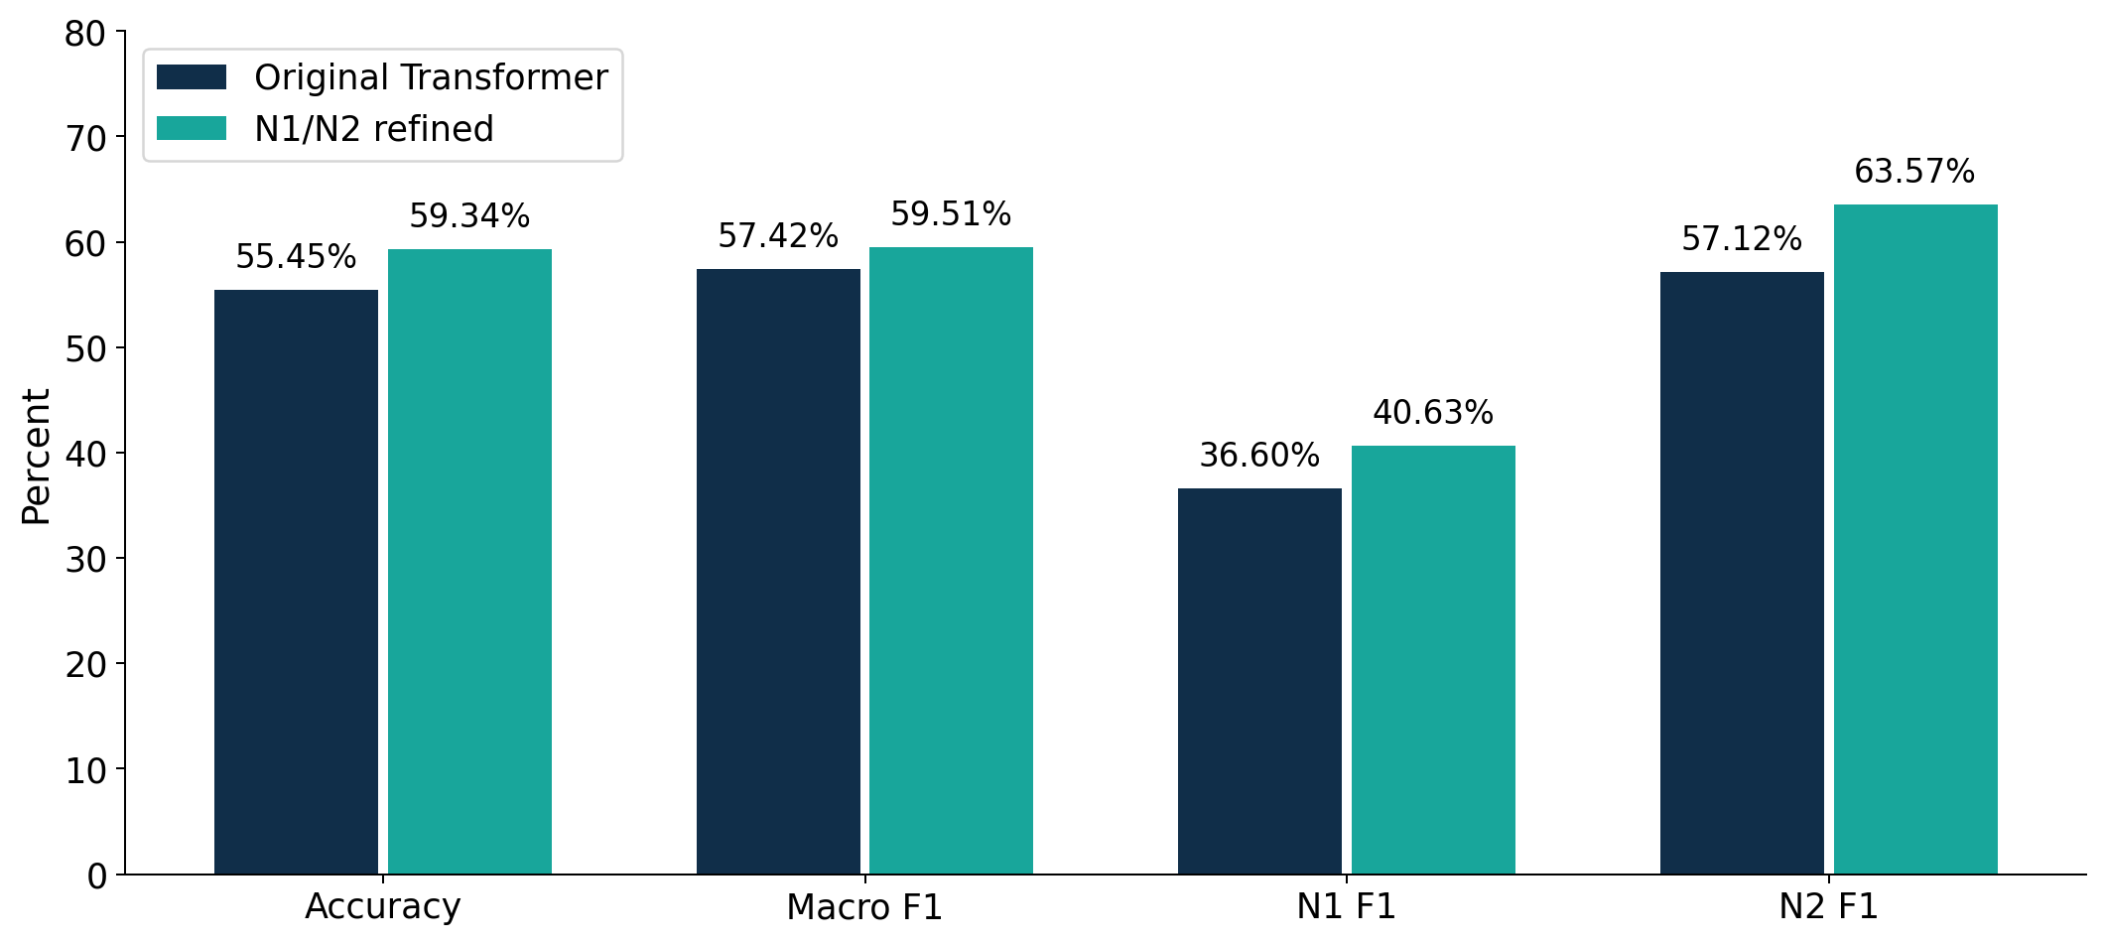
Effect of targeted N1/N2 refinement
Accuracy +3.89 pp; macro F1 +2.10 pp using unrounded values. N1 F1 +4.03 pp; N2 F1 +6.45 pp.
Source: HMC-N1N2-20261007 · notebook and reproduced artifacts
19 / 41
Notes:
Source: Biomarker_N1_N2_Refinement.ipynb cells 1–46; independent reproduction HMC-N1N2-20261007.
Accuracy +3.89 pp; macro F1 +2.10 pp using unrounded values. N1 F1 +4.03 pp; N2 F1 +6.45 pp.
HMC is a heterogeneous clinical cohort, not a healthy normative population.
Deviation levels count domains, not clinical severity or disease risk.
Stored SN001 has 190 epochs (95 minutes); whole-night interpretation is unsupported.
Epoch-index timing assumes continuity; original EDF alignment needs separate verification.
Reference architecture is estimated in sample on training recordings.
Transformer uncertainty applies to the original five-stage output, not refined classification confidence.

Slide 20
Which predictions changed?
Outcome | Epochs
Unchanged | 2,871
Corrected | 154
Wrong to wrong | 51
Degraded | 33
Total changed | 238
W, N3 and REM predictions are retained. Epochs truly in those stages can still enter refinement if originally predicted N1/N2.
Source: HMC-N1N2-20261007 · notebook and reproduced artifacts
20 / 41
Notes:
Source: Biomarker_N1_N2_Refinement.ipynb cells 1–46; independent reproduction HMC-N1N2-20261007.
W, N3 and REM predictions are retained. Epochs truly in those stages can still enter refinement if originally predicted N1/N2.
HMC is a heterogeneous clinical cohort, not a healthy normative population.
Deviation levels count domains, not clinical severity or disease risk.
Stored SN001 has 190 epochs (95 minutes); whole-night interpretation is unsupported.
Epoch-index timing assumes continuity; original EDF alignment needs separate verification.
Reference architecture is estimated in sample on training recordings.
Transformer uncertainty applies to the original five-stage output, not refined classification confidence.

Slide 21
Performance by test recording
Recording | Epochs | Baseline accuracy | Refined accuracy
SN001 | 190 | 46.84% | 48.42%
SN004 | 1,016 | 56.79% | 64.07%
SN009 | 901 | 61.27% | 64.48%
SN022 | 1,002 | 50.50% | 52.00%
The SN001 evaluation covers 95 minutes. No whole-night performance or external cohort validation is implied.
Source: HMC-N1N2-20261007 · notebook and reproduced artifacts
21 / 41
Notes:
Source: Biomarker_N1_N2_Refinement.ipynb cells 1–46; independent reproduction HMC-N1N2-20261007.
The SN001 evaluation covers 95 minutes. No whole-night performance or external cohort validation is implied.
HMC is a heterogeneous clinical cohort, not a healthy normative population.
Deviation levels count domains, not clinical severity or disease risk.
Stored SN001 has 190 epochs (95 minutes); whole-night interpretation is unsupported.
Epoch-index timing assumes continuity; original EDF alignment needs separate verification.
Reference architecture is estimated in sample on training recordings.
Transformer uncertainty applies to the original five-stage output, not refined classification confidence.

Slide 22
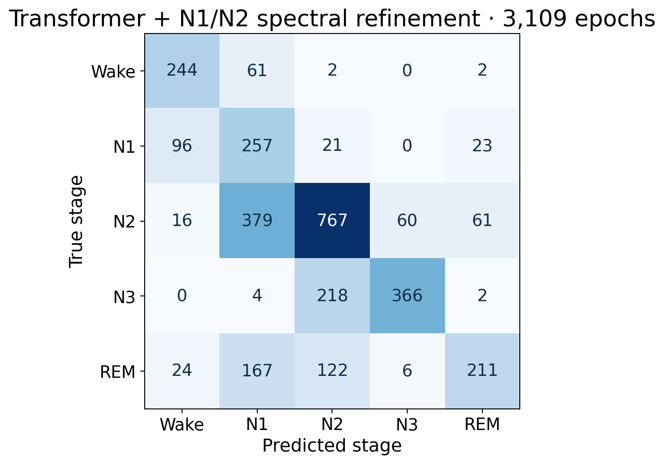
Refined confusion matrix
N2→N1 errors: 506 → 379. All true N1/N2 epochs: accuracy 53.75% → 60.95% (1,680 epochs).
Source: HMC-N1N2-20261007 · notebook and reproduced artifacts
22 / 41
Notes:
Source: Biomarker_N1_N2_Refinement.ipynb cells 1–46; independent reproduction HMC-N1N2-20261007.
N2→N1 errors: 506 → 379. All true N1/N2 epochs: accuracy 53.75% → 60.95% (1,680 epochs).
HMC is a heterogeneous clinical cohort, not a healthy normative population.
Deviation levels count domains, not clinical severity or disease risk.
Stored SN001 has 190 epochs (95 minutes); whole-night interpretation is unsupported.
Epoch-index timing assumes continuity; original EDF alignment needs separate verification.
Reference architecture is estimated in sample on training recordings.
Transformer uncertainty applies to the original five-stage output, not refined classification confidence.

Slide 23

Original and refined hypnogram — SN009
Targeted N1/N2 changes retain the other predicted stages and the recording order.
Source: HMC-N1N2-20261007 · notebook and reproduced artifacts
23 / 41
Notes:
Source: Biomarker_N1_N2_Refinement.ipynb cells 1–46; independent reproduction HMC-N1N2-20261007.
Targeted N1/N2 changes retain the other predicted stages and the recording order.
HMC is a heterogeneous clinical cohort, not a healthy normative population.
Deviation levels count domains, not clinical severity or disease risk.
Stored SN001 has 190 epochs (95 minutes); whole-night interpretation is unsupported.
Epoch-index timing assumes continuity; original EDF alignment needs separate verification.
Reference architecture is estimated in sample on training recordings.
Transformer uncertainty applies to the original five-stage output, not refined classification confidence.

Slide 24
Sleep architecture measurements
Metric | Definition
TST | N1 + N2 + N3 + REM time
Sleep efficiency | 100 × TST / evaluated recording duration
Stage percentages | 100 × stage sleep time / TST
WASO | Wake time after first sleep to sequence end
Fragmentation | All stage transitions / TST hours
Recording duration is an evaluated-window measure. Contiguous timing is assumed for the notebook NPZ sequences.
Source: HMC-N1N2-20261007 · notebook and reproduced artifacts
24 / 41
Notes:
Source: Biomarker_N1_N2_Refinement.ipynb cells 1–46; independent reproduction HMC-N1N2-20261007.
Recording duration is an evaluated-window measure. Contiguous timing is assumed for the notebook NPZ sequences.
HMC is a heterogeneous clinical cohort, not a healthy normative population.
Deviation levels count domains, not clinical severity or disease risk.
Stored SN001 has 190 epochs (95 minutes); whole-night interpretation is unsupported.
Epoch-index timing assumes continuity; original EDF alignment needs separate verification.
Reference architecture is estimated in sample on training recordings.
Transformer uncertainty applies to the original five-stage output, not refined classification confidence.

Slide 25
Sleep duration and efficiency
Each stored epoch contributes 0.5 minutes. Wake is excluded from TST.
Sleep efficiency uses the duration of the evaluated sequence, not independently verified time in bed.
N1/N2 refinement cannot change TST or efficiency because both labels are sleep.
SN001’s 91.5 minutes predicted sleep in a 95-minute segment must not be treated as whole-night sleep duration.
Source: HMC-N1N2-20261007 · notebook and reproduced artifacts
25 / 41
Notes:
Source: Biomarker_N1_N2_Refinement.ipynb cells 1–46; independent reproduction HMC-N1N2-20261007.
HMC is a heterogeneous clinical cohort, not a healthy normative population.
Deviation levels count domains, not clinical severity or disease risk.
Stored SN001 has 190 epochs (95 minutes); whole-night interpretation is unsupported.
Epoch-index timing assumes continuity; original EDF alignment needs separate verification.
Reference architecture is estimated in sample on training recordings.
Transformer uncertainty applies to the original five-stage output, not refined classification confidence.

Slide 26
Sleep initiation and Wake after sleep onset
SOL = index of first non-Wake epoch × 0.5 minutes.
WASO includes every Wake epoch after onset, including Wake at the end of this notebook’s sequence.
REM latency = time from first sleep epoch to first REM epoch.
No sleep or no REM makes the corresponding metric unavailable. Segment onset is relative to the segment, not lights-out.
Source: HMC-N1N2-20261007 · notebook and reproduced artifacts
26 / 41
Notes:
Source: Biomarker_N1_N2_Refinement.ipynb cells 1–46; independent reproduction HMC-N1N2-20261007.
HMC is a heterogeneous clinical cohort, not a healthy normative population.
Deviation levels count domains, not clinical severity or disease risk.
Stored SN001 has 190 epochs (95 minutes); whole-night interpretation is unsupported.
Epoch-index timing assumes continuity; original EDF alignment needs separate verification.
Reference architecture is estimated in sample on training recordings.
Transformer uncertainty applies to the original five-stage output, not refined classification confidence.

Slide 27
Stage percentages and fragmentation
N1%, N2%, N3%, REM% use TST as the denominator and sum to approximately 100%.
Awakenings count non-Wake → Wake transitions after first sleep.
Stage transitions count every adjacent pair whose labels differ.
Fragmentation = stage transitions / TST hours. This project-defined index is not EEG micro-arousal scoring.
Source: HMC-N1N2-20261007 · notebook and reproduced artifacts
27 / 41
Notes:
Source: Biomarker_N1_N2_Refinement.ipynb cells 1–46; independent reproduction HMC-N1N2-20261007.
HMC is a heterogeneous clinical cohort, not a healthy normative population.
Deviation levels count domains, not clinical severity or disease risk.
Stored SN001 has 190 epochs (95 minutes); whole-night interpretation is unsupported.
Epoch-index timing assumes continuity; original EDF alignment needs separate verification.
Reference architecture is estimated in sample on training recordings.
Transformer uncertainty applies to the original five-stage output, not refined classification confidence.

Slide 28
Recording-level EEG spectral biomarkers
Recording | Delta | Theta | Alpha | Sigma | Beta
SN001 | 0.6749 | 0.1201 | 0.0911 | 0.0420 | 0.0451
SN004 | 0.6632 | 0.1348 | 0.0703 | 0.0430 | 0.0611
SN009 | 0.6323 | 0.1284 | 0.0863 | 0.0562 | 0.0682
SN022 | 0.6826 | 0.1565 | 0.0384 | 0.0254 | 0.0781
Means of per-epoch relative features across all evaluated epochs, including Wake. Four band/Delta ratios are also retained.
Source: HMC-N1N2-20261007 · notebook and reproduced artifacts
28 / 41
Notes:
Source: Biomarker_N1_N2_Refinement.ipynb cells 1–46; independent reproduction HMC-N1N2-20261007.
Means of per-epoch relative features across all evaluated epochs, including Wake. Four band/Delta ratios are also retained.
HMC is a heterogeneous clinical cohort, not a healthy normative population.
Deviation levels count domains, not clinical severity or disease risk.
Stored SN001 has 190 epochs (95 minutes); whole-night interpretation is unsupported.
Epoch-index timing assumes continuity; original EDF alignment needs separate verification.
Reference architecture is estimated in sample on training recordings.
Transformer uncertainty applies to the original five-stage output, not refined classification confidence.

Slide 29
Master feature matrix and training reference
Test matrix: 4 rows × 23 columns = subject ID + 22 numeric fields.
Training reference matrix: 16 rows × 23 columns.
Numeric fields: 13 recording/architecture fields + nine EEG spectral features.
Deviation analysis excludes recording_minutes: 21 compared fields. Ten architecture metrics feed the four domain statuses.
Source: HMC-N1N2-20261007 · notebook and reproduced artifacts
29 / 41
Notes:
Source: Biomarker_N1_N2_Refinement.ipynb cells 1–46; independent reproduction HMC-N1N2-20261007.
HMC is a heterogeneous clinical cohort, not a healthy normative population.
Deviation levels count domains, not clinical severity or disease risk.
Stored SN001 has 190 epochs (95 minutes); whole-night interpretation is unsupported.
Epoch-index timing assumes continuity; original EDF alignment needs separate verification.
Reference architecture is estimated in sample on training recordings.
Transformer uncertainty applies to the original five-stage output, not refined classification confidence.

Slide 30
Training reference — architecture
Metric | Mean | SD | P10 | P90
TST minutes | 377.81 | 98.53 | 256.25 | 512.50
sleep efficiency percent | 78.60 | 14.17 | 59.16 | 93.11
sleep onset latency min | 9.63 | 7.21 | 3.50 | 14.25
WASO minutes | 88.06 | 61.09 | 27.75 | 179.25
N1 percent | 20.33 | 10.59 | 7.63 | 36.58
N2 percent | 40.48 | 14.03 | 24.70 | 57.26
N3 percent | 26.22 | 11.39 | 15.55 | 40.99
REM percent | 12.96 | 5.71 | 5.80 | 19.42
Sample SD uses ddof=1; empirical quantiles use linear interpolation. Reference architecture uses fitted training-recording predictions.
Source: HMC-N1N2-20261007 · notebook and reproduced artifacts
30 / 41
Notes:
Source: Biomarker_N1_N2_Refinement.ipynb cells 1–46; independent reproduction HMC-N1N2-20261007.
Sample SD uses ddof=1; empirical quantiles use linear interpolation. Reference architecture uses fitted training-recording predictions.
HMC is a heterogeneous clinical cohort, not a healthy normative population.
Deviation levels count domains, not clinical severity or disease risk.
Stored SN001 has 190 epochs (95 minutes); whole-night interpretation is unsupported.
Epoch-index timing assumes continuity; original EDF alignment needs separate verification.
Reference architecture is estimated in sample on training recordings.
Transformer uncertainty applies to the original five-stage output, not refined classification confidence.

Slide 31
Training reference — EEG features
EEG feature | Mean | SD | P10 | P90
delta relative | 0.6674 | 0.0674 | 0.5775 | 0.7401
theta relative | 0.1269 | 0.0219 | 0.1046 | 0.1500
alpha relative | 0.0888 | 0.0448 | 0.0491 | 0.1557
sigma relative | 0.0349 | 0.0085 | 0.0236 | 0.0465
beta relative | 0.0563 | 0.0284 | 0.0354 | 0.0926
sigma delta ratio | 0.0656 | 0.0221 | 0.0364 | 0.0930
theta delta ratio | 0.2234 | 0.0677 | 0.1706 | 0.3100
alpha delta ratio | 0.1985 | 0.1704 | 0.0754 | 0.3880
beta delta ratio | 0.1148 | 0.0715 | 0.0631 | 0.1878
Dataset-derived descriptive boundaries from 16 training recordings. No healthy normative cohort was established.
Source: HMC-N1N2-20261007 · notebook and reproduced artifacts
31 / 41
Notes:
Source: Biomarker_N1_N2_Refinement.ipynb cells 1–46; independent reproduction HMC-N1N2-20261007.
Dataset-derived descriptive boundaries from 16 training recordings. No healthy normative cohort was established.
HMC is a heterogeneous clinical cohort, not a healthy normative population.
Deviation levels count domains, not clinical severity or disease risk.
Stored SN001 has 190 epochs (95 minutes); whole-night interpretation is unsupported.
Epoch-index timing assumes continuity; original EDF alignment needs separate verification.
Reference architecture is estimated in sample on training recordings.
Transformer uncertainty applies to the original five-stage output, not refined classification confidence.

Slide 32
Z-scores and P10/P90 regions
z = (recording value − reference mean) / reference SD
LOW: below P10; NORMAL: P10 through P90; HIGH: above P90.
Z-score measures magnitude and direction; percentile regions provide a categorical reference comparison.
NORMAL means within the dataset interval. LOW/HIGH do not mean medically bad/good. Equality at either boundary stays within reference.
Source: HMC-N1N2-20261007 · notebook and reproduced artifacts
32 / 41
Notes:
Source: Biomarker_N1_N2_Refinement.ipynb cells 1–46; independent reproduction HMC-N1N2-20261007.
HMC is a heterogeneous clinical cohort, not a healthy normative population.
Deviation levels count domains, not clinical severity or disease risk.
Stored SN001 has 190 epochs (95 minutes); whole-night interpretation is unsupported.
Epoch-index timing assumes continuity; original EDF alignment needs separate verification.
Reference architecture is estimated in sample on training recordings.
Transformer uncertainty applies to the original five-stage output, not refined classification confidence.

Slide 33
Four sleep-health domains
Domain | Metrics used
Duration | TST
Continuity | Sleep efficiency, WASO, awakenings, fragmentation
Initiation | SOL
Architecture | N1%, N2%, N3%, REM%
Any LOW or HIGH metric makes its domain DEVIATED. EEG deviations are shown separately and do not determine domain counts.
Source: HMC-N1N2-20261007 · notebook and reproduced artifacts
33 / 41
Notes:
Source: Biomarker_N1_N2_Refinement.ipynb cells 1–46; independent reproduction HMC-N1N2-20261007.
Any LOW or HIGH metric makes its domain DEVIATED. EEG deviations are shown separately and do not determine domain counts.
HMC is a heterogeneous clinical cohort, not a healthy normative population.
Deviation levels count domains, not clinical severity or disease risk.
Stored SN001 has 190 epochs (95 minutes); whole-night interpretation is unsupported.
Epoch-index timing assumes continuity; original EDF alignment needs separate verification.
Reference architecture is estimated in sample on training recordings.
Transformer uncertainty applies to the original five-stage output, not refined classification confidence.

Slide 34
Overall descriptive profile levels
Deviated domains | Profile
0 | Within Reference
1 | Mild Deviation
2 | Moderate Deviation
3 or 4 | High Deviation
Reference boundaries describe the HMC training cohort; profile levels are descriptive domain counts.
Source: HMC-N1N2-20261007 · notebook and reproduced artifacts
34 / 41
Notes:
Source: Biomarker_N1_N2_Refinement.ipynb cells 1–46; independent reproduction HMC-N1N2-20261007.
Reference boundaries describe the HMC training cohort; profile levels are descriptive domain counts.
HMC is a heterogeneous clinical cohort, not a healthy normative population.
Deviation levels count domains, not clinical severity or disease risk.
Stored SN001 has 190 epochs (95 minutes); whole-night interpretation is unsupported.
Epoch-index timing assumes continuity; original EDF alignment needs separate verification.
Reference architecture is estimated in sample on training recordings.
Transformer uncertainty applies to the original five-stage output, not refined classification confidence.

Slide 35
Test-recording domain profiles
Recording | Duration | Continuity | Initiation | Architecture | Overall
SN001 | Deviated | Deviated | Deviated | Within ref. | High Deviation
SN004 | Within ref. | Deviated | Deviated | Deviated | High Deviation
SN009 | Within ref. | Deviated | Within ref. | Within ref. | Mild Deviation
SN022 | Within ref. | Deviated | Within ref. | Deviated | Moderate Deviation
SN001: segment profile. HMC reference deviations are neither disease-risk predictions nor validated severity levels.
Source: HMC-N1N2-20261007 · notebook and reproduced artifacts
35 / 41
Notes:
Source: Biomarker_N1_N2_Refinement.ipynb cells 1–46; independent reproduction HMC-N1N2-20261007.
SN001: segment profile. HMC reference deviations are neither disease-risk predictions nor validated severity levels.
HMC is a heterogeneous clinical cohort, not a healthy normative population.
Deviation levels count domains, not clinical severity or disease risk.
Stored SN001 has 190 epochs (95 minutes); whole-night interpretation is unsupported.
Epoch-index timing assumes continuity; original EDF alignment needs separate verification.
Reference architecture is estimated in sample on training recordings.
Transformer uncertainty applies to the original five-stage output, not refined classification confidence.

Slide 36

Interactive Sleep Studio dashboard
Select SN001/SN004/SN009/SN022. Inspect domains, sleep architecture, nine EEG features, z-scores, P10/P90, and source artifacts.
Source: HMC-N1N2-20261007 · notebook and reproduced artifacts
36 / 41
Notes:
Source: Biomarker_N1_N2_Refinement.ipynb cells 1–46; independent reproduction HMC-N1N2-20261007.
Select SN001/SN004/SN009/SN022. Inspect domains, sleep architecture, nine EEG features, z-scores, P10/P90, and source artifacts.
HMC is a heterogeneous clinical cohort, not a healthy normative population.
Deviation levels count domains, not clinical severity or disease risk.
Stored SN001 has 190 epochs (95 minutes); whole-night interpretation is unsupported.
Epoch-index timing assumes continuity; original EDF alignment needs separate verification.
Reference architecture is estimated in sample on training recordings.
Transformer uncertainty applies to the original five-stage output, not refined classification confidence.

Slide 37
Complete implemented pipeline
Raw EEG → existing preprocessing → evidential Transformer → targeted N1/N2 spectral refinement
Refined hypnogram → sleep architecture; EEG → spectral biomarkers
Recording feature matrix → 16-recording training reference → z-scores + P10/P90 regions
Four domain statuses → descriptive overall deviation profile → interactive dashboard and report exports
Source: HMC-N1N2-20261007 · notebook and reproduced artifacts
37 / 41
Notes:
Source: Biomarker_N1_N2_Refinement.ipynb cells 1–46; independent reproduction HMC-N1N2-20261007.
HMC is a heterogeneous clinical cohort, not a healthy normative population.
Deviation levels count domains, not clinical severity or disease risk.
Stored SN001 has 190 epochs (95 minutes); whole-night interpretation is unsupported.
Epoch-index timing assumes continuity; original EDF alignment needs separate verification.
Reference architecture is estimated in sample on training recordings.
Transformer uncertainty applies to the original five-stage output, not refined classification confidence.

Slide 38
Limitations and unimplemented extensions
No explicit spindle detector, dedicated formal SWA metric, or spectral edge frequency.
No clinically validated normative ranges, disease prediction, or diagnostic severity classification.
No documented repeated-night participant mapping for true longitudinal personalization.
Small clinical reference (16 recordings), assumed NPZ continuity, in-sample reference architecture, and a partial SN001 input.
Source: HMC-N1N2-20261007 · notebook and reproduced artifacts
38 / 41
Notes:
Source: Biomarker_N1_N2_Refinement.ipynb cells 1–46; independent reproduction HMC-N1N2-20261007.
HMC is a heterogeneous clinical cohort, not a healthy normative population.
Deviation levels count domains, not clinical severity or disease risk.
Stored SN001 has 190 epochs (95 minutes); whole-night interpretation is unsupported.
Epoch-index timing assumes continuity; original EDF alignment needs separate verification.
Reference architecture is estimated in sample on training recordings.
Transformer uncertainty applies to the original five-stage output, not refined classification confidence.

Slide 39
Model uncertainty and profile deviation
Quantity | Question answered | Source
Transformer uncertainty | How much evidence supports this epoch classification? | 5 / sum(alpha)
Sleep-health deviation | How does this recording compare with the training reference? | z-score and P10/P90
Overall profile | How many architecture domains deviate? | 0–4 domain count
The new label refinement does not recalibrate Transformer probabilities or provide uncertainty for the logistic classifier.
Source: HMC-N1N2-20261007 · notebook and reproduced artifacts
39 / 41
Notes:
Source: Biomarker_N1_N2_Refinement.ipynb cells 1–46; independent reproduction HMC-N1N2-20261007.
The new label refinement does not recalibrate Transformer probabilities or provide uncertainty for the logistic classifier.
HMC is a heterogeneous clinical cohort, not a healthy normative population.
Deviation levels count domains, not clinical severity or disease risk.
Stored SN001 has 190 epochs (95 minutes); whole-night interpretation is unsupported.
Epoch-index timing assumes continuity; original EDF alignment needs separate verification.
Reference architecture is estimated in sample on training recordings.
Transformer uncertainty applies to the original five-stage output, not refined classification confidence.

Slide 40
Project outcome
The retained Transformer’s test accuracy improves from 55.45% to 59.34% with targeted spectral refinement.
Macro F1 improves from 57.42% to 59.51%; N1 and N2 remain challenging.
The dashboard combines architecture, EEG spectral features, reference deviations, and four-domain profiles.
Reference boundaries describe the HMC training cohort; profile levels are descriptive domain counts.
Source: HMC-N1N2-20261007 · notebook and reproduced artifacts
40 / 41
Notes:
Source: Biomarker_N1_N2_Refinement.ipynb cells 1–46; independent reproduction HMC-N1N2-20261007.
HMC is a heterogeneous clinical cohort, not a healthy normative population.
Deviation levels count domains, not clinical severity or disease risk.
Stored SN001 has 190 epochs (95 minutes); whole-night interpretation is unsupported.
Epoch-index timing assumes continuity; original EDF alignment needs separate verification.
Reference architecture is estimated in sample on training recordings.
Transformer uncertainty applies to the original five-stage output, not refined classification confidence.

Slide 41
Sources and reproducibility
Implementation: Biomarker_N1_N2_Refinement.ipynb, new pipeline cells 1–46.
Independent Colab reproduction: HMC-N1N2-20261007; saved checkpoint and stored NPZ inputs.
HMC v1.1: Alvarez-Estevez & Rijsman (2022), DOI 10.13026/t79q-fr32.
Full feature tables, refiner scaler/coefficients, per-epoch outputs, hashes, and checks are in refinement_artifacts/verified.
Source: HMC-N1N2-20261007 · notebook and reproduced artifacts
41 / 41
Notes:
https://physionet.org/content/hmc-sleep-staging/1.1/
Independent reproduction script: refinement_artifacts/reproduce.py
HMC is a heterogeneous clinical cohort, not a healthy normative population.
Deviation levels count domains, not clinical severity or disease risk.
Stored SN001 has 190 epochs (95 minutes); whole-night interpretation is unsupported.
Epoch-index timing assumes continuity; original EDF alignment needs separate verification.
Reference architecture is estimated in sample on training recordings.
Transformer uncertainty applies to the original five-stage output, not refined classification confidence.

