Slide 1
FINAL PROJECT REPORT
Transformer-Based Sleep Stage Classification and Personalized Sleep Health Profiling
Using Fast SCFormer-U, Evidential Learning and Soft-Viterbi Sequence Decoding
Presented by: Rikin Parekh, Om Ahuja
Enrollment No.: 23BIT044, 23BIT014
Project Guide: Dr. Santosh Sathpathy
Department: Information and Communication Technology
Institute/University: Pandit Deendayal Energy University
Final evaluation: 7 October 2026
Academic engineering / AI project
Notes:
Authors, enrollment numbers, guide and institution are supplied by the project owner. Full project title retained across title and subtitle. HMC-PPT-20261007-01
Condensed 12-slide deck; future architecture is a proposal, not a reported experiment. Evidence run HMC-PPT-20261007-01

Slide 2
Introduction and Motivation
The engineering problem
Score EEG into Wake, N1, N2, N3 and REM, then turn the sequence into an interpretable sleep profile.
Why uncertainty and sequence context?
Epoch predictions can fluctuate. Evidence exposes ambiguity; training-derived transitions support coherent decoding.
Why personalized profiling?
Recording-level indicators summarize sleep patterns beyond a single accuracy score; their research validity must be checked against labels.
Academic research system; sleep profiles are not a medical diagnosis.
Source: HMC-PPT-20261007-01 | project scope, final_results.json
02
Notes:
Introduction and Motivation
Run: HMC-PPT-20261007-01
Sources: project scope, final_results.json
Test recordings: SN009, SN001, SN004, SN022.
Checkpoint: /content/drive/MyDrive/Sleep_Health_Profiling/models/HMC_CHECKPOINTS/best_objective1_model.keras
Checkpoint SHA256: 3bf1423246d5672ce7473562079cb4e8d9aa1a578e18c1cb65e6b43e4156b226
All classification results use identical corrected test epochs.
Only four test recordings; no external validation.
Final training hardware and global training RNG state not preserved.
Notebook execution counts were cleared; saved outputs are historical evidence rather than complete execution provenance.
Test records were evaluated repeatedly in notebook development; not a newly blinded clinical test.
Rule thresholds have no clinical validation in this project.
Evidential probabilities are not a separately fitted self-calibrated condition.
SN identifiers denote recordings; repository assumes one subject per ID and has no independent person-identity mapping.
Condensed 12-slide deck; future architecture is a proposal, not a reported experiment. Evidence run HMC-PPT-20261007-01

Slide 3
Project Objectives
1 Five-stage classification
Build a compact four-channel CNN–self-attention–BiLSTM classifier.
2 Uncertainty and temporal refinement
Use evidential probabilities and uncertainty; decode each recording independently with training-only transitions.
3 Verified research profiles
Compute source-defined sleep indicators and compare predicted profiles with ground truth.
Source: HMC-PPT-20261007-01 | checkpoint_config.json, transition_config.json, biomarker_validation.csv
03
Notes:
Project Objectives
Run: HMC-PPT-20261007-01
Sources: checkpoint_config.json, transition_config.json, biomarker_validation.csv
Test recordings: SN009, SN001, SN004, SN022.
Checkpoint: /content/drive/MyDrive/Sleep_Health_Profiling/models/HMC_CHECKPOINTS/best_objective1_model.keras
Checkpoint SHA256: 3bf1423246d5672ce7473562079cb4e8d9aa1a578e18c1cb65e6b43e4156b226
All classification results use identical corrected test epochs.
Only four test recordings; no external validation.
Final training hardware and global training RNG state not preserved.
Notebook execution counts were cleared; saved outputs are historical evidence rather than complete execution provenance.
Test records were evaluated repeatedly in notebook development; not a newly blinded clinical test.
Rule thresholds have no clinical validation in this project.
Evidential probabilities are not a separately fitted self-calibrated condition.
SN identifiers denote recordings; repository assumes one subject per ID and has no independent person-identity mapping.
Condensed 12-slide deck; future architecture is a proposal, not a reported experiment. Evidence run HMC-PPT-20261007-01

Slide 4
Literature Study
Study | Dataset | Modality | Protocol | Accuracy / macro F1
SeqSleepNet [1] 2019 | MASS; 200 | EEG+EOG+EMG | 20-fold subject CV | 87.10% / 83.30%
DeepSleepNet [2] 2017 | Sleep-EDF; 20 | EEG Fpz–Cz | 20-fold subject CV | 82.00% / 76.90%
Current raw model 2026 | HMC subset; 24 | Four-channel EEG | Fixed 16/4/4 split | 53.75% / 55.12%
Context only: different datasets, modalities and split protocols prevent direct ranking.
[1] DOI: 10.1109/TNSRE.2019.2896659
[2] DOI: 10.1109/TNSRE.2017.2721116
HMC dataset: DOI 10.13026/t79q-fr32. Full sources and protocols in references.txt.
Source: HMC-PPT-20261007-01 | literature_comparison.csv, references.txt
04
Notes:
Appendix — Related Literature
Run: HMC-PPT-20261007-01
Sources: literature_comparison.csv, references.txt
Test recordings: SN009, SN001, SN004, SN022.
Checkpoint: /content/drive/MyDrive/Sleep_Health_Profiling/models/HMC_CHECKPOINTS/best_objective1_model.keras
Checkpoint SHA256: 3bf1423246d5672ce7473562079cb4e8d9aa1a578e18c1cb65e6b43e4156b226
All classification results use identical corrected test epochs.
Only four test recordings; no external validation.
Final training hardware and global training RNG state not preserved.
Notebook execution counts were cleared; saved outputs are historical evidence rather than complete execution provenance.
Test records were evaluated repeatedly in notebook development; not a newly blinded clinical test.
Rule thresholds have no clinical validation in this project.
Evidential probabilities are not a separately fitted self-calibrated condition.
SN identifiers denote recordings; repository assumes one subject per ID and has no independent person-identity mapping.
Condensed 12-slide deck; future architecture is a proposal, not a reported experiment. Evidence run HMC-PPT-20261007-01

Slide 5
Dataset and Preprocessing
24 recordings
24 unique SN IDs
16 training
15,216 epochs
4 validation
3,619 epochs
4 test
3,773 epochs
22,608 usable epochs • 30 s/epoch • 256→100 Hz
50 Hz notch • 0.3–35 Hz bandpass • per-channel epoch standardization
Selected EEG channels: F4–M1 · C4–M1 · O2–M1 · C3–M2
Test IDs: SN009, SN001, SN004, SN022
Recording IDs are disjoint. SN001 test input was reconstructed from real EDF.
SN IDs are treated as subjects by the repository; person mapping is unavailable.
Source: HMC-PPT-20261007-01 | split_summary.json, split_subjects.csv, input_repairs.json
05
Notes:
Dataset and Experimental Split
Run: HMC-PPT-20261007-01
Sources: split_summary.json, split_subjects.csv, input_repairs.json
Test recordings: SN009, SN001, SN004, SN022.
Checkpoint: /content/drive/MyDrive/Sleep_Health_Profiling/models/HMC_CHECKPOINTS/best_objective1_model.keras
Checkpoint SHA256: 3bf1423246d5672ce7473562079cb4e8d9aa1a578e18c1cb65e6b43e4156b226
All classification results use identical corrected test epochs.
Only four test recordings; no external validation.
Final training hardware and global training RNG state not preserved.
Notebook execution counts were cleared; saved outputs are historical evidence rather than complete execution provenance.
Test records were evaluated repeatedly in notebook development; not a newly blinded clinical test.
Rule thresholds have no clinical validation in this project.
Evidential probabilities are not a separately fitted self-calibrated condition.
SN identifiers denote recordings; repository assumes one subject per ID and has no independent person-identity mapping.
Full split: {"train": ["SN017", "SN006", "SN020", "SN025", "SN015", "SN011", "SN019", "SN012", "SN016", "SN018", "SN002", "SN013", "SN023", "SN007", "SN010", "SN003"], "val": ["SN024", "SN005", "SN021", "SN008"], "test": ["SN009", "SN001", "SN004", "SN022"]}
Condensed 12-slide deck; future architecture is a proposal, not a reported experiment. Evidence run HMC-PPT-20261007-01

Slide 6
Current Model and Pipeline
EEG epoch
4 × 3000
Conv1D 64
k7, stride4
750 × 64
Conv1D 128
k5, stride4
188 × 128
Self-attention
4 heads, key16
188 × 128
Softplus 5
evidence
α = e + 1
Average pool
Dense 128
Dropout .2/.1
BiLSTM 64×2
188 × 128
Residual + LN
FFN 128→128
GELU
Hybrid CNN–Transformer/self-attention–BiLSTM | 225,925 trainable parameters
Source: HMC-PPT-20261007-01 | checkpoint_config.json, model_layers.csv
06
Notes:
Fast SCFormer-U Architecture
Run: HMC-PPT-20261007-01
Sources: checkpoint_config.json, model_layers.csv
Test recordings: SN009, SN001, SN004, SN022.
Checkpoint: /content/drive/MyDrive/Sleep_Health_Profiling/models/HMC_CHECKPOINTS/best_objective1_model.keras
Checkpoint SHA256: 3bf1423246d5672ce7473562079cb4e8d9aa1a578e18c1cb65e6b43e4156b226
All classification results use identical corrected test epochs.
Only four test recordings; no external validation.
Final training hardware and global training RNG state not preserved.
Notebook execution counts were cleared; saved outputs are historical evidence rather than complete execution provenance.
Test records were evaluated repeatedly in notebook development; not a newly blinded clinical test.
Rule thresholds have no clinical validation in this project.
Evidential probabilities are not a separately fitted self-calibrated condition.
SN identifiers denote recordings; repository assumes one subject per ID and has no independent person-identity mapping.
Condensed 12-slide deck; future architecture is a proposal, not a reported experiment. Evidence run HMC-PPT-20261007-01

Slide 7
Results Obtained — Raw vs Soft-Viterbi
Metric | Raw model | Soft-Viterbi
Accuracy | 53.75% | 61.99%
Balanced accuracy | 57.83% | 64.26%
Macro F1 | 55.12% | 61.76%
Weighted F1 | 54.92% | 61.93%
Cohen’s kappa | 0.4060 | 0.4999
Same 3,773 test epochs from four held-out recording IDs.
Accuracy gain: +8.24 percentage points; every listed aggregate metric improved.
Source: HMC-PPT-20261007-01 | raw_vs_smoothed_metrics.csv, final_results.json
07
Notes:
Results Obtained — Raw vs Soft-Viterbi
Run: HMC-PPT-20261007-01
Sources: raw_vs_smoothed_metrics.csv, final_results.json
Test recordings: SN009, SN001, SN004, SN022.
Checkpoint: /content/drive/MyDrive/Sleep_Health_Profiling/models/HMC_CHECKPOINTS/best_objective1_model.keras
Checkpoint SHA256: 3bf1423246d5672ce7473562079cb4e8d9aa1a578e18c1cb65e6b43e4156b226
All classification results use identical corrected test epochs.
Only four test recordings; no external validation.
Final training hardware and global training RNG state not preserved.
Notebook execution counts were cleared; saved outputs are historical evidence rather than complete execution provenance.
Test records were evaluated repeatedly in notebook development; not a newly blinded clinical test.
Rule thresholds have no clinical validation in this project.
Evidential probabilities are not a separately fitted self-calibrated condition.
SN identifiers denote recordings; repository assumes one subject per ID and has no independent person-identity mapping.
Condensed 12-slide deck; future architecture is a proposal, not a reported experiment. Evidence run HMC-PPT-20261007-01

Slide 8
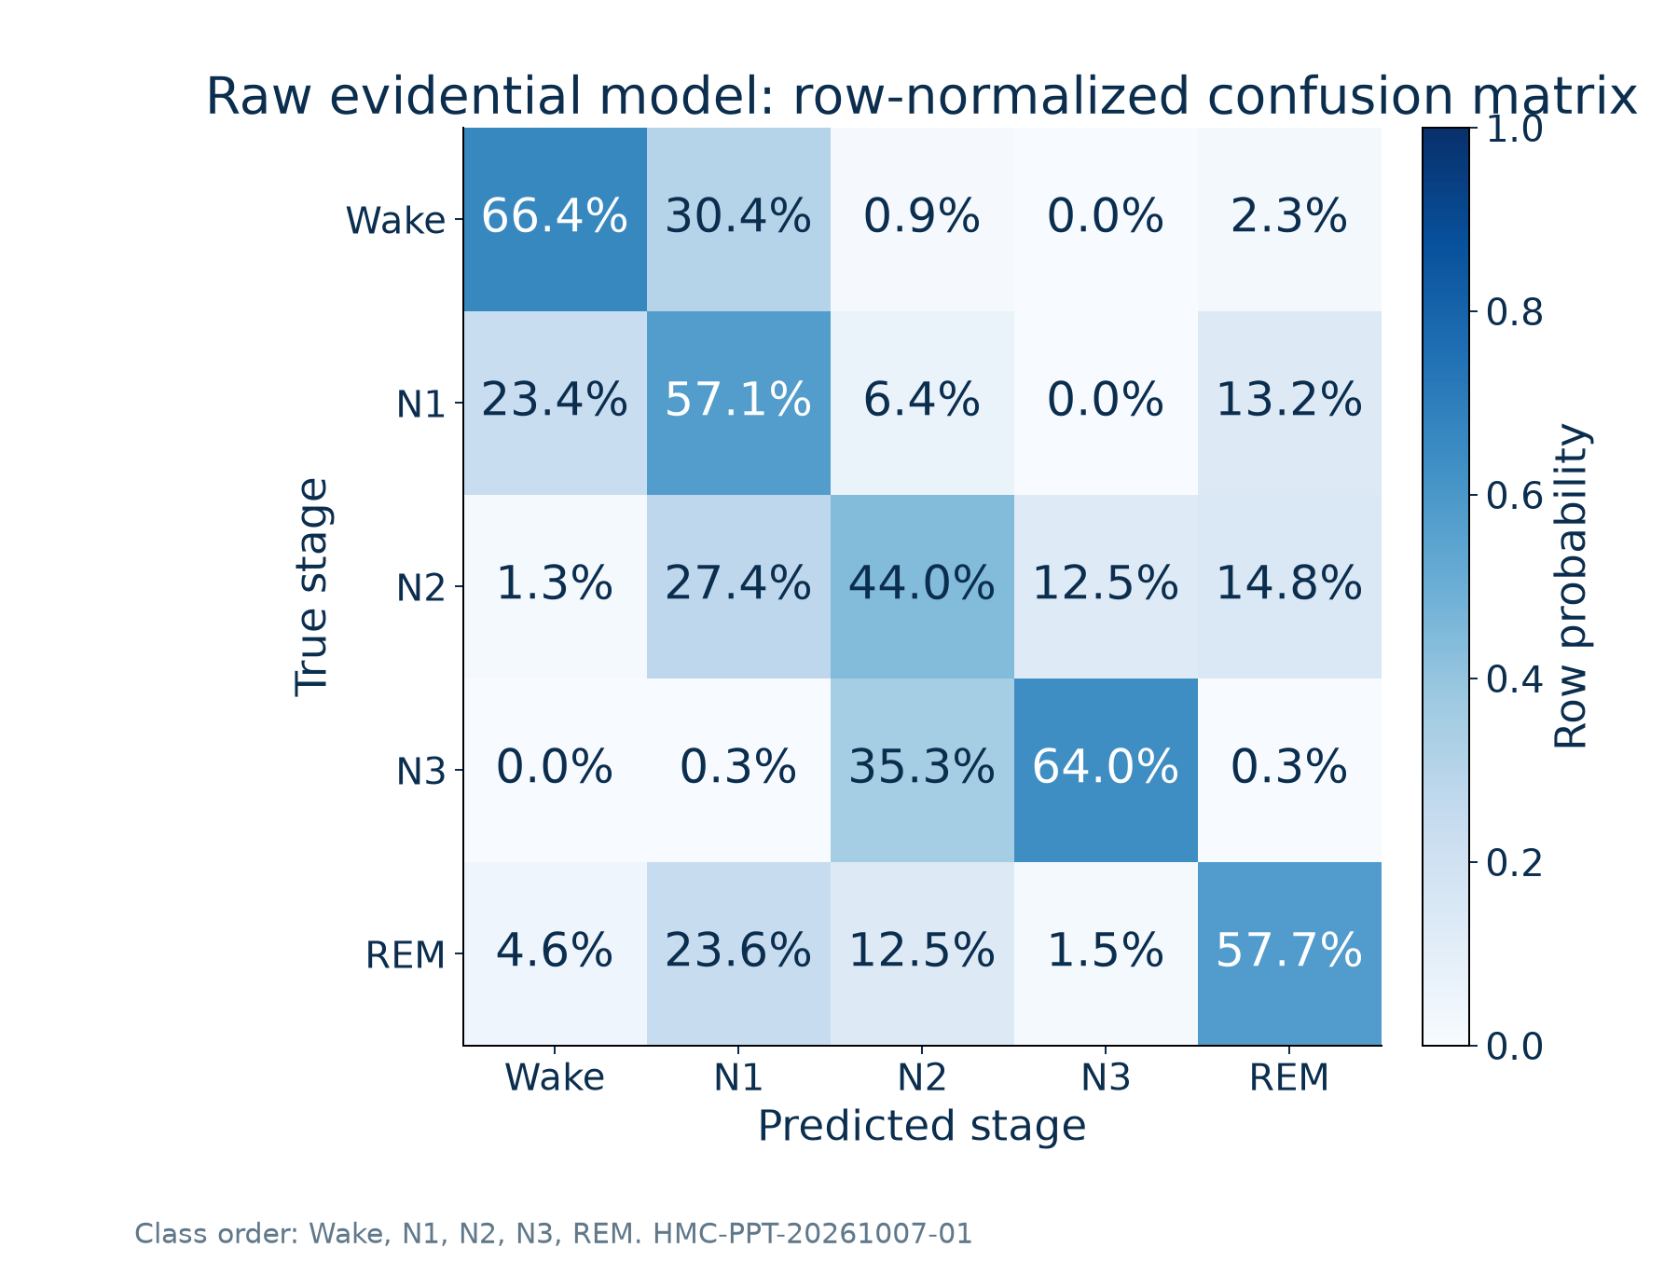
Results — Stage Errors and Uncertainty
Raw five-stage evaluation
Lowest F1: N1 = 0.366
Lowest recall: N2 = 44.00%
Error-detection AUROC: 0.580
ECE (10 bins): 0.0705
Uncertainty separates errors weakly; reliable referral is future work.
Source: HMC-PPT-20261007-01 | classification_report.csv, calibration_metrics.json
08
Notes:
Results — Stage Errors and Uncertainty
Run: HMC-PPT-20261007-01
Sources: classification_report.csv, calibration_metrics.json
Test recordings: SN009, SN001, SN004, SN022.
Checkpoint: /content/drive/MyDrive/Sleep_Health_Profiling/models/HMC_CHECKPOINTS/best_objective1_model.keras
Checkpoint SHA256: 3bf1423246d5672ce7473562079cb4e8d9aa1a578e18c1cb65e6b43e4156b226
All classification results use identical corrected test epochs.
Only four test recordings; no external validation.
Final training hardware and global training RNG state not preserved.
Notebook execution counts were cleared; saved outputs are historical evidence rather than complete execution provenance.
Test records were evaluated repeatedly in notebook development; not a newly blinded clinical test.
Rule thresholds have no clinical validation in this project.
Evidential probabilities are not a separately fitted self-calibrated condition.
SN identifiers denote recordings; repository assumes one subject per ID and has no independent person-identity mapping.
Condensed 12-slide deck; future architecture is a proposal, not a reported experiment. Evidence run HMC-PPT-20261007-01

Slide 9
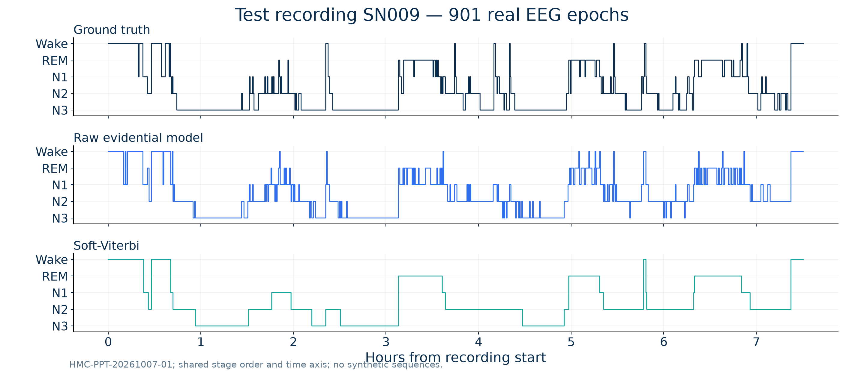
Sequence Refinement — Real Test Recording SN009
Source: HMC-PPT-20261007-01 | test_epoch_predictions.csv
09
Notes:
Raw vs Smoothed Sequence — SN009
Run: HMC-PPT-20261007-01
Sources: test_epoch_predictions.csv
Test recordings: SN009, SN001, SN004, SN022.
Checkpoint: /content/drive/MyDrive/Sleep_Health_Profiling/models/HMC_CHECKPOINTS/best_objective1_model.keras
Checkpoint SHA256: 3bf1423246d5672ce7473562079cb4e8d9aa1a578e18c1cb65e6b43e4156b226
All classification results use identical corrected test epochs.
Only four test recordings; no external validation.
Final training hardware and global training RNG state not preserved.
Notebook execution counts were cleared; saved outputs are historical evidence rather than complete execution provenance.
Test records were evaluated repeatedly in notebook development; not a newly blinded clinical test.
Rule thresholds have no clinical validation in this project.
Evidential probabilities are not a separately fitted self-calibrated condition.
SN identifiers denote recordings; repository assumes one subject per ID and has no independent person-identity mapping.
Decoder: weighted MAP Viterbi; emission log weight 0.9, training-only transitions, Laplace pseudocount 1, recording boundaries reset. All transitions possible.
Condensed 12-slide deck; future architecture is a proposal, not a reported experiment. Evidence run HMC-PPT-20261007-01

Slide 10
Personalized Research Profiles
Recording | SE proxy | WASO (min) | N3 / all | SFI (/h) | Risk
SN009 | 90.01% | 14.0 | 23.97% | 1.18 | Healthy
SN001 | 91.45% | 31.5 | 24.71% | 1.84 | Healthy
SN004 | 88.48% | 34.5 | 7.19% | 2.27 | Mild Risk
SN022 | 84.03% | 74.0 | 9.08% | 2.00 | Mild Risk
Source: Soft-Viterbi labels only. Ground-truth profiles are stored separately.
Research category agreement with ground truth: 2/4 recordings.
SFI is a stage-transition proxy. Time in bed was not directly verified.
Source: HMC-PPT-20261007-01 | subject_risk_profiles.csv, biomarker_validation.csv
10
Notes:
Test Subject Sleep Health Profiles
Run: HMC-PPT-20261007-01
Sources: subject_risk_profiles.csv, biomarker_validation.csv
Test recordings: SN009, SN001, SN004, SN022.
Checkpoint: /content/drive/MyDrive/Sleep_Health_Profiling/models/HMC_CHECKPOINTS/best_objective1_model.keras
Checkpoint SHA256: 3bf1423246d5672ce7473562079cb4e8d9aa1a578e18c1cb65e6b43e4156b226
All classification results use identical corrected test epochs.
Only four test recordings; no external validation.
Final training hardware and global training RNG state not preserved.
Notebook execution counts were cleared; saved outputs are historical evidence rather than complete execution provenance.
Test records were evaluated repeatedly in notebook development; not a newly blinded clinical test.
Rule thresholds have no clinical validation in this project.
Evidential probabilities are not a separately fitted self-calibrated condition.
SN identifiers denote recordings; repository assumes one subject per ID and has no independent person-identity mapping.
Condensed 12-slide deck; future architecture is a proposal, not a reported experiment. Evidence run HMC-PPT-20261007-01

Slide 11
Future Work — Multistage, Multi-model Pipeline
Signal quality
checks + flags
Model A: CNN
Wake / REM / NREM
Model B: CNN
N1 / N2 / N3
Soft composition: P(Nk) = P(NREM) × P(Nk | NREM), k = 1,2,3.
Retain Wake and REM probabilities; avoid irreversible hard routing.
Research profile
+ review flag
Model C: TCN
sequence refinement
Validation-fitted
fusion + calibration
Fuse hierarchical scores with the current five-stage model as a parallel baseline.
Add the sequence model only after measuring whether the experts help.
Evaluate stage recall, macro F1, calibration and cost; no future performance is claimed.
Source: HMC-PPT-20261007-01 | proposed design; not implemented, multistage_pipeline_proposal.md
11
Notes:
Future Work — Multistage, Multi-model Pipeline
Run: HMC-PPT-20261007-01
Sources: proposed design; not implemented, multistage_pipeline_proposal.md
Test recordings: SN009, SN001, SN004, SN022.
Checkpoint: /content/drive/MyDrive/Sleep_Health_Profiling/models/HMC_CHECKPOINTS/best_objective1_model.keras
Checkpoint SHA256: 3bf1423246d5672ce7473562079cb4e8d9aa1a578e18c1cb65e6b43e4156b226
All classification results use identical corrected test epochs.
Only four test recordings; no external validation.
Final training hardware and global training RNG state not preserved.
Notebook execution counts were cleared; saved outputs are historical evidence rather than complete execution provenance.
Test records were evaluated repeatedly in notebook development; not a newly blinded clinical test.
Rule thresholds have no clinical validation in this project.
Evidential probabilities are not a separately fitted self-calibrated condition.
SN identifiers denote recordings; repository assumes one subject per ID and has no independent person-identity mapping.
Proposal details: multistage_pipeline_proposal.md. Calibrate the final temporal-model output separately; no uncertainty threshold is set. Use out-of-fold expert predictions to train the refiner; preserve grouped splits and use a genuinely new locked test cohort.
Condensed 12-slide deck; future architecture is a proposal, not a reported experiment. Evidence run HMC-PPT-20261007-01

Slide 12
Conclusion and Future Priorities
What was demonstrated
One verified hybrid model and training-derived decoding: 53.75% raw → 61.99% decoded accuracy on 3,773 test epochs.
Next engineering milestone
Train coarse-stage and NREM experts; validate soft fusion against the current model. Then test a learned temporal refiner as an ablation.
What is required before stronger claims
Use grouped validation and a new locked test cohort; seek external validation and expert review of biomarker definitions and risk thresholds.
Current limits: four test recordings, historical test reuse, no clinical or external validation.
Source: HMC-PPT-20261007-01 | final_results.json, multistage_pipeline_proposal.md
12
Notes:
Conclusion and Future Priorities
Run: HMC-PPT-20261007-01
Sources: final_results.json, multistage_pipeline_proposal.md
Test recordings: SN009, SN001, SN004, SN022.
Checkpoint: /content/drive/MyDrive/Sleep_Health_Profiling/models/HMC_CHECKPOINTS/best_objective1_model.keras
Checkpoint SHA256: 3bf1423246d5672ce7473562079cb4e8d9aa1a578e18c1cb65e6b43e4156b226
All classification results use identical corrected test epochs.
Only four test recordings; no external validation.
Final training hardware and global training RNG state not preserved.
Notebook execution counts were cleared; saved outputs are historical evidence rather than complete execution provenance.
Test records were evaluated repeatedly in notebook development; not a newly blinded clinical test.
Rule thresholds have no clinical validation in this project.
Evidential probabilities are not a separately fitted self-calibrated condition.
SN identifiers denote recordings; repository assumes one subject per ID and has no independent person-identity mapping.
Condensed 12-slide deck; future architecture is a proposal, not a reported experiment. Evidence run HMC-PPT-20261007-01

