Slide 1

MID-VIVA • PROJECT PROGRESS
EEG Sleep Classification and
Reference-Based Sleep-Health Profiling
Biomarker-assisted N1/N2 refinement
Rikin Parekh · Om Ahuja
23BIT044 · 23BIT014
Guide: Dr. Santosh Sathpathy
Information and Communication Technology
Pandit Deendayal Energy University
Notebook + verified run HMC-N1N2-20261007
01 / 15
Notes:
Opening: Our project classifies five sleep stages, adds a targeted spectral refiner for N1/N2, and derives descriptive recording profiles. This is a progress presentation. The main implementation is the biomarker N1/N2 refinement notebook. Names and institutional details are retained from the existing deck.
Project evidence: Biomarker_N1_N2_Refinement.ipynb; refinement_artifacts/verified; independent reproduction HMC-N1N2-20261007.

Slide 2
Abstract
BACKGROUND
METHOD
Sleep-stage sequences describe sleep continuity and architecture. N1/N2 confusion can distort these profiles.
Four-channel EEG is scored in 30-second epochs. A retained hybrid model is refined using nine spectral features and logistic regression.
RESULTS
FUTURE WORK
On the same 3,109 test epochs, accuracy rose from 55.45% to 59.34%; macro-F1 rose from 57.42% to 59.51%.
Develop coarse and NREM specialist models, combine their probabilities, add temporal context, and validate on external recordings.
Source: Biomarker_N1_N2_Refinement.ipynb and verified held-out results
02 / 15
Notes:
Background: sleep staging supports descriptive sleep architecture; the project does not diagnose disorders. Method: the saved Fast SCFormer-U classifier uses four-channel 100 Hz EEG, 30-second epochs, with Conv1D, self-attention and BiLSTM within an epoch. The refinement uses nine spectral features, StandardScaler and balanced logistic regression; training uses training recordings only and inference gates on predicted N1/N2. Results are measured on the identical 3,109 held-out epochs: accuracy 55.4519% to 59.3438% (+3.89 percentage points); macro-F1 57.4155% to 59.5122% (+2.10 percentage points). Future work is proposed, not implemented: hierarchical coarse and NREM experts, probabilistic composition, optional baseline fusion, temporal context and external validation. Sources: Biomarker_N1_N2_Refinement.ipynb; refinement_artifacts/verified/final_results.json.

Slide 3
Why detect sleep stages? Why this project?
Sleep supports memory, learning and physical health.
Duration alone does not show when sleep is interrupted or how stages are distributed.
What stage detection gives us
Why we chose this project
Sleep onset and Wake time → continuity
N1 / N2 / N3 / REM time → architecture
A hypnogram → when patterns change
EEG records brain activity used in staging.
HMC provides labels to test our predictions.
N1/N2 confusion is a measurable target.
Potential benefit: assist sleep-study review and quantify patterns for research.
Our contribution: targeted refinement + descriptive profiles. Stage labels alone do not diagnose disease.
Sources: NIH sleep education; U-Sleep (2021); verified project artifacts
03 / 15
Notes:
Why the project exists: Sleep supports learning, memory and physical health. Time asleep does not describe interruptions or stage distribution. Sleep staging creates a hypnogram and enables onset, Wake after sleep onset, stage durations and stage proportions to be measured. These measurements describe sleep organization and can support research and expert sleep-study review.
Why choose this engineering project: EEG provides brain activity used in staging; the public HMC dataset provides expert labels for reproducible testing. Our saved baseline has 506 true N2 epochs predicted as N1, giving a specific, measurable weakness to investigate with complementary spectral features. N1/N2 errors can distort their proportions and transition counts. Relabeling between two sleep stages does not change total sleep time or efficiency. This is the reason for targeted refinement rather than a general claim of improving every aspect of sleep quality.
Potential users: researchers analyzing recordings and, after suitable external and clinical validation, experts reviewing sleep studies. Automation could reduce repetitive scoring work; this project has not measured clinician time savings or demonstrated clinical utility. It does not infer apnea, diagnose disease, or prescribe treatment. Those tasks require appropriate additional measurements and validation. Research reference profiles are not healthy normative judgments.
Sources:
https://www.nhlbi.nih.gov/health/sleep/why-sleep-important
https://www.nhlbi.nih.gov/health/sleep/stages-of-sleep
https://www.nature.com/articles/s41746-021-00440-5
https://physionet.org/content/hmc-sleep-staging/1.1/
Biomarker_N1_N2_Refinement.ipynb; refinement_artifacts/verified/final_results.json and confusion matrices.

Slide 4
Sleep stages and what a sleep cycle means
Stage | What it means | Why we measure it
Wake | Awake before or between sleep periods | Sleep onset and interruptions
N1 | Transition from Wake to light sleep | Onset of sleep; distinguish N1 from N2
N2 | Light non-REM sleep; brain activity slows | Time in N2; our refinement target
N3 | Deep, slow-wave sleep; supports restoration | Time spent in deep sleep
REM | Active brain, rapid eye movements; dreaming is common | Timing and duration of REM sleep
A cycle combines NREM and REM; these stages recur across the night.
Typically, more N3 occurs early and REM periods lengthen later. Both phases support learning and memory.
Sources: NIH / NHLBI Sleep Phases and Stages; NIH / NICHD What happens during sleep?
04 / 15
Notes:
Explain the distinction: N1, N2 and N3 are stages of non-REM sleep, and REM is the other sleep phase. Wake is an additional class used to score awake epochs; it is not a sleep stage. A sleep cycle is a repeating combination of NREM and REM, not a synonym for one stage. The real sequence varies and can include returns to lighter stages and brief awakenings. The current system classifies 30-second epochs and displays their sequence; it does not separately validate or count complete physiological cycles.
N1 is the transition into light sleep. N2 is light non-REM sleep with slower brain activity. N3 is deep slow-wave sleep and supports restoration. REM includes active brain activity, rapid eye movements and frequent vivid dreaming. N3 generally occupies more time early in the night; REM periods generally become longer later. Both non-REM and REM support learning and memory, so no single stage is a complete measure of sleep quality. Stage patterns vary with age and other factors. These are general physiology descriptions, not healthy threshold rules for this project. Eye movement and muscle tone are physiological characteristics; the current four-channel EEG classifier infers the stage and does not measure those signals directly.
Practical link: Wake epochs yield sleep onset and interruptions; sleep labels yield stage time and architecture. Confusing N1 and N2 changes the estimated architecture, motivating our focused refinement. Classifying stages is a prerequisite for useful descriptive summaries, while evidence for diagnosis or treatment remains separate.
Sources:
https://www.nhlbi.nih.gov/health/sleep/stages-of-sleep
https://www.nichd.nih.gov/health/topics/sleep/conditioninfo/Pages/what-happens.aspx
https://www.nhlbi.nih.gov/health/sleep/why-sleep-important

Slide 5
Literature review and project direction
Study | Main contribution | Relevance to our project
DeepSleepNet Supratak et al., 2017 | CNN features + BiLSTM across EEG epochs | Compare a learned sequence-context baseline
SeqSleepNet Phan et al., 2019 | Hierarchical recurrent sequence-to-sequence staging | Add context between epochs; current model is within-epoch
U-Sleep Perslev et al., 2021 | Fully convolutional staging across clinical cohorts | Test transfer and robustness on a separate dataset
RobustSleepNet Guillot & Thorey, 2021 | Montage flexibility and leave-one-dataset-out testing | Check channel compatibility and external generalization
SLEEPYLAND Dei Rossi et al., 2025* | Standardized evaluation; SOMNUS soft-voting ensemble | Test model fusion and calibrate the final output
Design direction: targeted experts + sequence context + fair external evaluation
*2025 arXiv preprint. Published scores use different datasets and protocols; no direct ranking is claimed.
Selected primary papers; full citations and links in speaker notes
05 / 15
Notes:
Literature review: DeepSleepNet: a Model for Automatic Sleep Stage Scoring based on Raw Single-Channel EEG, Supratak et al., IEEE TNSRE 2017, DOI 10.1109/TNSRE.2017.2721116. SeqSleepNet: End-to-End Hierarchical Recurrent Neural Network for Sequence-to-Sequence Automatic Sleep Staging, Phan et al., IEEE TNSRE 2019, DOI 10.1109/TNSRE.2019.2896659. U-Sleep: resilient high-frequency sleep staging, Perslev et al., npj Digital Medicine 2021, DOI 10.1038/s41746-021-00440-5. RobustSleepNet: Transfer learning for automated sleep staging at scale, Guillot and Thorey, 2021. SLEEPYLAND: trust begins with fair evaluation of automatic sleep staging models, Dei Rossi et al., 2025 arXiv preprint. These papers motivate context, robust evaluation and soft fusion. Our proposed coarse/NREM hierarchy is an engineering hypothesis, not an implementation attributed to any of these papers. Different data, channels and evaluation protocols prevent score comparison.
Project evidence: Biomarker_N1_N2_Refinement.ipynb; refinement_artifacts/verified; independent reproduction HMC-N1N2-20261007.
https://arxiv.org/abs/1703.04046
https://arxiv.org/abs/1809.10932
https://arxiv.org/abs/2101.02452
https://www.nature.com/articles/s41746-021-00440-5
https://arxiv.org/abs/2506.08574

Slide 6
Dataset and 30-second EEG epochs
HMC v1.1: 151 clinical PSG recordings; project subset: 24 recordings
Partition | Recordings | EEG epochs
Training | 16 | 15,216
Validation | 4 | 3,619
Test | 4 | 3,109
Total | 24 | 21,944
One EEG epoch = one 30 s segment
0–30 s
30–60 s
60–90 s
At 100 Hz: 30 × 100 = 3,000 samples
Four channels → input shape 4 × 3,000
F4-M1 · C4-M1 · O2-M1 · C3-M2
Split by recording ID. SN001 covers only 190 epochs (95 min); whole-night claims are unsupported.
PhysioNet HMC v1.1; verified split_summary.json
06 / 15
Notes:
PSG means polysomnography. HMC is a heterogeneous clinical population, not a healthy normative database. Four EEG derivations and original 256 Hz sampling are documented. We use a 24-recording subset, separated by recording ID into 16/4/4. IDs identify recordings; a repeated-person mapping is not provided, so person-level separation is not proven. Test IDs: SN001, SN004, SN009, SN022. EEG epoch is a temporal segment, whereas training epoch means one pass through the training data. Stored SN001 is a 95-minute segment. Dataset total is 15,216+3,619+3,109=21,944.
Project evidence: Biomarker_N1_N2_Refinement.ipynb; refinement_artifacts/verified; independent reproduction HMC-N1N2-20261007.
https://physionet.org/content/hmc-sleep-staging/1.1/

Slide 7
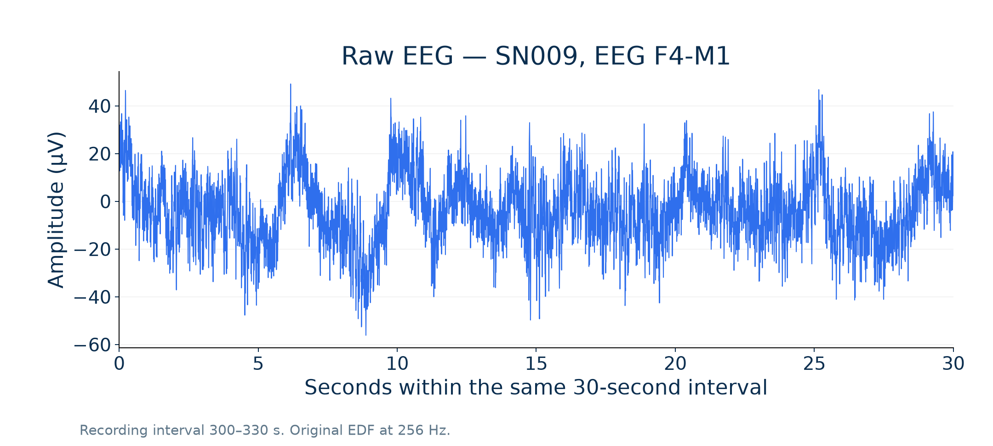
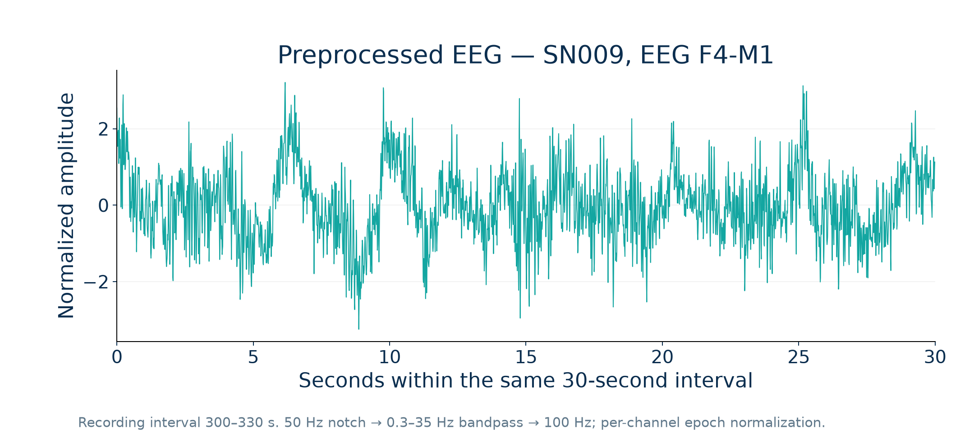
EEG preprocessing
Select 4
channels
50 Hz notch
at 256 Hz
Bandpass
0.3–35 Hz
Resample
to 100 Hz
30 s epochs
+ normalize
Raw EEG · SN009, F4-M1
Filtered and normalized EEG · same interval
Per-epoch, per-channel normalization. Apply the 50 Hz notch before resampling.
Archived 300–330 s signal illustration only; all performance results use the current 3,109-epoch run.
Notebook preprocessing lineage; archived matched SN009 signal example
07 / 15
Notes:
Source pipeline order from preprocessing_config.json: selected four channels, notch 50 Hz at original sampling rate, bandpass 0.3–35 Hz, resample 100 Hz, epoch and channel normalization. The current refinement notebook loads stored preprocessed NPZ EEG and normalizes each epoch again for neural inference; spectral extraction uses stored EEG before that second normalization. Automatic artifact rejection was not established in the source preprocessing; explicit quality gates are future work. Existing example metadata: SN009, F4-M1, index 10, 300–330 seconds, raw 256 Hz, processed 100 Hz; saved/reprocessed difference 0.0. These figures are retained as explanatory signal evidence from ppt_artifacts, not as evidence for the current numerical comparison.
Project evidence: Biomarker_N1_N2_Refinement.ipynb; refinement_artifacts/verified; independent reproduction HMC-N1N2-20261007.

Slide 8
Implemented system block diagram
Main implementation: Biomarker_N1_N2_Refinement.ipynb
Stored EEG
4 × 3,000
Fast SCFormer-U
5-stage output
Predicted N1/N2?
Spectral refiner
Final stage
per epoch
Welch spectral
features
Mean EEG features
per recording
Recording profile
+ reference comparison
Hypnogram +
sleep architecture
Architecture + spectral features → z-scores / P10–P90 → four-domain profile → dashboard
The 16-recording training reference provides dataset-relative descriptions.
Notebook + verified run HMC-N1N2-20261007
08 / 15
Notes:
Read the top path left to right: stored input, retained five-stage model, targeted N1/N2 refinement, final labels. Welch features support the refiner (shown explicitly on slide 8) and recording EEG means. Final labels produce architecture metrics. Both architecture and spectral means join the recording profile; the lower connector carries architecture into that profile. Ten architecture metrics determine four domain flags; EEG deviations are displayed separately. The training reference uses only 16 training recordings. The resulting profile is descriptive, not a diagnosis.
Project evidence: Biomarker_N1_N2_Refinement.ipynb; refinement_artifacts/verified; independent reproduction HMC-N1N2-20261007.

Slide 9
Existing model and training epochs
Conv1D encoder
64 → 128 filters
Self-attention
4 heads, key dim 16
BiLSTM
64 units / direction
Pooling + dense
5 evidence outputs
226,309 parameters · Attention and BiLSTM operate within each 30-second EEG epoch
Training / validation accuracy
A training epoch = one full
pass through training data
Adam · learning rate 0.0001
Batch size: 128
10 training epochs
Selected checkpoint: epoch 9
Current notebook loads this checkpoint; it trains the spectral refiner separately.
Notebook + verified run HMC-N1N2-20261007
09 / 15
Notes:
Architecture verified against model_layers.csv and saved checkpoint: first convolution kernel 7/stride 4, second kernel 5/stride 4, 64 and 128 filters; 4-head attention with key dimension 16, residual normalization/feed-forward layers; within-epoch bidirectional LSTM, 64 units in each direction; pooling, dense and five softplus evidence outputs. 226,309 total parameters. Dirichlet alpha=evidence+1; probability alpha/sum(alpha); original uncertainty=5/sum(alpha). Training chart is the saved historical training log for this retained model, not a new run. Ten maximum and actual training epochs, checkpoint selected at 9 by validation evidential accuracy (67.97%). No automatic scheduler in final training cell. The biomarker notebook loads the checkpoint and fits the refiner without retraining this neural model.
Project evidence: Biomarker_N1_N2_Refinement.ipynb; refinement_artifacts/verified; independent reproduction HMC-N1N2-20261007.

Slide 10
N1/N2 refinement flowchart
Initial stage
prediction
N1 or N2?
9 spectral features
+ StandardScaler
Balanced logistic
regression → N1 / N2
YES
NO
Retain original Wake / N3 / REM prediction
Fit on training data only
Feature group | Input to the refiner
Relative powers | Delta, Theta, Alpha, Sigma, Beta
Band / Delta ratios | Theta, Alpha, Sigma, Beta
True AND predicted N1/N2:
1,278 N1 + 4,588 N2 epochs
Test gate uses predictions only.
Welch: 4 s windows, 2 s overlap; average channel powers before computing ratios.
Notebook + verified run HMC-N1N2-20261007
10 / 15
Notes:
Exact training gate from notebook cells 20–21: true labels AND baseline predictions in {N1,N2}. This produces 5,866 training candidates. Pipeline: StandardScaler then LogisticRegression(class_weight="balanced", max_iter=2000, random_state=42). At inference, ONLY the initial predicted label routes the epoch. Ground truth is never an inference input. Nine features: relative Delta/Theta/Alpha/Sigma/Beta plus Sigma/Delta, Theta/Delta, Alpha/Delta, Beta/Delta. Bands: [0.5,4), [4,8), [8,12), [12,16), [16,30) Hz. Welch at 100 Hz uses 400 samples/window and 200 overlap; total power [0.5,30). Four channel powers are averaged first. Sigma power does not measure spindle density. Original predicted Wake/N3/REM labels are kept; original neural probabilities and uncertainty are not recalibrated to the refined labels.
Project evidence: Biomarker_N1_N2_Refinement.ipynb; refinement_artifacts/verified; independent reproduction HMC-N1N2-20261007.

Slide 11
Results and measured gains
+3.89 pp
Accuracy: 55.45% → 59.34%
+2.10 pp
Macro F1:
57.42% → 59.51%
154 corrected − 33 degraded = 121 net additional correct epochs
Same 3,109 test epochs across 4 recordings · 238 labels changed · pp = percentage points
Notebook + verified run HMC-N1N2-20261007
11 / 15
Notes:
Current experiment HMC-N1N2-20261007 only. Raw/refined accuracy: 0.5545191379864909 / 0.5934384046317144; macro F1 0.5741553020766511 / 0.5951219684303188. N1 F1 0.3660403618649965 / 0.4063241106719368; N2 F1 0.571173583221776 / 0.6357231661831745. Accuracy gain 3.8919267 percentage points; macro F1 gain 2.0966666 percentage points, rounded once to 3.89/2.10. Corrections 154, degradations 33, wrong-to-wrong 51, unchanged 2,871, total 3,109. Of 238 changes, 121 are net additional correct. N2-to-N1 errors 506 to 379. N1 F1 gain 4.03 pp; N2 F1 gain 6.45 pp. Kappa 0.4253 to 0.4647. Per-stage Wake/N3/REM F1 remain unchanged because predictions of these stages are retained. Results are modest and limited to this small subset; not a comparison against the literature datasets.
Project evidence: Biomarker_N1_N2_Refinement.ipynb; refinement_artifacts/verified; independent reproduction HMC-N1N2-20261007.

Slide 12


Project outputs: hypnogram and sleep profile
SN009 · verified stage sequence
Sleep Studio · current GUI
Architecture, spectral features,
reference deviations and exports
Stage labels → architecture metrics → training-reference comparison → four-domain profile
Duration · Continuity · Initiation · Architecture | Descriptive research profiles, not diagnoses
Notebook + verified run HMC-N1N2-20261007
12 / 15
Notes:
Hypnogram is the verified SN009 plot showing original and refined labels versus ground truth. SN009 has 901 epochs. Dashboard screenshot is from the current verified GUI; it demonstrates implemented outputs rather than a mockup. Master features have recording ID + 22 numeric fields; compare 21 fields after excluding recording_minutes. Architecture metrics include TST, efficiency, SOL, WASO, stage percentages, awakenings and project-defined fragmentation. Efficiency uses evaluated duration; stage percentages use TST. Reference mean/sample SD and P10/P90 derive from 16 training recordings; any out-of-interval architecture metric flags the corresponding domain. Four domains are Duration, Continuity, Initiation, Architecture. SN009: one deviated domain, descriptive Mild Deviation. EEG deviations do not contribute additional domains. HMC is clinical, not healthy normative data; in-sample architecture reference and unknown whole-night timing limit interpretation. Current GUI has PDF/JSON/CSV/ZIP exports and a Colab worker; live SN009 predictions were already independently reproduced.
Project evidence: Biomarker_N1_N2_Refinement.ipynb; refinement_artifacts/verified; independent reproduction HMC-N1N2-20261007.

Slide 13
Future plan: multistage, multimodel architecture
Proposed • not yet implemented or evaluated
Model A: coarse CNN
Wake / REM / NREM
Aligned EEG
+ quality checks
Soft probability
composition +
optional baseline fusion
Model C: TCN
Temporal CNN
across epochs
Model B: NREM expert
N1 / N2 / N3
Conditional NREM probabilities preserve five-class normalization
1 Experts
2 Context + confidence
3 Broader validation
Test coarse + NREM models
against the current baseline.
Train TCN on out-of-fold outputs.
Calibrate final probabilities.
New locked cohort, then external
data and optional EOG / EMG.
Proposed research design; inspired by SeqSleepNet, RobustSleepNet and SLEEPYLAND
13 / 15
Notes:
Proposed engineering design, not current implementation. Train compact Model A with Wake/REM/NREM targets, Model B on true training NREM epochs. Evaluate B on each inference epoch. Let g be coarse probabilities and h be conditional NREM probabilities: q=[gW,gNREM*hN1,gNREM*hN2,gNREM*hN3,gREM]. This sums to 1. Optional soft fusion r=lambda*q+(1-lambda)*p with the retained five-stage model p; choose lambda on development data only. Avoid hard gating because coarse mistakes could otherwise become irreversible. Model C is a small temporal convolutional network operating across consecutive epochs, unlike current within-epoch BiLSTM. Train it on out-of-fold expert predictions, preserve recording boundaries/gaps, then calibrate final output on a held-out validation partition. TCN and Viterbi are alternatives to compare by ablation, not refiners to stack automatically. Add EOG/EMG specialists only if aligned data and missing-modality tests are available. Start small with 24 recordings to limit overfitting. Current four test recordings have already been examined; reserve genuinely new recordings/person cohort before new tuning. Person-level grouping requires a verified mapping. Sequence context motivated by SeqSleepNet and L-SeqSleepNet; heterogeneous cohort testing by RobustSleepNet; soft voting and fair evaluation by SLEEPYLAND. Benefits are hypotheses, not guaranteed gains.
Project evidence: Biomarker_N1_N2_Refinement.ipynb; refinement_artifacts/verified; independent reproduction HMC-N1N2-20261007.
https://arxiv.org/abs/1809.10932
https://arxiv.org/abs/2301.03441
https://arxiv.org/abs/2101.02452
https://arxiv.org/abs/2506.08574

Slide 14
Conclusion and next milestones
What is demonstrated
Next milestones
Spectral features improve
N1/N2 discrimination
in the current experiment.
01 Audit full EDF alignment and quality;
reserve a new locked test cohort.
02 Compare experts, soft fusion and TCN
through controlled ablations.
59.34% test accuracy; 59.51% macro F1.
A complete notebook-to-GUI pipeline
produces stage labels and profiles.
03 Evaluate calibration, external data
and biomarker errors; add modalities.
Limits: 4 test recordings, partial SN001,
N1 F1 40.63%, no clinical validation.
Evaluate macro F1, N1/N2 F1, calibration,
latency and errors in sleep biomarkers.
Notebook + verified run HMC-N1N2-20261007
14 / 15
Notes:
Conclusion: the current reproducible experiment supports complementary spectral features for N1/N2. Net correction is 121 epochs and the gains are modest. The project also implements recording architecture and spectral features, descriptive reference profiles, a Windows Electron GUI and reports. It does not establish clinical diagnosis or superior performance versus the literature. Roadmap: verify original EDF alignment, retain timestamp continuity and quality checks, expand HMC data and reserve untouched recordings/person cohort; compare flat baseline, coarse/NREM composition, optional soft fusion, temporal model, and decoder alternatives on identical locked epochs. Fit scalers, class weights and transitions on training data only; use grouped development folds and out-of-fold base predictions for stacking. Report accuracy, macro F1, per-stage F1, kappa, ECE, error-detection AUROC, risk-coverage, latency and model size. Include recording/person bootstrap confidence intervals, stage distribution and individual recording variability. Validate TST/WASO/SOL/stage fractions against label-derived ground truth using verified denominators. Test external dataset/channel compatibility and optional aligned EOG/EMG specialists. No accuracy target or delivery date is promised without experiments.
Project evidence: Biomarker_N1_N2_Refinement.ipynb; refinement_artifacts/verified; independent reproduction HMC-N1N2-20261007.
https://physionet.org/content/hmc-sleep-staging/1.1/
https://arxiv.org/abs/2101.02452
https://arxiv.org/abs/2506.08574

Slide 15



Team members and project mentor
PROJECT MENTOR
TEAM MEMBER
TEAM MEMBER
Dr. Santosh Sathpathy
Om Ahuja
Rikin Parekh
Project guide
23BIT014
23BIT044
Information and Communication Technology Â· Pandit Deendayal Energy University
15 / 15
Notes:
Team: Om Ahuja (23BIT014) and Rikin Parekh (23BIT044). Project guide: Dr. Santosh Sathpathy. Names and IDs follow the supplied project presentation. Portraits and official logo were supplied by the user. Portrait backgrounds were removed with imagegen; the logo artwork was preserved.

