Slide 1
Work progress tracker
RIKIn tuladhar
Salina maharjan

Slide 2
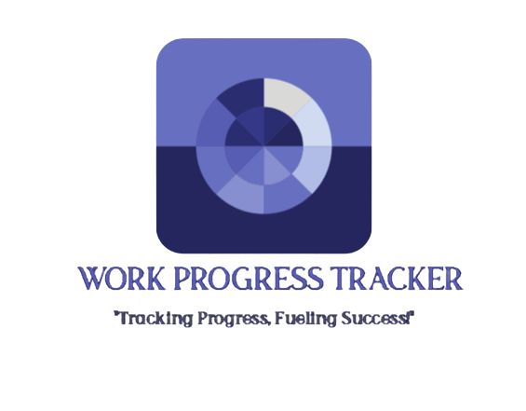
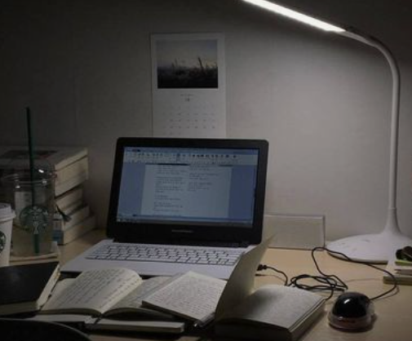


Introduction
“Work Progress Tracker” is a systematic and organized approach of tracking the completion of work, and ensuring that tasks assigned to employee stay on schedule.
It also allows managers to manage task, employee and provide feedback on their progress.

Slide 3
Problem Statement
Without a system for tracking employee status and performance, it can be difficult for managers to keep track of who is doing what, how well they are doing it, and whether they are meeting their goals and objectives.
Without regular performance evaluations and feedback, employees may not know where they stand or what they need to improve. This can lead to low morale and decreased job satisfaction.

Slide 4

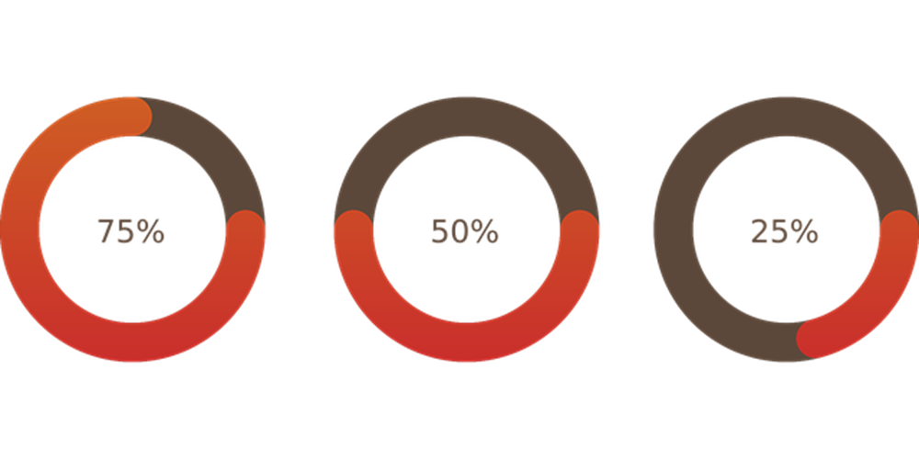
The objective of our system are given below: -To assign tasks to the employee with deadlines. -To provide platform that enables efficient tracking of employee work dates and status on the assigned task. -To provide feedback to employee from their supervisors after completion of task.
OBJECTIVES

Slide 5
Scope and limitations
Scope
Companies of all sizes can use work progress trackers to help their employees stay on track of assigned task.
This application can be used to meet deadlines and achieve their goals.
Limitations
There is no feature of team collaboration and assigning tasks to a group.
The representation of work status for task using a graph or bar not available.

Slide 6
Literature Review
.
There are many systems related to work progress tracker. We recently had studied about different system which works as like this website.
Some of them are:
Trello^{[1]} is a popular project management tool that allows you to create boards, lists, and cards to track the progress of your work.
Jira^{[2]} is a widely used project management and issue tracking tool, particularly popular among software development teams. It offers features like task management, agile project management
Basecamp^{[3]} is a project management and team communication platform that facilitates tracking of work progress.

Slide 7

Our approach is to achieve the limitation other system could not fulfill. Our system has the features like providing proper documentation of the performance of the employee, easy user interface ,the manager can also give feedback as the feedback option is also available

Slide 8
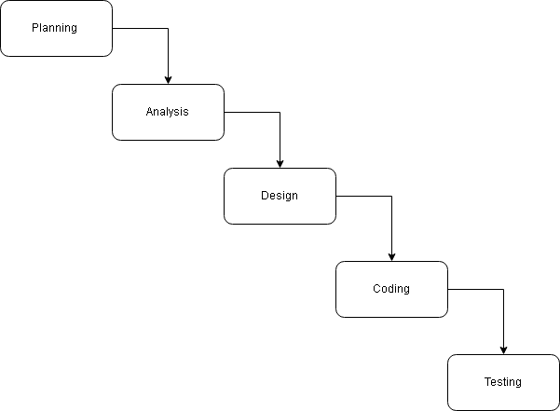
We have used waterfall model for development of our system. The Waterfall Model is a systematic approach to software or system development. This system is designed with the series of processes starting with requirement analysis, design, implementation, testing and deployment.
METHODOLOGY
Fig:Waterfall model for Work Progress Tracker

Slide 9
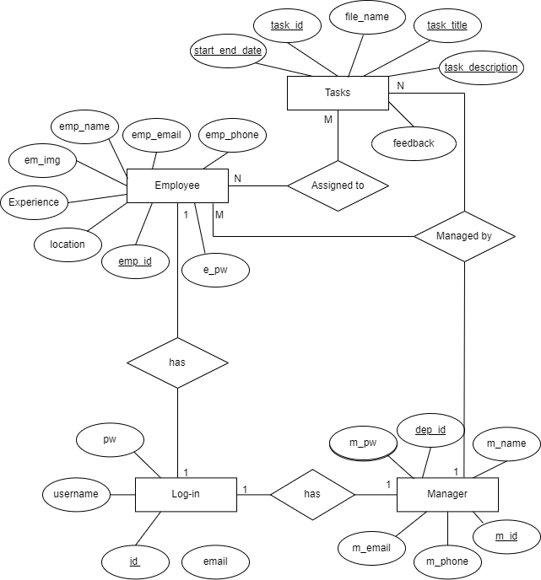
ER-Diagram for Work Progress Tracker

Slide 10
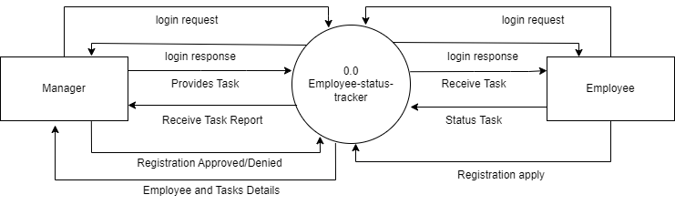
DFD Diagram
Fig: level 0 DFD for Work Progress Tracker

Slide 11
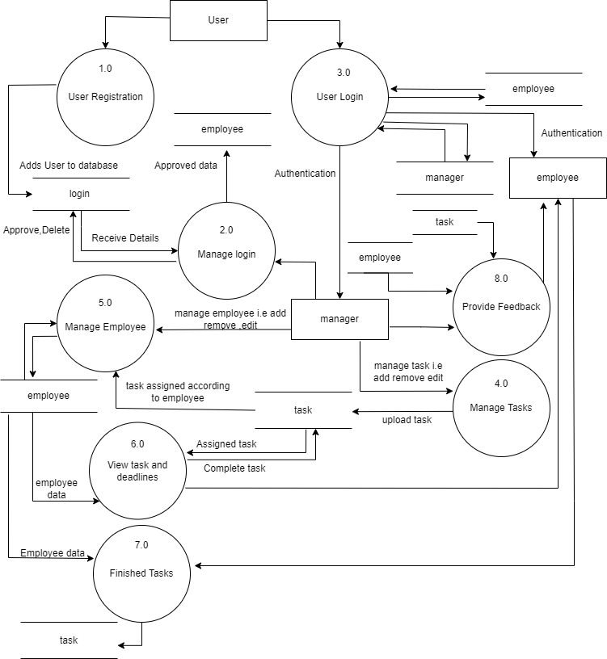
Fig: Level 1 DFD Diagram for Work Progress Tracker

Slide 12
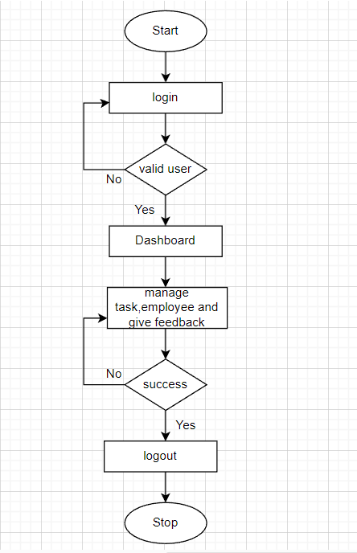
System Flowchart
For manager

Slide 13
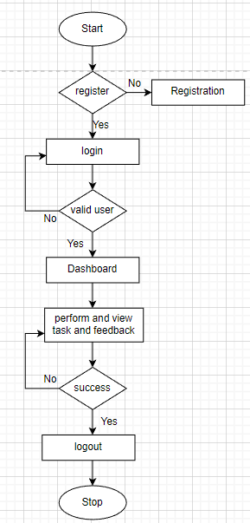
System Flowchart
For employee

Slide 14

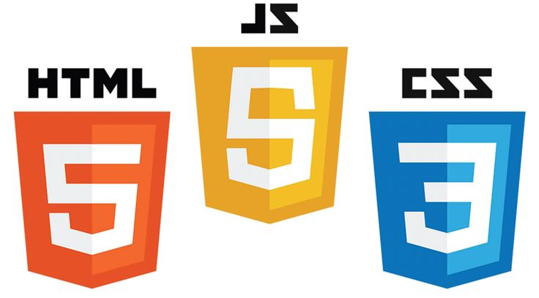
We have used programing languages like HTML ,CSS and JAVASCRIPT for front end and have used PHP for back end. Likewise, documentation tools like MS Office and Draw.io have been used for our projects documentation.
TOOLS USED

Slide 15
CONCLUSION AND FUTURE RECOMMENDATIONS
Developing a project makes us to learn and gain the knowledge in different aspects. In the following project, we have learned lots of problem-solving skills and learn things like team work, finding the solution on our own, proper use of guidelines, communication and writing skills and management of team.

Slide 16
Conclusion The work progress tracker has been successfully developed with predefined objectives. This system fulfills all the objectives that have been set to develop this system and this system can be viewed by employee and manager with the provided login information and the employee has to register before login in to the system. This system also provides easy and smooth user interface that can be used by non-technical users. This website makes easier for employee to view the tasks assigned to them, submit their task progress report.

Slide 17
The documentation process might have been better programming the project prior to any documentation. The system can be updated based on the users’ requirements recommendation.
Future Recommendations
Some of the future recommendations are given below:
OTP (One Time Password) feature can be added.
The representation of work status for task can be represented in a graph or bar not available.
Feature of team collaboration and assigning group tasks can be added.

Slide 18
Thank you
Regards,
Salina Maharjan
Rikin Tuladhar

