Slide 1
GPP Exam: Zombie AI
Delete all comments after reading
You are not allowed to add more slides to this presentation

Slide 2
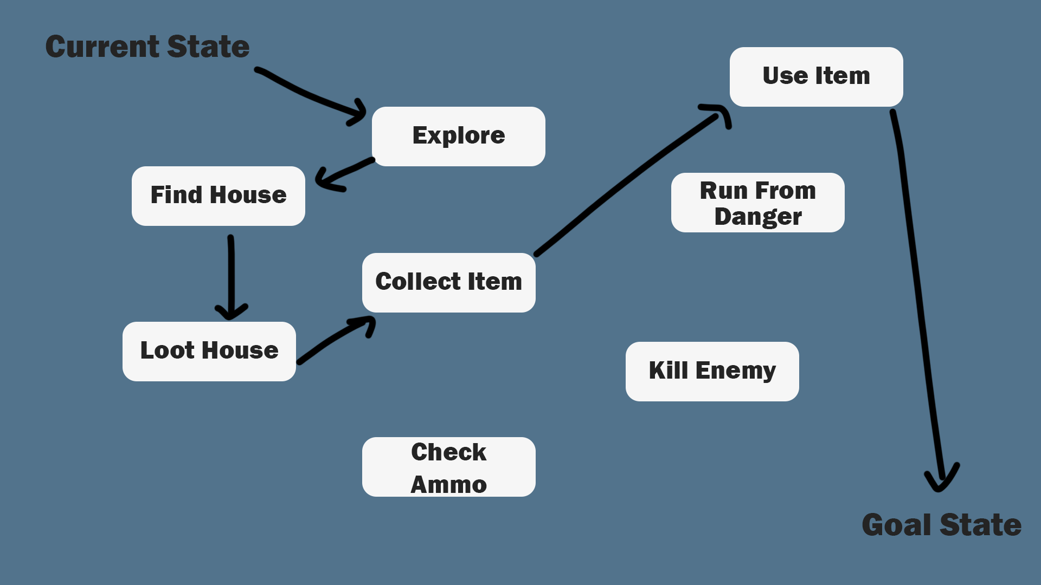
Decision Making

Slide 3
Enemy handling
-Sees enemy
-Ignore if no gun, else ->
-Faces enemy while fleeing away
-Shoots (uses shotgun first, else pistol)

Slide 4
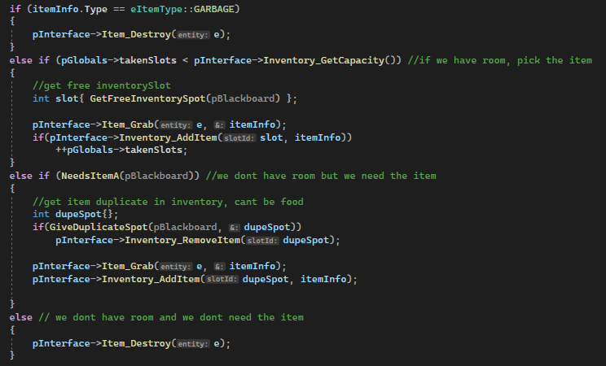
Inventory

Slide 5
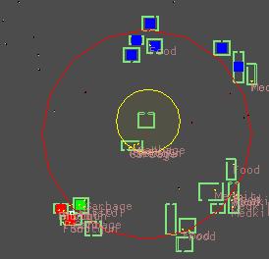
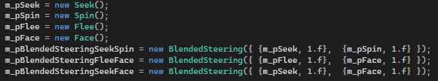
Movement & exploration

Slide 6
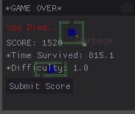
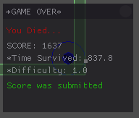
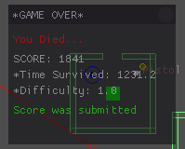
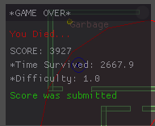
High Score

