Slide 1
NCCR MUONIVERSE · HSG
Milestone 1 Findings
Literature review · framework assessment · data compendium
A clean source-led deck: every finding uses an excerpt rendered directly from the cited paper, report, or official page.
Prepared for the NCCR Muoniverse team · August 2026

Slide 2
NCCR MUONIVERSE · HSG
02
LITERATURE REVIEW
Seven themes
What the primary literature converges on
Milestone 1 · source-led findings deck

Slide 3
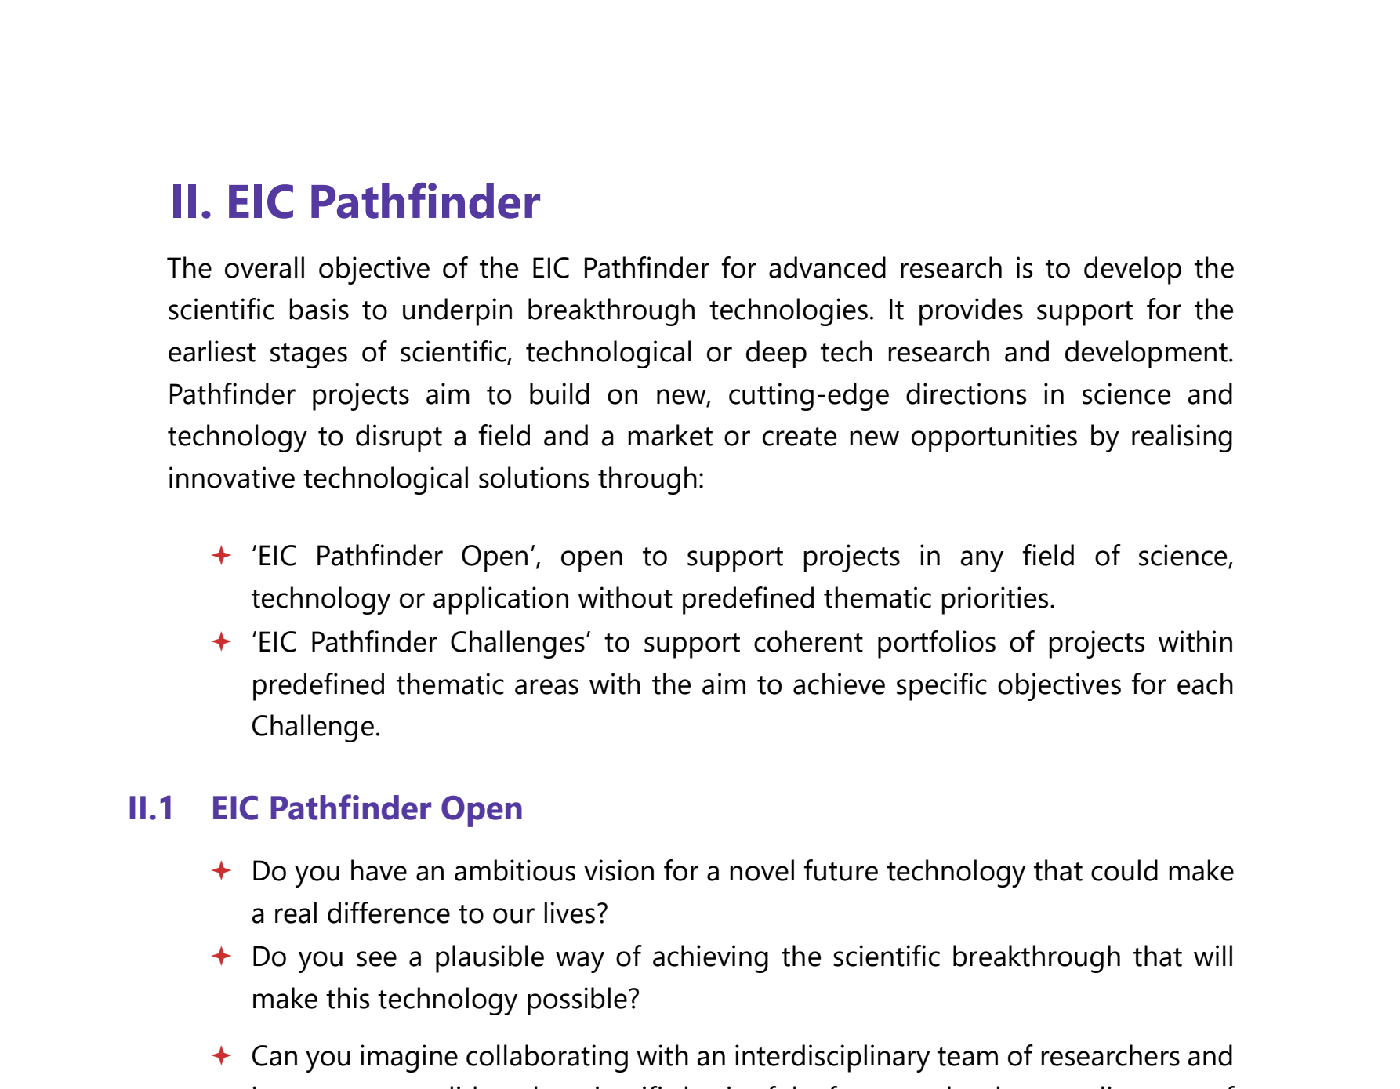
NCCR MUONIVERSE · HSG
03
LITERATURE REVIEW
SOURCE-LED FINDING
No existing framework was designed for TRL 1–3
ORIGINAL SOURCE EXCERPT · p. 26
COMMENTS
What the excerpt shows: the EU's own 'earliest stage' instrument, Pathfinder, opens at the earliest stages of deep tech research — the stage is officially recognised.
But recognition is not a method: Pathfinder funds research consortia, not market discovery. The gap is procedural, not conceptual.
Question for interviews: who owns market discovery at TRL 1–3 in Switzerland? Cf. the Innosuisse stage slide (24) and the CRL slides (18–20).
European Commission (2026), EIC Work Programme 2026, p. 26 (EIC Pathfinder).
Lorik Dalloshi · Milestone 1 · NCCR Muoniverse
03 / 42

Slide 4
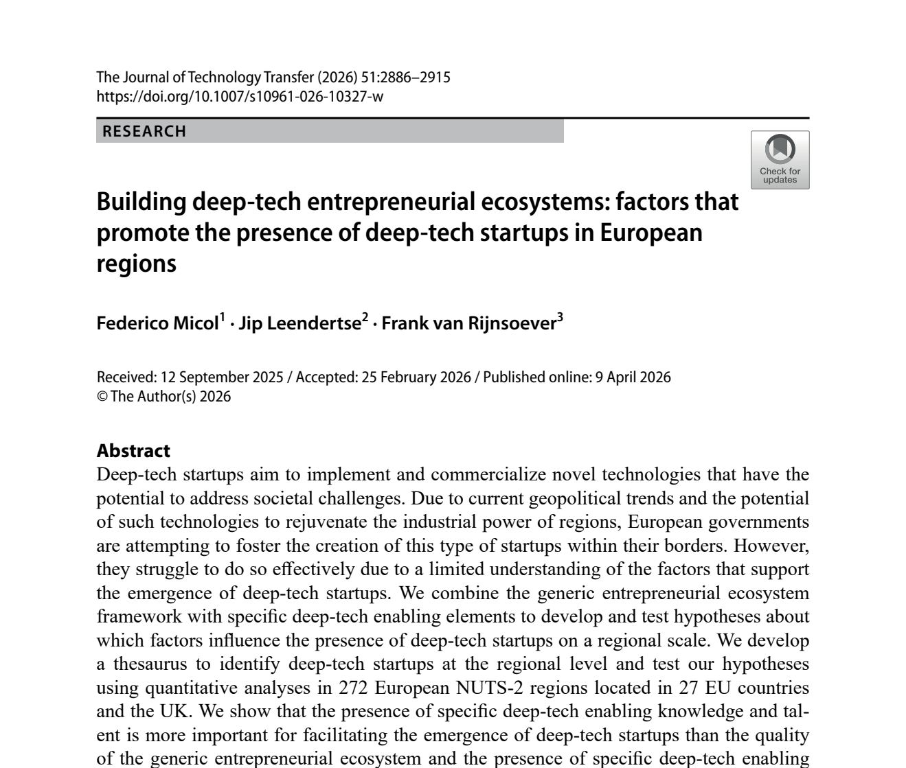
NCCR MUONIVERSE · HSG
04
LITERATURE REVIEW
SOURCE-LED FINDING
Ecosystem, not policy, drives deep tech
ORIGINAL SOURCE EXCERPT · p. 1
COMMENTS
What the excerpt shows: the study's own abstract — specific knowledge and talent matter more for deep-tech startup emergence than formal institutions.
Deep tech clusters where research infrastructure and specialised people already are; policy quality alone does not move it.
Muoniverse reading: the PSI/ETH/EPFL density is the asset to build on. Open question: does that talent pool cover commercial roles, not only physics? Cf. slide 31.
Micol, F., Leendertse, J. & van Rijnsoever, F. (2026), Journal of Technology Transfer 51, pp. 2886–2915.
Lorik Dalloshi · Milestone 1 · NCCR Muoniverse
04 / 42

Slide 5
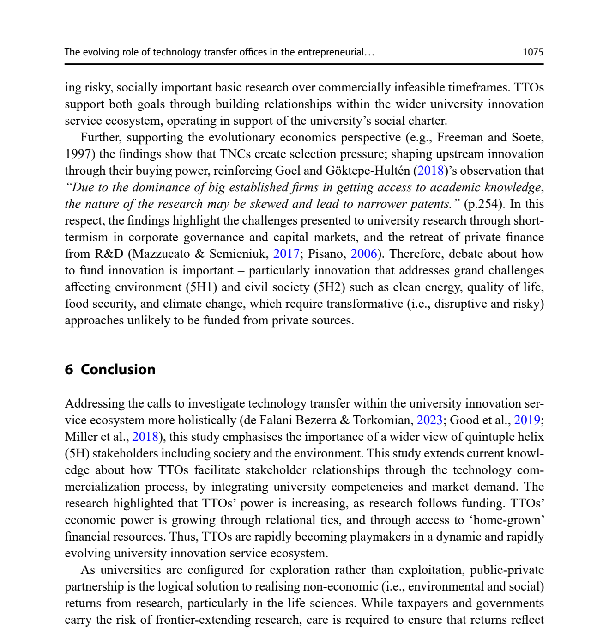
NCCR MUONIVERSE · HSG
05
LITERATURE REVIEW
SOURCE-LED FINDING
TTOs: relationships beat transactions
ORIGINAL SOURCE EXCERPT · p. 16
COMMENTS
What the excerpt shows: Chen et al.'s term 'playmakers' — TTOs that translate science through relationships across the innovation ecosystem.
Transfer behaves as an orchestration capability, not a licensing-desk function; the survival panel reaches the same conclusion independently (slide 34).
Interview probe: is PSI's knowledge-transfer office resourced and measured for orchestration, or for transactions (patents, licences)?
Chen, Z., Little, V. & Thuan, N. (2025), Journal of Technology Transfer 50, pp. 1060–1079.
Lorik Dalloshi · Milestone 1 · NCCR Muoniverse
05 / 42

Slide 6
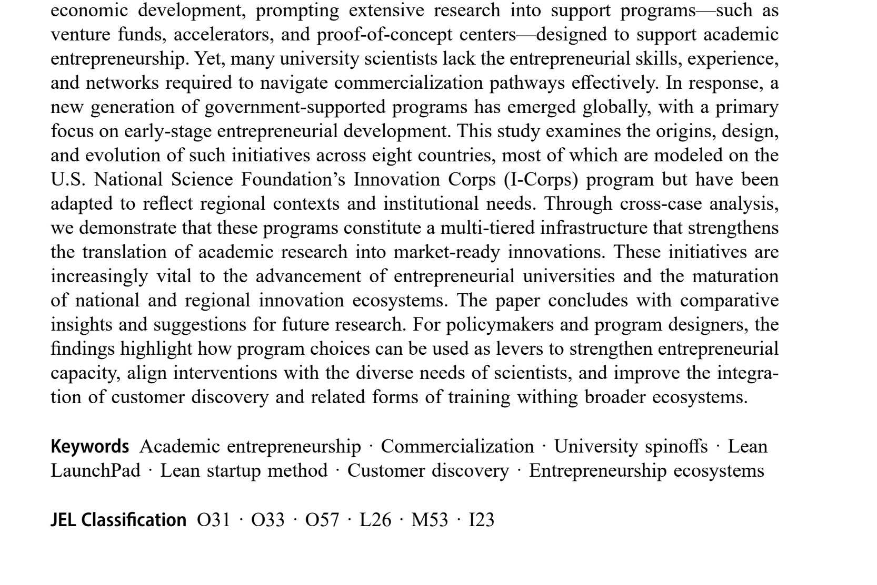
NCCR MUONIVERSE · HSG
06
LITERATURE REVIEW
SOURCE-LED FINDING
Structured frameworks work — if adapted
ORIGINAL SOURCE EXCERPT · p. 1
COMMENTS
What the excerpt shows: Hayter et al. trace I-Corps-style programs — structured customer discovery — spreading across national systems.
A standardised methodology travels, and every adopter adapts it locally: structure wins over ad hoc, but not unchanged.
Design tension for Milestone 2: methodology-driven (I-Corps) vs mentor-driven (Innosuisse, slide 22). Which fits a physics NCCR?
Hayter, C. S. et al. (2025), Journal of Technology Transfer, DOI 10.1007/s10961-025-10288-6.
Lorik Dalloshi · Milestone 1 · NCCR Muoniverse
06 / 42

Slide 7
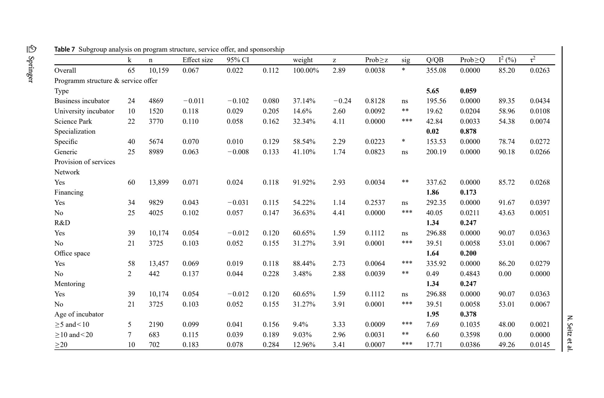
NCCR MUONIVERSE · HSG
07
LITERATURE REVIEW
SOURCE-LED FINDING
Configuring support matters more than providing it
ORIGINAL SOURCE EXCERPT · p. 32
COMMENTS
What the excerpt shows: the moderator rows — university incubators (r = 0.118) outperform generic ones; mentoring's coefficient is slightly negative (−0.012).
The variable is not support volume but configuration: who hosts it and what it connects you to. Negative mentoring reads as opportunity cost of founder time.
Pairs with the advisor coefficients on slide 33 — two independent studies question 'add more mentors' as a strategy.
Seitz, N. et al. (2026), Review of Managerial Science, DOI 10.1007/s11846-026-01017-w, Table of moderator effects.
Lorik Dalloshi · Milestone 1 · NCCR Muoniverse
07 / 42

Slide 8
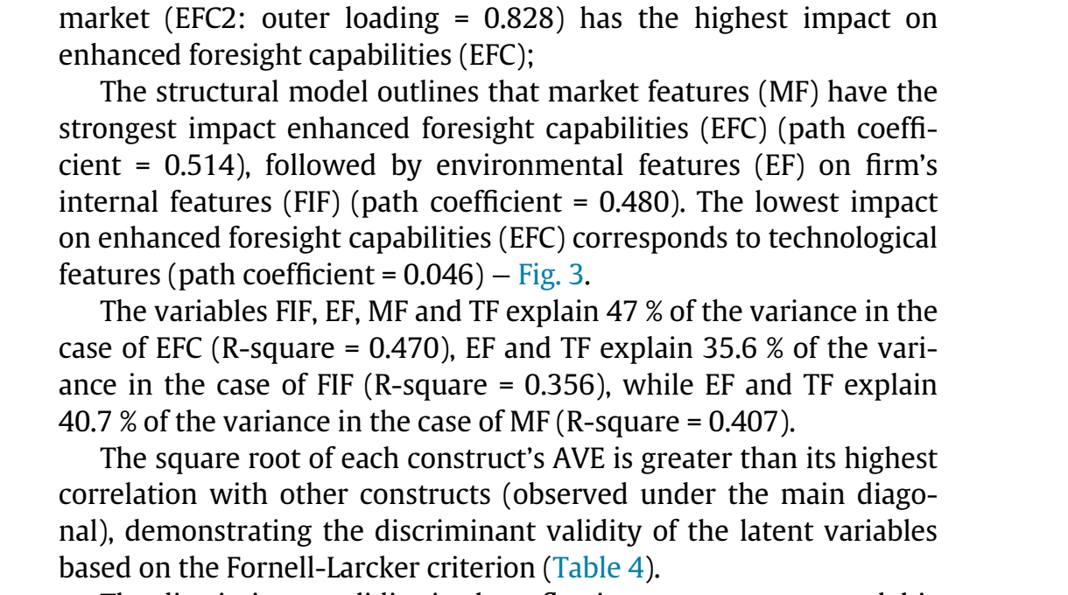
NCCR MUONIVERSE · HSG
08
LITERATURE REVIEW
SOURCE-LED FINDING
Market is the binding constraint
ORIGINAL SOURCE EXCERPT · p. 10
COMMENTS
What the excerpt shows: in the structural model, market features drive foresight capability hardest (path = 0.514), ahead of technology features.
The mechanism is capability-building: market signals teach firms to see where the technology could go — firm-internal factors were not significant.
For muon applications with no existing market, that foresight process must be organised deliberately. Cf. the flipped-Lean answer, slide 17.
Capatina, A., Bleoju, G. & Kalisz, D. (2024), Journal of Innovation & Knowledge 9, 100515.
Lorik Dalloshi · Milestone 1 · NCCR Muoniverse
08 / 42

Slide 9
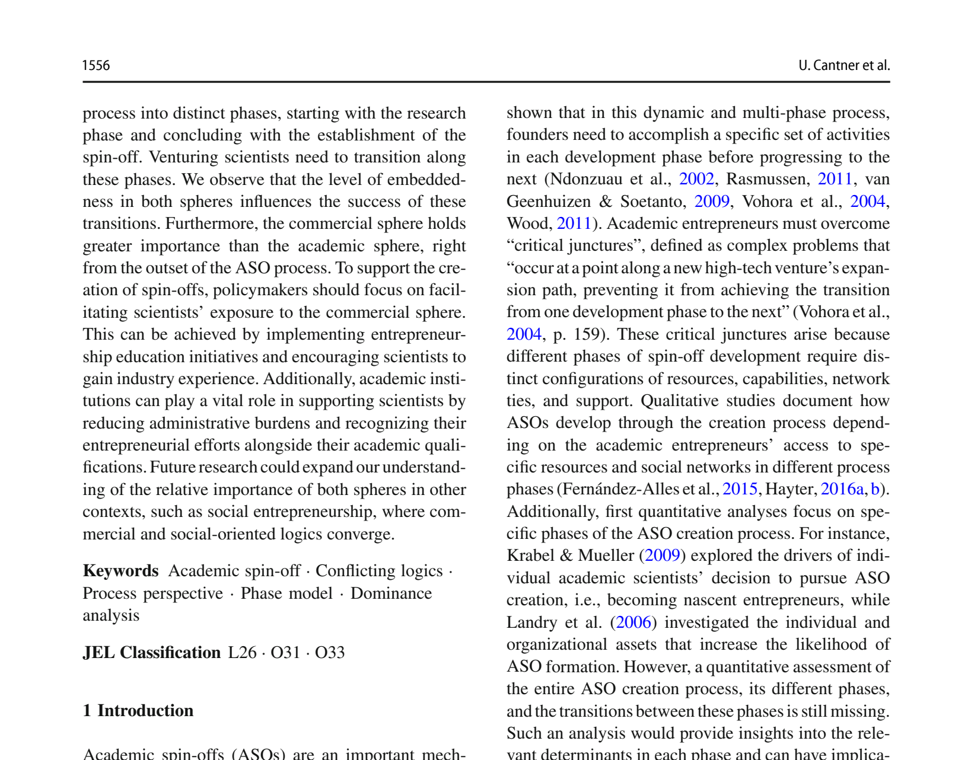
NCCR MUONIVERSE · HSG
09
LITERATURE REVIEW
SOURCE-LED FINDING
Commercial exposure from day one
ORIGINAL SOURCE EXCERPT · p. 2
COMMENTS
What the excerpt shows: in Cantner's panel, the commercial sphere outweighs the academic sphere from the very outset of spin-off creation.
This falsifies 'research first, commercialise later' sequencing — commercial capability is built in parallel, not afterwards.
Hard question for muons: what is commercial exposure when the product is 10–20 years out? A Milestone 2 interview anchor; cf. slide 41.
Cantner, U. et al. (2024), Small Business Economics 62, pp. 1555–1590.
Lorik Dalloshi · Milestone 1 · NCCR Muoniverse
09 / 42

Slide 10
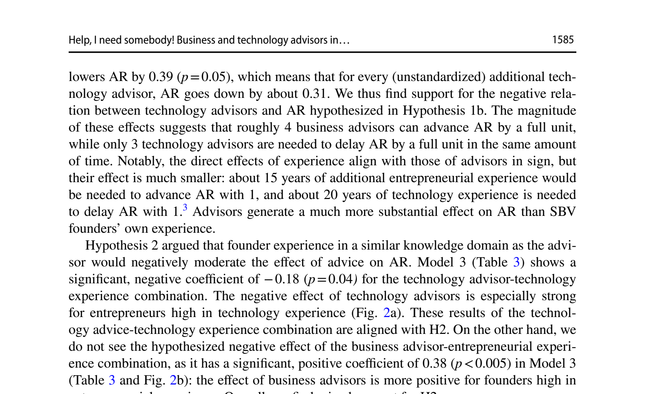
NCCR MUONIVERSE · HSG
10
LITERATURE REVIEW
SOURCE-LED FINDING
Advisor type matters more than quantity
ORIGINAL SOURCE EXCERPT · p. 19
COMMENTS
What the excerpt shows: each business advisor raises application readiness by ~0.23; each technology advisor lowers it by ~0.31.
Counterintuitive but consistent with Theme 4: at early stages the scarce input is business framing, not more technical validation.
Implication for the NCCR advisor pool: recruit advisors who have priced deep-tech markets, not more professors. Cf. slide 7.
Denoo, L., Van Boxstael, A. & Belz, A. (2024), Journal of Technology Transfer 49, pp. 1567–1605.
Lorik Dalloshi · Milestone 1 · NCCR Muoniverse
10 / 42

Slide 11
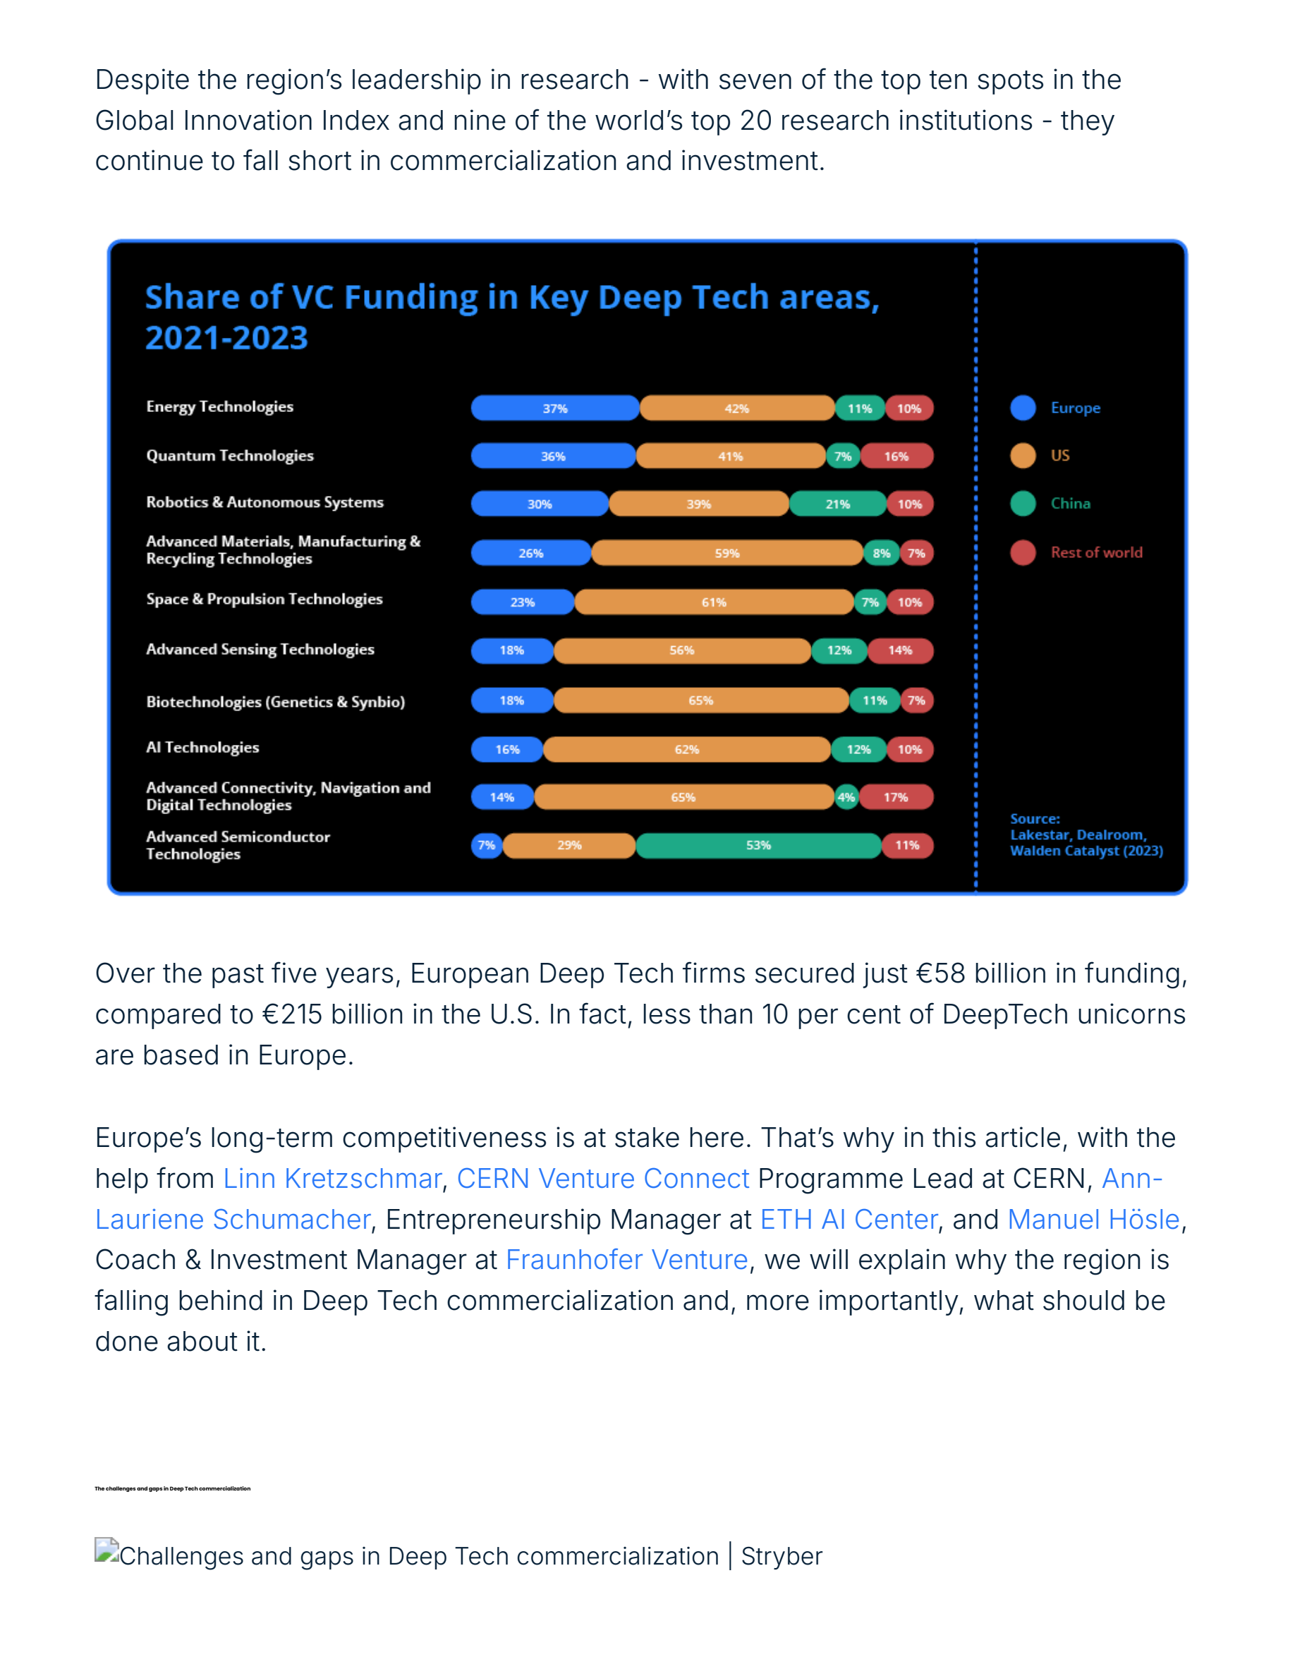
NCCR MUONIVERSE · HSG
11
LITERATURE REVIEW
SOURCE-LED FINDING
Europe's structural barriers
ORIGINAL SOURCE EXCERPT · p. 3
COMMENTS
What the excerpt shows: European deep tech firms secured a fraction of US capital — €58B vs €215B over the report's window.
The gap is structural — investor risk appetite and failure stigma, not just fund volume; capital alone cannot close it.
Switzerland leads per capita (slide 35), but late-stage rounds still face EU-scale limits; cf. restored EIC access, slide 26.
Stryber (2025), Deep Tech commercialization in Europe: the gap, the challenge, and the fix.
Lorik Dalloshi · Milestone 1 · NCCR Muoniverse
11 / 42

Slide 12
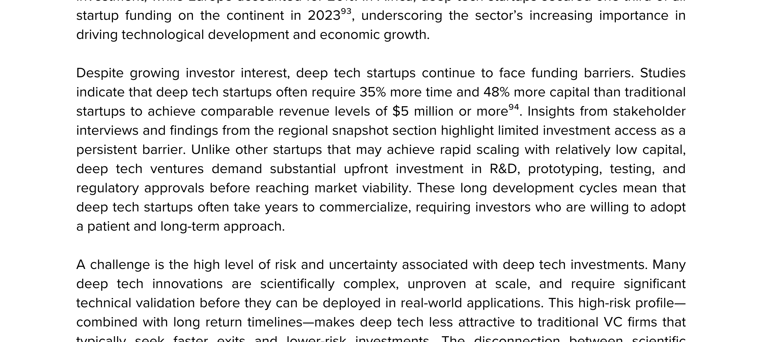
NCCR MUONIVERSE · HSG
12
LITERATURE REVIEW
SOURCE-LED FINDING
Deep tech needs 35% more time, 48% more capital
ORIGINAL SOURCE EXCERPT · p. 54
COMMENTS
What the excerpt shows: deep tech takes on average 35% more time and 48% more capital to reach equivalent milestones.
That premium is an average across all deep tech — physics ventures sit further into the tail of both distributions.
Design constraint for every instrument in this deck: BRIDGE runs 12 months, VC funds 3–5 years. Cf. slides 37 and 41.
UNDP (2025), Global Deep Tech Ecosystems: Catalyzing Innovation for Sustainable Development, p. 54.
Lorik Dalloshi · Milestone 1 · NCCR Muoniverse
12 / 42

Slide 13
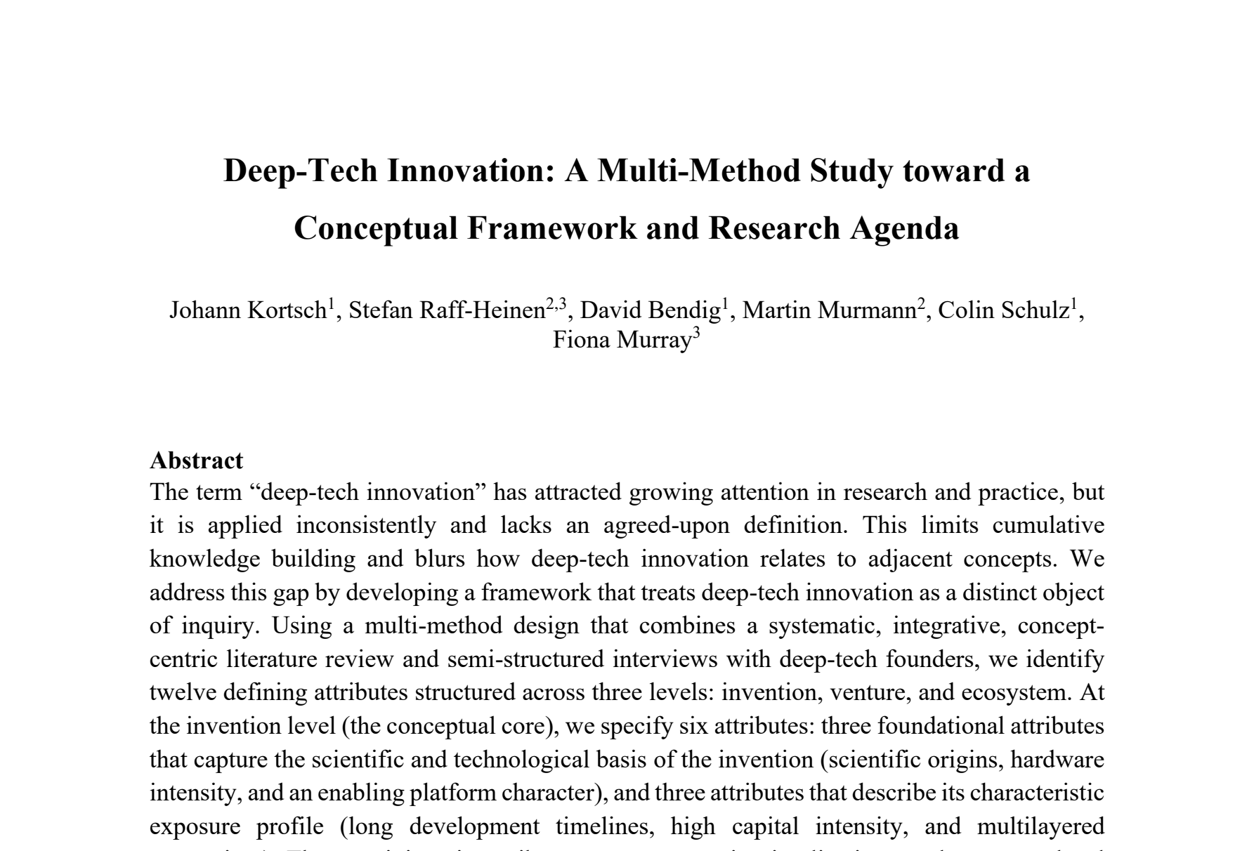
NCCR MUONIVERSE · HSG
13
LITERATURE REVIEW
SOURCE-LED FINDING
Converging on what deep tech is
ORIGINAL SOURCE EXCERPT · p. 1
COMMENTS
What the excerpt shows: twelve defining attributes structured across technology, venture and ecosystem levels — the field is converging on a definition.
Convergence is what makes cross-study comparison legitimate; muon technology satisfies the technology-side attributes by construction.
Use the three levels as the interview sampling frame: each level names different actors to talk to.
Kortsch, J. et al. (2024), Deep-Tech Innovation: A Multi-Method Study, MIT Sloan / University of Münster.
Lorik Dalloshi · Milestone 1 · NCCR Muoniverse
13 / 42

Slide 14
NCCR MUONIVERSE · HSG
14
FRAMEWORK ASSESSMENT
Four frameworks, one gap
RCA / Imperial · CRL · Innosuisse · EIC · candidates
Milestone 1 · source-led findings deck

Slide 15
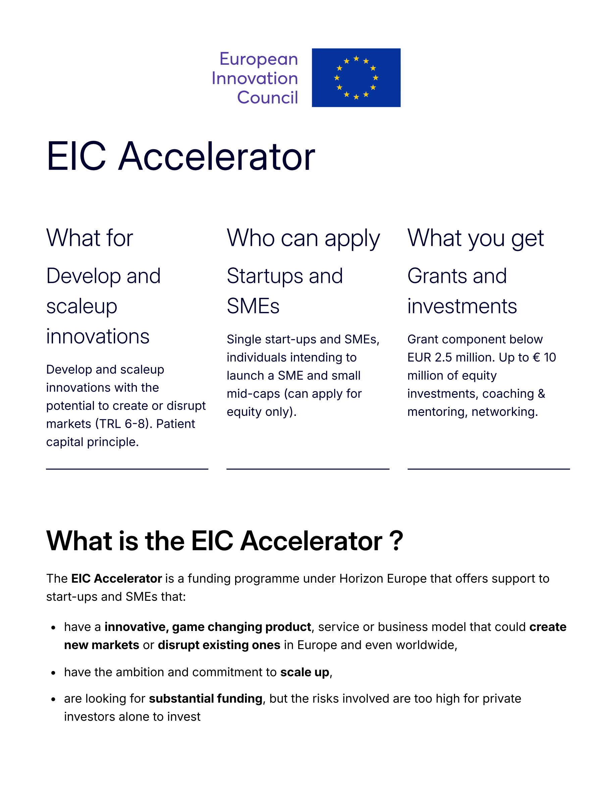
NCCR MUONIVERSE · HSG
15
FRAMEWORK ASSESSMENT
SOURCE-LED FINDING
The official pipeline starts at TRL 1 — but scale-up begins later
ORIGINAL SOURCE EXCERPT · p. 1
COMMENTS
What the excerpt shows: the EU's flagship commercial instrument, the Accelerator, requires TRL 6–8 — demonstration, not discovery.
The official pipeline funds research early (Pathfinder) but starts commercial support only at TRL 5–6: the commercial gap is precisely TRL 1–3.
This slide is the thesis's central finding; the rest of the deck maps what exists on each side of that gap.
European Innovation Council (2026), EIC Accelerator official programme page.
Lorik Dalloshi · Milestone 1 · NCCR Muoniverse
15 / 42

Slide 16
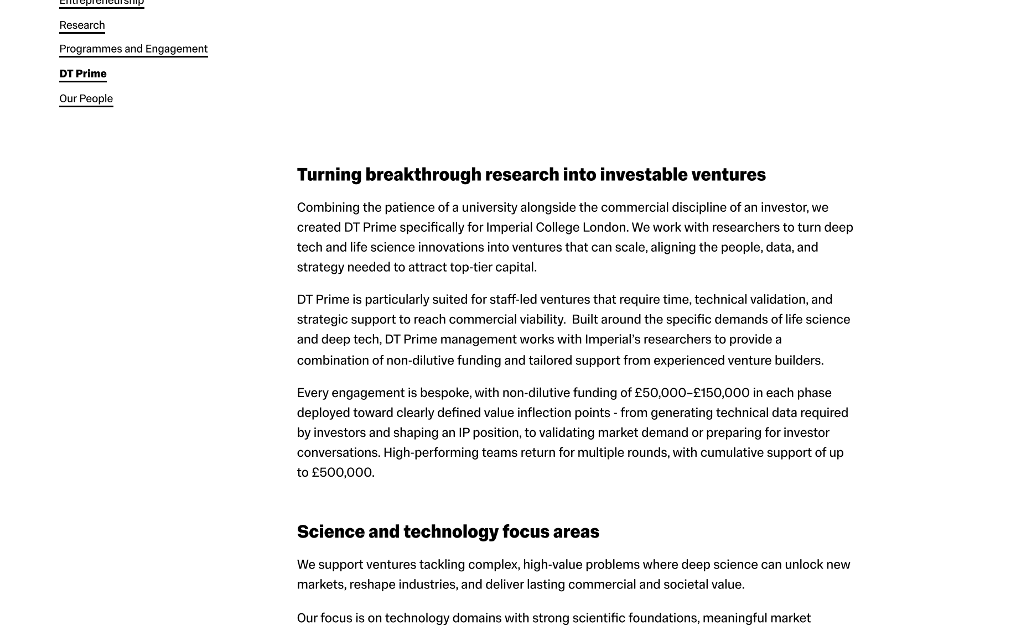
NCCR MUONIVERSE · HSG
16
FRAMEWORK ASSESSMENT
SOURCE-LED FINDING
RCA/Imperial: a cluster, not a program
ORIGINAL SOURCE EXCERPT · p. 1
COMMENTS
What the excerpt shows: DT Prime's official page — turning breakthrough research into investable ventures with non-dilutive funding.
It is a venture builder attached to a university, not a course: governance and capital sit alongside the methodology.
Benchmark question for November: could an equivalent attach to PSI? The methodology transfers; the institution does not automatically.
Imperial College London, DT Prime, Institute for Deep Tech Entrepreneurship (official page).
Lorik Dalloshi · Milestone 1 · NCCR Muoniverse
16 / 42

Slide 17
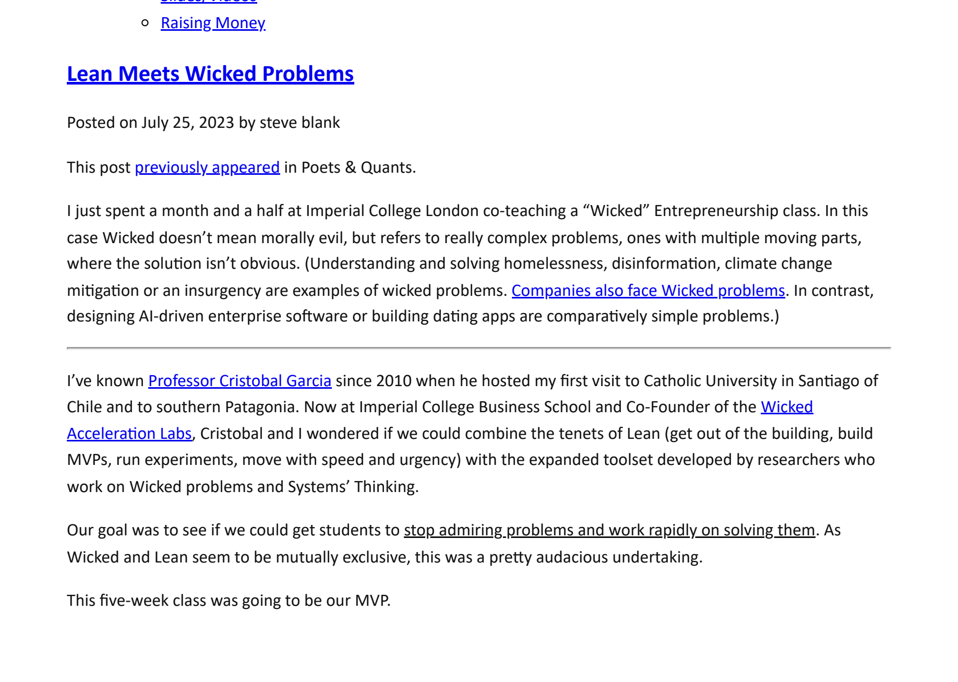
NCCR MUONIVERSE · HSG
17
FRAMEWORK ASSESSMENT
SOURCE-LED FINDING
RCA/Imperial: 'flipping' Lean Startup
ORIGINAL SOURCE EXCERPT · p. 8
COMMENTS
What the excerpt shows: Blank's own account of adapting Lean for wicked problems — technology first, then the search for applications.
The flip inverts classic lean: instead of starting from a customer problem, you start from a capability and hunt for contexts where it matters.
Key open issue: what replaces customer discovery when no customer exists yet — Blank's answer is lead and extreme users.
Blank, S. (2023), Lean Meets Wicked Problems, Steve Blank blog / Imperial College Business School class account.
Lorik Dalloshi · Milestone 1 · NCCR Muoniverse
17 / 42

Slide 18
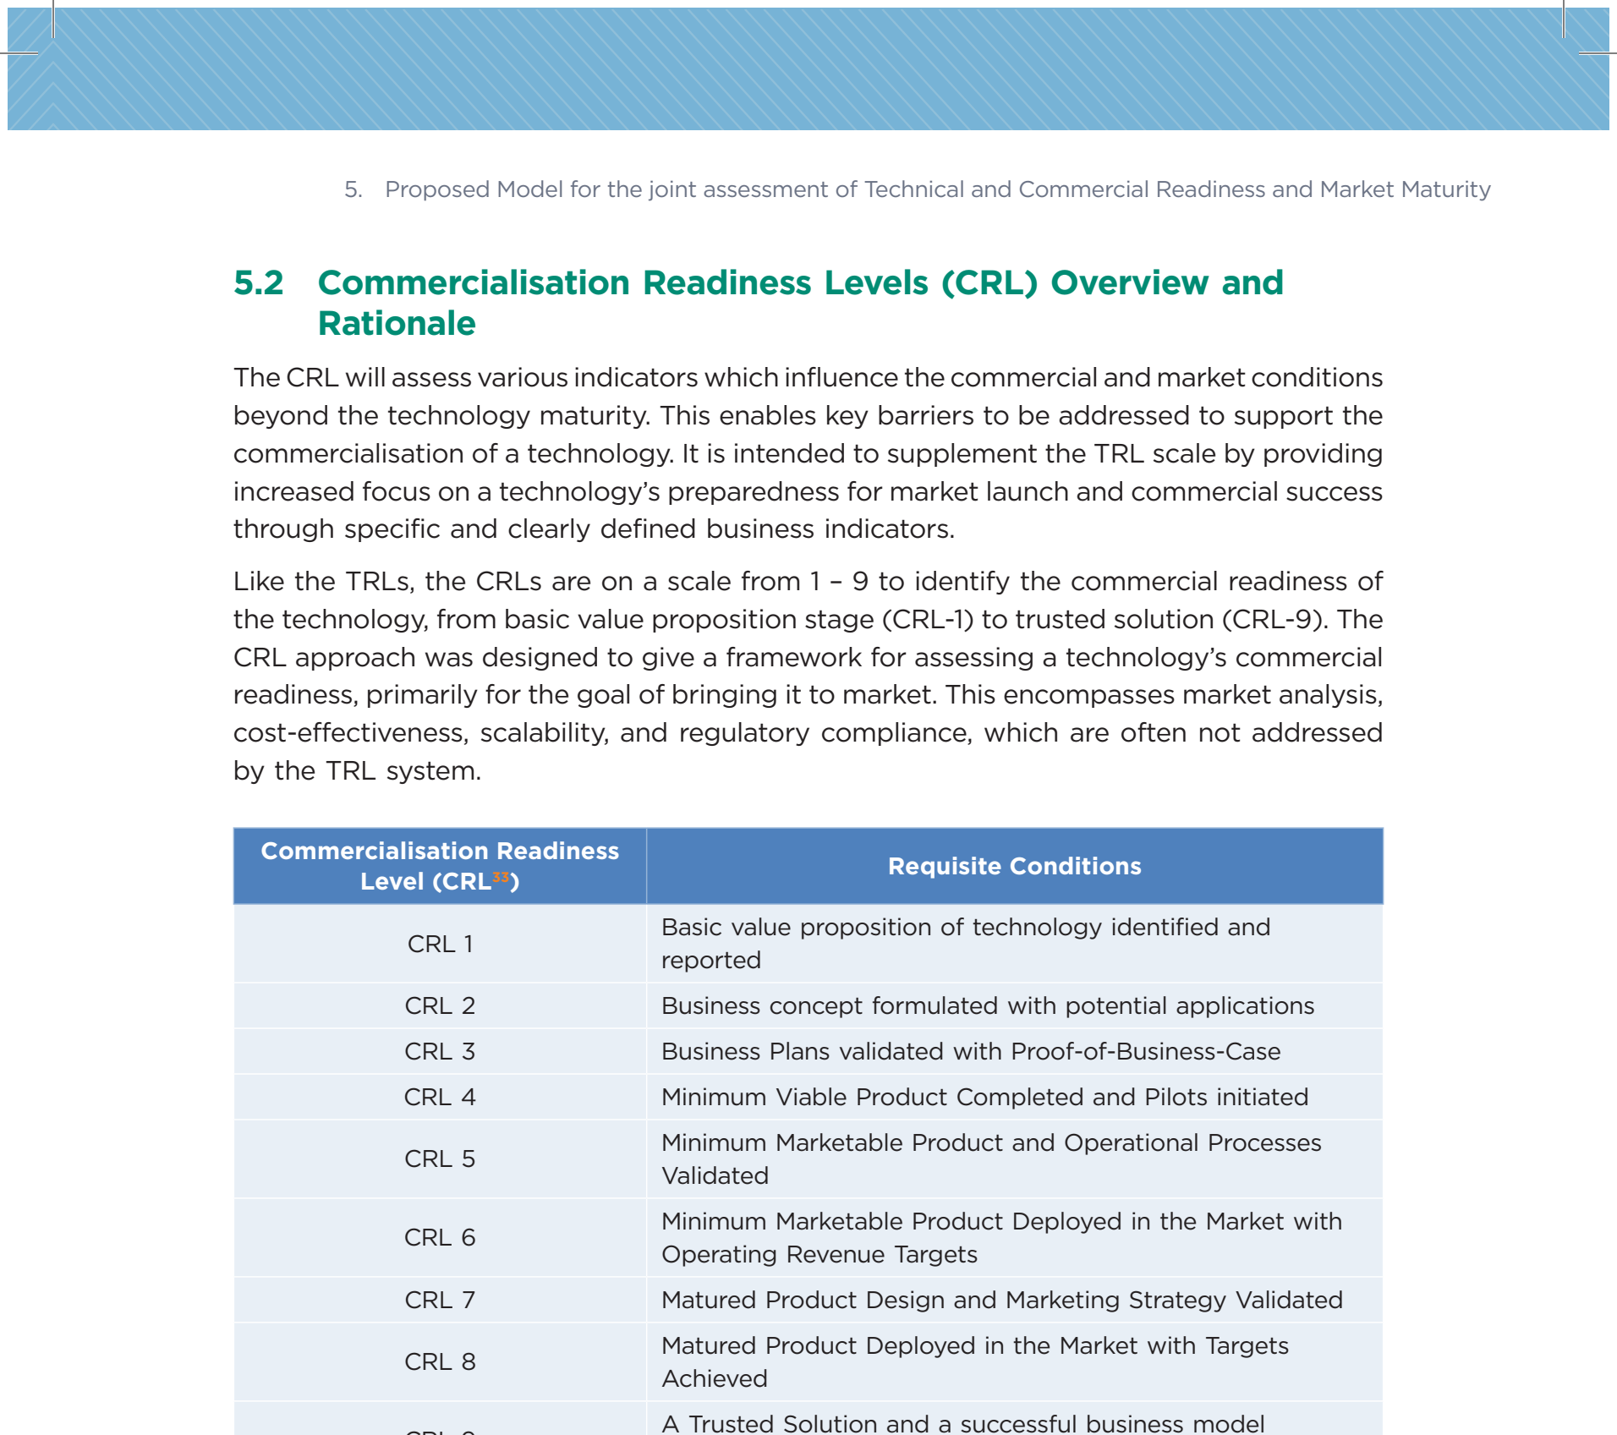
NCCR MUONIVERSE · HSG
18
FRAMEWORK ASSESSMENT
SOURCE-LED FINDING
CRL: the 9-point commercial scale
ORIGINAL SOURCE EXCERPT · p. 31
COMMENTS
What the excerpt shows: CRL codified 1–9, from basic value proposition to real market competitiveness — a government found it useful enough to operationalise.
Practitioner traction despite no peer-reviewed origin is itself a finding: there is real demand for a commercial axis to complement TRL.
CRL 1–3 (opportunity recognition → market sizing) maps onto the thesis's target stage; read against the TRL table, slide 39.
NITI Aayog (2023), A New Lens for Innovation in New India: TCRM Matrix, p. 31.
Lorik Dalloshi · Milestone 1 · NCCR Muoniverse
18 / 42

Slide 19
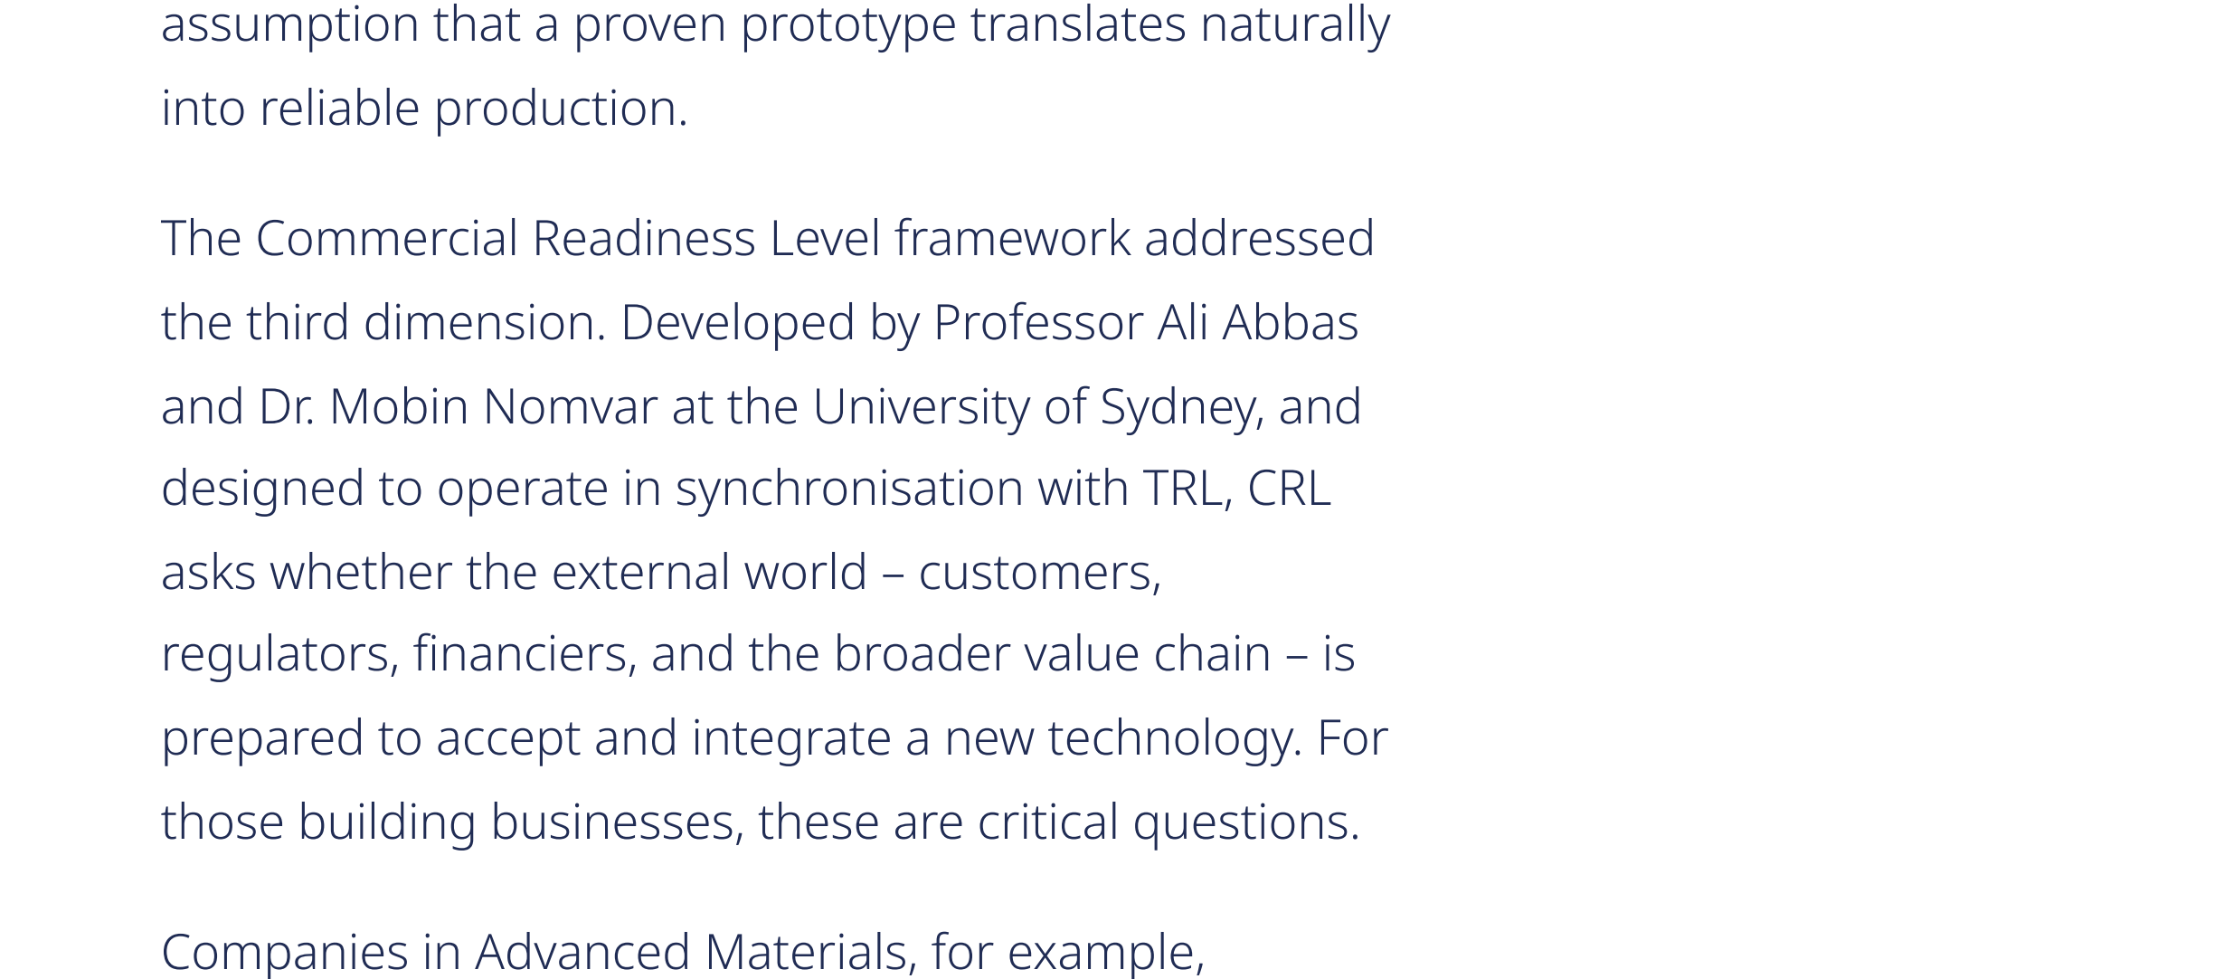
NCCR MUONIVERSE · HSG
19
FRAMEWORK ASSESSMENT
SOURCE-LED FINDING
CRL: the documentation problem
ORIGINAL SOURCE EXCERPT · p. 8
COMMENTS
What the excerpt shows: secondary sources describing and propagating CRL — none of them cites a primary, peer-reviewed source.
Adoption by citation chain without a canonical paper: building analysis on it requires explicit methodological honesty.
Thesis position: CRL is treated as a practitioner framework, not a validated instrument — stated openly in the assessment.
Deep Tech Leaders (2025), TRL, MRL & CRL Explained, Part 1, p. 8.
Lorik Dalloshi · Milestone 1 · NCCR Muoniverse
19 / 42

Slide 20
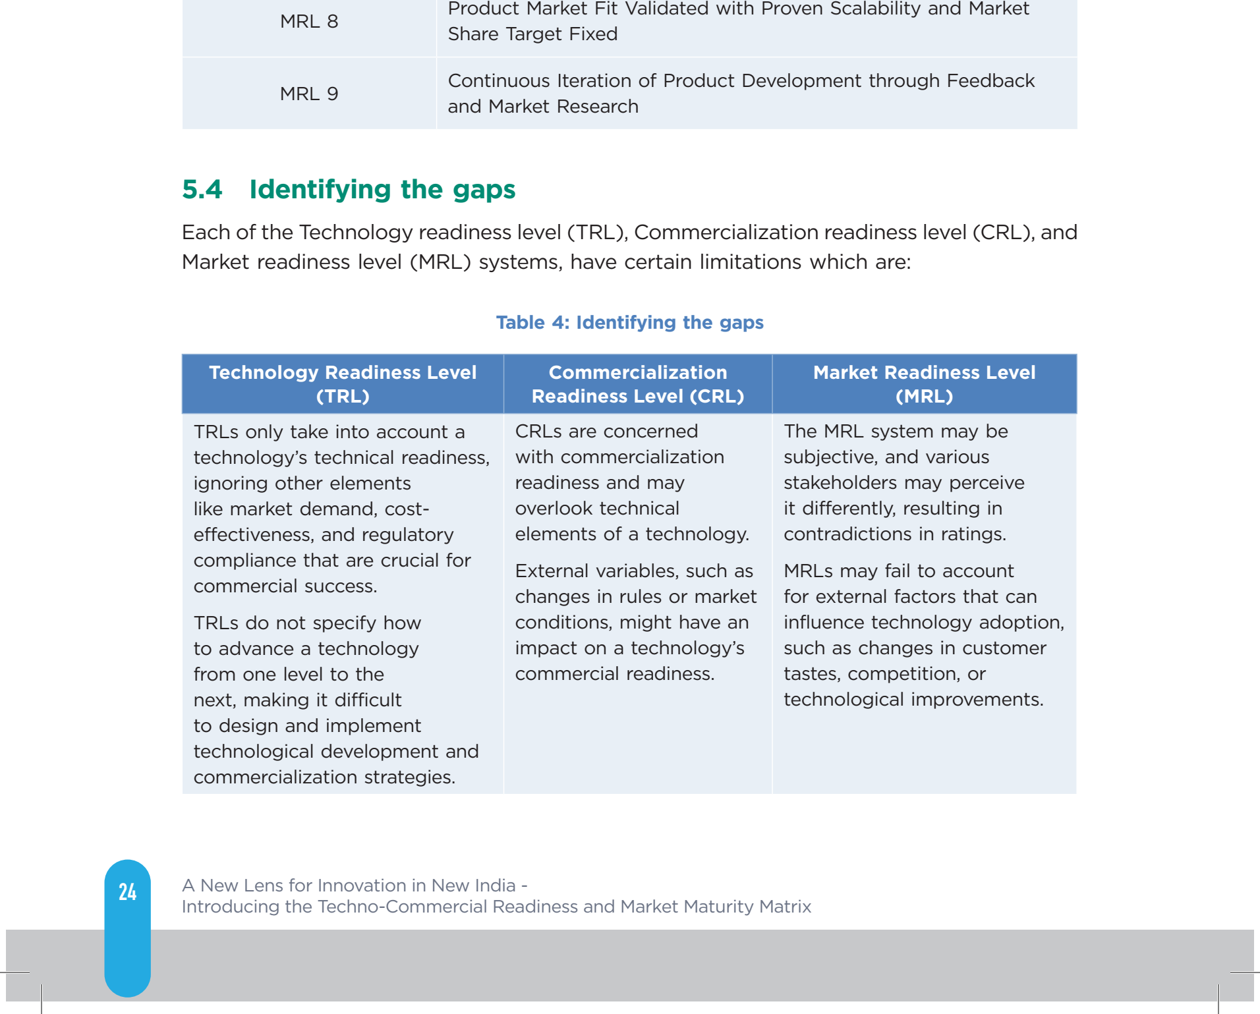
NCCR MUONIVERSE · HSG
20
FRAMEWORK ASSESSMENT
SOURCE-LED FINDING
CRL: the commercial dimension TRL misses
ORIGINAL SOURCE EXCERPT · p. 32
COMMENTS
What the excerpt shows: even NITI's motivation mirrors the thesis — TRL accounts only for technical readiness, not commercial readiness.
The criticism is validated; the remedy is thin: CRL describes where you are, not what to do next — no rubric or checklist exists.
Milestone 2 opening: ask actors how they actually gauge commercial readiness — a detector can be TRL 9 and CRL 1.
NITI Aayog (2023), TCRM Matrix, p. 32 (identifying the limits of TRL and the need for commercial readiness).
Lorik Dalloshi · Milestone 1 · NCCR Muoniverse
20 / 42

Slide 21
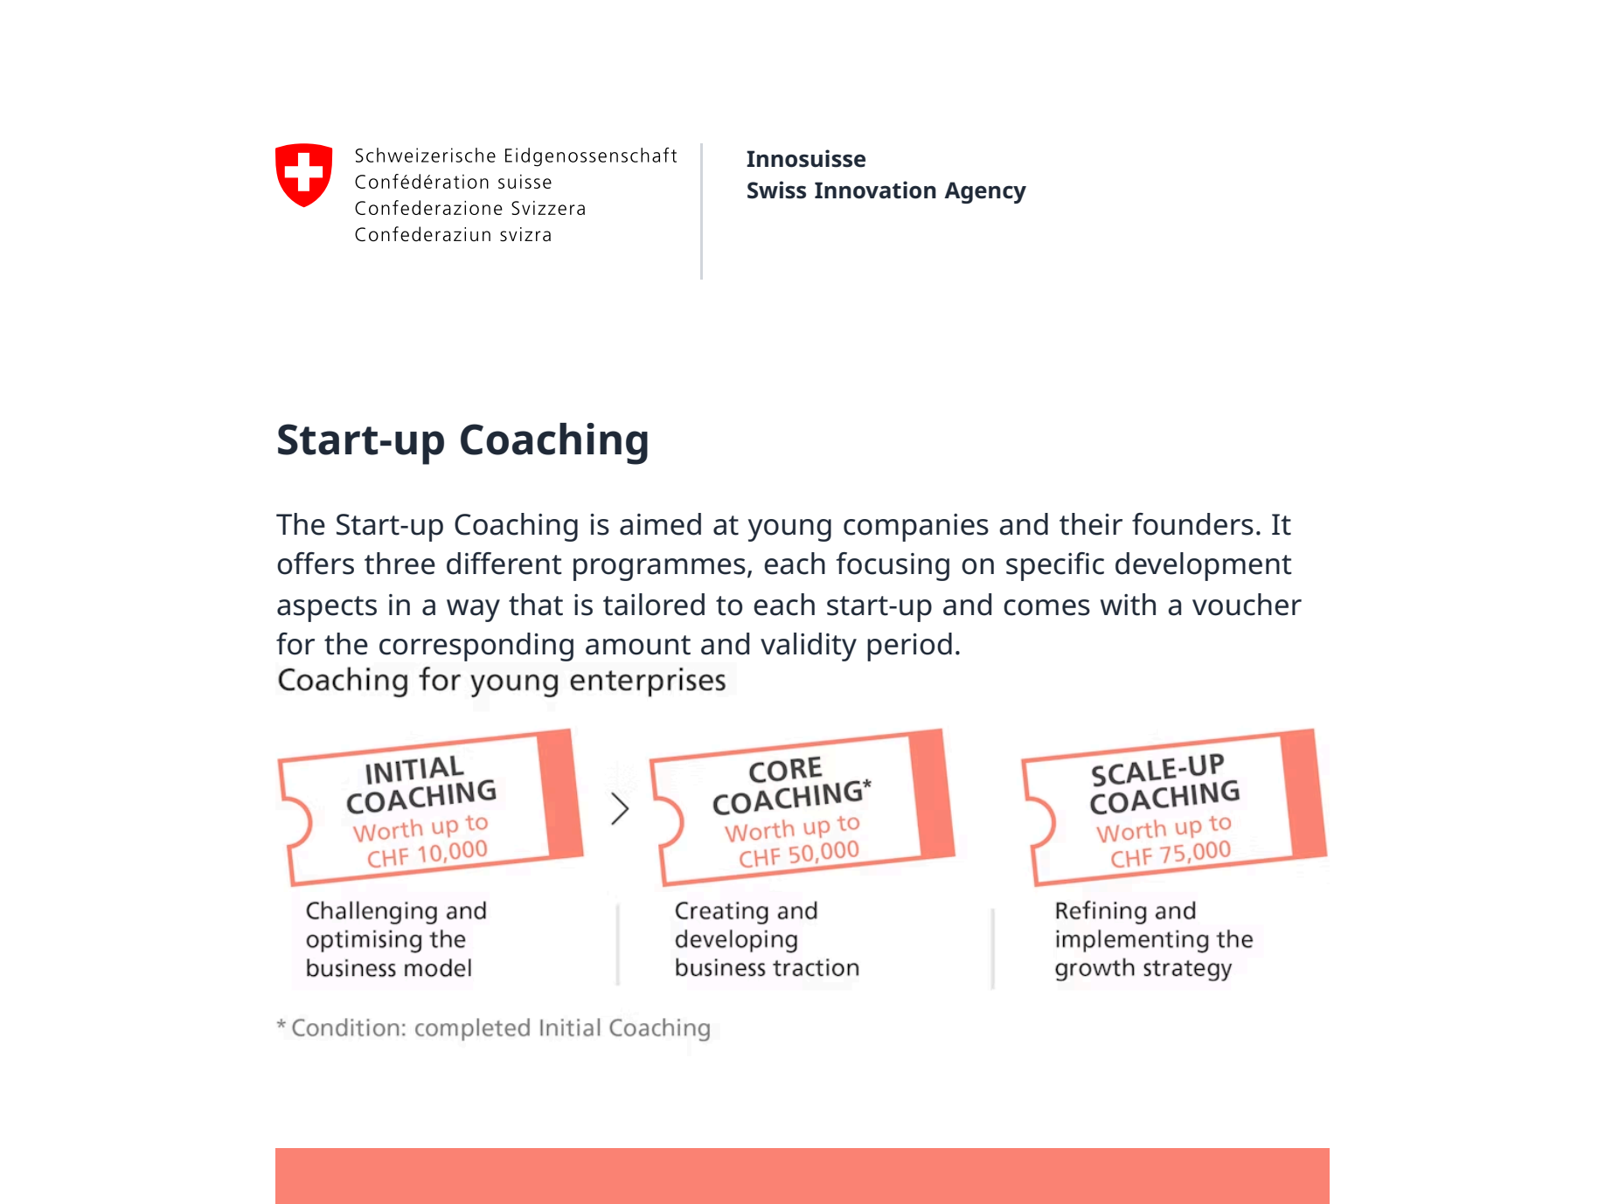
NCCR MUONIVERSE · HSG
21
FRAMEWORK ASSESSMENT
SOURCE-LED FINDING
Innosuisse: the native Swiss framework
ORIGINAL SOURCE EXCERPT · p. 1
COMMENTS
What the excerpt shows: the official Start-up Coaching offer aimed at young companies — the instrument every Swiss venture touches.
The design is a voucher system: flexibility and founder choice, rather than a standardised curriculum.
Cf. slide 28: Switzerland chose mentor-driven over methodology-driven — a deliberate contrast for the benchmarking.
Innosuisse (official), Start-up Coaching overview.
Lorik Dalloshi · Milestone 1 · NCCR Muoniverse
21 / 42

Slide 22
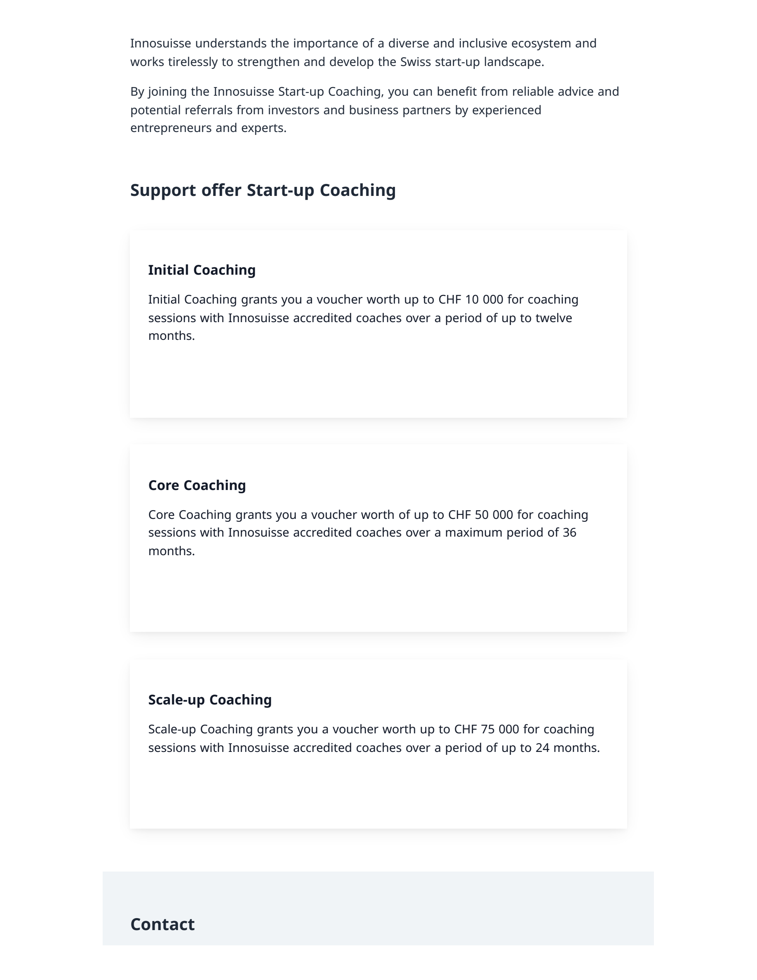
NCCR MUONIVERSE · HSG
22
FRAMEWORK ASSESSMENT
SOURCE-LED FINDING
Innosuisse: bespoke, voucher-based coaching
ORIGINAL SOURCE EXCERPT · p. 2
COMMENTS
What the excerpt shows: initial coaching is a voucher (up to CHF 10,000) with which founders choose accredited coaches themselves.
Demand-side design presupposes informed demand — at TRL 1–3, scientists may not yet know what support they need.
Interview probe: how many accredited coaches have priced particle-physics applications? Supply of relevant expertise is the test.
Innosuisse (official), Start-up Coaching overview, voucher-based programme description.
Lorik Dalloshi · Milestone 1 · NCCR Muoniverse
22 / 42

Slide 23
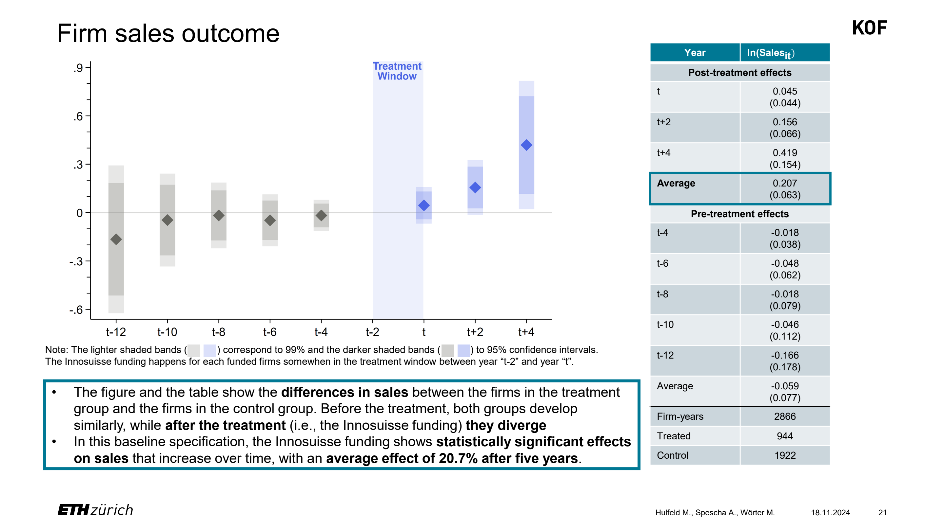
NCCR MUONIVERSE · HSG
23
FRAMEWORK ASSESSMENT
SOURCE-LED FINDING
Innosuisse: KOF-verified causal effect
ORIGINAL SOURCE EXCERPT · p. 21
COMMENTS
What the excerpt shows: the KOF difference-in-differences estimate — +20.7% sales on average five years after funding.
Rare causal evidence in this field, and the effect grows with time — consistent with patient, compounding returns.
Boundary condition: strongest for small firms working with ETH-domain partners — evidence about firms, silent on pre-founding TRL 1–3.
Hulfeld, F., Spescha, A. & Wörter, M. (KOF ETH Zurich, 2024), Funding R&D Cooperation between Firms and Universities.
Lorik Dalloshi · Milestone 1 · NCCR Muoniverse
23 / 42

Slide 24
NCCR MUONIVERSE · HSG
24
FRAMEWORK ASSESSMENT
SOURCE-LED FINDING
Innosuisse support is stage-specific
ORIGINAL SOURCE EXCERPT · p. 2
COMMENTS
What the excerpt shows: the coaching ladder — initial, core, scale-up — where every rung presupposes an existing young company.
Before founding there is no rung: the gap is stage mismatch inside a well-run system, not a missing system.
With BRIDGE (slide 37): proof-of-concept money exists but runs 12 months — cf. UNDP's +35% time premium, slide 41.
Innosuisse (official), Start-up Coaching overview — stage-specific support and durations.
Lorik Dalloshi · Milestone 1 · NCCR Muoniverse
24 / 42

Slide 25
NCCR MUONIVERSE · HSG
25
FRAMEWORK ASSESSMENT
SOURCE-LED FINDING
EIC Accelerator: TRL 6–8
ORIGINAL SOURCE EXCERPT · p. 1
COMMENTS
What the excerpt shows: the Accelerator's own terms — TRL 6–8, blended finance (grant + equity), single-digit success rate.
For muon ventures this is a later-stage target, not an entry point; the pathway runs Pathfinder → Transition → Accelerator.
Sequencing, not any single instrument, is the operative design question; cf. Swiss eligibility, slide 26.
European Innovation Council (official), EIC Accelerator programme page.
Lorik Dalloshi · Milestone 1 · NCCR Muoniverse
25 / 42

Slide 26
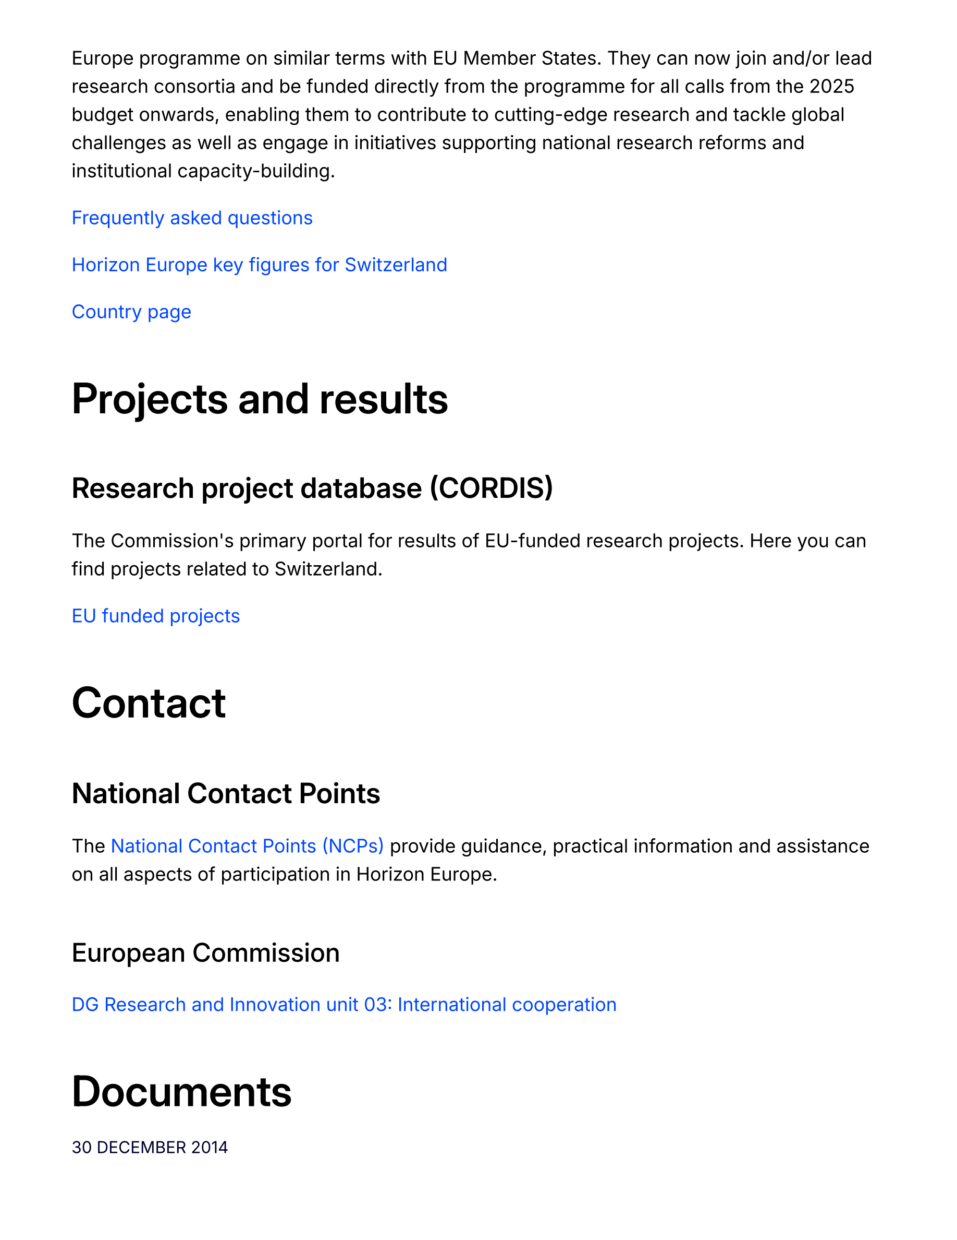
NCCR MUONIVERSE · HSG
26
FRAMEWORK ASSESSMENT
SOURCE-LED FINDING
EIC: Switzerland fully eligible since Jan 2025
ORIGINAL SOURCE EXCERPT · p. 2
COMMENTS
What the excerpt shows: Switzerland associated to Horizon Europe 'on similar terms with EU Member States' — full eligibility restored.
The EU pipeline is a real option again for Swiss ventures; recent EIC winners confirm actual uptake.
Interview probe: which PSI-adjacent teams already coordinate EU consortia — capability, not just eligibility, gates access.
European Commission (official), International cooperation with Switzerland in research and innovation.
Lorik Dalloshi · Milestone 1 · NCCR Muoniverse
26 / 42

Slide 27
NCCR MUONIVERSE · HSG
27
FRAMEWORK ASSESSMENT
SOURCE-LED FINDING
Candidate: CERN Venture Connect
ORIGINAL SOURCE EXCERPT · p. 3
COMMENTS
What the excerpt shows: CERN's Venture Connect lead among the study's expert sources — CERN is actively building a venture path for particle physics.
The closest institutional sibling to Muoniverse: same science, same pre-market problem, answered with a curated, zero-equity model.
November benchmarking target: what transfers from CERN's portfolio curation to a Swiss NCCR context?
Stryber (2025), Deep Tech commercialization in Europe — source identifying CERN Venture Connect as a relevant institutional actor.
Lorik Dalloshi · Milestone 1 · NCCR Muoniverse
27 / 42

Slide 28
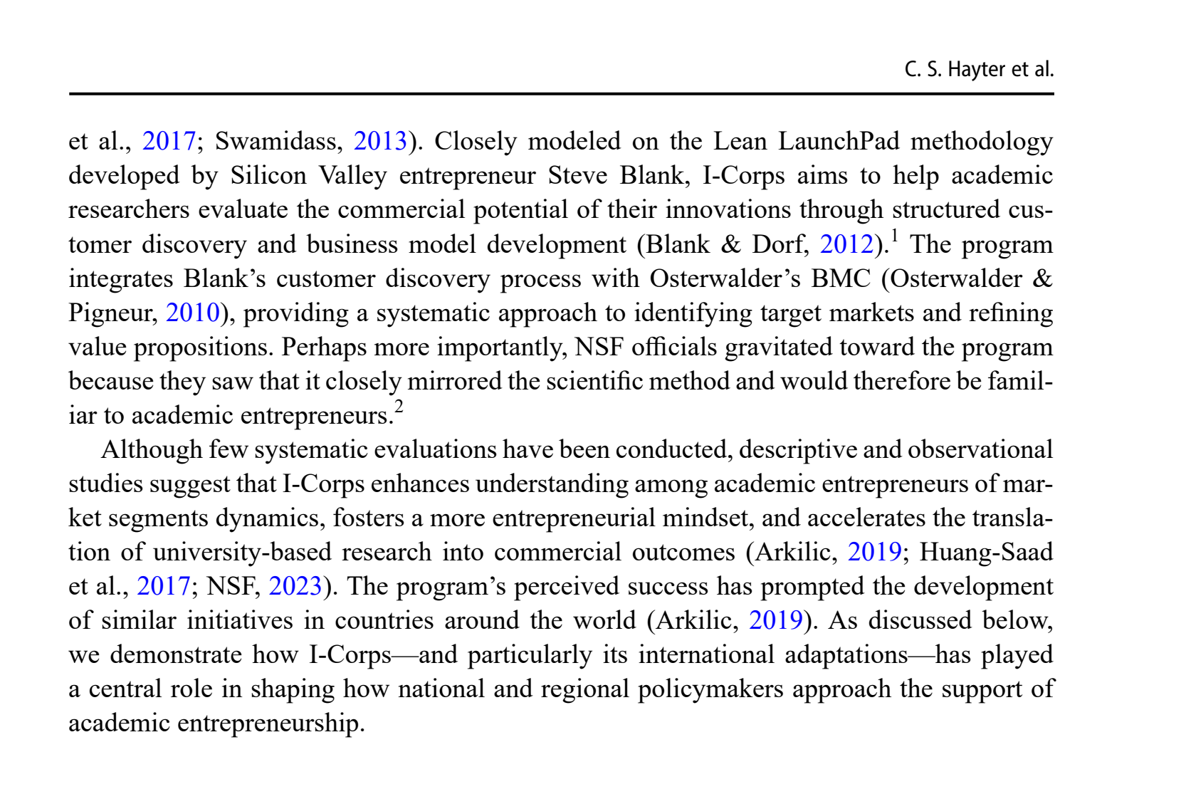
NCCR MUONIVERSE · HSG
28
FRAMEWORK ASSESSMENT
SOURCE-LED FINDING
Candidate: NSF I-Corps
ORIGINAL SOURCE EXCERPT · p. 4
COMMENTS
What the excerpt shows: I-Corps' core as Hayter et al. document it — structured customer discovery and business model development.
It is a methodology rather than an institution: adoptable without new bodies, which makes it the cheapest candidate to pilot.
Open question: does a 7-week customer-discovery sprint fit muon validation cycles? Cf. flipped Lean, slide 17.
Hayter, C. S. et al. (2025), Journal of Technology Transfer, p. 4.
Lorik Dalloshi · Milestone 1 · NCCR Muoniverse
28 / 42

Slide 29
NCCR MUONIVERSE · HSG
29
DATA COMPENDIUM
The numbers
Statistical evidence behind the findings
Milestone 1 · source-led findings deck

Slide 30
NCCR MUONIVERSE · HSG
30
DATA COMPENDIUM
SOURCE-LED FINDING
Market features dominate (β = 0.514)
ORIGINAL SOURCE EXCERPT · p. 10
COMMENTS
What the excerpt shows: the coefficient hierarchy — market features 0.514 vs technology ~0.31; firm-internal features not significant.
Market-side variance explains the foresight capability outcome (R² = 0.47); the internal factors managers control directly did not register.
Caveat for the thesis: cross-sectional PLS-SEM, n = 110 — association, not causation. Would it replicate for physics ventures?
Capatina, A., Bleoju, G. & Kalisz, D. (2024), Journal of Innovation & Knowledge 9, 100515, structural model.
Lorik Dalloshi · Milestone 1 · NCCR Muoniverse
30 / 42

Slide 31
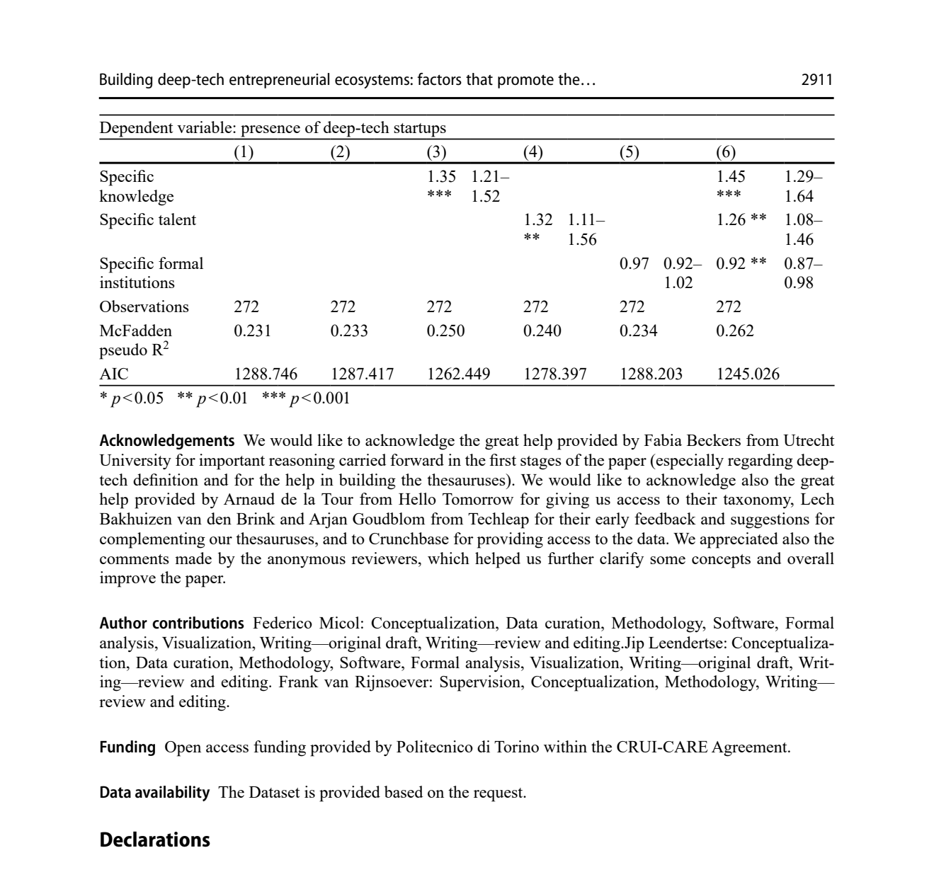
NCCR MUONIVERSE · HSG
31
DATA COMPENDIUM
SOURCE-LED FINDING
Talent and knowledge drive deep tech
ORIGINAL SOURCE EXCERPT · p. 40
COMMENTS
What the excerpt shows: the regression table — specific knowledge and talent significant; formal institutions not, across 272 regions.
The significant predictors are slow variables: research infrastructure and people accumulate over decades, not funding cycles.
Swiss reading: one very strong node (PSI/ETH/EPFL) — is that concentration a leverage point or a single-point fragility?
Micol, F., Leendertse, J. & van Rijnsoever, F. (2026), Journal of Technology Transfer, Table 4.
Lorik Dalloshi · Milestone 1 · NCCR Muoniverse
31 / 42

Slide 32
NCCR MUONIVERSE · HSG
32
DATA COMPENDIUM
SOURCE-LED FINDING
Incubation: type and age matter
ORIGINAL SOURCE EXCERPT · p. 32
COMMENTS
What the excerpt shows: the moderator rows — university incubators 0.118 vs generic 0.067; incubators older than 20 years reach 0.183.
Networks compound: incubator age nearly doubles the effect — evidence the real asset is accumulated relationships.
A new PSI-hosted incubator starts at age zero; renting maturity through partners (CERN, ETH) may beat building it. Cf. slide 27.
Seitz, N. et al. (2026), Review of Managerial Science, moderator table.
Lorik Dalloshi · Milestone 1 · NCCR Muoniverse
32 / 42

Slide 33
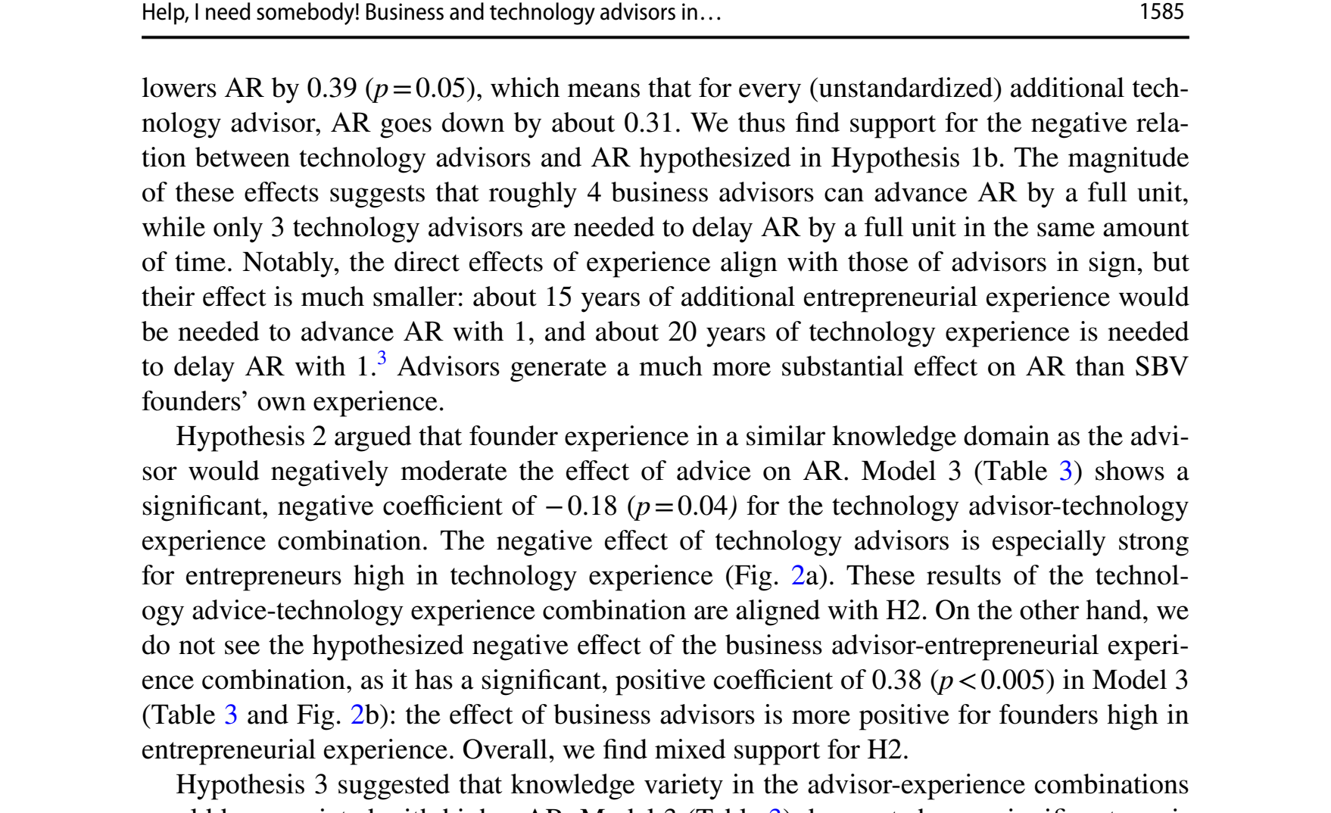
NCCR MUONIVERSE · HSG
33
DATA COMPENDIUM
SOURCE-LED FINDING
Advisors: business +0.23, technology −0.31
ORIGINAL SOURCE EXCERPT · p. 19
COMMENTS
What the excerpt shows: the substitution rate — roughly four business advisors advance application readiness by one full unit.
Advisor design becomes arithmetic: the question is not whether advisors help, but which type and in what ratio.
Boundary condition: n = 112 ventures; the outcome is readiness, not survival. What a business advisor does pre-product is untested.
Denoo, L., Van Boxstael, A. & Belz, A. (2024), Journal of Technology Transfer, p. 1585.
Lorik Dalloshi · Milestone 1 · NCCR Muoniverse
33 / 42

Slide 34
NCCR MUONIVERSE · HSG
34
DATA COMPENDIUM
SOURCE-LED FINDING
TTOs become playmakers through relationships
ORIGINAL SOURCE EXCERPT · p. 16
COMMENTS
What the excerpt shows: the playmaker mechanism — relationships within the wider university innovation-service ecosystem.
Two literatures converge: Chen supplies the mechanism; the survival panel (business relationships, p = 0.0034) supplies the magnitude.
Measurement implication: a TTO's KPIs could count ties built and introductions made — not only patents filed.
Chen, Z., Little, V. & Thuan, N. (2025), Journal of Technology Transfer, p. 1075.
Lorik Dalloshi · Milestone 1 · NCCR Muoniverse
34 / 42

Slide 35
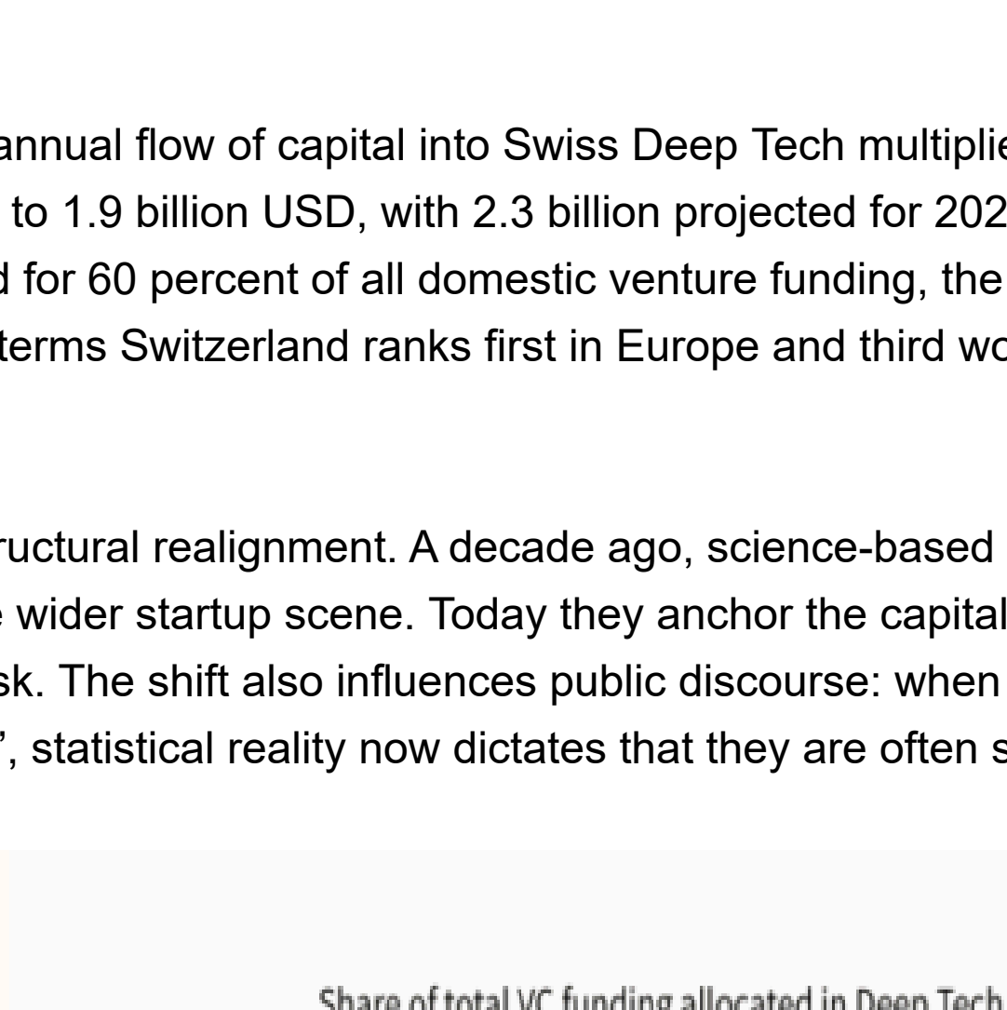
NCCR MUONIVERSE · HSG
35
DATA COMPENDIUM
SOURCE-LED FINDING
Switzerland: #1 per capita, 3× the runner-up
ORIGINAL SOURCE EXCERPT · p. 3
COMMENTS
What the excerpt shows: 60% of Swiss venture funding flows to deep tech — the highest share of any country.
The ecosystem is deep-tech-native: capital preference, per-capita spinout value (100 vs 33 for the runner-up), top-ranked universities.
Tension with slides 40–41: strength at formation — but will Swiss capital hold for 10–20-year physics timelines? An interview anchor.
Deep Tech Nation Switzerland / Dealroom.co (2025), Swiss Deep Tech Report 2025, via Swiss Startup Association reproduction.
Lorik Dalloshi · Milestone 1 · NCCR Muoniverse
35 / 42

Slide 36
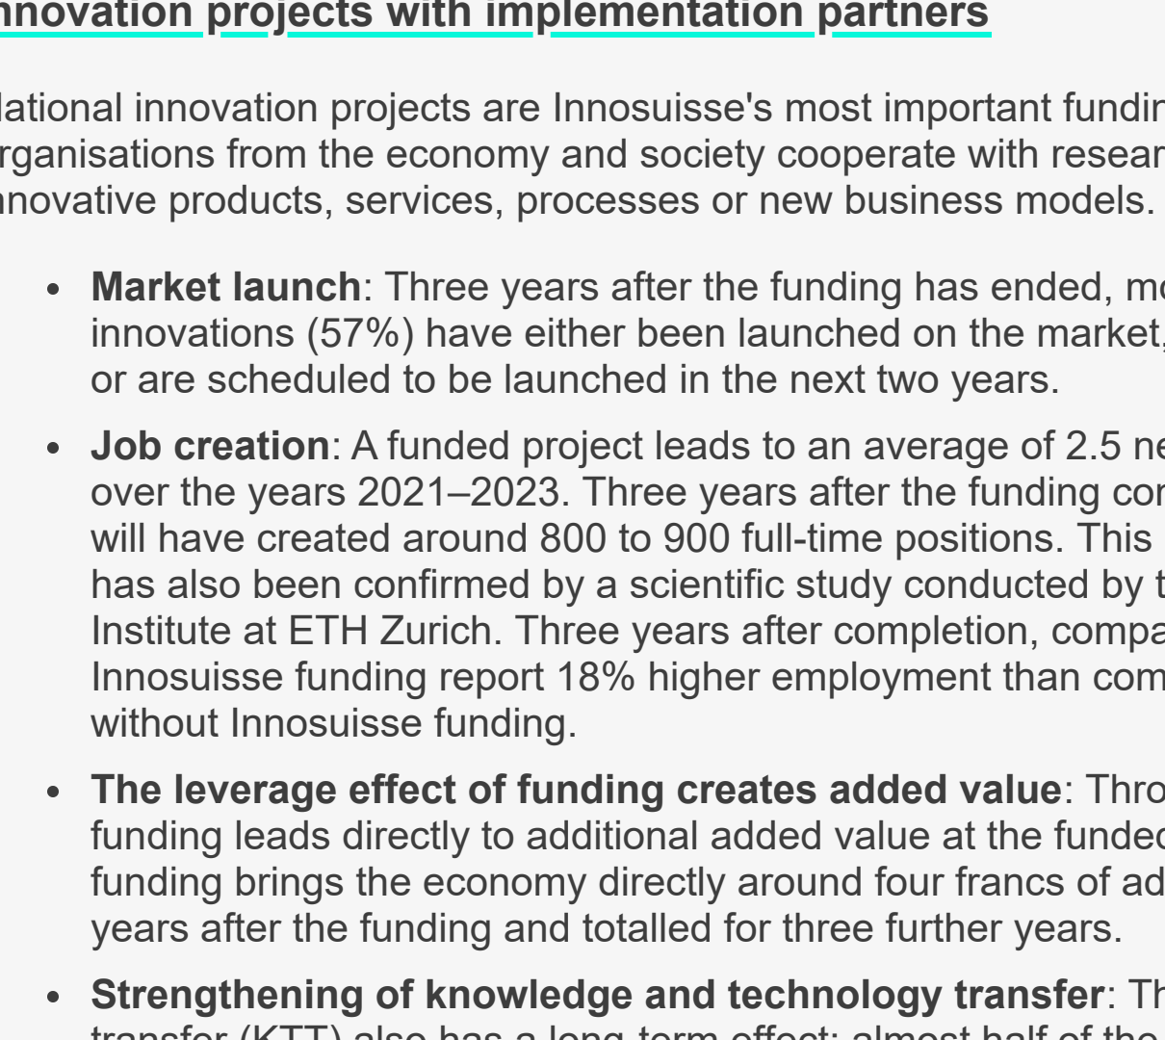
NCCR MUONIVERSE · HSG
36
DATA COMPENDIUM
SOURCE-LED FINDING
Innosuisse Innovation Projects: 57% launch rate
ORIGINAL SOURCE EXCERPT · p. 2
COMMENTS
What the excerpt shows: 57% of innovation projects reach market launch within three years of funding ending.
Solid conversion — but the sample is existing firm–university R&D consortia; selection happens before the statistic.
The metric counts launches, not scale — and for muon ventures the whole 3-year window is pre-market. Cf. slide 41.
Innosuisse (2025), Impact monitoring 2021–2023.
Lorik Dalloshi · Milestone 1 · NCCR Muoniverse
36 / 42

Slide 37
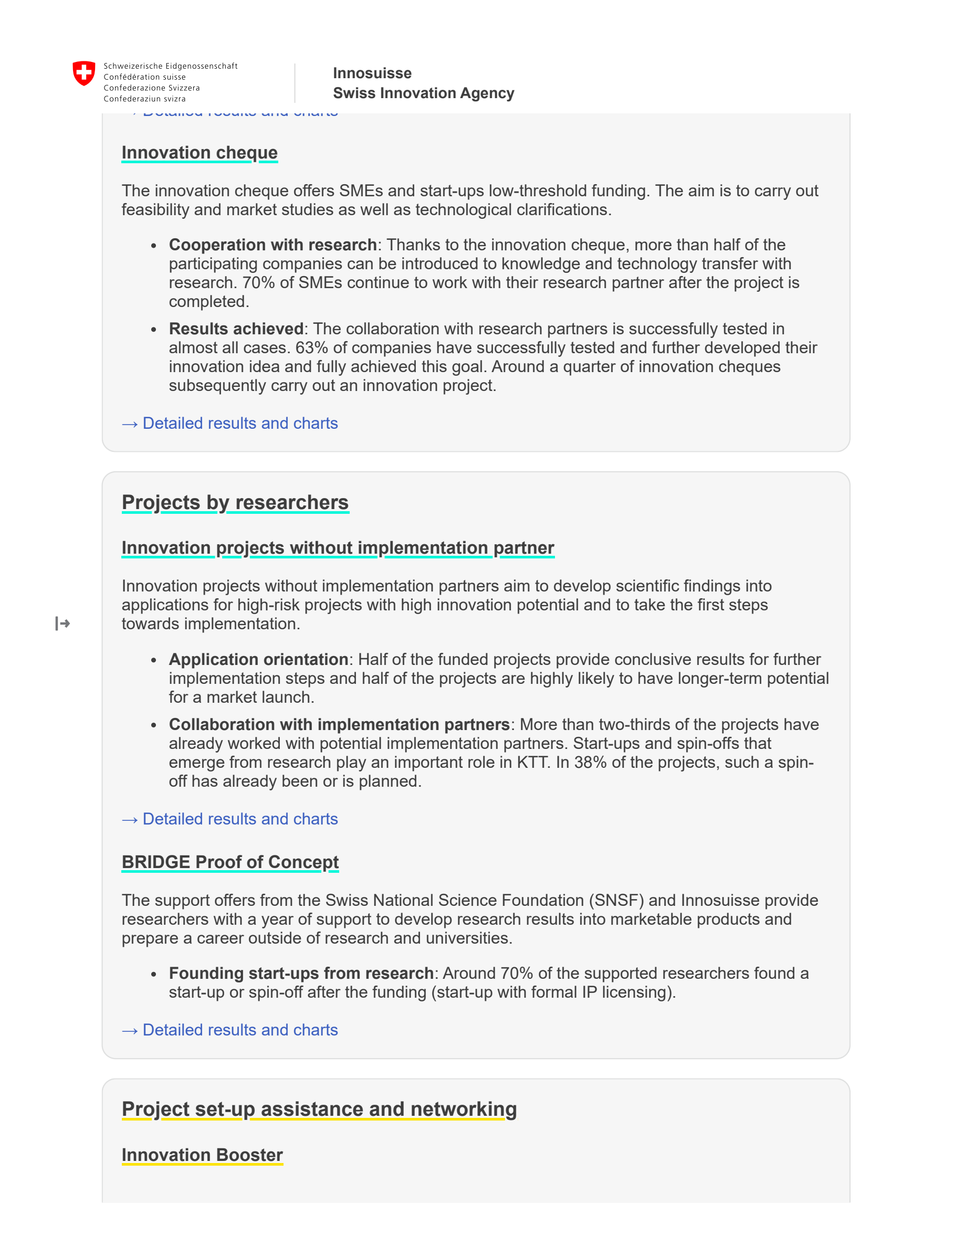
NCCR MUONIVERSE · HSG
37
DATA COMPENDIUM
SOURCE-LED FINDING
BRIDGE PoC: 70% founding rate
ORIGINAL SOURCE EXCERPT · p. 3
COMMENTS
What the excerpt shows: around 70% of BRIDGE-supported researchers go on to found a startup — the highest conversion of any instrument.
Willingness is not the bottleneck: when an instrument fits the stage, researchers do found companies.
The 12-month, CHF 130K format proves the concept — and its boundary: muon validation cycles outlast the window.
Innosuisse (2025), Impact monitoring 2021–2023, BRIDGE Proof of Concept.
Lorik Dalloshi · Milestone 1 · NCCR Muoniverse
37 / 42

Slide 38
NCCR MUONIVERSE · HSG
38
DATA COMPENDIUM
SOURCE-LED FINDING
KOF causal effect: +20.7% sales, +17.6% employment
ORIGINAL SOURCE EXCERPT · p. 21
COMMENTS
What the excerpt shows: the 20.7% average sales effect; within the panel it rises from +7.8% (yr 0) toward ~28% (yr 4).
Compounding returns argue for patient evaluation: a short measurement window would score these projects as failures.
Same boundary as slide 23: significant for small firms with ETH-domain partners; silent on the pre-founding stage this thesis targets.
Hulfeld, F., Spescha, A. & Wörter, M. (KOF ETH Zurich, 2024), causal difference-in-differences result.
Lorik Dalloshi · Milestone 1 · NCCR Muoniverse
38 / 42

Slide 39
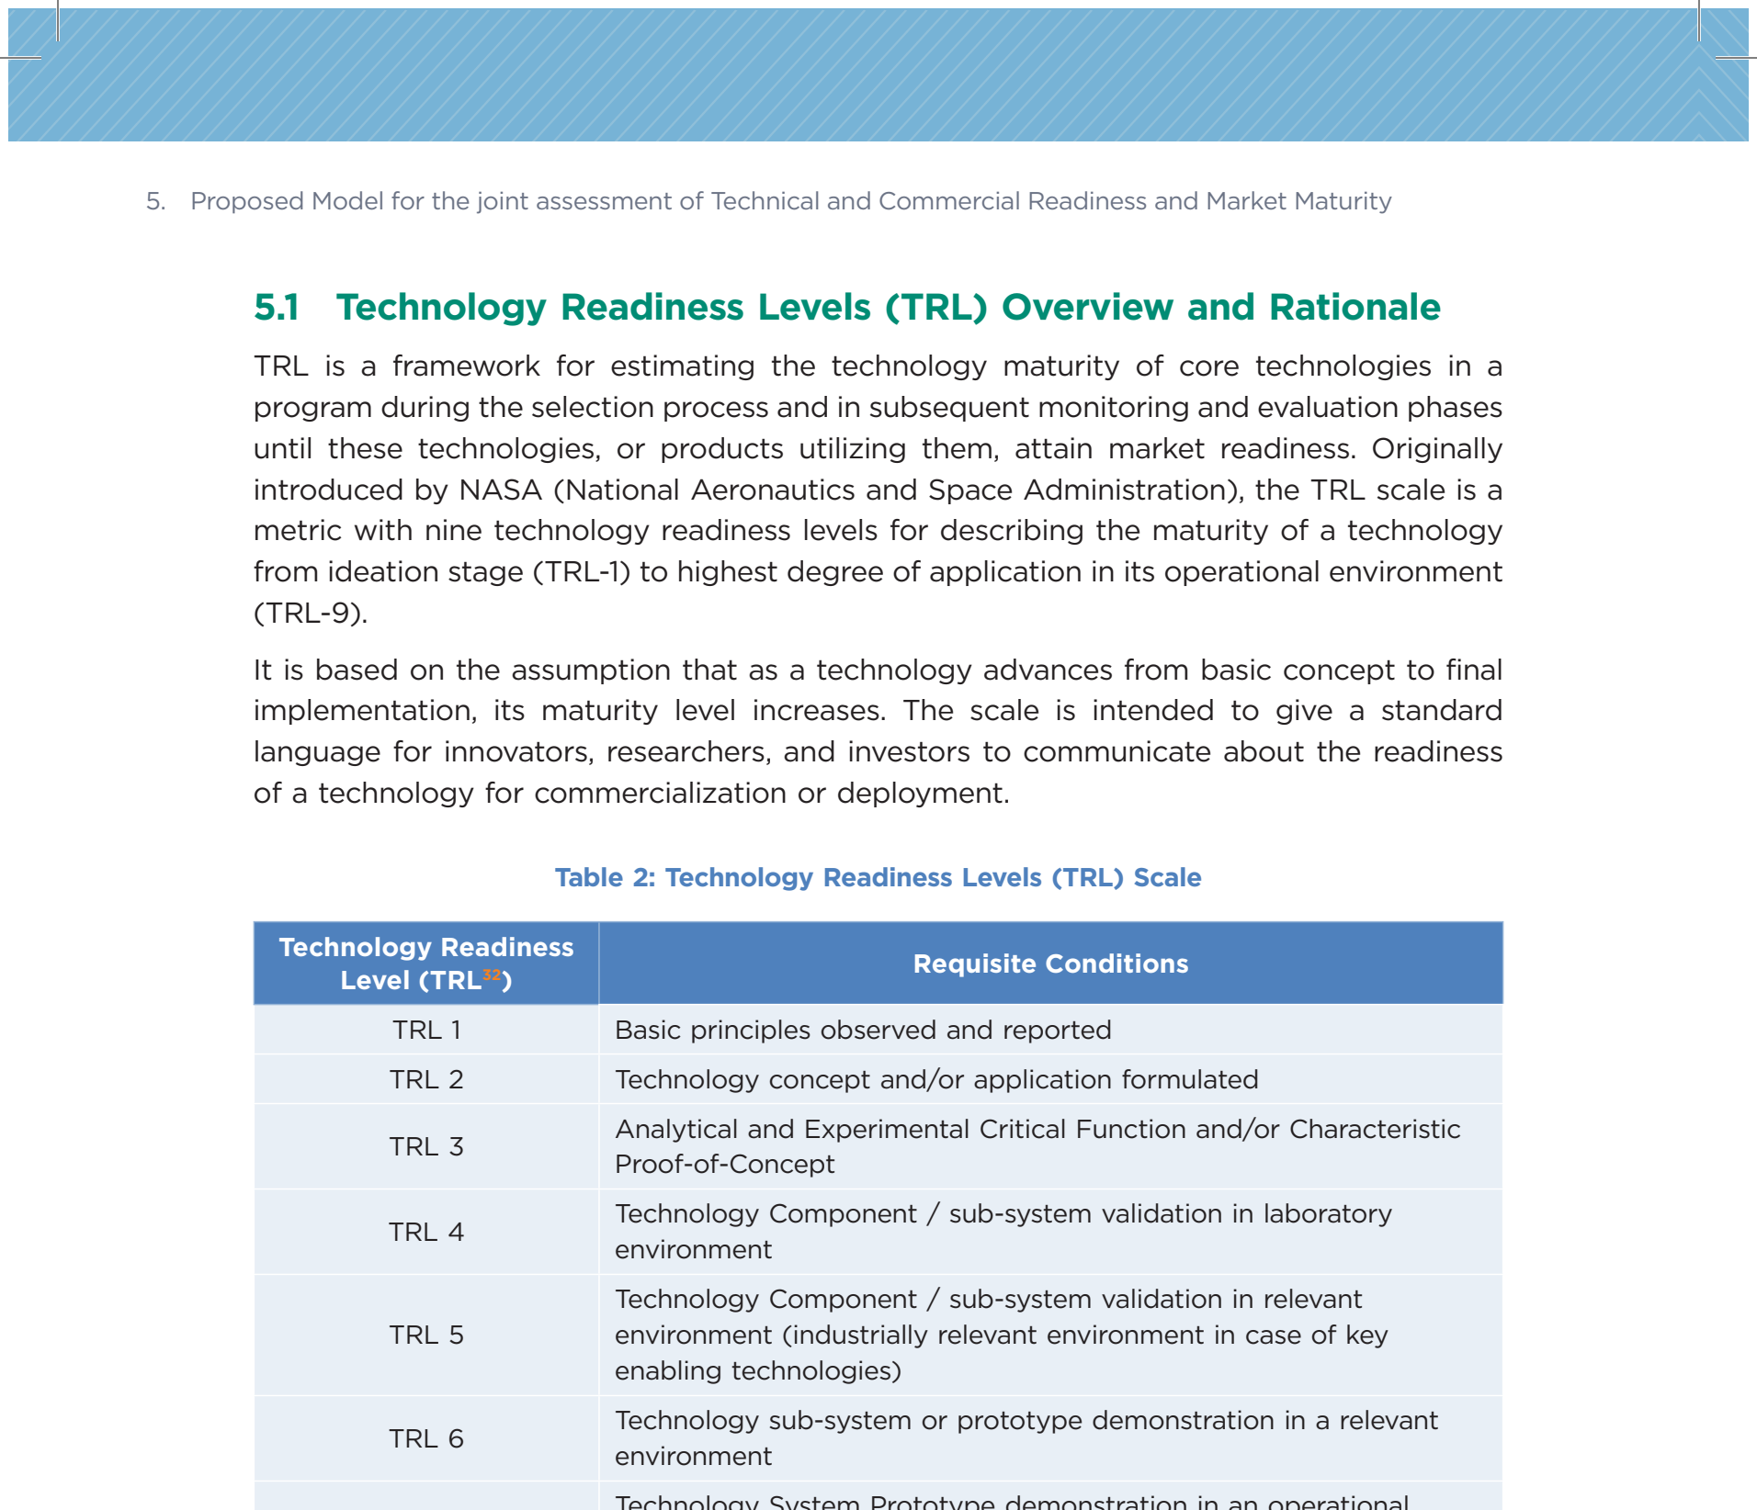
NCCR MUONIVERSE · HSG
39
DATA COMPENDIUM
SOURCE-LED FINDING
The TRL 1–3 gap, visualized
ORIGINAL SOURCE EXCERPT · p. 30
COMMENTS
What the excerpt shows: the TRL scale itself — from 'basic principles observed' to 'proven in operations'.
Nothing in the nine levels asks whether anyone would buy the technology: it measures maturity of proof, not of market.
Read side-by-side with the CRL table (slide 18): together they give the thesis its two-axis readiness framing.
NITI Aayog (2023), TCRM Matrix, p. 30 (TRL scale).
Lorik Dalloshi · Milestone 1 · NCCR Muoniverse
39 / 42

Slide 40
NCCR MUONIVERSE · HSG
40
DATA COMPENDIUM
SOURCE-LED FINDING
EU vs US: a 3.7× capital gap
ORIGINAL SOURCE EXCERPT · p. 3
COMMENTS
What the excerpt shows: European deep tech secured €58B against the US €215B — with investor behaviour explaining part of the difference.
Stacked on the +48% capital premium (slide 41), the distance to the same milestone is multiplicative, not additive.
Switzerland's 60% deep-tech share (slide 35) is the national answer — yet Series B scale still leaks to larger pools. Interview probe.
Stryber (2025), Deep Tech commercialization in Europe.
Lorik Dalloshi · Milestone 1 · NCCR Muoniverse
40 / 42

Slide 41
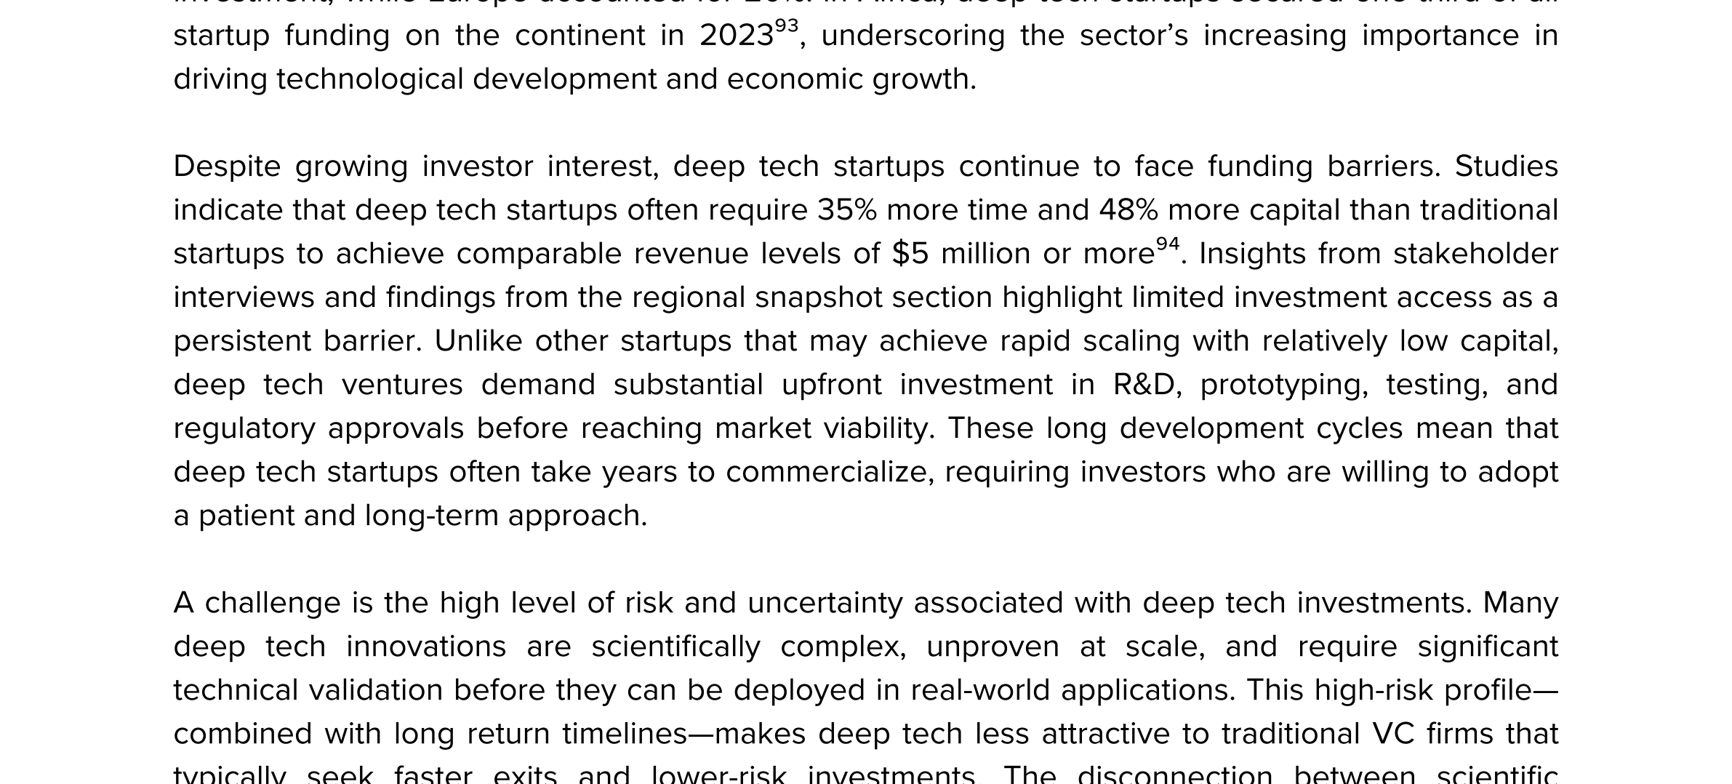
NCCR MUONIVERSE · HSG
41
DATA COMPENDIUM
SOURCE-LED FINDING
Deep tech: +35% time, +48% capital
ORIGINAL SOURCE EXCERPT · p. 54
COMMENTS
What the excerpt shows: the UNDP quantification — 35% more time and 48% more capital for equivalent milestones.
Every instrument in this deck is shorter than the asset it supports: coaching 36 months, BRIDGE 12, VC funds 3–5 years.
This number is the design constraint the thesis answers with sequencing — see the EIC pathway, slides 25–26.
UNDP (2025), Global Deep Tech Ecosystems, p. 54.
Lorik Dalloshi · Milestone 1 · NCCR Muoniverse
41 / 42

Slide 42
NCCR MUONIVERSE · HSG
42
MILESTONE 1
Source-led evidence → interview questions
The practical conclusion: early-TRL physics commercialization is not missing ideas — it is missing a support architecture designed for the gap.
Next: Milestone 2 interviews · September 1, 2026
All source excerpts are embedded from the primary PDFs/pages listed beneath each image.

