Slide 1
NCCR MUONIVERSE · HSG
Milestone 1 Findings
Literature review · framework assessment · data compendium
A clean source-led deck: every finding uses an excerpt rendered directly from the cited paper, report, or official page.
Prepared for the NCCR Muoniverse team · August 2026

Slide 2
NCCR MUONIVERSE · HSG
02
LITERATURE REVIEW
Seven themes
What the primary literature converges on
Milestone 1 · source-led findings deck

Slide 3
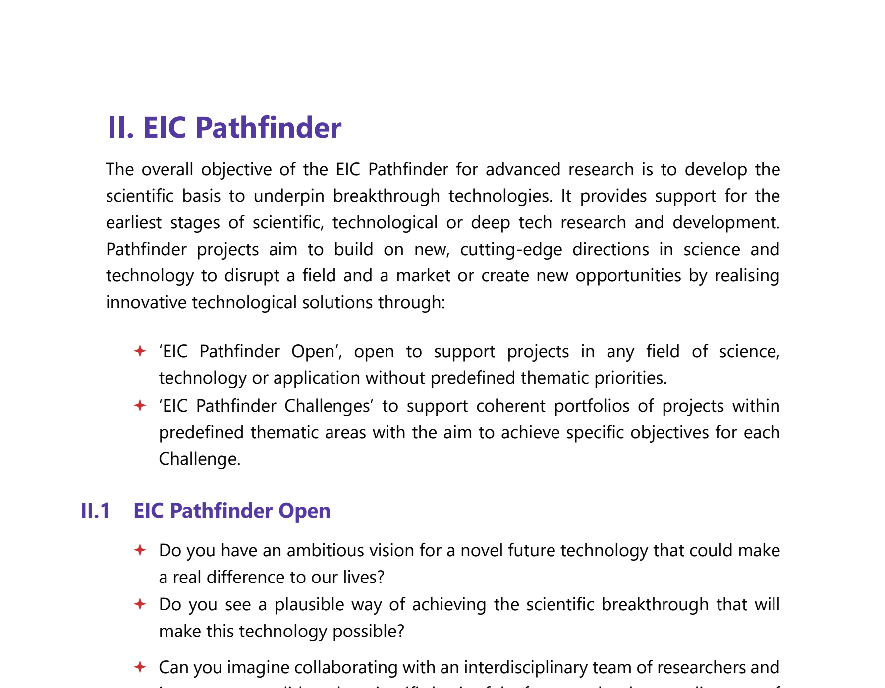
NCCR MUONIVERSE · HSG
03
LITERATURE REVIEW
SOURCE-LED FINDING
No existing framework was designed for TRL 1–3
ORIGINAL SOURCE EXCERPT · p. 26
COMMENTS
The space where NCCR Muoniverse operates — fundamental physics at TRL 1–3 — is precisely where no commercialization framework was designed to work.
Every framework assessed (RCA/Imperial, CRL, Innosuisse, EIC) has a structural gap at this stage.
This gap is the thesis's core motivation: identify what support mechanisms fill it.
European Commission (2026), EIC Work Programme 2026, p. 26 (EIC Pathfinder).
Lorik Dalloshi · Milestone 1 · NCCR Muoniverse
03 / 42

Slide 4
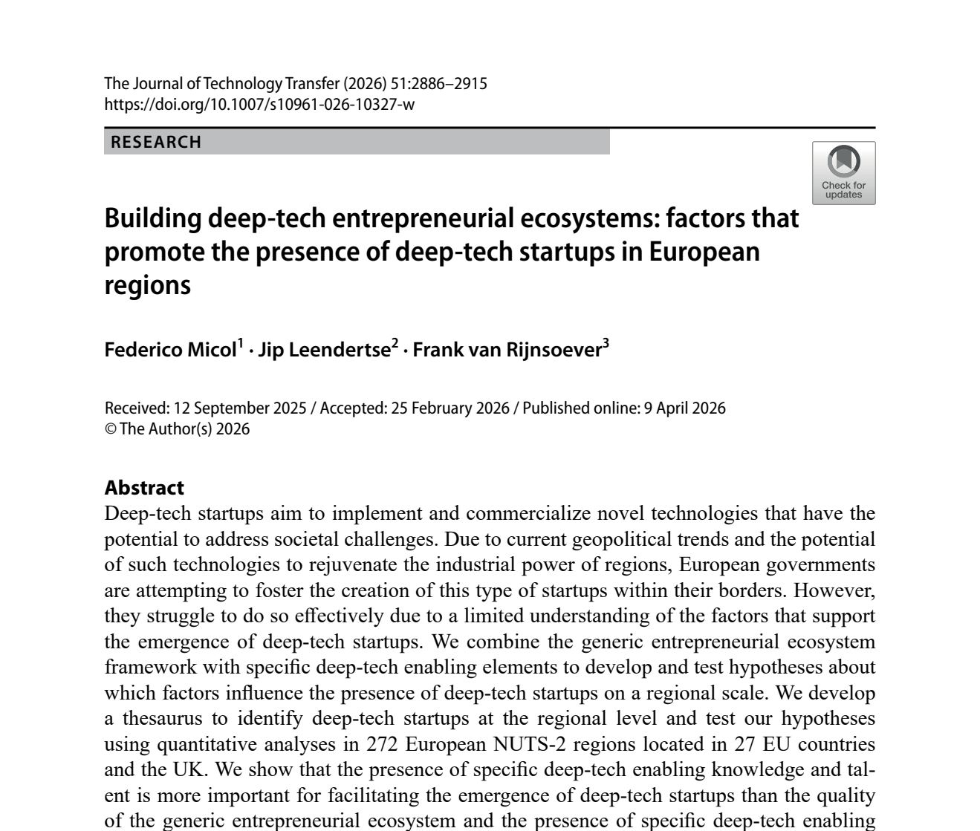
NCCR MUONIVERSE · HSG
04
LITERATURE REVIEW
SOURCE-LED FINDING
Ecosystem, not policy, drives deep tech
ORIGINAL SOURCE EXCERPT · p. 1
COMMENTS
The primary study finds that specific deep-tech knowledge and talent matter more for startup emergence than generic ecosystem quality or formal institutions.
Its regional analysis covers 272 European NUTS-2 regions and 1,605 deep-tech startups.
→ For Switzerland, specialized research infrastructure and talent concentration are strategic assets.
Micol, F., Leendertse, J. & van Rijnsoever, F. (2026), Journal of Technology Transfer 51, pp. 2886–2915.
Lorik Dalloshi · Milestone 1 · NCCR Muoniverse
04 / 42

Slide 5
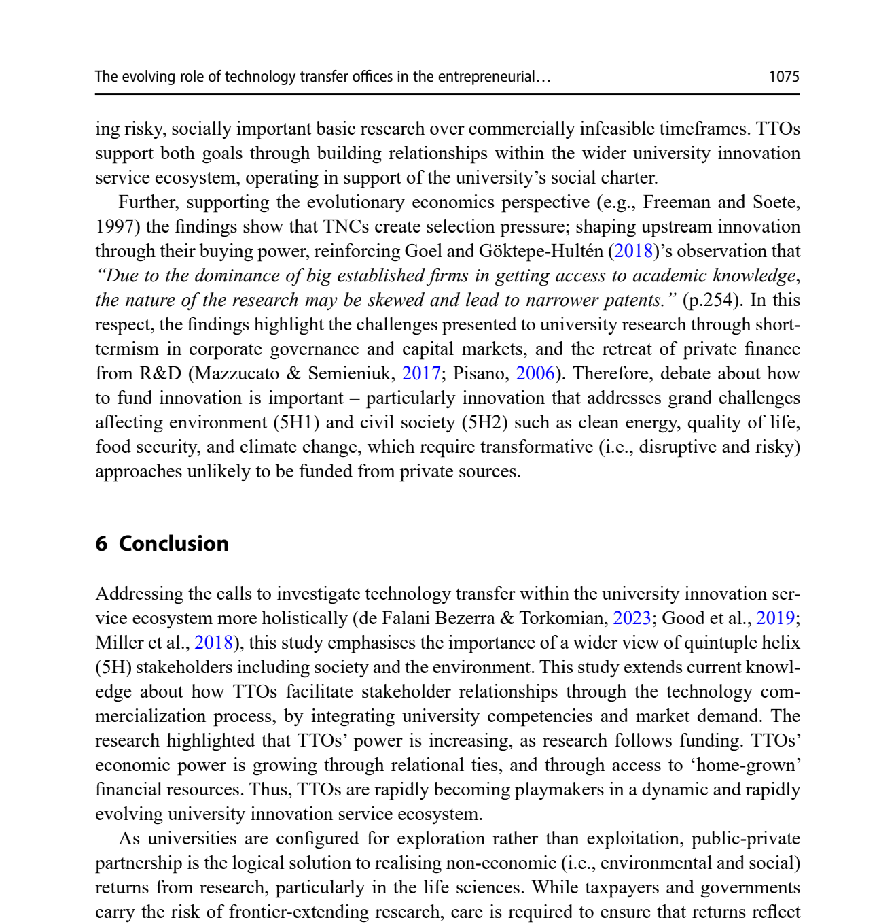
NCCR MUONIVERSE · HSG
05
LITERATURE REVIEW
SOURCE-LED FINDING
TTOs: relationships beat transactions
ORIGINAL SOURCE EXCERPT · p. 16
COMMENTS
Chen et al. describe TTOs as actors that translate science into commercially and socially valuable outcomes.
The playmaker role is relational: TTOs build relationships across the wider university innovation-service ecosystem.
→ PSI's TTO should be designed as an active orchestrator, not only a transaction desk.
Chen, Z., Little, V. & Thuan, N. (2025), Journal of Technology Transfer 50, pp. 1060–1079.
Lorik Dalloshi · Milestone 1 · NCCR Muoniverse
05 / 42

Slide 6
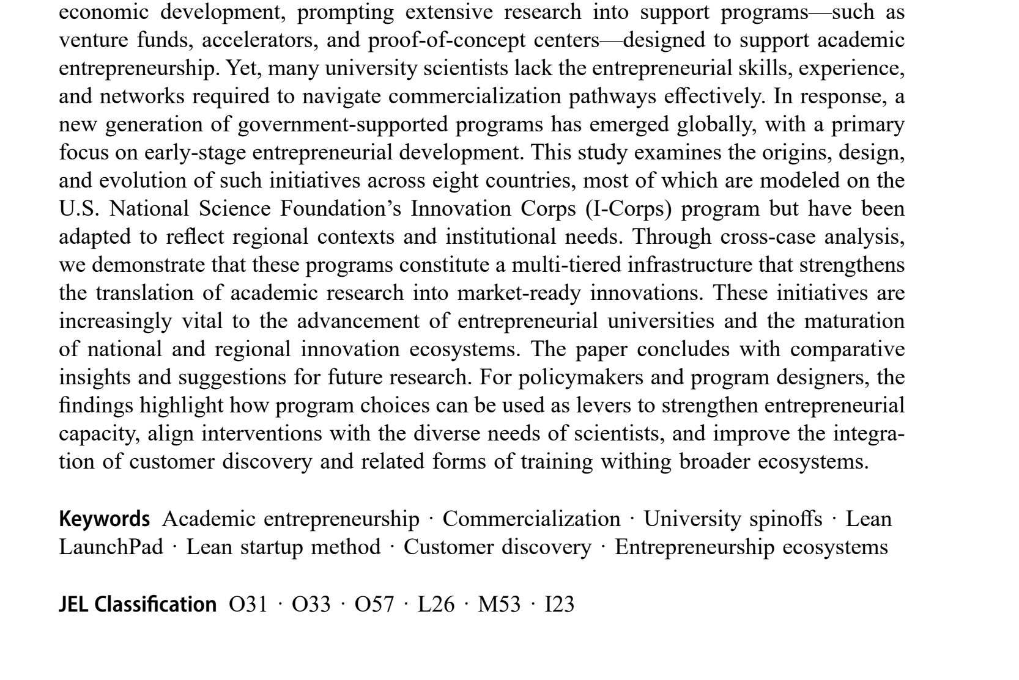
NCCR MUONIVERSE · HSG
06
LITERATURE REVIEW
SOURCE-LED FINDING
Structured frameworks work — if adapted
ORIGINAL SOURCE EXCERPT · p. 1
COMMENTS
I-Corps (lean + customer discovery, 7-week immersion) independently adopted in 8 countries — a natural experiment: structured works, but every system adapted it locally.
Frameworks need explicit abandon/pivot decision points — sunk-cost protection on 5–15 yr timelines.
100 customer interviews in 9 weeks = paradigm shift in scientists' market understanding.
Hayter, C. S. et al. (2025), Journal of Technology Transfer, DOI 10.1007/s10961-025-10288-6.
Lorik Dalloshi · Milestone 1 · NCCR Muoniverse
06 / 42

Slide 7
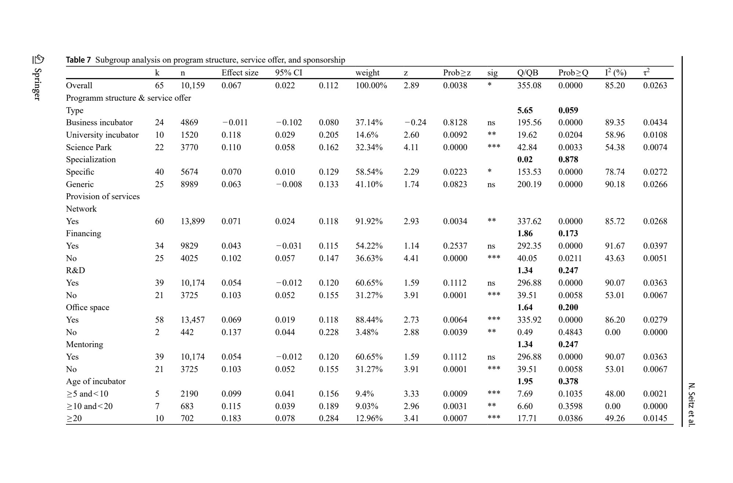
NCCR MUONIVERSE · HSG
07
LITERATURE REVIEW
SOURCE-LED FINDING
Configuring support matters more than providing it
ORIGINAL SOURCE EXCERPT · p. 32
COMMENTS
3 effective configurations of 5 orchestration functions — no single configuration is universally optimal.
Founders value mentors (64%) and customer intros (61%) above investment (37%) — capital is NOT Europe's scarcest resource.
Networking helps (r = 0.071); more mentoring can even reduce performance (opportunity cost).
Seitz, N. et al. (2026), Review of Managerial Science, DOI 10.1007/s11846-026-01017-w, Table of moderator effects.
Lorik Dalloshi · Milestone 1 · NCCR Muoniverse
07 / 42

Slide 8
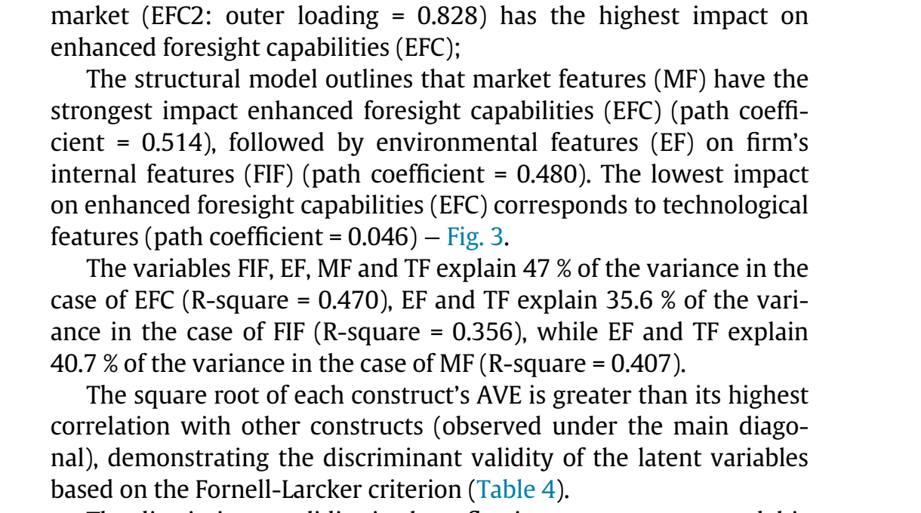
NCCR MUONIVERSE · HSG
08
LITERATURE REVIEW
SOURCE-LED FINDING
Market is the binding constraint
ORIGINAL SOURCE EXCERPT · p. 10
COMMENTS
Market features (β = 0.514) predict success nearly 2× better than technology features (β = 0.310).
Firm internal factors (team quality, management) are NOT significant.
Cantner (n = 1,149): the commercial sphere dominates from day one of spin-off creation.
→ For muons: finding applications beats scientific excellence.
Capatina, A., Bleoju, G. & Kalisz, D. (2024), Journal of Innovation & Knowledge 9, 100515.
Lorik Dalloshi · Milestone 1 · NCCR Muoniverse
08 / 42

Slide 9
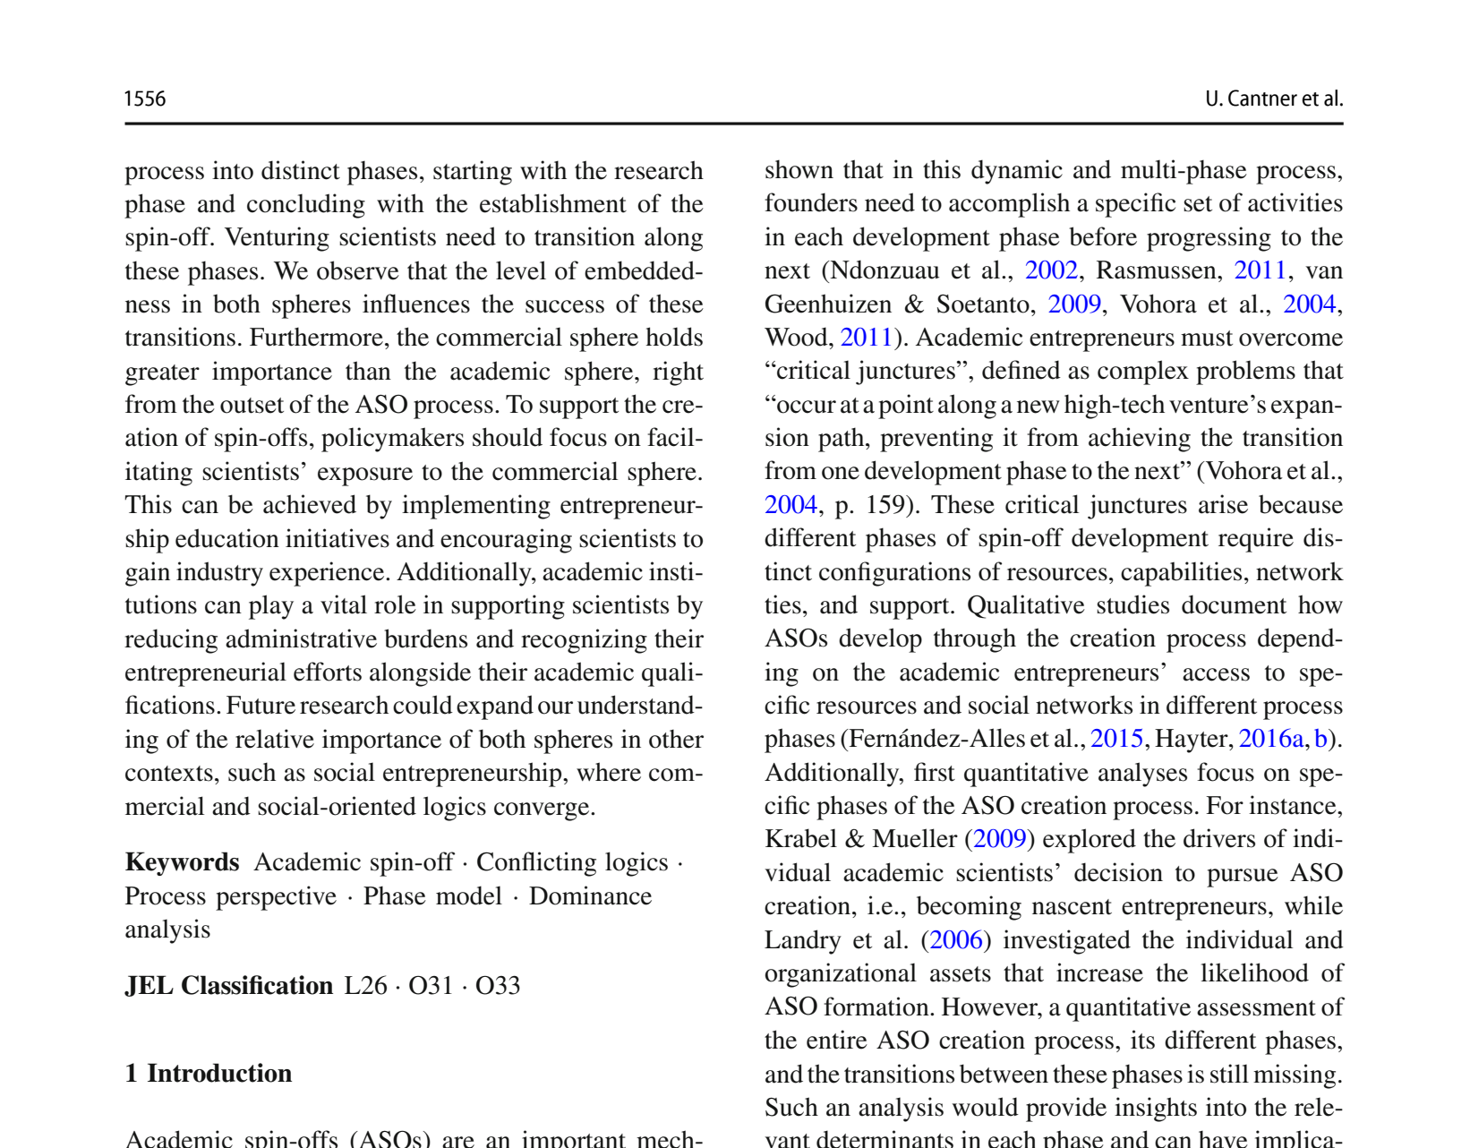
NCCR MUONIVERSE · HSG
09
LITERATURE REVIEW
SOURCE-LED FINDING
Commercial exposure from day one
ORIGINAL SOURCE EXCERPT · p. 2
COMMENTS
Dominance analysis: commercial sphere (industry contacts, market knowledge) dominates from the very outset — not in later stages.
Challenges the assumption 'research first, commercialize later' — empirically wrong.
→ Support design principle: start commercial exposure immediately.
Cantner, U. et al. (2024), Small Business Economics 62, pp. 1555–1590.
Lorik Dalloshi · Milestone 1 · NCCR Muoniverse
09 / 42

Slide 10
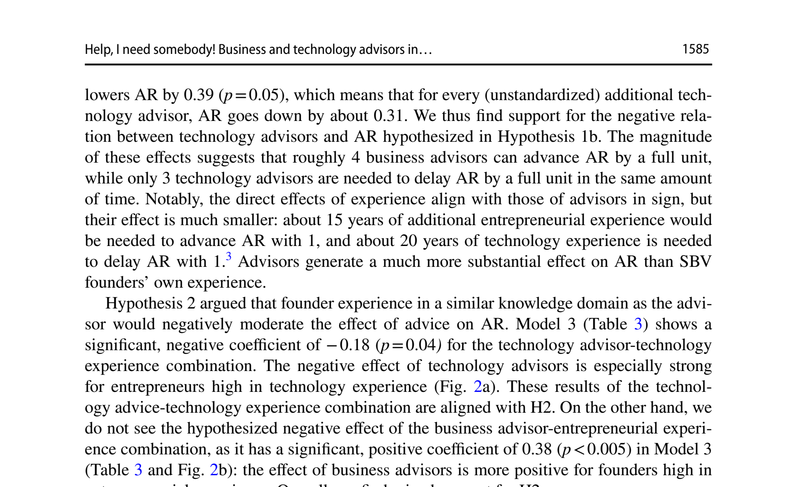
NCCR MUONIVERSE · HSG
10
LITERATURE REVIEW
SOURCE-LED FINDING
Advisor type matters more than quantity
ORIGINAL SOURCE EXCERPT · p. 19
COMMENTS
Each business advisor: +0.23 application-readiness units (p = 0.04).
Each technology advisor: −0.31 units (p = 0.05) — actively delays.
4 business advisors ≈ +1 full unit ≈ 15 years of entrepreneurial experience.
→ Counterintuitive but evidence-based: limit tech advisors, prioritize business advisors.
Denoo, L., Van Boxstael, A. & Belz, A. (2024), Journal of Technology Transfer 49, pp. 1567–1605.
Lorik Dalloshi · Milestone 1 · NCCR Muoniverse
10 / 42

Slide 11
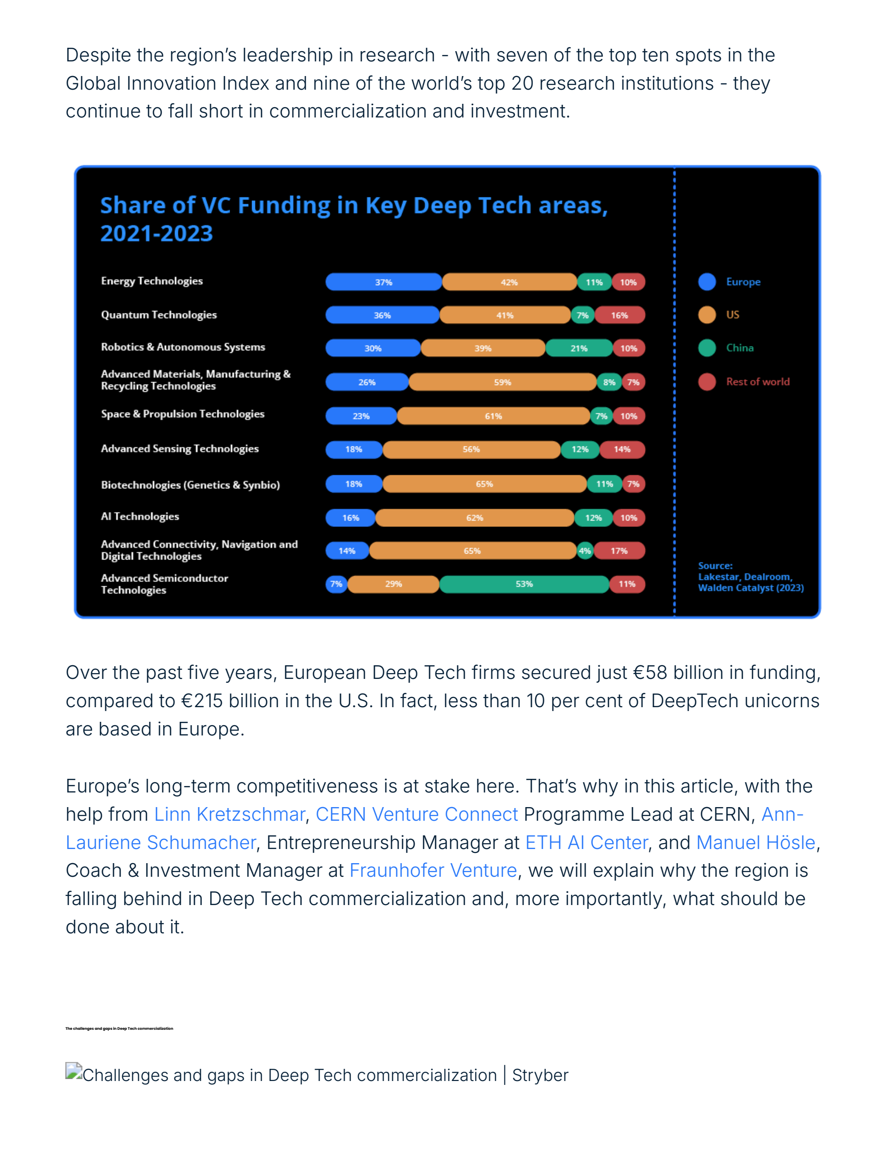
NCCR MUONIVERSE · HSG
11
LITERATURE REVIEW
SOURCE-LED FINDING
Europe's structural barriers
ORIGINAL SOURCE EXCERPT · p. 3
COMMENTS
€58B EU deep tech VC vs €215B US — a 3.7× gap.
62% of EU investors reject failed founders vs 23% US; 15% vs 45% of PhDs pursue startups.
12% vs 40% of corporations engage with deep tech.
→ Cultural and structural — cannot be fixed by capital alone.
Stryber (2025), Deep Tech commercialization in Europe: the gap, the challenge, and the fix.
Lorik Dalloshi · Milestone 1 · NCCR Muoniverse
11 / 42

Slide 12
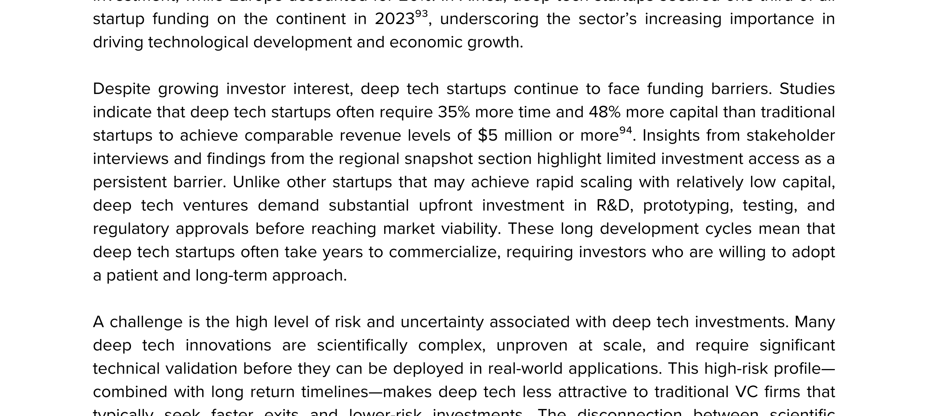
NCCR MUONIVERSE · HSG
12
LITERATURE REVIEW
SOURCE-LED FINDING
Deep tech needs 35% more time, 48% more capital
ORIGINAL SOURCE EXCERPT · p. 54
COMMENTS
Deep tech takes 35% more time and 48% more capital to reach equivalent milestones.
These compound with European structural deficits: 3–5 yr VC fund cycles clash with deep tech timelines.
→ Muon tech's 10–20 yr horizon exceeds every Swiss instrument's design parameters.
UNDP (2025), Global Deep Tech Ecosystems: Catalyzing Innovation for Sustainable Development, p. 54.
Lorik Dalloshi · Milestone 1 · NCCR Muoniverse
12 / 42

Slide 13
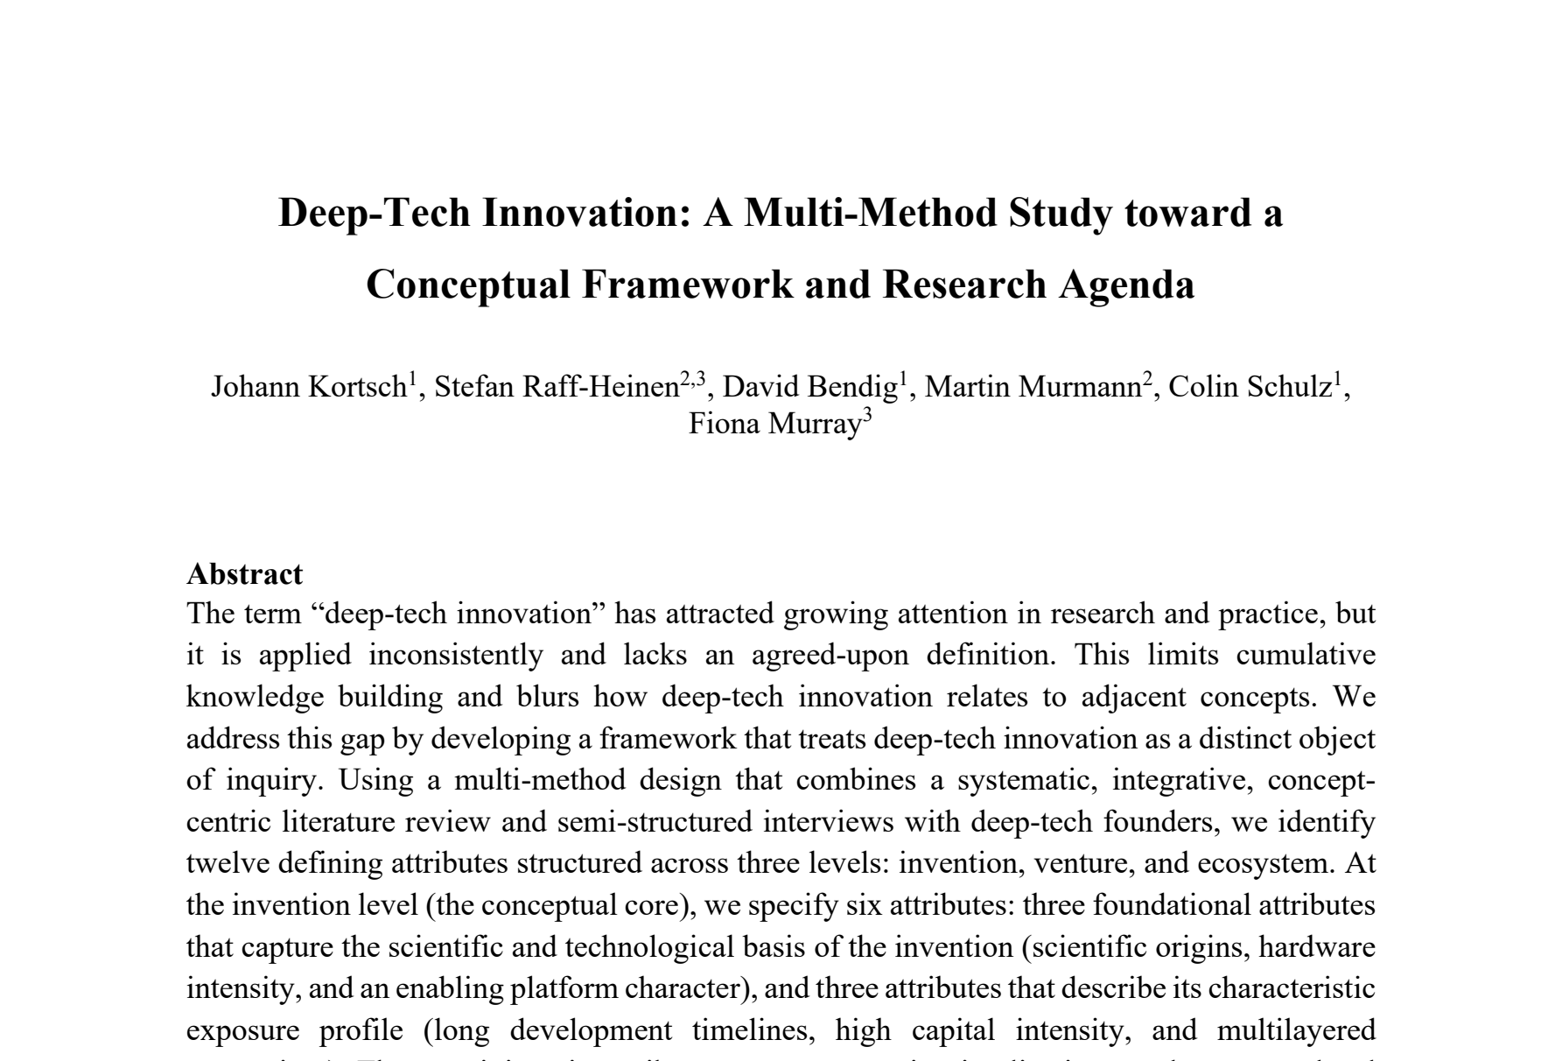
NCCR MUONIVERSE · HSG
13
LITERATURE REVIEW
SOURCE-LED FINDING
Converging on what deep tech is
ORIGINAL SOURCE EXCERPT · p. 1
COMMENTS
12 defining attributes across 3 levels: technology (science-based, hardware, platforms), venture (5–15+ yr timelines, capital intensity), ecosystem (knowledge, talent, infrastructure).
Cabanes: deep tech as a 'performative innovation regime' — patient capital, long-term partnerships, ecosystem orchestration.
→ Definitional convergence legitimizes a physics-specific commercialization lens.
Kortsch, J. et al. (2024), Deep-Tech Innovation: A Multi-Method Study, MIT Sloan / University of Münster.
Lorik Dalloshi · Milestone 1 · NCCR Muoniverse
13 / 42

Slide 14
NCCR MUONIVERSE · HSG
14
FRAMEWORK ASSESSMENT
Four frameworks, one gap
RCA / Imperial · CRL · Innosuisse · EIC · candidates
Milestone 1 · source-led findings deck

Slide 15
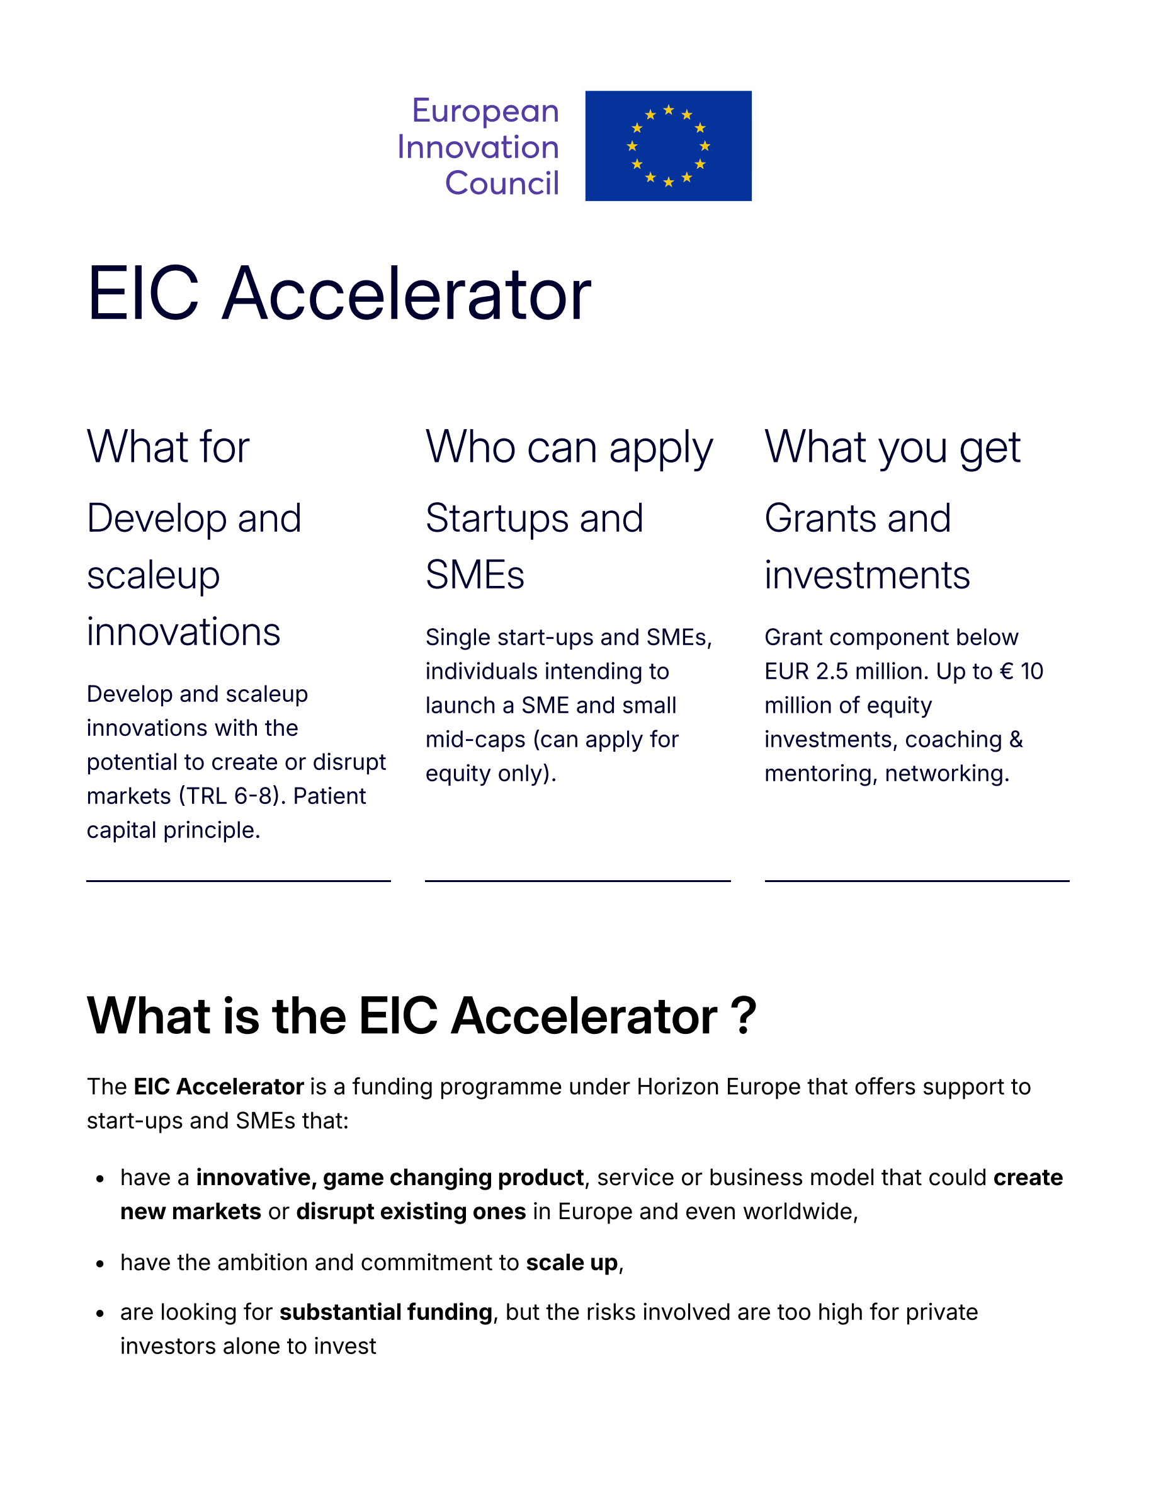
NCCR MUONIVERSE · HSG
15
FRAMEWORK ASSESSMENT
SOURCE-LED FINDING
The official pipeline starts at TRL 1 — but scale-up begins later
ORIGINAL SOURCE EXCERPT · p. 1
COMMENTS
RCA/Imperial: designed for TRL 4–6. CRL: conceptually 1–9 but operationally thin. Innosuisse: optimized for TRL 4–7. EIC Accelerator: TRL 5+.
The space where Muoniverse operates is where no framework was designed to work.
→ Thesis contribution: adapt/combine existing frameworks to reach this unaddressed space.
European Innovation Council (2026), EIC Accelerator official programme page.
Lorik Dalloshi · Milestone 1 · NCCR Muoniverse
15 / 42

Slide 16
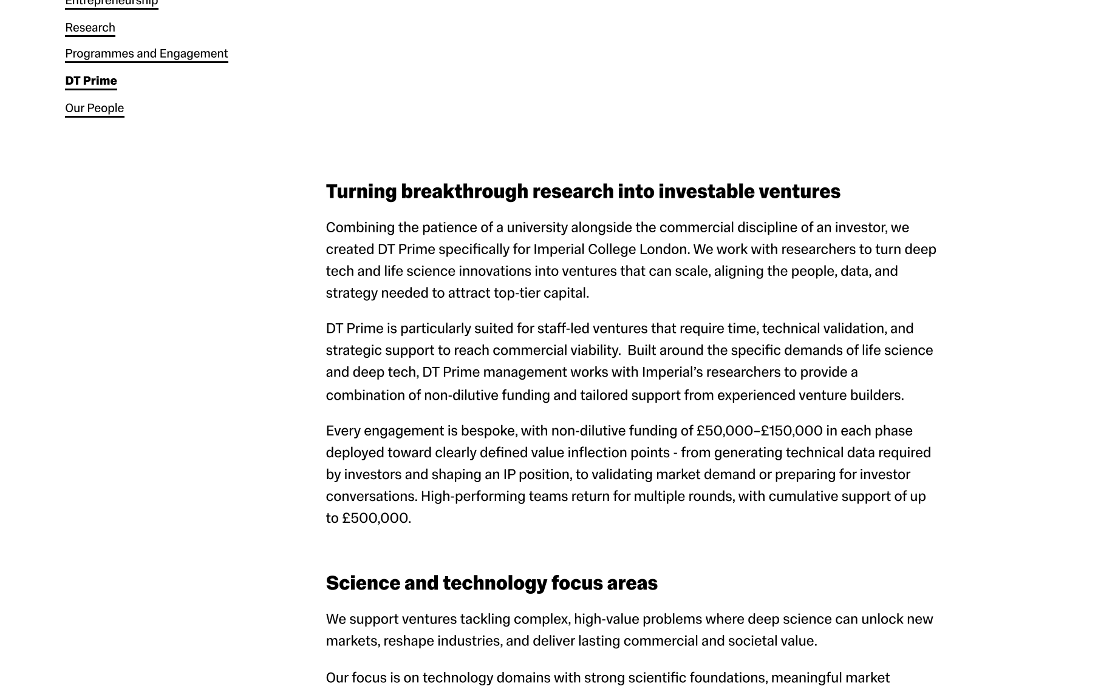
NCCR MUONIVERSE · HSG
16
FRAMEWORK ASSESSMENT
SOURCE-LED FINDING
RCA/Imperial: a cluster, not a program
ORIGINAL SOURCE EXCERPT · p. 1
COMMENTS
4 components: Innovation Challenge (1-week MBA), Wicked Module (1-month, with Steve Blank 2023), Wicked Acceleration Labs (WAL), DT Prime (£50–500K non-dilutive venture builder).
The Challenge is a pedagogical exercise, not a spin-off mechanism.
→ Methodology transferable; structure is not (institution-bound, MBA/design students).
Imperial College London, DT Prime, Institute for Deep Tech Entrepreneurship (official page).
Lorik Dalloshi · Milestone 1 · NCCR Muoniverse
16 / 42

Slide 17
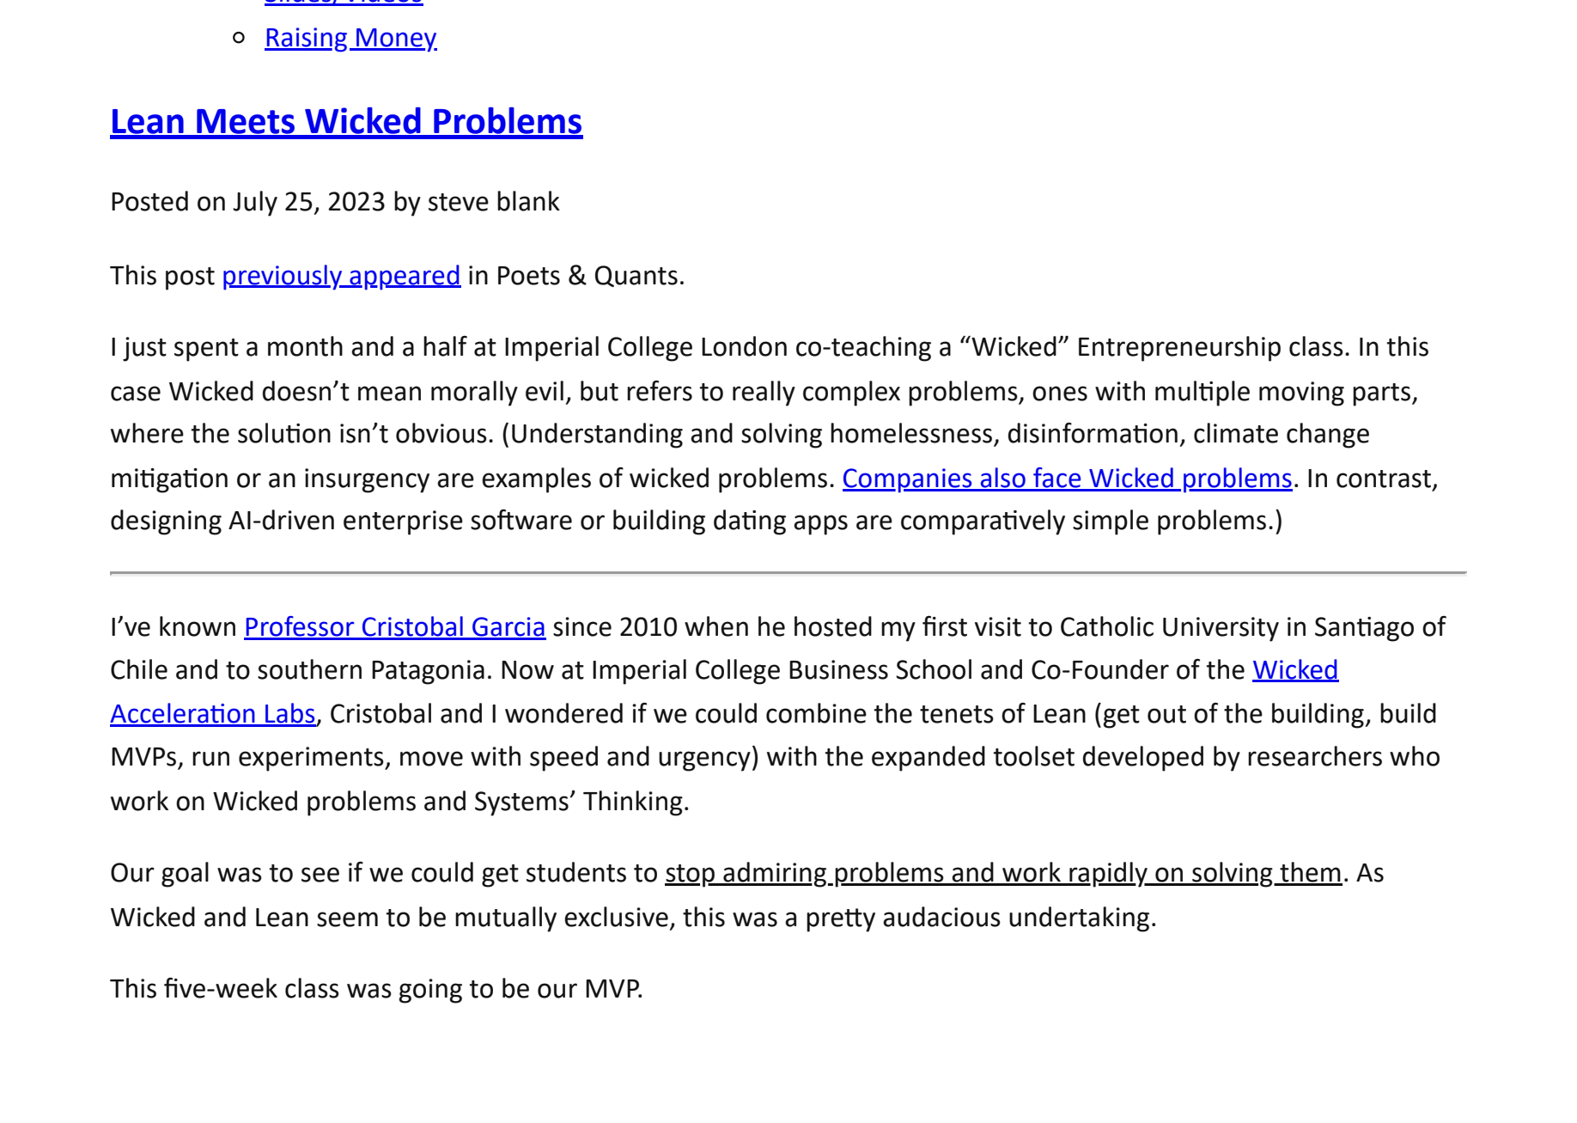
NCCR MUONIVERSE · HSG
17
FRAMEWORK ASSESSMENT
SOURCE-LED FINDING
RCA/Imperial: 'flipping' Lean Startup
ORIGINAL SOURCE EXCERPT · p. 8
COMMENTS
Standard Lean Startup starts with a customer problem; deep tech starts with a technology capability and often NO existing market.
WAL inverts the logic: technology-first speculative design → then validate with lead/extreme users.
Endorsed by Steve Blank as a legitimate evolution for deep tech.
→ The key asset NCCR Muoniverse should adopt: the flipped methodology.
Blank, S. (2023), Lean Meets Wicked Problems, Steve Blank blog / Imperial College Business School class account.
Lorik Dalloshi · Milestone 1 · NCCR Muoniverse
17 / 42

Slide 18
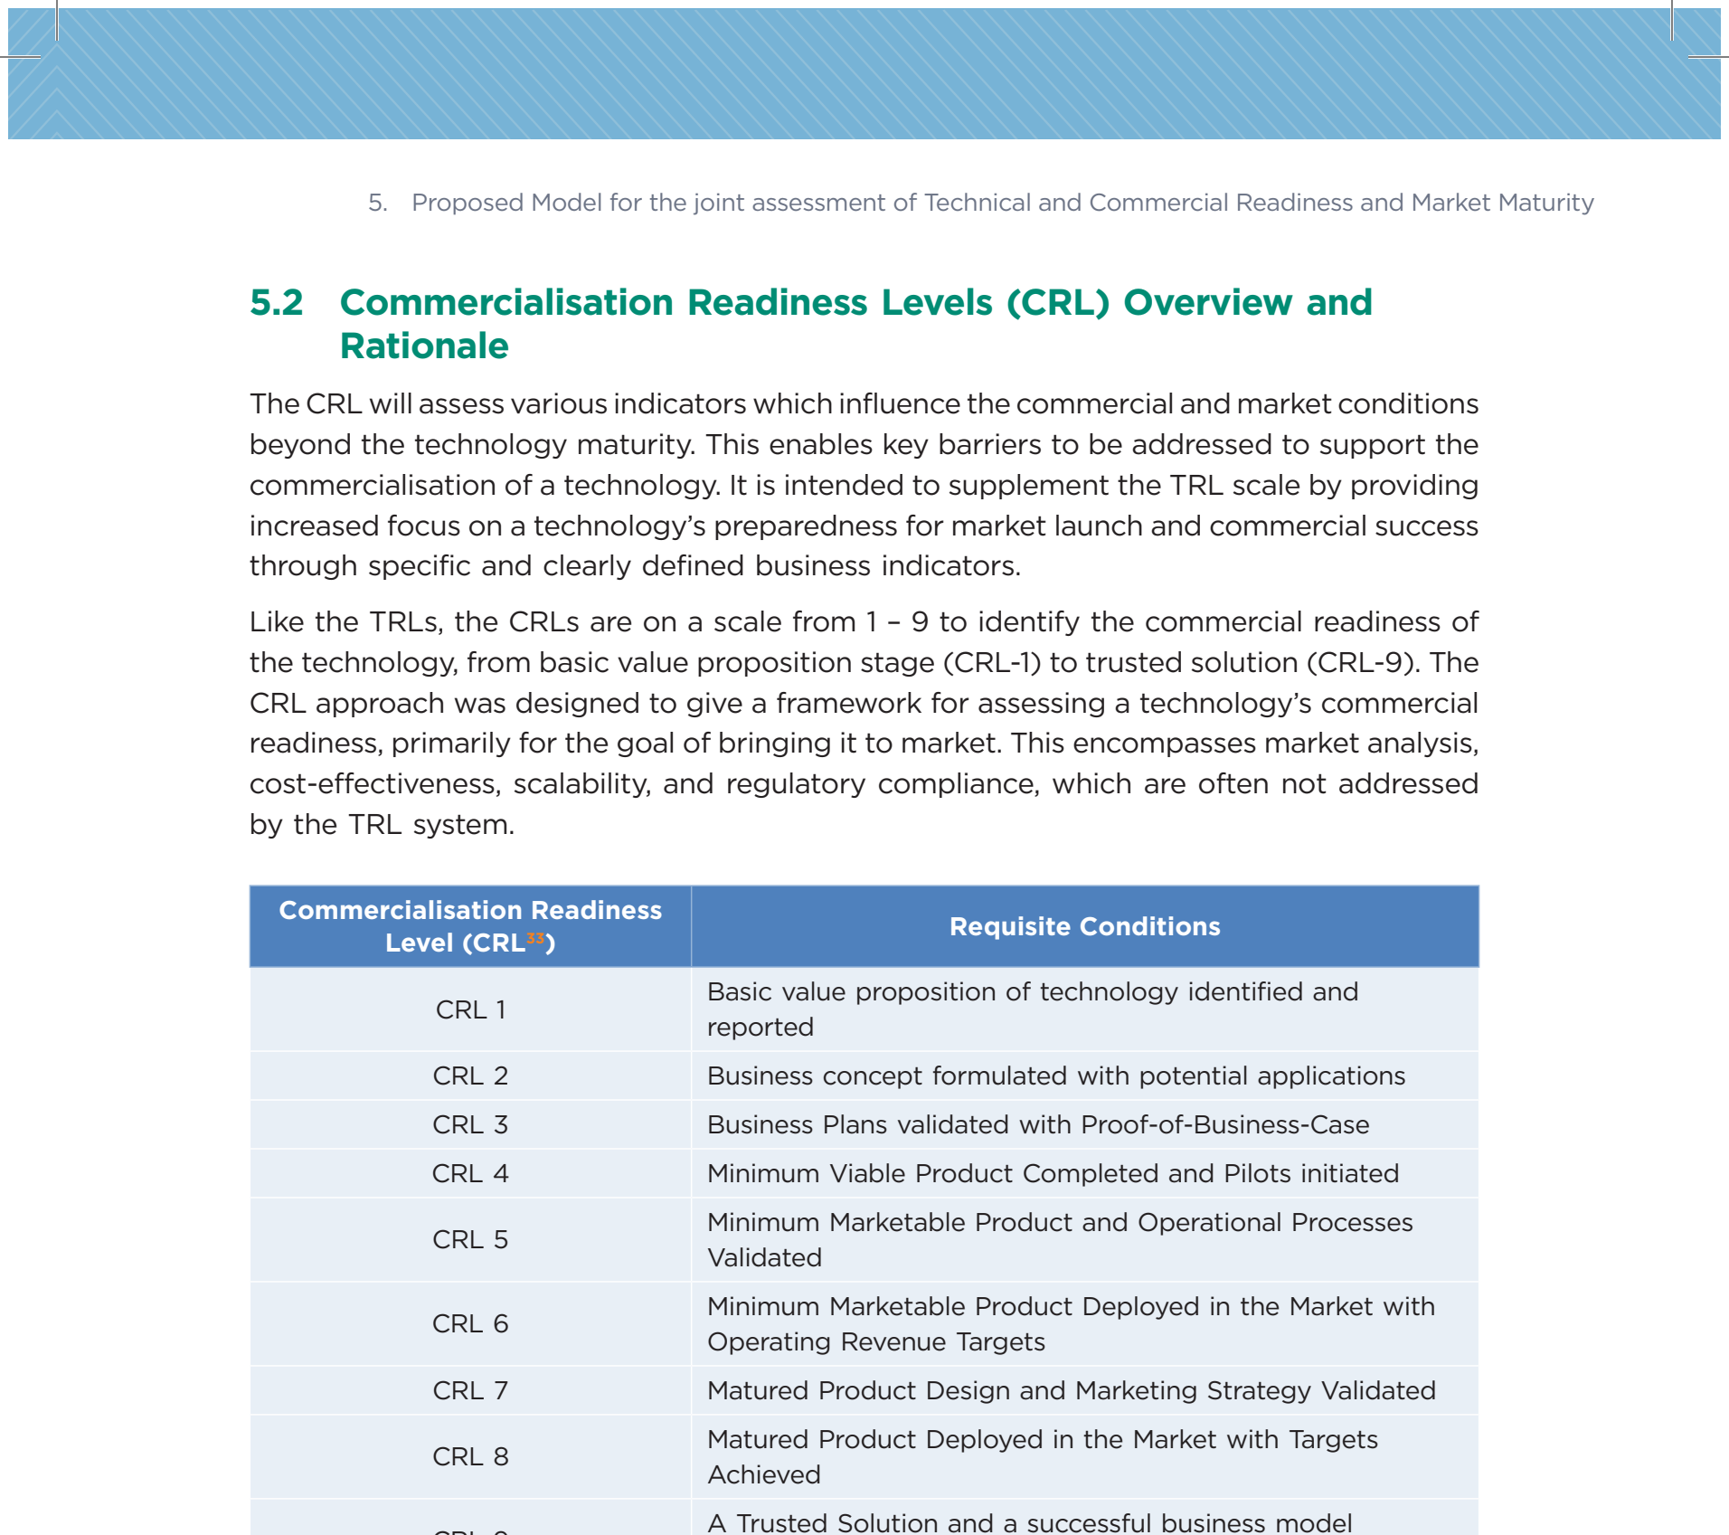
NCCR MUONIVERSE · HSG
18
FRAMEWORK ASSESSMENT
SOURCE-LED FINDING
CRL: the 9-point commercial scale
ORIGINAL SOURCE EXCERPT · p. 31
COMMENTS
Runs parallel to NASA TRL; with MRL forms three 'orthogonal' maturity axes.
Key concept: the binding constraint — whichever axis lags blocks progress. Rule: CRL should always ≥ TRL.
CRL 1–3 covers opportunity recognition → market sizing → competitiveness — conceptually relevant to TRL 1–3.
NITI Aayog (2023), A New Lens for Innovation in New India: TCRM Matrix, p. 31.
Lorik Dalloshi · Milestone 1 · NCCR Muoniverse
18 / 42

Slide 19
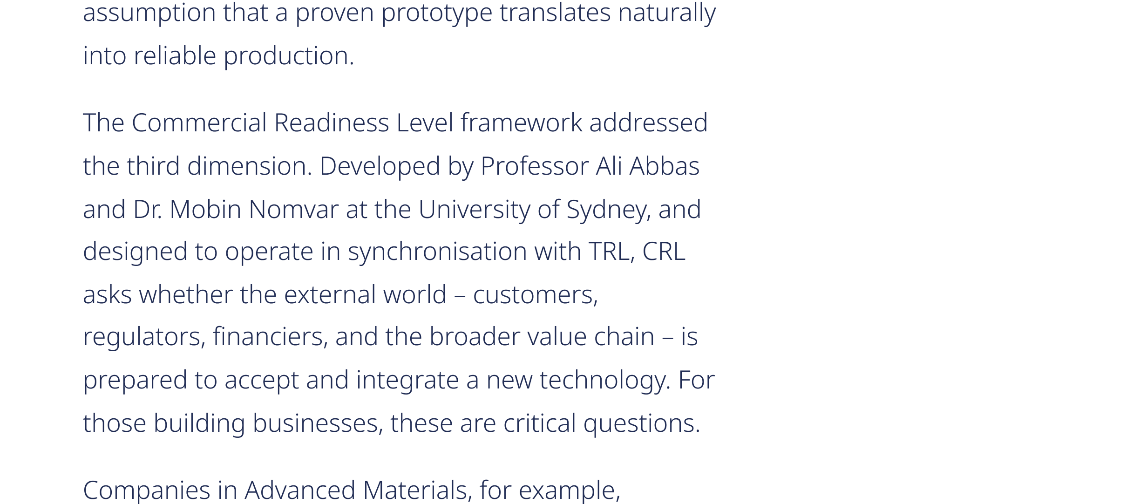
NCCR MUONIVERSE · HSG
19
FRAMEWORK ASSESSMENT
SOURCE-LED FINDING
CRL: the documentation problem
ORIGINAL SOURCE EXCERPT · p. 8
COMMENTS
Despite being one of the most-cited 'commercial readiness' concepts, CRL has NO peer-reviewed primary paper.
Exists as proprietary consultancy IP; cited by Deep Tech Leaders, ITONICS, NITI Aayog.
The '22_CRL_Abbas.pdf' in the evidence folder is a DIFFERENT EIT Urban Mobility variant — not Abbas & Nomvar.
→ Must be cited as a practitioner framework, not an academically validated instrument.
Deep Tech Leaders (2025), TRL, MRL & CRL Explained, Part 1, p. 8.
Lorik Dalloshi · Milestone 1 · NCCR Muoniverse
19 / 42

Slide 20
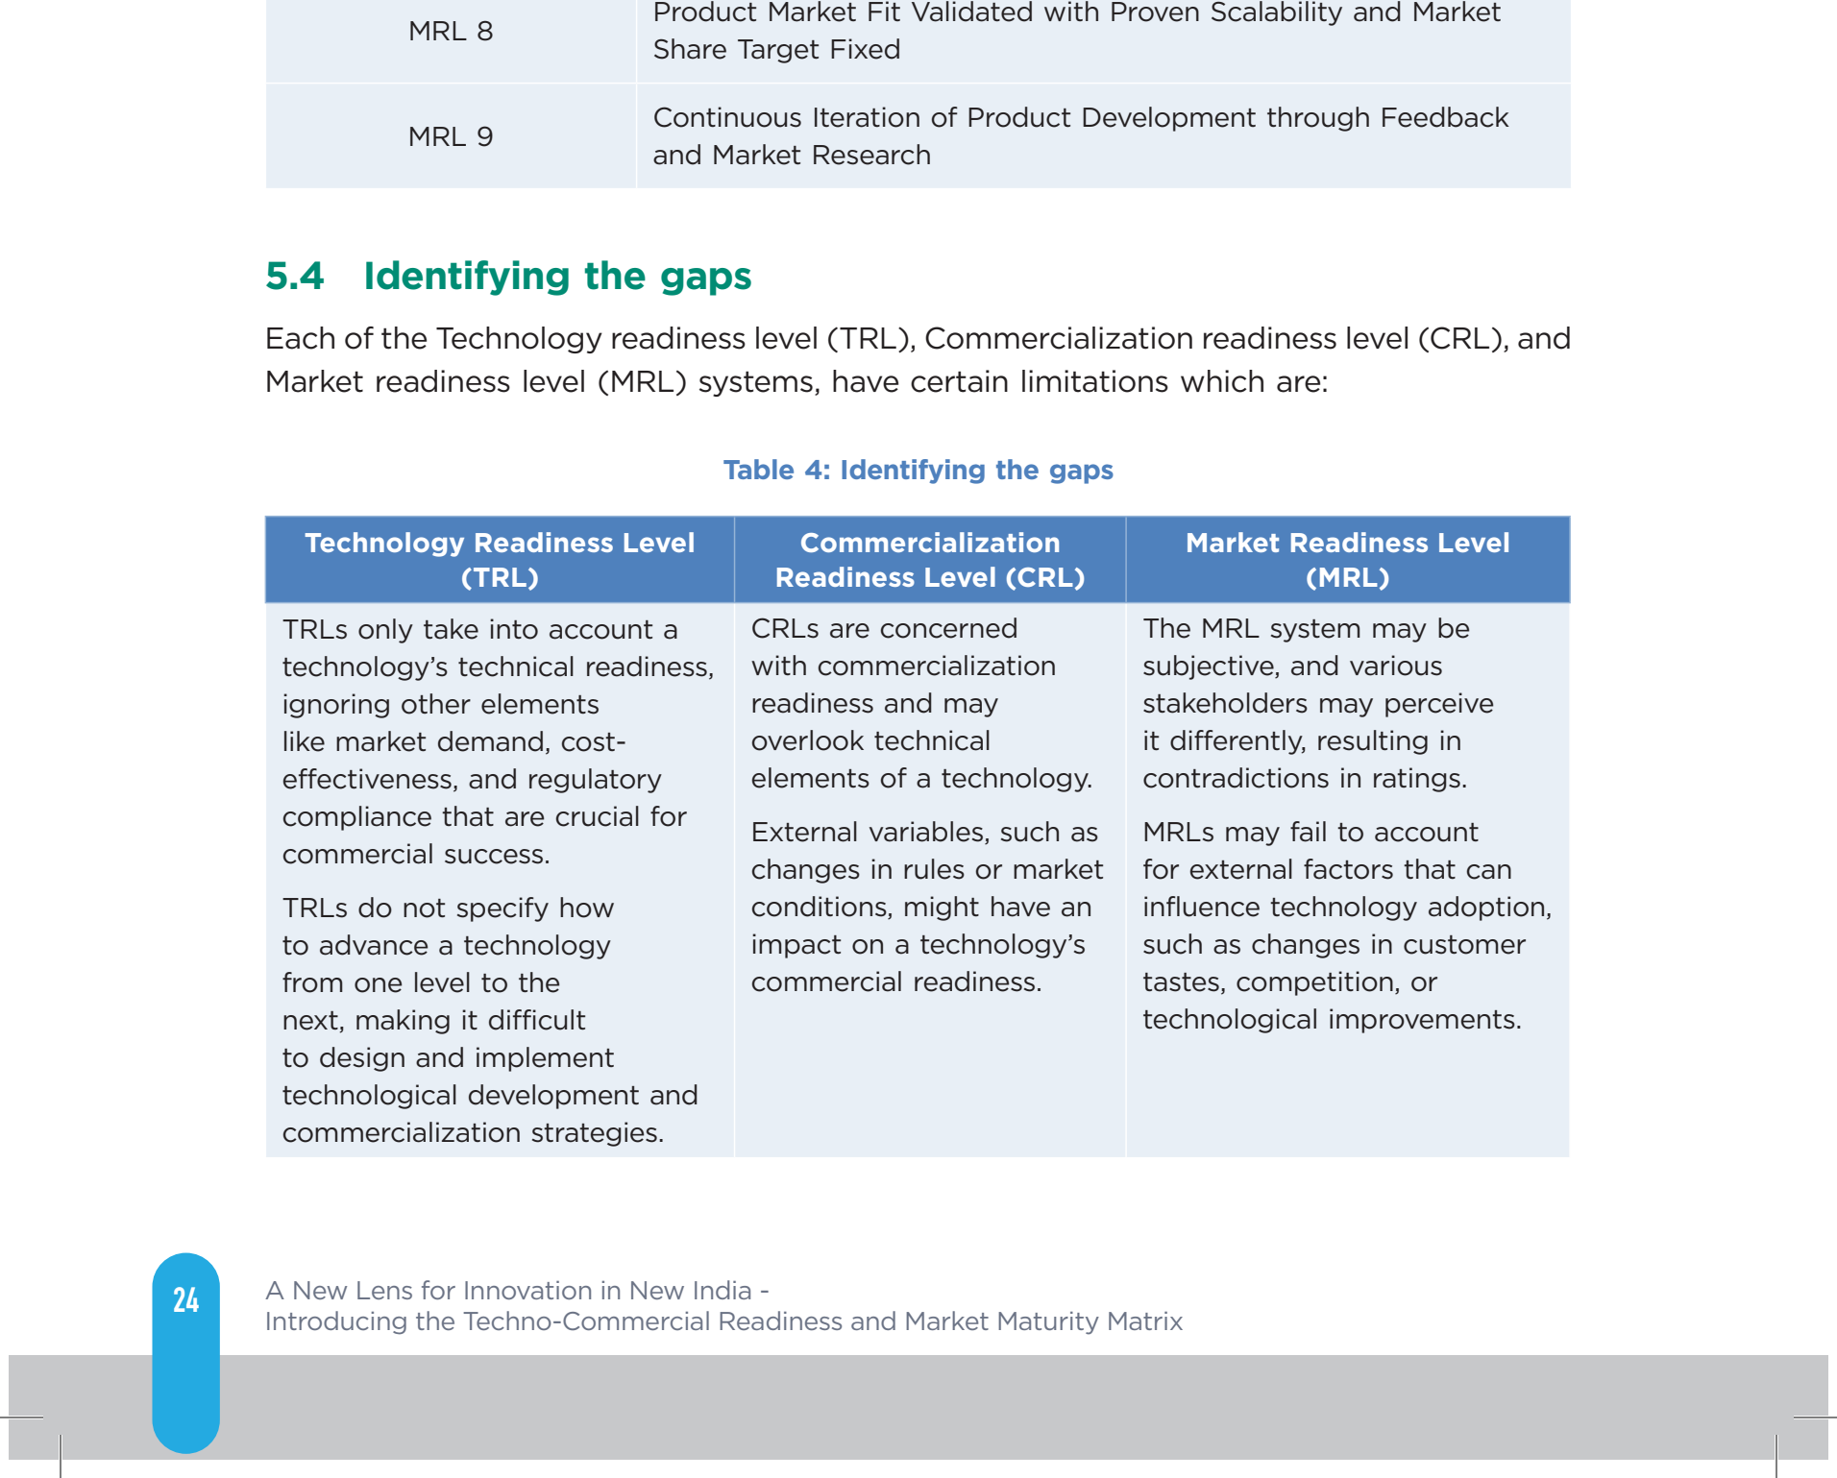
NCCR MUONIVERSE · HSG
20
FRAMEWORK ASSESSMENT
SOURCE-LED FINDING
CRL: the commercial dimension TRL misses
ORIGINAL SOURCE EXCERPT · p. 32
COMMENTS
No per-level evidence checklists, no rubric, no independent assessment protocol, no certification.
Descriptive (where you are) not prescriptive (what to do next) — unlike IRL/VIRAL.
Operationally thin at low levels: CRL 1 looks identical for a muon venture and a mobile app.
→ Best used as a diagnostic framing tool (a detector can be TRL 9 but CRL 1).
NITI Aayog (2023), TCRM Matrix, p. 32 (identifying the limits of TRL and the need for commercial readiness).
Lorik Dalloshi · Milestone 1 · NCCR Muoniverse
20 / 42

Slide 21
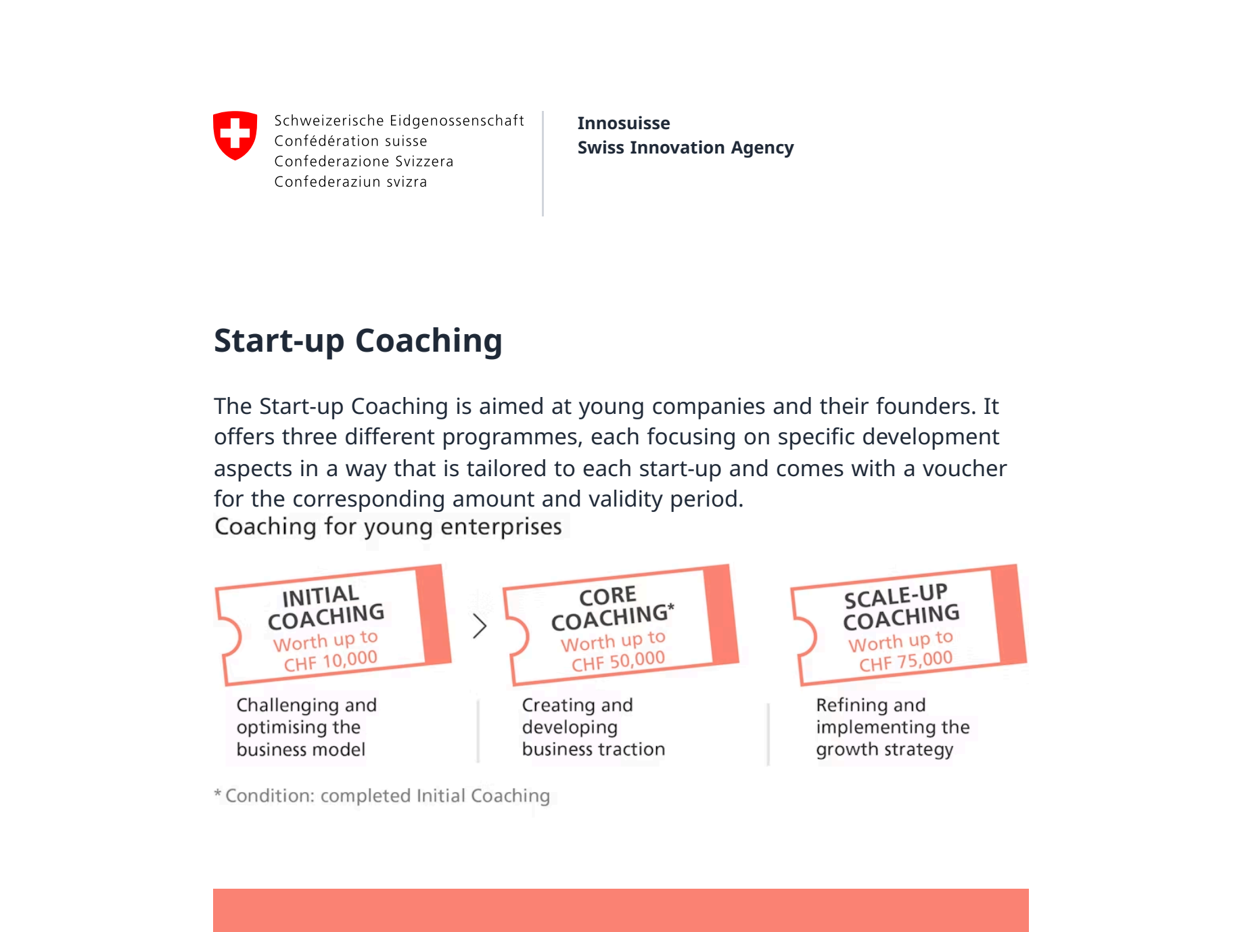
NCCR MUONIVERSE · HSG
21
FRAMEWORK ASSESSMENT
SOURCE-LED FINDING
Innosuisse: the native Swiss framework
ORIGINAL SOURCE EXCERPT · p. 1
COMMENTS
~CHF 300M/yr, ~20 instruments — the most institutionally relevant framework: any NCCR venture will interact with it.
Coaching: Initial (CHF 10K/12 mo) → Core (CHF 50K/36 mo, milestone-gated) → Scale-up (CHF 75K/24 mo).
Voucher system: startups choose their own accredited coaches.
Innosuisse (official), Start-up Coaching overview.
Lorik Dalloshi · Milestone 1 · NCCR Muoniverse
21 / 42

Slide 22
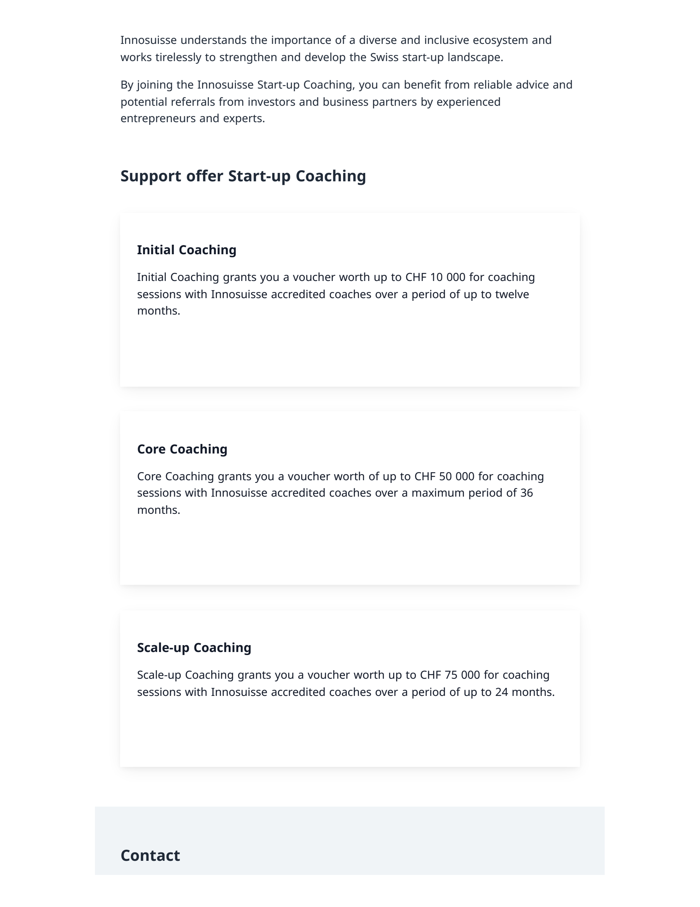
NCCR MUONIVERSE · HSG
22
FRAMEWORK ASSESSMENT
SOURCE-LED FINDING
Innosuisse: bespoke, voucher-based coaching
ORIGINAL SOURCE EXCERPT · p. 2
COMMENTS
Coaching methodology is NOT explicitly based on I-Corps or a formal Lean Startup curriculum.
Mentor-driven, bespoke per startup — fundamentally different from I-Corps' standardized 7-week immersion.
Entrepreneurship Training (venturelab, since 2004) IS curriculum-based — alumni include Climeworks, GetYourGuide.
→ A direct methodological contrast for the benchmarking: mentor-driven vs methodology-driven.
Innosuisse (official), Start-up Coaching overview, voucher-based programme description.
Lorik Dalloshi · Milestone 1 · NCCR Muoniverse
22 / 42

Slide 23
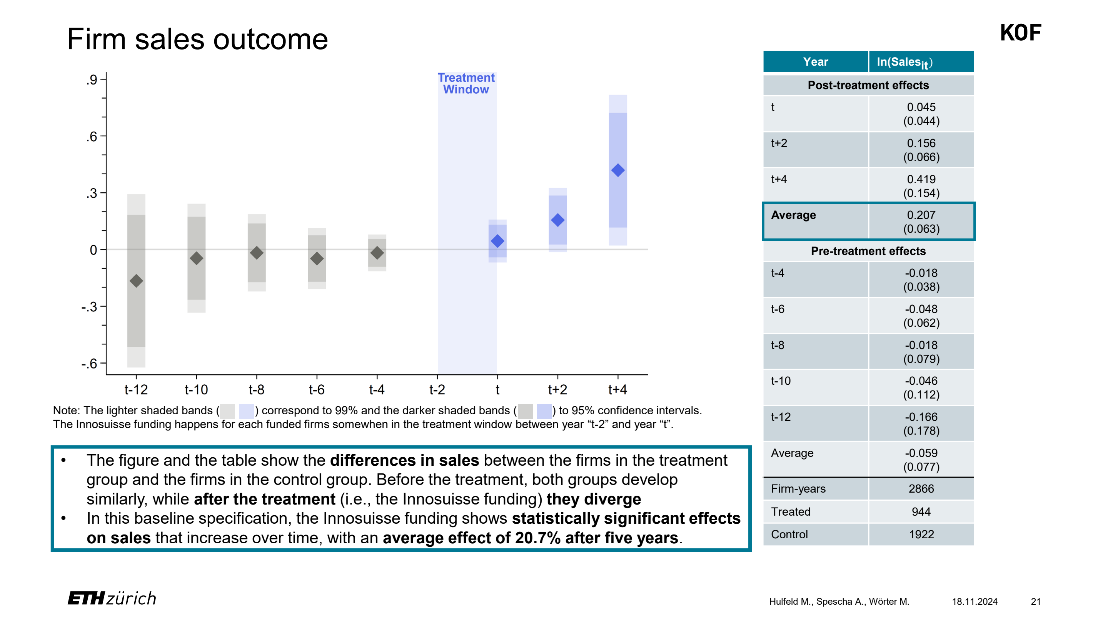
NCCR MUONIVERSE · HSG
23
FRAMEWORK ASSESSMENT
SOURCE-LED FINDING
Innosuisse: KOF-verified causal effect
ORIGINAL SOURCE EXCERPT · p. 21
COMMENTS
Only independently verified causal estimate: +20.7% sales, +17.6% employment over 5 years (matched control of 537 firms).
Effects accelerate: employment +7.8% (yr 0) → +17.2% (yr 2) → +27.9% (yr 4).
Strongest for small firms (5–50 employees) with ETH Domain research partners.
→ The only framework in the benchmark with causal validation.
Hulfeld, F., Spescha, A. & Wörter, M. (KOF ETH Zurich, 2024), Funding R&D Cooperation between Firms and Universities.
Lorik Dalloshi · Milestone 1 · NCCR Muoniverse
23 / 42

Slide 24
NCCR MUONIVERSE · HSG
24
FRAMEWORK ASSESSMENT
SOURCE-LED FINDING
Innosuisse support is stage-specific
ORIGINAL SOURCE EXCERPT · p. 2
COMMENTS
No instrument designed for TRL 1–3 commercialization; BRIDGE PoC (12 months, CHF 130K) is too short for muon validation cycles.
Coaching vouchers can't buy lab time, detector development, or validation experiments.
Vanishingly few accredited coaches have scaled particle-physics ventures.
Bottom-up model may not mobilize mission-oriented physics commercialization.
Innosuisse (official), Start-up Coaching overview — stage-specific support and durations.
Lorik Dalloshi · Milestone 1 · NCCR Muoniverse
24 / 42

Slide 25
NCCR MUONIVERSE · HSG
25
FRAMEWORK ASSESSMENT
SOURCE-LED FINDING
EIC Accelerator: TRL 6–8
ORIGINAL SOURCE EXCERPT · p. 1
COMMENTS
Flagship Accelerator requires TRL 5–8 — years away for emerging muon ventures.
Blended finance (grant up to €2.5M + equity €0.5–10M); success rate 3–7% — among the most competitive globally.
Relevant early-TRL pathway: Pathfinder (TRL 1–4, €3–4M grants) + Transition (TRL 3–6), both needing international consortia.
European Innovation Council (official), EIC Accelerator programme page.
Lorik Dalloshi · Milestone 1 · NCCR Muoniverse
25 / 42

Slide 26
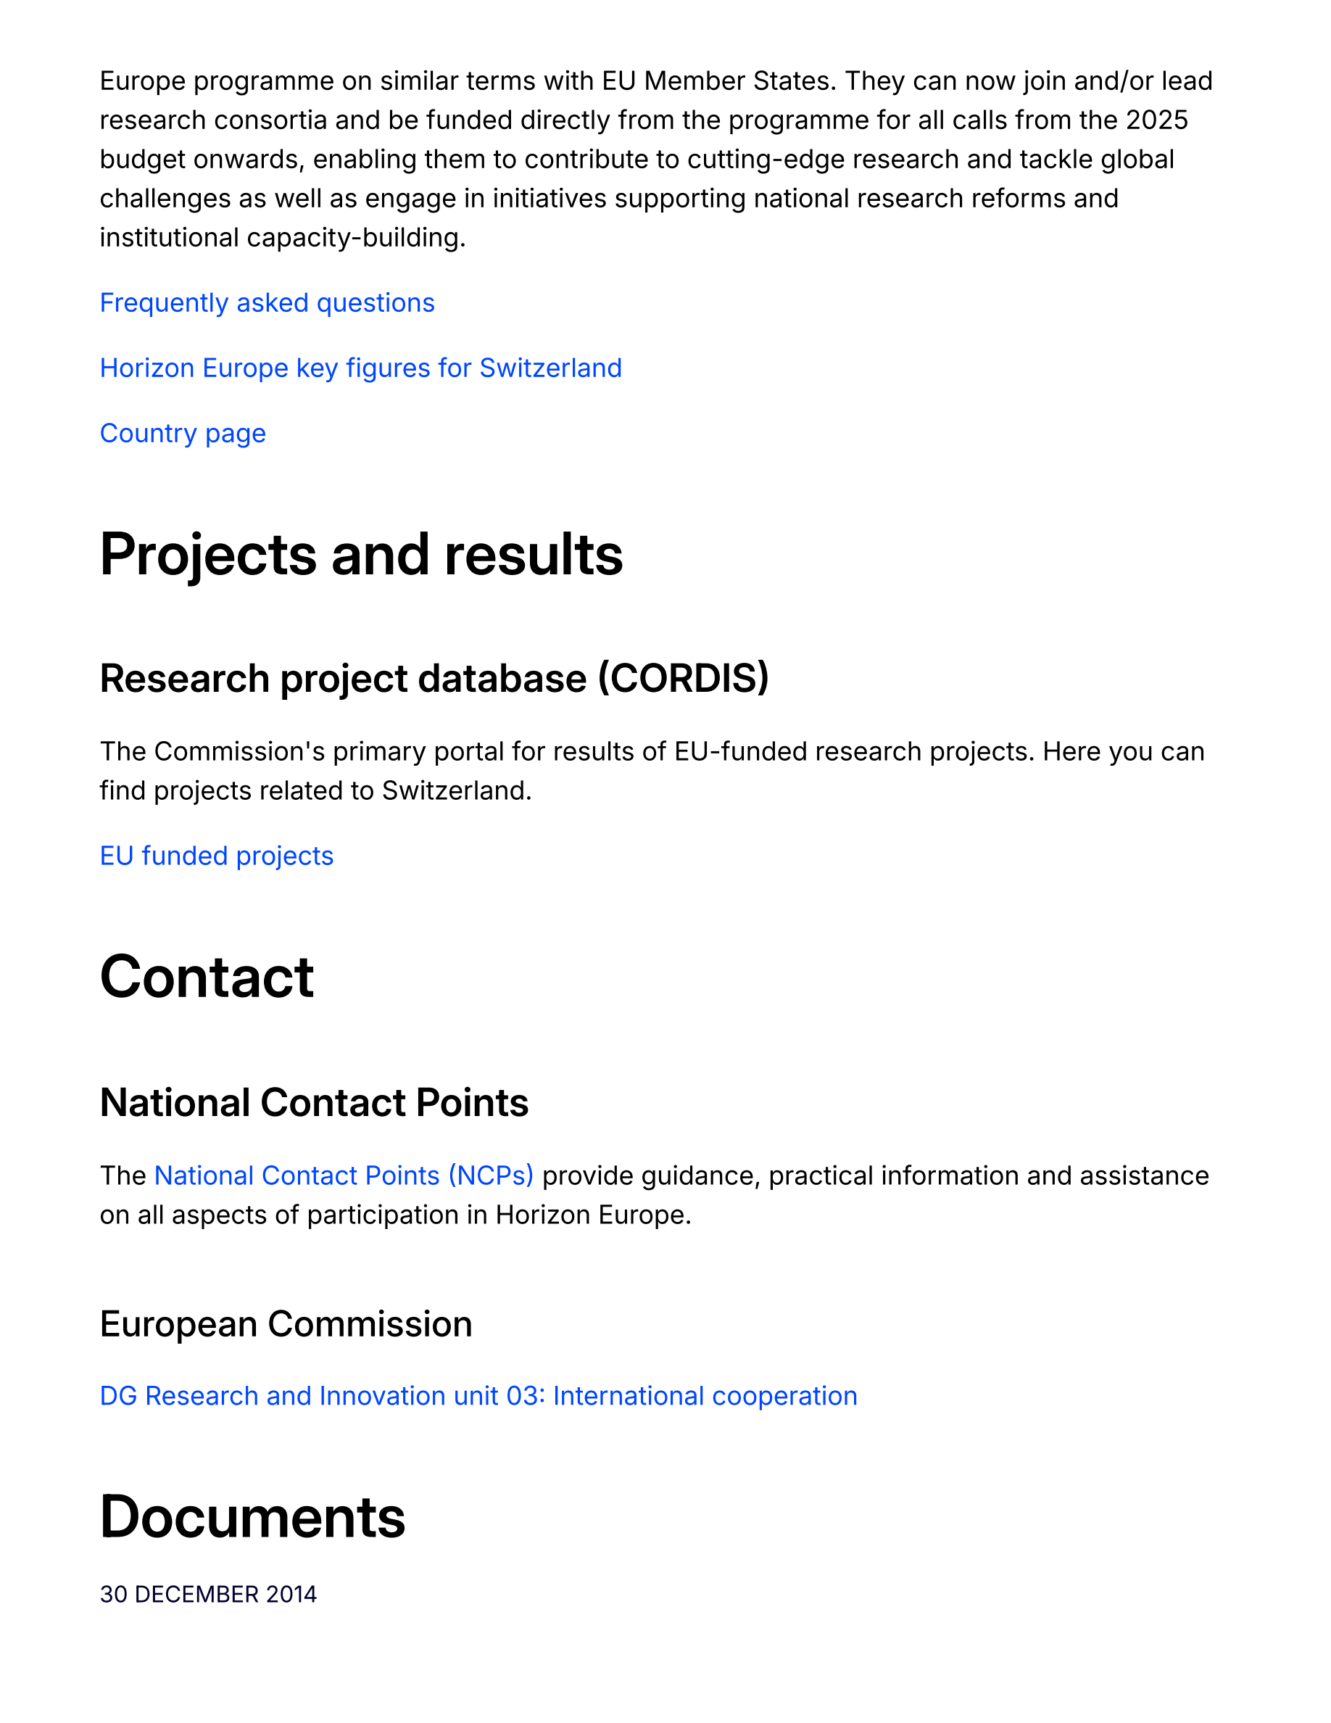
NCCR MUONIVERSE · HSG
26
FRAMEWORK ASSESSMENT
SOURCE-LED FINDING
EIC: Switzerland fully eligible since Jan 2025
ORIGINAL SOURCE EXCERPT · p. 2
COMMENTS
Swiss firms fully eligible for all instruments incl. equity; can coordinate consortia.
Feb 2026: 4 Swiss winners (Neutrality, Verity, Pregnolia, DePoly); June 2026: 4 of 38 — incl. BTRY (€2.2M) and Nanoflex (€12.5M).
Swiss EIC winners are typically Venture Kick / Venture Leaders alumni — the national pipeline prepares them.
→ Sequencing: Innosuisse early → EIC Pathfinder/Transition → Accelerator → STEP Scale Up.
European Commission (official), International cooperation with Switzerland in research and innovation.
Lorik Dalloshi · Milestone 1 · NCCR Muoniverse
26 / 42

Slide 27
NCCR MUONIVERSE · HSG
27
FRAMEWORK ASSESSMENT
SOURCE-LED FINDING
Candidate: CERN Venture Connect
ORIGINAL SOURCE EXCERPT · p. 3
COMMENTS
CERN faces the IDENTICAL challenge as NCCR Muoniverse: fundamental particle physics → commercial applications.
CVC model: 0% equity, express agreements, curated technology portfolio, 60 partner orgs across 18 countries.
8 startups joined in 2025, collectively raising >€5M.
→ The most directly comparable institutional model — must be benchmarked in Part 2.
Stryber (2025), Deep Tech commercialization in Europe — source identifying CERN Venture Connect as a relevant institutional actor.
Lorik Dalloshi · Milestone 1 · NCCR Muoniverse
27 / 42

Slide 28
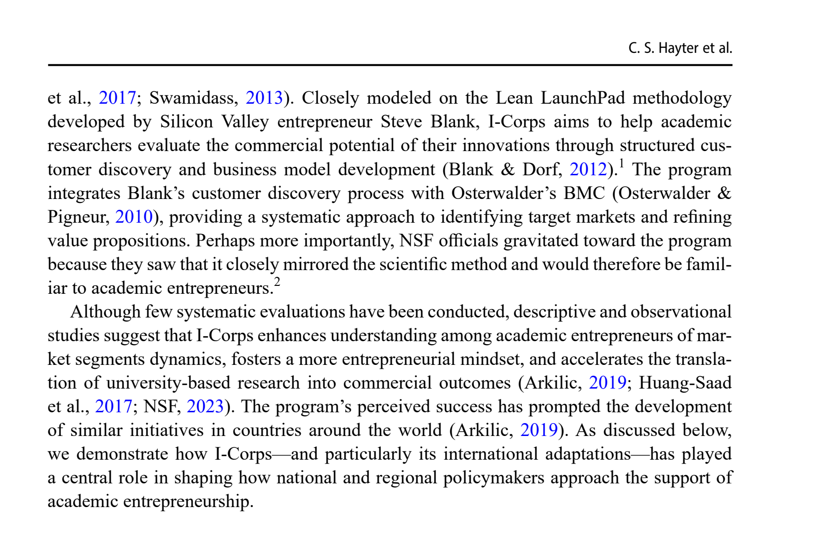
NCCR MUONIVERSE · HSG
28
FRAMEWORK ASSESSMENT
SOURCE-LED FINDING
Candidate: NSF I-Corps
ORIGINAL SOURCE EXCERPT · p. 4
COMMENTS
The most internationally validated early-TRL commercialization program — adopted in 8 countries (EXIST Germany, Brazil, +6).
Core methodology: lean startup + intensive customer discovery, structured 7-week immersion.
Direct comparator to Innosuisse's bespoke coaching: methodology-driven vs mentor-driven.
→ STRONGLY RECOMMENDED for the November 1 benchmarking milestone.
Hayter, C. S. et al. (2025), Journal of Technology Transfer, p. 4.
Lorik Dalloshi · Milestone 1 · NCCR Muoniverse
28 / 42

Slide 29
NCCR MUONIVERSE · HSG
29
DATA COMPENDIUM
The numbers
Statistical evidence behind the findings
Milestone 1 · source-led findings deck

Slide 30
NCCR MUONIVERSE · HSG
30
DATA COMPENDIUM
SOURCE-LED FINDING
Market features dominate (β = 0.514)
ORIGINAL SOURCE EXCERPT · p. 10
COMMENTS
Market features β = 0.514 — strongest predictor by far.
Technology β = 0.310, environmental β = 0.306.
Firm internal features: NOT significant.
→ Market identification is the single highest-leverage activity.
Capatina, A., Bleoju, G. & Kalisz, D. (2024), Journal of Innovation & Knowledge 9, 100515, structural model.
Lorik Dalloshi · Milestone 1 · NCCR Muoniverse
30 / 42

Slide 31
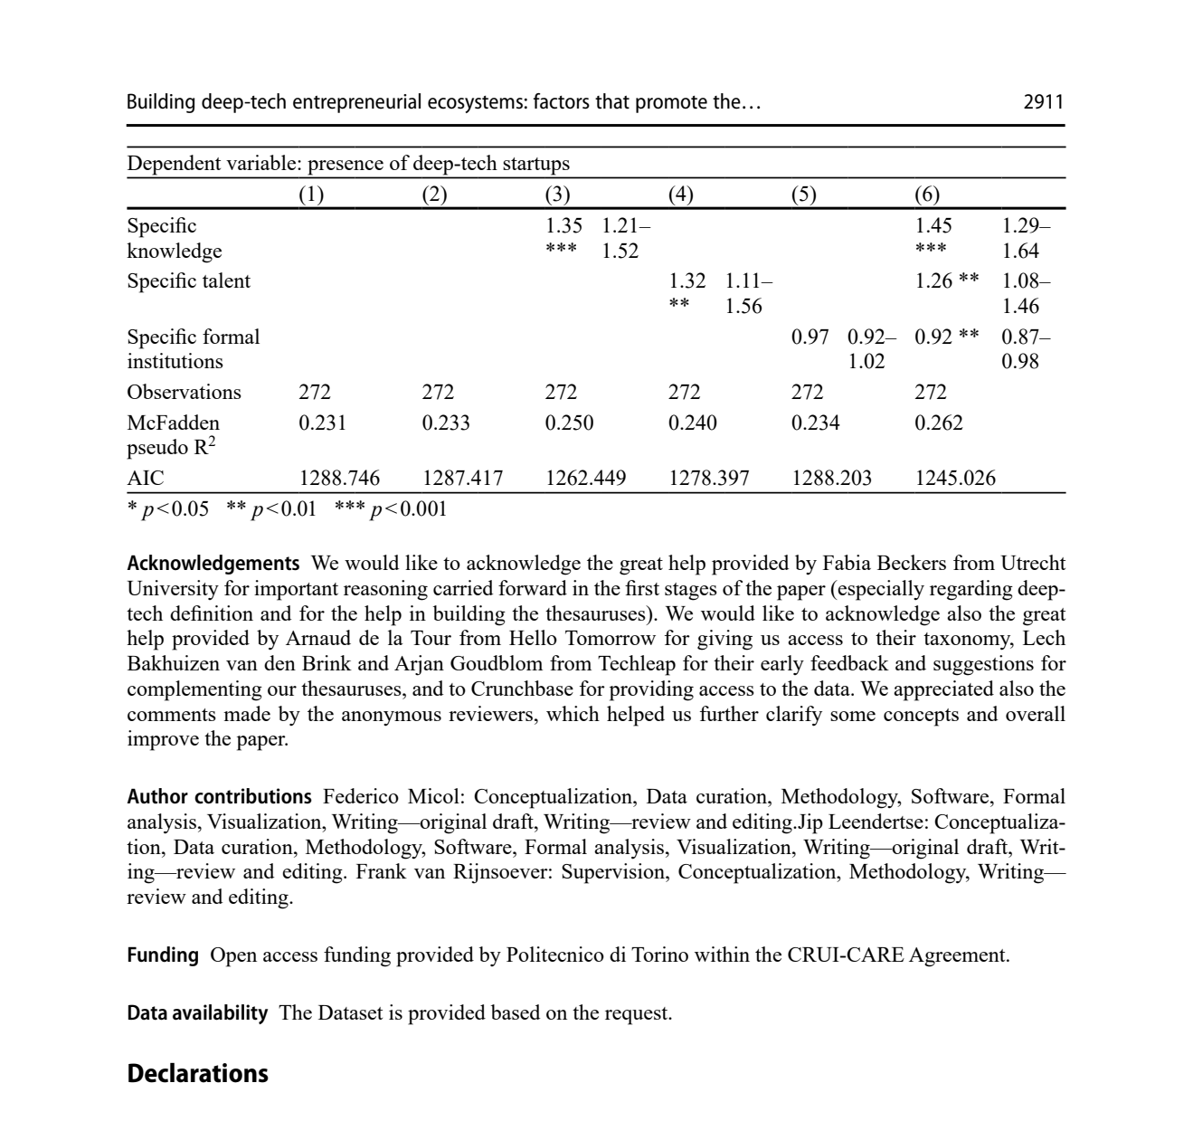
NCCR MUONIVERSE · HSG
31
DATA COMPENDIUM
SOURCE-LED FINDING
Talent and knowledge drive deep tech
ORIGINAL SOURCE EXCERPT · p. 40
COMMENTS
Talent pools: IRR 1.66 — strongest predictor.
Knowledge infrastructure: IRR 1.48.
Formal institutions (policy, IP law): NOT significant.
Top 10 regions = 40% of all deep tech startups.
Micol, F., Leendertse, J. & van Rijnsoever, F. (2026), Journal of Technology Transfer, Table 4.
Lorik Dalloshi · Milestone 1 · NCCR Muoniverse
31 / 42

Slide 32
NCCR MUONIVERSE · HSG
32
DATA COMPENDIUM
SOURCE-LED FINDING
Incubation: type and age matter
ORIGINAL SOURCE EXCERPT · p. 32
COMMENTS
University incubators r = 0.118 vs overall 0.067; older (>20 yrs) r = 0.183; generic business incubators −0.011 (NS).
Networking service r = 0.071; mentoring r = −0.012 (NS).
Technology/R&D ventures benefit more (0.082–0.130).
Seitz, N. et al. (2026), Review of Managerial Science, moderator table.
Lorik Dalloshi · Milestone 1 · NCCR Muoniverse
32 / 42

Slide 33
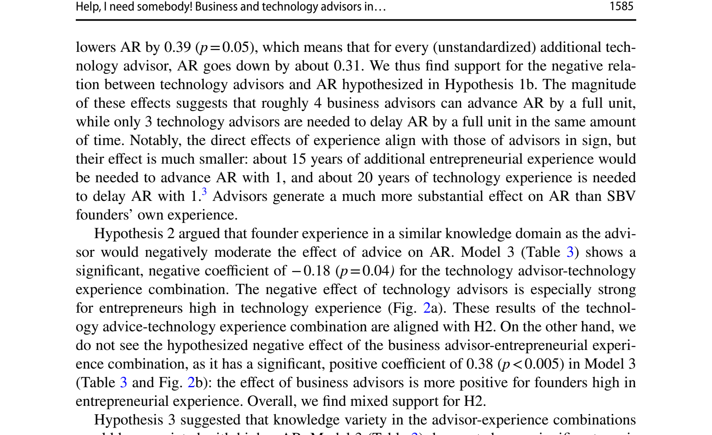
NCCR MUONIVERSE · HSG
33
DATA COMPENDIUM
SOURCE-LED FINDING
Advisors: business +0.23, technology −0.31
ORIGINAL SOURCE EXCERPT · p. 19
COMMENTS
Each business advisor: +0.23 AR units (p = 0.04).
Each technology advisor: −0.31 AR units (p = 0.05).
4 business advisors ≈ +1 unit ≈ 15 yrs experience; 3 tech advisors ≈ −1 unit.
80%+ of ventures used at least one advisor — ubiquitous policy tool.
Denoo, L., Van Boxstael, A. & Belz, A. (2024), Journal of Technology Transfer, p. 1585.
Lorik Dalloshi · Milestone 1 · NCCR Muoniverse
33 / 42

Slide 34
NCCR MUONIVERSE · HSG
34
DATA COMPENDIUM
SOURCE-LED FINDING
TTOs become playmakers through relationships
ORIGINAL SOURCE EXCERPT · p. 16
COMMENTS
The primary case study describes TTOs as 'playmakers' whose influence grows through relational ties and access to the wider innovation-service ecosystem.
The key mechanism visible in the source is relationship-building, not a narrow technology-transfer transaction.
→ The interview phase should test whether Swiss TTOs operate this way in practice.
Chen, Z., Little, V. & Thuan, N. (2025), Journal of Technology Transfer, p. 1075.
Lorik Dalloshi · Milestone 1 · NCCR Muoniverse
34 / 42

Slide 35
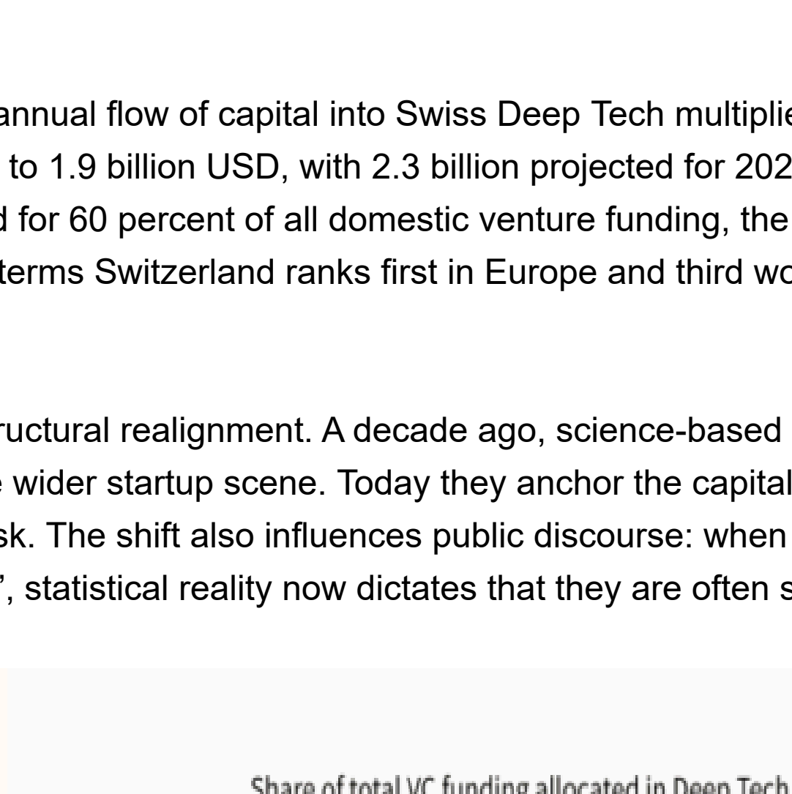
NCCR MUONIVERSE · HSG
35
DATA COMPENDIUM
SOURCE-LED FINDING
Switzerland: #1 per capita, 3× the runner-up
ORIGINAL SOURCE EXCERPT · p. 3
COMMENTS
Spinout value per capita index: 100 vs 33 (runner-up).
ETH #3, EPFL #4, UZH #8 in Europe.
60–63% of Swiss VC flows to deep tech — #1 globally (China 56%, US 54%).
3 of 6 global >$1B spinout exits in 2025 were Swiss (Araris, Nexthink, u-blox).
Deep Tech Nation Switzerland / Dealroom.co (2025), Swiss Deep Tech Report 2025, via Swiss Startup Association reproduction.
Lorik Dalloshi · Milestone 1 · NCCR Muoniverse
35 / 42

Slide 36
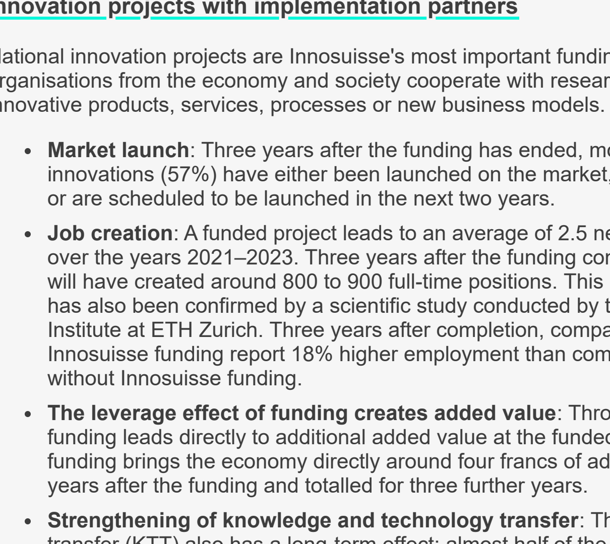
NCCR MUONIVERSE · HSG
36
DATA COMPENDIUM
SOURCE-LED FINDING
Innosuisse Innovation Projects: 57% launch rate
ORIGINAL SOURCE EXCERPT · p. 2
COMMENTS
57% market launch within 3 years post-funding.
2.5 highly qualified jobs per project (~800–900 FTE per cohort).
Leverage: 1 CHF → 4 CHF value added.
~50% continue with the research partner after 3 years.
Innosuisse (2025), Impact monitoring 2021–2023.
Lorik Dalloshi · Milestone 1 · NCCR Muoniverse
36 / 42

Slide 37
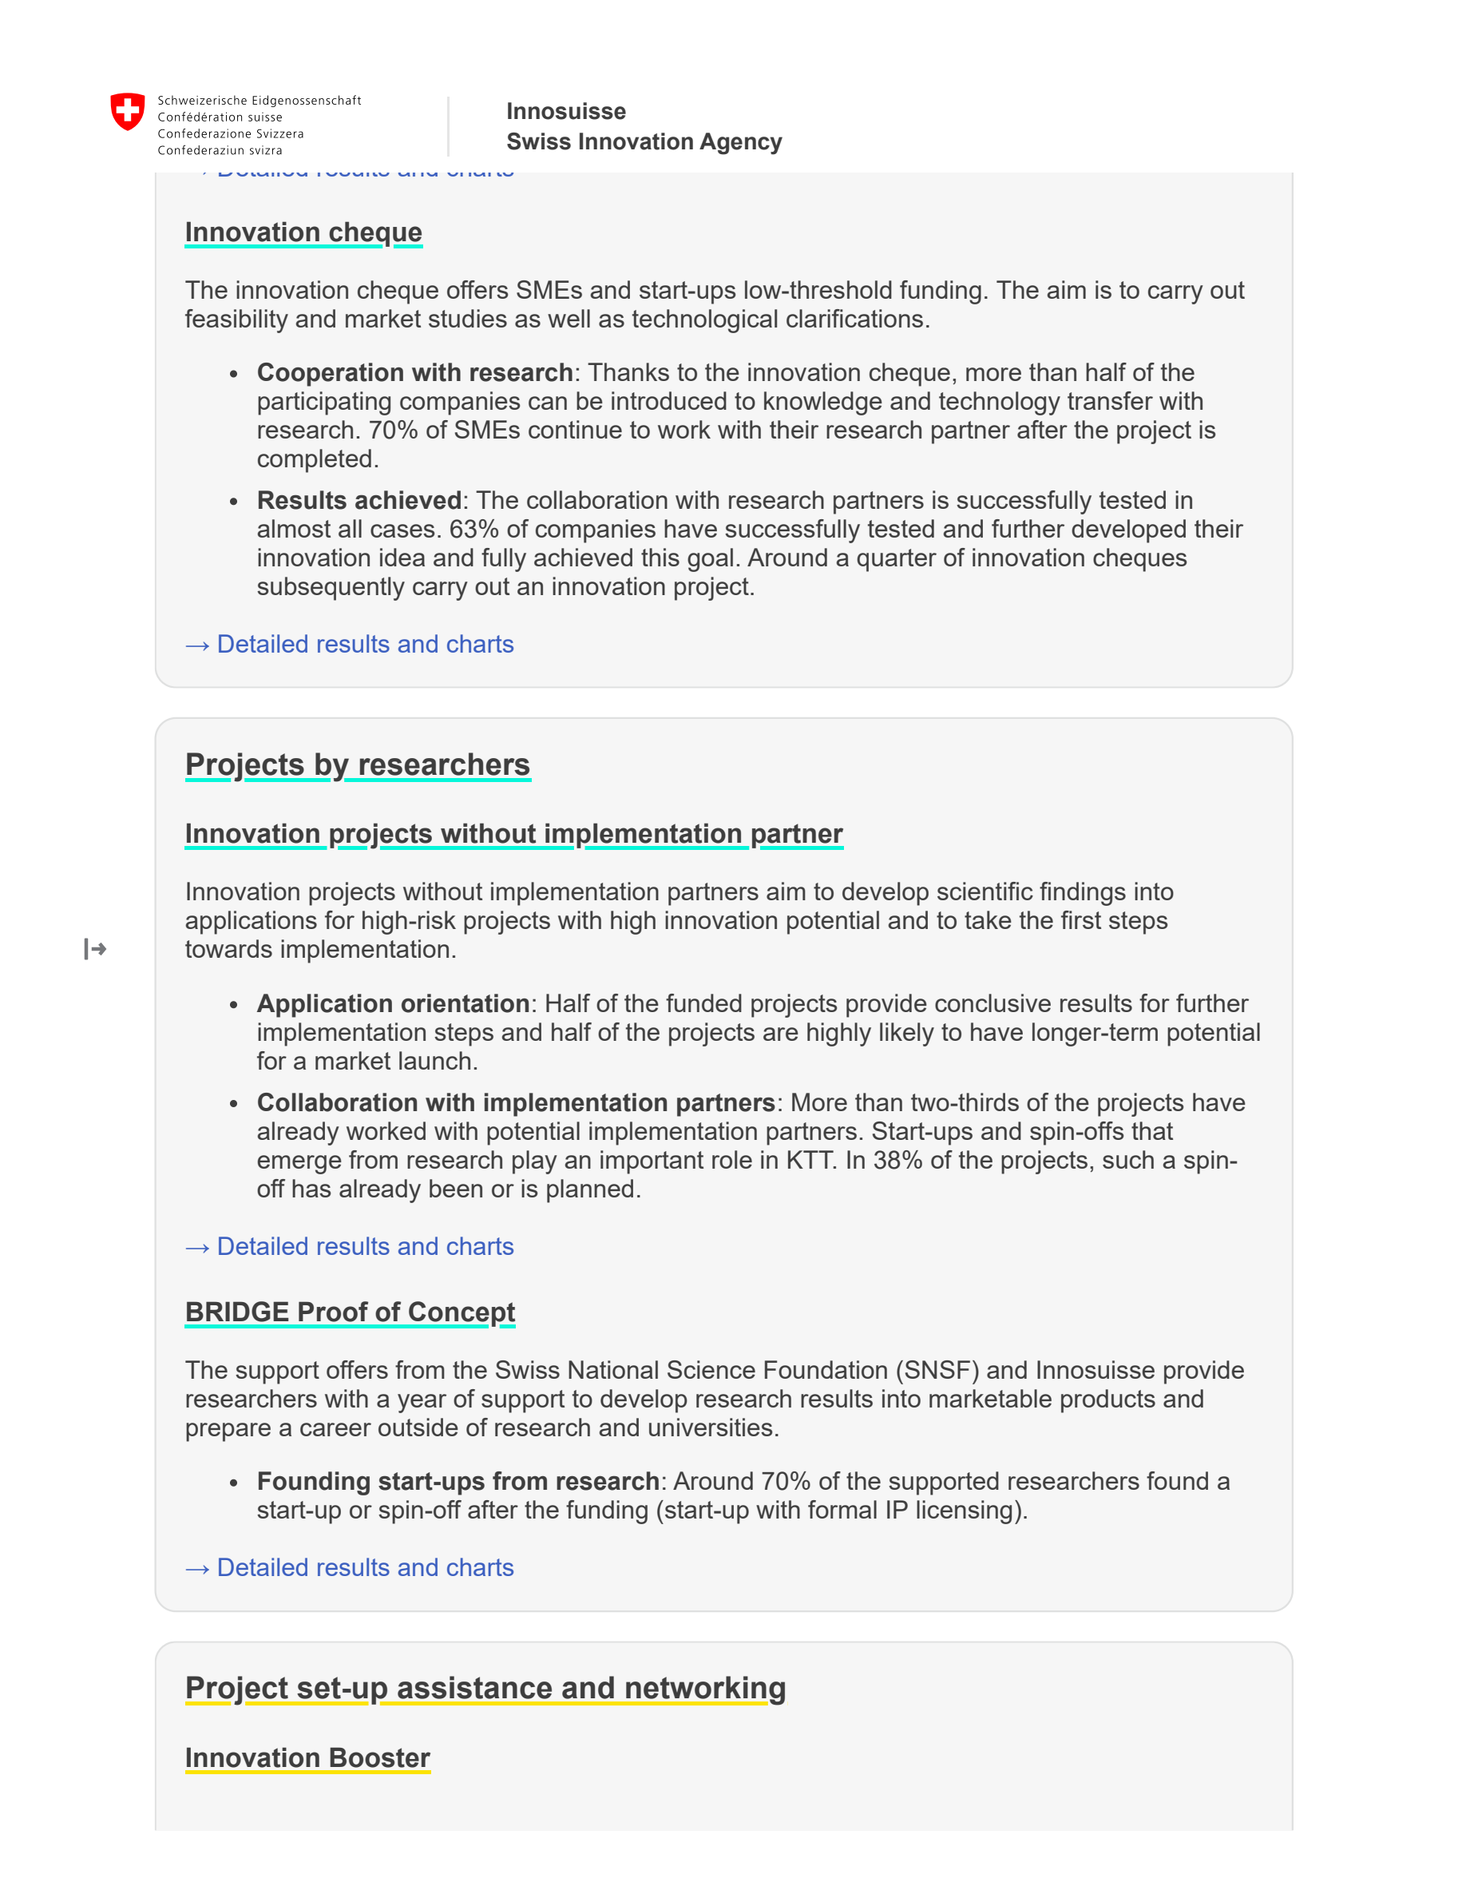
NCCR MUONIVERSE · HSG
37
DATA COMPENDIUM
SOURCE-LED FINDING
BRIDGE PoC: 70% founding rate
ORIGINAL SOURCE EXCERPT · p. 3
COMMENTS
70% of funded researchers go on to found a startup — highest conversion of any Innosuisse instrument.
CHF 130K over 12 months; 80 startups created from 121 PoC projects.
→ Proves the concept works when the timeline fits — muon timelines do not.
Innosuisse (2025), Impact monitoring 2021–2023, BRIDGE Proof of Concept.
Lorik Dalloshi · Milestone 1 · NCCR Muoniverse
37 / 42

Slide 38
NCCR MUONIVERSE · HSG
38
DATA COMPENDIUM
SOURCE-LED FINDING
KOF causal effect: +20.7% sales, +17.6% employment
ORIGINAL SOURCE EXCERPT · p. 21
COMMENTS
+20.7% sales and +17.6% employment over 5 years vs matched controls.
Employment effect grows: +7.8% (yr 0) → +17.2% (yr 2) → +27.9% (yr 4).
Statistically significant only for small firms (5–50 employees) with ETH Domain partners.
Hulfeld, F., Spescha, A. & Wörter, M. (KOF ETH Zurich, 2024), causal difference-in-differences result.
Lorik Dalloshi · Milestone 1 · NCCR Muoniverse
38 / 42

Slide 39
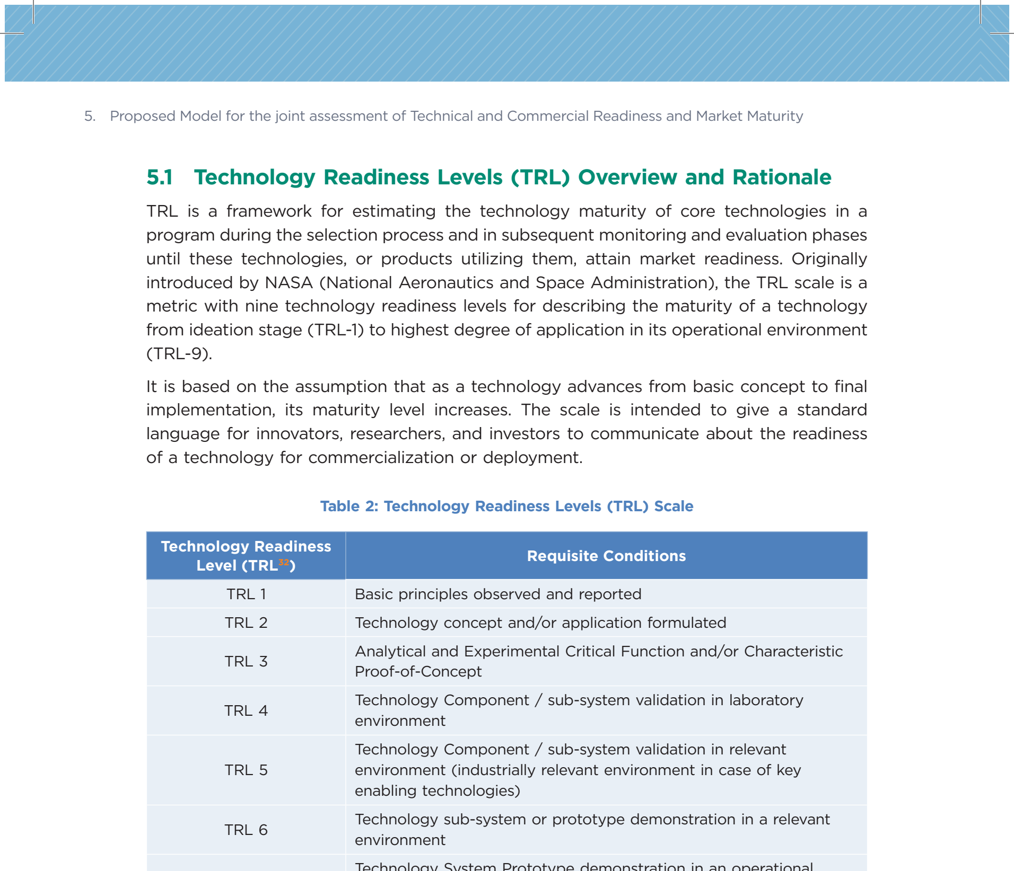
NCCR MUONIVERSE · HSG
39
DATA COMPENDIUM
SOURCE-LED FINDING
The TRL 1–3 gap, visualized
ORIGINAL SOURCE EXCERPT · p. 30
COMMENTS
RCA/Imperial: TRL 4–6. CRL: 1–9 (conceptual only). Innosuisse: 4–7. EIC: 1–8 pipeline.
Red zone = TRL 1–3 — where NCCR Muoniverse operates.
Only Innosuisse has independent causal validation (KOF DiD); only EIC publishes an assessment methodology.
NITI Aayog (2023), TCRM Matrix, p. 30 (TRL scale).
Lorik Dalloshi · Milestone 1 · NCCR Muoniverse
39 / 42

Slide 40
NCCR MUONIVERSE · HSG
40
DATA COMPENDIUM
SOURCE-LED FINDING
EU vs US: a 3.7× capital gap
ORIGINAL SOURCE EXCERPT · p. 3
COMMENTS
Deep tech VC: €58B (EU) vs €215B (US) — 3.7× gap.
62% of EU investors reject failed founders vs 23% US (2.7× more risk-averse).
PhD-to-startup: 15% vs 45%; corporate engagement: 12% vs 40%.
US holds 49% of global deep tech VC.
Stryber (2025), Deep Tech commercialization in Europe.
Lorik Dalloshi · Milestone 1 · NCCR Muoniverse
40 / 42

Slide 41
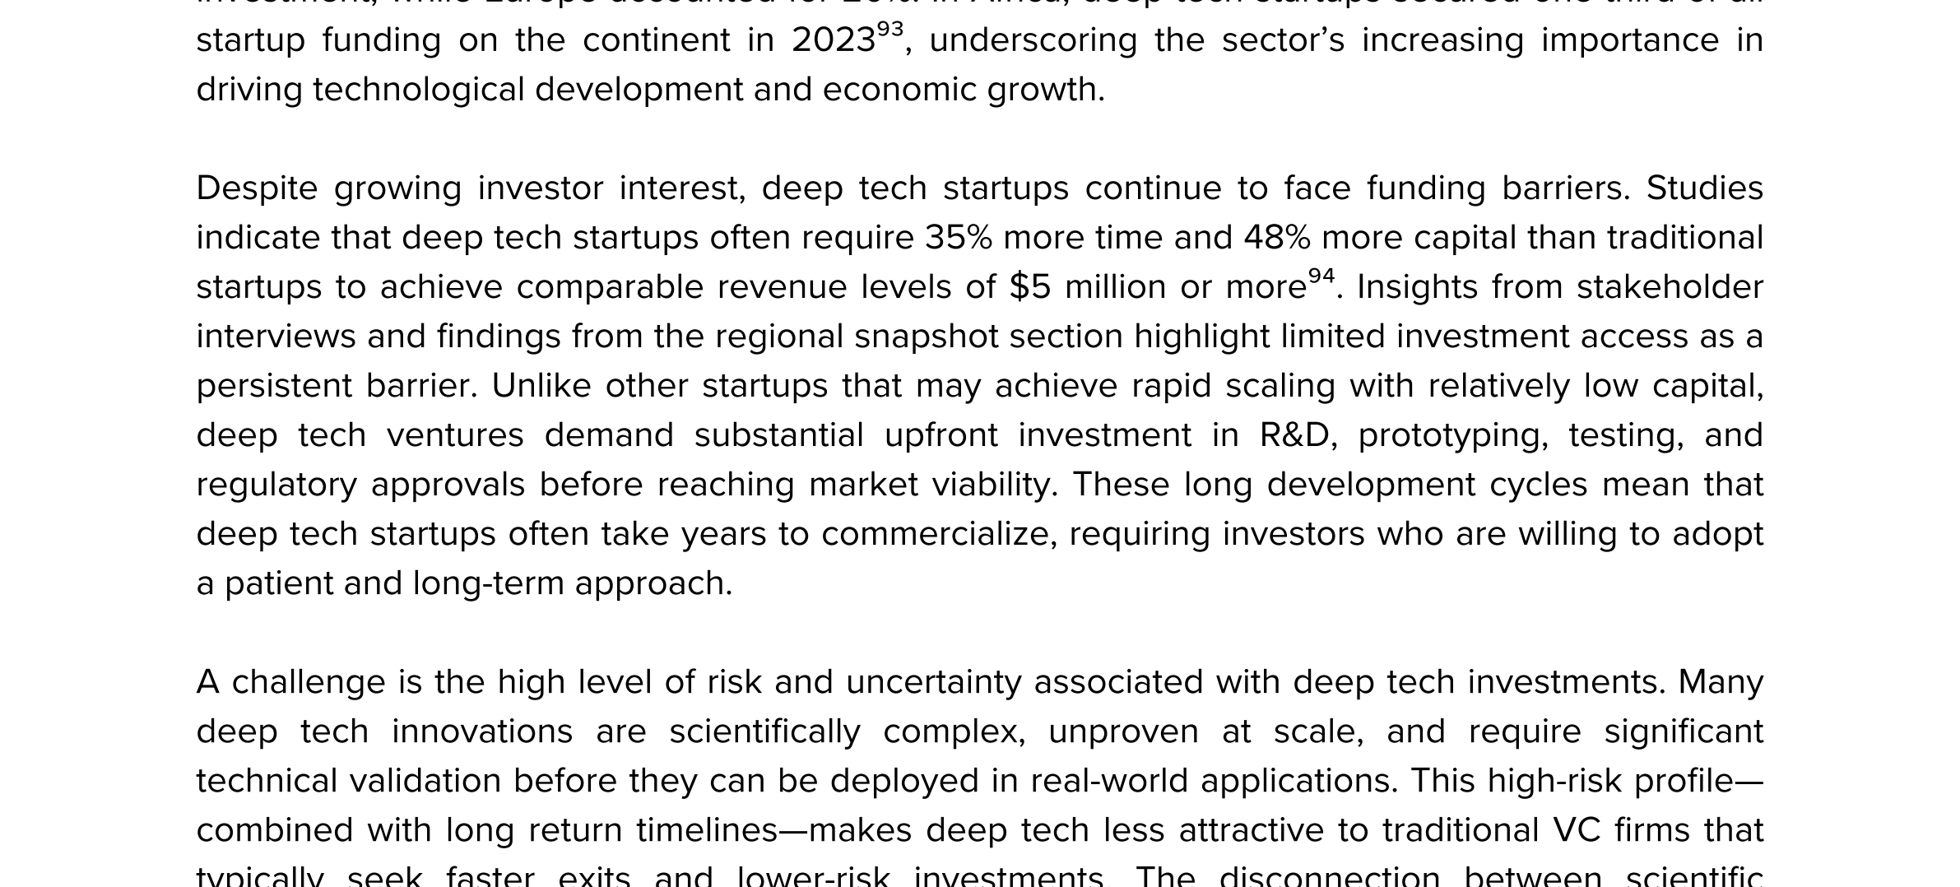
NCCR MUONIVERSE · HSG
41
DATA COMPENDIUM
SOURCE-LED FINDING
Deep tech: +35% time, +48% capital
ORIGINAL SOURCE EXCERPT · p. 54
COMMENTS
Time to milestones: 135 vs 100 (+35%).
Capital required: 148 vs 100 (+48%).
Development timeline: 1–3 yrs conventional vs 5–15+ yrs deep tech.
97% of deep tech ventures contribute to ≥1 SDG.
UNDP (2025), Global Deep Tech Ecosystems, p. 54.
Lorik Dalloshi · Milestone 1 · NCCR Muoniverse
41 / 42

Slide 42
NCCR MUONIVERSE · HSG
42
MILESTONE 1
Source-led evidence → interview questions
The practical conclusion: early-TRL physics commercialization is not missing ideas — it is missing a support architecture designed for the gap.
Next: Milestone 2 interviews · September 1, 2026
All source excerpts are embedded from the primary PDFs/pages listed beneath each image.

