Slide 1
Enhancing Pathfinding Reinforcement Learning Agents with Pheromone
By Mingkun Yu

Slide 2
Outline
Problem Setup
Agent Setup
ACO and Pheromone
Experiments & Results
Next Steps

Slide 3
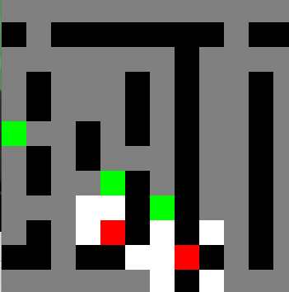
Problem Setup
2D maze, with one agent and multiple destinations.
The goal is to visit all destinations.
Fixed map, randomly generated starting and destination positions.
Partial Observation.

Slide 4
Why maze?
It’s a well-defined problem, simple in concept but not-so-simple for ML.
It is a benchmark used in many literature.
Relatively easy to implement.
Fast execution.
Many real-world applications.

Slide 5
Agent Setup
Atari-net Style CNN-MLP neural network.
Deep Q learning.
Observation: everything(land, trace, destinations) within its sight range.
Action: left/down/up/right
Reward: 1 for reaching each goal.

Slide 6
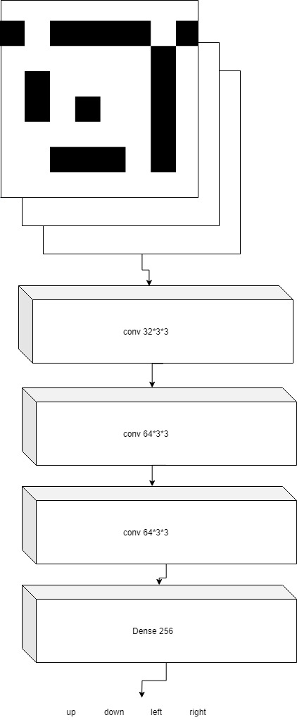

Slide 7
Naïve Approach
Is this network enough for solving complete observation case?
Is it enough for partial observation?

Slide 8
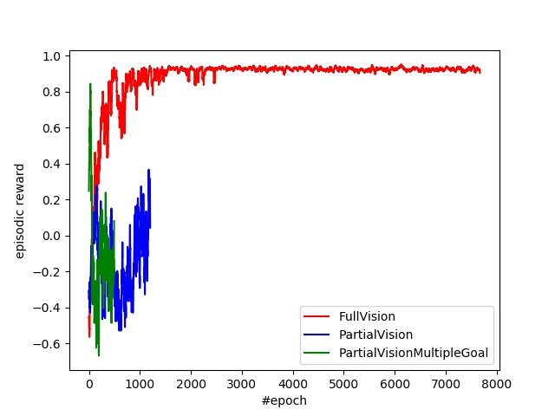
A little demonstration on the difficulty
Single agent single goal
Single agent multiple goals
Single agent single goal partial observation

Slide 9
Previous Application for ACO in ML
Use ACO to train neural nets.
Use ACO to tune hyperparameters.
Use ACO to evolve the structures.

Slide 10
ACO Philosophy
Leave trace(pheromone) on ground that guides exploration.
(Therefore the trace serves as external memory)
Trace are used by all agents(in multiagent case).
Same trace-painting strategy for all agents(in multiagent case).
Here we start with single agent case.

Slide 11
So… How?
What to leave as trace?
Do we use any global updating rule?

Slide 12
Selecting Trace Value
Some existing value in the NN.
Some newly generated value.

Slide 13
Painting Existing Values
Since it’s Q learning, how about we simply leave the Q values on ground?
Intuitively, this would work well for fixed destination scenario, but maybe not so well for changing destination scenario.

Slide 14
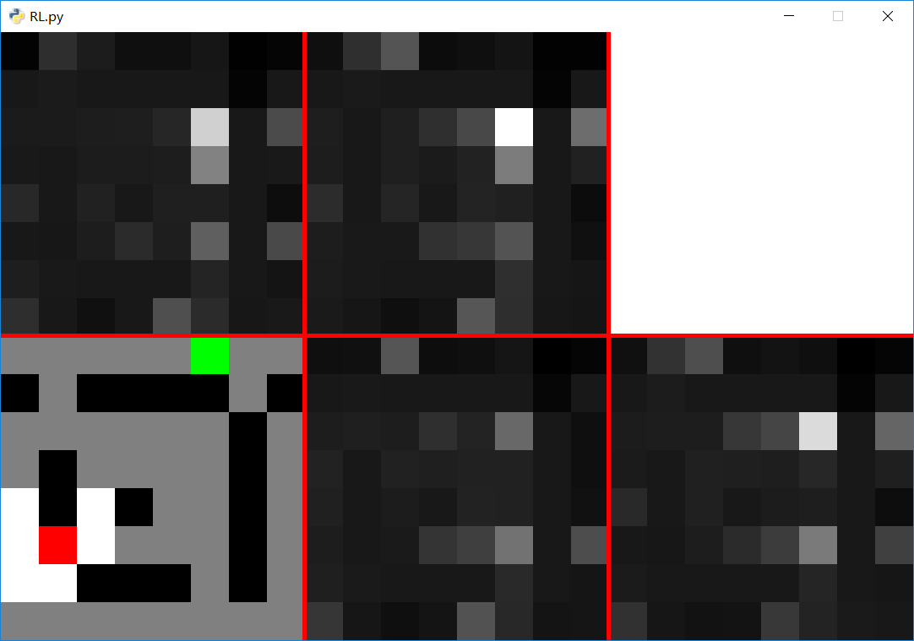
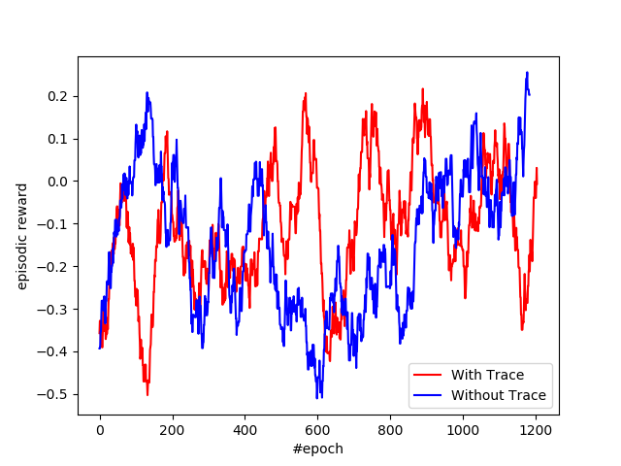
Result

Slide 15
Selective painting
How about we only paint the q-value for the direction that we goes to?

Slide 16
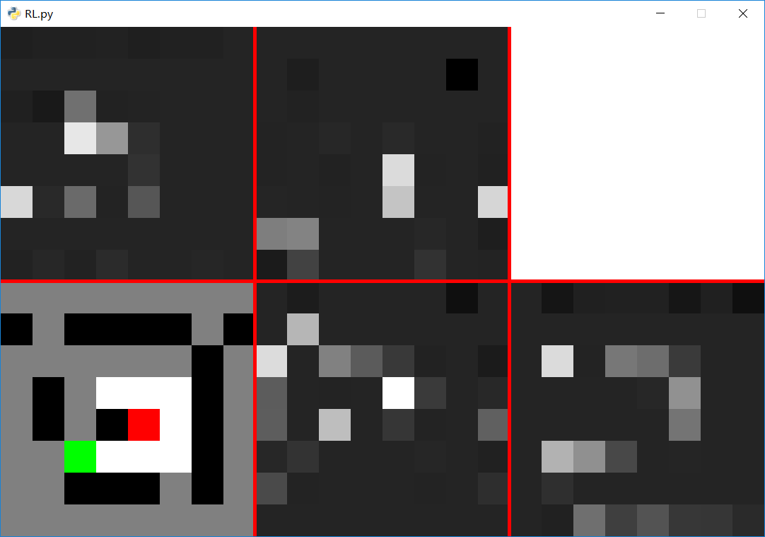
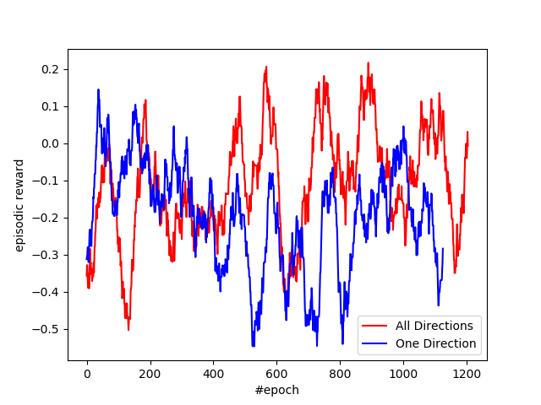
Result

Slide 17
Trace Patterns...
These traces follow simple patterns.
They reflect how often destination appears, instead of the structure of the maze.
Therefore they convey messages like “how likely is destination to be spawned here”.

Slide 18
Constant Value
Intuitively constant value traces serve as a heatmap telling the agent how much time it has spent getting stuck there.
Hopefully this would guide agent to get out of deadends.

Slide 19
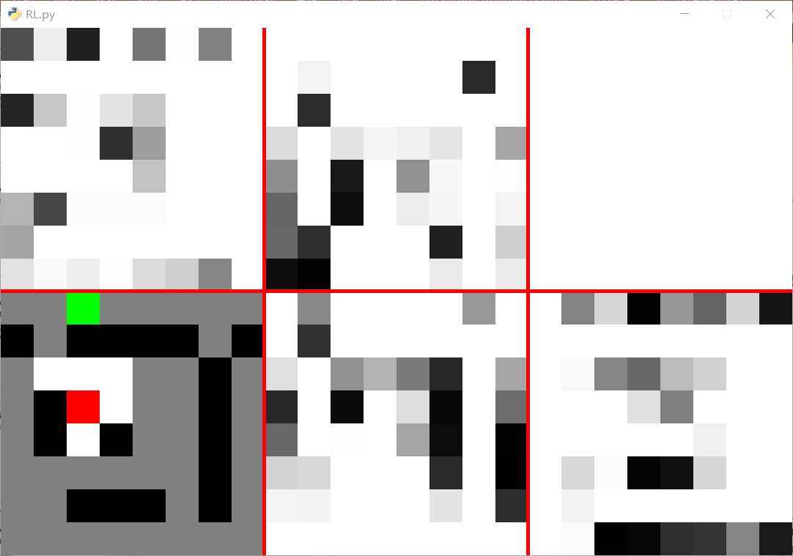
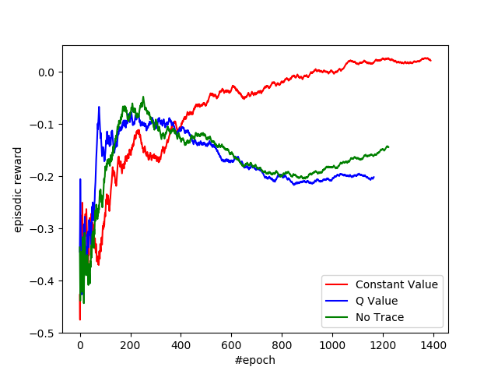
Result

Slide 20
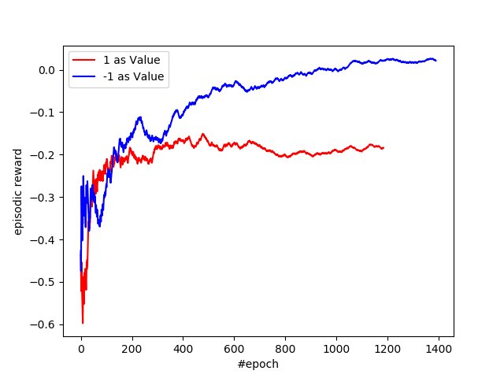
Const=1 vs Const=-1

Slide 21
Next Steps…
This training is not very stable, which means that it requires more time.
Analyzing what role these trace actually plays with quantitive data.
Better strategy for existing-value trace.
Let the agent learn what trace to leave.
Multiagent?

Slide 22
Questions?

