Slide 1
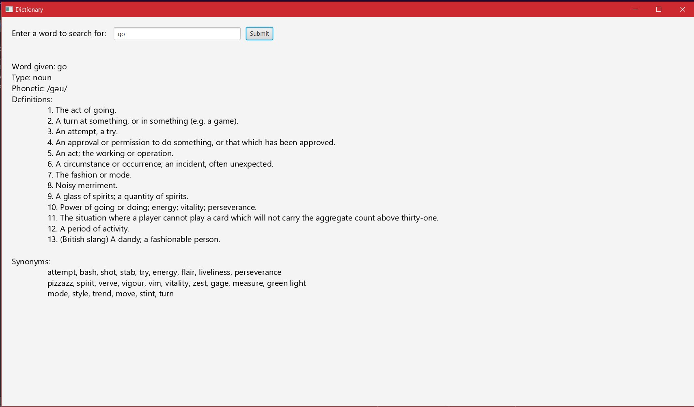
A Project On a Simple Dictionary App Using JAVA
A simple dictionary application made suing JavaFX

Slide 2
Submitted By: Team JHeads
Riktam Santra (11900221008)
Rishu Raj (11900221007)
Subham Ghosh (11900221005)
Ranjit Rai (11900221010)
Jubaraj Chowdhury(11900221009) Baidurjya Sikder (Lateral)
Ayan Das (Lateral)
Najmul Haque(11900121069) Swagata Dey(11900121087)
Badal Kumar Singh(11900121117) Ansh Raj (11900121114)
Saugad Bahadur (11900121119)
Manzoor Elahi (11900121129)

Slide 3
Table of Contents
1. Introduction ............................................................ 1
2. The Java Programming Language.................... 2 3. A Little About OpenJDK........................................ 3 4. JavaFx and org.JSON.............................................. 4 5. The IDE ........................................................................ 5
6. The Code..................................................................... 6- 10
7. Specifications............................................................ 10
8. Thank You.................................................................... 11

Slide 4
Introduction
Dictionary is a Java application made with the help of JavaFX to show word meaning of any English
word recognized by dictionaries
With dictionary, it is easy to get a word’s phoenetic, their definition and their synonyms with a single click!
Dictionary’s easy to use UI and simplicity reduces the excess clutter, making it easier to see the results

Slide 5

The Java Programming Language
Java is a high-level, class-based,
Object-Oriented Programming language that is designed to have as few implementation dependencies as possible.
It introduces modern programming language concepts that has inspired modern languages such as C#, Dart, and other OOPS dependent languages.

Slide 6


A Little About OpenJDK
OpenJDK 11 was used for this
project. It is a modern and open source implementation of the java platform provided by the Eclipse foundation itself.
OpenJDK provides the Java Development Kit to program and create Java GUIs and CLIs.

Slide 7


JavaFX and org.Json
JavaFX is a UI Library made for Java used to create modern Java GUIs. JavaFX 19 has been used for this project
Org.Json is another Java library used to parse JSON to a Java Objects and vice-versa. org.JSON version 20220320 was used
for this project

Slide 8
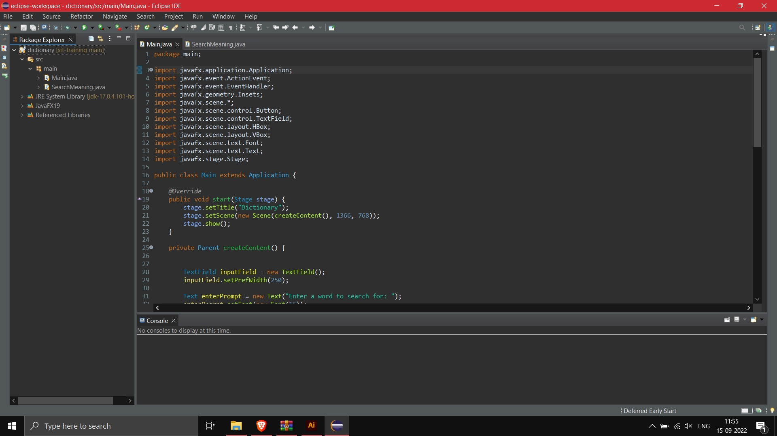
The Integrated Development Environment (IDE)
Eclipse IDE version 2022-06 (4.24.0) was used for this project,
it is an excellent IDE that provides most tools out of the box and includes support to deal with maven dependencies and projects well
Eclipse IDE also provides the eclipse marketplace which is a free plugins manager which provides 1000+ plugins provided by the eclipse community itself.

Slide 9
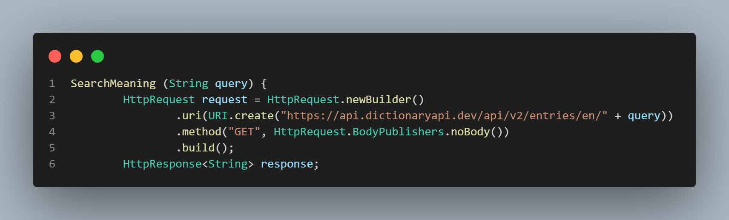
We start with creating a constructor for our Search meaning class whose instance is used to acces the data we get from the request to the API
The Code:
We then create an HttpRequest Object which is a class of out org.Json dependency to create a client to send and receives data over Http and maintain a connection to the
API server. We then store the JSON response in a HttpResponse Object pf type String.

Slide 10
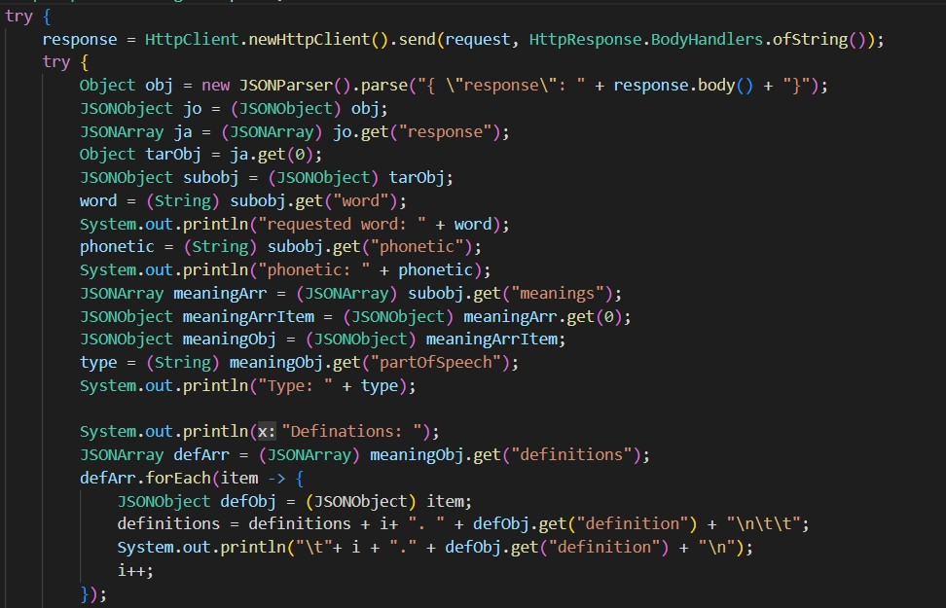
Getting the Response and Parsing the JSON
The request we created is finally sent and the JSON data recieved back is finally stored in the response variable we created in the last slide.
The JSON String received is then converted to a simple Object using the JSONParser class’s parse() method and then the simple Object is then casted to a JSONObject through which all JSON fields are read using it’s get() method.

Slide 11
Creating the UI
VBox
HBox
Text prompt
Input Field
Button
The layout of the UI is created using VBoxes and HBoxes UI classes of the JavaFX UI library which determine how the components are rendered
A VBox lays out all of it’s components vertically
A HBox lays out all of it’s components horizontally
Text 1
Text 1
Text 1
Text 1
Text 1
VBox

Slide 12
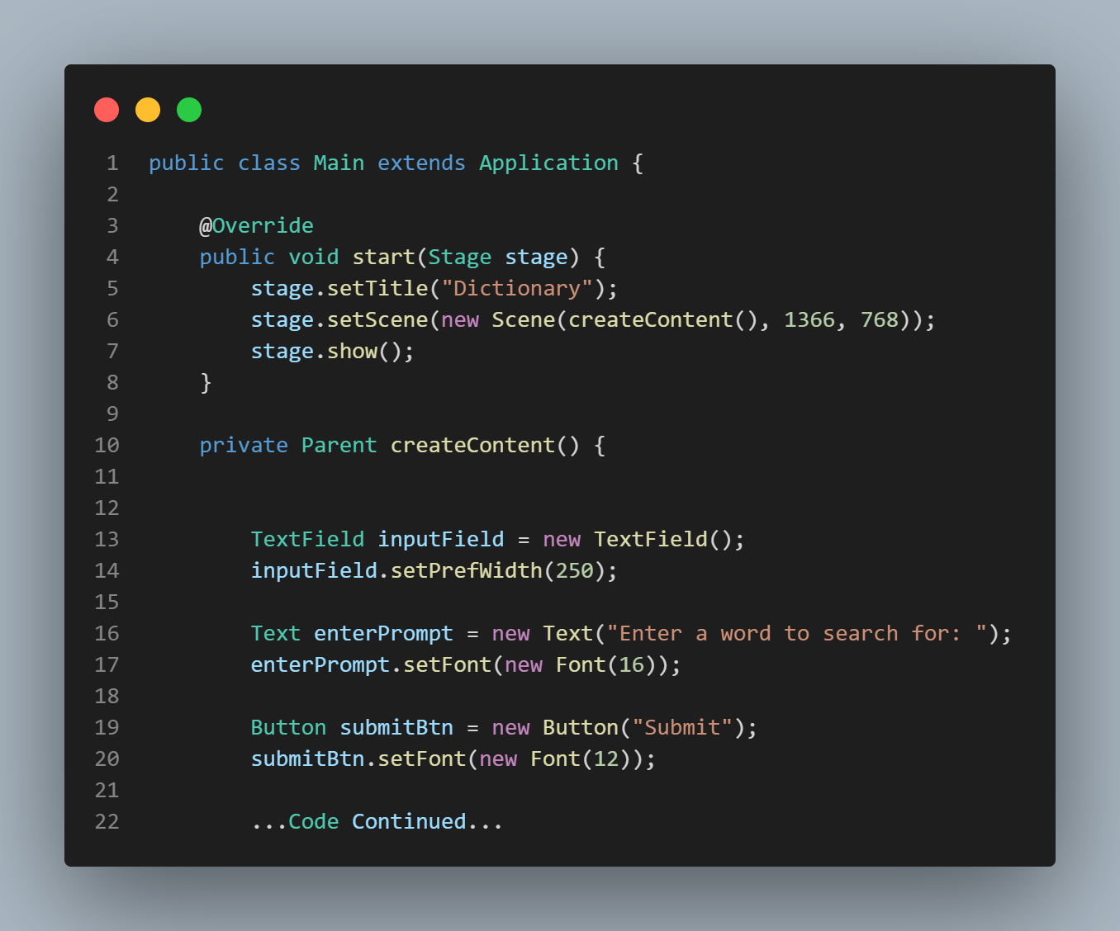
We define a start function which is automatically called when starting the GUI which provides what to show.
Implementing the GUI
We then define the createContent() function which adds all the required UI components to out GUI.
We Start out Main class by extending the Application class of JavaFX which makes it easier for us to implement all properties of the Application class.

Slide 13
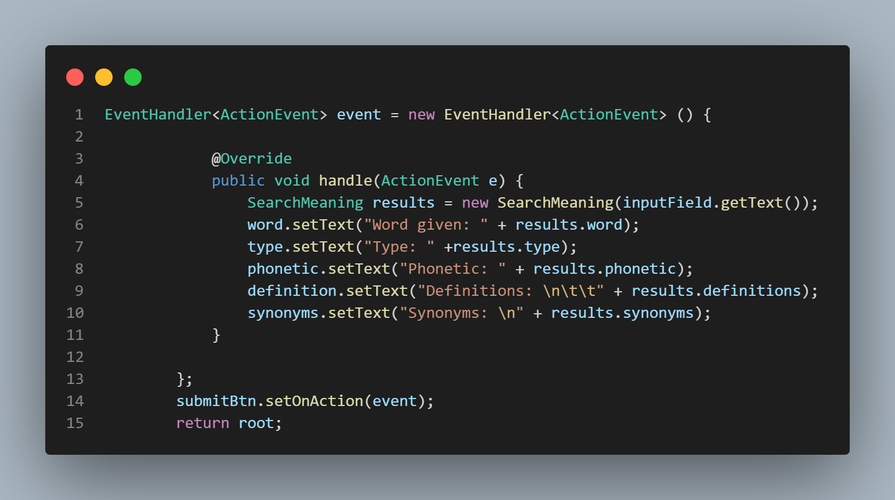
We then write the handle function which sets the text of the UI according to the results we receive from the SearchMeaning class by using an instance of it.
Handling the button Click
To handle what out button does, we create an EventHandler object on which we are to implement what the program is supposed to do on button clicks.
We then finally finally add the event to out button by using the setOnAction() function and then return the components we created by packing all of them
inside a single component

Slide 14
Specifications
PC Specifications:
Device Type: Laptop / Notebook
IDE Used: Eclipse IDE for Java Developers Version: 2022-06 (4.24.0)
Dependencies Used:
JavaFX Version: 19 org.Json
Version: 20220320
Processor: Intel(R) Core(TM)
i5-8265U CPU @ 1.60GHz
1.80 GHz
RAM: 8.00 GB
Graphics: Nvidia GeForce MX130 2GB Intel HD 4000 Graphics
System type: 64-bit operating system,
x64-based processor
JDK Used:
OpenJDK
Version: 17.0.12 2021-07-20
Operating System:
Windows 10
Home Single Language
Version: 20H2
OS build: 19042.1149

Slide 15
Thank You!

