Slide 1
Tests

Slide 2
Objectives
Understand what is endogeneity
Test for endogeneity in panel regression
Conduct regression model tests
Conduct other tests

Slide 3
Definition of Endogeneity
Endogeneity occurs when an independent variable is correlated with the error term in a statistical model.
This correlation violates the key assumption of ordinary least squares (OLS) regression, which assumes that explanatory variables are independent of the error term.

Slide 4
How Endogeneity Affects Regression Analysis
In a regression model, the dependent variable (Y) is predicted using independent variables (X₁, X₂, …, Xₙ).
If any predictor (X) is correlated with the error term (ε), the estimated coefficients will be biased and inconsistent.
This means the model fails to capture the true causal effect, leading to misleading statistical inferences.

Slide 5
Why Endogeneity is a Problem in Statistics
Causes Bias: The estimated coefficients do not reflect the true relationship between variables.
Affects Hypothesis Testing: Standard errors may be incorrect, leading to unreliable statistical significance results.
Undermines Causal Inference: Makes it difficult to determine whether changes in the independent variable truly cause changes in the dependent variable.
Leads to Incorrect Policy or Business Decisions: In fields like economics, finance, and social sciences, incorrect conclusions due to endogeneity can result in poor decision-making.

Slide 6
Key Takeaways
✅ Endogeneity occurs when an independent variable correlates with the error term.
✅ It leads to biased, inconsistent, and misleading regression results.
✅ Addressing endogeneity is crucial for making valid statistical inferences and reliable decisions.

Slide 7
Sources of Endogeneity
Omitted Variable Bias
Occurs when a relevant variable is left out of the model.
The omitted variable may be correlated with both:
Predictor variables (independent variables in the model).
Dependent variable (outcome being studied).
This leads to biased and inconsistent estimates of the predictor variable’s effect.
Example: Studying the effect of education on income while ignoring intelligence. Intelligence could influence both education level and income, leading to misleading results.

Slide 8
Sources of Endogeneity
Measurement Error
Happens when the values of predictor variables are inaccurately recorded.
Can result from:
Misreporting or recall bias (e.g., self-reported income data).
Imprecise measurement tools (e.g., rounding errors in survey responses).
Coding errors in data entry.
Leads to attenuation bias, where the estimated effect of a variable is weaker than it actually is.

Slide 9
Sample Selection Bias
Occurs when the sample is not randomly selected, making it unrepresentative of the population.
Causes bias if certain groups are systematically excluded or overrepresented in the dataset.
Example:
A study on employee wages using only data from employed individuals may ignore the impact of unemployment, biasing the results.
Clinical trials excluding patients with severe conditions may not generalize to real-world cases.

Slide 10
Sources of endogeniety
Simultaneity (Reverse Causality)
Happens when the predictor variable and dependent variable influence each other simultaneously.
Creates a circular causation problem, making it difficult to determine the true causal direction.
Example: Relationship between education and income:
Higher education may lead to higher income.
However, higher income might also enable individuals to pursue further education.

Slide 11
Addressing Endogeneity in Statistical Analysis
Instrumental Variables (IV) Approach
Concept: Uses external variables (instruments) to remove endogeneity bias.
Requirements for a good IV:
Relevance Condition – The instrument must be highly correlated with the endogenous predictor variable.
Exogeneity Condition – The instrument must not be correlated with the error term (should not directly affect the dependent variable).
Example:
Studying the effect of education on income, where distance to the nearest college can be used as an IV for education (assuming distance affects education but not income directly).
Methods:
Two-Stage Least Squares (2SLS) – First stage predicts the endogenous variable using the instrument, and the second stage estimates the effect on the dependent variable.

Slide 12
Heckman Correction for Sample Selection Bias
Used when sample selection bias is a concern.
Two-step method:
Estimate the probability of selection into the sample using a probit model.
Incorporate the selection probability into the outcome equation to adjust for bias.
Example:
Estimating wages using only employed workers may cause bias; the Heckman correction adjusts for this by modeling the probability of being employed.

Slide 13
Correction methods
Fixed Effects and Difference-in-Differences (DID)
Fixed Effects Model:
Controls for unobserved variables that do not change over time (e.g., personal traits).
Useful in panel data analysis where individuals are observed over multiple time periods.
Difference-in-Differences (DID):
Compares changes in outcomes before and after a policy or event between a treatment group and a control group.
Helps eliminate biases due to time trends affecting both groups equally.

Slide 14
Correction methods
Lagged Variables and Dynamic Panel Models
Lagging predictors (using past values) can reduce simultaneity bias.
Dynamic Panel Models (e.g., GMM Estimation) address endogeneity by using past values of variables as instruments.

Slide 15
Endogeneity Tests in Panel Data Analysis
Hausman Test
Purpose: Determines whether the Fixed Effects (FE) or Random Effects (RE) model should be used.
Interpretation: If the test rejects the null hypothesis, the RE model is inconsistent, and FE should be used.
Stata Command: stata CopyEdit hausman fe re
Hypothesis statements:
Null Hypothesis (H₀): The Random Effects (RE) model is appropriate (no correlation between regressors and error term).
Alternative Hypothesis (H₁): The Fixed Effects (FE) model is preferred (regressors are correlated with the error term, indicating endogeneity).

Slide 16
Serial correlation
Wooldridge Test for Autocorrelation
Purpose: Detects autocorrelation, which can indicate endogeneity in panel data.
Interpretation: Rejection suggests the presence of serial correlation.
Stata Command: xtserial y x1 x2
Hypothesis Statements:
Null Hypothesis (H₀): No first-order autocorrelation exists in the panel data.
Alternative Hypothesis (H₁): First-order autocorrelation is present, which may indicate endogeneity.

Slide 17
Test in GMM models
Arellano-Bond Test for AR(1) and AR(2)
Purpose: Checks for autocorrelation in dynamic panel data models.
Interpretation: AR(1) is expected, but AR(2) suggests endogeneity.
Hypothesis statements Arellano-Bond Test for AR(1) and AR(2)
Null Hypothesis (H₀) for AR(1): The first-differenced errors exhibit first-order autocorrelation (expected in dynamic models).
Null Hypothesis (H₀) for AR(2): There is no second-order autocorrelation in the differenced errors.
Alternative Hypothesis (H₁) for AR(2): Second-order autocorrelation exists, suggesting endogeneity.

Slide 18
Tests in GMM models
Sargan-Hansen Test
Null Hypothesis (H₀): The instruments are valid (uncorrelated with the error term).
Alternative Hypothesis (H₁): The instruments are not valid (correlated with the error term, suggesting endogeneity).

Slide 19
Test in GMM models
Difference-in-Hansen Test
Null Hypothesis (H₀): The subset of instruments is valid (uncorrelated with the error term).
Alternative Hypothesis (H₁): The subset of instruments is invalid (suggesting over-identification or weak instruments).

Slide 20
Other tests

Slide 21
Lagrange Multiplier (LM) Test for Random Effects
Purpose of the LM Test
Determines whether a random effects model is appropriate.
Tests if random effects are significant or if a pooled OLS model should be used instead.
Helps identify potential unobserved heterogeneity, which can cause endogeneity.
Hypothesis Statements
H₀ (Null Hypothesis): No random effects exist (a pooled OLS model is appropriate).
H₁ (Alternative Hypothesis): Random effects exist (a random effects model is preferred).
If H₀ is rejected, use a random effects model (suggests possible endogeneity from unobserved factors).
If H₀ is not rejected, use a pooled OLS model (random effects are not significant).

Slide 22
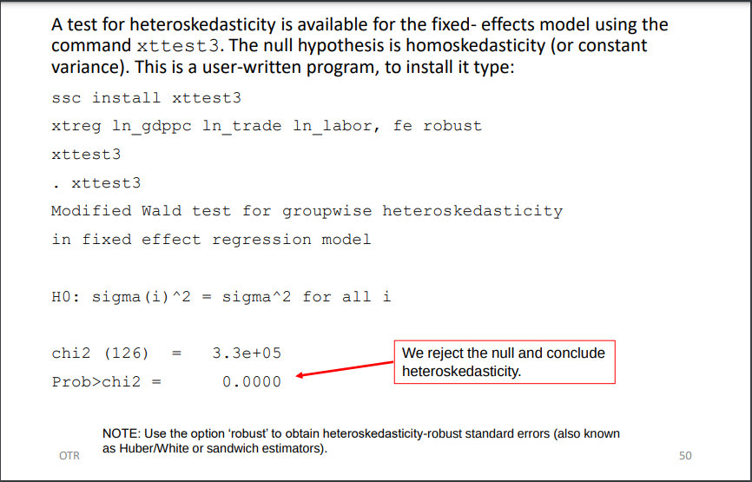
Test for heteroscedasticity

Slide 23
Cross-sectional dependence
The problem of cross-sectional dependence arises if the n individuals in our sample are no longer independently drawn observations but affect each other's outcomes

Slide 24
Baltagi-Pesaran Lagrange Multiplier (B-P/LM) Test for Cross-Sectional Dependence
Purpose of the B-P/LM Test
Determines whether cross-sectional dependence exists in panel data models.
Essential for macro panels with long time series (typically over 20–30 years, as suggested by Baltagi).
Helps assess whether residuals are correlated across entities, which can lead to biased estimates.

Slide 25
cont’d….
Hypothesis Statements
H₀ (Null Hypothesis): No cross-sectional dependence (residuals across entities are not correlated).
H₁ (Alternative Hypothesis): Cross-sectional dependence exists (residuals across entities are correlated).

Slide 26
cont’d
Why It Matters?
Cross-sectional dependence can arise due to common shocks, spillover effects, or omitted variables.
If detected, adjustments such as Driscoll-Kraay standard errors or spatial econometric models may be needed.

Slide 27
cont’d
Stata Commands
Install the necessary command (only once): ssc install xttest2
Run a fixed effects regression: xtreg ln_gdppc ln_trade ln_labor, fe robust
Conduct the B-P/LM test: xttest2

Slide 28
cont’d
Interpretation
If H₀ is rejected → Cross-sectional dependence exists → Consider correcting for dependence in the model.
If H₀ is not rejected → No evidence of cross-sectional dependence → Standard panel methods may be used.

