Slide 1
Support Vector Machines
Chapter 18.9

Slide 2
Support Vector Machines
Andrew W. Moore
Professor
School of Computer Science
Carnegie Mellon University
www.cs.cmu.edu/~awm
awm@cs.cmu.edu
412-268-7599
Note to other teachers and users of these slides. Andrew would be delighted if you found this source material useful in giving your own lectures. Feel free to use these slides verbatim, or to modify them to fit your own needs. PowerPoint originals are available. If you make use of a significant portion of these slides in your own lecture, please include this message, or the following link to the source repository of Andrew’s tutorials: http://www.cs.cmu.edu/~awm/tutorials . Comments and corrections gratefully received.
Copyright © 2001, 2003, Andrew W. Moore
Nov 23rd, 2001

Slide 3
Overviews
Proposed by Vapnik and his colleagues
  Started in 1963, taking shape in late 70’s as part of his statistical learning theory (with Chervonenkis)
  Current form established in early 90’s (with Cortes)
Becomes popular in last decade
  Classification, regression (function approx.), optimization
  Compared favorably to MLP
Basic ideas
  Overcoming linear seperability problem by transforming the problem into higher dimensional space using kernel functions
    (become equiv. to 2-layer perceptron when kernel is sigmoid function)
  Maximize margin of decision boundary
Copyright © 2001, 2003, Andrew W. Moore

Slide 4
Linear Classifiers
α
x
f
y^{est}
f(x,w,b) = sign(w. x + b)
denotes +1
denotes -1
How would you classify this data?
Copyright © 2001, 2003, Andrew W. Moore

Slide 5
Linear Classifiers
α
x
f
y^{est}
f(x,w,b) = sign(w. x + b)
denotes +1
denotes -1
How would you classify this data?
Copyright © 2001, 2003, Andrew W. Moore

Slide 6
Linear Classifiers
α
x
f
y^{est}
f(x,w,b) = sign(w. x + b)
denotes +1
denotes -1
How would you classify this data?
Copyright © 2001, 2003, Andrew W. Moore

Slide 7
Linear Classifiers
α
x
f
y^{est}
f(x,w,b) = sign(w. x + b)
denotes +1
denotes -1
How would you classify this data?
Copyright © 2001, 2003, Andrew W. Moore

Slide 8
Linear Classifiers
α
x
f
y^{est}
f(x,w,b) = sign(w. x + b)
denotes +1
denotes -1
Any of these would be fine..
..but which is best?
Copyright © 2001, 2003, Andrew W. Moore

Slide 9
Classifier Margin
α
x
f
y^{est}
f(x,w,b) = sign(w. x + b)
denotes +1
denotes -1
Define the margin of a linear classifier as the width that the boundary could be increased by before hitting a datapoint.
Copyright © 2001, 2003, Andrew W. Moore

Slide 10
Maximum Margin
α
x
f
y^{est}
f(x,w,b) = sign(w. x + b)
denotes +1
denotes -1
The maximum margin linear classifier is the linear classifier with the, um, maximum margin.
This is the simplest kind of SVM (Called an LSVM)
Linear SVM
Copyright © 2001, 2003, Andrew W. Moore

Slide 11
Maximum Margin
α
x
f
y^{est}
f(x,w,b) = sign(w. x + b)
denotes +1
denotes -1
The maximum margin linear classifier is the linear classifier with the, um, maximum margin.
This is the simplest kind of SVM (Called an LSVM)
Support Vectors are those datapoints that the margin pushes up against
Linear SVM
Copyright © 2001, 2003, Andrew W. Moore

Slide 12
Why Maximum Margin?
Intuitively this feels safest.
If we’ve made a small error in the location of the boundary (it’s been jolted in its perpendicular direction) this gives us least chance of causing a misclassification.
CV is easy since the model is immune to removal of any non-support-vector datapoints.
There’s some theory that this is a good thing.
Empirically it works very very well.
f(x,w,b) = sign(w. x - b)
denotes +1
denotes -1
The maximum margin linear classifier is the linear classifier with the, um, maximum margin.
This is the simplest kind of SVM (Called an LSVM)
Support Vectors are those datapoints that the margin pushes up against
Copyright © 2001, 2003, Andrew W. Moore

Slide 13
Specifying a line and margin
Plus-Plane
“Predict Class = +1” zone
Classifier Boundary
Minus-Plane
“Predict Class = -1” zone
How do we represent this mathematically?
…in m input dimensions?
Copyright © 2001, 2003, Andrew W. Moore

Slide 14
Specifying a line and margin
Plus-Plane
“Predict Class = +1” zone
Classifier Boundary
Minus-Plane
“Predict Class = -1” zone
wx+b=1
wx+b=0
wx+b=-1
Conditions for optimal separating hyperplane for data points
(x₁, y₁),…,(x_{l}, y_{l}) where y_{i} =±1
w . x_{i} + b ≥ 1 if y_{i} = 1 (points in plus class)
w . x_{i} + b ≤ -1 if y_{i} = -1 (points in minus class)
Copyright © 2001, 2003, Andrew W. Moore

Slide 15
Computing the margin width
M = Margin Width
“Predict Class = +1” zone
How do we compute M in terms of w and b?
“Predict Class = -1” zone
wx+b=1
wx+b=0
wx+b=-1
Plus-plane = { x : w . x + b = +1 }
Minus-plane = { x : w . x + b = -1 }
Claim: The vector w is perpendicular to the Plus Plane. Why?
Copyright © 2001, 2003, Andrew W. Moore

Slide 16
Computing the margin width
M = Margin Width
“Predict Class = +1” zone
How do we compute M in terms of w and b?
“Predict Class = -1” zone
wx+b=1
wx+b=0
wx+b=-1
Plus-plane = { x : w . x + b = +1 }
Minus-plane = { x : w . x + b = -1 }
Claim: The vector w is perpendicular to the Plus Plane. Why?
Let u and v be two vectors on the Plus Plane. What is w . ( u – v ) ?
And so of course the vector w is also perpendicular to the Minus Plane
Copyright © 2001, 2003, Andrew W. Moore

Slide 17
Computing the margin width
x⁺
M = Margin Width
“Predict Class = +1” zone
How do we compute M in terms of w and b?
x⁻
“Predict Class = -1” zone
wx+b=1
wx+b=0
wx+b=-1
Plus-plane = { x : w . x + b = +1 }
Minus-plane = { x : w . x + b = -1 }
The vector w is perpendicular to the Plus Plane
Let x⁻ be any point on the minus plane
Let x⁺ be the closest plus-plane-point to x⁻.
Any location in ^{m}: not necessarily a datapoint
Any location in R^{m}: not necessarily a datapoint
Copyright © 2001, 2003, Andrew W. Moore

Slide 18
Computing the margin width
x⁺
M = Margin Width
“Predict Class = +1” zone
How do we compute M in terms of w and b?
x⁻
“Predict Class = -1” zone
wx+b=1
wx+b=0
wx+b=-1
Plus-plane = { x : w . x + b = +1 }
Minus-plane = { x : w . x + b = -1 }
The vector w is perpendicular to the Plus Plane
Let x⁻ be any point on the minus plane
Let x⁺ be the closest plus-plane-point to x⁻.
Claim: x⁺ = x⁻ + λ w for some value of λ. Why?
Copyright © 2001, 2003, Andrew W. Moore

Slide 19
Computing the margin width
x⁺
M = Margin Width
“Predict Class = +1” zone
The line from x⁻ to x⁺ is perpendicular to the planes.
So to get from x⁻ to x⁺ travel some distance in direction w.
How do we compute M in terms of w and b?
x⁻
“Predict Class = -1” zone
wx+b=1
wx+b=0
wx+b=-1
Plus-plane = { x : w . x + b = +1 }
Minus-plane = { x : w . x + b = -1 }
The vector w is perpendicular to the Plus Plane
Let x⁻ be any point on the minus plane
Let x⁺ be the closest plus-plane-point to x⁻.
Claim: x⁺ = x⁻ + λ w for some value of λ. Why?
Copyright © 2001, 2003, Andrew W. Moore

Slide 20
Computing the margin width
x⁺
M = Margin Width
“Predict Class = +1” zone
x⁻
“Predict Class = -1” zone
wx+b=1
wx+b=0
wx+b=-1
What we know:
w . x⁺ + b = +1
w . x⁻ + b = -1
x⁺ = x⁻ + λ w
|x⁺ - x⁻ | = M
It’s now easy to get M in terms of w and b
Copyright © 2001, 2003, Andrew W. Moore

Slide 21
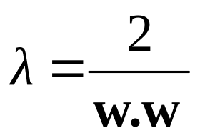
Computing the margin width
x⁺
M = Margin Width
“Predict Class = +1” zone
x⁻
“Predict Class = -1” zone
wx+b=1
wx+b=0
w . (x ⁻ + λ w) + b = 1
=>
w . x ⁻ + b + λ w .w = 1
=>
-1 + λ w .w = 1
=>
wx+b=-1
What we know:
w . x⁺ + b = +1
w . x⁻ + b = -1
x⁺ = x⁻ + λ w
|x⁺ - x⁻ | = M
It’s now easy to get M in terms of w and b
Copyright © 2001, 2003, Andrew W. Moore

Slide 22
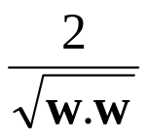
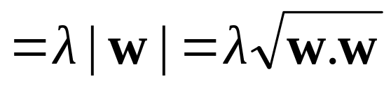
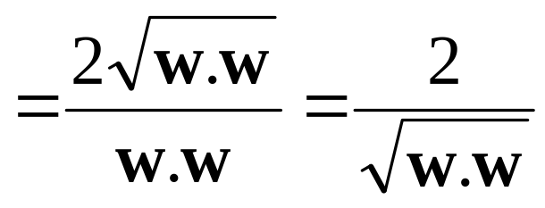
Computing the margin width
x⁺
M = Margin Width =
“Predict Class = +1” zone
x⁻
“Predict Class = -1” zone
wx+b=1
wx+b=0
M = |x⁺ - x⁻ | =| λ w |=
wx+b=-1
What we know:
w . x⁺ + b = +1
w . x⁻ + b = -1
x⁺ = x⁻ + λ w
|x⁺ - x⁻ | = M
Copyright © 2001, 2003, Andrew W. Moore

Slide 23
Learning the Maximum Margin Classifier
x⁺
M = Margin Width =
“Predict Class = +1” zone
x⁻
“Predict Class = -1” zone
wx+b=1
wx+b=0
wx+b=-1
Given a guess of w and b we can
Compute whether all data points in the correct half-planes
Compute the width of the margin
So now we just need to write a program to search the space of w’s and b’s to find the widest margin that matches all the datapoints. How?
Gradient descent? Simulated Annealing? Matrix Inversion? EM? Newton’s Method?
Copyright © 2001, 2003, Andrew W. Moore

Slide 24
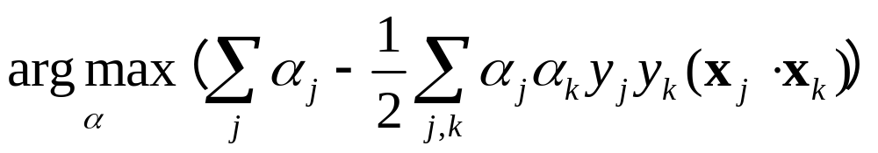
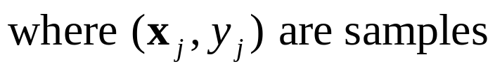

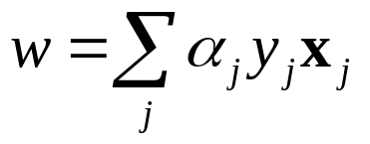
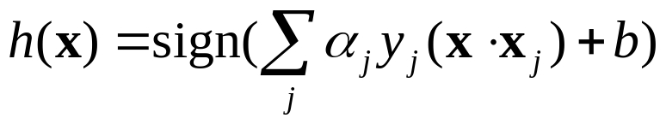
Learning via Quadratic Programming
Optimal separating hyperplane can be found by solving
  This is a quadratic function
  Once are found,
  the weight matrix
  the decision function is
This optimization problem can be solved by quadratic programming
QP is a well-studied class of optimization algorithms to maximize a quadratic function subject to linear constraints
Copyright © 2001, 2003, Andrew W. Moore

Slide 25
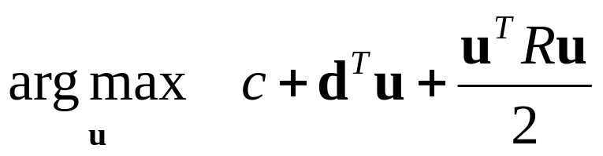
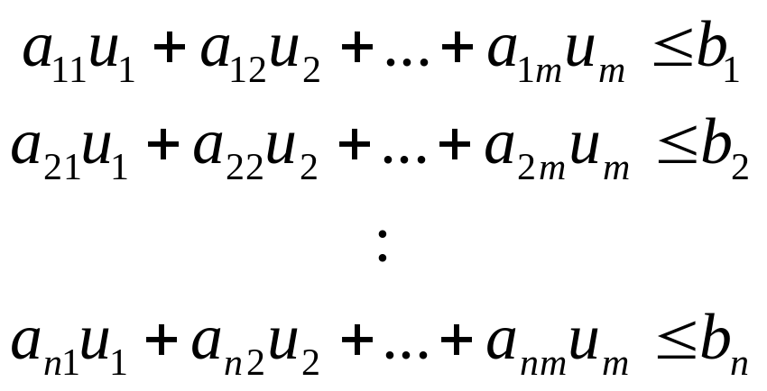
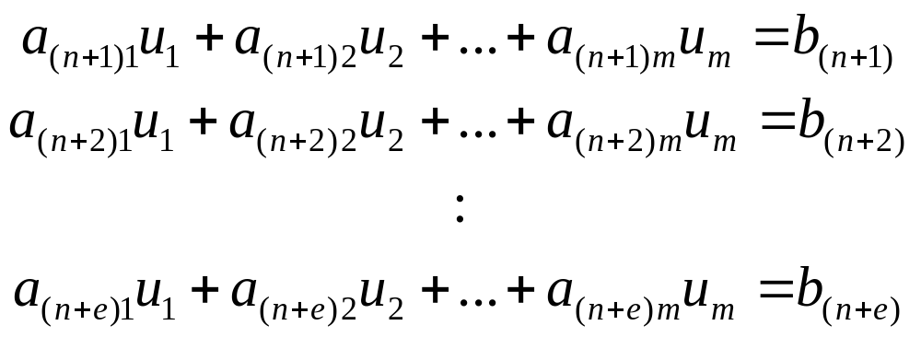
Quadratic Programming
Find
Quadratic criterion
Subject to
n additional linear inequality constraints
And subject to
e additional linear equality constraints
Copyright © 2001, 2003, Andrew W. Moore

Slide 26
Quadratic Programming
Find
Quadratic criterion
There exist algorithms for finding such constrained quadratic optima much more efficiently and reliably than gradient ascent.
(But they are very fiddly…you probably don’t want to write one yourself)
Subject to
n additional linear inequality constraints
And subject to
e additional linear equality constraints
Copyright © 2001, 2003, Andrew W. Moore

Slide 27
Learning the Maximum Margin Classifier
M =
Given guess of w , b we can
Compute whether all data points are in the correct half-planes
Compute the margin width
Assume R datapoints, each (x_{k},y_{k}) where y_{k} = +/- 1
“Predict Class = +1” zone
“Predict Class = -1” zone
wx+b=1
wx+b=0
wx+b=-1
What should our quadratic optimization criterion be?
How many constraints will we have?
What should they be?
Copyright © 2001, 2003, Andrew W. Moore

Slide 28
Suppose we’re in 1-dimension
What would SVMs do with this data?
x=0
Copyright © 2001, 2003, Andrew W. Moore

Slide 29
Suppose we’re in 1-dimension
Not a big surprise
x=0
Positive “plane”
Negative “plane”
Copyright © 2001, 2003, Andrew W. Moore

Slide 30
Harder 1-dimensional dataset
That’s wiped the smirk off SVM’s face.
What can be done about this?
x=0
Copyright © 2001, 2003, Andrew W. Moore

Slide 31
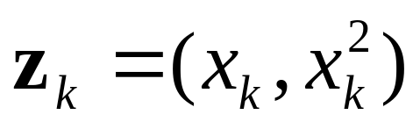
Harder 1-dimensional dataset
Remember how permitting non-linear basis functions made linear regression so much nicer?
Let’s permit them here too
x=0
Copyright © 2001, 2003, Andrew W. Moore

Slide 32
Harder 1-dimensional dataset
Remember how permitting non-linear basis functions made linear regression so much nicer?
Let’s permit them here too
x=0
Copyright © 2001, 2003, Andrew W. Moore

Slide 33
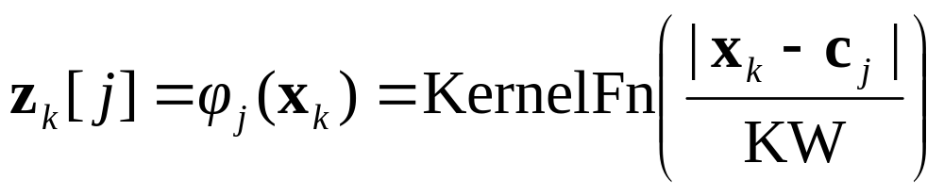
Common SVM basis functions
z_{k} = ( polynomial terms of x_{k} of degree 1 to q )
z_{k} = ( radial basis functions of x_{k} )
z_{k} = ( sigmoid functions of x_{k} )
Copyright © 2001, 2003, Andrew W. Moore

Slide 34
Explosion of feature space dimensionality
Consider a degree 2 polynomial kernel function
z = φ(x) for data point x = (x₁, x₂, …, x_{n})
z₁= x₁, …, z_{n} = x_{n}
z_{n+1}= (x₁)², …, z_{2n} = (x_{n})²
z_{2n+1}= x₁ x₁, …, z_{N} = x_{n-1} x_{n}
where N = n(n+3)/2
When constructing polynomials of degree 5 for a 256- dimensional input space the feature space is billion-dimensional
Copyright © 2001, 2003, Andrew W. Moore

Slide 35
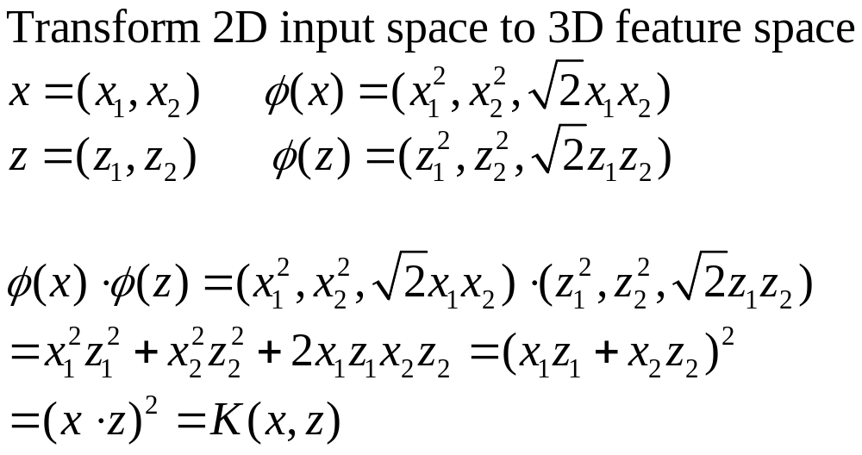
Kernel trick
Example: polynomial kernel
Copyright © 2001, 2003, Andrew W. Moore

Slide 36
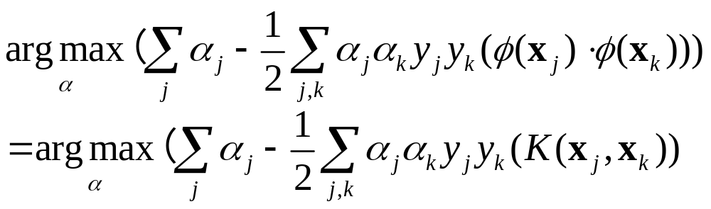
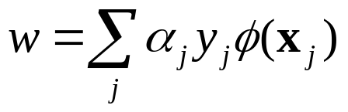
Kernel trick + QP
Max margin classifier can be found by solving
the weight matrix (no need to compute and store)
the decision function is
Copyright © 2001, 2003, Andrew W. Moore

Slide 37

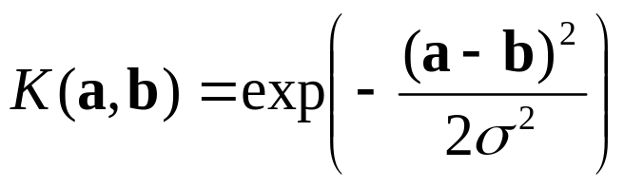

SVM Kernel Functions
Use kernel functions which compute
K(a, b)=(a ⋅ b +1)^{d} is an example of an SVM polynomial Kernel Function
Beyond polynomials there are other very high dimensional basis functions that can be made practical by finding the right Kernel Function
Radial-Basis-style Kernel Function:
Neural-net-style Kernel Function:
σ, κ and δ are magic parameters that must be chosen by a model selection method such as CV or VCSRM*
*see last lecture
Copyright © 2001, 2003, Andrew W. Moore

Slide 38
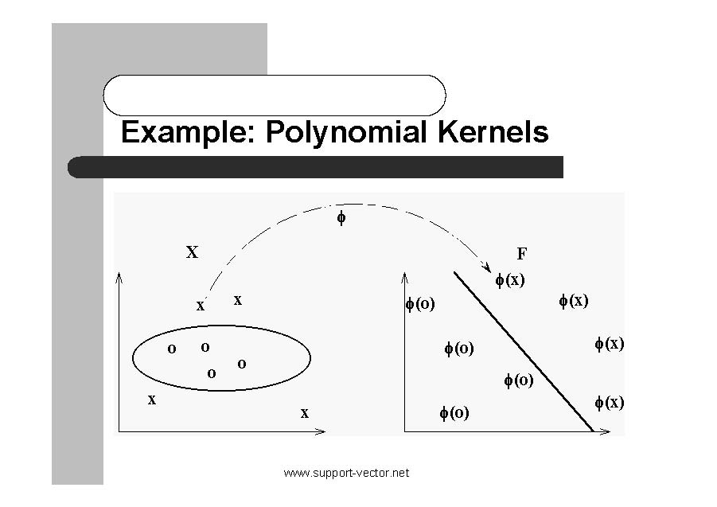
Copyright © 2001, 2003, Andrew W. Moore

Slide 39
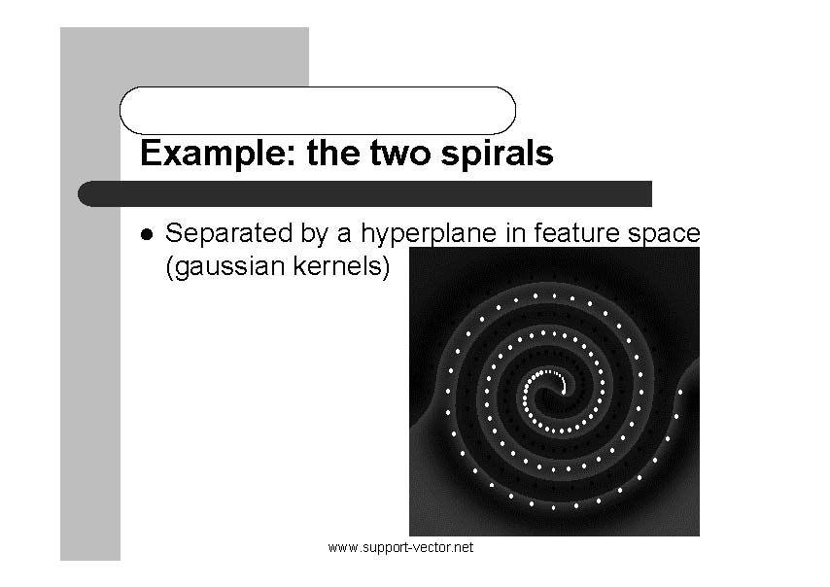
Copyright © 2001, 2003, Andrew W. Moore

Slide 40
SVM Performance
Anecdotally they work very very well indeed.
  Overcomes linear separability problem
    Transforming input space to a higher dimension feature space
    Overcome dimensionality explosion by kernel trick
  Generalizes well (overfitting not as serious)
    Maximum margin separator
    Find MMS by quadratic programming
Example:
  currently the best-known classifier on a well-studied hand-written-character recognition benchmark
  several reliable people doing practical real-world work claim that SVMs have saved them when their other favorite classifiers did poorly.
Copyright © 2001, 2003, Andrew W. Moore

Slide 41
Hand-written character recognition
MNIST: a data set of hand-written digits
  60,000 training samples
  10,000 test samples
  Each sample consists of 28 x 28 = 784 pixels
Various techniques have been tried
  Linear classifier: 12.0%
  2-layer BP net (300 hidden nodes) 4.7%
  3-layer BP net (300+200 hidden nodes) 3.05%
  Support vector machine (SVM) 1.4%
  Convolutional net 0.4%
  6 layer BP net (7500 hidden nodes): 0.35%
Failure rate for
test samples

Slide 42
SVM Performance
There is a lot of excitement and religious fervor about SVMs as of 2001.
Despite this, some practitioners are a little skeptical.
Copyright © 2001, 2003, Andrew W. Moore

Slide 43
Doing multi-class classification
SVMs can only handle two-class outputs (i.e. a categorical output variable with arity 2).
Extend to output arity N, learn N SVM’s
  SVM 1 learns “Output==1” vs “Output != 1”
  SVM 2 learns “Output==2” vs “Output != 2”
  :
  SVM N learns “Output==N” vs “Output != N”
SVM can also be extended to compute any real value functions.
Copyright © 2001, 2003, Andrew W. Moore

Slide 44
References
An excellent tutorial on VC-dimension and Support Vector Machines:
    C.J.C. Burges. A tutorial on support vector machines for pattern recognition. Data Mining and Knowledge Discovery, 2(2):955-974, 1998. http://citeseer.nj.nec.com/burges98tutorial.html
The VC/SRM/SVM Bible:
    Statistical Learning Theory by Vladimir Vapnik, Wiley-Interscience; 1998
Download SVM-light:
http://svmlight.joachims.org/
Copyright © 2001, 2003, Andrew W. Moore

