Slide 1
Data Mining via Support Vector Machines
Olvi L. Mangasarian
University of Wisconsin - Madison
IFIP TC7 Conference on
System Modeling and Optimization
Trier July 23-27, 2001

Slide 2
What is a Support Vector Machine?
An optimally defined surface
Typically nonlinear in the input space
Linear in a higher dimensional space
Implicitly defined by a kernel function

Slide 3
What are Support Vector Machines Used For?
Classification
Regression & Data Fitting
Supervised & Unsupervised Learning
(Will concentrate on classification)

Slide 4
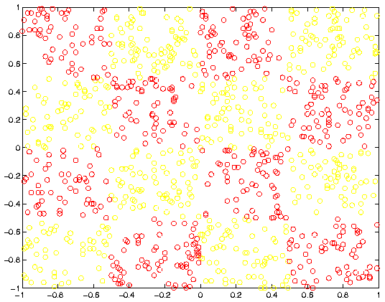
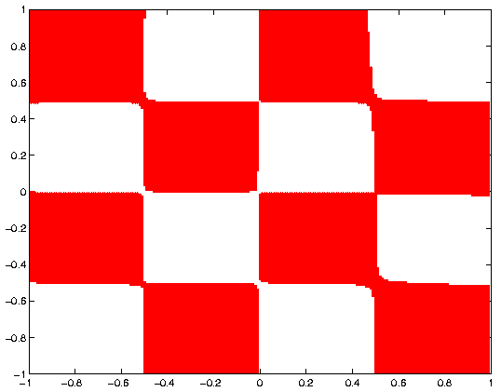
Example of Nonlinear Classifier:
Checkerboard Classifier

Slide 5
Outline of Talk
Generalized support vector machines (SVMs)
  Completely general kernel allows complex classification (No positive definiteness “Mercer” condition!)
Smooth support vector machines
  Smooth & solve SVM by a fast global Newton method
Reduced support vector machines
  Handle large datasets with nonlinear rectangular kernels
  Nonlinear classifier depends on 1% to 10% of data points
Proximal support vector machines
  Proximal planes replace halfspaces
  Solve linear equations instead of QP or LP
  Extremely fast & simple

Slide 6

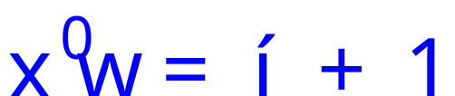
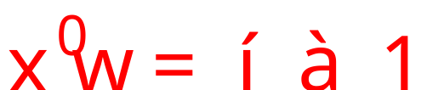
Generalized Support Vector Machines
2-Category Linearly Separable Case
A+
A-

Slide 7


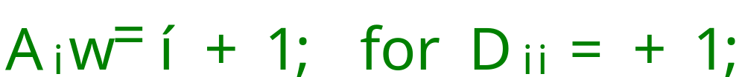

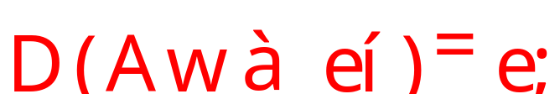
Generalized Support Vector Machines
Algebra of 2-Category Linearly Separable Case
Given m points in n dimensional space
Represented by an m-by-n matrix A
Membership of each in class +1 or –1 specified by:
An m-by-m diagonal matrix D with +1 & -1 entries
      Separate by two bounding planes,
More succinctly:
where e is a vector of ones.

Slide 8


Generalized Support Vector Machines
Maximizing the Margin between Bounding Planes
A+
A-

Slide 9
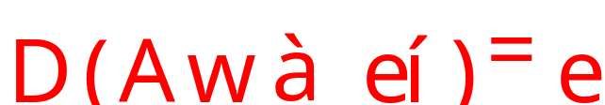

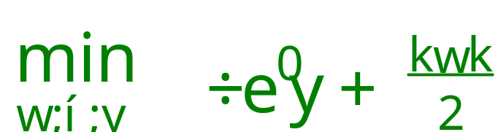

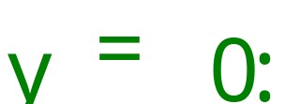




Generalized Support Vector Machines
The Linear Support Vector Machine Formulation
Solve the following mathematical program for some :
The nonnegative slack variable is zero iff:
  Convex hulls of and do not intersect
  is sufficiently large

Slide 10
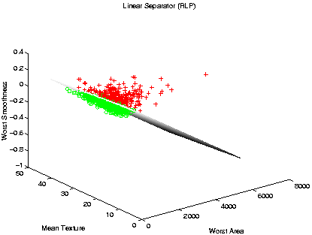
Breast Cancer Diagnosis Application
97% Tenfold Cross Validation Correctness
780 Samples:494 Benign, 286 Malignant

Slide 11
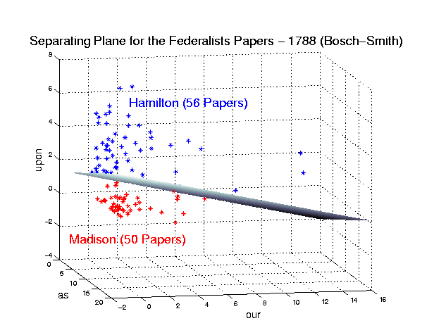
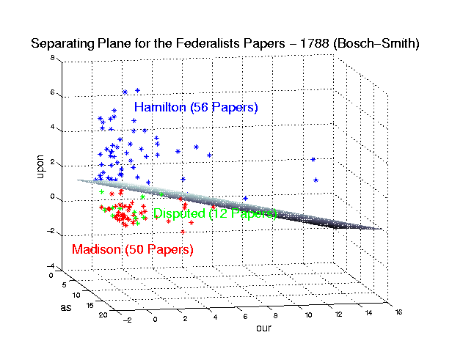
Another Application: Disputed Federalist Papers
Bosch & Smith 1998
56 Hamilton, 50 Madison, 12 Disputed

Slide 12

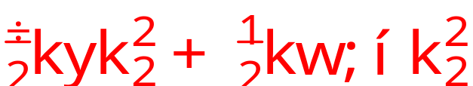




SVM as an
Unconstrained Minimization Problem
Changing to 2-norm and measuring margin in (
) space:
min
(QP)
s. t.
At the solution of (QP) :
,
where
Hence (QP) is equivalent to the nonsmooth SVM:
min

Slide 13
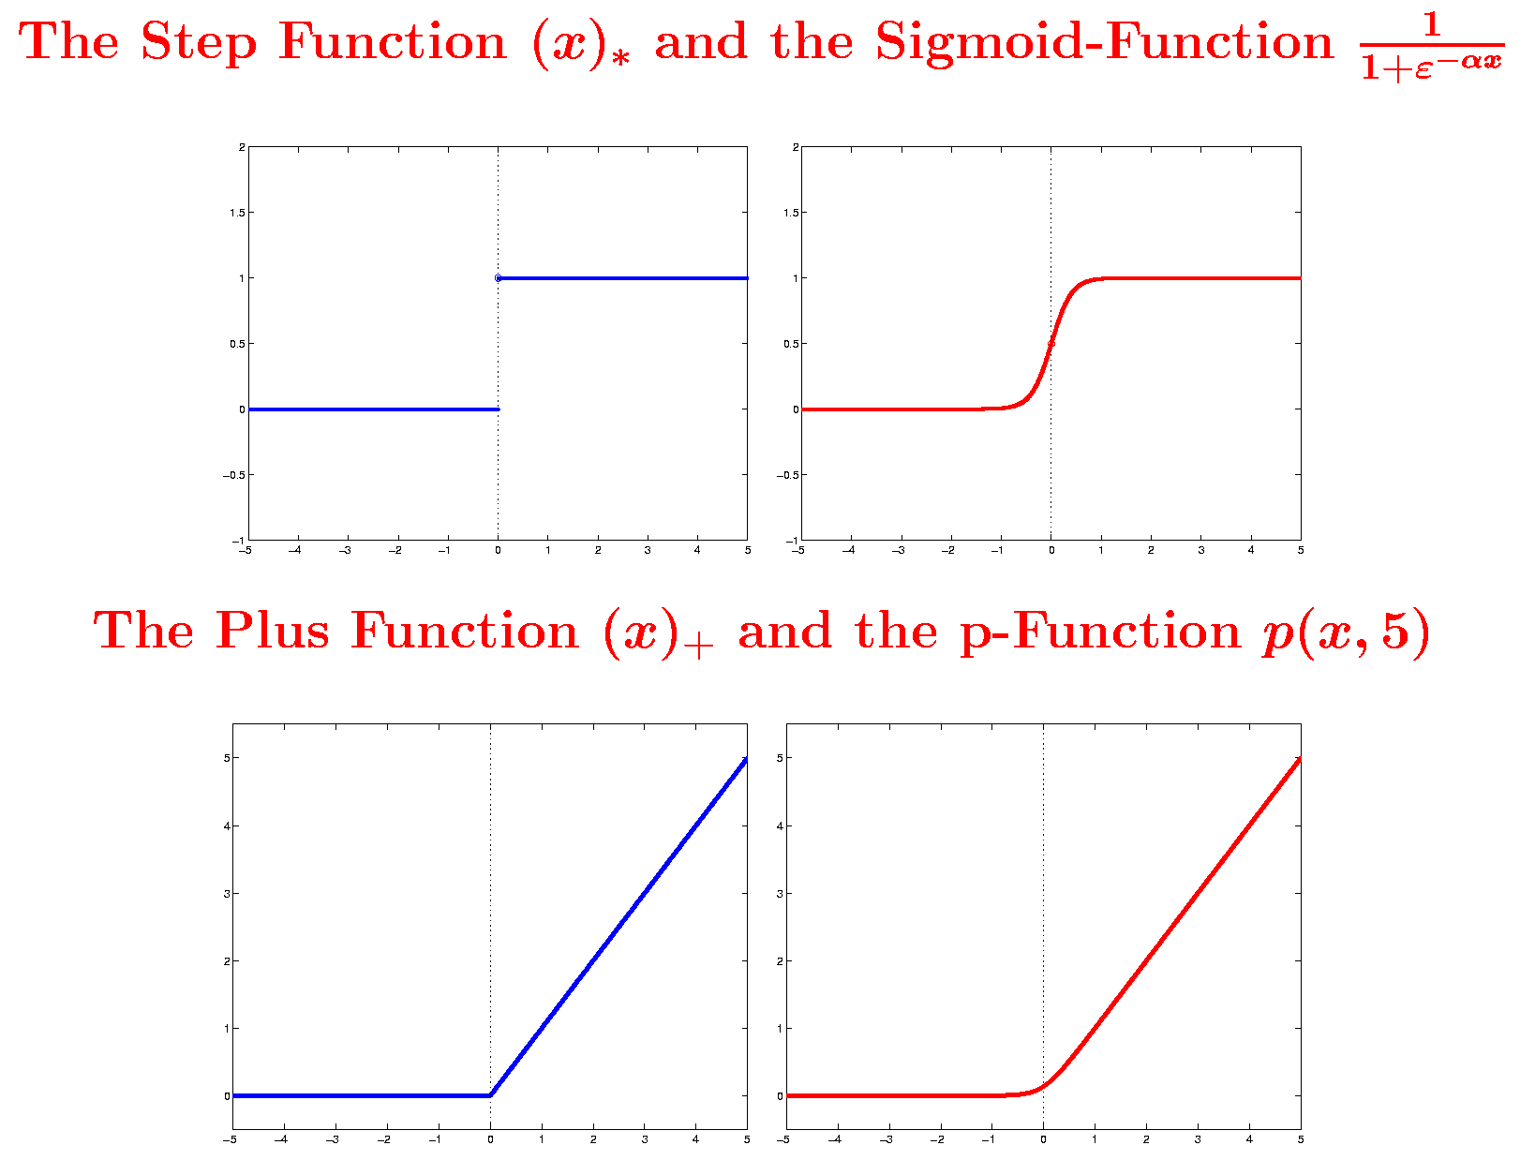
Smoothing the Plus Function:
Integrate the Sigmoid Function

Slide 14
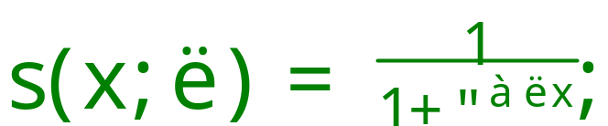

SSVM: The Smooth Support Vector Machine
Smoothing the Plus Function
Integrating the sigmoid approximation to the step function:
gives a smooth, excellent approximation to the plus function:
Replacing the plus function in the nonsmooth SVM
by the smooth approximation gives our SSVM:

Slide 15
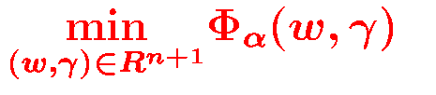
Newton: Minimize a sequence of quadratic approximations
to the strongly convex objective function, i.e. solve a sequence
of linear equations in n+1 variables. (Small dimensional input
space.)
Armijo: Shorten distance between successive iterates so as to generate sufficient decrease in objective function. (In computational reality, not needed!)
Global Quadratic Convergence: Starting from any point,
the iterates guaranteed to converge to the unique solution
at a quadratic rate, i.e. errors get squared. (Typically, 6 to 8
iterations without an Armijo.)

Slide 16







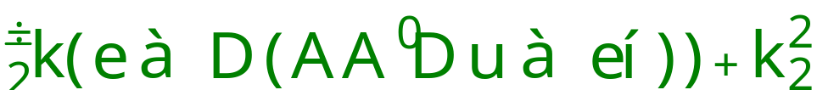
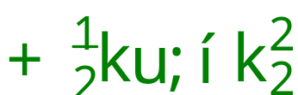



Nonlinear SSVM Formulation
(Prior to Smoothing)
Linear SSVM: (Linear separating surface:
)
min
(QP)
s. t.
By QP “duality”,
. Maximizing the margin
in the “dual space” , gives:
min
Replace
by a nonlinear kernel
:
min

Slide 17

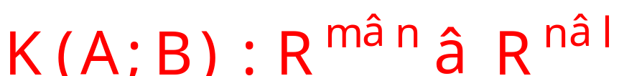

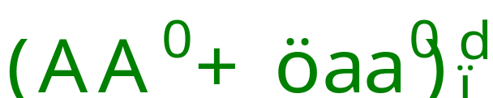
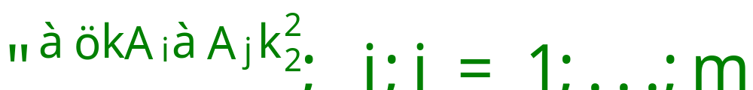
The Nonlinear Classifier
The nonlinear classifier :
Where K is a nonlinear kernel, e.g.:
Polynomial Kernel
:
Gaussian (Radial Basis) Kernel
:

Slide 18
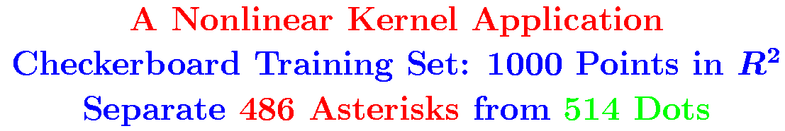
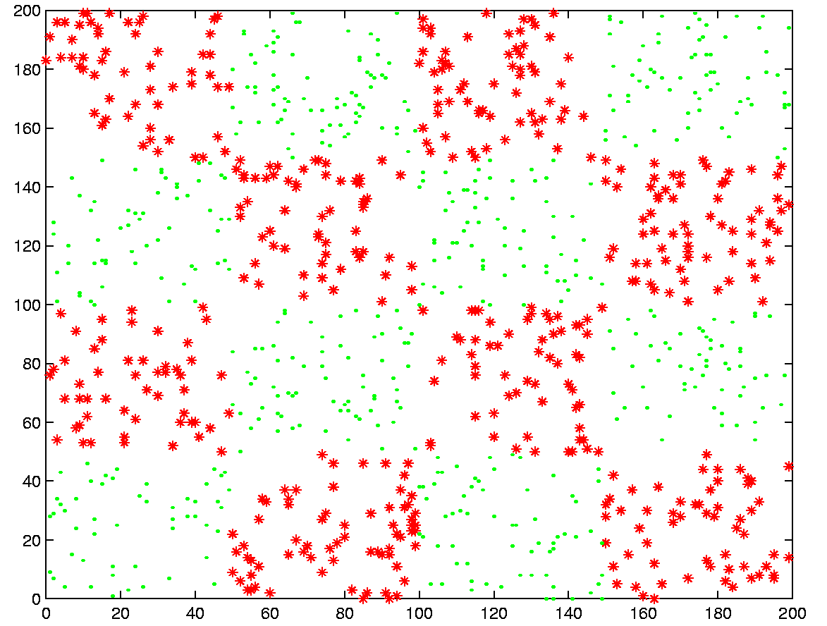

Slide 19
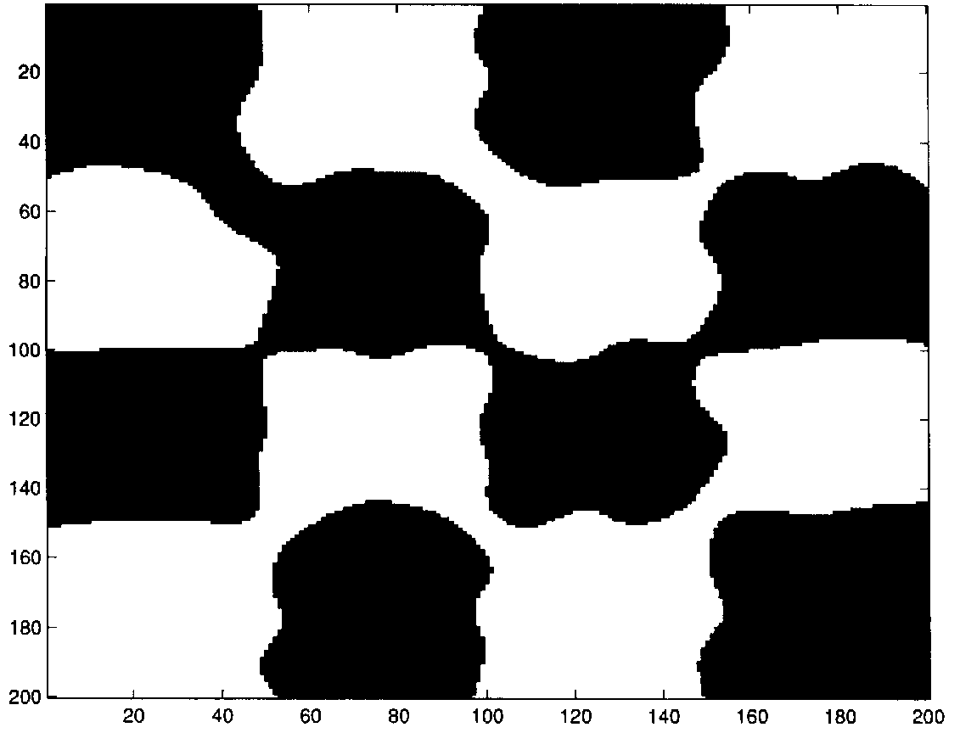
Checkerboard Polynomial Kernel Classifier
Best Previous Result: [Kaufman 1998]

Slide 21







Difficulties with Nonlinear SVM for Large Problems
Need to solve a huge unconstrained or constrained
optimization problem with
entries
The nonlinear kernel
is fully dense
Long CPU time to compute
numbers
Large memory to store an
kernel matrix
Runs out of memory even before solving the
optimization problem
Computational complexity depends on
Complexity of nonlinear SSVM
Nonlinear separator depends on almost entire dataset
Have to store the entire dataset after solve the problem

Slide 22
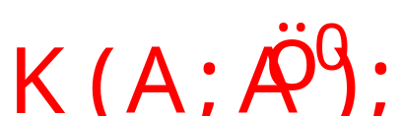




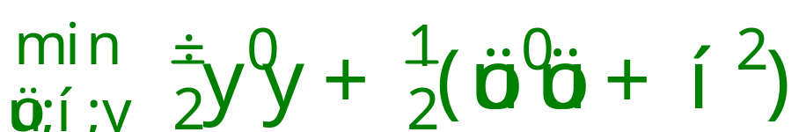



Reduced Support Vector Machines (RSVM)
Large Nonlinear Kernel Classification Problems
Key idea: Use a rectangular kernel.
where
is a small random sample of
Typically
has 1% to 10% of the rows of
Two important consequences:
RSVM can solve very large problems
Nonlinear separator depends on
only
Separating surface:
gives lousy results

Slide 23
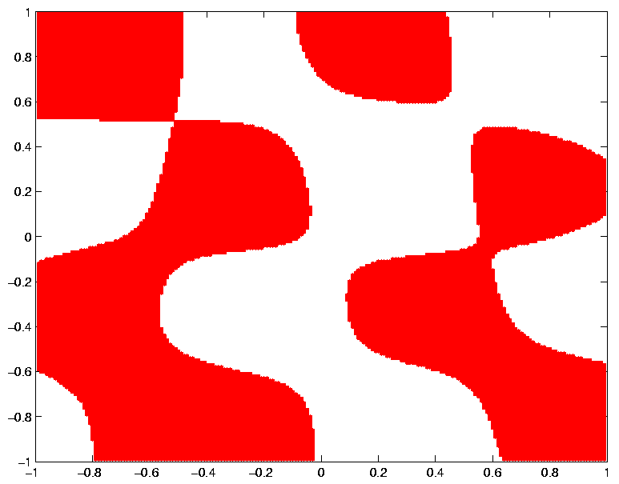
Checkerboard 50-by-50 Square Kernel
Using 50 Random Points Out of 1000

Slide 24

RSVM Result on Checkerboard
Using SAME 50 Random Points Out of 1000

Slide 25












RSVM on Large UCI Adult Dataset
Standard Deviation over 50 Runs = 0.001
 | Average Correctness % & Standard Deviation, 50 Runs
(6414, 26148) | 84.47 | 0.001 | 77.03 | 0.014 | 210 3.2%
(11221, 21341) | 84.71 | 0.001 | 75.96 | 0.016 | 225 2.0%
(16101, 16461) | 84.90 | 0.001 | 75.45 | 0.017 | 242 1.5%
(22697, 9865) | 85.31 | 0.001 | 76.73 | 0.018 | 284 1.2%
(32562, 16282) | 85.07 | 0.001 | 76.95 | 0.013 | 326 1.0%

Slide 26
CPU Times on UCI Adult Dataset
RSVM, SMO and PCGC with a Gaussian Kernel
Adult Dataset : CPU Seconds for Various Dataset Sizes
Size | 3185 | 4781 | 6414 | 11221 | 16101 | 22697 | 32562
RSVM | 44.2 | 83.6 | 123.4 | 227.8 | 342.5 | 587.4 | 980.2
SMO (Platt) | 66.2 | 146.6 | 258.8 | 781.4 | 1784.4 | 4126.4 | 7749.6
PCGC (Burges) | 380.5 | 1137.2 | 2530.6 | 11910.6 | Ran out of memory

Slide 27
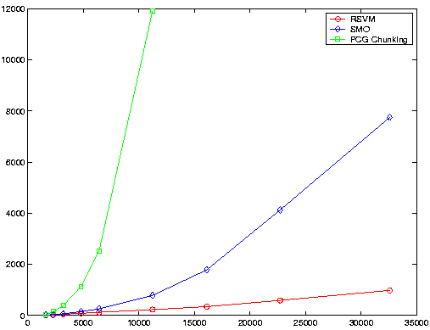
CPU Time Comparison on UCI Dataset
RSVM, SMO and PCGC with a Gaussian Kernel
Time( CPU sec. )
Training Set Size

Slide 28
PSVM: Proximal Support Vector Machines
Fast new support vector machine classifier
Proximal planes replace halfspaces
Order(s) of magnitude faster than standard classifiers
Extremely simple to implement
  4 lines of MATLAB code
  NO optimization packages (LP,QP) needed

Slide 29

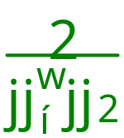
Proximal Support Vector Machine:
Use 2 Proximal Planes Instead of 2 Halfspaces
A+
A-

Slide 30





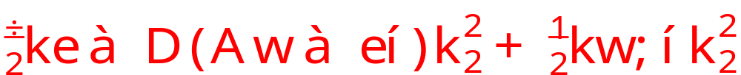
PSVM Formulation
We have the SSVM formulation:
PSVM
min
(QP)
s. t.
Solving for in terms of and gives:
min
This simple, but critical modification, changes the nature
of the optimization problem significantly!

Slide 31
Advantages of New Formulation
Objective function remains strongly convex
An explicit exact solution can be written in terms of the problem data
PSVM classifier is obtained by solving a single system of linear equations in the usually small dimensional input space
Exact leave-one-out-correctness can be obtained in terms of problem data

Slide 32
Linear PSVM
We want to solve:
min
Setting the gradient equal to zero, gives a nonsingular system of linear equations.
Solution of the system gives the desired PSVM classifier

Slide 33
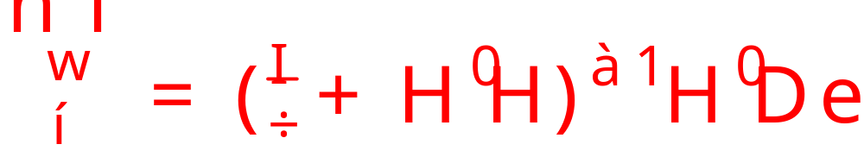





Linear PSVM Solution
Here,
The linear system to solve depends on:
which is of the size
is usually much smaller than

Slide 34



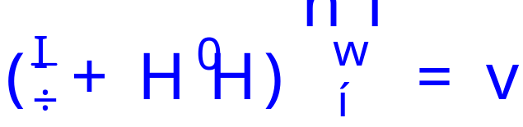

Linear Proximal SVM Algorithm
Input
Define
Calculate
Solve
Classifier:

Slide 35


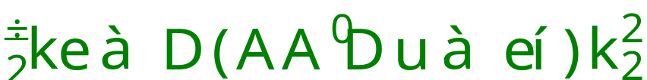
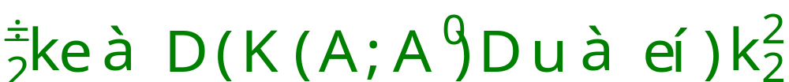
Nonlinear PSVM Formulation
Linear PSVM: (Linear separating surface:
)
min
(QP)
s. t.
By QP “duality”,
. Maximizing the margin
in the “dual space” , gives:
min
Replace
by a nonlinear kernel
:
min

Slide 36
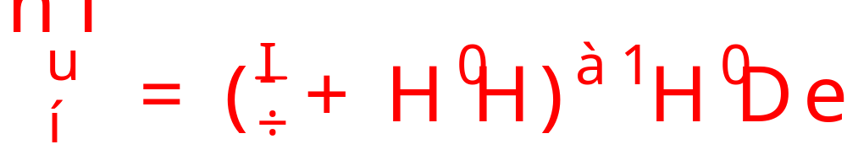


Nonlinear PSVM
Similar to the linear case,
setting the gradient equal to zero, we obtain:
Define slightly different:
  Here, the linear system to solve is of the size
However, reduced kernel technique (RSVM) can be used
to reduce dimensionality.

Slide 37





Linear Proximal SVM Algorithm
Non
Input
Define
Calculate
Solve
Classifier:
Classifier:

Slide 38
PSVM MATLAB Code
function [w, gamma] = psvm(A,d,nu)
% PSVM: linear and nonlinear classification
% INPUT: A, d=diag(D), nu. OUTPUT: w, gamma
% [w, gamma] = pvm(A,d,nu);
[m,n]=size(A);e=ones(m,1);H=[A -e];
v=(d’*H)’ %v=H’*D*e;
r=(speye(n+1)/nu+H’*H)\v % solve (I/nu+H’*H)r=v
w=r(1:n);gamma=r(n+1); % getting w,gamma from r

Slide 39

Linear PSVM
Comparisons with Other SVMs
Much Faster, Comparable Correctness
Data Set m x n | PSVM Ten-fold test % Time (sec.) | SSVM Ten-fold test % Time (sec.) | SVM Ten-fold test % Time (sec.)
WPBC (60 mo.) 110 x 32 | 68.5 0.02 | 68.5 0.17 | 62.7 3.85
Ionosphere 351 x 34 | 87.3 0.17 | 88.7 1.23 | 88.0 2.19
Cleveland Heart 297 x 13 | 85.9 0.01 | 86.2 0.70 | 86.5 1.44
Pima Indians 768 x 8 | 77.5 0.02 | 77.6 0.78 | 76.4 37.00
BUPA Liver 345 x 6 | 69.4 0.02 | 70.0 0.78 | 69.5 6.65
Galaxy Dim 4192 x 14 | 93.5 0.34 | 95.0 5.21 | 94.1 28.33

Slide 40
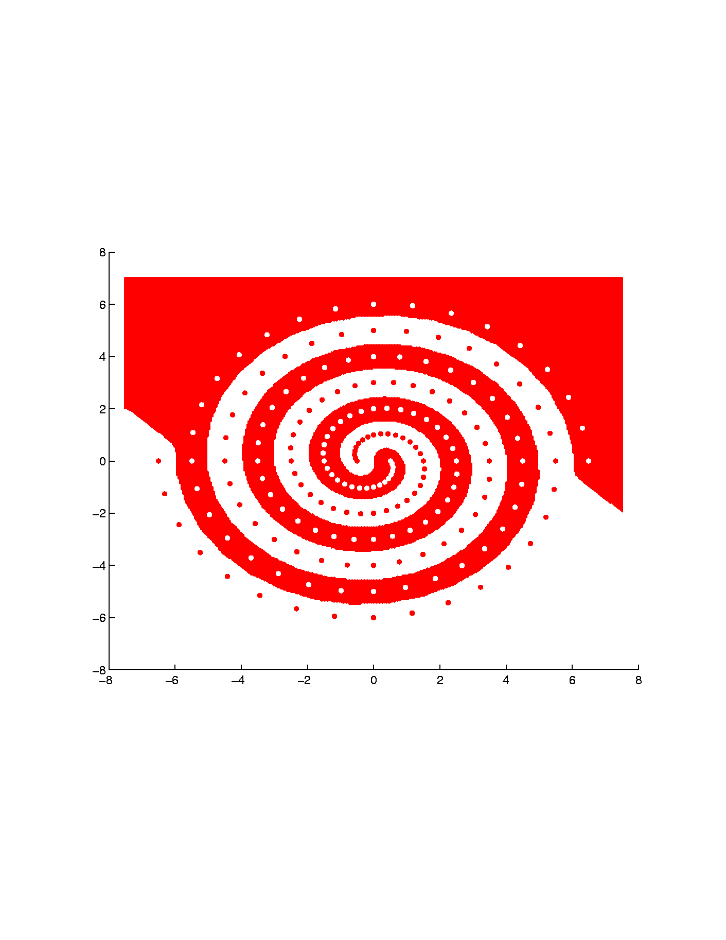
Gaussian Kernel PSVM Classifier
Spiral Dataset: 94 Red Dots & 94 White Dots

Slide 41
Conclusion
Mathematical Programming plays an essential role in SVMs
  Theory
    New formulations
      Generalized & proximal SVMs
    New algorithm-enhancement concepts
      Smoothing (SSVM)
      Data reduction (RSVM)
  Algorithms
        Fast : SSVM, PSVM
        Massive: RSVM

Slide 42

Future Research
  Theory
    Concave minimization
      Concurrent feature & data reduction
      Multiple-instance learning
    SVMs as complementarity problems
    Kernel methods in nonlinear programming
  Algorithms
      Chunking for massive classification:
        Multicategory classification algorithms
        Incremental algorithms

Slide 43
Talk & Papers Available on Web
www.cs.wisc.edu/~olvi

