Slide 1
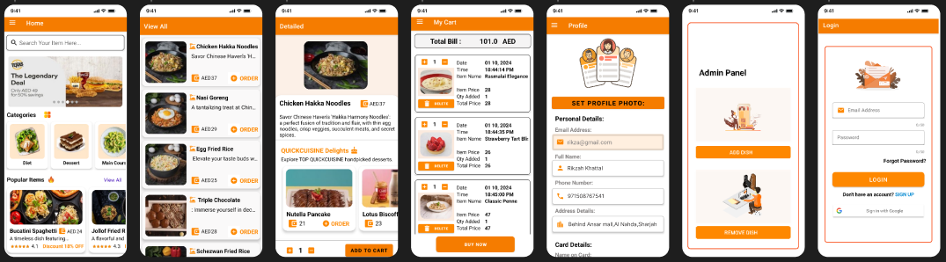

BY: RIKZAH KHATTAL
STUDENT ID: 21587109
QUICK CUISINE

Slide 2
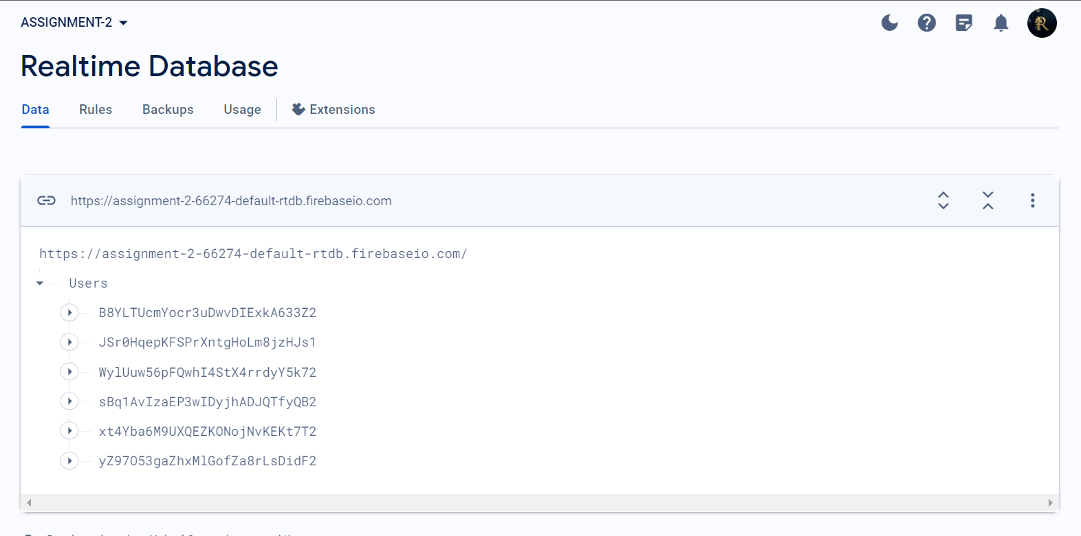
All User data is stored in RealTime database

Slide 3
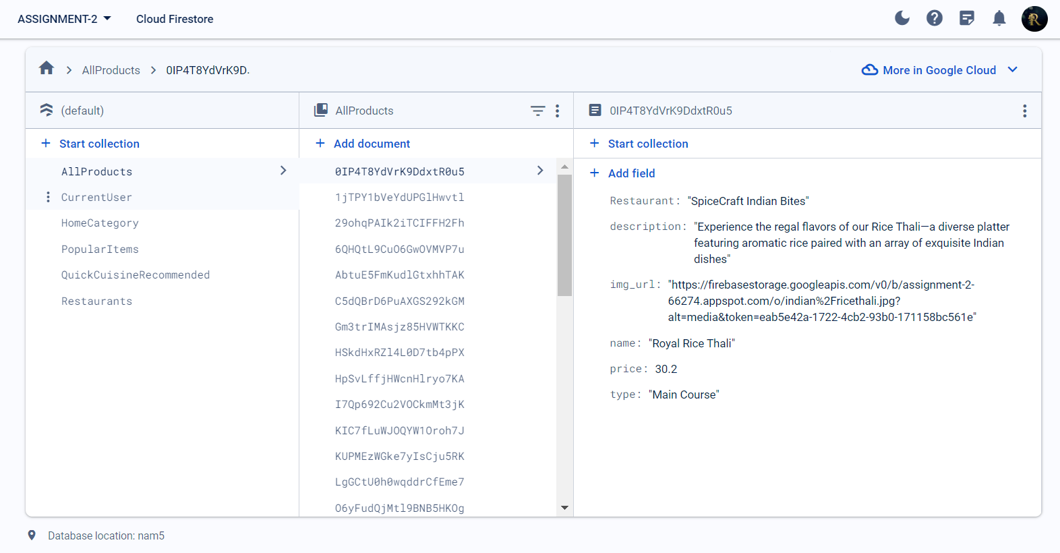
App Data( product,cart, order) details are stored in firestore.

Slide 4
User details are stored in Realtime Database for real time updates while the broader app data resides in Firestore for scalability, flexible querying, and synchronized storage, effectively separating user and app data. Users Account is connected to his cart and orders using firebase auth.getuserid() method.

Slide 5
Data Base includes: FETCH,ADD, REMOVE, UPDATE AND DELETE OPERATIONS
PROFILE: FETCH AND UPDATE OPERATIONS
CART: FETCH, UPDATE, DELETE OPERATIONS
ADMIN: ADD,DELETE OPERATIONS

Slide 6
Going Above and Beyond

Slide 7
Going Above and Beyond

Slide 8
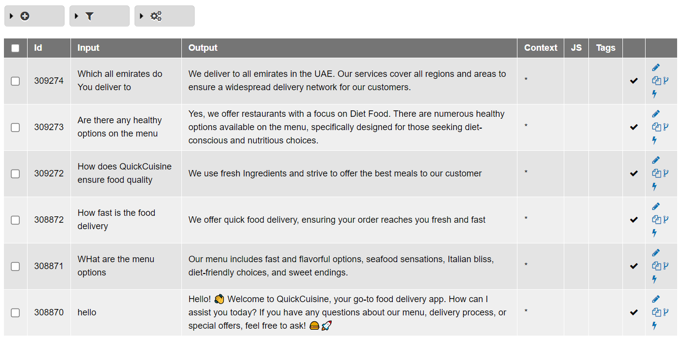
QuickCuisine Chat bot developed using Brainshop

Slide 9
Run and show it works but under dev

Slide 10
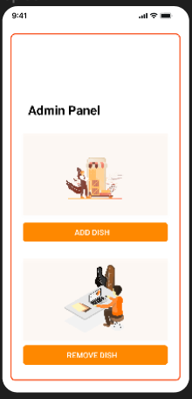
ADMIN PANEL Restaurant Owners can: Add new products or Delete existing products.

Slide 11
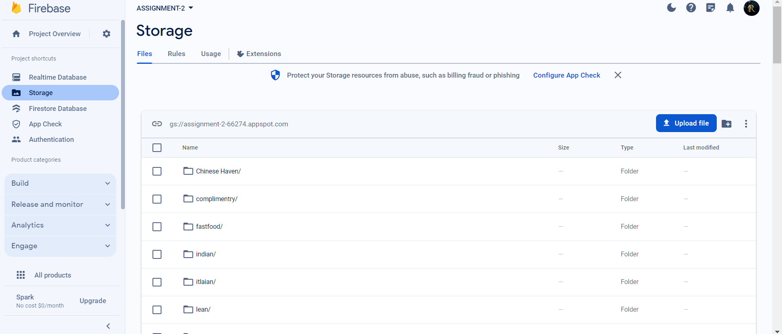
All Images are saved in firestore, and can dynamically be added( profile photo, new product image)

Slide 12
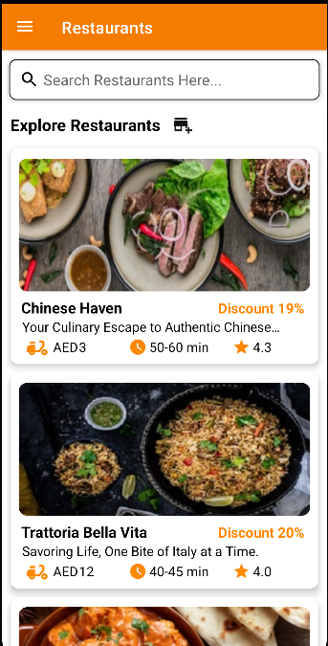
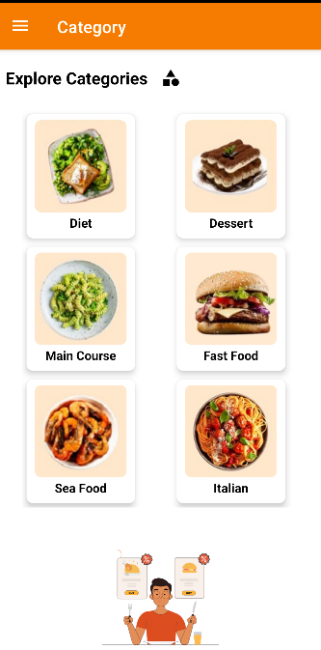
Restaurant and Categories

Slide 13
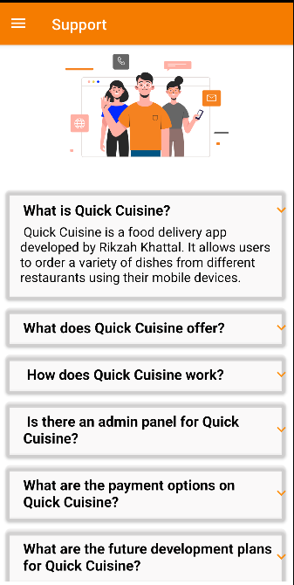

New Products and Support page

Slide 14
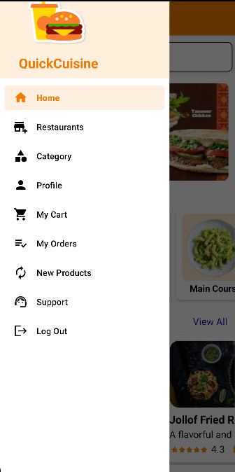
Side panel To showcase all functionalities.

Slide 15
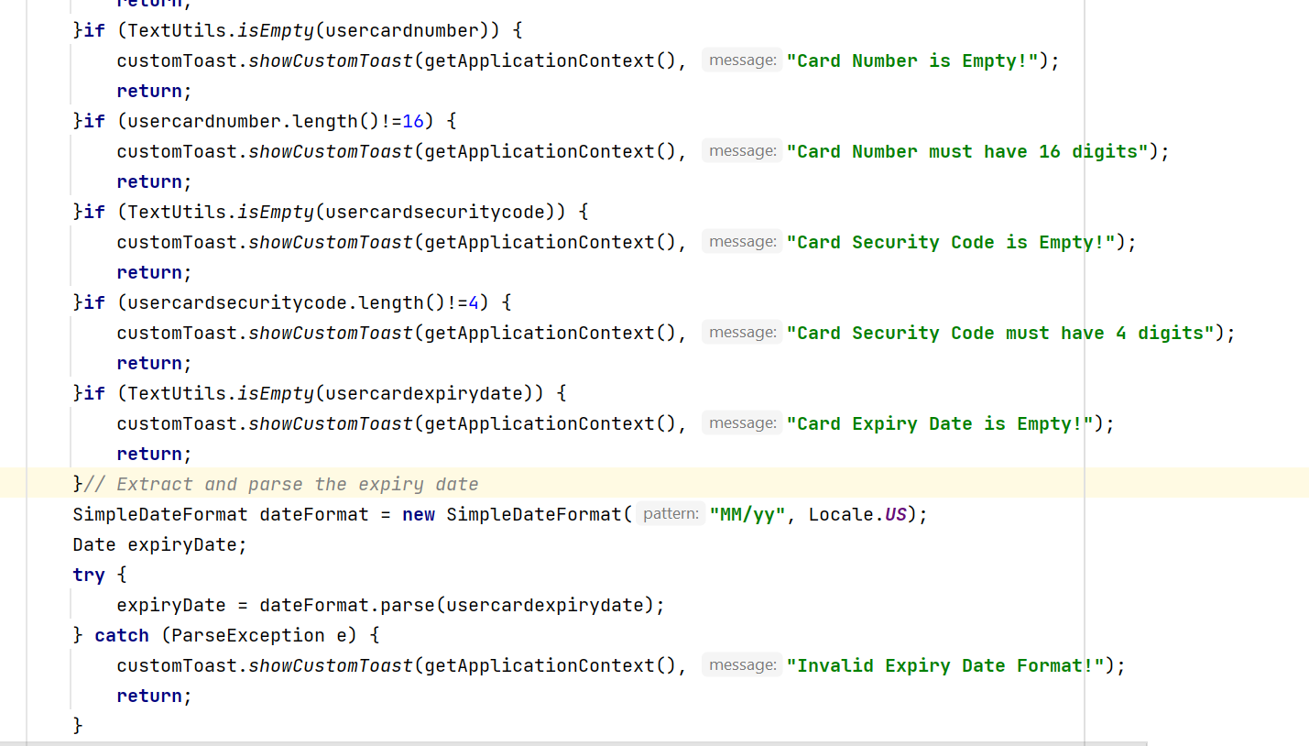
SignUp validations used

Slide 16
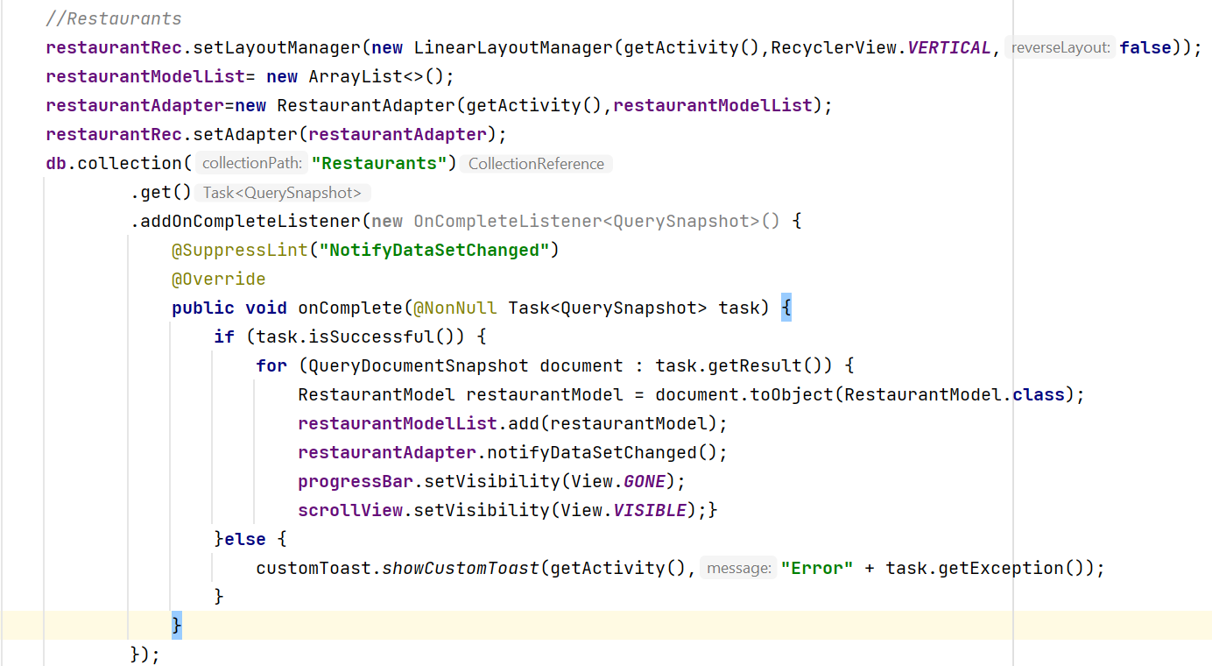
Recycler View Setup

Slide 17
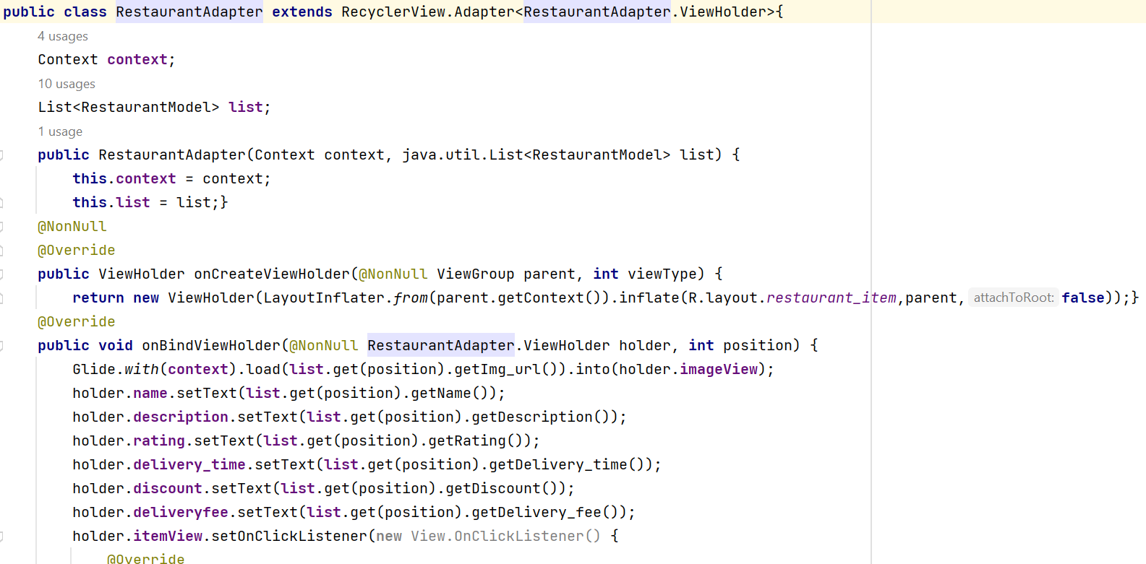
Recycler View Adapter

Slide 18
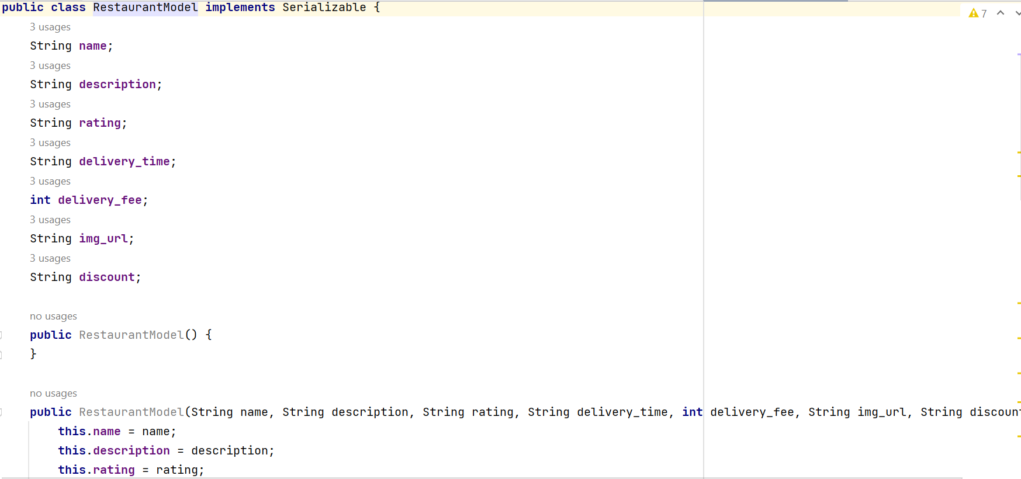
Recycler View Model

Slide 19
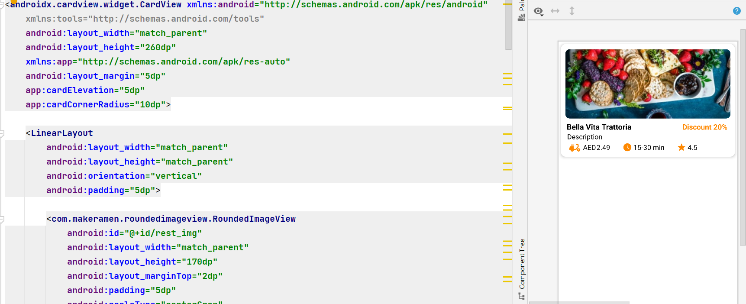
Recycler View Item

Slide 20
Search Bar ( Available in 2 places :home and Restaurants Page). -User can browse through collection of items available in app in home page. -In Restaurants page user can search for specifc items.

Slide 21
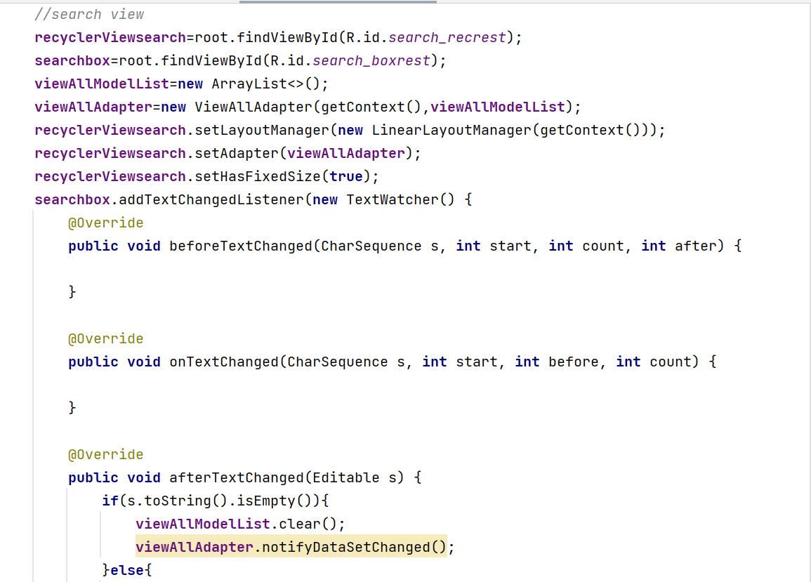
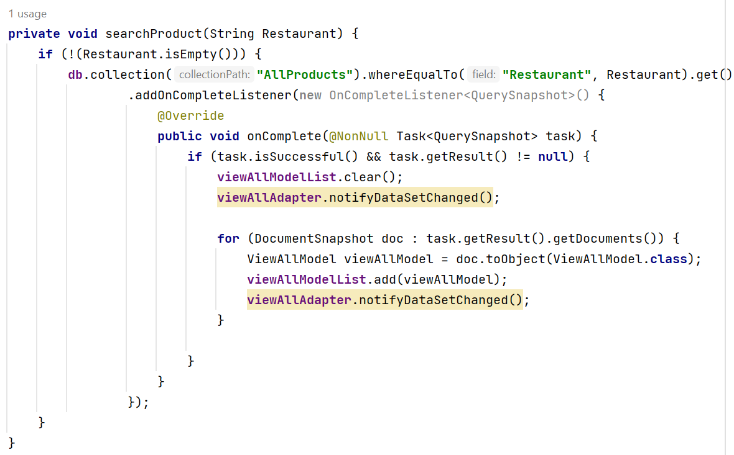
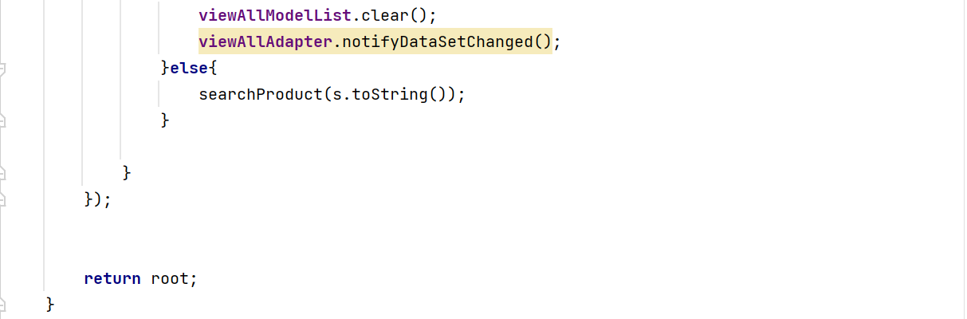
Search Bar

Slide 22
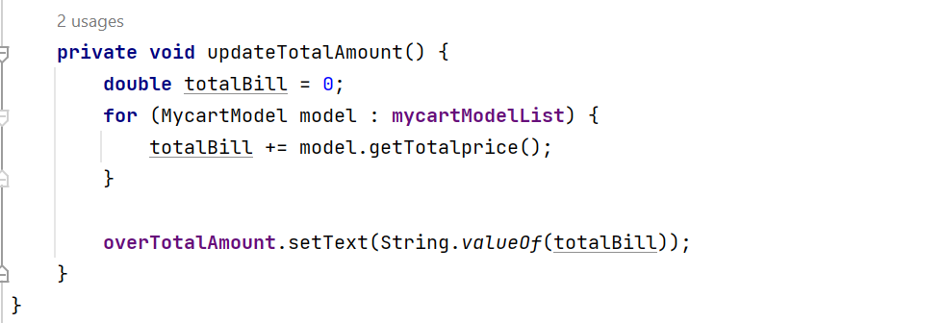
Cart Total Amount dynamically updated using:

Slide 23
Lets get started!

Slide 24
Lottie animations everywhere to enhance ui
Start with onboarding jav adapter say use saved pref
Home page multiple recycle rvews fo rbroader user otions along with serach bar
clcik on catefories show all items in that category using filter where equal to one activity view all is used throught app for showcasing all items code reuse
Show detiled actvty by click any item firther show quickcuisine rceommnded items
Show side bar say why use it instead of bttom nav
Al feturse cart orer profile need user authntcn show support fragmnt
Clcick on any page register login, forgot same time later cant come to tsi page show mail tehn continue.
again hoem page now Clcik on popular detiled show increase qty and add to cart go back ( show db cart ne witem added colllctn path)
Show restrt and ctegroy page now add any item directly to cart
Show cart increase qty and checkout show vldtn fo rcheckout
Show order history pae, then profile change data close app and show updated chnge profile picture
Logout
Admin add new item show in new products section. ( show in db collctn path new ietm added)
Remve new added item.
Logout of app

