Slide 1

Data Analysis of the Arbitration Process in the MLB
By
Alex Riles
Advised By
Dr. Tisha Hooks

Slide 2
CBA
What is CBA?
Collective Bargaining Agreement
Between Player’s Union and The MLB
Contains
Season Length
Minimum Salary
Revenue-sharing
Luxury Tax
Draft picks
Arbitration

Slide 3
Arbitration
Started in 1973
Reasons why it exists
Reserve rule in 1879
3 Supreme Court cases
To prevent prolonged disputes
Avoids holdouts
Players and Teams can settle on their own
Settlement only last one year

Slide 4

Example of Arbitration
Player
Bob Ross
Position in pitcher
Player Amount
$5 Million
Team Amount
$3 Million
Midpoint
$4 Million
Settled Amount
$4.25 Million

Slide 5
Research Question
Can we accurately predict the outcome of the arbitration process in the MLB?
Which predictive model is better?
Neural Network
Random Forests
Will fit separate models for pitchers and position players

Slide 6
DATA
Lahman’s Baseball Database
Basic statistics
Fangraphs
Sabermetrics
mlbtraderumors.com
Arbitration data

Slide 7
Predictors
Position player
WAR
Wins Above Replacement
OPS +
OnBase Plus Slugging Plus
Takes in to account league average and ball park factors
DRS
Defensive Runs Saved
Runs saved through range, and fielding ability
RC
Runs Created
The amount of runs created using hits, walks, stolen bases, and other stats

Slide 8
Predictors
Pitchers
WAR
Wins Above Replacement
FIP
Field Independent Pitching
Uses ERA but takes out balls that are hit into play
WHIP
Walks Hits per Innings Pitched

Slide 9
Response
Outcome of arbitration was coded as 1, 2, or 3
Player side
Player Amount = $1.550M
Team Amount = $1.150M
Midpoint = $1.350M
Settled Amount = $1.40M
Outcome = 1
Midpoint
Midpoint = $4.300M
Settled Amount = $4.300M
Outcome = 2
Team side
Player Amount = $4.875M
Team Amount = $3.500M
Settled Amount = $4.000M
Midpoint = $4.188M
Outcome = 3

Slide 10
Packages and Functions
Packages
dplyr
Join different data tables
Select and edit data
Stack
Stack data sets
caret
Found transformation using BoxCox
nnet
Run Neural Network
randomForest
Run Random Forest
Functions
Clean
Clean the arbitration data
Needed to use encoding UTF-8
cnnet.cv
Run cross validation for Neural Network
rrf.sscv
Run cross validation for Random Forest
rfimp.class
Plot the variables of importance for Random Forest

Slide 11
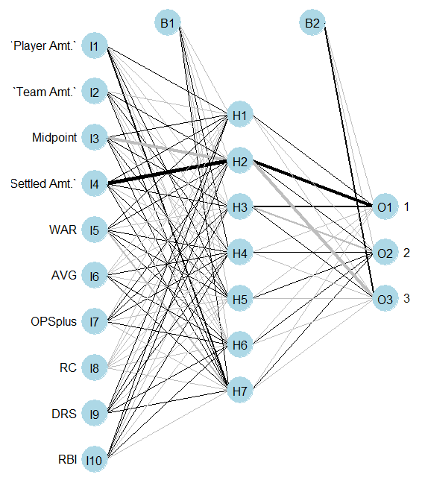
Neural Network
Position Players
Size = 7
Decay = .01

Slide 12
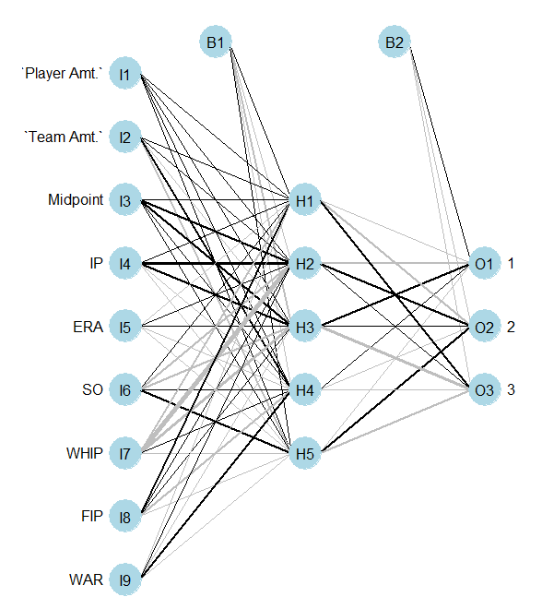
Neural Network
Pitchers
Size = 5
Decay = .001

Slide 13
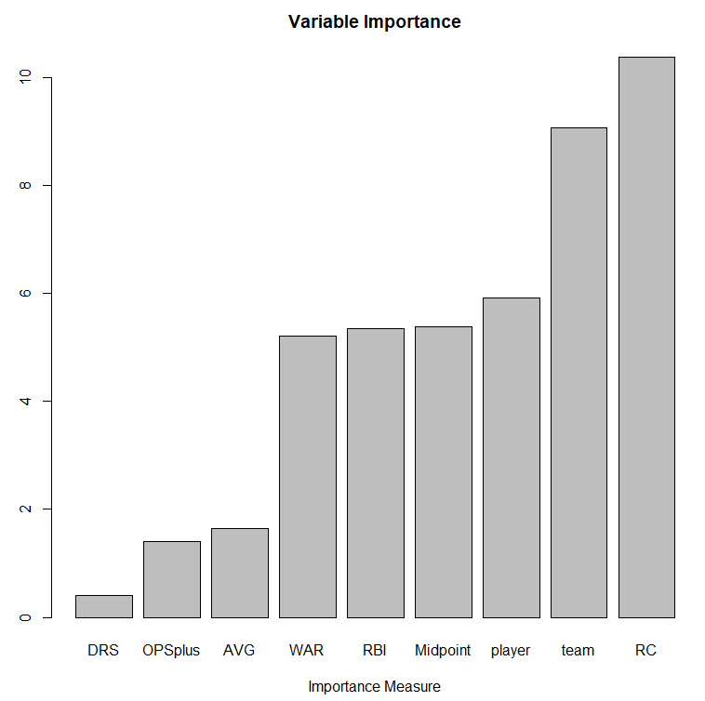
Random Forests
Position Players
Mtry = 5
Maxnodes = 5

Slide 14
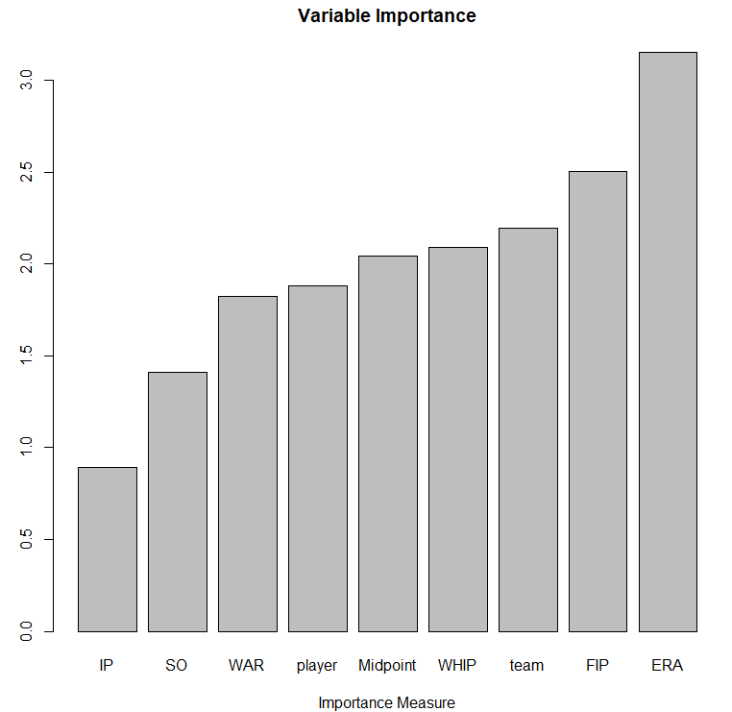
Random Forests
Pitchers
Mtry = 3
Maxnodes = 5

Slide 15
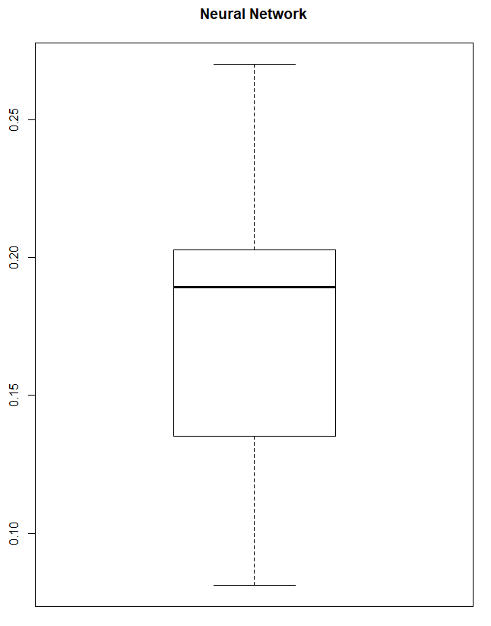
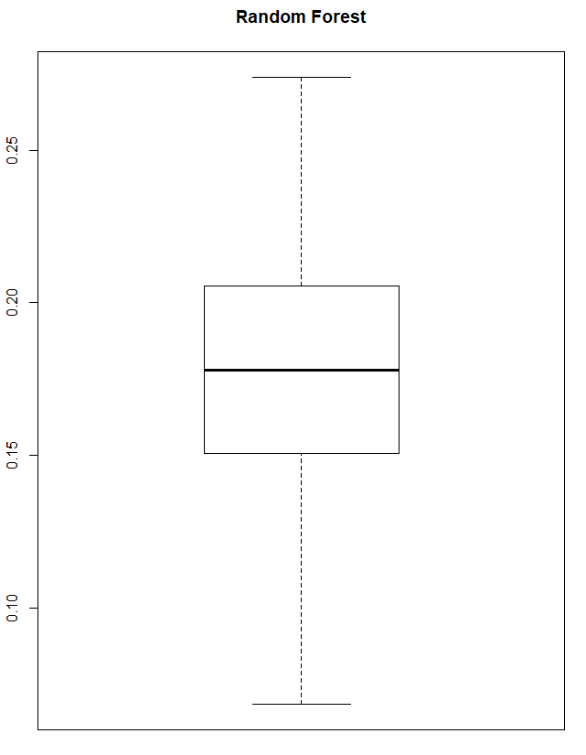
Cross Validation
Position Players
Neural Network
Min = .08108
Mean = .17243
Max = .27027
Median = .18919
Random Forests
Min = .06849
Mean = .17589
Max = .27397
Median = .17808

Slide 16
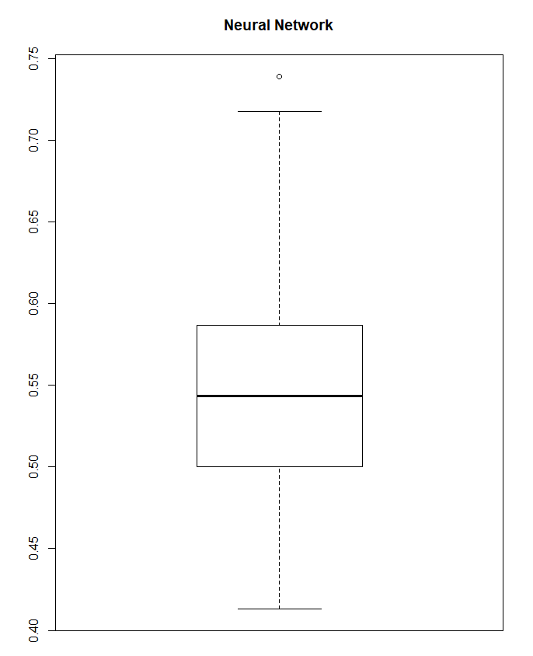
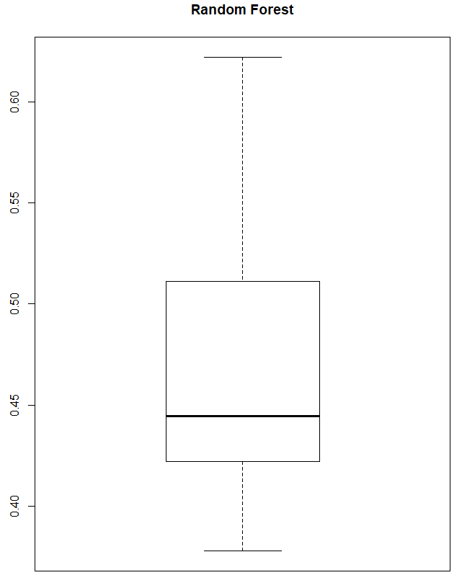
Cross Validation
Pitchers
Neural Network
Min = .4130
Mean = .5496
Max = .7391
Median = .5435
Random Forest
Min = .3778
Mean = .4658
Max = .6222
Median = .4444

Slide 17
Final Model
Position Players
Neural Network
Min = .08108
Mean = .17243
Max = .27027
Median = .18919
Pitchers
Random Forests
Min = .3333
Mean = .4764
Max = .6000
Median = .4667

Slide 18
Conclusion
Which predictive model is better?
Neural Network
Random Forests
Can we accurately predict the outcome of the arbitration process in the MLB?
Yes for position players
No for pitchers

Slide 19
Future Research
Predict actual settled amount for arbitration
Expand into predicting free agent salaries and amount of years
Make a prediction model to see which statistics are important to winning a MVP or Cy Young award
Investigate whether a player performs better going through arbitration each year or does better signing long term

Slide 20
Sources
Monhait, Jeff. “Baseball Arbitration: An ADR Success.” 2013.
Dr. Brant Deppa DSCI 425 Handouts
Slowinski, Steve. “FIP.” FIP | Sabermetrics Library, 2010, library.fangraphs.com/pitching/fip/.
Slowinski, Steve. “What Is WAR?” What Is WAR? | Sabermetrics Library, 2010, library.fangraphs.com/misc/war/.
Slowinski, Steve. “WAR for Position Players.” WAR for Position Players | Sabermetrics Library, 2012, library.fangraphs.com/war/war-position-players/.
Slowinski, Steve. “WAR for Pitchers.” WAR for Pitchers | Sabermetrics Library, 2012, library.fangraphs.com/war/calculating-war-pitchers/.
“Batting Stats Glossary.” Baseball, www.baseball-reference.com/about/bat_glossary.shtml.
Slowinski, Steve. “DRS.” DRS | Sabermetrics Library, 2010, library.fangraphs.com/defense/drs/.

Slide 21
Questions?

