Slide 1
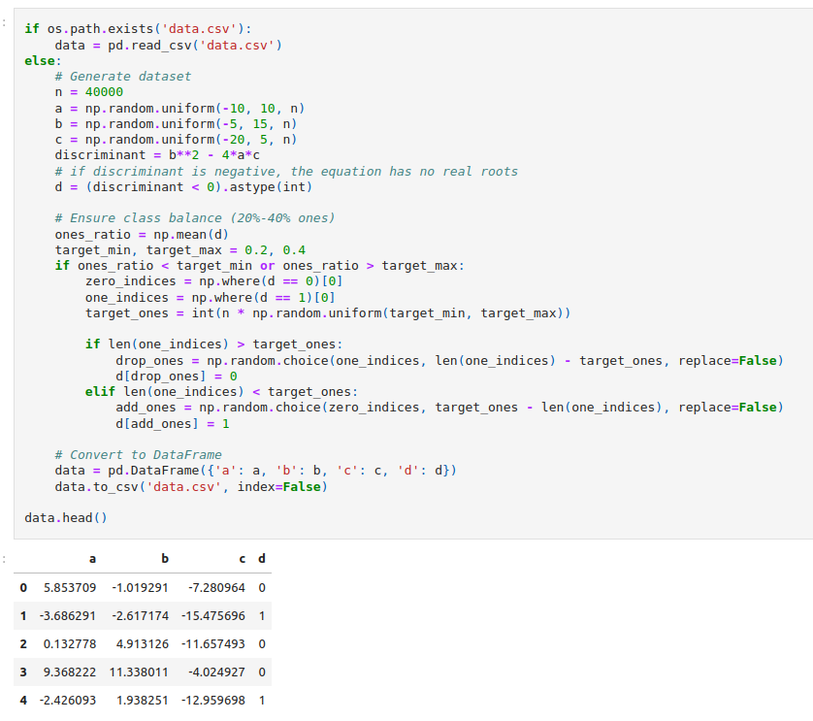
Data synthesis, with targeted class ratio.
Classes generated by thresholding the descriminant < 0. (complex)

Slide 2

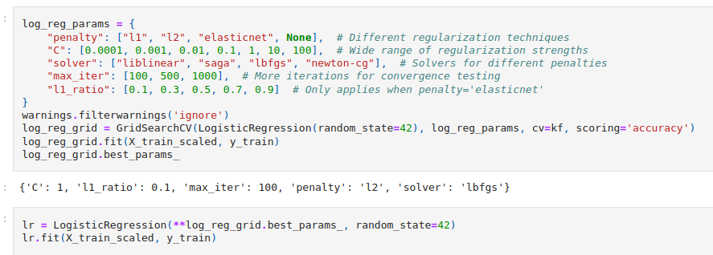
Data split into train/test.
KFold CV used to estimate test metrics without data leakage.
Data standardized for optimal fit.
GridSearchCV used for best model params.

Slide 3
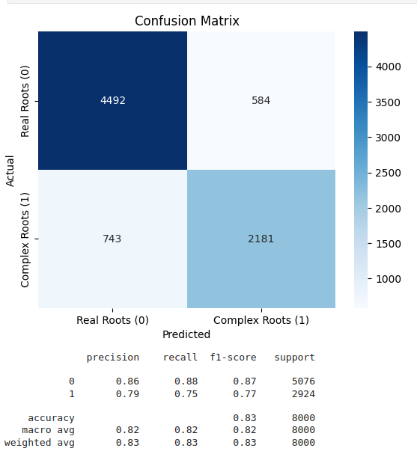
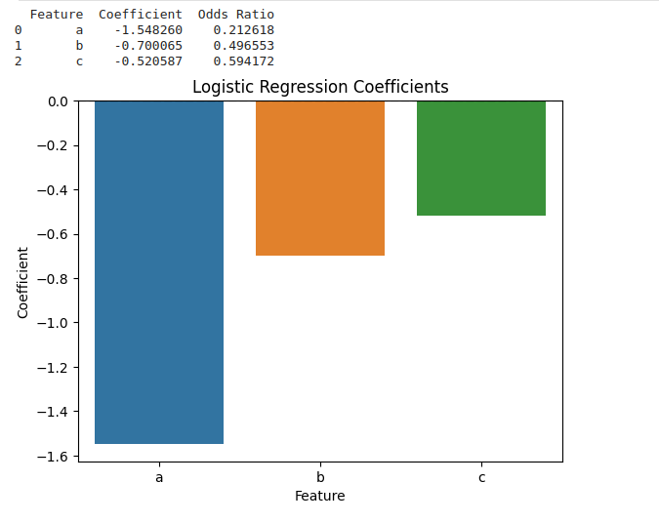


Slide 4
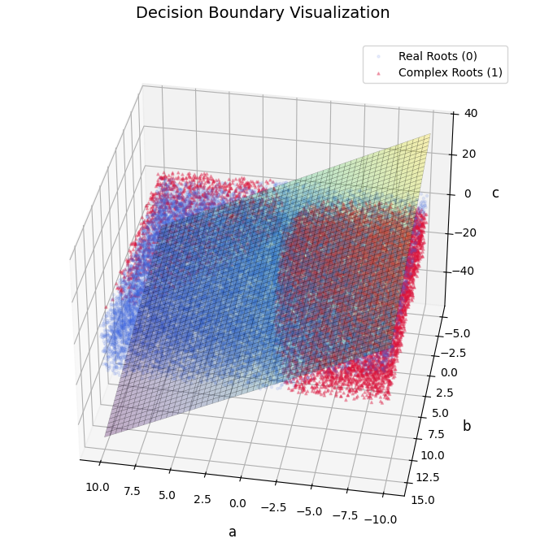

Slide 5

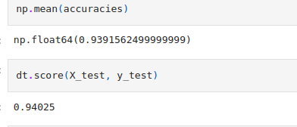
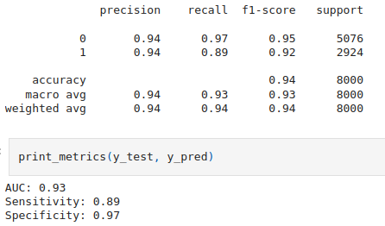
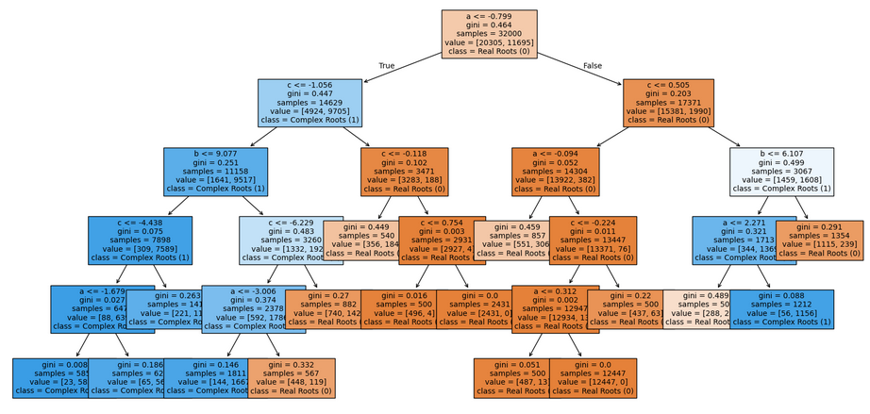

Slide 6
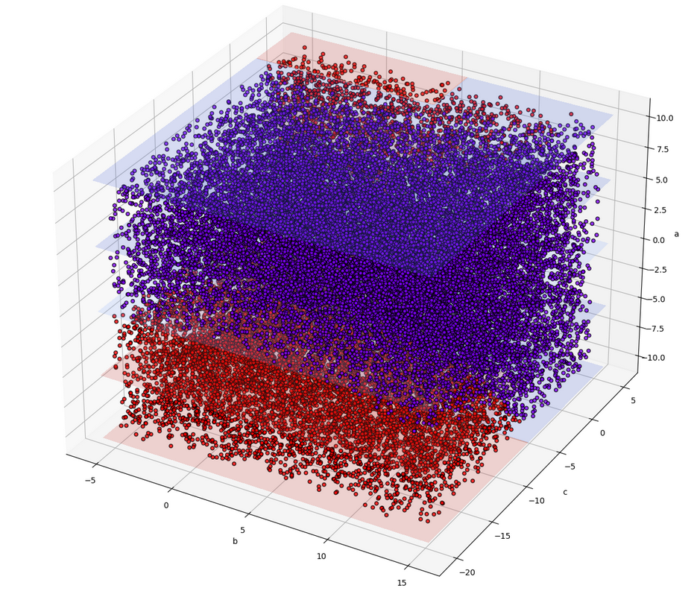

Slide 7
