Slide 1

SOCIAL ENGINEERING FAKE NEWS
CSCI 404/604
Ethical Hacking
North Dakota State University
Spring 2021
Notes:
Geri

Slide 2
SOCIAL ENGINEERING
Wide range of malicious activities accomplished through human interactions.
Utilizing psychological manipulations to persuade users into making security gaffes.
Relies on humans to be effective; human nature and the desire to be helpful.
Notes:
Geri
Consider talking about:
Spyware

Slide 3
FAKE NEWS
Is a social engineering strategy that uses malicious news content masquerading as content originating from authoritative sources.
Purveyors seek to deliberately misinform users and/or cause viral spread of content that is designed to elicit outrage and/or change opinions.
Can cause an inadvertent consumption of opinions that may be detrimental to an enterprise.
Notes:
Geri
Consider talking about:
Spyware

Slide 4
TYPES OF SOCIAL ENGINEERING
Baiting
Scareware
Pretexting
Phishing
Spear Phishing
Notes:
Geri

Slide 5
IMPACTS OF SOCIAL ENGINEERING
Financial Losses
Loss of Productivity
Operational Disruption
Reputational Damage
Notes:
Geri

Slide 6
Research Goals
What are some of the most effective social engineering tactics?
Is there a certain group of people more susceptible to social engineering attacks?
How do people respond to social engineering attempts?
Do people identify social engineering?
Notes:
Joshua
The goals of our research were to answer the following questions.
What are some of the most effective social engineering tactics?
Is there a certain group of people more susceptible to social engineering attacks?
How do people respond to social engineering attempts?
Do people identify social engineering?

Slide 7
Social Engineering Scenario Survey
Demographic
Questions
Pre-Education
Scenarios
Education
Post-Education
Scenarios
Notes:
Alison

Slide 8
Scenario Example
You work for a company with a large office building where all visitors must sign the visitor log and be escorted by an employee while in the building. All entrances to the building require an employee badge to enter. One day as you are coming back from lunch you walk toward the employee entrance in the back of the building and scan your badge to get in. As you are opening the door you notice an individual walking up to the door holding several boxes and bags that are from a local office supply store. This individual is struggling with the number of items and is also trying to reach into their pocket to retrieve something.
Would you hold the door open for this individual?
Notes:
Alison

Slide 9
Scenario Data Analysis
Scenario Type | Pre-Education Yes Responses | Post-Education Yes Responses
Shoulder Surfing | 25.5% | 16.0%
Phishing | 17.9% | 24.5%
Tailgating | 68.9% | 33.0%
Scareware | 13.21% | 3.8%
Baiting | 19.8% | 11.3%
Notes:
Alison

Slide 10
Demographic | Demographic Sub-Category >5 participants | Highest Yes Responses | Increase/*No change in Yes Responses Post-Education
Age | 18-24 | Tailgating | Phishing
 | 25-34 | Tailgating | Phishing*
Gender | Female | Tailgating | Phishing
 | Male | Tailgating | Phishing
Security Training | Training | Tailgating | Shoulder Surfing Phishing Scareware* 0%
 | No Training | Tailgating | Phishing
Education Level | Some College | Tailgating | Phishing
 | Associate’s Degree | Tailgating | Shoulder Surfing* Phishing*
 | Bachelor’s Degree | Tailgating | Phishing
 | Postgraduate Degree | Tailgating | Phishing Tailgating* Scareware* 0%

Slide 11
Scenario Data Analysis Conclusions
Participant Demographics
Pre-Education vs. Post-Education Responses
Effective Tactics
Tailgating
Phishing
Notes:
Alison

Slide 12
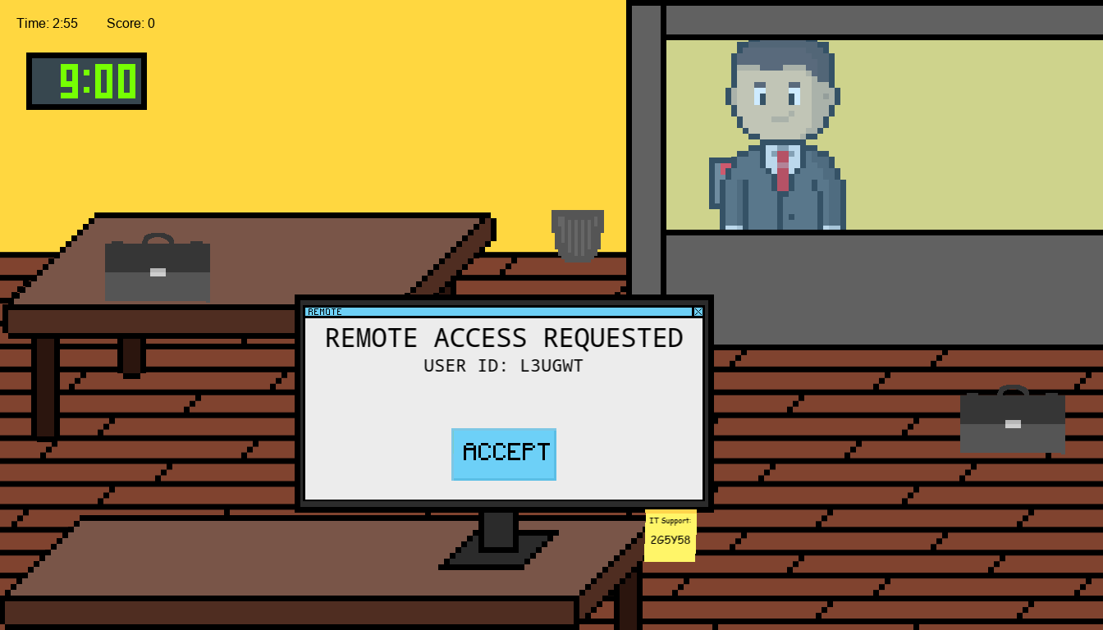
The Simulation
Notes:
Riley

Slide 13
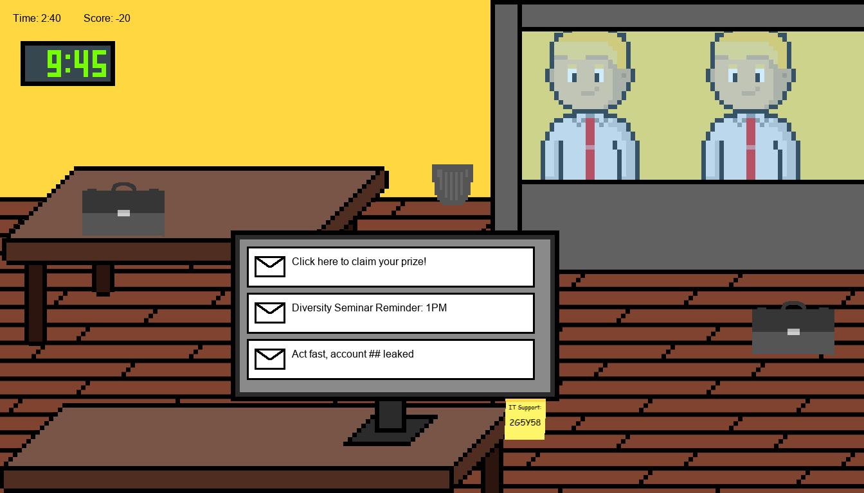
The Simulation
Built in GameMaker Studio 2
Simulates Office Worker Life
Assigns Various Tasks
“Complete An Entire Workday in 3 Minutes!”
Notes:
Riley

Slide 14
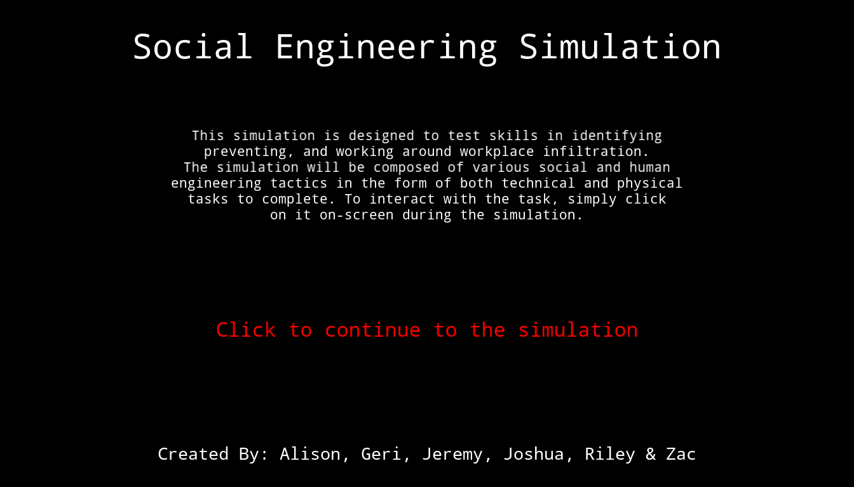
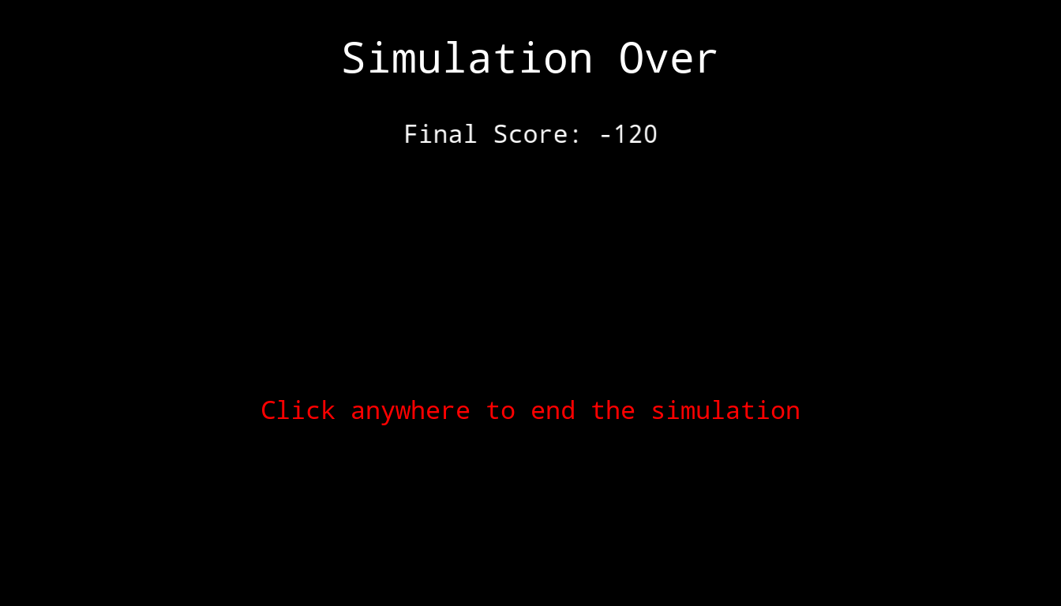
Simulation Flow
Notes:
Riley

Slide 15
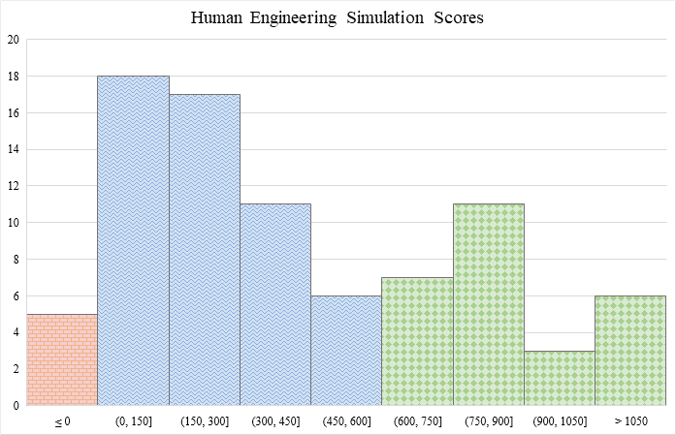
Simulation Analysis
Notes:
Riley

Slide 16
Simulation Analysis
Highest level of Education | High School Graduate | Some College, No Degree | Associate’s Degree | Bachelor’s Degree | Postgraduate Degree | Prefer Not to Say
Total | 5 | 56 | 8 | 28 | 13 | 2
≤ 0 | 0 | 4 | 0 | 1 | 3 | 1
(0-150] | 1 | 6 | 1 | 6 | 0 | 0
(150-300] | 2 | 10 | 0 | 4 | 1 | 0
(300-450] | 0 | 7 | 1 | 3 | 0 | 0
(450-600] | 0 | 2 | 0 | 2 | 2 | 0
(600-750] | 0 | 3 | 2 | 2 | 0 | 0
(750-900] | 0 | 5 | 2 | 3 | 1 | 0
(900-1050] | 0 | 2 | 1 | 0 | 0 | 0
> 1050 | 0 | 4 | 0 | 2 | 0 | 0
Text Response | 0 | 2 | 0 | 1 | 1 | 0
No Response | 2 | 11 | 1 | 4 | 5 | 1
Has Security Training | Yes | No | Prefer not to say
Total | 39 | 72 | 1
≤ 0 | 1 | 4 | 0
(0-150] | 6 | 12 | 0
(150-300] | 3 | 14 | 0
(300-450] | 7 | 4 | 0
(450-600] | 2 | 4 | 0
(600-750] | 2 | 5 | 0
(750-900] | 5 | 6 | 0
(900-1050] | 1 | 2 | 0
> 1050 | 1 | 5 | 0
Text Response | 0 | 3 | 0
No Response | 10 | 13 | 1
Notes:
Riley

Slide 17
Future Work
Recruit Wider Range of Demographics
Extend Type of Tactics
Collect Participant Comments
Notes:
Jeremy
No future work is presently planned for this research, but there is potential for it to be extended and built upon.
In order to determine if a certain demographic is more susceptible to social engineering attempts the research could recruit more participants from a wider age range.
If determining the effectiveness of different types of social engineering attempts is desired this research could be extended to include tactics not already included. Comments could also be gathered from participants to determine why they made certain decisions and to also give insight into why certain tactics are more effective than others.

Slide 18
Conclusion
Effective Tactics
Tailgating
Phishing
Demographic Susceptibility
Unable to determine
Identification of Social Engineering
Notes:
We were able to answer the majority of our questions that we had set out to answer for our project.
We found from the scenario data that tailgating and phishing were consistently a tactic that most participants responding to with yes indicating potential susceptibility.
Our demographics were mainly college students and therefore we were unable to determine if a certain demographic is more susceptible to social engineering.
We saw that individuals identify social engineering to differing extents and with differing knowledge.
It is important to educate ourselves on the potential social engineering threats that are present currently and that may present themselves in the future.

