Slide 1
CSIS 485 Cyber Security Capstone One
Phase Two Focused Data Historian Delivery
Team One
-
Julia Wilkins
Kayla Echols
Brett Wolff
Riley Dorough

Slide 2
Overview
Requirements & Specs
Project Scope
Project Schedule
Product Structure
Security & Testing Cycles
Lessons Learned & Feedback
Conclusion

Slide 3
Requirements & Specs
Hybrid Agile/ Waterfall methodology for DevSecOps
Request for Proposal (RFP) – Initial Startup
Statement of Work (SoW) – Scope/ Boundaries
Proof of Concept (PoC) – Product Delivered
RFP Checklist Completed
Unapproved exemptions to be completed next semester
Notes:
Beginning of semester received RFP to design an open-source data historian
SOW – an outline to define the scope of the project and generalized trimline
PoC – Expected deliverable functioning open-source data historian Compatible with OPTO Hardware
RFP Checklist – We completed most requirements, and any unapproved exemptions are to be completed in the spring

Slide 4
Project Scope
Based on Opto Infrastructure
Cost - $0 spent
Asides from Licensing costs and opto hardware costs, which could not be estimated.
Software
Windows 10
Windows Server 2016
Ubuntu Desktop 20.04

Slide 5
Project Schedule
August 23, 2021 and November 24, 2021
Phase 1
Understanding Scope of Project
Phase 2
Building system architecture and achieving data flow
Phase 3
Security Testing and building Data Historian
Phase 4
Final Acceptance Testing

Slide 6
Product Structure
Operates on OPTO22 DataLink & Control Basic
HMI on PAC Display Runtime Basic
Transfers Data to SQL Server 2012
Visualizes data with Grafana
Data historian combined systems
SQL Server
Grafana

Slide 7
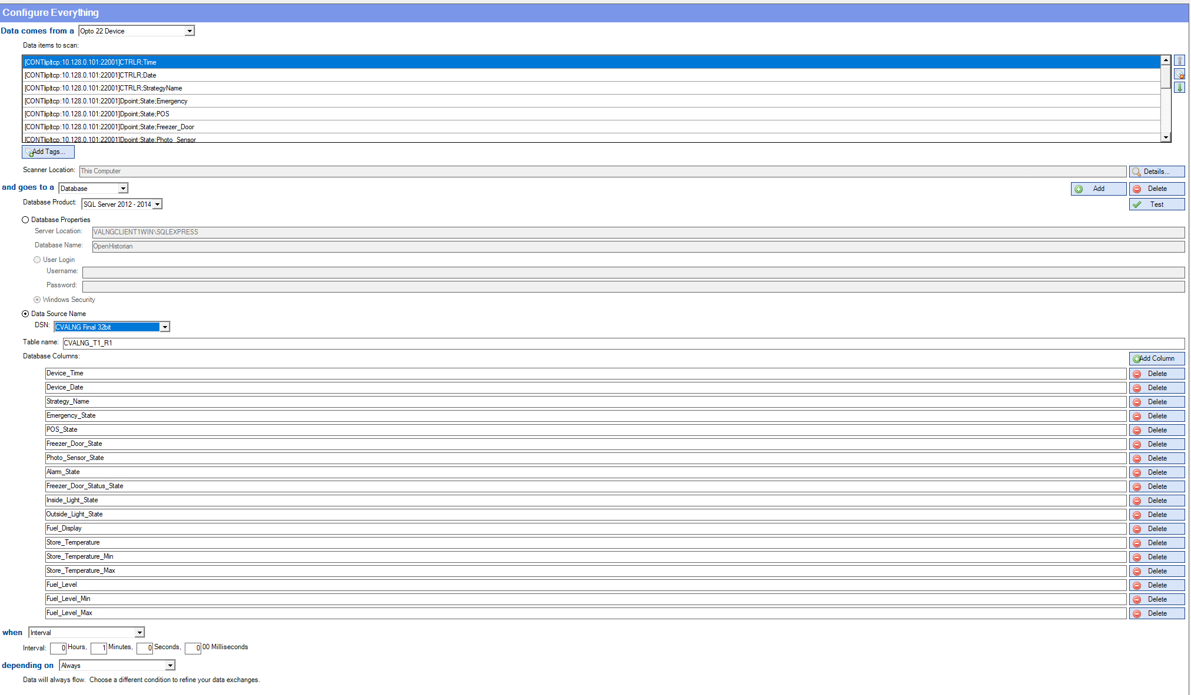

Slide 8
Product Structure
Database
OPTO Datalink into SQL Server 2012
SQL Server 2012 collects the following datapoints
Date and Time Stamps
Temperature
Fuel Level
Light Status
Switch Status

Slide 9
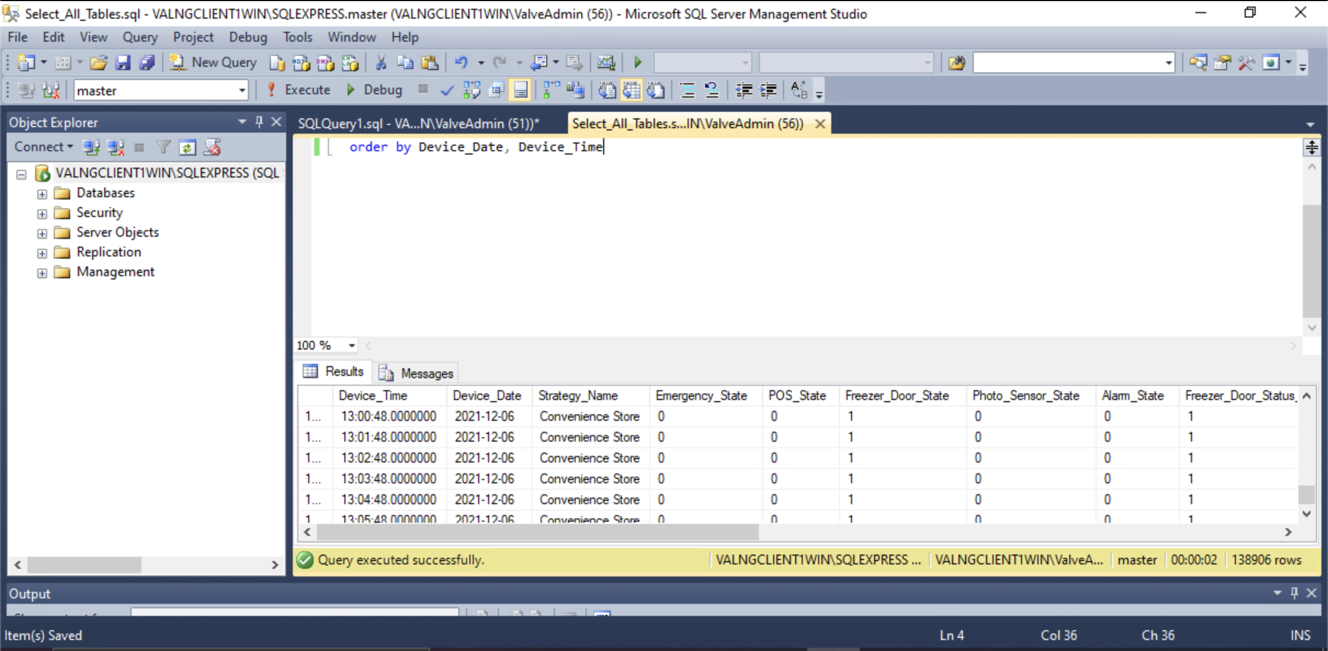

Slide 10
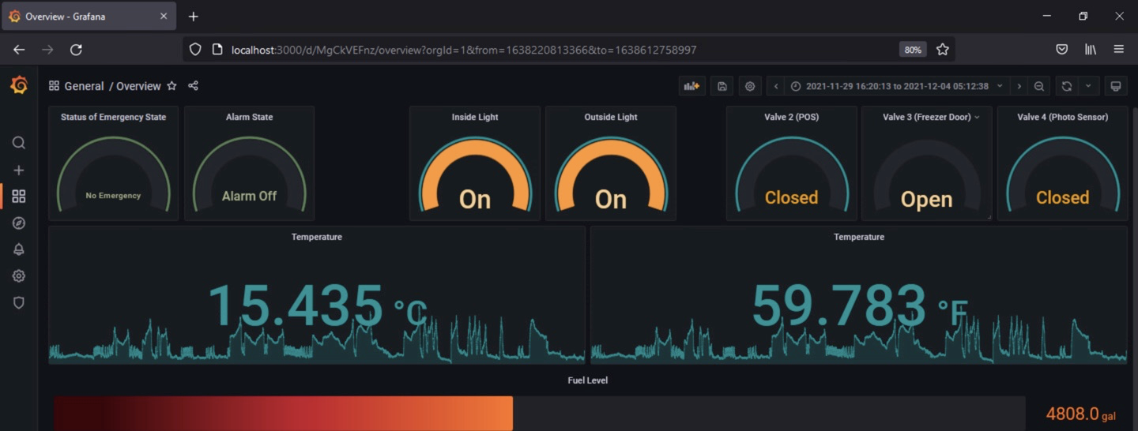
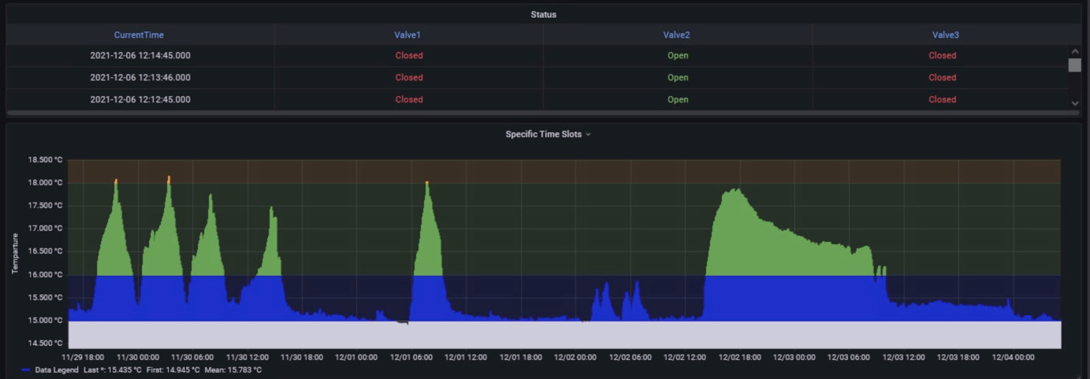
Grafana
.

Slide 11
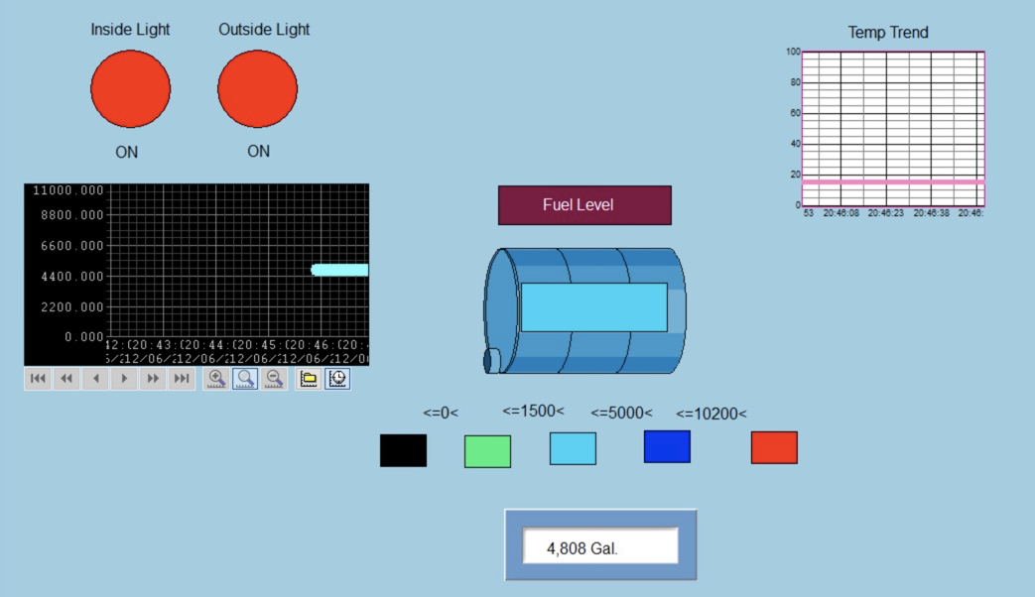
Human Machine Interface (HMI)
.

Slide 12
Security & Testing Cycles
CVES
CVE's were prioritized as they would be the most likely to be exploited.
Five CVE’s were chosen to prioritized, based on severity
Code Reviews
Not performed due to the open-source style of code used
Network Security Measures
Network Security Measures are planned however were not tested.
Plans focused on preventing MITM attacks

Slide 13
Lessons Learned & Feedback
SCADA Framework
Data Acquisition
Data Communication
Data presentation
Control
Why we made the product the way we did
Notes:
Not roadblocks but what we learned and how we came up with an effective design. A design is effective when the client accepts it. Focus on the value of your team. What the team focus was.

Slide 14
Conclusions
Requirements & Specs
Project Scope
Project Schedule
Product Structure
Security & Testing Cycles
Lessons Learned & Feedback
Demo available upon request

Slide 15
Questions?

Slide 16

Secret Slides
01010100 01100101 01100001 01101101 00100000 00110001

Slide 17
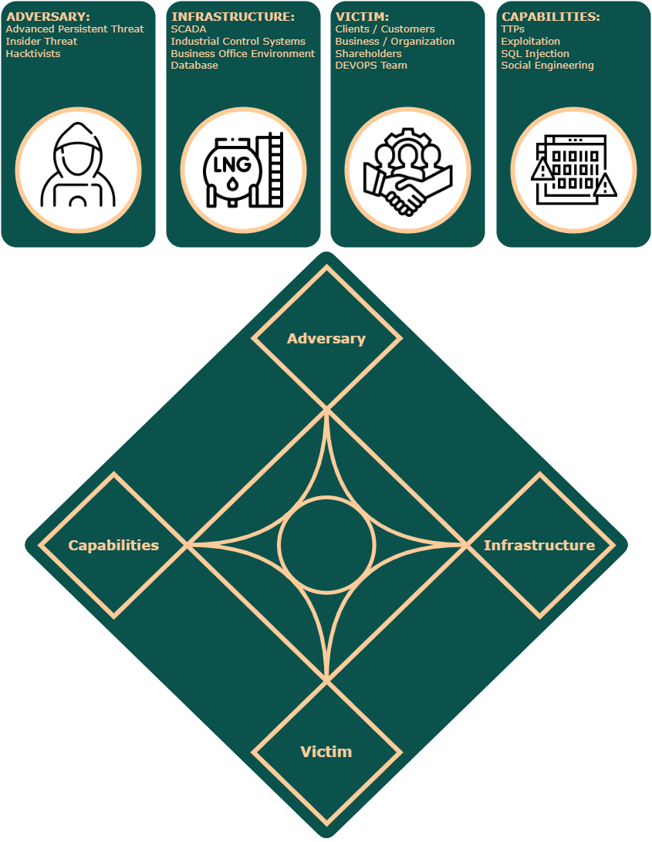

Slide 18
