Slide 1


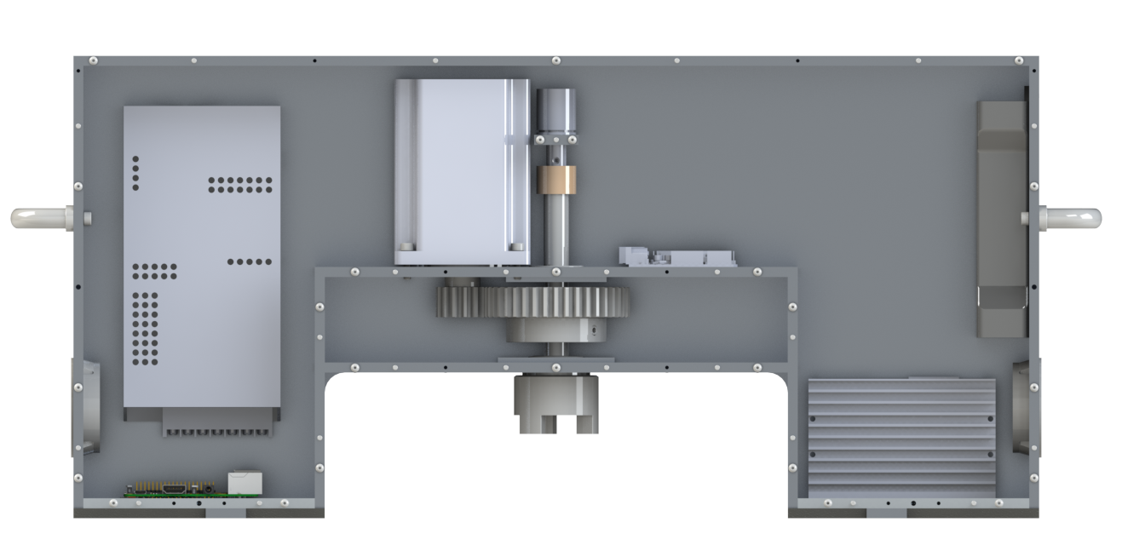
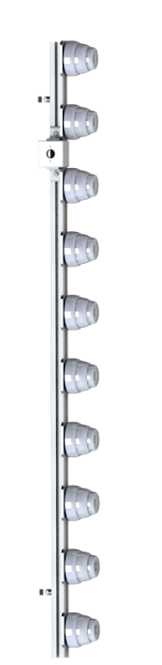
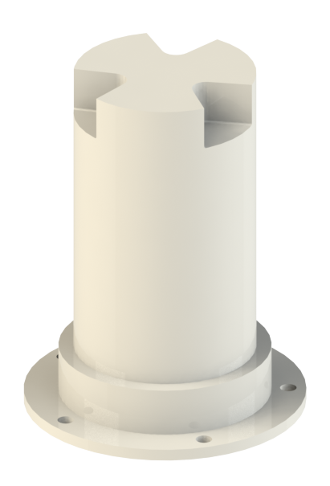
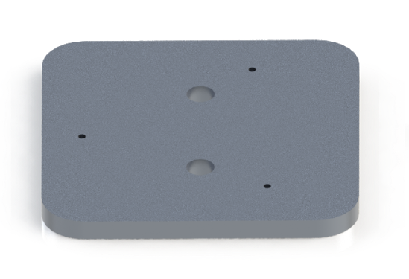
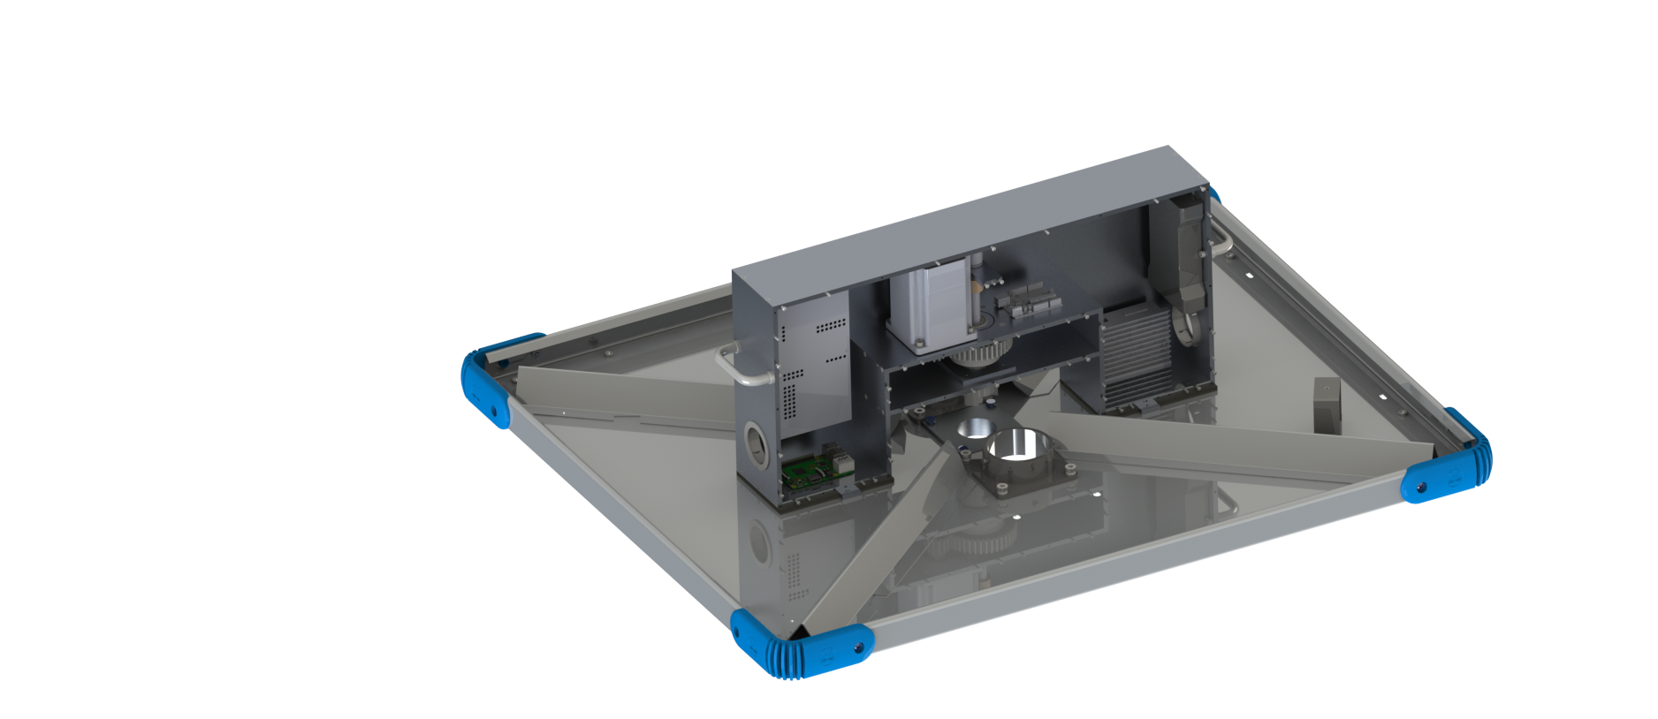
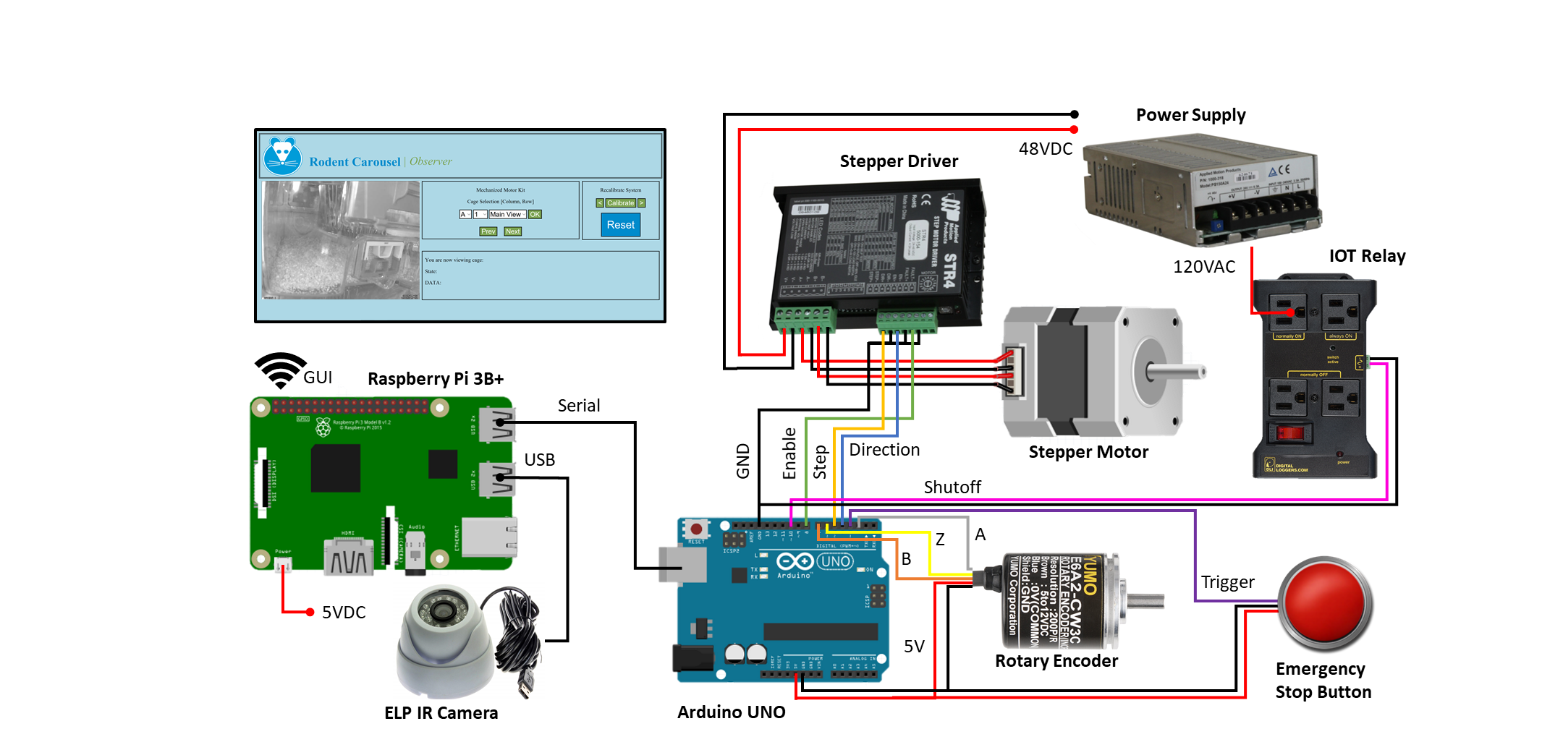
Mechanized Motor Kit
Animal Care Systems
Bryce Adelman | Thomas Fugikawa | Michael Gini | Jacob Her | Riley Kenyon | Melissa Messinger
Objective
Our team designed and prototyped a motor kit and monitoring system for ACS’s Optimice100 system. This allows for remote subject monitoring to aid in laboratory research.
Transmission System
Requirement Verification
Monitoring System
Rotary Encoder
Motor
Cameras
Requirements
Animal Comfort Standards
Noise < 45 dB under 20 kHz
Vibration < 1/20 g
Light Intensity < 1 lux above 600 nm
Design Specifications
Remote rotation using user interface
Attachable/detachable components
Motor system does not impede manual operation
Low light visibility with camera
Power
Supply
Custom Step Down Adapter
5/8” to 4 mm
80/20 Central Column
Motor Driver
Custom Camera Plates
Design Challenges
Modify existing structure to transmit motor torque
No solid internal central shaft in carousel
Space limitations due to HVAC, top sheet flanges, and hole patterns
Ways to attach to existing structure
Expandable to up to 10 cameras
Raspberry Pi
Arduino
Flexible Coupling Hub
Custom Delrin Shaft
Cutout pattern matches Coupling Hub
Gear Train
3:1 Gear ratio
14 & 42 tooth gears
P-Clamps
Transmission System
Communication
Requirement Verification
Noise Test Results: Increase of only 2dB of noise measured from ambient environment
Lux Test Results: Used a paper diffuser to achieve < 0.1 lux
Vibration Test Results: 0.012 g achieved with our motor acceleration/deceleration profiles
Central Shaft Hole
s
Impact & Future Work
“We truly believe that technology and automation will have a significant impact on the quality of data that is being produced… We are looking forward to taking the prototype motor/camera system from the CU team and coming up with a way to move this into full scale production.”
- Robert Tierney, Animal Care Systems, CEO
Drainage Holes
Flanges
HVAC Tubes
Acknowledgements:
Dallas Blackwood and the ACS staff | Paul Larsen | Shirley Chessman | Dan Godrick | Daria Kotys-Schwartz | Victoria Lanaghan | Chase Lodgsdon | Greg Potts | Julie Steinbrenner |

