Slide 1
Do Public Opinion Polls Matter for Campaign Contributors? Evidence from Brazil.
Daniel Marcelino

Slide 2
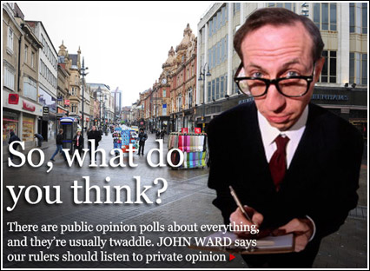
Related topic
Do Public Opinion Polls Matter for Campaign Contributors? Evidence from Brazil.
- Contribution campaign.
Importance of Public Opinion Polls:
- voters,
- politicians,
- supporters to manager resources.
- Static picture what the contest is about.
Notes:
Opinions polls give a static picture of the race working sometimes as a useful device showing what the contest is about

Slide 3
Why do I choose research Senate elections?
Do Public Opinion Polls Matter for Campaign Contributors? Evidence from Brazil.
Geographic area.
High spending levels in recent elections.
Senate contests are distinguished by closer competition .

Slide 4
Framing
Do Public Opinion Polls Matter for Campaign Contributors? Evidence from Brazil.
Incumbents vs. Challengers
Front vs. Trailer
Notes:
Contributions to both incumbents and challengers depend on the degree of competition in the race.
The fundraising perspective might be different for front-runners and trailing candidates unlike the traditional.

Slide 5
The problem at glance
Do Public Opinion Polls Matter for Campaign Contributors? Evidence from Brazil.
Notes:
There are possible explanation for such variability?
How about this picture?

Slide 6
Amount of revenues
Do Public Opinion Polls Matter for Campaign Contributors? Evidence from Brazil.

Slide 7
Number of contributions
Do Public Opinion Polls Matter for Campaign Contributors? Evidence from Brazil.

Slide 8
Dependent Variables
Do Public Opinion Polls Matter for Campaign Contributors? Evidence from Brazil.
REVENUE > totals of dollars in the week
N_ENDOWMENT > number of contributions in the week

Slide 9
Independent Variables
Do Public Opinion Polls Matter for Campaign Contributors? Evidence from Brazil.
DIFFLAG1 > 1 week delayed
DIFFLAG2 > 2 weeks delayed
DIFFLAG3 > 3 weeks delayed

Slide 10
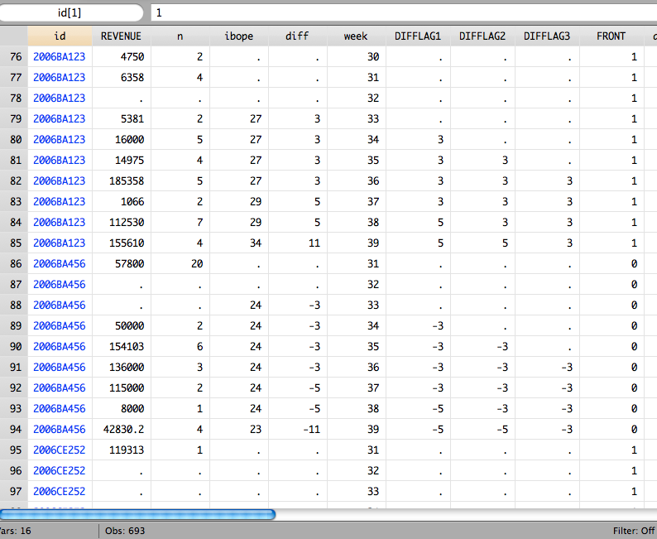
How this works?
Do Public Opinion Polls Matter for Campaign Contributors? Evidence from Brazil.

Slide 11
Covariate Structure
Do Public Opinion Polls Matter for Campaign Contributors? Evidence from Brazil.
FRONT > candidates that started in front
TRAILER > second-place candidates

Slide 12
Estimates results
Do Public Opinion Polls Matter for Campaign Contributors? Evidence from Brazil.

Slide 13
Estimates results
Do Public Opinion Polls Matter for Campaign Contributors? Evidence from Brazil.

Slide 14
Estimates results
Do Public Opinion Polls Matter for Campaign Contributors? Evidence from Brazil.

Slide 15
Estimates results
Do Public Opinion Polls Matter for Campaign Contributors? Evidence from Brazil.

Slide 16
Final Remarks
Do Public Opinion Polls Matter for Campaign Contributors? Evidence from Brazil.
Weak empirical evidence;
Contributions to campaigns is not simply seen as a one-time opportunity; rather, it is a judgment that individuals and organizations update and revise as new information becomes available over the course of a race. The degree of beliefs about their candidate’s likelihood to getting better, influence the potential contributor’s decision to donate money to the campaigns.

